Slide 1
Improving Inclusion for Neurodivergent Students in Mathematics
Michael Cavaliere

Slide 2
What is neurodivergence?
Someone is neurodivergent if they think and process information in a way that is considered ‘atypical’.
This is different to neurodiversity, which refers to the natural variations between everyone in thinking and processing.
Not everyone is neurodivergent, but together we are neurodiverse!

Slide 3
Approximately 15% of the UK population is neurodivergent.
This includes:
ADHD (4%)
Autism (1%)
Dyslexia (10%)
Dyspraxia (6%)
Tourette’s Syndrome (1%)
Recently, some definitions of neurodivergence include mental health conditions that involve identifiable differences in the brain’s structure and function, such as OCD or schizophrenia.

Slide 4
Common challenges in university contexts
Information processing
Dyslexic students often have difficulties with reading and retaining text
Dyspraxic students often have difficulties with spatial processing
Autistic students may have issues with auditory processing and need information to be written down clearly and unambiguously
Sensory processing
Autistic students often have difficulties with filtering out background noise and can find busy lecture theatres overwhelming
Students with Tourette’s syndrome may find that different environmental stimuli can worsen their tics

Slide 5
Communication
Autistic students often have difficulties with both verbal and non-verbal communication
Dyspraxic students may struggle with communicating their ideas and arguments in assignments
Executive functioning
Students with ADHD may struggle to meet deadlines or remain focused on a particular task
Autistic students often find transitioning between different tasks challenging and have anxiety around change
Motor planning
Dyspraxic students may have difficulties with handwriting or typing, preventing them from keeping up in lectures
Students with Tourette’s syndrome may have motor tics that interfere with movement

Slide 6
Neurodivergence in Higher Education
5.1% of entrants in 2021/22 disclosed cognitive or learning difficulties.
1.0% of entrants in 2021/22 disclosed social or communication impairments.
4.5% of entrants in 2021/22 disclosed a mental health condition.

Slide 7
Across the university, there has been a 43% increase in students declaring neurodivergent conditions since 2019/20.
In the Warwick Maths Institute:
6.9% of the 2023/24 undergraduate cohort disclosed that they have neurodevelopmental, social or communication differences.
1.9% of the 2023/24 undergraduate cohort disclosed that they have a mental health condition.

Slide 8
Mental Disability

Slide 9
‘Improving Diversity and Inclusivity Amongst Warwick Maths Undergraduates’
Funded by the Dean of Students’ Office.
Three student interns (myself, Olivia Lancastle and Lebo Nthoiwa) working alongside Dr Siri Chongchitnan and Dr Helena Verrill.
Survey sent to all undergraduate students in the department (154 responses), followed by in-depth interviews with a diverse range of students (18 interviews).
Four key themes:
  Gender
  Race and ethnicity
  Disability and neurodivergence
  Socioeconomic background

Slide 10
Responses from disabled students heavily skewed towards neurodivergent students:
  Of 154 responses, 31 students indicated that they have ‘autism, dyslexia, ADHD or other types of neurodivergence’.
  Only one student indicated that they have access requirements but were not neurodivergent.
  This is in line with neurodevelopmental, social or communication differences being the most common declared disability.
  All five disabled students who were interviewed were neurodivergent (including ADHD, autism, dyslexia and dyspraxia), with one additionally having physical disabilities.

Slide 11
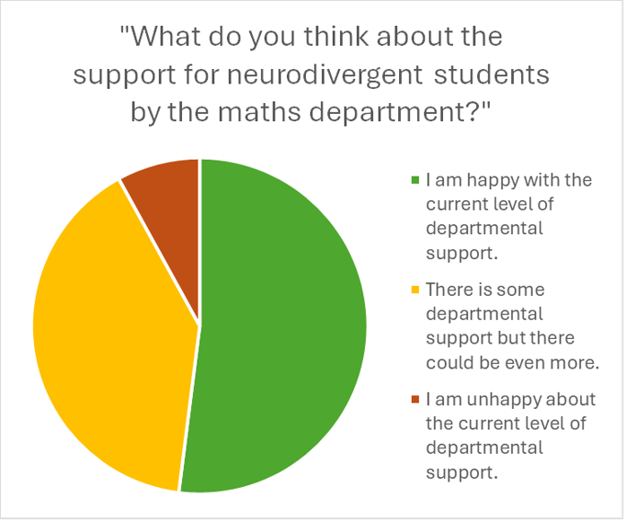
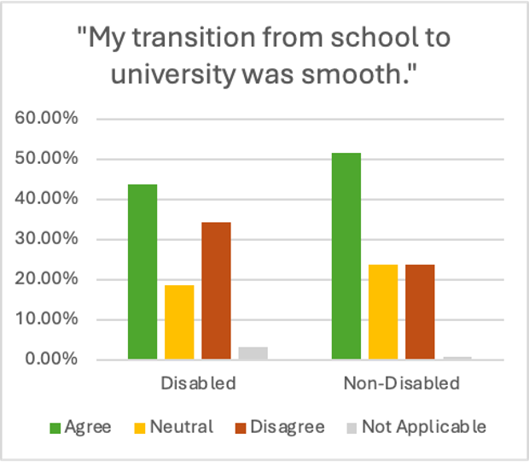
“People will understand a physical condition more than a mental and neurological thing … it feels like an autism diagnosis or a mental health diagnosis doesn't seem to carry as much weight even though it should.”​
“I felt I couldn't really get a lot of support with my assignments. But I understand why they can't do flexible deadlines, but there are times when my disability fluctuates and some days and weeks are worse than others.”​

Slide 12
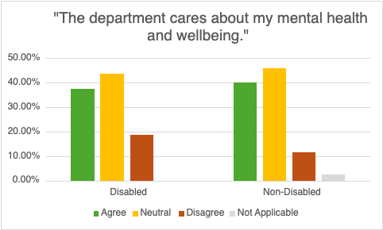
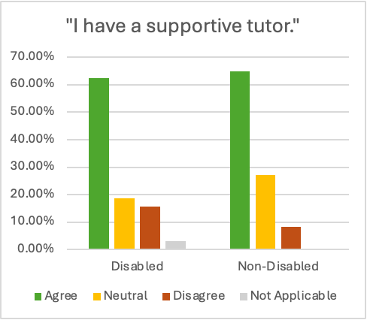
“I quite like my tutor though, but when I found out I had ADHD, we talked about it and I don’t think he knew anything about it … I had to defer all my exams and he didn’t know how to do it.”
“It would be really nice if maths also had a forum for people to help find study groups … because I can find it quite hard to work with someone who's higher, like who gets things quite easily, because it felt a little bit less of us bouncing ideas of each other … them explaining things to me rather than me feeling like I'm being active in it.”

Slide 13
Recommendations
Have specific information about support for disabled students at open days and a specific departmental induction for disabled students. ​
Assign neurodivergent students to personal tutors who have more training or personal interest in supporting them. ​
Have a member of staff in the department specifically responsible for disabled students. ​

Slide 14
Provide typed lecture notes in advance and improve the availability of lecture capture. ​
Investigate accessibility of supervisions and support classes for neurodivergent students by reducing class sizes or grouping neurodivergent students together. ​
Implement a more consistent approach to “breather week” across the department. ​
Investigate how the exam timetable can be adapted to ensure exams are better spread out. ​
Implement self-certifications for students eligible for flexible deadlines. ​

Slide 15
Progress since this work
The university is introducing ‘Disabled Student Champions’ so disabled students have a member of staff in their department to be signposted to.
The department have introduced self-certifications for students in place of flexible deadlines.

Slide 16
What next?
Continuing to implement the recommendations from our study!
Postgraduate and beyond:
  8.4% of the university’s PGR population have disclosed a ‘mental disability’.
  0.26% of academic staff have declared neurodevelopmental, social or communication differences.
  Most recommendations for neurodivergent students are very general and does not address discipline-specific issues, which becomes more of an issue at the research level.

Slide 17
Thank you for listening!
If you have any questions or suggestions, feel free to speak to me after the talk or email me at michael.cavaliere@warwick.ac.uk

