Slide 1
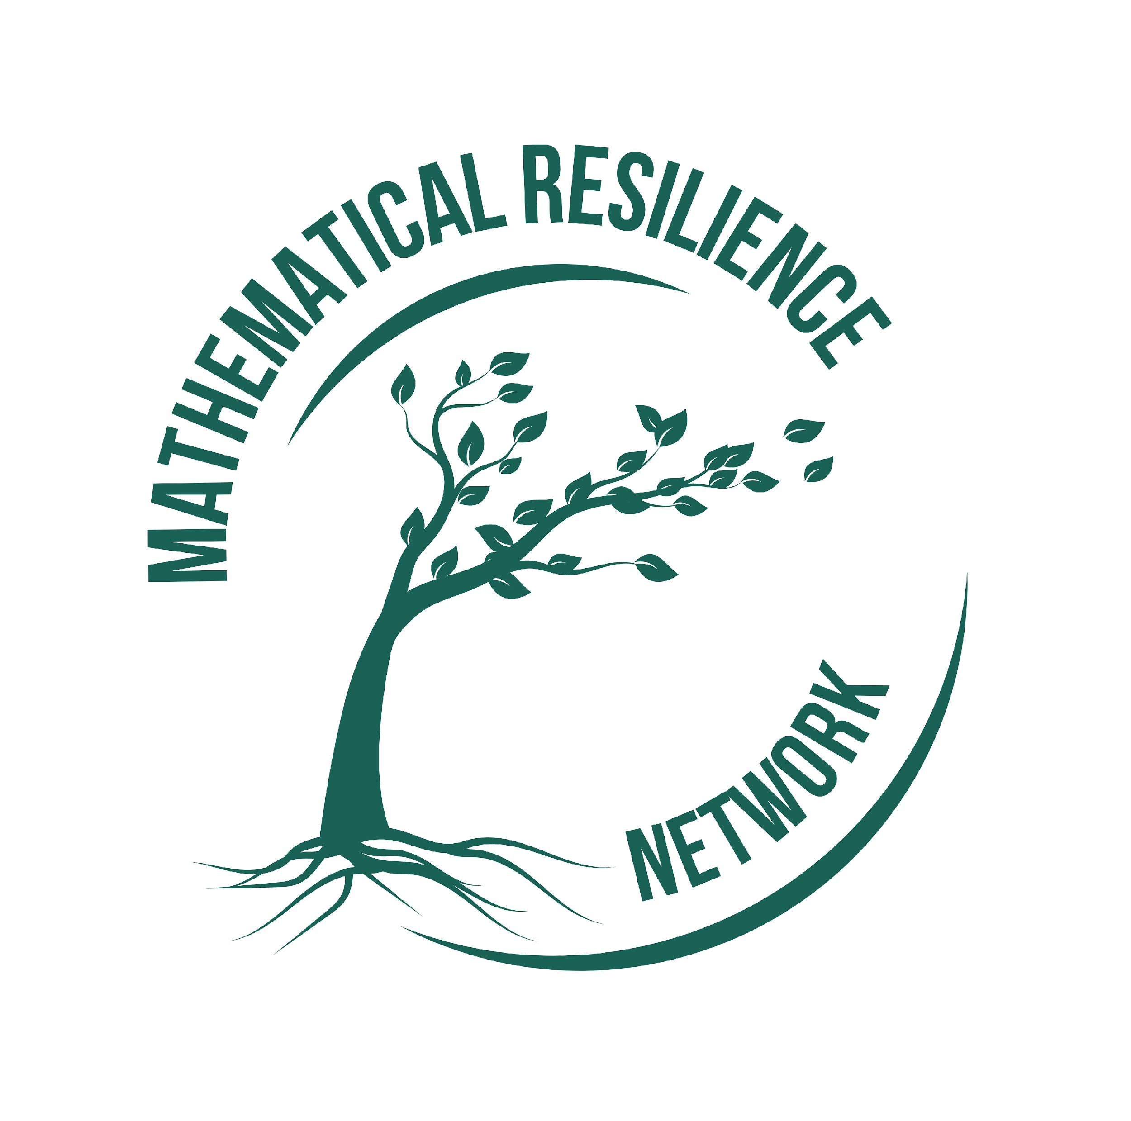
Decolonising as part of the strategy of reducing maths anxiety
Sue Johnston-Wilder
sue.johnston-wilder@warwick.ac.uk

Slide 2
Hypotheses
mathematics anxiety is prevalent in most countries
“colonial mathematics” is a root cause of mathematics anxiety
decolonising mathematics will benefit anxious learners in all communities: school, FE, HE, parents, teachers….

Slide 3
What is maths anxiety?
• a feeling of tension or fear when engaging with maths
• affects confidence, performance, and engagement
• common across age groups, attainment levels and backgrounds
• affects more than 1 in 3 across the world

Slide 4
The lion Mathematics
I could never have gone far in any science because on the path of every science the lion Mathematics waits for you.
C S Lewis (1955)

Slide 5
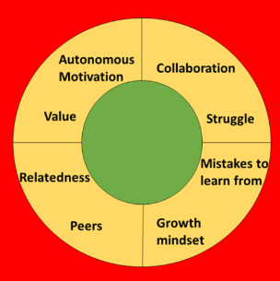
To address maths anxiety …
comfort = safe
growth = brave
danger = threatened
Notes:
In order to address mathematics anxiety, learners need to experience the personal value and relevance of the mathematics they are learning;
they need a brave learning space where productive attempts to solve a problem are harnessed and feedback is growth promoting
cope better with adversity
more likely to persist in the face of challenges
view setbacks as opportunities for growth.

Slide 6
Colonial mathematics …
is universal, objective, superior and excluding, a filter in colonial and post-colonial education systems, determining access to higher education and power.
marginalises alternative mathematical systems and contributions.
imposes one “correct” way of doing mathematics and disregards multiple ways of knowing or alternative mathematical frameworks (e.g., oral, visual, embodied).

Slide 7
Colonial maths is exclusive
Mathematics is abstracted from cultural context, making it harder to relate to lived experience and perceive personal value.
Local, familial and trade-specific systems of measurement, patterning, trade, and spatial reasoning are dismissed as “non-mathematical” and are not recognized or valued.

Slide 8
Learning requires psychological safety…
Psychological safety requires relatedness, autonomous value and experiences of competence
(Ryan and Deci, 2017)

Slide 9
Colonial maths thwarts relatedness (Jackie)
feeling comfortable and valued in English lessons, but not in mathematics lessons
perceiving that no-one had ever taken time with her individually.
publicly told that she got it wrong and feeling too embarrassed to ask for what she wanted: an idea of why mathematics matters.

Slide 10
What Does Decolonising Mathematics Mean?
• Recognising and valuing diverse mathematical contributions
• Challenging Eurocentric and elitist narratives
• Making maths more inclusive, relevant, and human
•Dispelling the idea that only a few are “naturally good” at maths

Slide 11
Making maths relevant
• Use real-world, culturally grounded examples from a range of cultures, from African fractals to Indian algebra to carpenters, craft workers and dressmakers etc.
• Show how maths connects to everyday/professional life and local contexts
• Relevance increases psychological safety and builds engagement.

Slide 12
Multiple ways to think and solve
• Emphasise different methods and strategies
• Validate diverse thinking styles
• Reduce fear of being “wrong” and support flexible learning
Remember how Ramanujan shocked and surprised Hardy and Littlewood!!

Slide 13
From Competition to Collaboration
• Shift away from high-stakes, individual testing
• Encourage group work & collective problem-solving
• Build community and lower pressure
• Broaden what “success” looks like
• Include creativity, persistence, and reasoning
• More students feel recognised and capable

Slide 14
Inclusion and psychological safety
• Decolonising maths makes it more inclusive, relatable, and empowering
• Students feel safer, more capable, and less anxious
• Everyone benefits from a broader, more humane maths education
Notes:
Typical prior experiences

Slide 15
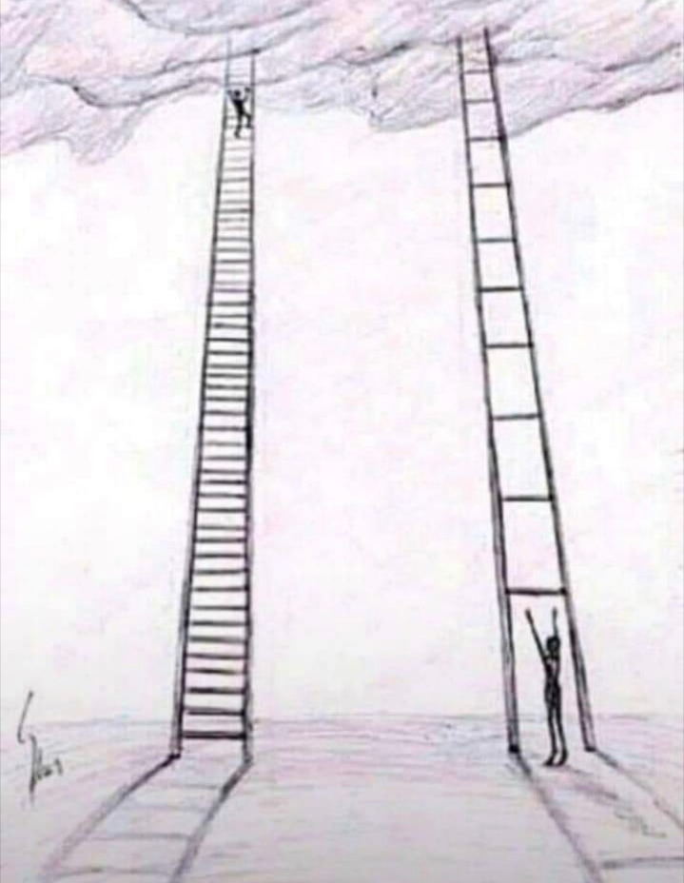
The ladder model – a 4th tool
“I need
another
rung”

Slide 16
Humanising the Maths Learning Experience
• Incorporate stories, context, and emotions
• Help students see maths as part of the human story
• Less abstraction/more scaffolding = less fear

Slide 17
Ubuntu as an example framework for an alternative pedagogy
Strength lies in unity and community.
Dignity and respect for self and others.
Everyone has worth.
Seek out ways to connect.
Embrace diversity.
Kindness.
Tolerance.
Power of listening.
Ngomane (2019)

Slide 18
Ubuntu-inspired mathematics classroom
1 An inclusive, collaborative learning environment
• Group work prioritised over individual competition: students solve problems in teams, where understanding and helping each other is prioritized over getting the right answer. just
• Peer teaching: more experienced students help guide others, reinforcing their own learning in the process.

Slide 19
Ubuntu-inspired mathematics classroom
2. Real-world and Community-Based Maths
• Lessons connect maths to real-life community problems—e.g., budgeting for a village project, measuring land for farming, or interpreting local data (like rainfall or crops).
• Maths shown as a tool for collective upliftment, not just individual success

Slide 20
Ubuntu-inspired mathematics classroom
3. Emphasis on Dialogue and Respect
• Maths dialogues where everyone’s perspective is heard and respected, even when discussing problem-solving methods.
• Storytelling to introduce mathematical concepts through cultural and historical contexts.

Slide 21
Ubuntu-inspired mathematics classroom
4. Celebration of Diverse Thinking
• Multiple problem-solving strategies are welcomed and explored.
• Mistakes are seen as learning moments shared with the group rather than failures

Slide 22
Ubuntu-inspired mathematics classroom
5. Teacher as a Facilitator, Not Just Instructor
• The teacher nurtures a space of trust, empathy, and collective growth.
• Power dynamics are softened; students are co-creators in the learning journey.
Notes:
Typical prior experiences

Slide 23
Ubuntu-inspired mathematics classroom
6. Use of Local Contexts and Indigenous Knowledge
• Incorporating local patterns, architecture, games, and crafts to teach geometry, counting systems, and logic.
• Honouring traditional ways of reasoning and problem-solving.

Slide 24
Ubuntu-inspired mathematics classroom
7. Atmosphere and Aesthetics
• Flexible spaces for group work.
• Displays of student work, community contributions, and visuals celebrating culture and unity.
• A “maths wall” where students post challenges for others to solve collectively.

Slide 25
In contrast – students’ adverse prior experiences
[the teacher] would make you stand in front of everyone, and then she would just be, like, “You’re not good, you don’t understand, you’re stupid.” (Halima)
I always felt like I was stupid … Starting maths this year it still gives me chills …‘Cos even now, you know, that fear of saying ‘Oh I don’t get it! I still don’t get it!’ is still there. (Nina)
Molly’s father would grasp her neck in frustration when she didn’t get it.

Slide 26
Some brain facts for maths teachers
As a survival strategy, the brain seeks to distinguish challenge from threat to well-being or survival
Includes physical and social threats, such as being left behind or humiliated or shouted at
Previous threats are remembered
When the brain (sub-consciously) perceives a threat, it initially responds by fight or flight mode

Slide 27
The MR tools in action
Sue, it works!
96% pass rate on maths test for student nurses at Coventry University
What happened to the other 4%?

Slide 28
The GZM in action
By talking and acknowledging that in order to learn we have to feel uncomfortable, this made a noticeable difference to the students asking for help or telling me when they did not understand.
The culture of the maths lessons became more about understanding process than getting to the correct answer.
Angles MathsHub (2023)

Slide 29
Impact
On reflection, just opening up that dialogue around Maths Anxiety and acknowledging its existence and that it is a real thing has had a big impact on my relationship with parents outside of my own class. They feel able to approach me and ask me questions about Maths without fear of being made to feel foolish or (as one parent put it) ‘less than’. That in itself is worth the effort.

Slide 30
Summary
Decolonising maths challenges the idea that mathematics only belongs to the few, and instead makes space for multiple ways of knowing, learning, and doing mathematics.
It connects mathematics to students’ cultures, histories, and real-life experiences.
As such, I contend it is a core process for reducing mathematics anxiety.
I hope this helps reinforce the work on decolonisation.

