Slide 1

Beyond the Textbook
Decolonising Algebra through Historical Knowledge and Relational Learning
Holly Heshmati (University of Warwick)
Powerful is s/he who has knowledge.
From knowledge, the old man's heart becomes young. (Ferdowsi, c.940–1020)

Slide 2

Why This Matters?
TRIED or ALIVE?
Accessible
Linked
Inclusive
Values-based
Engaging
T
R
I
E
D
A
L
I
V
E
Tedious
Rote
Isolated
Elitist
De-personalised
(adapted from Nardi & Steward, 2003)
(Johnston-Wilder et al, 2015)

Slide 3
Dialogic Teaching in Maths
Alexander (2017) defines dialogic teaching as the use of talk to stimulate and extend students’ thinking. In contrast to question–response–feedback, dialogic teaching is focused on meaning-making, reasoning, and co-construction of knowledge (teacher as the more knowledgeable participant).
Notes:
Many students struggle with mathematical problem-solving because success requires more than just content knowledge. It also depends on strategies, metacognition, productive beliefs, and collaborative practices. However, schools often limit opportunities to develop these skills by emphasising rules, speed, and correct answers over exploration and reasoning. Therefore, effective instruction must be intentionally designed to foster strategic thinking, metacognitive reflection, and collaborative sense-making, while actively challenging narrow views of what it means to "do" mathematics. We can see how dialogic practices transform a routine exercise into an opportunity for exploration, reasoning, and collaborative sense-making.
What activities or tasks can you introduce in your teaching? What questions will you ask? How would you enable students to identify patterns, make conjectures and generalise?

Slide 4
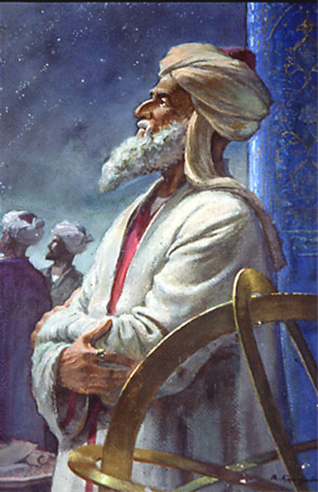
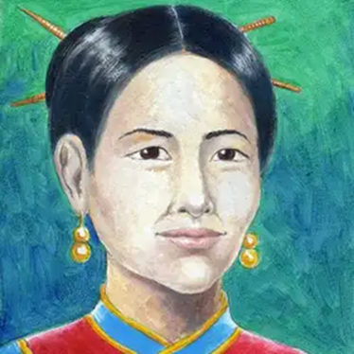
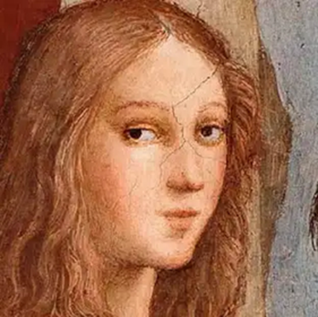
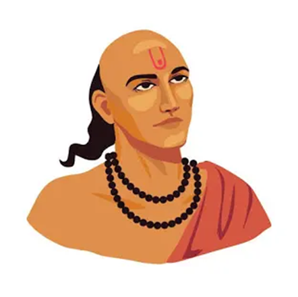
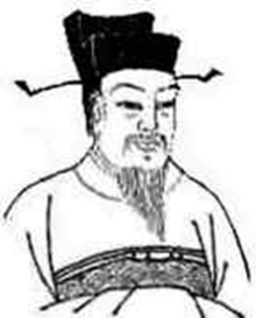
Decolonising Maths: Beyond Tokenism
Not just adding names
Focus on knowledge development & Relational learning
Mathematics as human and evolving

Slide 5
Project Overview
Secondary Maths PGCE (2023-26)
Decolonising Secondary Maths
Focus on conceptual understanding
Reflective practice

Slide 6
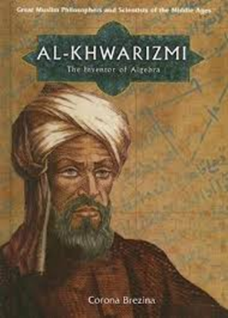
Example: Early Algebra
al-jabr = restoration / completion
Written in words
No symbols
Example: 'A square and ten roots equal thirty-nine’
Restoration (removing negatives)
Balancing (simplifying both sides)
Foundation of solving equations

Slide 7
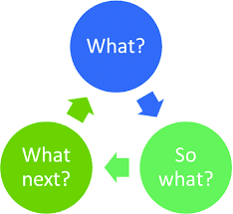
Reflective Task & Impact
Choose topic
Identify concepts
Explore knowledge development
Apply to teaching
Stronger understanding
Better explanations
Increased confidence
Inclusive perspectives

Slide 8
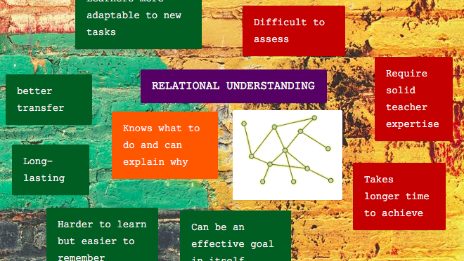
Implications for Practice: Relational Learning
Ask 'why?'
Use historical context
Emphasise reasoning
Connect ideas
Not separate goals
Mutually reinforcing
Supports understanding and inclusion
Maths is a human, evolving discipline
Supports conceptual understanding
Supports mathematical disposition

Slide 9
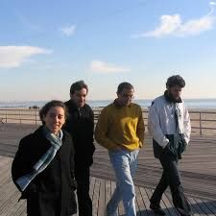
Implications for Practice: Mathematical Disposition
Mathematical disposition is a learner's positive, habitual tendency to view mathematics as sensible, useful, and worthwhile, combined with a belief that effort in learning pays off. It encompasses attitudes like positive self-perception, curiosity, perseverance in problem solving, and flexibility, which are critical for mathematical learning.

Slide 10
Dispositions
“I find it problematic to try to explain the performance of somebody by, first of all, referring to the background of the person. This could be any kind of performance, and also (high/low) achievements of students in a mathematics classroom. ‘Referring only to the background’ is a strategy by means of which the political nature of learning obstacles can be eliminated. If, instead, we try to explain the performances in terms of the background, the here-and-now situation, and the foreground of each student, then the political nature of the learning obstacles becomes more obvious.” (Ole Skovsmose, in ‘Foregrounds and politics of learning obstacles’, 25(1), 6—7.)
Notes:
How background, present and foreground shape dispositions?

Slide 11
Dispositions
A fuller picture comes when we look at three aspects together:
- Background: the person’s past experiences, culture and situations they’ve been part of.
- Here-and-now: the present moment, including the classroom situation.
- Foreground: the opportunities a person sees for themselves in the future, shaped by the social, political, and cultural world around them.
- These dispositions don’t directly “cause” actions, but they influence how individuals act, make choices, set priorities, and view the world.
- Finally, dispositions are not static. They are always being reshaped through our interactions with others and our environments. They are resources we draw on as we navigate life and learning.
Notes:
-Foreground: Importantly, these are not just the “objective” opportunities available, but how the person perceives them.
-When we combine these, we get what we call a person’s dispositions. Dispositions are not fixed or simple. They can include conflicts and contradictions. For example, a person may have hopes and aspirations (foregrounds) that don’t align neatly with their background.
-These dispositions need in no way be homogeneous entities.
Dispositions don’t just apply to individuals; groups of people with similar backgrounds and opportunities can also share dispositions.

Slide 12

Thank you!

Slide 13

Questions & Feedback

Slide 14
References
Alexander, R. J. 2017. Towards Dialogic Teaching: Rethinking Classroom Talk. 5th ed. York: Dialogos.
Johnston-Wilder, S., Lee, C., Brindley, J. and Garton, E. (2015) Developing mathematical resilience in school-students who have experienced repeated failure. Paper presented at the 8th International Conference of Education, Research and Innovation (ICERI2015), Seville, Spain, 16–18 November 2015.
Meeran, S. (2024) ‘Decolonising mathematics education: Teachers’ initial experiences of using ethnomathematical games in the intermediate phase’, Interdisciplinary Journal of Sociality Studies, 4(S1). doi:10.38140/ijss-2024.vol4.s1.03
Nardi, E. and Steward, S., 2003. Is mathematics T.I.R.E.D? A profile of quiet disaffection in the secondary mathematics classroom. British Educational Research
Journal, 29(3), pp.345–367.
Skemp, R.R. (1976) ‘Relational understanding and instrumental understanding’, Mathematics Teaching, 77, pp. 20–26.
Skovsmose, O. (2005) ‘Foregrounds and politics of learning obstacles’, For the Learning of Mathematics, 25(1), pp. 4–10.

