Slide 1
History for Inclusion & Diversity in Mathematics
Diversity & Decolonisation in Mathamatics 2026, Warwick
Isobel Falconer
ijf3@st-andrews.ac.uk
Notes:
Introduce myself

Slide 2
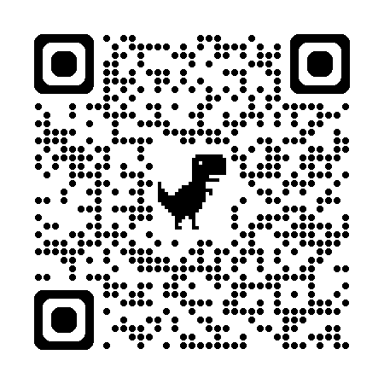
HIDIM aims:
To build a network around using history of mathematics to promote equality, diversity and inclusion in the mathematics curriculum in UK HE
https://mathshist4edi.wp.st-andrews.ac.uk/
History for Inclusion & Diversity in Mathematics

Slide 3
Is Mathematics Inclusive or Exclusive, Jan 2022 - Some actions:
  • Provide support for projects to develop resources for incorporating ethics and race in teaching,
  • Develop an easily searchable and accessible means of sharing such resources,[but plan for this, rather than do it in this project]
  • Organise follow up/follow on events to provide further opportunities for collaboration and discussion
HIDIM background

Slide 4




Isaac Newton Institute funded 2023-2025
St Andrews, Open University, Oxford, led startup phase
Current steering group:: Troy Astarte (Swansea); Ilaria Bussoli (Bath); Gemma Crowe (Manchester); Isobel Falconer (St Andrews); Ciarán Mac an Bhaird (Maynooth), Peter Rowlett (Sheffield Hallam), Rehan Shah (Queen Mary, London)
HIDIM startup

Slide 5
In what ways are current HE maths curricula experienced as exclusive?
What examples are there of using history to make the curriculum more inclusive?
What support do practitioners need in using history to diversify the curriculum?
How is the effectiveness of such initiatives best evaluated?
Focus Group Qs (Staff)

Slide 6
Do you feel represented and included by the mathematics curriculum you have experienced?
What does EDI mean to you?
During your undergraduate *maths* lectures in what ways has historical material been included?
How has this impacted EDI within your mathematics degree?
Focus Group Qs (students)

Slide 7
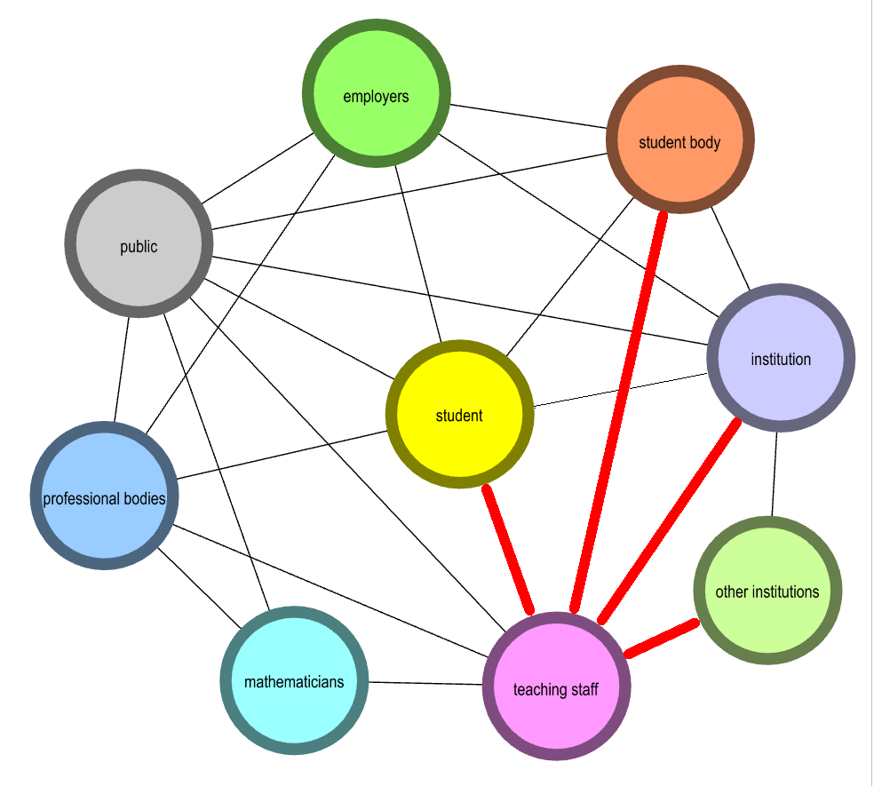
Complex web of stakeholder interactions affect a student’s feeling of inclusion in mathematics
Red = interactions within which individual educators have the most agency – HIDIM is supporting these
employers
student body
public
Focus Group Outcomes
institution
student
professional
bodies
other institutions
mathemati-cians
teaching staff
Notes:
Focus group discussions revealed a complex web of stakeholder interactions that affect a student’s feeling of inclusion in mathematics. Those that most closely affect the opportunity an individual educator has to enhance inclusion are identified in red in Figure 1. HIDIM has focused on supporting change through these.

Slide 8
HoM counters the widespread perception that mathematics is an abstract and fully-formed subject, divorced from social – which is detrimental to students’ mathematical understanding.
Positive attitudes to HoM
Maths goes through a degree of dehumanisation…. Facts are thought of as true, even though it’s not possible for these facts to be thought of as true without humans agreeing on what is an acceptable amount of information to prove a result.
Notes:
Biased self-selected group – unsurprising they were generally positive

Slide 9
HoM is only one potential contributor to this aim
HoM is the study with the most potential to bring about the necessary cultural change
BUT going outside standard 21st – century (European) mathematics can confuse students
Caveat: Tackling EDI is the main aim
On occasion, we may ‘deliberately not use history because it runs counter to what we are trying to teach. An example might be the tension between teaching calculus using rigorous methods versus teaching it through its historical development.’

Slide 10
Barriers
 | Development time/resource | Curriculum time/space
Contributing factors | Mathematics research culture does not recognise the need for EDI initiatives or acquisition of soft skills. Little or no reward for time spent on EDI initiatives vs. on mathematics research – particularly likely to affect mathematicians from under-represented groups. Steep learning curve to acquire adequate knowledge of HoM, exacerbated by lack of research evidence and guidelines on how to use it effectively. Lack of confidence in using HoM and/or EDI ideas. | Mathematics research culture does not recognise the need for EDI initiatives or acquisition of soft skills. Student and staff perceptions that HoM (or EDI) interventions distract from ‘real’ maths. The curriculum is already too full of essential mathematical content and skills – with no space for HoM as well
Tensions | ‘real’ history vs mythology | ‘real’ maths vs history of maths

Slide 11
Expertise and confidence building (online reading group, workshops, JISCmail);
Community and confidence building through:
  Collaborative development and sharing of ‘ready-made’ teaching activities incorporating HoM;
  Collaborative funding proposals for resource development & evaluation
  Making resources easily shareable and discoverable through a specially designed repository tool (still at an early stage);
Supporting research, evaluation and evidence-
gathering through repository features and metrics,
and by developing a tailored evaluation framework
(still at an early stage).
https://mathshist4edi.wp.st-andrews.ac.uk/
Tackling lack of development time

Slide 12
In teaching maths, we are teaching the history of the discipline by default, as the results we teach were proved by someone. Teaching that results were proven by white men creates a history for people in the discipline. We need more representation.
Or,
We need to interrogate the usual suspects in the history of maths and challenge misconceptions about common role models. Myths, legends and hypothetical stories about mathematicians are often embedded into the curriculum. How do we reconcile these stories with real history? We should challenge these myths.
‘Real’ history vs mythology
Notes:
Subliminal messages

Slide 13
Provision of role models (e.g. posters; vignettes within teaching materials)
Teaching HoM explicitly (e.g. guest lectures; dedicated HoM module; HoM projects)
Leveraging mathematical precedents from non-European or minoritised cultures (e.g. mathematics activities that embed historical examples, methods and/or data)
Sensitising staff to the historical specificity of current mathematical practices
Approaches to using HoM
Difficulty increases
Notes:
Mathematics a universal language?????
These approaches are listed in order of increasing social and conceptual difficulty. Network members have found it relatively easy to drop small vignettes or snippets about past mathematicians into teaching materials, or display posters, without anyone objecting. It is harder to argue for the resource or curriculum time for guest lectures, dedicated modules or projects. Harder still, though here the difficulty is conceptual as much as social, is to devise activities that use historical examples to promote mathematical understanding while enhancing inclusivity. Most difficult is educating colleagues in the historical processes through which current mathematical practices have become exclusive and the need to reverse this trend.

Slide 14
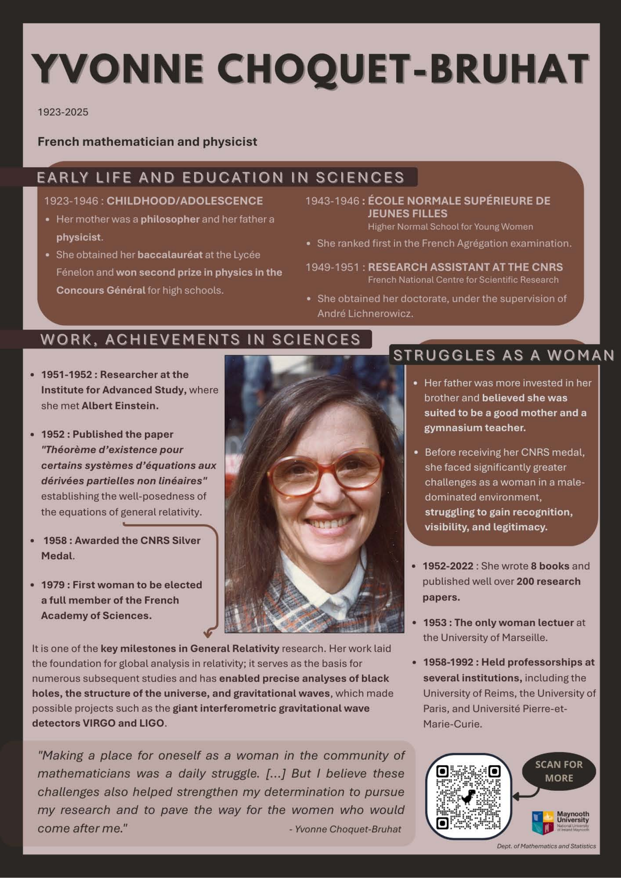
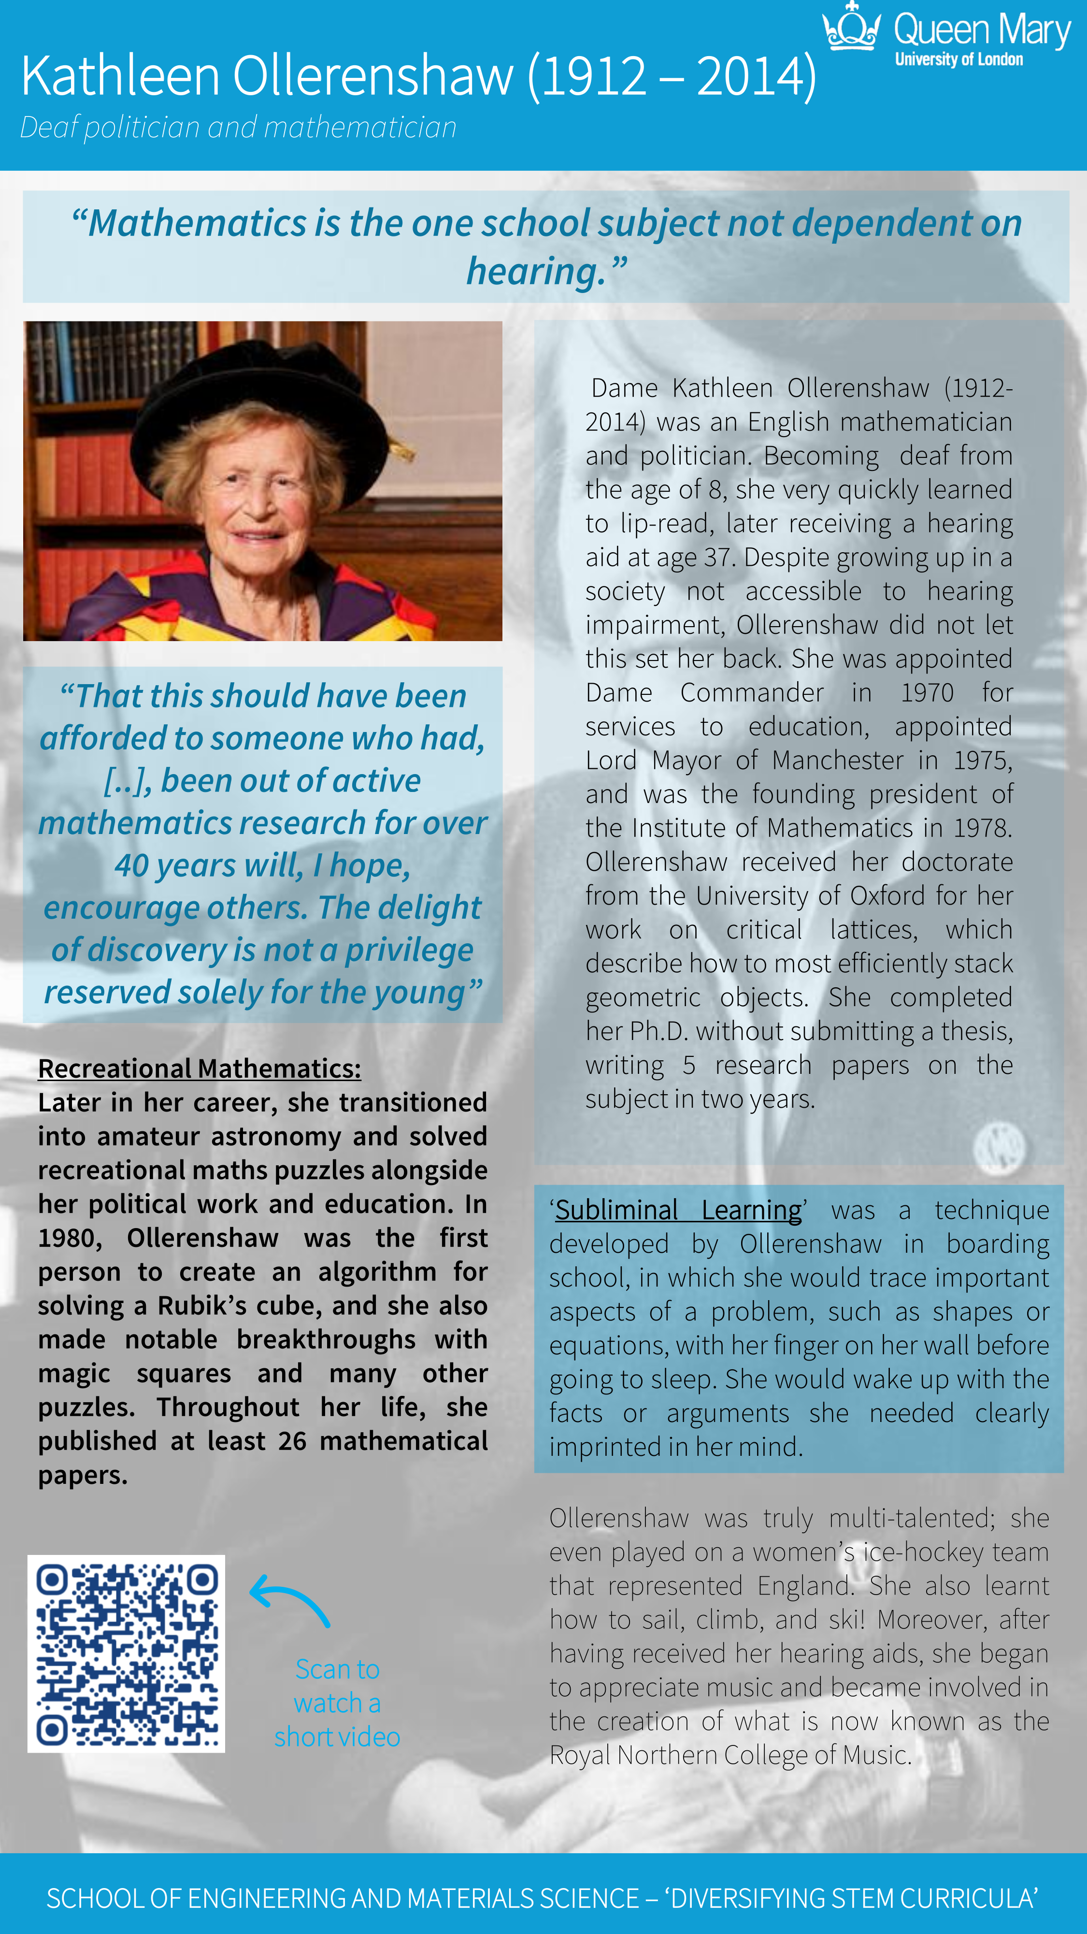
Designed by Léana Vernet as part of the 'Increasing Awareness of Diversity in Mathematics and Statistics through Biography and History' project led by Ciarán Mac an Bhaird and Niamh Cahill at Maynooth University (https://www.maynoothuniversity.ie/mathematics-and-statistics/EDI-Resources).
Examples: posters
Poster of Kathleen Ollerenshaw from the Making Diversity Count project at AMUL, led by Rehan Shah https://www.sems.qmul.ac.uk/staff/r.shah/research/impact/
Notes:
Co-creation a major methodology

Slide 15
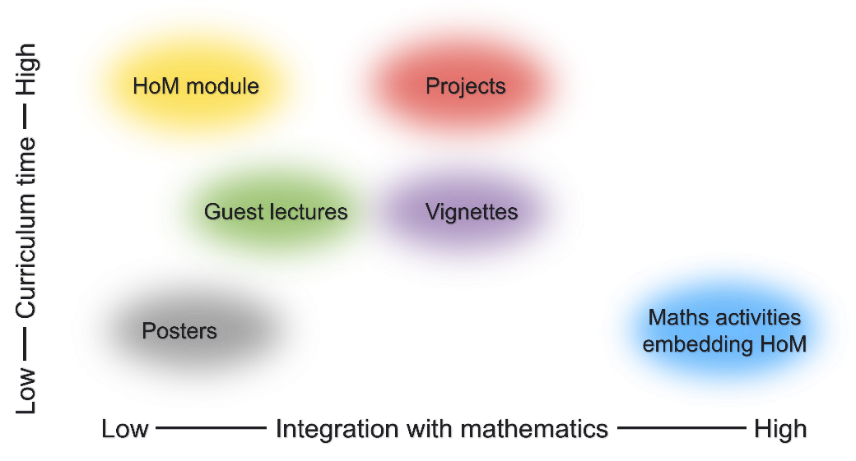
Tackling lack of curriculum time
Notes:
It can be useful to think of the activities associated with the first three approaches in terms of the time they might occupy in the curriculum, and the extent to which they integrate HoM with technical mathematics
.

Slide 16
Common solutions (quotations) | Issues
Diversity events are often extra-curricula | Optionality: students who might benefit most may be those least circumstanced to take on optional extras
History of maths modules are often non-credit-bearing
Dropping snippets of history into maths modules is relatively common (deemed to be “nice”), but is not seen as core to the mathematics | Assessment: mathematics educators often lack expertise and confidence in assessing HoM, students are very resistant to the idea, teaching HoM is not the main aim; inclusivity in the curriculum is
Need to bring history of maths into assessment, otherwise it will not be considered core
‘Real’ maths vs HoM

Slide 17

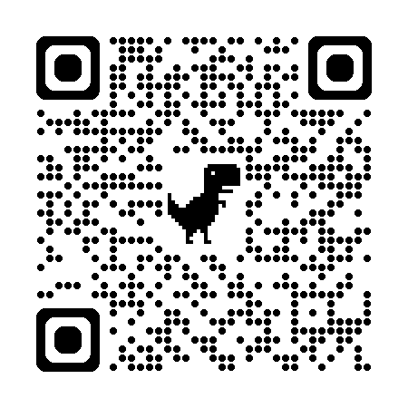
Examples: posters
https://www.mathshist4edi.org.uk/
Notes:
Generating evidence of impact
Platform for collaborative development

Slide 18
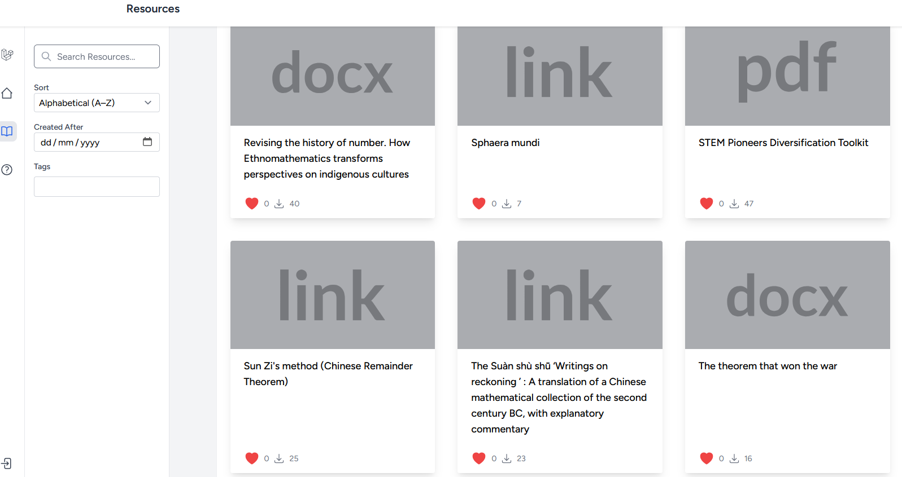
Examples: posters

Slide 19
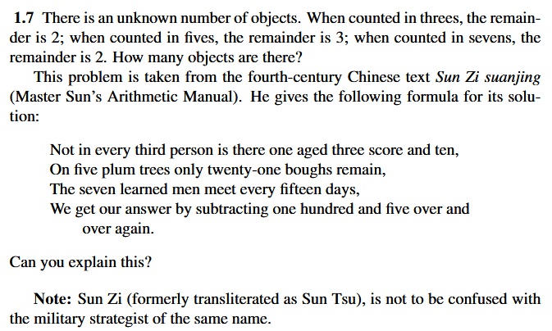
Examples: embedded HoM
Number theory activity on Sun Zi’s method (the Chinese remainder theorem)Cameron, Peter, et al. (2009) “A course on number theory” p9, available from https://cameroncounts.wordpress.com/lecture-notes/
Notes:
Tackling problems posed in unfamiliar ways – resilience – alternative methods
Is subliminal enough?

Slide 20
How to include history as a core element of mathematics rather than an optional extra?
Examples: embedded HoM

Slide 21
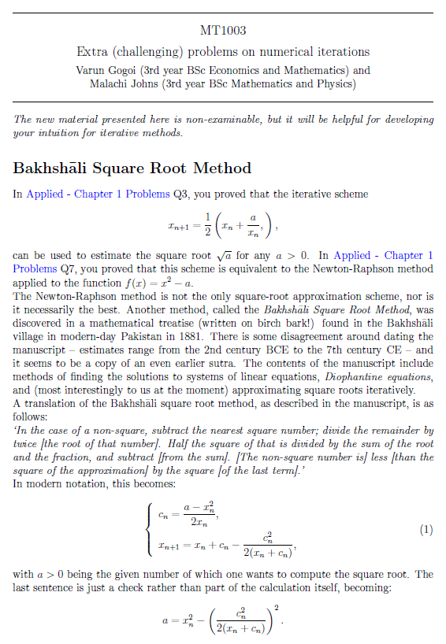
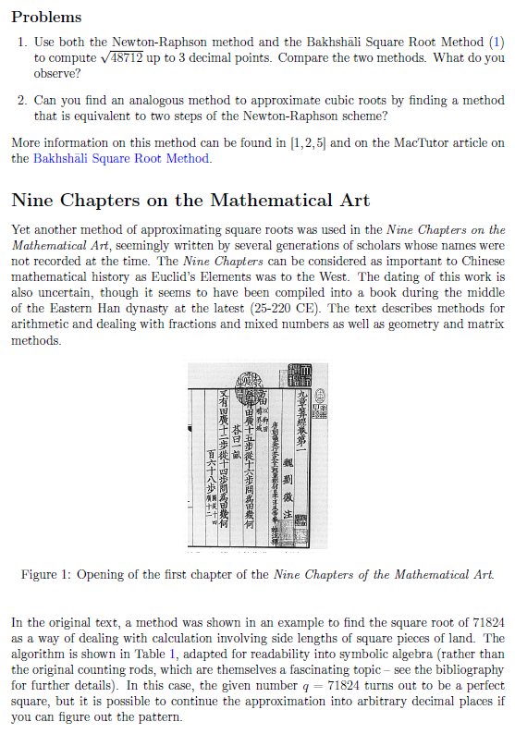
Examples: embedded HoM
St Andrews MT1003 iterative methods activities,
Varun Gogoi, Malachi Johns, Stefania Lisai
Notes:
Co-creating with students – university EDI fund
Some historical context
Additional ‘challenging’ problems – signposted as for keen students

Slide 22
What do you think the value to you might be of studying older [iterative] methods such as the Bakhshali method and that from the Nine Chapters?
It seems very valuable especially because of the speed of convergence and cultural context. Knowledge of maths external to European maths is vital especially because maths was around so early there, e.g. ancient architecture like Alhambra
Examples: embedded HoM
St Andrews MT1003 iterative methods activities,
Varun Gogoi, Malachi Johns, Stefania Lisai
Notes:
Evaluation tricky – if you get any answers, students often give the answer they think you want
Most students hadn’t attempted
But v. little negativity
Not clear whether incidental messages getting across

Slide 23
The 2022 Kenya Demographic and Health Survey was carried out by the Kenya National Bureau of Statistics and the Ministry of Health. The sampling design is briefly described below:
The 2019 census was used to divide the country into 129,067 enumeration areas (EA).
10,000 EAs were selected at random in proportion to their size.
Each EA was divided into 4 equal subsamples, and one subsample in each EA was selected at random for inclusion in the study.
25 households in each subsample were selected; if there were fewer than 25 households, all households were included. This was called a cluster (of households).
Each cluster was classified as either rural or urban. In total there were 1,026 rural clusters and 666 urban clusters.
All women aged 15-49 in the selected households were eligible to take part in the study (33,879 women in total); 32,156 women were interviewed.
All men aged 15-54 in half of the selected households were eligible to take part (16,552 men in total); 14,453 men were interviewed.
Is this a nationally representative sample? What aspects of the design are beneficial, and could any improvements be made? Is there any other information that might be useful to have?
Examples: embedded HoM
St Andrews MT1007 sampling strategy activities, Michelle Arnette, Malachi Johns, Louise Burt, Charles Paxton
Notes:
Stats Qs much better integrated and not separately badged
No historical context (not very historical). But felt important to state who carried out the survey – Kenyans can do well-designed statistical surveys

Slide 24
Is the IQ test a reliable measure of intelligence? Justify your answer
This question involves four groups (A, B, C, and D) where each group differs in origin and culture. An IQ test was designed by people from group A and was heavily influenced by the cultural intelligence metrics of that group. This test was taken by people from all four groups. The following table shows the mean of the IQ test results and the sample size of each group:
Group | Mean | Sample Size
A | 104.32 | 1689
B | 100.21 | 233
C | 90.42 | 254
D | 88.63 | 67
A person claims that since the mean IQ of group A is higher than group D, then everyone from group A has a higher IQ than everyone from group D. Is this a justifiable claim? Why or why not?
If the person modifies their statement to “most group A members have a higher IQ than most group D members”, would the claim be sufficiently justified?
Is the IQ test a reliable measure of intelligence? Justify your answer
Examples: embedded HoM
St Andrews MT1007 statistics in society activity, Michelle Arnette, Malachi Johns, Louise Burt, Charles Paxton
Notes:
But here did not name the groups actually involved

Slide 25
Is the IQ test a reliable measure of intelligence? Justify your answer
How, (if at all) did these problems change your experience of studying statistics?
These problems showed how statistics applies to real-world issues beyond standard examples
How (if at all) did these problems change your sense of being included in the statistics community?
They slightly improved my sense of inclusion by showing a wider range of contexts
If any problems stood out as particularly useful or unhelpful, please tell us about them
Problems using real world data-sets were more engaging and helpful
Examples: embedded HoM
St Andrews MT1007 statistics in society activity, Michelle Arnette, Malachi Johns, Louise Burt, Charles Paxton
Notes:
Give the answers they think you are looking for
Marginal gains
Have failed to get student volunteers for focus groups

Slide 26
Is the IQ test a reliable measure of intelligence? Justify your answer
How to evaluate: what has worked, for whom, why, and in what circumstances,?
  Confirmation bias
  Students working harder
  Novelty
  Lack of recognition of resource constraints
Difficulties of addressing diverse audience
  Entrenched social & cultural attitudes
Pitfalls
  Tokenism
  Irrelevance
  Insider view
Pressing challenges
Notes:
How to make past maths relevant and not tokenistic. E.g. controversy over African maths – ancient more than a sop to sense of African identity

Slide 27
https://mathshist4edi.wp.st-andrews.ac.uk/
15 May, Seminar by Rowena Ball (Australia National University)
Empirical Mathematics in Australian Indigenous Smoke Telegraphy
5 June, Experience sharing by David Pritchard (Strathclyde University)
New Y1 Mathematics in Society module
7-8 September, 2-day workshop, Manchester University
Co-creating and curating resources with students
  JISCmail list signup
  https://www.jiscmail.ac.uk/cgi-bin/webadmin?SUBED1=HISTORY-FOR-EDI-IN-MATHS&A=1
Forthcoming Events
Website https://mathshist4edi.wp.st-andrews.ac.uk/

Slide 28
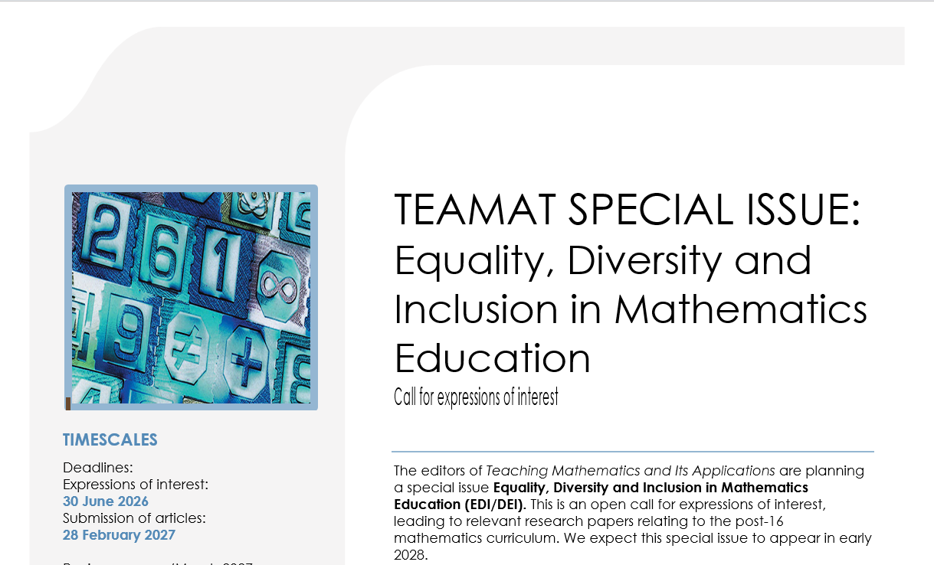
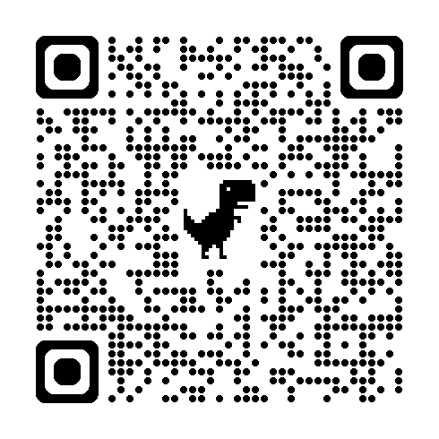
Is the IQ test a reliable measure of intelligence? Justify your answer
https://forms.gle/BnwzbWHoF4vTqKg66
Forthcoming Publication

Slide 29
Is the IQ test a reliable measure of intelligence? Justify your answer
Many thanks to all HIDIM members and especially Laura Johnson and Stefania Lisai
Thank You!

