Slide 1
Reading Time in Exams
Support for English Language Learners
Martyn Parker

Slide 2
Overview
Present a case for reading time across in-person examinations.
Show some data while making no claims regarding causality.
I am not stating that examinations are terrible!

Slide 3
Context
Summer 2022 (end of 21/22 AY), a student-led project examined teaching, assessment, and student experience.
Carried out against the background of:
  Covid;
  the OfS conditions of registration;
  Warwick’s Inclusive Education Action plans incoming for 2022/23;
  Requirement to make progress on attainment gaps.
We focus on one area that emerged, the role of linguistic demand.

Slide 4
Where we were
Data redacted from public presentation

Slide 5
The problem
What can a timed examination unintentionally assess?
Alongside knowledge, it may also test a student’s ability to:
process dense written English quickly;
decode complex vocabulary under pressure;
interpret complex phrasing before writing begins.
A hidden/implicit curriculum requirement not explicitly part of module ILOs.
Study highlighted evidence of additional demands for ELLs around:
unfamiliar or infrequent vocabulary;
multiple linguistic demands within the same task.
These features may introduce construct-irrelevant barriers.

Slide 6
Existing support is not the whole answer
At Warwick, bilingual dictionaries are permitted in examinations.
However, dictionary use:
carries a clear time cost;
can interrupt concentration and task flow;
helps with vocabulary, but not necessarily with syntax or task structure;
is less effective when all clarification must come out of writing time.

Slide 7
Solution
So we just use universal design for learning and problem solved…..

Slide 8
Aside: implementation gap
The following is from a LinkedIn post made by Emily Nordmann based on something from Philip Dawson. It illustrates what I call the implementation gap.
The problem, they opined wisely, is not AI, it’s that everything about higher education assessment is and has always been terrible.
“Ok, but concretely, can you tell how how I can adapt my assessments?”
Trust your students.
“Ok, but we know they’re cheating at scale and even when it’s not cheating, they’re cognitively offloading all the processes that let them learn anything so I’m not sure that romanticising them is the way forward?”
Authentic assessment.
“Ok, but AI can now do almost any task, including reflection. Also why isn’t having knowledge you can draw on without looking it up authentic?”
Exams are bad. Rote memorisation is bad.
“Ok, but again, concretely, can you tell me how I can adapt my assessments?”
Assess the process.
“Ok, I have 600 students, concretely, can you tell how do I do this at scale?”
“Hello?”
This came up countless times during a project on SEM assessment. There is a huge gap between the strategic deliverables and practical implementation.

Slide 9
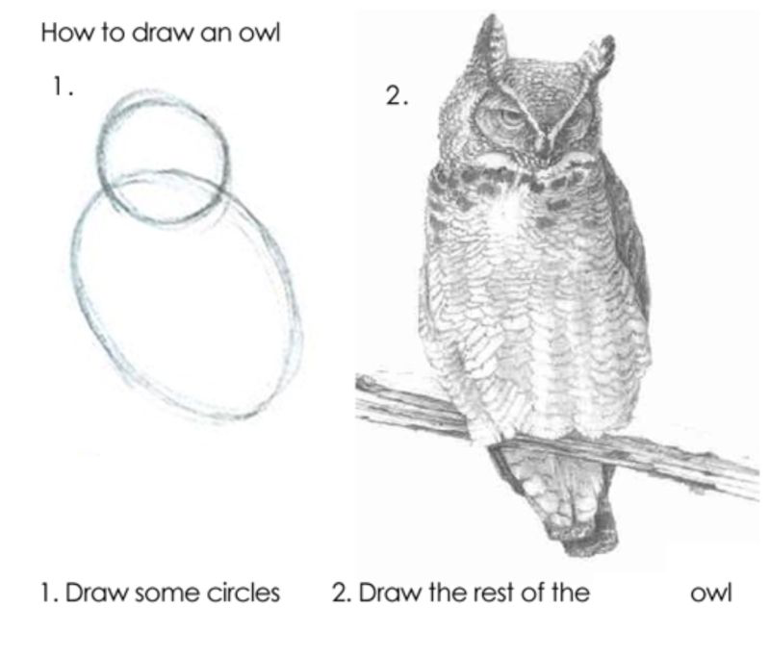
Aside: implementation gap
What practical, scalable, and evidence-informed approaches can
Bridge the implementation gap between broad principles and day-to-day practice?
Make assessment more inclusive in ways that remain manageable for staff and robust against current challenges such as scale, workload, and AI-enabled cognitive offloading?

Slide 10
The intervention: reading time
Reading time was introduced across in-person Statistics examinations to give students a defined period to:
read and process questions before writing begins;
identify difficult vocabulary or phrasing;
understand the structure of tasks;
plan their approach before the formal timed period starts.
The underlying aim was simple: reduce an avoidable barrier to task access without changing academic standards.

Slide 11
Where are we
Data redacted from public presentation

Slide 12
Comments
Plots of estimated yearly change in agreed mark, with:
dot: estimated change in marks;
horizontal line: uncertainty;
vertical line at 0: no change over time.
Reading:
if the interval is entirely to the right of 0, that suggests a positive increase over time;
if it crosses 0, the evidence for change is weak or uncertain;
if it is entirely to the left of 0, that suggests decline over time.

Slide 13
Comments
Data redacted from public presentation

Slide 14
Conclusion to finish
No assessment is always bad: in fact, this project highlighted that many students “excelled” in examinations compared to other assessment types.
Consider accessibility before the exam starts, not only through compensatory support during it.
Small, scalable changes can prompt useful rethinking of what assessments are really measuring.
Reading time in examinations can be understood as a practical response to an issue.
Suggests a relatively modest changes to examination conditions may improve access to assessment, while also prompting wider reflection.
Some prompts to think about:
Should we review content irrelevant “demands” in examinations?
What counts as inclusive design, rather than individual accommodation?
Which small assessment changes have had the greatest impact in your context?

