Slide 1
On the representations of GL3(Fp) (UG colloquium talk). - Supporting slides -
Dylan Johnston

Slide 2
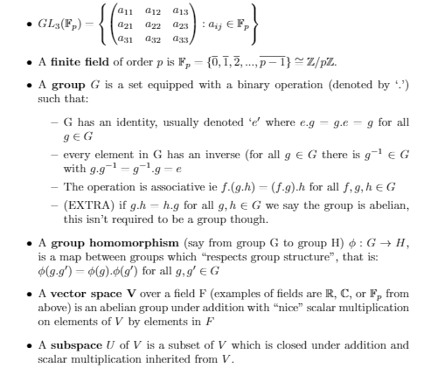
Background - rough definitions

Slide 3
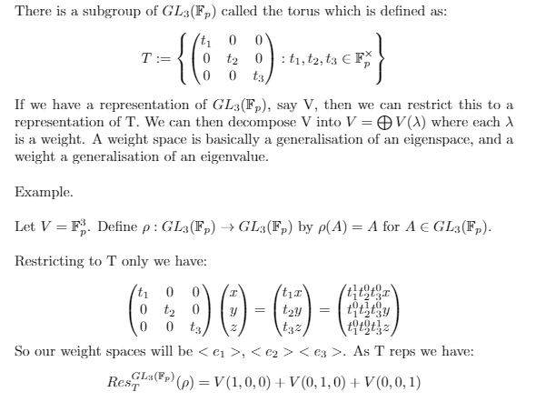
Restriction to the torus subgroup

Slide 4
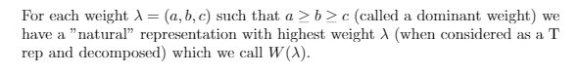
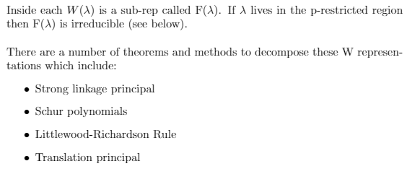
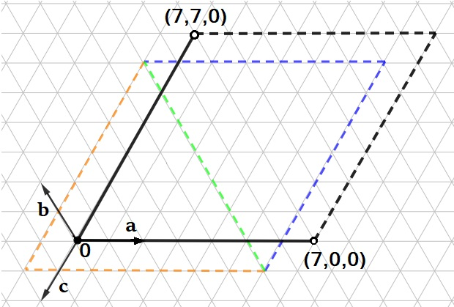
Labelling representations of GL3.

Slide 5
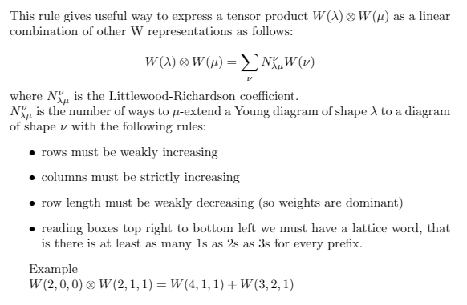
Littlewood-Richardson rule

Slide 6
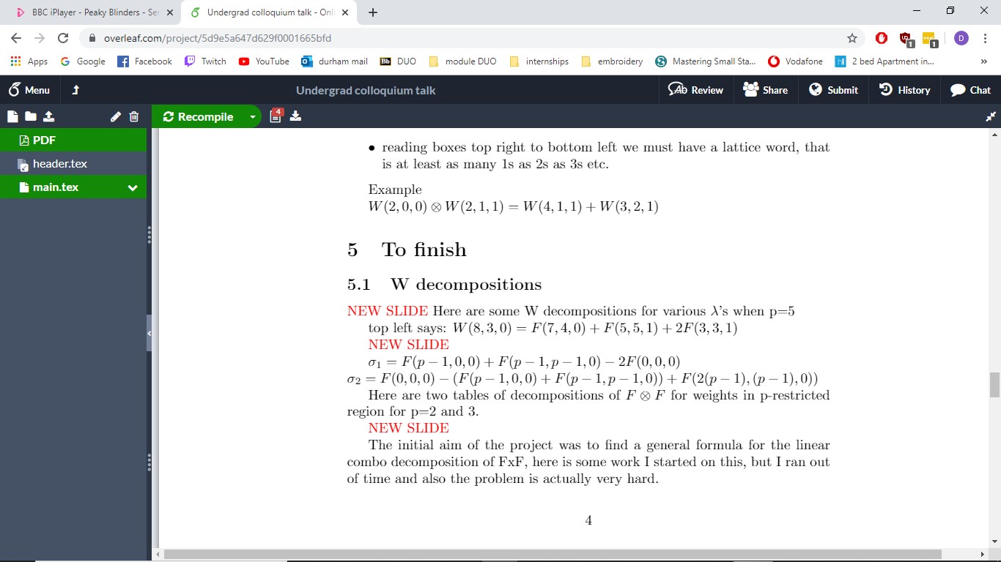
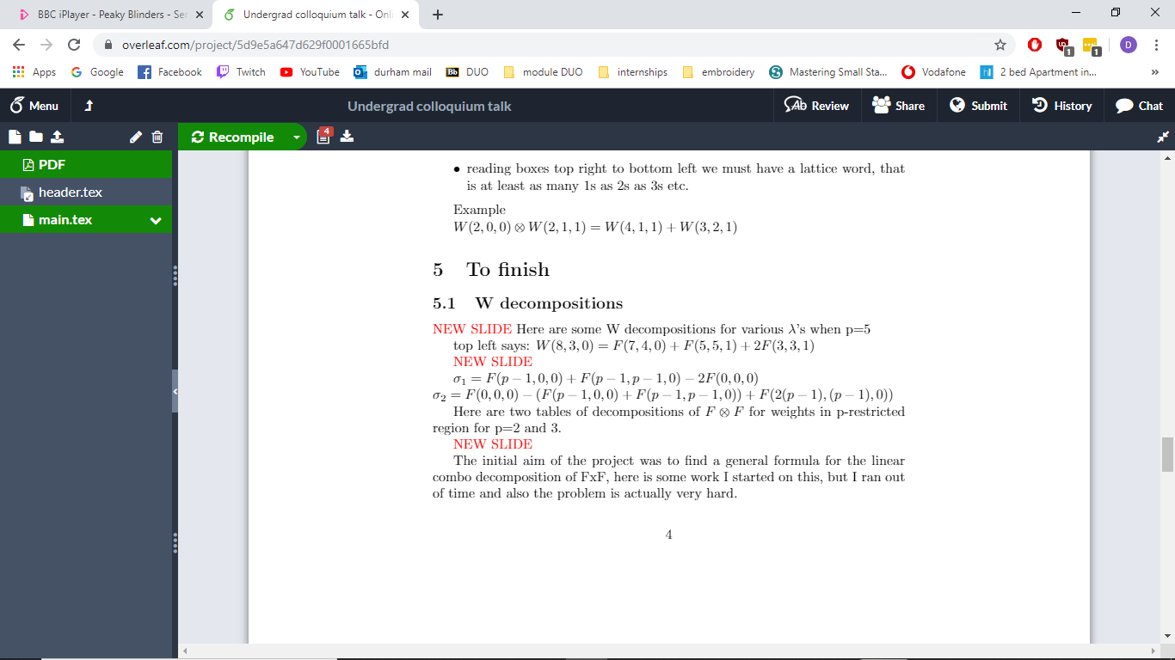
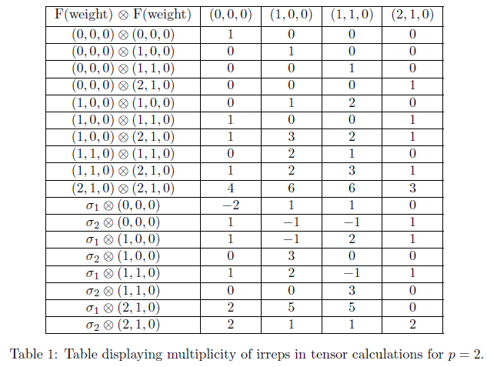
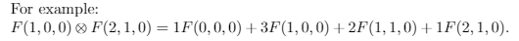
p=2 and p=3 table. (1/2)

Slide 7
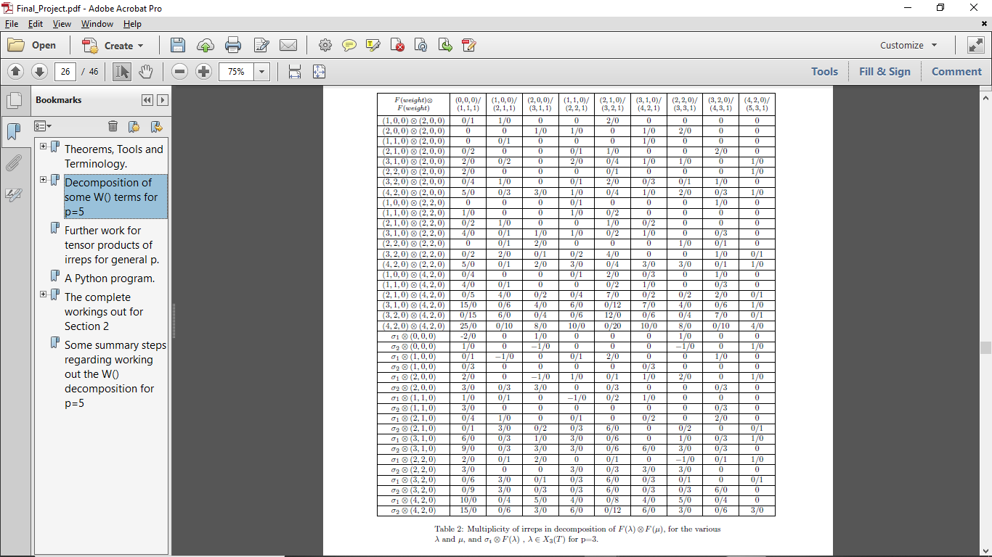
P=2 and p=3 table. (2/2)

Slide 8
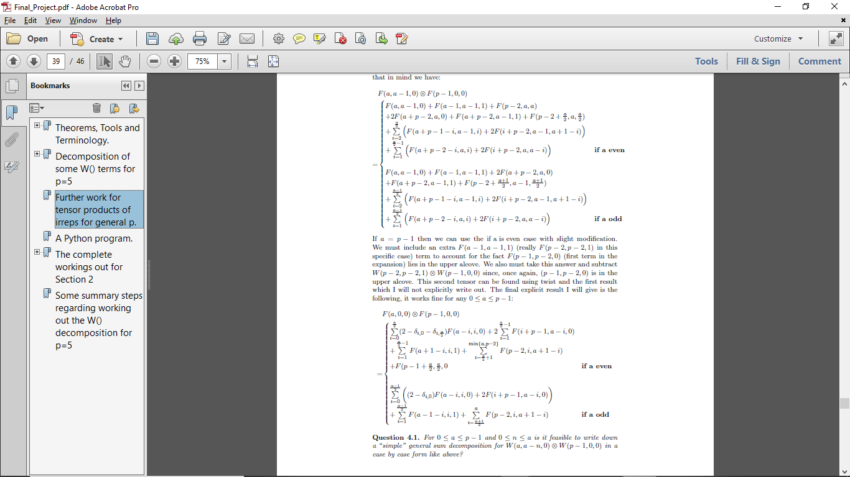
General F tensor F formula (for 0 < a < p)

