Slide 1
Shared Facilities Update
Prof. David Quigley
Scientific Computing Research Technology Platform
warwick.ac.uk/scrtp
12th DECEMBER 2020
Warwick and the Alan Turing Institute

Slide 2

Shared facilities at Warwick
What I’m here to say…. “Warwick has new shared kit you might want to use”
“More kit is coming”
“Help is available on how to use it”
What I’m NOT here to say…. “Don’t use cloud virtual machines” “Don’t buy your own kit” “You’re all doing it wrong”

Slide 3
RTP Shared Facilities
Shared facilities suitable for:
non-interactive batch workloads
workflows/software with checkpoint & resume capability
Yes
you can run Docker images developed elsewhere (via Singularity)
you can install your own Python/R/Julia packages
we have Tensorflow
No
you can’t run whenever you want for as long as your want
you can’t have admin privileges on the shared hardware

Slide 4
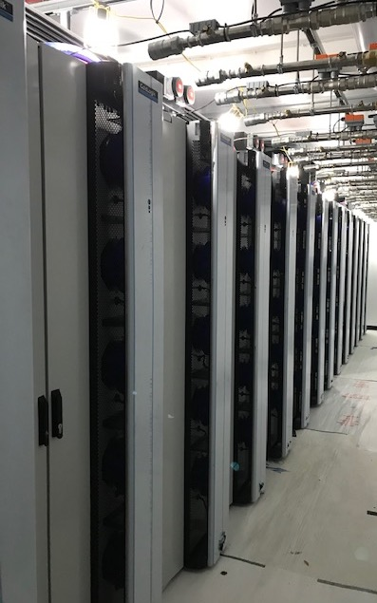
Avon (2020)
Compute nodes: Dell C6420 servers with 2 x Intel Xeon 8268 (Cascade Lake) 2.9 GHz 24-core processors; 48 cores per node; 180 nodes; 8,640 cores total; 192 GB DDR4-2933 RAM per node
Interconnect: Mellanox HDR100, 100 Gbit/s with sub 0.6 μs latency
GPU nodes: As above with 3x Nvidia RTX 6000 per node; 16 nodes; 192 GB RAM per node
High memory nodes: 1.5 TB RAM per node; 48 cores per node; 4 nodes
Availability: All researchers at Warwick on an (unequal) fair-share basis from November(ish)

Slide 5
HPC for Data Science Training
Turing funded project – warwick.ac.uk/hpcdatasci
Moved to “asynchronous delivery” due to covid-19
First video lectures released last week
Exercises to follow
Will ”run” in December, i.e. with some opportunity for live discussion/feedback
Topics
Converting notebooks to batch scripts
Using containerised software in a shared environment
Dealing with limited runtimes on shared clusters
…and more

Slide 6
EPSRC tier-2 service for ensemble computing
£3M capital award deferred from 2019 panel
Awarded to the HPC Midlands+ consortium (ATI is a partner)
Available to researchers in the Midlands via university access, and nationally via mechanisms TBA
Kit coming to Warwick in December 2020, online around April 2021
12,000 to 18,000 cores
120 to 180 Quadro RTX GPUs
Challenges around “ensemble computing”
Replicating workstation-scale workflows thousands of times concurrently
Marshalling loosely-coupled (e.g. Python driven) workflows
Limitations of file-based IO
Fault tolerance etc

Slide 7
warwick.ac.uk/scrtp

