Slide 1
Nonlinear Evolution Equations in the Combinatorics of Random Maps
Random Combinatorial Structures and Statistical Mechanics
Venice, Italy
May 8, 2013

Slide 2
Combinatorial Dynamics
Random Graphs
Random Matrices
Random Maps
Polynuclear Growth
Virtual Permutations
Random Polymers
Zero-Range Processes
Exclusion Processes
First Passage Percolation
Singular Toeplitz/Hankel Ops.
Fekete Points
Clustering & “Small Worlds”
2D Quantum Gravity
Stat Mech on Random Lattices
KPZ Dynamics
Schur Processes
Chern-Simons Field Theory
Coagulation Models
Non-equilibrium Steady States
Sorting Networks
Quantum Spin Chains
Pattern Formation
Notes:
edit

Slide 3
Combinatorial Dynamics
Random Graphs
Random Matrices
Random Maps
Polynuclear Growth
Virtual Permutations
Random Polymers
Zero-Range Processes
Exclusion Processes
First Passage Percolation
Singular Toeplitz/Hankel Ops.
Fekete Points
Clustering & “Small Worlds”
2D Quantum Gravity
Stat Mech on Random Lattices
KPZ Dynamics
Schur Processes
Chern-Simons Field Theory
Coagulation Models
Non-equilibrium Steady States
Sorting Networks
Quantum Spin Chains
Pattern Formation

Slide 4
Overview
Combinatorics Analytical Combinatorics Analysis

Slide 5
Analytical Combinatorics
Discrete → Continuous
Generating Functions
Combinatorial Geometry

Slide 6
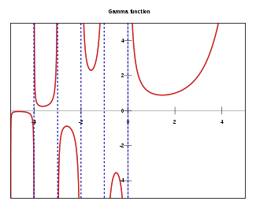
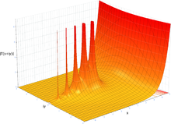
Euler & Gamma
|Γ(z)|

Slide 7
Analytical Combinatorics
Discrete → Continuous
Generating Functions
Combinatorial Geometry

Slide 8
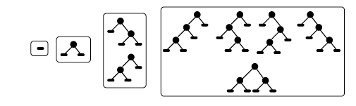
The “Shapes” of Binary Trees
One can use generating functions to study the problem of enumerating binary trees.
C_{n} = # binary trees w/ n binary branching (internal) nodes =
# binary trees w/ n + 1 external nodes
C₀ = 1, C₁ = 1, C₂ = 2, C₃ = 5, C₄ = 14, C₅ = 42

Slide 9
Generating Functions

Slide 10
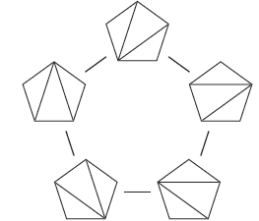
Catalan Numbers
Euler (1751) How many triangulations of an
(n+2)-gon are there?
Euler-Segner (1758) :
Z(t) = 1 + t Z(t)•Z(t)
Pfaff & Fuss (1791) How many dissections of a
(kn+2)-gon are there using (k+2)-gons?

Slide 11
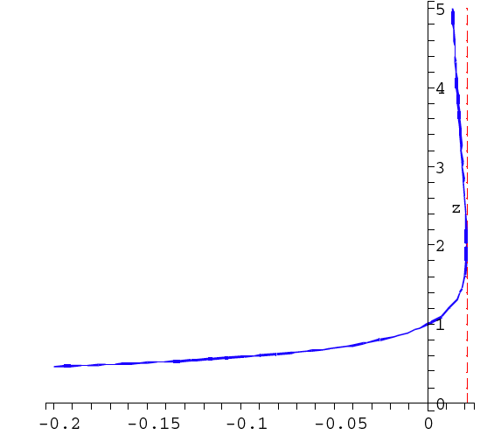
Algebraic OGF
➔ Z(t) = 1 + t Z(t)²

Slide 12
Coefficient Analysis
Extended Binomial Theorem:

Slide 13
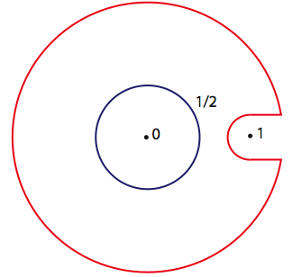
The Inverse: Coefficient Extraction
Study asymptotics by steepest descent.
Pringsheim’s Theorem: Z(t) necessarily has a singularity
at t = radius of convergence.
Hankel Contour:

Slide 14
Catalan Asymptotics
C₁* = 2.25 vs. C₁ = 1
Error
 10% for n=10
< 1% for any n ≥ 100
Steepest descent: singularity at ρ ➔ asymptotic form of coefficients is ρ^{-n} n^{-3/2}
Universality in large combinatorial structures:
coefficients ~ K A^{n} n^{-3/2} for all varieties of trees

Slide 15
Analytical Combinatorics
Discrete → Continuous
Generating Functions
Combinatorial Geometry

Slide 16
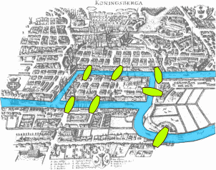
Euler & Königsberg
Birth of Combinatorial Graph Theory
Euler characteristic of a surface
= 2 – 2g = # vertices - # edges + # faces

Slide 17
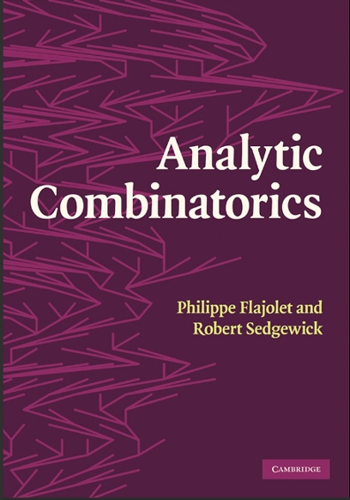

Singularities & Asymptotics
Phillipe Flajolet

Slide 18
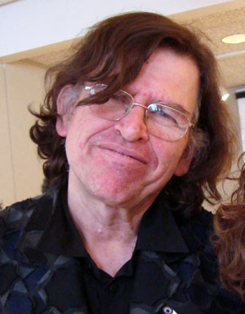
Low-Dimensional Random Spaces
Bill Thurston

Slide 19

Solvable Models & Topological Invariants
Miki Wadati

Slide 20
Overview
Combinatorics Analytical Combinatorics Analysis

Slide 21
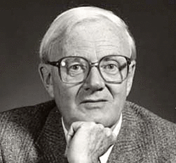
Combinatorics of Maps
This subject goes back at least to the work of Tutte in the ‘60s and was motivated by the goal of classifying and algorithmically constructing graphs with specified properties.
William Thomas Tutte (1917 –2002) British, later Canadian, mathematician and codebreaker.
A census of planar maps (1963)

Slide 22
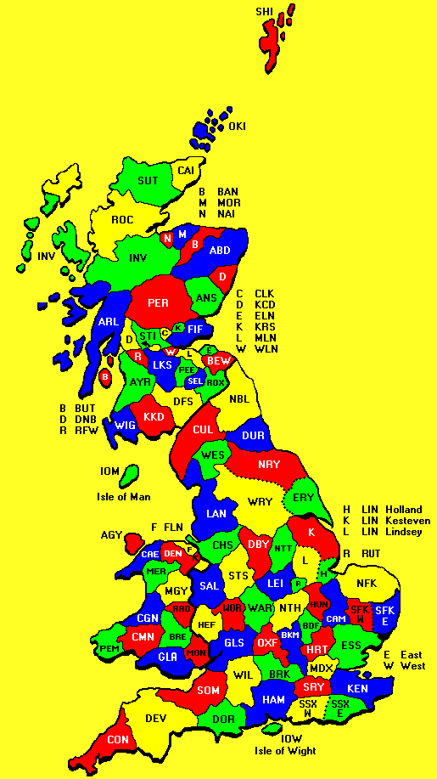
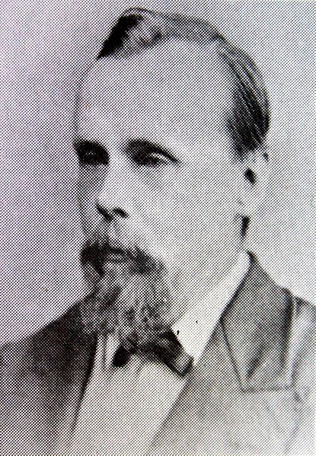
Four Color Theorem
Francis Guthrie (1852) South African
botanist, student at University
College London
Augustus de Morgan
Arthur Cayley (1878)
Computer-aided proof
by Kenneth Appel &
Wolfgang Haken (1976)

Slide 23
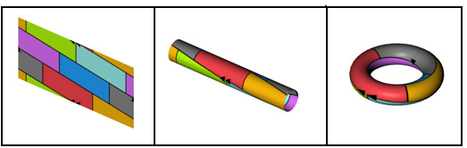
Generalizations
Heawood’s Conjecture (1890) The chromatic number, p, of an orientable Riemann surface of genus g is
p = {7 + (1+48g)^{1/2} }/2
Proven, for g ≥ 1 by Ringel & Youngs (1969)

Slide 24
Duality

Slide 25
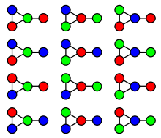
Vertex Coloring
Graph Coloring (dual problem): Replace each region (“country”) by a vertex (its “capital”) and connect the capitals of contiguous countries by an edge. The four color theorem is equivalent to saying that
The vertices of every planar graph can be colored with just four colors so that no edge has vertices of the same color; i.e.,
Every planar graph is 4-partite.

Slide 26
Edge Coloring
Tait’s Theorem: A bridgeless trivalent planar map is 4-face colorable iff its graph is 3 edge colorable.
Submap density – Bender, Canfield, Gao, Richmond
3-matrix models and colored triangulations--Enrique Acosta

Slide 27
g - Maps

Slide 28
Random Surfaces
Random Topology (Thurston et al)
Well-ordered Trees (Schaefer)
Geodesic distance on maps (DiFrancesco et al)
Maps ←→ Continuum Trees (a la Aldous)
Brownian Maps (LeGall et al)

Slide 29
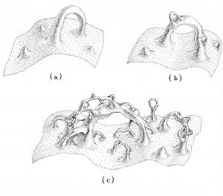
Random Surfaces
Black Holes and Time Warps: Einstein's Outrageous Legacy, Kip Thorne

Slide 30
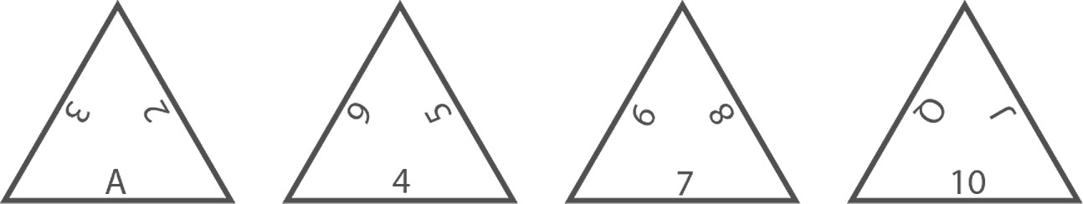
Some Examples

Slide 31
Some Examples
Randomly Triangulated Surfaces (Thurston)
n = # of faces (even), # of edges = 3n/2
V = # of vertices = 2 – 2g(Σ) + n/2
c = # connected components

Slide 32
Some Examples
Randomly Triangulated Surfaces (Thurston)
n = # of faces (even), # of edges = 3n/2
V = # of vertices = 2 – 2g(Σ) + n/2
c = # connected components
P_{U}(c ≥ 2) = 5/18n + O(1/n²)

Slide 33
Some Examples
Randomly Triangulated Surfaces (Thurston)
n = # of faces (even), # of edges = 3n/2
V = # of vertices = 2 – 2g(Σ) + n/2
c = # connected components
P_{U}(c ≥ 2) = 5/18n + O(1/n²)
E_{U}(g) = n/4 - ½ log n + O(1)

Slide 34
Some Examples
Randomly Triangulated Surfaces (Thurston)
n = # of faces (even), # of edges = 3n/2
V = # of vertices = 2 – 2g(Σ) + n/2
c = # connected components
P_{U}(c ≥ 2) = 5/18n + O(1/n²)
E_{U}(g) = n/4 - ½ log n + O(1)
Var(g) = O(log n)

Slide 35
Some Examples
Randomly Triangulated Surfaces (Thurston)
n = # of faces (even), # of edges = 3n/2
V = # of vertices = 2 – 2g(Σ) + n/2
c = # connected components
P_{U}(c ≥ 2) = 5/18n + O(1/n²)
E_{U}(g) = n/4 - ½ log n O(1)
Var(g) = O(log n)
Random side glueings of an n-gon (Harer-Zagier)
→ computes Euler characteristic of M_{g} = -B_{2g} /2g

Slide 36
Stochastic → Quantum
Black Holes & Wheeler’s Quantum Foam
Feynman, t’Hooft and Bessis-Itzykson-Zuber (BIZ)
Painlevé & Double-Scaling Limit
Enumerative Geometry of moduli spaces of Riemann surfaces (Mumford, Harer-Zagier, Witten)

Slide 37
Overview
Combinatorics Analytical Combinatorics Analysis

Slide 38
Quantum Gravity
Einstein-Hilbert action
Discretize (squares, fixed area)
← → 4-valent maps Σ
A(Σ) = n₄
<n₄ > = Σ_{Σ} n₄ (Σ) p(Σ)
Seek t_{c} so that <n₄ > → ∞
as t → t_{c}

Slide 39
Quantum Gravity

Slide 40
Overview
Combinatorics Analytical Combinatorics Analysis

Slide 41
Random Matrix Measures (UE)
M ε H_{n} , n x n Hermitian matrices
Family of measures on H_{n} (Unitary Ensembles)
N = 1/g_{s} x=n/N (t’Hooft parameter) ~ 1
τ²_{n,N} (t) = Z(t)/Z(0)
t = 0: Gaussian Unitary Ensemble (GUE)
Notes:
Brief overview of stat mech
Continuous parameter: t Discrete parameters: n, N, \nu

Slide 42
Matrix Moments
Notes:
Stat mech: partition fcns
Pro & Stat: moment gen fcn
Cramers: bridge to analysis

Slide 43
Matrix Moments
Notes:
Stat mech: partition fcns
Pro & Stat: moment gen fcn
Cramers: bridge to analysis

Slide 44
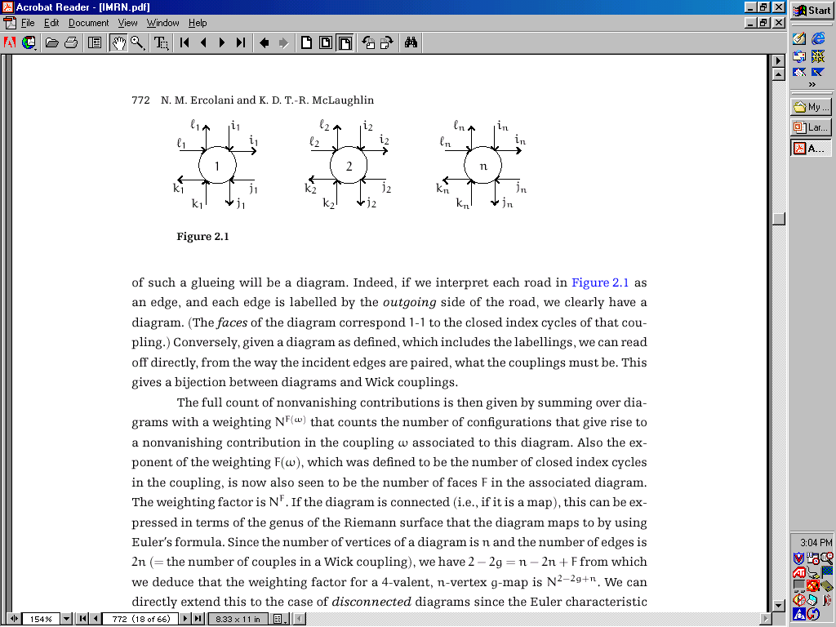
Feynman/t’Hooft Diagrams
ν = 2 case
A 4-valent diagram consists of
n (4-valent) vertices;
a labeling of the vertices by the numbers 1,2,…,n;
a labeling of the edges incident to the vertex s
(for s = 1 , …, n) by letters i_{s} , j_{s} , k_{s} and l_{s} where this alphabetic order corresponds to the cyclic order of the edges around the vertex).
….

Slide 45
The Genus Expansion
e_{g}(x, t_{j}) = bivariate generating function for g-maps with m vertices and f faces.
Information about generating functions for graphical enumeration is encoded in asymptotic correlation functions for the spectra of random matrices and vice-versa.

Slide 46
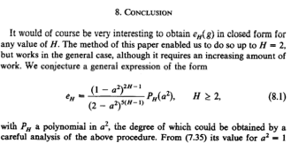
BIZ Conjecture (‘80)

Slide 47
Rationality of Higher e_{g} (valence 2ν) E-McLaughlin-Pierce

Slide 48
BIZ Conjecture (‘80)

Slide 49
Rigorous Asymptotics [EM ‘03]
uniformly valid as N −> ∞ for x ≈ 1, Re t > 0, |t| < T.
e_{g}(x,t) locally analytic in x, t near t=0, x≈1.
Coefficients only depend on the endpoints of the
support of the equilibrium measure (thru z₀(t) = β²/4).
The asymptotic expansion of t-derivatives may be
calculated through term-by-term differentiation.
Notes:
Use diagram, . Pictues

Slide 50
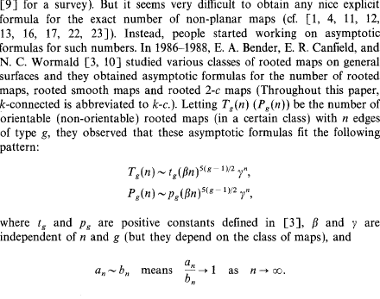
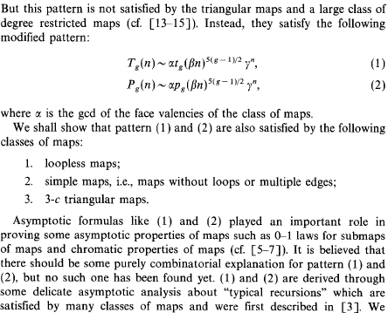
Universal Asymptotics ? Gao (1993)

Slide 51
Quantum Gravity

Slide 52
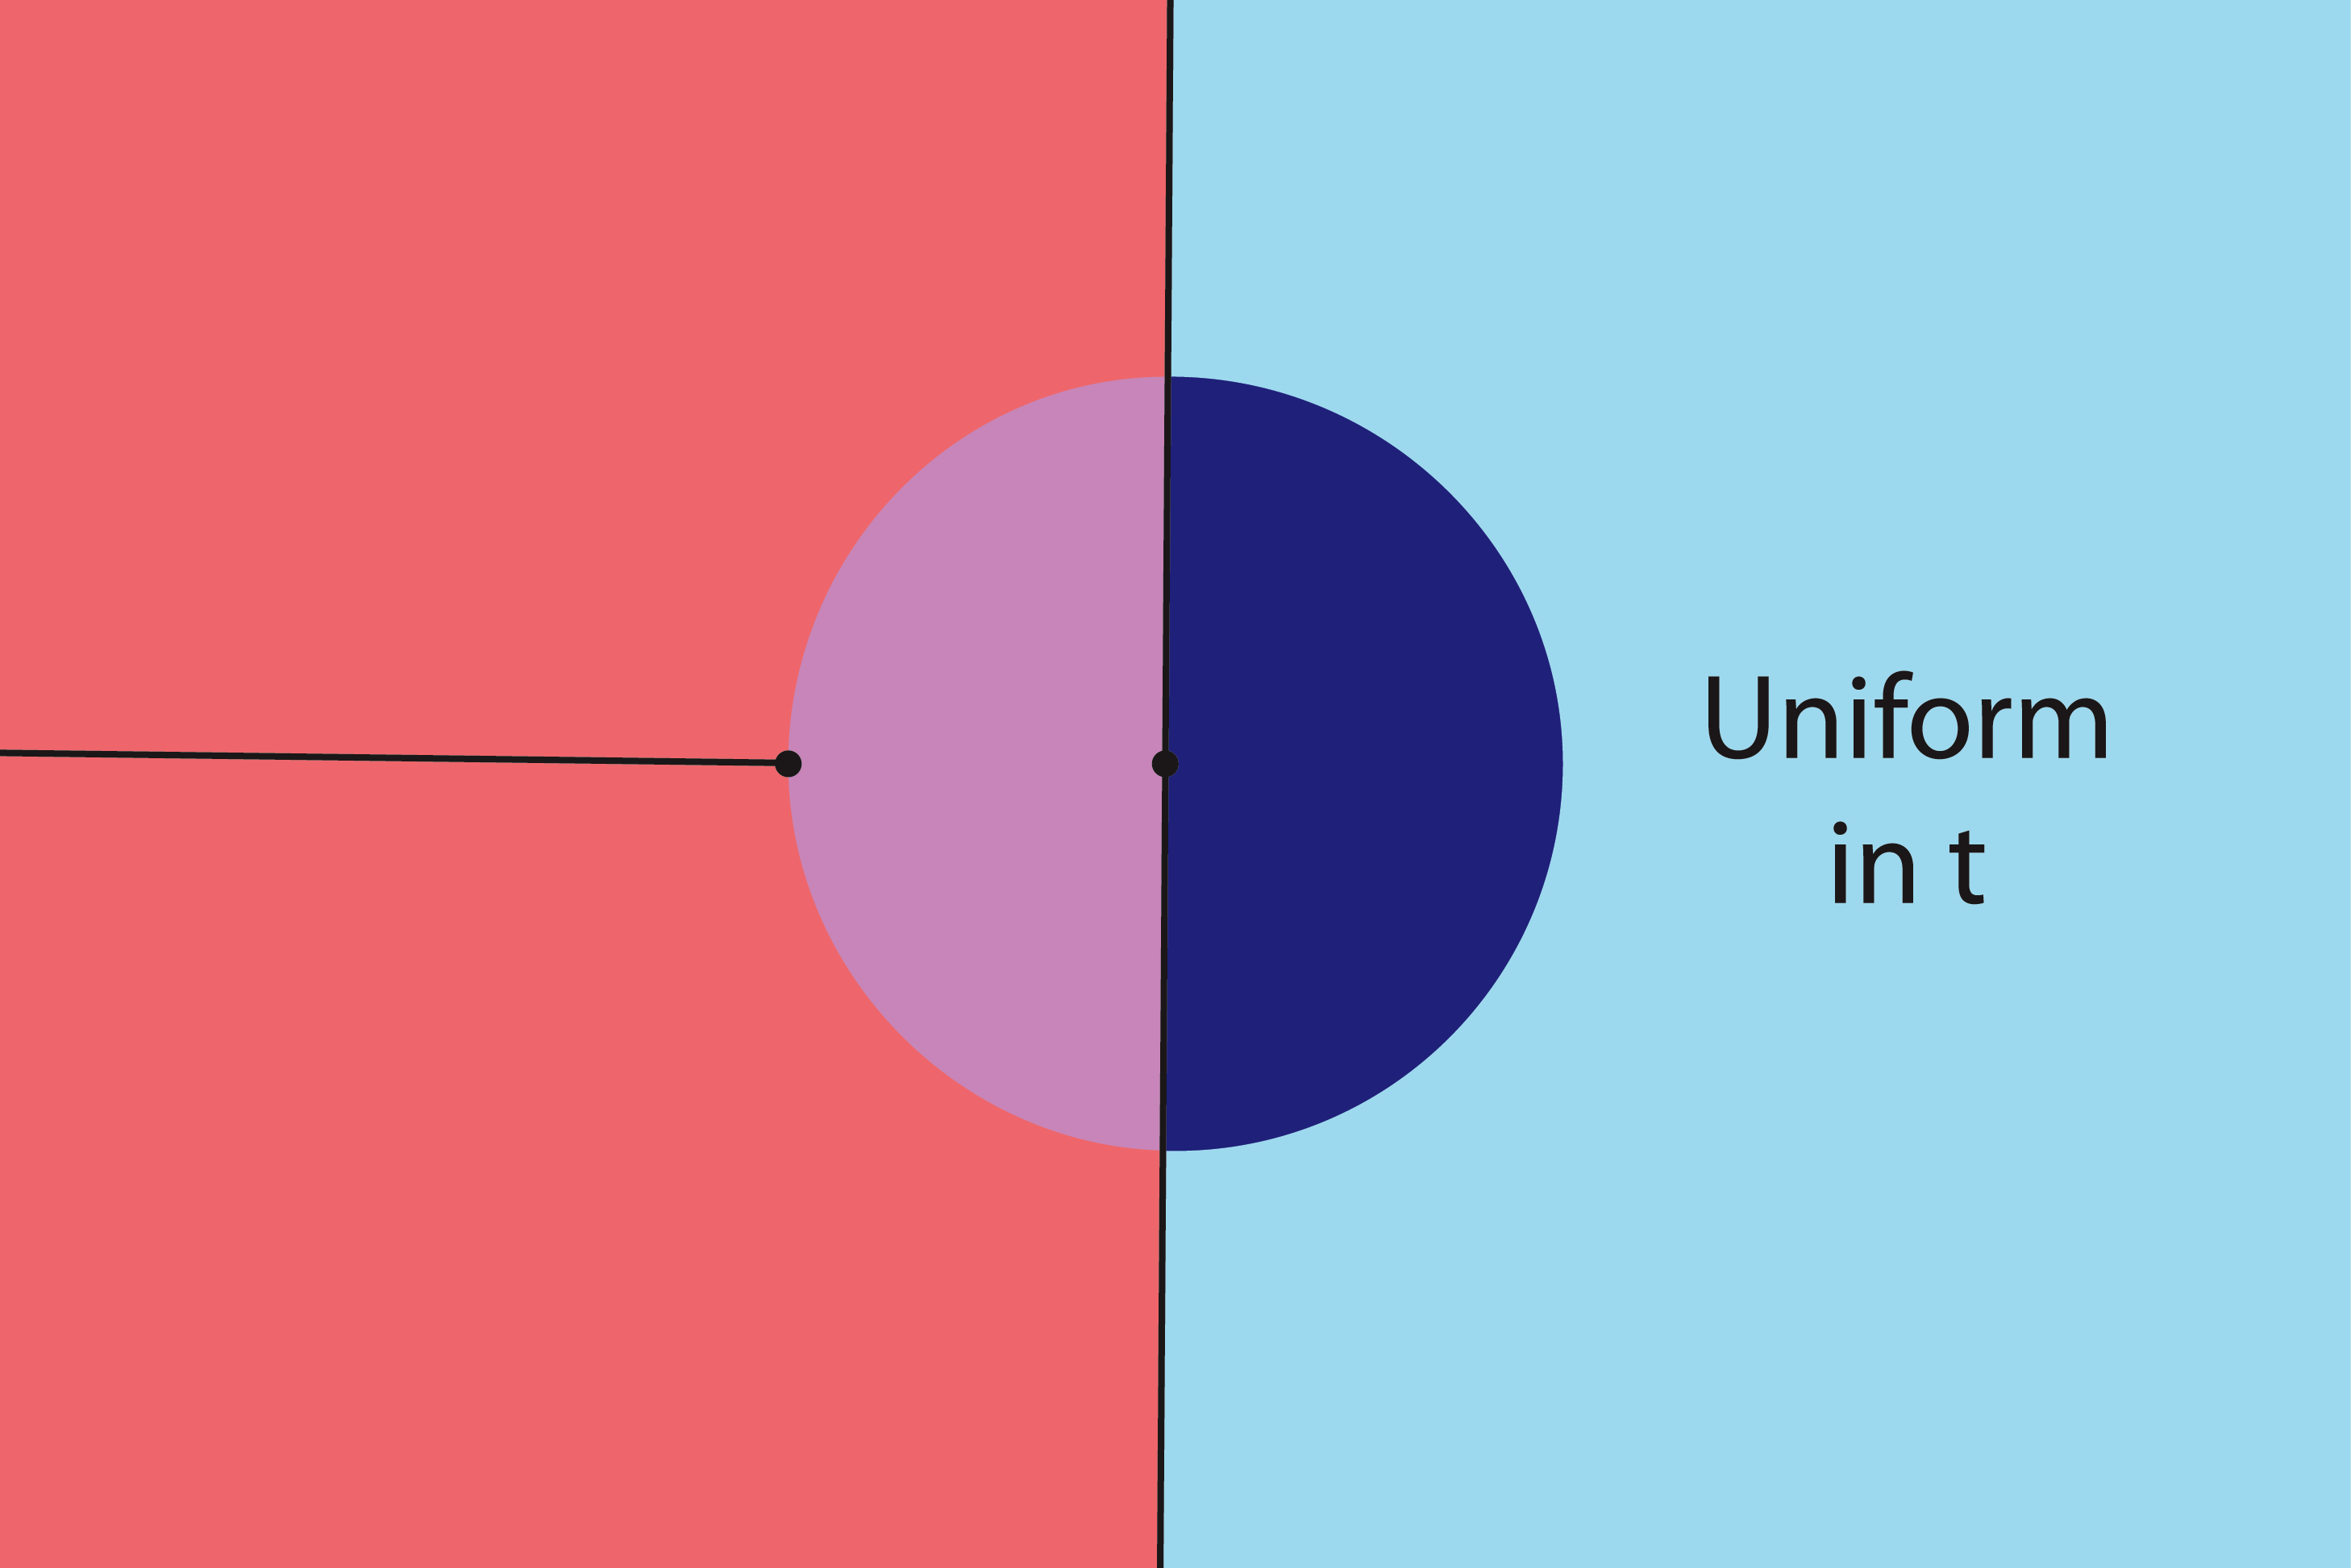
Max Envelope of Holomorphy for e_{g}(t)
“e_{g}(x,t) locally analytic in x, t near t=0, x≈1”

Slide 53
Overview
Combinatorics Analytical Combinatorics Analysis

Slide 54
Overview
Combinatorics Analytical Combinatorics Analysis

Slide 55
Orthogonal Polynomials with Exponential Weights

Slide 56
Weighted Lattice Paths
P ^{j}(m₁, m₂) =set of Motzkin paths of length j from m₁ to m₂
1 a₂ b₂²

Slide 57
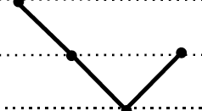
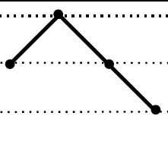
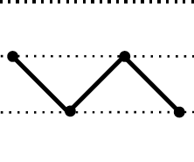
Examples

Slide 58
Overview
Combinatorics Analytical Combinatorics Analysis

Slide 59
Hankel Determinants
----------------------------------

Slide 60
The Catalan Matrix
L = (a_{n,k})
a_{0,0} = 1, a_{0,k} = 0 (k > 0)
a_{n,k} = a_{n-1,k-1} + a_{n-1,k+1} (n ≥ 1)
Note that a_{2n,0} = C_{n}

Slide 61
General Catalan Numbers & Matrices
Now consider complex sequences
σ = {s₀ , s₁ , s₂ , …} and τ = {t₀ , t₁ , t₂ , …} (t_{k} ≠ 0)
Define A^{σ τ} by the recurrence
a_{0,0} = 1, a_{0,k} = 0 (k > 0)
a_{n,k} = a_{n-1,k-1} + s_{k} a_{n-1,k} + t_{k+1} a_{n-1,k+1} (n ≥ 1)
Definition: L^{σ τ} is called a Catalan matrix and
H_{n} = a_{n,0} are called the Catalan numbers associated to σ, τ.

Slide 62
Hankel Determinants
----------------------------------

Slide 63
Szegö – Hirota Representations

Slide 64
Overview
Combinatorics Analytical Combinatorics Analysis

Slide 65
Max Envelope of Holomorphy for e_{g}(t)
“e_{g}(x,t) locally analytic in x, t near t=0, x≈1”

Slide 66
Mean Density of Eigenvalues (GUE)
One-point Function
Integrable Kernel for a Determinantal Point Process (Gaudin-Mehta)

Slide 67
Mean Density of Eigenvalues
One-point Function
where Y solves a RHP (Its et al) for monic orthogonal polys. p_{j}(λ) with weight e^{-NV(λ)}
Integrable Kernel for a Determinantal Point Process (Gaudin-Mehta)

Slide 68
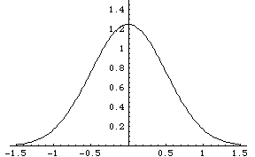
Mean Density of Eigenvalues (GUE)
n = 1 … 50
Courtesy K. McLaughlin

Slide 69
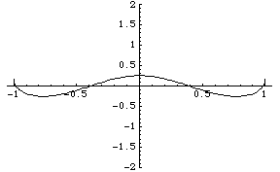
Mean Density Correction (GUE)
n x (MD -SC)
Courtesy K. McLaughlin

Slide 70
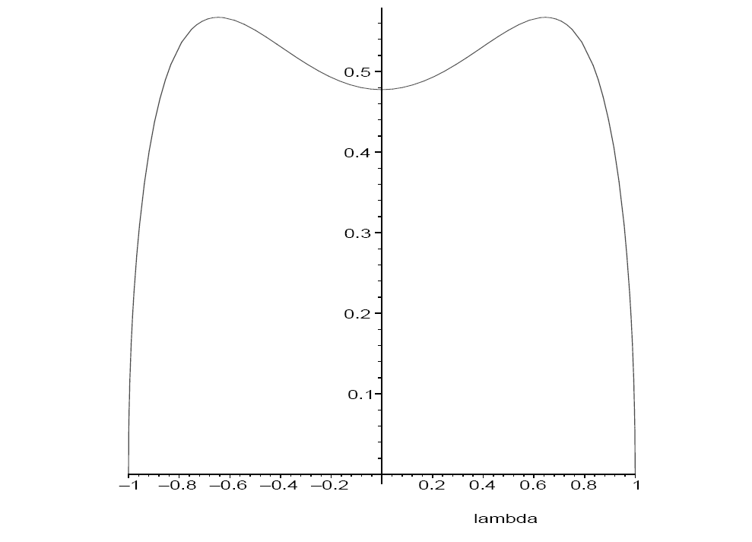
Spectral Interpretations of z₀(t)
Equilibrium measure for V = ½ λ² + t λ⁴, t=1

Slide 71
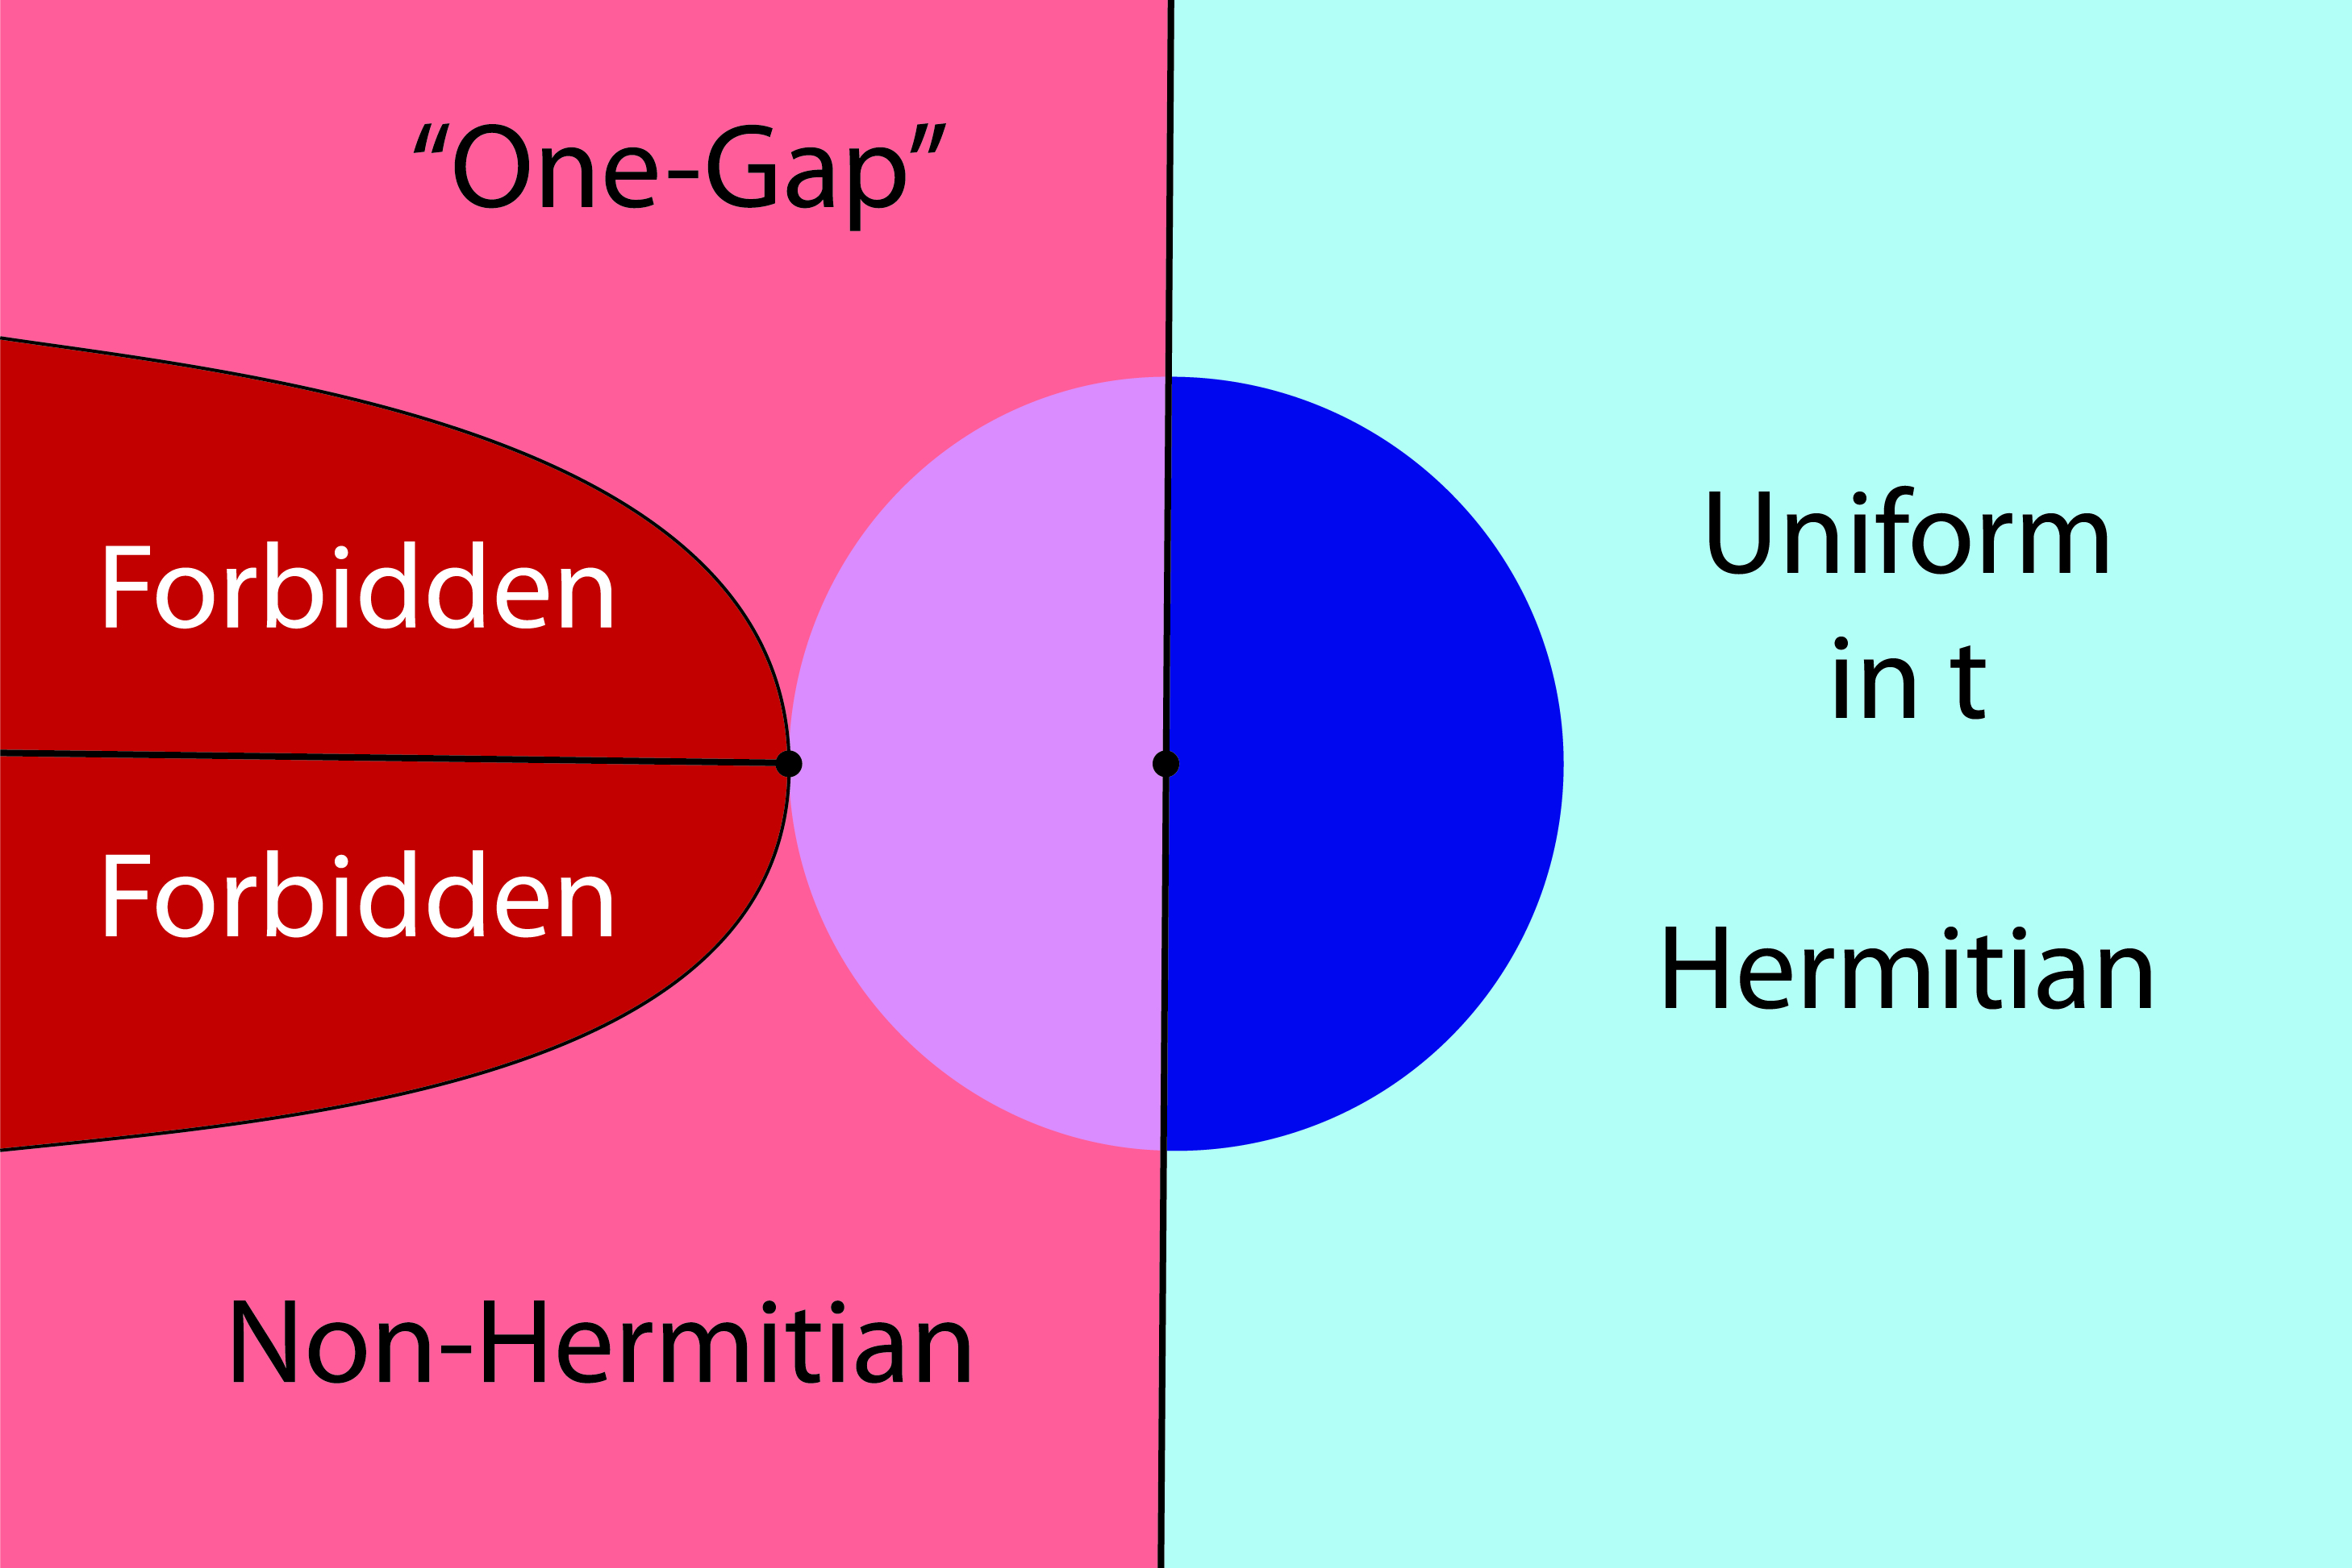
Phase Transitions/Connection Problem

Slide 72
Uniformizing the Equilibrium Measure
For λ = 2 z₀^{1/2} η
= z₀ û_{Gauss}(η) + (1 – z₀) û_{mon(2ν)}(η)
Each measure continues to the complex η plane as a differential whose square is a holomorphic quadratic differential.

Slide 73
Analysis Situs for RHPs
Trajectories
Orthogonal Trajectories
z₀ = 1

Slide 74
Phase Transitions/Connection Problem

Slide 75
Double-Scaling Limits
(ν – (ν−1) z₀) ∼ Ν^{δ} such that highest order terms have a common factor in Ν that is independent of g :
δ = - 2/5 ➔ Ν^{4/5} (t – t_{c}) = γ^{(ν)} ξ where t_{c} = (ν-1)^{ν-1}/(c_{ν} ν^{ν})
Notes:
Explain choice of double-scaling

Slide 76
New Recursion Relations
Coincides with with the recursion for PI in the case ν = 2.

Slide 77
Overview
Combinatorics Analytical Combinatorics Analysis

Slide 78
Discrete → Continuous
Based on 1/n² expansion of the recursion operator
n >> 1 ; w = x(1 + l/n) = (n + l) /N

Slide 79
Overview
Combinatorics Analytical Combinatorics Analysis

Slide 80
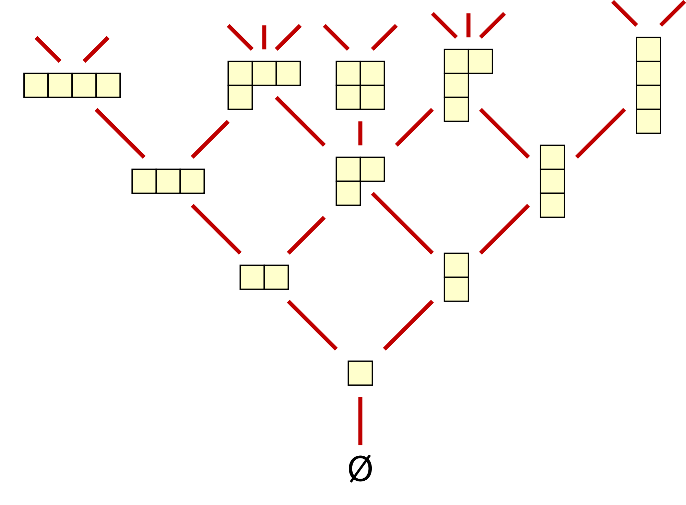
Differential Posets
The Toda, String and Schwinger-Dyson equations are bound together in a tight configuration that is well suited to the mutual analysis of their cluster expansions that emerge in the continuum limit. However, this is only the case for recursion operators with the asymptotics described here.
Example: Even Valence String Equations

Slide 81
Differential Posets

Slide 82
Closed Form Generating Functions
Patrick Waters

Slide 83
Trivalent Solutions
w/ Virgil Pierce

Slide 84
Overview
Combinatorics Analytical Combinatorics Analysis

Slide 85
“Hyperbolic” System
Virgil Pierce

Slide 86
Riemann Invariants

Slide 87
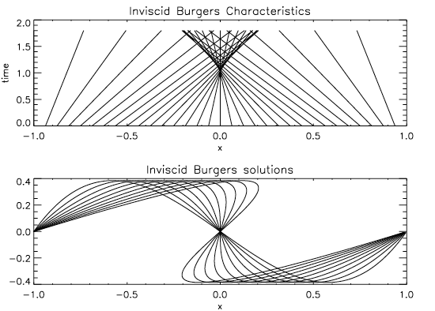
Characteristic Geometry

Slide 88
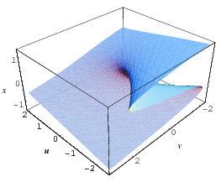
Characteristic Geometry
Courtesy Wolfram Math World

Slide 89
Recent Results (w/ Patrick Waters)
Universal Toda
Valence free equations
Riemann-invariants & the edge of the spectrum

Slide 90
Universal Toda

Slide 91
Valence Free Equations
h₁= 1/2 h_{0,1}
e₂ =

Slide 92
Riemann Invariants & the Spectral Edge
r₋
r₊

Slide 93
Overview
Combinatorics Analytical Combinatorics Analysis

Slide 94
Phase Transition at t_{c}
Dispersive Regularization & emergence of KdV
Small h-bar limit of Non-linear Schrodinger

Slide 95
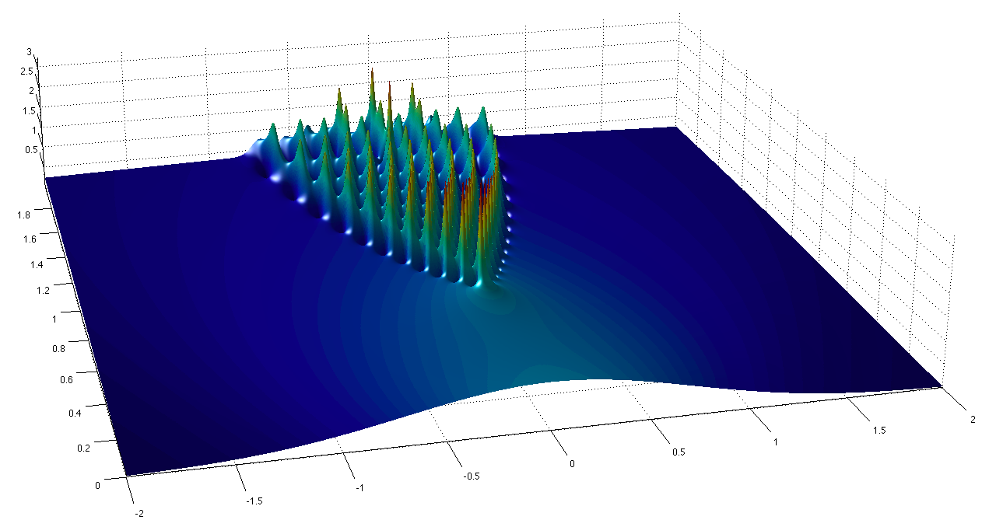
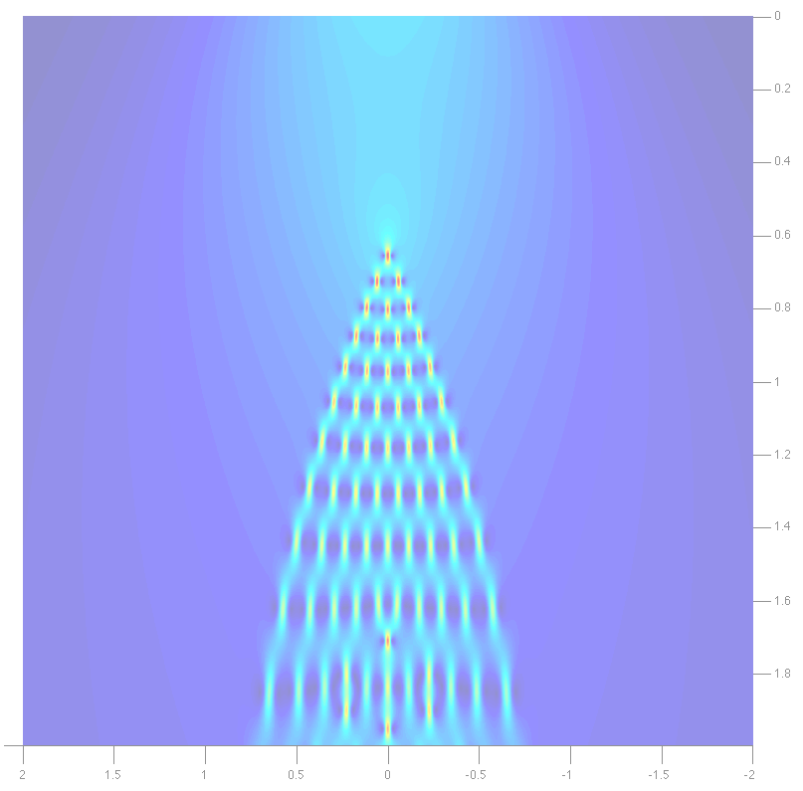
Small ħ-Limit of NLS
Riemann-Hilbert Analysis P. Miller & K. McLaughlin
Bertola, Tovbis, (2010) Universality for focusing NLS at the gradient catastrophe point:
Rational breathers and poles of the tritronquée solution to Painlevé I

Slide 96
Phase Transition at t_{c}
Dispersive Regularization & emergence of KdV
Small h-bar limit of Non-linear Schrodinger
Statistical Mechanics on Random Lattices

Slide 97
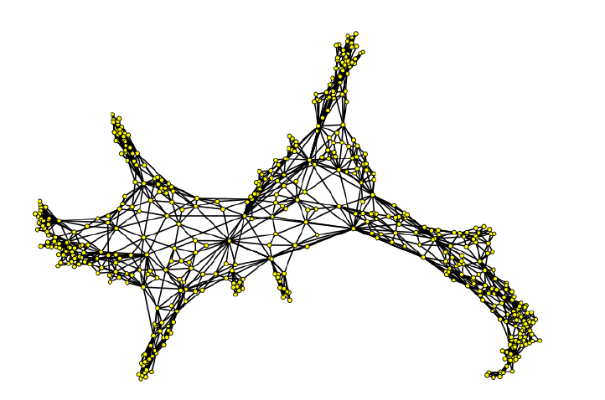
Brownian Maps
Large Random Triangulation of the Sphere

Slide 98
References
Asymptotics of the Partition Function for Random Matrices via Riemann-Hilbert Techniques, and Applications to Graphical Enumeration, E., K. D.T.-R. McLaughlin, International Mathematics Research Notices 14, 755-820 (2003).
Random Matrices, Graphical Enumeration and the Continuum Limit of Toda Lattices, E., K. D. T-R McLaughlin and V. U. Pierce, Communications in Mathematical Physics 278, 31-81, (2008).
Caustics, Counting Maps and Semi-classical Asymptotics, E., Nonlinearity 24, 481–526 (2011).
The Continuum Limit of Toda Lattices for Random Matrices with Odd Weights, E. and V. U. Pierce, Communications in Mathematical Science 10, 267-305 (2012).

Slide 99
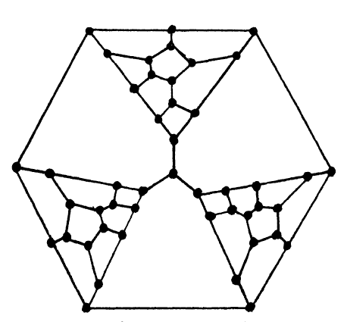
Tutte’s Counter-example to Tait
A trivalent planar graph that is not Hamiltonian

Slide 100
Recursion Formulae & Finite Determinacy
Derived Generating Functions
Coefficient Extraction

Slide 101
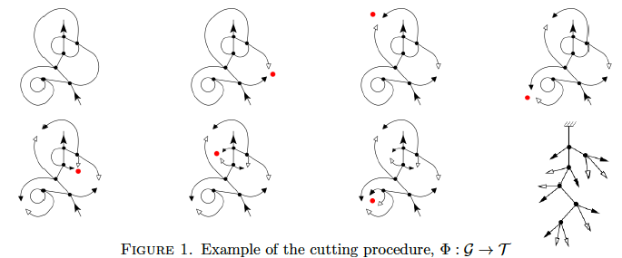
Blossom Trees (Cori, Vauquelin; Schaeffer)
z₀(s) = gen. func. for 2-legged 2ν valent planar maps
= gen. func. for blossom trees w/ ν−1 black leaves

Slide 102
Geodesic Distance (Bouttier, Di Francesco & Guitter}
geod. dist. = min_{paths leg(1)→leg(2)}{# bonds crossed}
R_{nk} = # 2-legged planar maps w/ k nodes, g.d. ≤ n

Slide 103
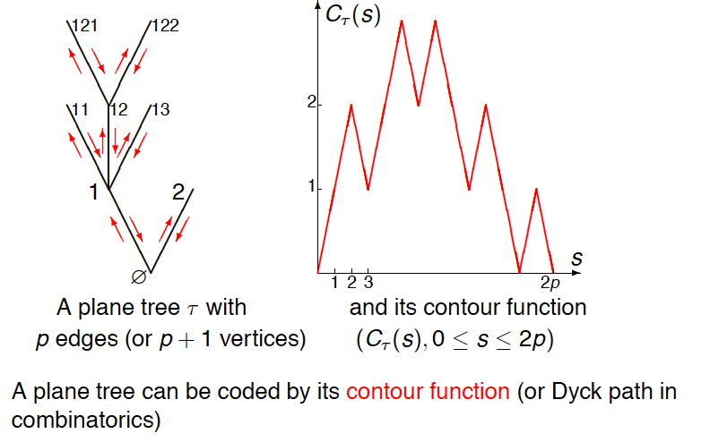
Coding Trees by Contour Functions

Slide 104
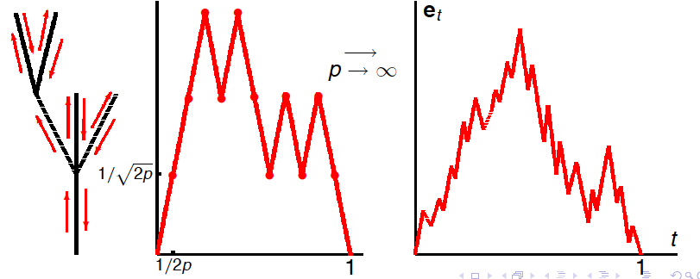
Aldous’ Theorem (finite variance case)

Slide 105
Duality
over “0” over “1” over “∞”
over (1, ∞) over (0,1) over (0, ∞)

Slide 106
Bulk Asymptotics of the One-Point Function [EM ‘03]
In the bulk,
where H and G are explicit locally analytic functions expressible in terms of the eq. measure. Here, and more generally, ρ₁^{(N)} depends only on the equilibrium measure, dμ = ψ(λ) dλ.

Slide 107
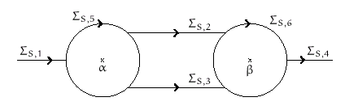
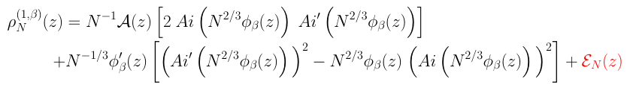
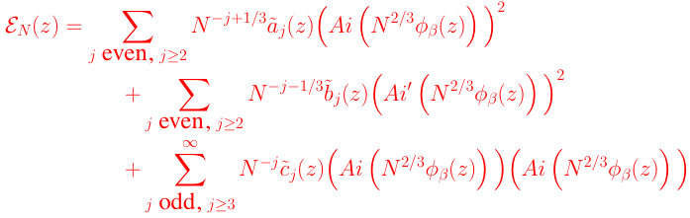
Endpoint Asymptotics of the One-Point Function [EM ‘03]
Near an endpoint:

Slide 108
Schwinger – Dyson Equations (Tova Lindberg)

Slide 109
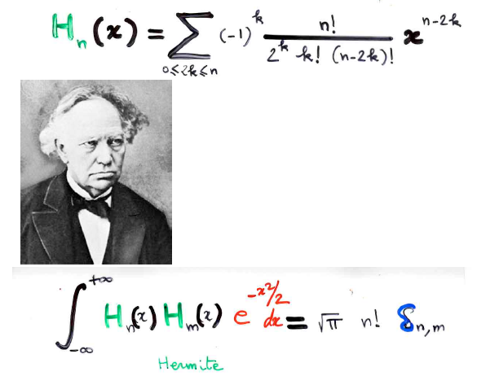
Hermite Polynomials
Courtesy X. Viennot

Slide 110
Gaussian Moments

Slide 111
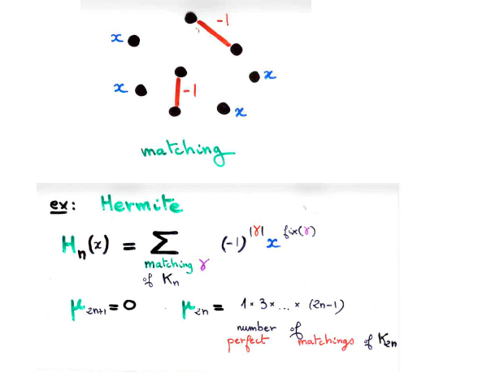
Matchings

Slide 112
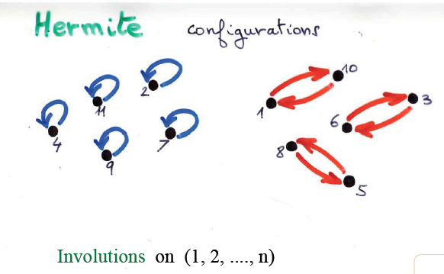
Involutions

Slide 113
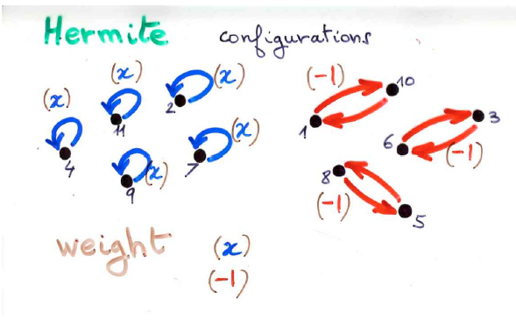
Weighted Configurations

Slide 114
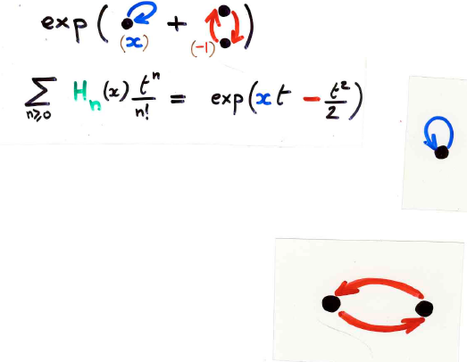
Hermite Generating Function

Slide 115
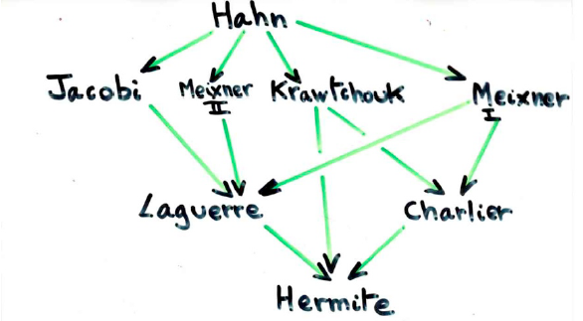
Askey-Wilson Tableaux

Slide 116
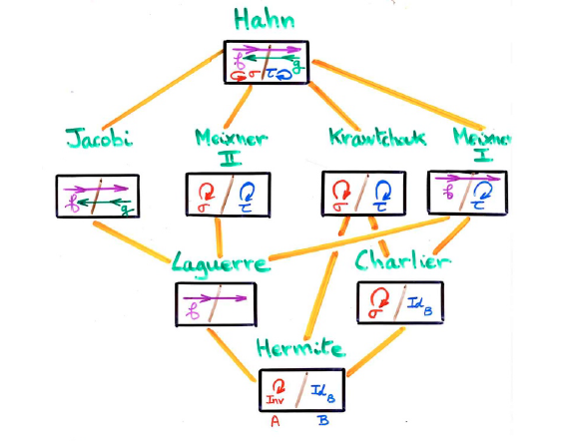
Combinatorial Interpretations

