Slide 1
Modelling the effects of short-term immune responses on competing influenza strains
Ben Ashby
Department of Zoology, University of Oxford

Slide 2
Introduction
Modelling the effects of short-term immune responses on competing influenza strains
Influenzavirus A exhibits:
Antigenic drift (via point mutations in the surface glycoproteins HA and NA)
Antigenic shift (via recombination of multiple strains)
Investigate notions of ‘antigenic space’
Normally model cross-immunity a function of distance

Slide 3
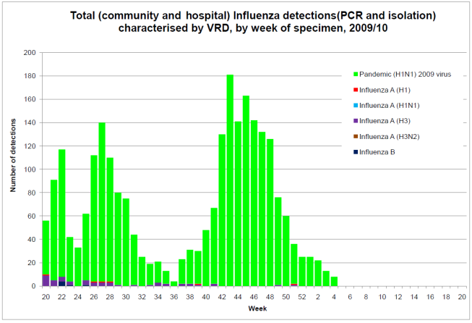
Problems
Modelling the effects of short-term immune responses on competing influenza strains
Pandemic strains are completely novel, so we should have no cross-immunity to them
i.e. seasonal strains should be unaffected by pandemics
However, this is not the pattern we see in the data

Slide 4
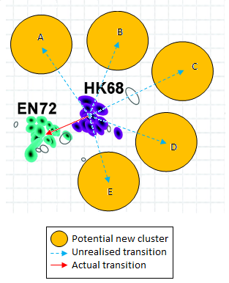
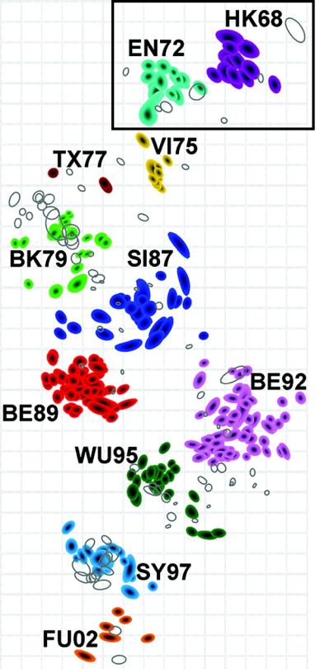
Problems
Modelling the effects of short-term immune responses on competing influenza strains
Seasonal strains should see an exponential growth in lineages, but again this is not the case
Antigenic map of H3N2¹:
¹Smith et al. Mapping the antigenic and genetic evolution of the influenza virus. Science, 305:371-376 2004.

Slide 5
Possible solutions
Modelling the effects of short-term immune responses on competing influenza strains
Limit the dimensionality of antigenic space
Limit the ‘size’ of antigenic space (Recker et al. 2007)
Employ strain-transcending short-term immunity (Ferguson and Bush 2004)

Slide 6
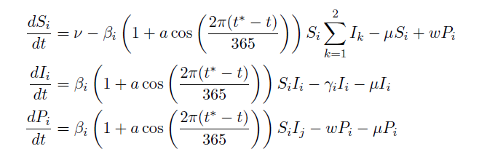
Methodology
Modelling the effects of short-term immune responses on competing influenza strains
Introduce strain-transcending (heterosubtypic) temporary immunity:

Slide 7
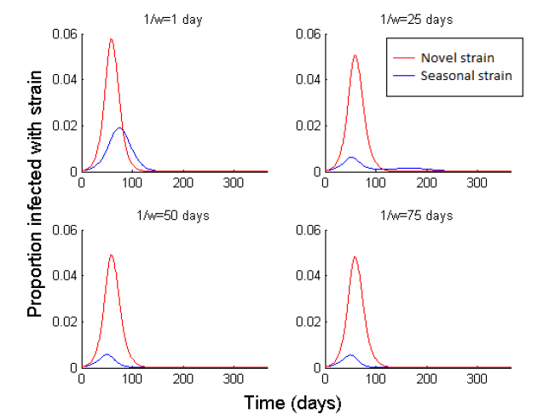
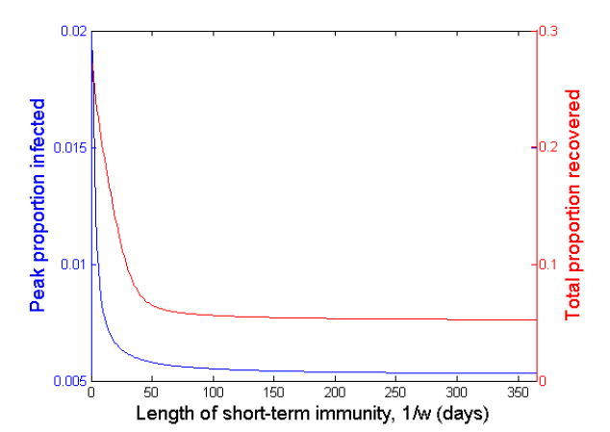
Modelling the effects of short-term immune responses on competing influenza strains
Summary of Results
Pandemic influenza
Even very short periods of temporary immunity can dramatically reduce the prevalence of seasonal influenza
Effects are most pronounced in the 0-50 day range in this example
Provides an explanation as to why seasonal strains ‘disappear’ in pandemic years

Slide 8
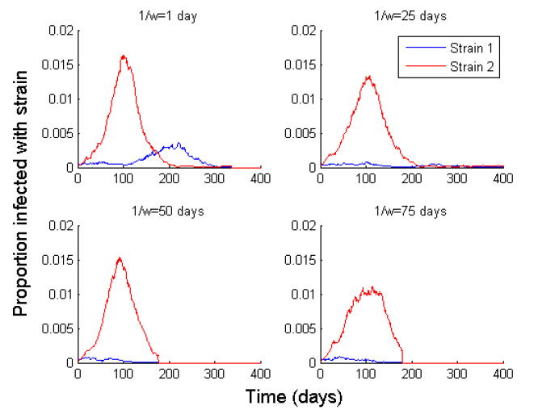
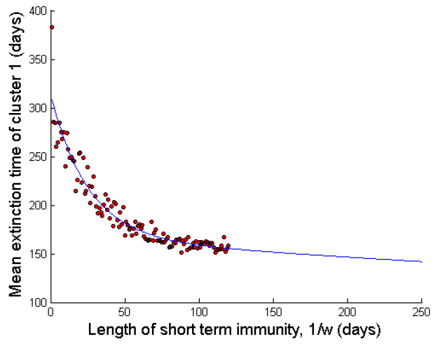
Modelling the effects of short-term immune responses on competing influenza strains
Summary of Results
Seasonal influenza
Limited the investigation to a two-strain system for simplicity
Used a stochastic, individual-based model to measure the mean time to extinction of one strain, following the introduction of a second strain
Results of 6000 simulations:

Slide 9
Modelling the effects of short-term immune responses on competing influenza strains
Summary of Results
Effects of temporary immunity on host-contact networks (HCNs)
Previous models assumed the population mixed homogeneously
A more realistic approach is to create a social contact network between hosts, through which infection can be transmitted
i.e. you are more likely to infect family and friends than strangers due to more frequent contact, so this should be reflected in the model

Slide 10
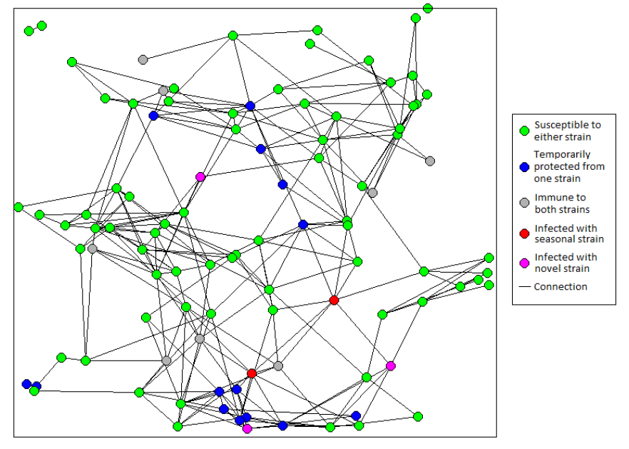
Modelling the effects of short-term immune responses on competing influenza strains
Summary of Results
Effects of temporary immunity on host-contact networks (HCNs)
Why introduce this?
Temporary immunity may produce a synergistic effect on HCNs by increasing the average path length between individuals

Slide 11
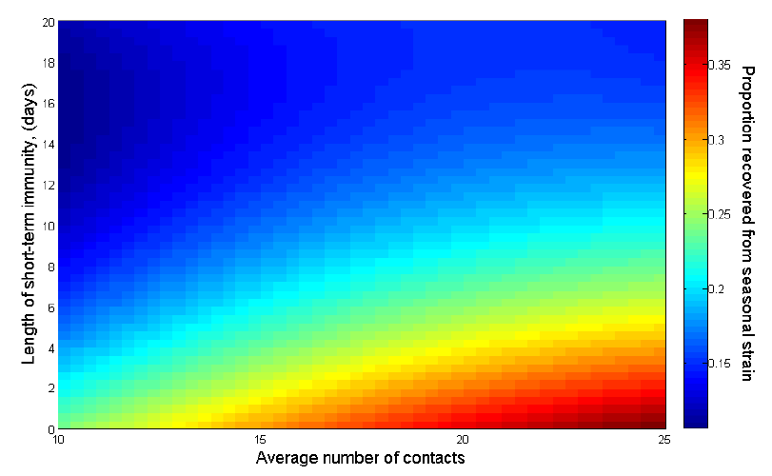
Modelling the effects of short-term immune responses on competing influenza strains
Summary of Results
Effects of temporary immunity on host-contact networks (HCNs)
3360 simulations over 336 parameter combinations
Results indicate temporary immunity does block transmission routes on HCNs and can be crucial in suppressing other strains
Notes:
Talk about gradient in horizontal and vertical

Slide 12
Discussion
Modelling the effects of short-term immune responses on competing influenza strains
Notable caveats:
The seasonal model was quite idealised (only two strains & new strain always seeded at the same time)
HCN model was of a small population (5000) – a good preliminary investigation, but further work is required in this area before deeper conclusions can be drawn
No conclusive biological data to consistently demonstrate this effect

Slide 13
Discussion
Modelling the effects of short-term immune responses on competing influenza strains
Implications:
Short-term, heterosubtypic (strain-transcending) immunity appears to explain some of the problems associated with many influenza models
Temporary immunity could be masking mutation and recombination rates, as many new strains could be suppressed before they are established

Slide 14
Questions
Modelling the effects of short-term immune responses on competing influenza strains

