Slide 1

Long-range correlations in driven systems
David Mukamel

Slide 2
Outline
Will discuss two examples where long-range correlations show up
and consider some consequences
Example I: Effect of a local drive on the steady state of a system
Example II: Linear drive in two dimensions: spontaneous symmetry
breaking

Slide 3
Example I :Local drive perturbation
T. Sadhu, S. Majumdar, DM, Phys. Rev. E 84, 051136 (2011)

Slide 4

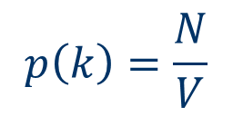
Local perturbation in equilibrium
Particles diffusing (with exclusion) on a grid
occupation number $τ_{i}=0,1$
N particles
V sites
$$p\left(k\right)=\frac{N}{V}$$
Prob. of finding a particle at site k

Slide 5


Add a local potential u at site 0
1
1
1
$$e^{βu}$$
1
N particles
V sites
0
1
$$1$$
The density changes only locally.

Slide 6
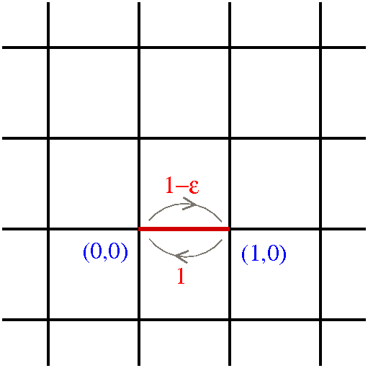
Effect of a local drive: a single driving bond

Slide 7
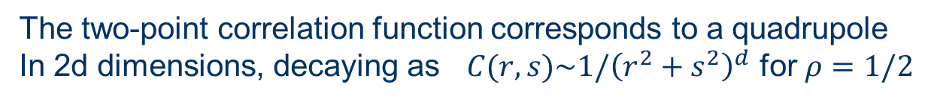
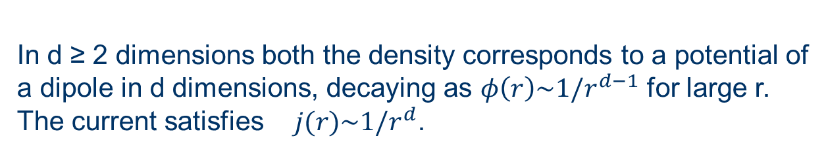
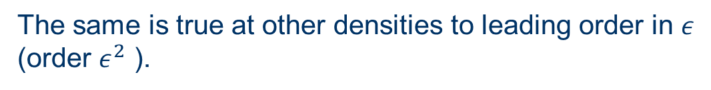
Main Results
In d ≥ 2 dimensions both the density corresponds to a potential of
a dipole in d dimensions, decaying as $φ\left(r\right)\sim 1/r^{d−1}$ for large r.
The current satisfies $j(r)\sim 1/r^{d}$.
The same is true for local arrangements of driven bonds.
The power law of the decay depends on the specific
configuration.
The two-point correlation function corresponds to a quadrupole
In 2d dimensions, decaying as $C(r,s)\sim 1/{\left(r^{2}+s^{2}\right)}^{d}$ for $ρ=1/2$
The same is true at other densities to leading order in $ε$
(order $ε^{2}$ ).

Slide 8
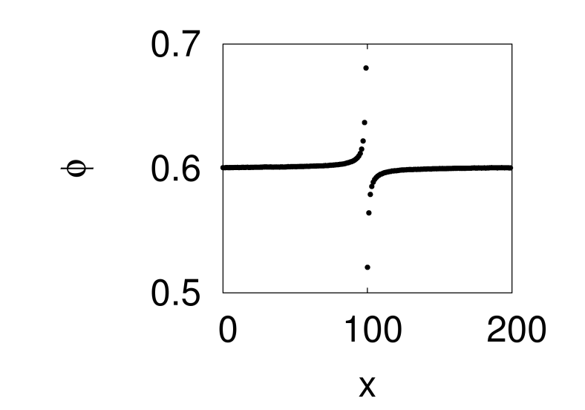
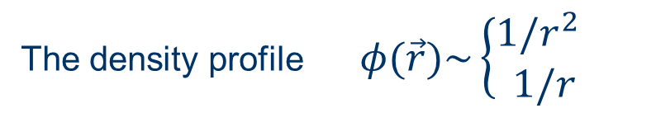
Density profile (with exclusion)
The density profile $φ(\vec{r})\sim \left\{\begin{aligned}1/r^{2 } \\ 1/r\end{aligned}\right.$
along the y axis
in any other direction

Slide 9

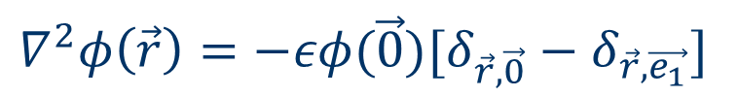
Non-interacting particles
Time evolution of density:
$∂_{t}φ\left(\vec{r}, t\right)=∇^{2}φ\left(\vec{r}, t\right)+εφ\left(\vec{0},t\right)[δ_{\vec{r},\vec{0}}−δ_{\vec{r},\vec{e_{1}}}]$
$$∇^{2}=φ\left(m+1,n\right)+φ\left(m−1,n\right)+φ\left(m,n+1\right)+φ\left(m,n−1\right)−4φ(m,n)$$
The steady state equation
$$∇^{2}φ\left(\vec{r}\right)=−εφ(\vec{0})[δ_{\vec{r},\vec{0}}−δ_{\vec{r},\vec{e_{1}}}]$$
particle density $→$ electrostatic potential of an electric dipole

Slide 10



$$∇^{2}φ\left(\vec{r}\right)=−εφ(\vec{0})[δ_{\vec{r},\vec{0}}−δ_{\vec{r},\vec{e_{1}}}]$$
Green’s function
$$∇^{2}G\left(\vec{r},{\vec{r}}_{o}\right)=−δ_{\vec{r},{\vec{r}}_{o}}$$
solution
$φ\left(\vec{r}\right)=ρ+εφ\left(\vec{0}\right)[G\left(\vec{r},\vec{0}\right)−G(\vec{r},{\vec{e}}_{1})]$
Unlike electrostatic configuration here the strength of
the dipole should be determined self consistently.

Slide 11
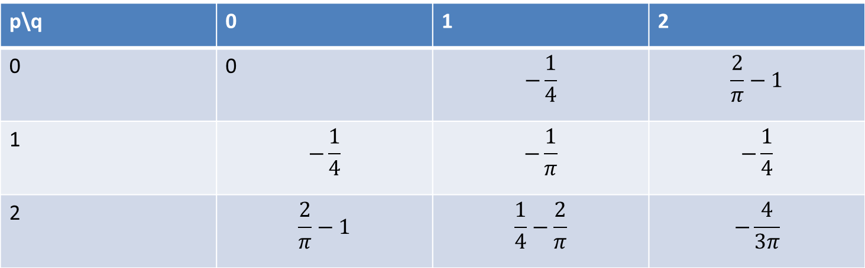
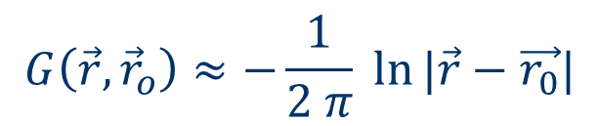
Green’s function of the discrete Laplace equation
p\q | 0 | 1 | 2
0 | 0 | $$−\frac{1}{4}$$ | $$\frac{2}{π}−1$$
1 | $$−\frac{1}{4}$$ | $$−\frac{1}{π}$$ | $$−\frac{1}{4}$$
2 | $$\frac{2}{π}−1$$ | $$\frac{1}{4}−\frac{2}{π}$$ | $$−\frac{4}{3π}$$
$$G\left(\vec{r},{\vec{r}}_{o}\right)≈−\frac{1}{2 π} ln⁡|\vec{r}−\vec{r_{0}}|$$

Slide 12

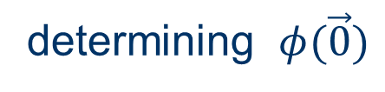

determining $φ(\vec{0})$
To find $φ(\vec{0})$ one uses the values $G\left(\vec{0},\vec{0}\right)=0 , G\left(\vec{0},{\vec{e}}_{1}\right)=−\frac{1}{4}$
$$φ\left(\vec{0}\right)=\frac{ρ}{1−\frac{ε}{4}}$$

Slide 13
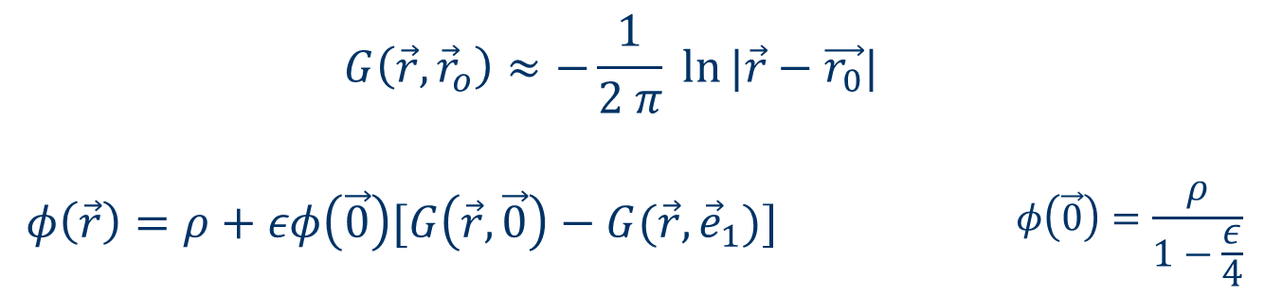
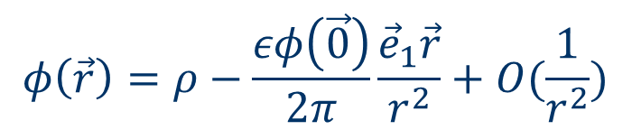
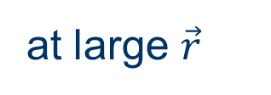
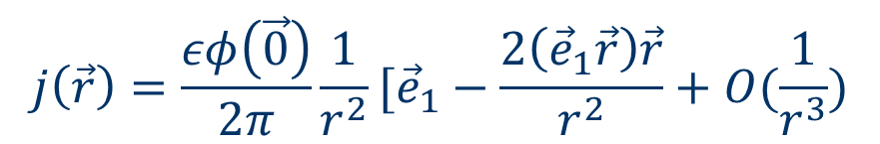
at large $\vec{r}$
$$φ\left(\vec{r}\right)=ρ−\frac{εφ\left(\vec{0}\right)}{2π}\frac{{\vec{e}}_{1}\vec{r}}{r^{2}}+O(\frac{1}{r^{2}})$$
density:
$$j\left(\vec{r}\right)=\frac{εφ\left(\vec{0}\right)}{2π}\frac{1}{r^{2}}[{\vec{e}}_{1}−\frac{2\left({\vec{e}}_{1}\vec{r}\right)\vec{r}}{r^{2}}+O(\frac{1}{r^{3}})$$
current:

Slide 14
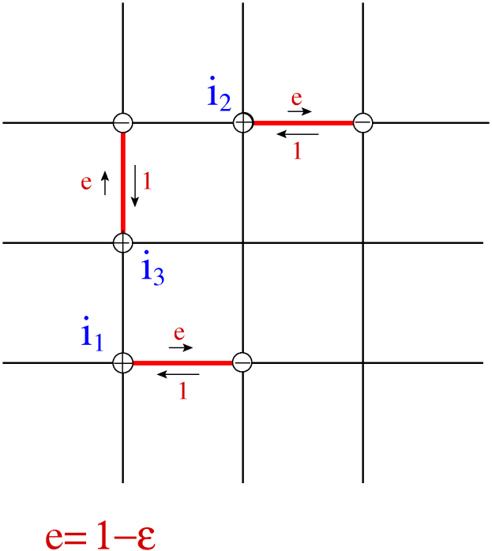
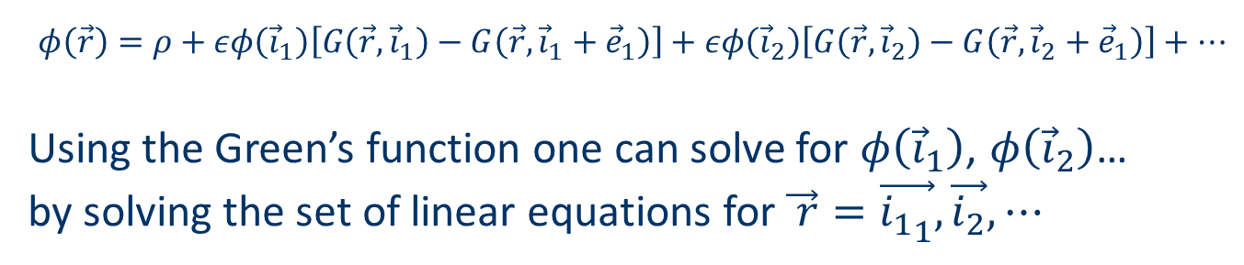
Multiple driven bonds
$φ\left(\vec{r}\right)=ρ+εφ\left({\vec{i}}_{1}\right)\left[G\left(\vec{r}, {\vec{i}}_{1}\right)−G\left(\vec{r}, {\vec{i}}_{1}+{\vec{e}}_{1}\right)\right]+εφ\left({\vec{i}}_{2}\right)\left[G\left(\vec{r}, {\vec{i}}_{2}\right)−G\left(\vec{r}, {\vec{i}}_{2}+{\vec{e}}_{1}\right)\right]+…$
Using the Green’s function one can solve for $φ\left({\vec{i}}_{1}\right)$, $φ\left({\vec{i}}_{2}\right)$…
by solving the set of linear equations for $\vec{ r}=\vec{{i_{1}}_{1}},\vec{i_{2}},⋯$

Slide 15
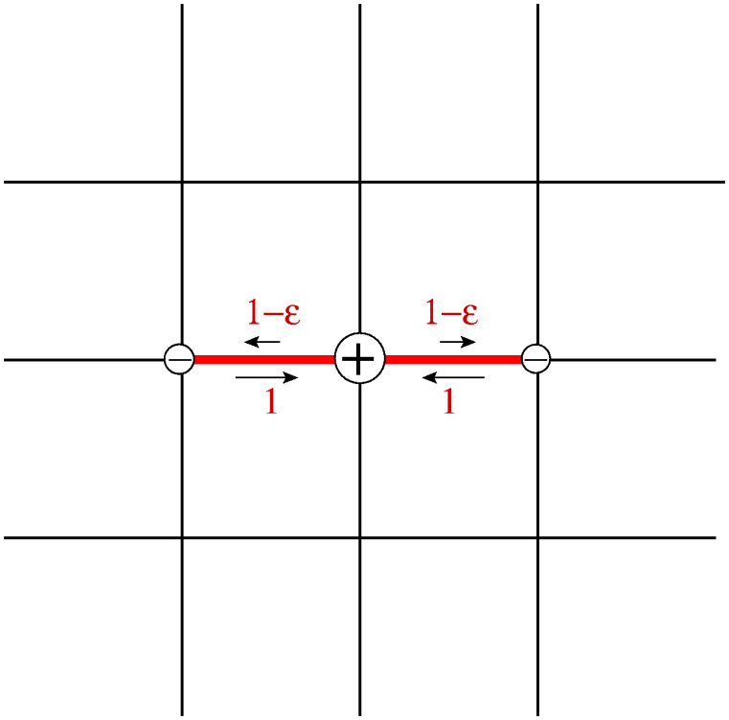
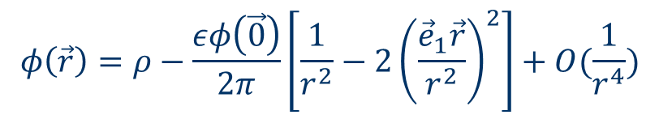
Two oppositely directed driven bonds – quadrupole field
The steady state equation: $∇^{2}φ\left(\vec{r}\right)=−εφ(\vec{0})[2δ_{\vec{r},\vec{0}}−δ_{\vec{r},{\vec{e}}_{1}}{−δ}_{\vec{r},{−\vec{e}}_{1}}]$
$$φ\left(\vec{r}\right)=ρ−\frac{εφ\left(\vec{0}\right)}{2π}\left[\frac{1}{r^{2}}−2{\left(\frac{{\vec{e}}_{1}\vec{r}}{r^{2}}\right)}^{2}\right]+O(\frac{1}{r^{4}})$$

Slide 16
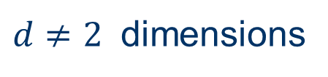

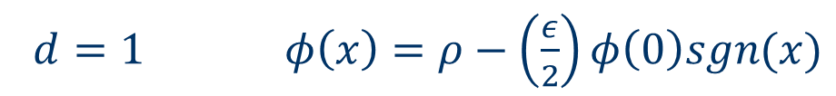
$d≠2$ dimensions
$d=1 φ\left(x\right)=ρ−\left(\frac{ε}{2}\right)φ\left(0\right)sgn(x)$
$G\left(x,x_{o}\right)=−\frac{\left|x−x_{o}\right|}{2}$
$d≥2$ $φ\left(\vec{r}\right)∼\frac{1}{r^{d−1}}$

Slide 17
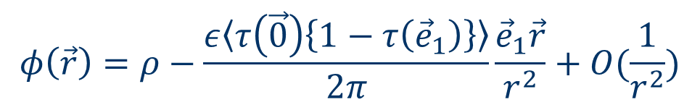

The model of local drive with exclusion
Here the steady state measure is not known however one can
determine the behavior of the density.
$$∂_{t}φ\left(\vec{r}, t\right)=∇^{2}φ\left(\vec{r}, t\right)+ε〈τ\left(\vec{0}\right)\left\{1−τ\left({\vec{e}}_{1}\right)\right\}〉[δ_{\vec{r},\vec{0}}−δ_{\vec{r},\vec{e_{1}}}]$$
$τ=0,1$is the occupation variable
$$φ\left(\vec{r}\right)=ρ−\frac{ε〈τ\left(\vec{0}\right)\left\{1−τ\left({\vec{e}}_{1}\right)\right\}〉}{2π}\frac{{\vec{e}}_{1}\vec{r}}{r^{2}}+O(\frac{1}{r^{2}})$$

Slide 18

$$φ\left(\vec{r}\right)=ρ−\frac{ε〈τ\left(\vec{0}\right)\left\{1−τ\left({\vec{e}}_{1}\right)\right\}〉}{2π}\frac{{\vec{e}}_{1}\vec{r}}{r^{2}}+O(\frac{1}{r^{2}})$$
The density profile is that of the dipole potential with a dipole
strength which can only be computed numerically.

Slide 19
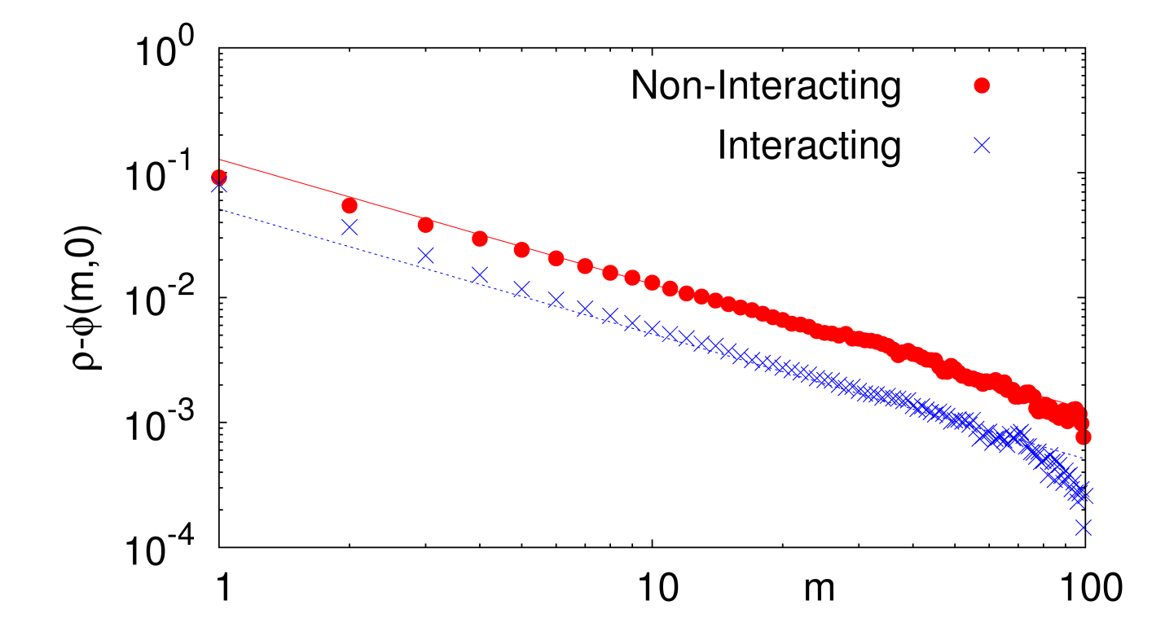
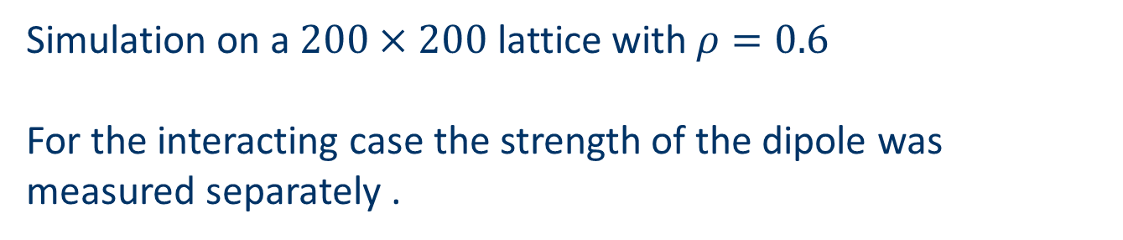
Simulation results
Simulation on a $200×200$ lattice with $ρ=0.6$
For the interacting case the strength of the dipole was measured separately .

Slide 20
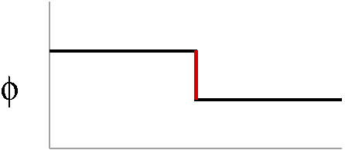
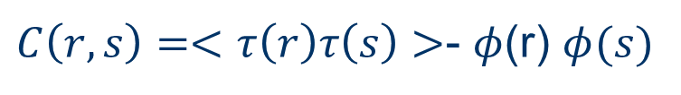
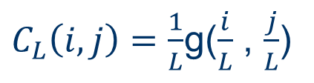
Two-point correlation function
$C\left(r,s\right)=<τ\left(r\right)τ\left(s\right)>$- $φ$(r) $φ(s)$
In d=1 dimension, in the hydrodynamic limit
$C_{L}\left(i,j\right)=\frac{1}{L}$g($\frac{i}{L}$ , $\frac{j}{L}$)
T. Bodineau, B. Derrida, J.L. Lebowitz, JSP, 140 648 (2010).

Slide 21
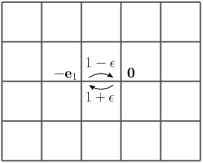
In higher dimensions local currents do not vanish for large
L and the correlation function does not vanish in this limit.
T. Sadhu, S. Majumdar, DM, in progress

Slide 22






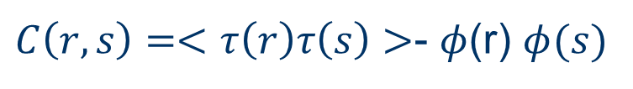
Symmetry of the correlation function:
$C\left(r,s\right)=<τ\left(r\right)τ\left(s\right)>$- $φ$(r) $φ(s)$
inversion
$$C_{ε}\left(r,s\right)=C_{−ε}(−r,−s)$$
particle-hole
$$C_{ε,ρ}\left(r,s\right)=C_{−ε,1−ρ}(r,s)$$
at $ρ=1/2$
$$C_{ε}\left(r,s\right)=C_{−ε}(r,s)$$
$$\int{d^{d}r C\left(r,s\right)=0}$$
$$\left(Δ_{r}+Δ_{s}\right)C\left(r,s\right)=σ_{}\left(r,s\right)$$
$C(r,s)$ corresponds to an electrostatic potential in $2d$induced by $σ$

Slide 23


Consequences of the symmetry:
The net charge =0
At $ρ=0.5 C_{ε}\left(r,s\right)$ is even in $ε$
Thus the charge cannot support a dipole and the
leading contribution in multipole expansion is
that of a quadrupole (in 2d dimensions).
$$C(r,s)\sim 1/{\left(r^{2}+s^{2}\right)}^{d}$$

Slide 24
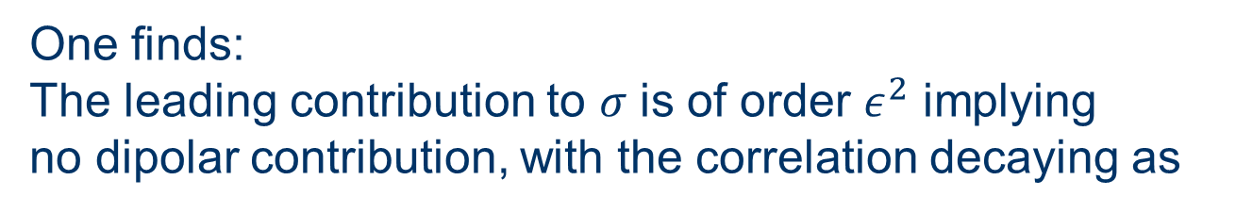


For $ρ≠0.5$one can expand $σ$ in powers of $ε$
One finds:
The leading contribution to $σ$ is of order $ε^{2}$ implying
no dipolar contribution, with the correlation decaying as
$$C(r,s)\sim 1/{\left(r^{2}+s^{2}\right)}^{d}$$

Slide 25
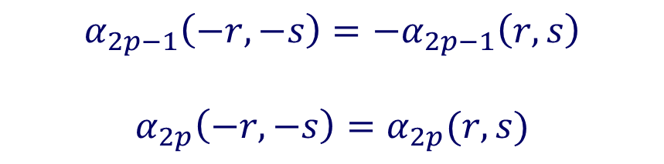
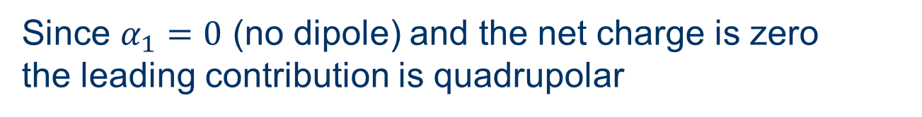
$$C\left(r,s\right)=εα_{1}\left(r,s\right)+ε^{2}α_{2}\left(r,s\right)+…$$
$$α_{2p−1}\left(−r,−s\right)=−α_{2p−1}\left(r,s\right)$$
$$α_{2p}\left(−r,−s\right)=α_{2p}(r,s)$$
Since $α_{1}=0$ (no dipole) and the net charge is zero
the leading contribution is quadrupolar

Slide 26
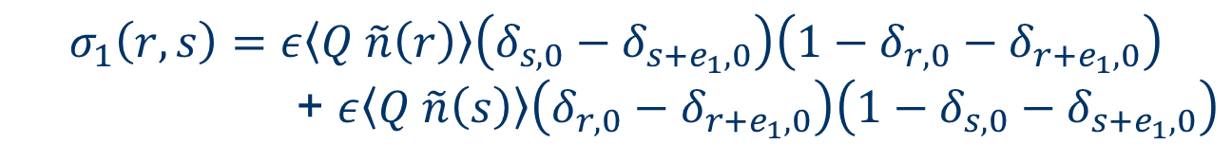
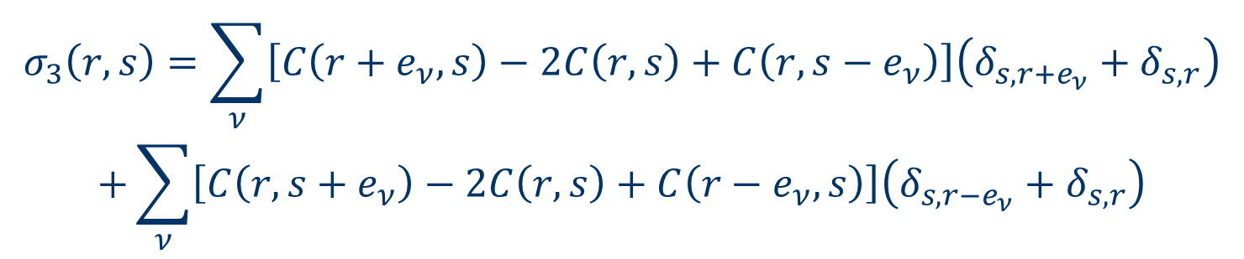
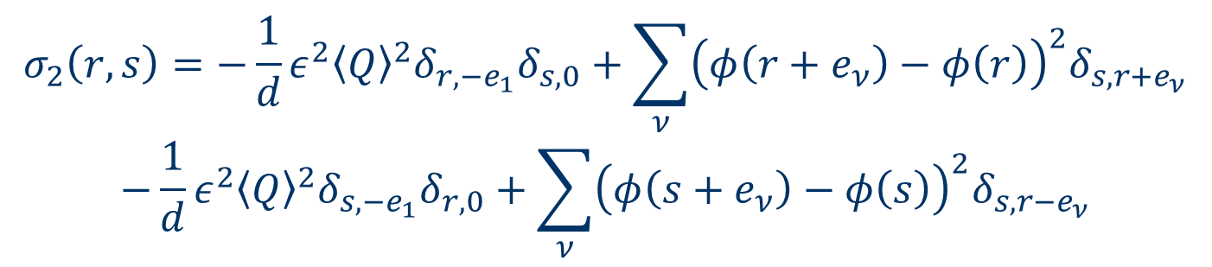
$$\left(Δ_{r}+Δ_{s}\right)C\left(r,s\right)=σ_{1}\left(r,s\right)+σ_{2}\left(r,s\right)+σ_{3}(r,s)$$
$$σ_{1}\left(r,s\right)=ε〈Q \tilde{n}\left(r\right)〉\left(δ_{s,0}−δ_{s+e_{1},0}\right)\left(1−δ_{r,0}−δ_{r+e_{1},0}\right)$$
+ $ε〈Q \tilde{n}\left(s\right)〉\left(δ_{r,0}−δ_{r+e_{1},0}\right)\left(1−δ_{s,0}−δ_{s+e_{1},0}\right)$
$$σ_{2}\left(r,s\right)=−\frac{1}{d}ε^{2}{〈Q〉}^{2}δ_{r,{−e}_{1}}δ_{s,0}+\sum_{ν}{{\left(φ\left(r+e_{ν}\right)−φ\left(r\right)\right)}^{2}δ_{s,r+e_{ν}}}$$
$$−\frac{1}{d}ε^{2}{〈Q〉}^{2}δ_{s,{−e}_{1}}δ_{r,0}+\sum_{ν}{{\left(φ\left(s+e_{ν}\right)−φ\left(s\right)\right)}^{2}δ_{s,r−e_{ν}}}$$
$$σ_{3}\left(r,s\right)=\sum_{ν}{\left[C\left(r+e_{ν},s\right)−2C\left(r,s\right)+C\left(r,s−e_{ν}\right)\right]\left(δ_{s,r+e_{ν}}+δ_{s,r}\right)}$$
$$+\sum_{ν}{\left[C\left(r,s+e_{ν}\right)−2C\left(r,s\right)+C\left(r−e_{ν},s\right)\right]\left(δ_{s,r−e_{ν}}+δ_{s,r}\right)}$$
$$Q=n\left(0\right)\left(1−n\left(−e_{1}\right)\right)+n(−e_{1})\left(1−n(0)\right)$$

Slide 27


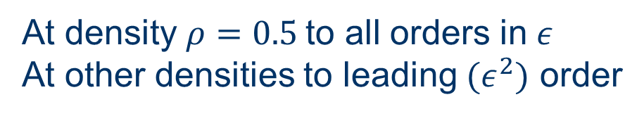
Summary
Local drive in $d>1$dimensions results in:
Density profile corresponds to a dipole in d dimensions
$$φ\left(r\right)\sim 1/r^{d−1}$$
Two-point correlation function corresponds to a quadrupole
in 2d dimensions
$$C(r,s)\sim 1/{\left(r^{2}+s^{2}\right)}^{d}$$
At density $ρ=0.5$to all orders in $ε$
At other densities to leading $(ε^{2})$ order

Slide 28
Example II: a two dimensional model with a driven line
The effect of a drive on a fluctuating interface
T. Sadhu, Z. Shapira, DM PRL 109, 130601 (2012)

Slide 29
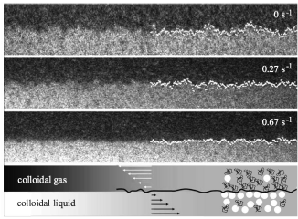
Motivated by an experimental study of the effect of shear on
colloidal liquid-gas interface.
D. Derks, D. G. A. L. Aarts, D. Bonn, H. N. W. Lekkerkerker, A. Imhof,
PRL 97, 038301 (2006).
T.H.R. Smith, O. Vasilyev, D.B. Abraham, A. Maciolek, M. Schmidt,
PRL 101, 067203 (2008).

Slide 30
What is the effect of a driving line on an interface?
-
+

Slide 31

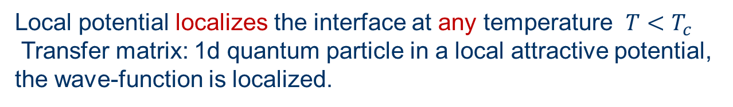
In equilibrium- under local attractive potential
+
-
Local potential localizes the interface at any temperature $T<T_{c}$
Transfer matrix: 1d quantum particle in a local attractive potential,
the wave-function is localized.
no localizing potential: $<Δh^{2}>\sim L$
with localizing potential: $<J <Δh^{2}> \sim const$

Slide 32
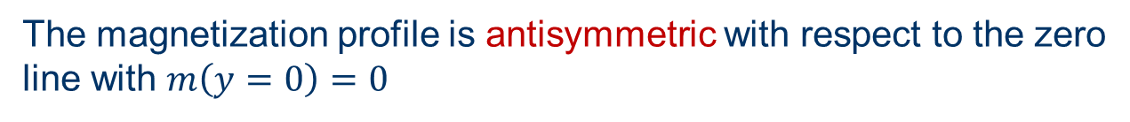
Schematic magnetization profile
The magnetization profile is antisymmetric with respect to the zero
line with $m\left(y=0\right)=0$

Slide 33
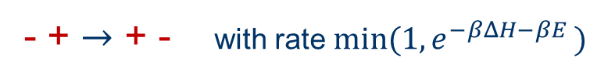
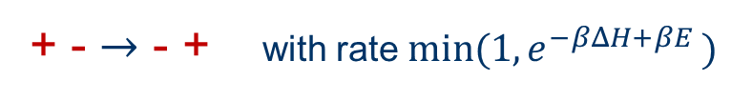
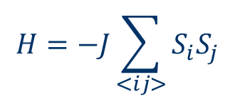
Consider now a driving line
+ - $→$ - + with rate ${min⁡(1,e}^{−βΔH+βE })$
- + $→$ + - with rate $min(1, e^{−βΔH−βE })$
$$H=−J\sum_{<ij>}{S_{i}S_{j}}$$
Ising model with Kawasaki dynamics which is biased on the middle row

Slide 34
Main results
The interface width is finite (localized)
A spontaneous symmetry breaking takes place
by which the magnetization of the driven line
is non-zero and the magnetization profile is not
symmetric.
The fluctuation of the interface are not symmetric around
the driven line.
These results can be demonstrated analytically in certain limit.

Slide 35
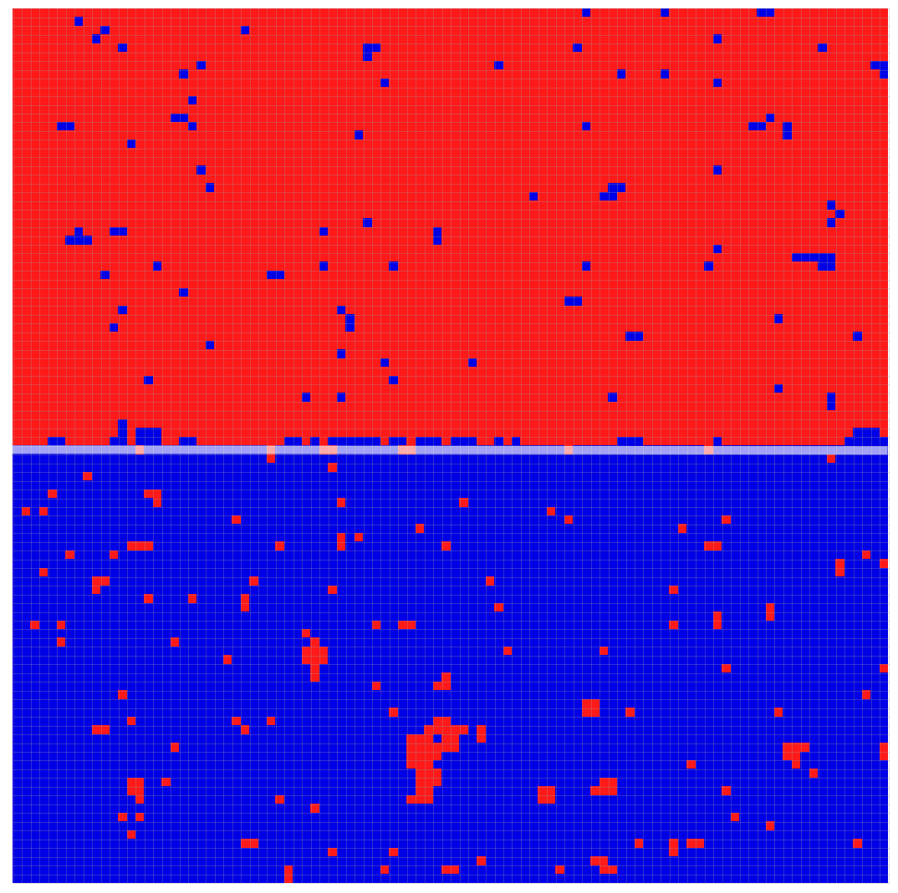
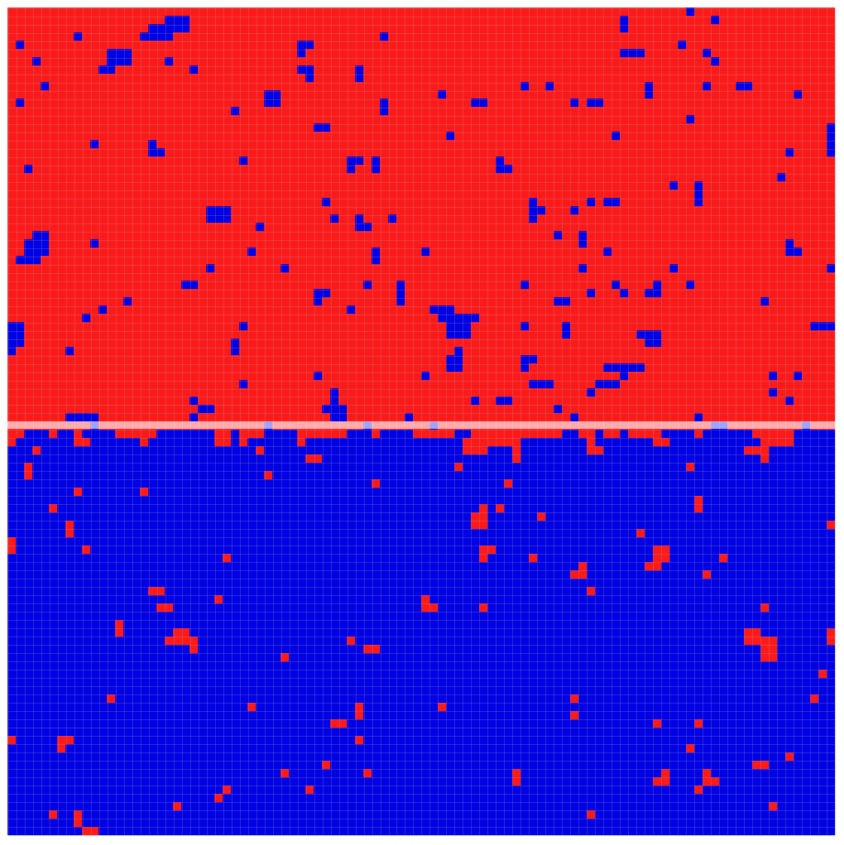
Results of numerical simulations
Example of configurations in the two mesoscopic states for a 100X101 with fixed boundary at T=0.85Tc

Slide 36
Schematic magnetization profiles
unlike the equilibrium antisymmetric profile

Slide 37
Averaged magnetization profile in the two states
L=100 T=0.85Tc

Slide 38
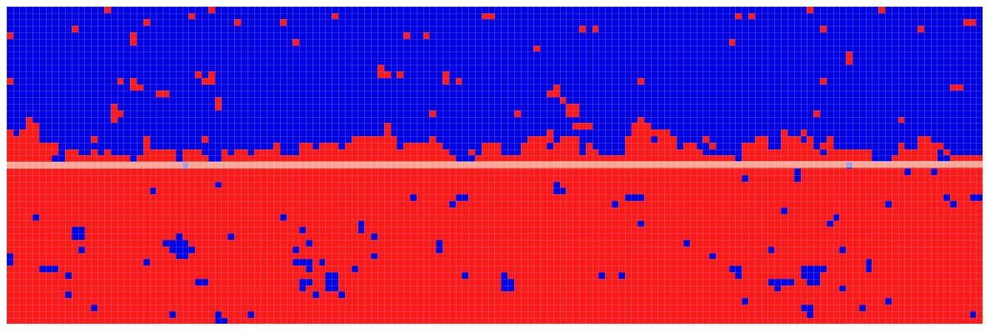

Slide 39
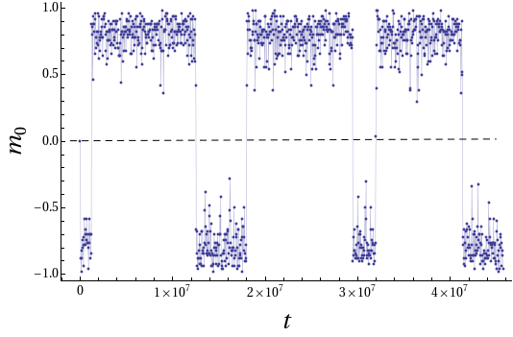
Time series of Magnetization of driven lane for a 100X101 lattice at T= 0.6Tc.

Slide 40
Switching time on a square LX(L+1) lattice with Fixed boundary at T=0.6Tc.

Slide 41




Analytical approach
In general one cannot calculate the steady state measure of this system.
However in a certain limit, the steady state distribution (the large
deviations function) of the magnetization of the driven line can be calculated.
Typically one is interested in calculating $−F\left(m\left(x,y\right)\right)$
the large deviation function of a magnetization profile
$$P(m\left(x,y\right))\sim e^{−L^{2}F(m\left(x,y\right))}$$
We show that in some limit a restricted large deviation function,
that of the driven line magnetization, $m_{0}$ , can be computed
$$P\left(m_{0}\right)=e^{−LU(m_{0})}$$

Slide 42


The following limit is considered
Slow exchange rate between the driven line and the rest of the system
Large driving field $E≫J$
Low temperature
In this limit the probability distribution of $m_{0}$is $P\left(m_{0}\right)=e^{−LU(m_{0})}$
where the potential (large deviations function) $U\left(m_{0}\right)$ can be computed.

Slide 43



The large deviations function
$$U$$
$$P\left(m_{0}\right)=e^{−LU(m_{0})}$$

Slide 44





Slow exchange between the line and the rest of the system
$$rw(ΔH)$$
$$+ − ⇆ − +$$
$$r<O(\frac{1}{L^{3}})$$
$$rw(−ΔH)$$
$$w\left(ΔH\right)=min⁡(1,e^{−βΔH})$$
In between exchange processes the systems is
composed of 3 sub-systems evolving independently

Slide 45


Fast drive $E≫J$
the coupling $J$ within the lane can be ignored. As a result
the spins on the driven lane become uncorrelated and they are
randomly distributed (TASEP)
The driven lane applies a boundary field $Jm_{0}$ on the two other
parts
Due to the slow exchange rate with the bulk, the two bulk
sub-systems reach the equilibrium distribution of an Ising model
with a boundary field $Jm_{0}$
Low temperature limit
In this limit the steady state of the bulk sub systems can
be expanded in T and the exchange rate with the driven line can
be computed.

Slide 46






$m_{o}⟶m_{o}+\frac{2}{L}$ with rate $p(m_{o})$
$m_{o}⟶m_{o}−\frac{2}{L}$ with rate $q(m_{o})$
$$q(m_{0})$$
$$p(m_{0})$$
$m_{o}$performs a random walk with a rate which depends on $m_{o}$
$$P\left(m_{o}=\frac{2k}{L}\right)=\frac{p(0)⋯⋯p(\frac{2\left(k−1\right)}{L})}{q(\frac{2}{L})⋯⋯q(\frac{2k}{L})}≡e^{−U(m_{o})}$$
$$U\left(m_{o}\right)=−\sum_{k=0}^{\frac{m_{o}L}{2}−1}{\ln{p\left(\frac{2k}{L}\right)+\sum_{k=1}^{\frac{m_{o}L}{2}}{q(\frac{2k}{L})}}}$$

Slide 47

Calculate p$\left(m_{o}\right)$ at low temperature
- - - - -
- - - - -
+ - +
+ + + + +
+ + + + +

Slide 48
- - - - -
- - - - -
+ - +
+ + + + +
+ + + + +
contribution to p$\left(m_{o}\right): \frac{1}{8}\left(1−m_{o}\right)⁢{\left(1+m_{o}\right)}^{2}e^{−2βJ}e^{−2βJ_{1}}$
$J_{1}$is the exchange rate between the driven line and the adjacent lines

Slide 49





The magnetization of the driven lane $m_{∘}$changes in steps of $2/L$
Expression for rate of increase, p$(m_{o})$
$$p\left(m_{0}\right)=\frac{1}{8}{\left(1+m_{0}\right)}^{2}\left(1−m_{0}\right)e^{−2β\left(J+J_{1}\right)}$$
$$+\frac{1}{8}[2\left(1+m_{0}\right){\left(1−m_{0}\right)}^{2}\left(e^{−2βJ_{1}}+e^{2βJ_{1}m_{0}}\right)$$
$$+{\left(1+m_{0}\right)}^{2}(1−m_{0})e^{2βJ_{1} m_{0}}+{\left(1−m_{0}\right)}^{3}e^{2βJ_{1}m_{0}}]e^{−6βJ}+O{(e}^{−8βJ})$$
$$q\left(m_{o}\right)=p(−m_{o})$$
$$U\left(m\right)=−\int_{0}^{m}{\ln{p\left(k\right)}dk+\int_{0}^{m}{\ln{q\left(k\right)dk}}}$$

Slide 50



$$U$$
This form of the large deviation function demonstrates
the spontaneous symmetry breaking. It also yield the
exponential flipping time at finite $L. (T=0.6T_{c} , J_{1}=J)$
$$P\left(m_{0}\right)=e^{−LU(m_{0})}$$
$$<m_{o}>1−O(e^{−4βJ})$$

Slide 51
Summary
Simple examples of the effect of long range correlations in driven
models have been presented.
A limit of slow exchange rate is discussed which enables
the evaluation of some large deviation functions far from
equilibrium.

