Slide 1
Highlights from the Classification of the Finite Simple Groups
Ron Solomon, The Ohio State University
University of Warwick Talk
November 27, 2020

Slide 2
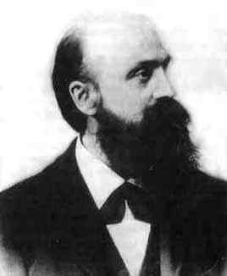
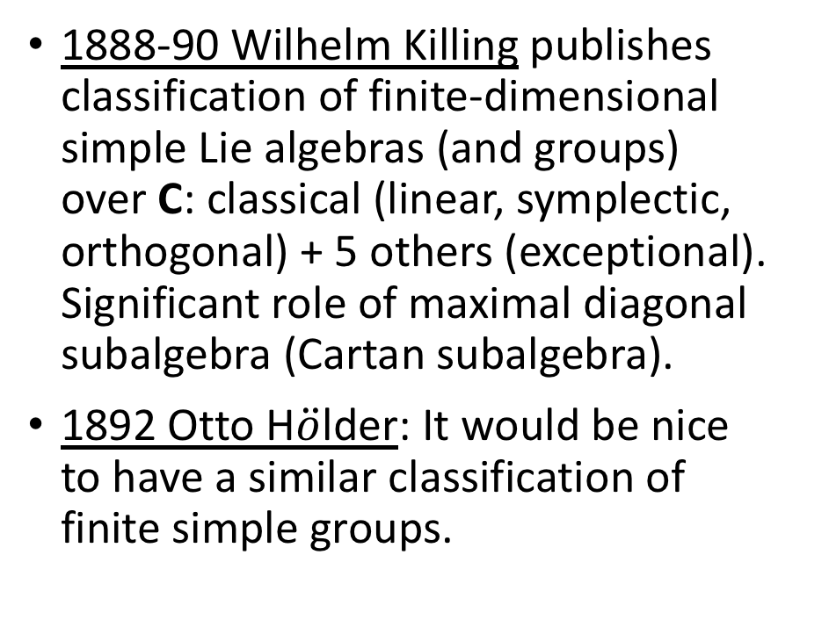
Classification Pre-History
1888-90 Wilhelm Killing publishes classification of finite-dimensional simple Lie algebras (and groups) over C: classical (linear, symplectic, orthogonal) + 5 others (exceptional). Significant role of maximal diagonal subalgebra (Cartan subalgebra).
1892 Otto H$\ddot{o}$lder: It would be nice to have a similar classification of finite simple groups.
Wilhelm Killing

Slide 3
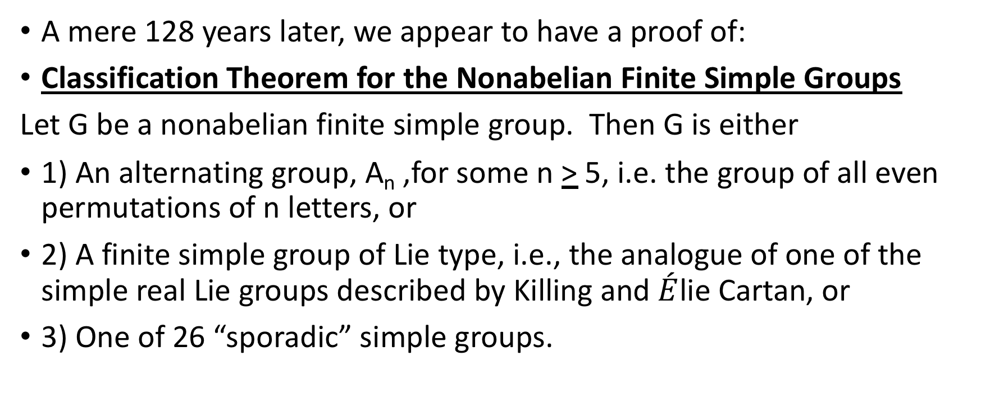
Finally .. Success!
A mere 128 years later, we appear to have a proof of:
Classification Theorem for the Nonabelian Finite Simple Groups
Let G be a nonabelian finite simple group. Then G is either
1) An alternating group, A_{n} ,for some n > 5, i.e. the group of all even permutations of n letters, or
2) A finite simple group of Lie type, i.e., the analogue of one of the simple real Lie groups described by Killing and $\acute{E}$lie Cartan, or
3) One of 26 “sporadic” simple groups.

Slide 4
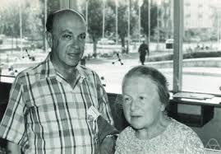
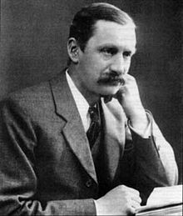
A Start: Richard Brauer (1950) [Foreshadowed by Burnside]
Richard and
Ilse Brauer
Let G be a finite simple group of even order. G contains involutions (elements x of order 2, i.e. x² = 1, x not 1).
Let H = C_{G} (x) = { y in G : yx = xy }
(centralizer in G of x)
Brauer Philosophy: Given H, it should be possible to find all simple groups G with H=C_{G}(x) for some involution x in G.
Brauer-Fowler Theorem: For any given H, there are only finitely many simple groups G such that H = C_{G} (x) for some involution x. Indeed, |G| < (|H|²)!.
Brauer Test Case: If C _{G}(x) ~ GL₂(q), q odd, then G ~ L₃(q), or q = 3 and G~ L₃(3) or M₁₁ , the smallest sporadic simple group.
William
Burnside

Slide 5
Architecture of Finite Groups: Hans Fitting
Hans Fitting (1938) found the right way to think about a finite solvable group G:
There is a unique maximal normal nilpotent subgroup of G, F(G) (the Fitting subgroup of G), often a p-group, and
C_{G}(F(G)) < F(G)).
G/C _{G} (F(G)) embeds in Aut(F(G)).
Helmut Bender (1970) extended Fitting’s analysis to all finite groups.
His generalized Fitting subgroup F*(G)
has the Fitting property C_{G} (F*(G)) < F*(G)
but need not be nilpotent.
Example: The symmetric group S₄:
F(S₄) = V₄ ~ C₂ x C₂
S₄/V₄ ~ Aut(V₄) = GL(2,2) ~ S₃
F(S₃)~ C₃
S₃/C₃~ Aut(C₃)~ C₂
C₂
C₃
C₂ x C₂

Slide 6
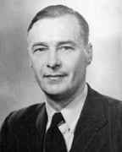
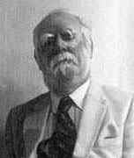
A Role for Linear Algebra: P. Hall – G. Higman (1956)
Many important subgroups N of simple groups G have the property that F*(N) is a p-group. If F*(N) = V ~ C_{p} x … x C_{p} , then N/V acts via conjugation as a group of invertible linear operators on V, i.e. a subgroup of GL(V), and can be studied by the methods of linear algebra.
A small but very important example:
V = C_{N}(V) ~ C_{p} x C_{p} , N/V ~ SL(2,p).
N = ASL(2,p),
the 2-dimensional affine special linear group. If p = 2,
ASL(2,2) = (C₂ x C₂):SL(2,2) = V₄:S₃ = S₄ .
Philip Hall
Graham Higman

Slide 7

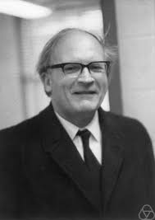
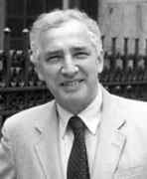
The Classification Begins: M. Suzuki, W. Feit, J. G. Thompson
If G is a group such that each Sylow p-subgroup is contained in a unique maximal (or maximal p-local) subgroup of G, let’s say G is “p-unital”.
If G involves (contains) ASL(2,p), let’s say G is ”p-geometric”.
Key examples of “p-unital” simple groups G are the Zassenhaus groups, an important class of doubly transitive permutation groups studied by Zassenhaus in the 1930s, and classified by Feit and Suzuki in the 1950s as:
PSL(2,p^{n}) and Sz(2^{n}) (for p=2).
Michio Suzuki
Hans Zassenhaus
Walter Feit

Slide 8
A 2-unital Simple Group : A_{5,} |A₅| = 60 = 12x5 = 4x3x5
A₅ , the alternating group of degree 5, is a Zassenhaus group two ways. Indeed, A₅ ~ PSL(2,4) ~ PSL(2,5).
A Sylow 2-subgroup U of A₅ is contained in a unique maximal subgroup B isomorphic to A₄. There are 5 cosets of B in A₅ , and A₅ permutes this set of 5 cosets as it does {1,2,3,4,5}.
Note: A₅ is not 2-geometric. It does not contain ASL(2,2) ~ S₄ .
[RECALL: A Sylow p-subgroup of a group G is a maximal p-subgroup of G.
By Sylow’s Theorem, all Sylow p-subgroups of G are G-conjugate and have size the p-part of |G|. ]
E

Slide 9
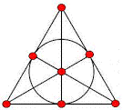

A 2-geometric Simple Group : SL(3,2) = L₃(2)
G
M N
U
|SL(3,2)| = 168 = 24x7 = 8x3x7
If U is the group of 8 unimodular upper triangular matrices in L₃(2), then U is the stabilizer of a maximal flag, i.e. an incident point-line pair (P,L) in the Fano plane (= projective plane of order 2), and U is contained in two different ASL(2,2) subgroups: the stabilizer M of P and the stabilizer N of L. The cosets of M and N give the 7 points and 7 lines of the Fano plane. Incidence is defined by non-trivial intersection xM h yN.

Slide 10
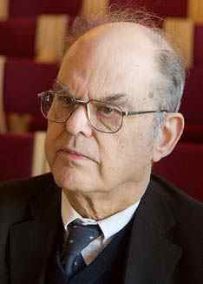

The Minimal Case: Groups with a Strongly Embedded Subgroup
The fact that “G is p-unital” is (roughly) equivalent to: “G is not p-geometric”
was the discovery of John G. Thompson .
Note: 6 divides |SL(2,p)| = (p-1)p(p+1). So,
6 divides |G| for every p-geometric group G
The following deep theorem combines the
Feit-Thompson Odd Order Theorem (1963) and the Suzuki-Bender Strongly Embedded Subgroup Theorem (1971).
Theorem: Let G be a p-unital (+ e) finite simple group, where p is the smallest prime divisor of |G|. Then p=2 and G ~ PSL(2,2^{n}), PSU(3,2^{n}), or Sz(2^{n}). [See also Holt’s Thm]
Helmut Bender
John G. Thompson

Slide 11
The Endgame: An example of an identification theorem
Suppose we have a finite group G with F*(G) simple, containing an involution t with C_{G} (t) = < t > x K ~ C₂ x S_{n} , the symmetric group of degree n, for some n > 11. We would like to prove that G is isomorphic to S_{n+2} .
By Glauberman’s Z* -Theorem, C_{G} (t) – { t } contains a G-conjugate s of t . With a bit of effort we can show that s is a transposition in K. In particular, C_{K} (s)= < s > x J with J ~ S_{n-2} . Since s is G-conjugate to t, C_{G}(s) = < s > x L, with L ~ S_{n} , t in L, and J = K h L.
Now H := < K,L > contains involutions t = t₁ , t₂ , … , t_{n+1} = s clearly satisfying all but one of the defining relations in the Coxeter presentation for S_{n+2} :
(t_{i}t_{i+1})³ = 1 for all i [i.e., < t_{i},t_{i+1}> ~ S₃], t_{i}t_{j} = t_{j}t_{i} whenever |i-j| > 1 .

Slide 12
The example completed
The missing relation is: t₂t_{n} = t_{n}t₂ .
But since n > 11 and t₅ is G-conjugate to t and commutes with both t₂
and t_{n} , we can verify the relation t₂ t_{n} = t_{n} t₂ inside C_{G} (t₅), thereby proving that H is isomorphic to S_{n+2} .
It remains to show that H = G. But this can be deduced from the Suzuki-Bender Theorem, and we have
Theorem: Let G be a finite group with F*(G) simple. Suppose t is an involution of G such that C_{G}(t) is isomorphic to C ₂ x S_{n} for some n > 11. Then G is isomorphic to S_{n+2} .

Slide 13
The “Curse” of Small Cases and Sporadic Simple Groups
Remark: The theorem is false for n = 5, 6, 8 and 10.
Suppose n = 8 and C_{G}(t) = < t > x K, with K ~ S₈ . Then G could be S₁₀ . But also G could be Aut(HS), where HS is the sporadic simple group discovered by Don Higman and Charlie Sims in 1967.
Similarly, if C_{G}(t) = < t > x K, where K ~ S₁₀ , then G could be S₁₂ . But also G could be Aut(HN), where HN is the sporadic simple group discovered in 1973 by Koichiro Harada and Simon Norton inside the Monster, the largest sporadic simple group.

Slide 14
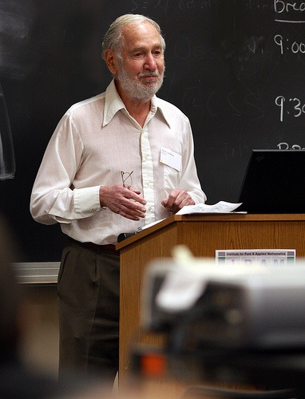


Presentations for Quasi-Simple Groups
Presentations exist for the quasi-simple groups G(q) of Lie type similar to the Coxeter presentations for S_{n} , by work of Steinberg, Curtis and Tits.
G(q) = < L₁,L₂, … , L_{n} > with
L_{i} usually isomorphic to SL(2,q).
For G(q) = SL(n,q), the relations are:
< L_{i}, L_{i+1} > = SL(3,q), [L_{i},L_{j}] = 1, |i-j|> 1
These presentations may be used to identify G(q), just as the Coxeter presentations are used to identify S_{n+2}.
H.S.M.Coxeter
Robert Steinberg
Charles W. Curtis

Slide 15
Getting to the Endgame: Examples
Can we get from knowing G is simple and 2-geometric, to statements like:
G contains an involution t with C_{G}(t) = C₂ x S_{n} with C₂ cyclic of order 2 ?
TWO EXAMPLES:
If G = GL(n,p^{m}), p odd, and t = diag(-1,1,…,1), then
C_{G}(t) ~ GL(1,p^{m}) x GL(n-1,p^{m}) ~ C_{r} x GL(n-1,p^{m}) with C_{r} cyclic, r = p^{m} – 1.
This is similar to the G = S_{n+2} case.
BUT … If G = PSL(n,2^{m}), then elements of order 2 in G are unipotent, not diagonalizable. Then F*(C_{G}(t)) is a 2-group.
This is very different from the S_{n+2} and GL(n,p ^{m} ), p odd, cases.

Slide 16
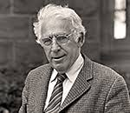

Getting to the Endgame: The Dichotomy Theorem
Theorem (Gorenstein-Walter, Aschbacher, 1967-1974): Let G be a finite simple group. Then one of the following holds:
1) Odd Type Case: For some involution t, C_{G}(t) has a large normal quasisimple subgroup K_{t} (or K_{t} ~ SO₄⁺ (q)), or
2) Even Type Case: For all involutions t, F*(C_{G}(t)) is a 2-group U_{t} , or
3) The Small Case: G has a dihedral Sylow 2-subgroup, and G = A₇ or PSL(2,q) for some odd q > 5.
Daniel Gorenstein
Michael Aschbacher

Slide 17
The Odd Type Case
In this case, the target groups are:
1) the alternating groups A_{n}, n > 9,
2) the groups G(q) of Lie type for q odd, with a few small exceptions, and
3) many of the sporadic simple groups.
For the first two cases, the strategy is similar to that described for the S_{n+2} example, using Coxeter or Steinberg-Curtis-Tits-Phan presentations to identify the groups. A proof is contained in GLS Volumes 4 – 8.

Slide 18



The Even Type Case
Meierfrankenfeld-Stellmacher-Stroth Approach: Stick with the prime 2
Expand Thompson’s Failure of Factorization Theory to determine the structure of all maximal (parabolic) subgroups P ₁ , …, P _{n} of G containing B = N_{G}(U) for some Sylow 2-subgroup U of G. Use these to define a Tits building (a geometry like the Fano plane for G = SL(3,2)), whose automorphism group is (roughly) equal to G.
Target: Groups of Lie type over F_{q} , q = 2^{n} , + some sporadic groups
Jacques
Tits
Bernd
Stellmacher
Gernot Stroth

Slide 19
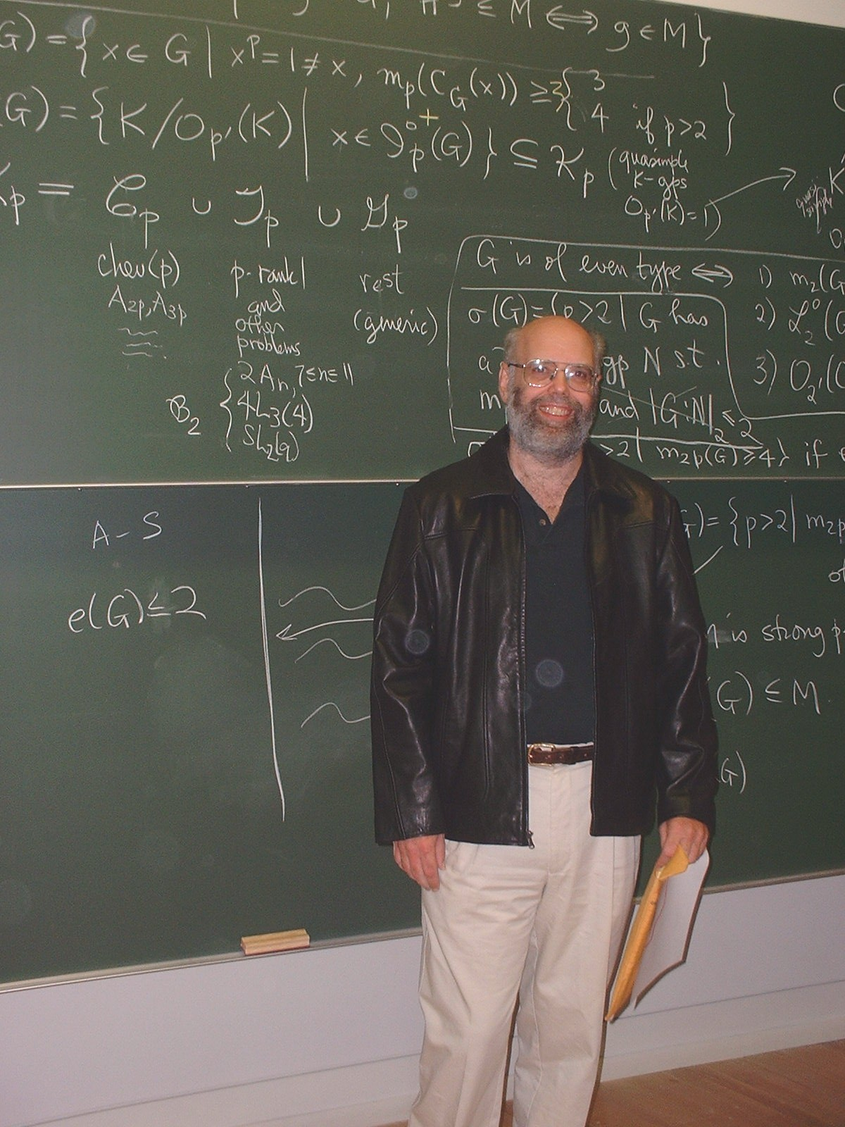
Another Way: Gorenstein-Lyons Strategy for the Even Type Case
Shift from 2 to an odd prime p where elements of order p are “diagonalizable” (or “almost diagonalizable”). Recall Killing.
Example: G = SL(n,4).Choose p = 3
t₁ = diag(w,w⁻¹,1,…,1), w³ = 1
C_{G}(t₁) = < t₁ > x K₁, K₁ ~ SL(n-2,4)
Now implement same strategy as in groups of odd type, p = 2. Find the L_{i}’s inside the K_{i} ‘s, t_{i} diagonal
Problem: What if no such p can be found? Then G is of “p-type” for all primes p. [2-type = even type]
Richard Lyons

Slide 20
Klinger-Mason Theorem (1975)
Definition: G is of characteristic p-type if for every non-identity p-subgroup P of G, F*(N_{G}(P)) is a p-group. (Example: Every simple group of Lie type in characteristic p is a group of characteristic p-type.)
NOTE: N_{G}(P) = { g in G : gP = Pg }, the normalizer in G of P.
Example: G = PSp(4,3) ~ PSU(4,2) is a finite simple group with
|G| = 2⁶ x 3⁴ x 5. G is of characteristic 2-type and of characteristic 3-type, and even of characteristic 5-type.
Klinger-Mason Theorem: Suppose G is a finite simple group of characteristic p-type for all primes p. Then G is quasithin, i.e., no 2-subgroup of G is normalized by a C_{p} x C_{p} x C_{p} for any odd prime p.

Slide 21

Problem Solved: The Quasithin Theorem of Aschbacher and Stephen D. Smith (2004)
Quasithin Theorem (Aschbacher-Smith): Let G be a quasithin simple group of even type. Then either
G is a simple group of Lie type in characteristic 2 and of Lie rank at most 2, or
G is one of 12 sporadic simple groups, or
G = L₃(3), U₃(3), PSp₄(3), L₄(3) ,
U₄(3) or G₂(3).
The proof uses the Thompson factorization method, as do MSS.
Stephen D. Smith (with Ron Solomon)

Slide 22
Summary of the GLS Strategy (Work in progress with I. Capdeboscq, Chris Parker and G. Stroth)
Hypothesis: G is a minimal unknown simple group.
1) Use Feit-Thompson Theorem + Suzuki-Bender Theorem to conclude that G has even order and is 2-geometric.
2) Use the Dichotomy Theorem to conclude that either G is of Odd Type or G is of Even Type.
3) Use the Klinger-Mason Theorem and the Quasithin Theorem to conclude that if G is of even type (= 2-type), then there is an odd prime p such that G is not of p-type and G contains a C_{p} x C_{p} x C_{p} subgroup.

Slide 23
Summary of the GLS Strategy, Part 2
4) Now, for suitable p (= 2, if G is of Odd Type), find t in G of order p so that (very roughly) C_{G}(t) = < t > x K, with K quasisimple, as in the S_{n} case. Then identify G, as in the S_{n} example.
Caveat: If p is odd, a theorem on p-unital groups G of even type is needed, analogous to the Suzuki-Bender Theorem. One such was proved by Aschbacher, and another, in our setting, by Stroth.
Conclusion: G was not unknown after all. So, all finite simple groups are known. [Work continues with Capdeboscq and Parker on the “almost” quasithin case. The first step, CGLS Volume 9, has been accepted for publication by the AMS. (C = Capdeboscq) ]

Slide 24
Thank you !

