Slide 1
Mathematics Teaching and Learning seminar – 10th Feb 2022
Maths Anxiety and Resilience
Sue Johnston-Wilder (Education)

Slide 2
Introducing the invisible maths monster:
addressing maths anxiety with students, and the adults around them

Slide 3
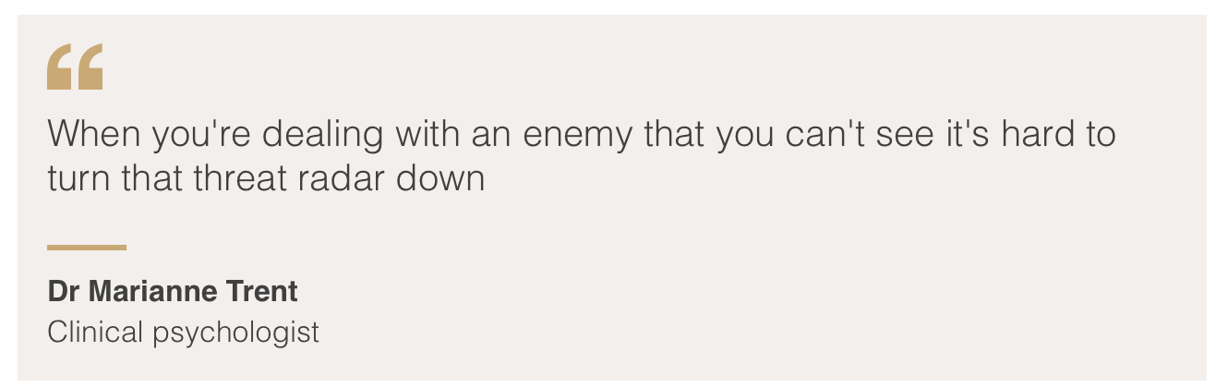
The power of the invisible threat
Notes:
In a different context Dr Trent said this.

Slide 4
Maths anxiety …
...is like an invisible monster, a grim reality for a
significant proportion of learners
… is acquired
...is disabling
...has been written about since 1950s
...now affects large numbers of people
...causes reduced or backwards progression
...can be addressed

Slide 5
Maths anxiety …
...can be considered a psychological safe-guarding issue!

Slide 6
Results of maths anxiety
“A feeling of tension, apprehension, or fear that interferes with maths performance” (Ashcraft, 2002)
that results in:
negative attitudes & motivation towards maths
avoidance
lower grades
negative self-perceptions
impact on working memory
http://www.mccc.edu/~jenningh/Courses/documents/math_anxiety.pdf

Slide 7
An emotional handbrake
You might find it helpful to think of maths anxiety as an “emotional handbrake” on learning mathematics – a handbrake that affects a large minority of our staff and students.

Slide 8
The problem
Although learners are naturally curious
fear is learned; maths anxiety is contagious
things that cause fear become avoided
vicious cycle
combined with fixed mindsets:
“I am not a maths person”
self-fulfilling prophecy

Slide 9
Some brain facts we need as educators
As a survival strategy the brain seeks to distinguish challenge from threat to well-being or survival
The brain doesn’t distinguish between physical and social threats, such as being left behind or humiliated or shouted at
Previous threats are remembered – survival strategy
When the brain (sub-consciously) perceives a threat, it initially responds by fight or flight mode

Slide 10
Student experience
[the teacher] would make you stand in front of everyone, and then she would just be, like, “You’re not good, you don’t understand, you’re stupid.” (Halima)
I always felt like I was stupid … Starting maths this year it still gives me chills …‘Cos even now, you know, that fear of saying ‘Oh I don’t get it! I still don’t get it!’ is still there. (Nina)
Molly’s father would grasp her neck in frustration when she didn’t get it.

Slide 11
Not stupid but panicking
Panic is temporary
To build resilience, learners need to understand this state is temporary. (Seligman)
Need “anxiety-safe” learning

Slide 12
Psychological safety requires …
Relatedness
Autonomy
Competence
…including competence to self-safeguard
Ryan and Deci (2017)

Slide 13
Competence to self-safeguard …
…can be achieved using four tools:
growth zone model
hand model of brain
triggering relaxation response
the ladder model
Shared between teacher and students, the tools help improve dialogue, awareness, and apt responses to reduce maths anxiety.

Slide 14
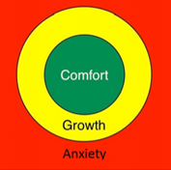
The growth zone model
a means to safeguard the mathematical wellbeing of those involved in learning or supporting maths…

Slide 15
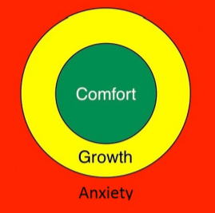
The growth zone model: green zone
Cruising in the comfort zone can build self-confidence & provide opportunities for practice & automaticity.

Slide 16
The growth zone model: amber zone
New learning happens in the growth zone where learners experience challenge with sufficient safe-guarding – it should be safe to make mistakes, get stuck, require support, find activities tiring.

Slide 17
The growth zone model: red zone
The danger zone is where what is being asked is not within the learner’s reach yet, even with support, and mathematical well-being is under threat.
Stress increases to the point of flight, fight or freeze; little or no useful learning takes place.

Slide 18
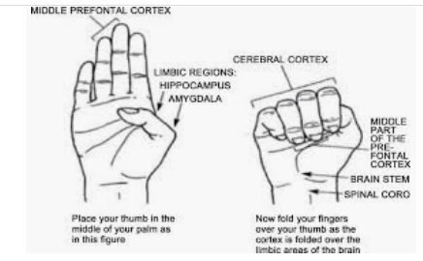
The hand model of the brain
(Dan Siegel)

Slide 19
The hand model of the brain
Key message: the brain can’t panic and think effectively at the same time
Dan Siegel explaining his model:
https://www.youtube.com/watch?v=gm9CIJ74Oxw
Maths resilience version:
https://www.youtube.com/watch?v=7zW8w9kuu6E&t=7s
Notes:
Please feel free to make your own, or invite the learners to make one.

Slide 20
The growth zone model in action
a means to help learners understand and articulate their feelings when they are learning mathematics...
Read about it in action:
https://www.mathsontoast.org.uk/how-talking-about-maths-suddenly-became-easier/

Slide 21
Using the growth zone model
Accept feeling of stupidity in red zone as temporary
How to get out of the red zone?
Building experience of being in and extending the amber/growth zone

Slide 22
Getting out of the red zone
Relaxation response (Benson 2000)
Rest and digest
5/7 breathing
Focus on 5 things you can hear
Go for a walk
Has anyone met mindfulness?
Don’t try to do maths whilst your brain is focused on the “maths monster”!
…
Notes:
Arousal – time to experience 5/7 breathing

Slide 23
Building the amber/growth zone
Ask questions
Try a simpler example
Support each other
Recruit help
Use the Internet
Expect to get stuck
Expect to make mistakes
Use rough work
Take time
...

Slide 24
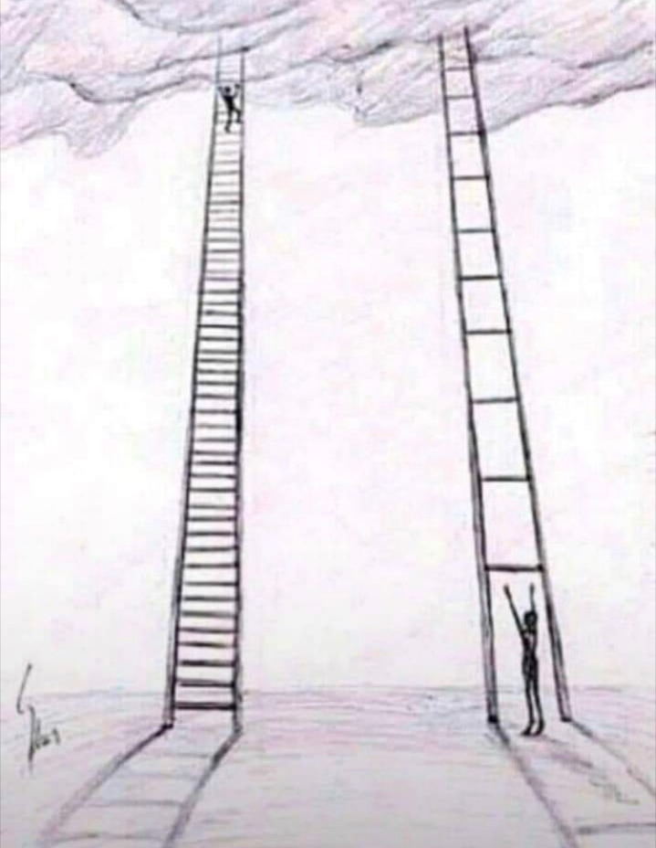
The ladder model
“I need
another
rung”
Notes:
Teachers listening to learner experience as ladder is invisible in maths

Slide 25
Mathematical resilience
confidence + persistence + perseverance
(Williams, 2014, based on Seligman)
growth mindset + inclusion + agency + resources (Johnston-Wilder and Lee, 2013)
what it takes to stay longer in the mathematical growth zone ...

Slide 26
Tools in practice
Building a shared language for mathematical safeguarding
Red means stop talking and listen! This practice takes a while to develop as a teacher!
Some teachers give each learner a copy of the GZM to use with a coin as a marker
Some teachers give learners opportunity to write their own words for the feelings in each zone
How would you use the tools?

Slide 27
We can tackle the very real, invisible maths monster, together …
…building awareness, developing a shared language for mathematical safeguarding, enabling learner autonomy, encouraging learning communities that don’t leave people behind, building growth mindsets …

Slide 28
Further reading
The tools:
https://www.scirp.org/journal/paperabs.aspx?paperid=102510
At home:
https://www.scirp.org/journal/paperinformation.aspx?paperid=55378
With a PhD student:
https://www.scirp.org/journal/paperinformation.aspx?paperid=85398
1 to 1 with an adult:
https://www.scirp.org/journal/paperinformation.aspx?paperid=112110
In class:
Para and Johnston-Wilder (submitted) Addressing Mathematics Anxiety: a case study in a High School in Brazil – copy available from author
Background:
Siegel D (2011) Mindsight: The New Science of Personal Transformation
Benson H (2000) The Relaxation Response

