Slide 1
Considering resilience and wellbeing in the context of mathematics: seeking to address the prevalence of maths anxiety and increase self-regulation
Sue Johnston-Wilder

Slide 2
Emotions …
... influence how well we learn and affect academic outcomes
Li et al. (2020)

Slide 3
Positive emotions …
have a beneficial effect on cognitive functions
encourage individuals to breakthrough thinking limits
strengthen cognitive flexibility, increasing the efficiency of problem-solving and promote personal resources
Li et al. (2020)

Slide 4
Negative emotions …
lead to a decline in students’ working memory capacity
focus on safety and survival

Slide 5
Evidence on Emotions and Maths
Meta-analyses show that emotions such as anger, frustration, hopelessness, and shame are strongly negatively correlated with maths achievement (average correlations around −0.20 to −0.38), while positive emotions like enjoyment and pride improve performance.
Schoenherr et al., 2025

Slide 6
Maths anxiety in male Autists
overall trait math anxiety levels similar
autistic participants performed worse on timed math tasks when experiencing higher emotional arousal and worry before the test
negative emotional states (low valence, high stress) correlated with poorer performance under time pressure
Lievore and Mammarella, 2025

Slide 7
Impact of Negative Emotions on Cognitive Processing
Negative emotions generally impair attention, working memory, and executive function—skills essential for solving maths problems.
Effect amplified in autists: often experience emotional dysregulation and sensory sensitivities, making stress responses more intense and prolonged
Guy-Evans, 2024

Slide 8
Math Anxiety in Autism
Autistic learners may not always show higher baseline math anxiety than peers, but they are particularly vulnerable to situational stressors like unexpected changes, time limits, or sensory overload.
These factors can trigger anxiety that disrupts problem-solving and memory retrieval.
Chenoy, 2024

Slide 9
Thinking of maths anxiety through the lens of trauma and adverse experience
I will give an introduction
Then explain our current approach to addressing MA and developing self-regulation, our 4 tools and our coaching programme
Then I am very much looking forward to discussion.

Slide 10
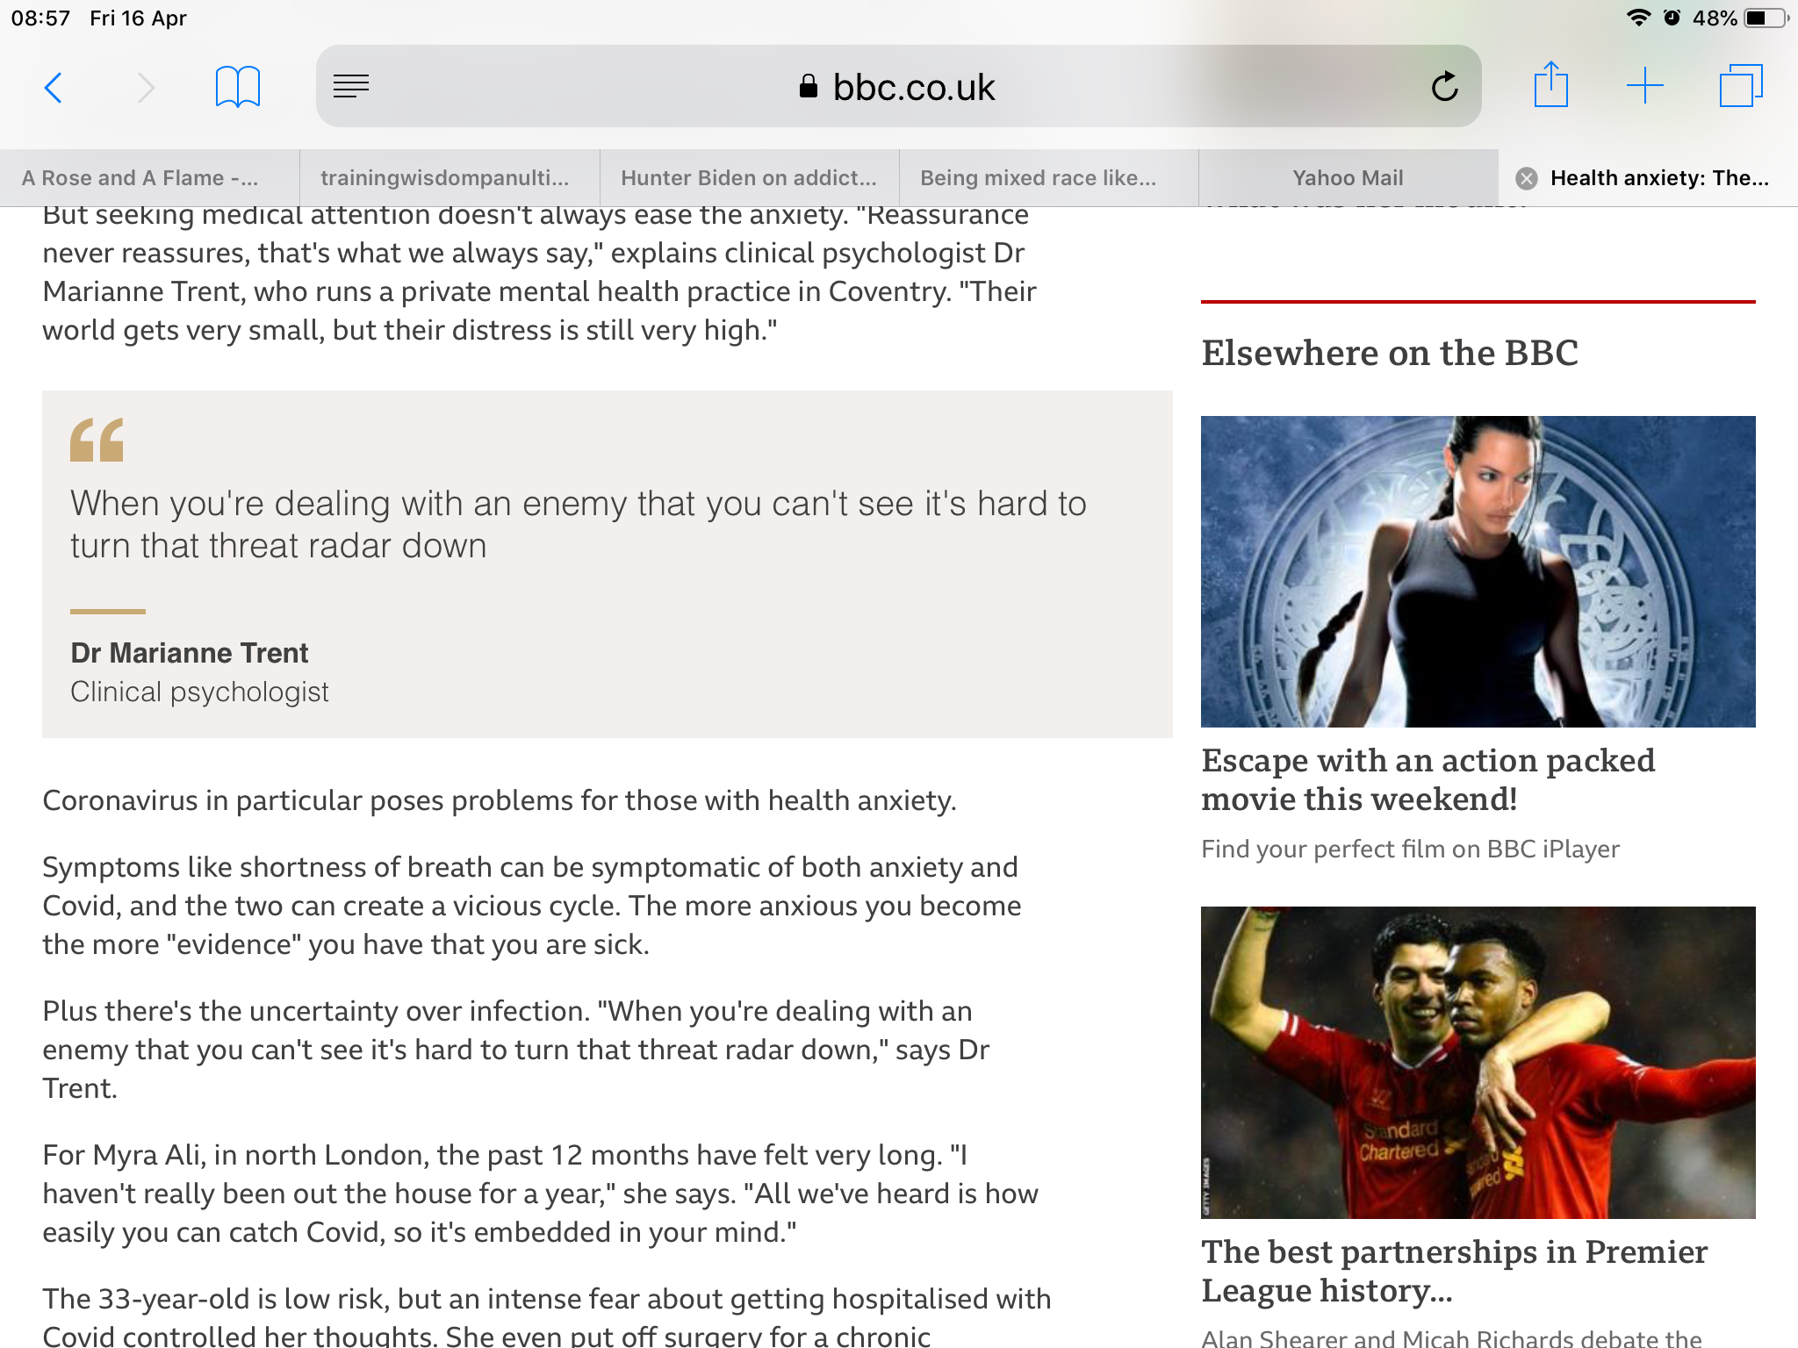
The power of the invisible threat

Slide 11
Maths anxiety …
...is like an invisible monster, a grim reality for a significant proportion of learners
… is acquired
...is disabling
...has been written about since 1924
...now affects large numbers of people
...causes reduced or backwards progression
...can be addressed

Slide 12
Some brain facts for maths educators
As a survival strategy, the brain seeks to distinguish challenge from threat to well-being or survival
Includes physical and social threats, such as being left behind or humiliated or shouted at
Previous threats are remembered
When the brain (sub-consciously) perceives a threat, it initially responds by fight or flight mode

Slide 13
Psychological safety requires …
Relatedness
Autonomy
Competence …
… including competence to self-safeguard
Ryan and Deci (2017)

Slide 14
Competence to self-safeguard …
…can be achieved using four tools:
growth zone model
hand model of brain
triggering relaxation response
the ladder model
Shared between teacher and students, the tools help improve dialogue, awareness, and apt responses to reduce maths anxiety.

Slide 15
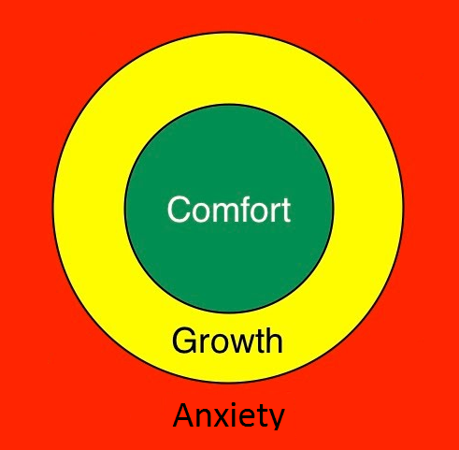
The growth zone model
Fight or flight mode
Notes:
Comfort – easy; Anxiety – not yet- too hard
Growth: safe enough, brave,
Heart racing; Mind goes blank; Feel stupid; Sweaty hands; Overwhelmed; Ashamed, embarrassed; Angry

Slide 16
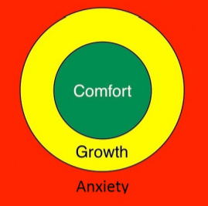
The growth zone model: green zone
Cruising in the comfort zone can build self-confidence and confidence in the teacher & provide opportunities for practice & automaticity.

Slide 17
The growth zone model: amber zone
New learning happens in the growth zone where learners experience challenge with sufficient safe-guarding – it should be safe enough to make mistakes, get stuck, require support, find activities tiring.

Slide 18
The growth zone includes:
growth mindset (Dweck, 2006)
struggle (persistence and perseverance) (Seligman and Williams)
value – and autonomous motivation (Ryan & Deci, 2017)
support and relatedness (being enabled to recruit)

Slide 19
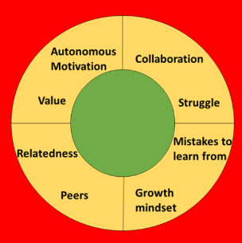
The annotated growth zone model

Slide 20
Warwick students ...
... value maths but may not yet understand the value of a particular topic
... are accustomed to finding maths relatively easy
... have not all learned to struggle yet
... many carry a fixed mindset
... many have not yet learned to recruit support
... have not all yet learned self-regulation

Slide 21
The growth zone model: red zone
The danger zone is where what is being asked is not within the learner’s reach yet, even with support, and mathematical well-being is under threat.
Stress increases, possibly to panic; little or no useful learning takes place.

Slide 22
Not stupid but panicking
Panic is temporary
To build resilience, learners need to understand this state is temporary (Seligman).

Slide 23
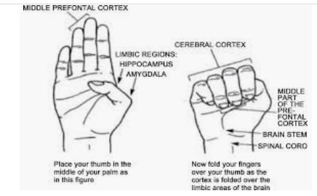
The hand model of the brain (Dan Siegel)

Slide 24
The hand model of the brain
Key message: the brain can’t panic and think effectively at the same time
Dan Siegel explaining his model:
https://www.youtube.com/watch?v=gm9CIJ74Oxw
Maths resilience version:
https://www.youtube.com/watch?v=7zW8w9kuu6E&t=7s
Notes:
Please feel free to make your own, or invite the learners to make one.

Slide 25
When the maths brain goes offline ...
Anxiety acts as an emotional handbrake
Anxiety uses up the working memory
Learner is in fight – flight - freeze
An alarm is going off in the head
The learner can’t hear you
Notes:
Please feel free to make your own, or invite the learners to make one.

Slide 26
Using the growth zone model
Accept feeling of stupidity in red zone as temporary
How to get out of the red zone?
Building experience of being in and extending the amber/growth zone
Notes:
Cliff into beach

Slide 27
Getting out of the red zone
Relaxation response (Benson 2000)
Rest and digest
5/7 breathing
Focus on 5 things you can hear
Go for a walk
…
Don’t try to do maths whilst your brain is focused on the “maths monster”!
Notes:
Micromindfulness

Slide 28
Building the amber/growth zone
Try a simpler example
Support each other
Recruit help
Use the Internet
Expect to get stuck
Expect to make mistakes
Use rough work
Take time
...

Slide 29
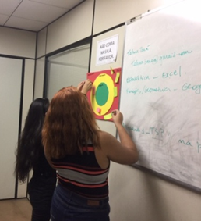
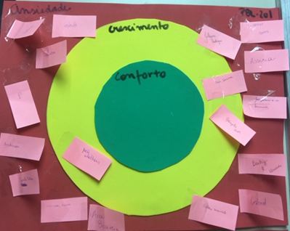
The growth zone model in action
Let’s have a go …
Notes:
Safe; relaxed ; at ease
Excited; nervous; alert
Frightened; panicky; anxious

Slide 30
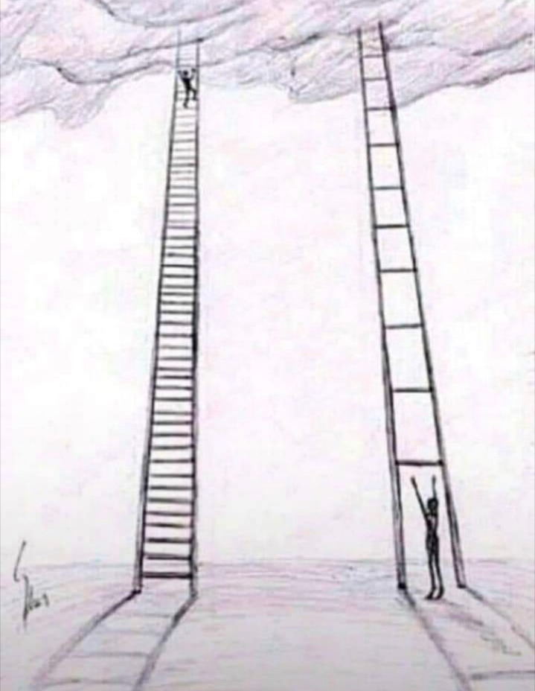
The ladder model
“I need
another
rung”
Notes:
Teachers listening to learner experience as ladder is invisible in maths

Slide 31
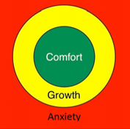
The growth zone model
a means to help learners understand and articulate their feelings when they are learning maths...
a means to safeguard the mathematical wellbeing of those involved in learning or supporting maths…
Notes:
Build a shared language for mathematical safeguarding, awareness, dialogue and action.
Red means stop talking and listen! This practice can take a while to develop as a maths teacher!
Some teachers give each learner a copy of the GZM to use with a coin as a marker

Slide 32
Resilient no – not yet
Arises from:
self-awareness
values
well-being
Results in:
growth
protection
focus
Notes:
Build a shared language for mathematical safeguarding, awareness, dialogue and action.
Red means stop talking and listen! This practice can take a while to develop as a maths teacher!
Some teachers give each learner a copy of the GZM to use with a coin as a marker

Slide 33
MR Toolkit in action 1
... A widening participation student score 40% in the end of year exam
... After one session introducing these tools, they scored 80% in the resit
Notes:
Build a shared language for mathematical safeguarding, awareness, dialogue and action.
Red means stop talking and listen! This practice can take a while to develop as a maths teacher!
Some teachers give each learner a copy of the GZM to use with a coin as a marker

Slide 34
MR Toolkit in action 2
a second-year student found their mind going blank when they tried a maths worksheet
they were going to change course
“I’m not clever enough for maths”
after one session introducing these tools, and explaining fixed/growth mindset, they continued with maths
Notes:
Build a shared language for mathematical safeguarding, awareness, dialogue and action.
Red means stop talking and listen! This practice can take a while to develop as a maths teacher!
Some teachers give each learner a copy of the GZM to use with a coin as a marker

Slide 35
We can tackle the very real, invisible maths monster, together …
…building awareness, developing a shared language for mathematical safeguarding, enabling learner autonomy, encouraging learning communities that don’t leave people behind, building growth mindsets …

Slide 36

The Mathematical Resilience Book

Slide 37
Further reading
The tools:
https://www.scirp.org/journal/paperabs.aspx?paperid=102510
At home:
https://www.scirp.org/journal/paperinformation.aspx?paperid=55378
https://www.mathsontoast.org.uk/how-talking-about-maths-suddenly-became-easier/
With a PhD student:
https://www.scirp.org/journal/paperinformation.aspx?paperid=85398
1 to 1 with an adult:
https://www.scirp.org/journal/paperinformation.aspx?paperid=112110
In class:
Para and Johnston-Wilder (submitted) Addressing Mathematics Anxiety: a case study in a High School in Brazil – copy available from author
Background:
Siegel D (2011) Mindsight: The New Science of Personal Transformation
Benson H (2000) The Relaxation Response

