Slide 1

MacTutor – a collection of great mathematicians?
Edmund F Robertson
University of St Andrews
University of Warwick
10 November 2022

Slide 2
Abstract
Is MacTutor a collection of great mathematicians? What is a “great mathematician?” How did I choose who to write about?
In many ways the archive "just happened" without either John O'Connor or myself having any definite strategy on who to include in the archive.
In retrospect, however, there were many influences which determined the selection of mathematicians who are included and in this talk I want to try to give you some idea about how the MacTutor History of Mathematics Archive developed.

Slide 3
Great mathematicians
Most people essentially define the greatest mathematicians as those having the greatest influence on mathematical research. I’m happy for that to be one source of great mathematicians but for me there are many others.
How about someone who has a major influence on how mathematics is taught to children.
How about someone who has been a role model in studying mathematics for their sex/race/ beliefs/…
How about those who founded influential mathematical societies or journals.
How about major conference organisers.
How about great inspirational teachers of mathematics.
For me these, and many more, are all Great Mathematicians.

Slide 4
The starting point
There were two main factors involved in the very early development of MacTutor.
1. The website was created in late 1994 by John O’Connor and myself with history of mathematics material extracted from our teaching software, the Mathematical MacTutor Tutorial System, which we had begun to develop in 1988.
2. We had developed an honours module on the History of Mathematics in the 1970s and I taught part of that course from the start.

Slide 5
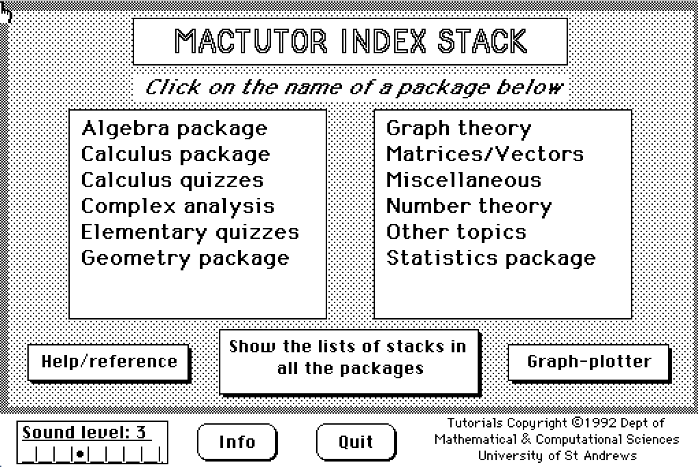
MacTutor 1992

Slide 6
Mathematicians
The 1992 version of our teaching software contained a stack called 'Mathematicians' in our 'Miscellaneous Index'. There were exactly 100 mathematicians in this collection. Each had a picture (consisting of black and white dots), year and place of birth and death, and one or two sentences about each.

Slide 7
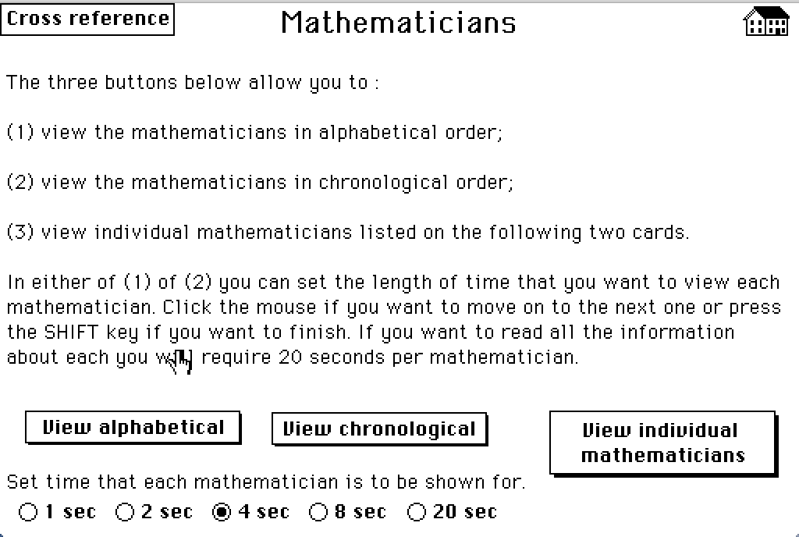
Mathematicians

Slide 8
Famous Curves
Its main purpose at this stage was to complement our Famous Curves package. You could experiment with each famous curve and a "History" button took you to the mathematician the curve was named for. Other stacks used the Mathematicians, for example the Finite Fields stack had a button "Tell me about Galois and finite fields" and the Fourier Analysis stack had a button "Tell me about Fourier and series".

Slide 9
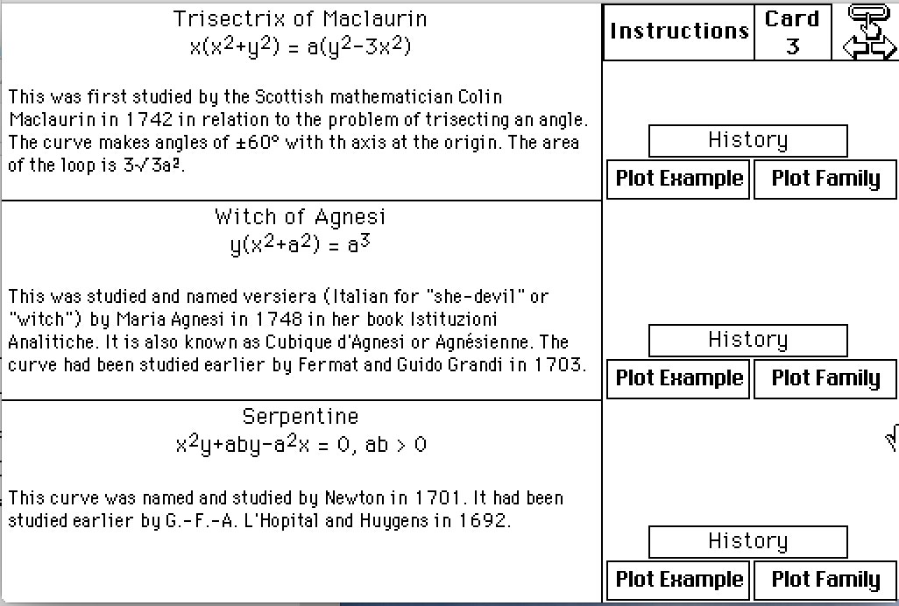
Famous curves
You could experiment with each famous curve and a "History" button took you to the mathematician the curve was named for.

Slide 10
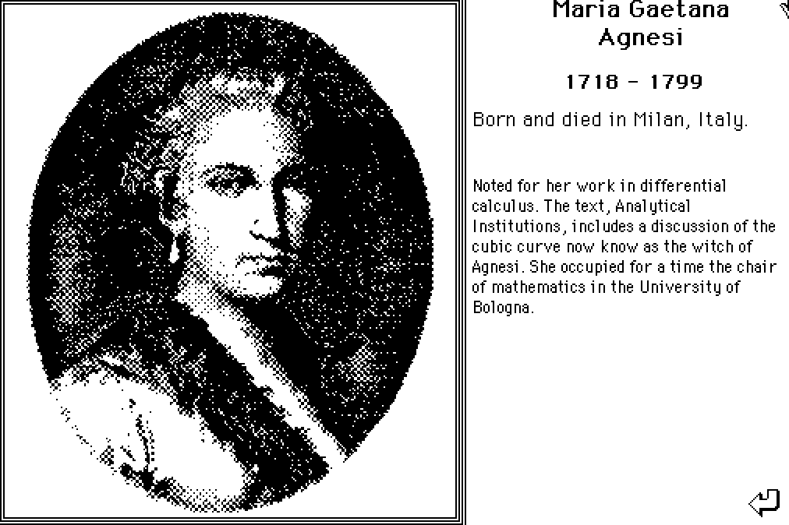
Agnesi

Slide 11
Who was included?
Of course, a consequence of the mathematicians being chosen to support the teaching material meant that we only had information about mathematicians whose names were attached to concepts or theorems. The mathematicians, therefore, were almost self-selected depending on the material we chose to teach.

Slide 12
European Academic Software Award
In 1994 we entered our teaching software for the European Academic Software Award. We put the history material on the web which was comparatively new at that time. In our submission we wrote the following about this History Archive:
"One of the recent innovations has been the inclusion of an archive on the History of Mathematics. This is not used primarily to teach the history as a subject in its own right, but to motivate and illustrate the mathematical content. Mathematics is often a very abstract subject and sometimes the best way to enliven a topic is to show how this part of the subject was originally developed and how it fits into a historical rather than a theoretical framework."
We were shortlisted for the finals in Heidelberg, Germany, and won the European Academic Software Award.

Slide 13
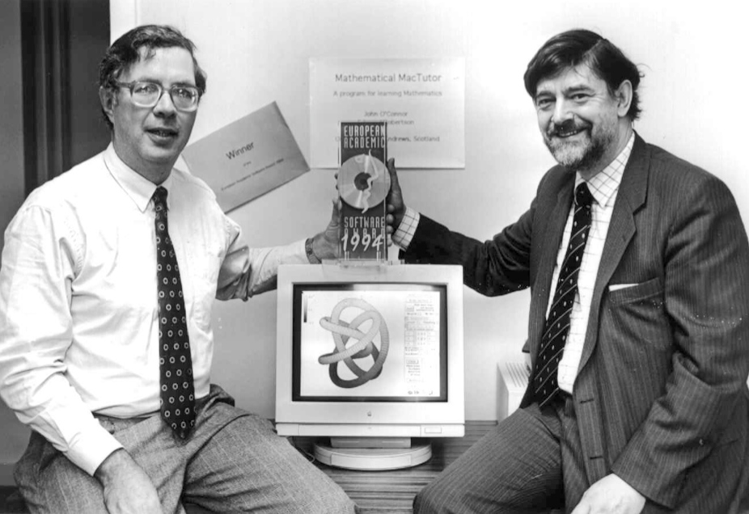
European Academic Software Award

Slide 14
The problem!
The problem now was that the MacTutor History of Mathematics Archive could be accessed by anyone as a stand-alone site without the teaching material it was designed to support. Because we received an enthusiastic world-wide response, we began to try to build the site as a History of Mathematics Archive in its own right.

Slide 15
History of Mathematics Course
I taught a history of mathematics course on the history of algebra, or the history of the development of the number systems.
My interest in history came through teaching. I wanted to emphasise that mathematics was the product of people, "like you and me" I would say to my students. I also wanted to be able to say to a student who said, "I understand this proof but I can't imagine how I could ever invent something like that" that the proof had been polished sometimes over centuries, and understanding its history was the answer to the question.
My course naturally led me to study Chinese, Indian, Arabic mathematics and mathematicians.

Slide 16
Our Eurocentric mathematics
I quickly came to realise how Eurocentric our mathematics was.
The personalities of mathematicians and the environment in which they worked was so important to the way they thought about mathematics.

Slide 17
There is no mission
I want to stress that I am not trying to develop MacTutor to make a point.
I develop MacTutor because I enjoy doing it and I only include biographies I want to write.
But, of course, those I include are “great mathematicians” in my eyes!

Slide 18
Unusual mathematicians
From the start, I was keen to include people for whom mathematics was important but they were known for other achievements.
Albrecht Dürer - artist who wrote the first German arithmetic.
Florence Nightingale – nurse whose success was through statistics.
Christopher Wren – architect who became an FRS for his mathematical contributions.

Slide 19
My favourite mathematician
For many years people would ask me who was my favourite mathematician and I would reply - Omar Khayyam. Here was someone from a totally different background, a different time, culture, religion, but reading his writings I felt this strong connection - we both thought like mathematicians.

Slide 20
Walter Ledermann
An important influence has been Walter who I knew for many years. I learnt from him first hand what it was like to be a Jew studying mathematics in Nazi Germany.
But we discriminated too! He had to begin his university studies again.

Slide 21
Indian Mathematics
Around 20 years ago Ian G Pearce did an undergraduate project on Indian Mathematics which I supervised. We put his honours project into MacTutor and Ian was invited in 2004 to be a main speaker at a conference in Louisiana. He went and contributed a major paper to the conference proceedings.

Slide 22
Ian’s Abstract
Mathematics has long been considered an invention of European scholars, as a result of which the contributions of non-European countries have been severely neglected in histories of mathematics. Worse still, many key mathematical developments have been wrongly attributed to scholars of European origin. This has led to so-called Eurocentrism. The neglect of non-European mathematics is no more apparent than when studying the contributions of India. Contrary to Eurocentric belief, scholars from India, over a period of some 4500 years, contributed to some of the greatest mathematical achievements in the history of the subject.

Slide 23
Redressing the balance
I have continued in my attempts to "redress the balance", not only through MacTutor but also in the LMS Hirst Prize lecture I delivered.
Our list of ancient Indian mathematicians contains 32 entries. Our list of mathematicians born in India has 62 entries, and in Pakistan has 4 entries.

Slide 24
African Mathematics
We have full biographies of 42 African mathematicians some, such as the ancient Greeks, have been in the Archive from the very beginning, while other were added in a project I undertook in 2019.
We list 404 African men giving biographical data on 102 who where awarded Ph.D.s up to 1981 and less information about those awarded Ph.D.s from 1982 to 1999.
We also list 99 African women giving biographical data.
Let us look at Ismail Jacobus Mohamed.

Slide 25
Ismail Jacobus Mohamed
Ismail Mohamed (1930-2013) was a South African mathematician who specialised in group theory. He studied at the University of the Witwatersrand, obtaining a B.Sc. and an M.Sc. He obtained a scholarship to study for a Ph.D. at the University of London which he was awarded in 1960. His thesis was entitled On Series of Subgroups Related to Groups of Automorphisms, and his thesis advisor had been Kurt Hirsch. He was appointed as an assistant lecturer at the University of London but, after the racial riots in South Africa, chose to return to a position at the University of the Witwatersrand, turning down the offer of a permanent position at the University of London. Back in South Africa he campaigned for human rights.

Slide 26
Groups St Andrews and Mohamed
In 1983 my colleague Colin Campbell and myself announced a major conference, Groups St Andrews 1985, to be held in St Andrews in July-August 1985. Our plenary speakers were four leading group theorists; we mention in particular, Gilbert Baumslag, a South African working at the City University of New York, and Jim Roseblade who gave lectures on the Heineken-Mohamed groups. Mohamed wrote to us saying he wished to attend Groups St Andrews 1985 and we invited him to lecture to the conference.

Slide 27
Support for Mohamed
On 18 February 1985 Mohamed was arrested along with other leaders of the United Democratic Front so could not attend Groups St Andrews 1985. During the conference I was approached by some participants who wanted to write to the South African government arguing for Mohamed's release as a prisoner of conscience and wanted to invite other conference participants to sign their letter. I had a worry about this for I had no idea what Gilbert Baumslag's political views were and I had no wish to offend him. Gilbert, however, fully supported it and wished to add his signature in support of Mohamed. The letter was sent off signed by around 300 of the world's leading group theorists. I doubt if it had any impact but the trial of United Democratic Front members collapsed (some of the State's evidence was suspect) and all were released by June 1986.

Slide 28
Maurice Audin 1
Maurice Audin (1932-1957) was an excellent Tunisian topologist who was murdered by the French before submitting his doctoral thesis to Paris.
I wouldn’t count him as a “great mathematician” – sadly he didn’t have a chance to prove that.
He studied with René de Possel at the Faculty of Science at Algiers. By 1957 he had published six papers and was working on his Ph.D. thesis.

Slide 29
Maurice Audin 2
In spring 1957 he went to Paris and had discussions with Laurent Schwartz. Back in Algiers he was murdered by the French. He was a member of the Communist Party of Algeria and strongly supported Algeria's right to be independent of France. Audin's thesis was accepted posthumously on 2 December 1957 by the University of Paris.
For years his Algerian family and mathematicians in Paris fought for justice. Emmanuel Macron in 2018 admitted “Maurice Audin was tortured then executed or tortured to death by the soldiers who arrested him at his home.”

Slide 30
African Americans
Recently we have added 'African American' to our list of categories.
I have produced a list of all African Americans who were awarded a Ph.D. in mathematics up to and including 1960 giving basic details such as date and place of birth, titles of Ph.D. thesis, university awarding the degree and the name of their Ph.D. advisor. There are 32 mathematicians on this list.
For those with a full MacTutor biography we have a link to that page, and for the others I have given fairly full biographical details.

Slide 31
Eugene Graham, Jr. (1925-1997)
He was born in Philadelphia and served in the U.S. army during World War II. He was sent to Italy and was awarded the Silver Star for gallantry. After the war he returned to the United States and studied for an M.A. at Pennsylvania University and electrical engineering at MIT.

Slide 32
Eugene Graham, Jr. (1925-1997)
He went to Italy and was awarded a mathematics doctorate from the Università degli Studi di Torino. Returning to the U.S.A. he rented a house, paid a deposit, but when he came to collect the key he was refused it. He went to court because of the discrimination and won his deposit back. After this he went to France where he lived for the rest of his life.
He wrote a book, Buffalo, about his experiences in a segregated and under-staffed battalion in World War II. He could not get it published in the USA, so it was published in France in 1969.

Slide 33
Royal Observatory Greenwich
There were the women employed at the Royal Observatory Greenwich who were well qualified in mathematics, often similar to a Chief Assistant at the Observatory, but paid a minimal salary. These included Alice Everett (1865-1949) and Annie Russell (1868-1947).

Slide 34
Mina Rees (1902-1997)
Some people made major contributions to mathematics but produced little in the way of theorems. Mina Rees was an American mathematician and a pioneer in the history of computing. She had a major impact on the academic and research culture of the United States. Let us quote from a 2002 article in The American Mathematical Monthly:
Mina Rees had a profound, though for the most part unseen, impact on the mathematical sciences in the United States. However, the academic and research culture in which many of us work is in large part a product of her insight and dedication.

Slide 35
Mina Rees

Slide 36
Eugenics women
It is now almost unacceptable to mention eugenics. However, many women worked in eugenics and did excellent work and should not be removed from history because they worked at the Eugenics Laboratory. For example Alice Lee (1858-1939), who wanted to write a thesis disproving the theory, held by most experts at that time, that the capacity of a person's skull was closely related to their intellectual ability, i.e. the larger the head, the cleverer the person would be. This belief, of course, led to the immediate corollary that men were more intelligent than women since, on average, men had considerably larger heads. Her work showed that there was no correlation between size of skull and intellectual ability. She was eventually awarded a Ph.D. by the University of London, but only after a long struggle against examiners who refused to believe her results.

Slide 37
Alice Lee

Slide 38
Chaim Samuel Hönig (1926-2018)
Hönig was born in Berlin into a Jewish family that fled Germany in 1937. He became a Brazilian citizen.
He was the founder of the Brazilian Mathematics Colloquium in 1957 and its first organiser.
He was also a founder of the Brazilian Mathematical Society in 1969 and its first president.

Slide 39
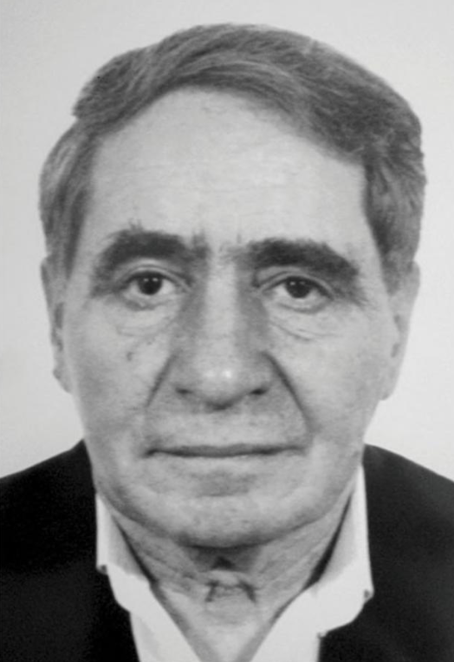
Chaim Samuel Hönig

