Slide 1
90% of jobs need maths; 30% of the population has maths anxiety: what can we do?
Sue Johnston-Wilder

Slide 2
Aims of this session
Raise awareness of maths anxiety
Explore how it affects an average 30% of the people around you and in the wider community
Explore how you can begin to become part of the solution
Introduce the Mathematical Resilience toolkit

Slide 3
Key concepts
maths anxiety
prior harm
adverse prior experiences
psychological safety
resilience
a little psychoeducation

Slide 4
What is their first reaction to ‘maths’? What is their first reaction to being asked to do stats?

Slide 5

What happened to you?

Slide 6
Some brain facts we need to understand
As a survival strategy, the brain seeks to distinguish challenge from threat to well-being or survival
Includes physical and social threats, such as being left behind or humiliated or shouted at
Previous threats are remembered
When the brain (sub-consciously) perceives a threat, it initially responds by fight or flight mode

Slide 7
Adverse prior experiences?
Maths is either right or wrong
I might reach my ceiling in maths
I don’t have a growth zone in maths
My teacher says I am stupid

Slide 8
Student experience
[the teacher] would make you stand in front of everyone, and then she would just be, like, “You’re not good, you don’t understand, you’re stupid.” (Halima)
I always felt like I was stupid … Starting maths this year it still gives me chills …‘Cos even now, you know, that fear of saying ‘Oh I don’t get it! I still don’t get it!’ is still there. (Nina)
Molly’s father would grasp her neck in frustration when she didn’t get it.
Notes:
Typical prior experiences

Slide 9
“If nobody is talking about it, it must be me.” Brene Brown

Slide 10
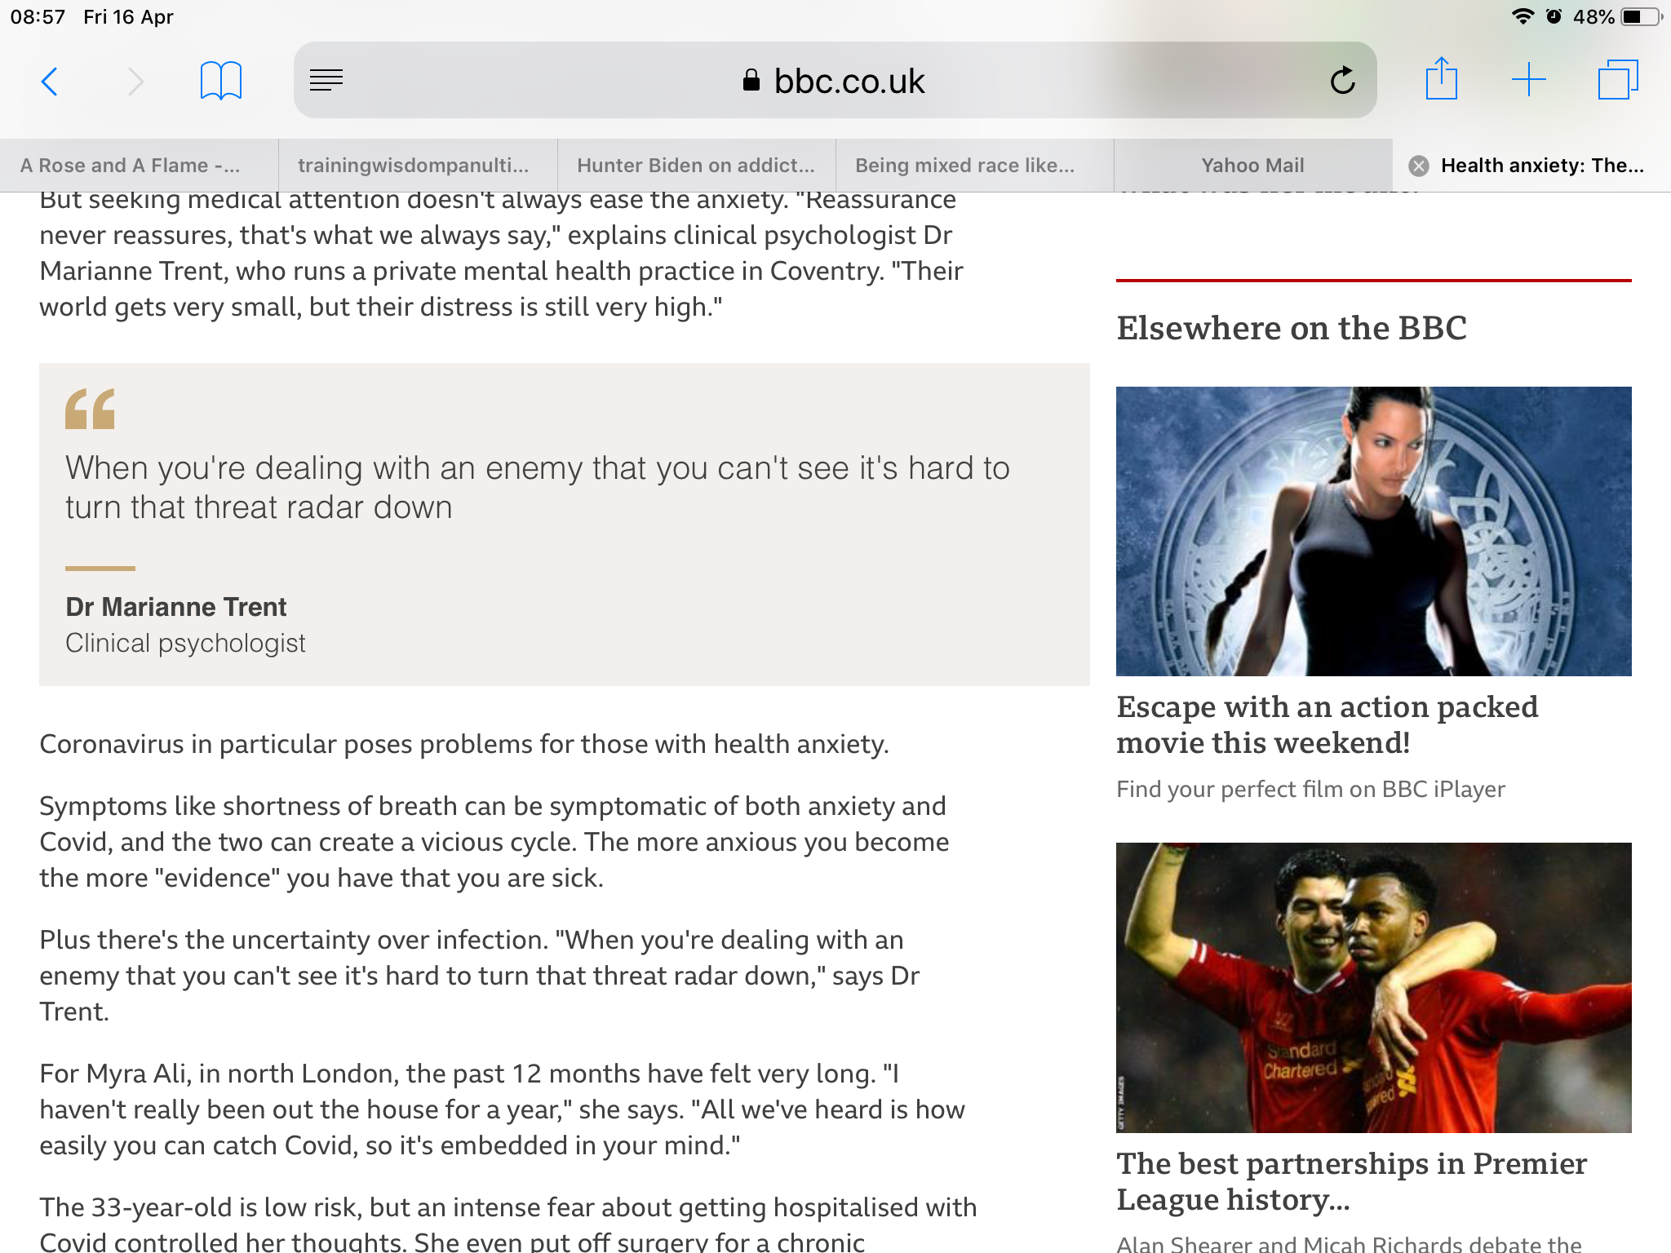
The power of the invisible threat
Notes:
In a different context Dr Trent said this.
K drew an image of herself protected by armour.

Slide 11
Maths anxiety
“A feeling of tension, apprehension, or fear that interferes with maths performance” (Ashcraft, 2002)

Slide 12
Maths anxiety …
...is like an invisible monster, a grim reality for a significant proportion of learners
… is acquired
...is disabling
...has been written about since 1950s
...now affects large numbers of people
...causes reduced or backwards progression
...can be addressed

Slide 13
Maths with chocolate
The expression “maths monster” arose at the end of a course for staff at University of Warwick who self-identified as maths anxious:
“Thank you for rescuing me from the maths monster.”

Slide 14
Psychological safety requires …
Relatedness
Autonomy
Competence …
… including competence to self-safeguard
Ryan and Deci (2017)

Slide 15
Competence to self-safeguard …
…can be achieved using three tools:
growth zone model
hand model of brain
triggering relaxation response
Shared between teacher and students, the tools help improve dialogue, awareness, and apt responses to reduce maths anxiety.

Slide 16
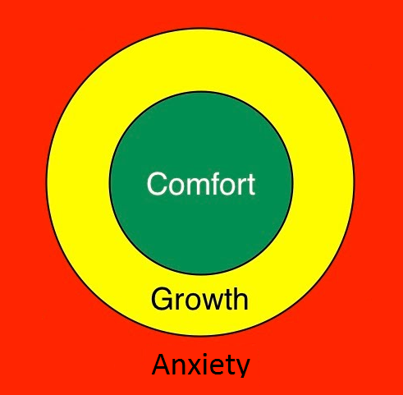
The growth zone model
Fight or flight mode
Notes:
Comfort – easy; Anxiety – not yet- too hard
Growth: safe enough, brave,
Heart racing; Mind goes blank; Feel stupid; Sweaty hands; Overwhelmed; Ashamed, embarrassed; Angry

Slide 17
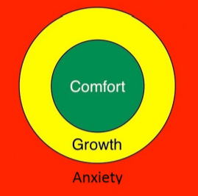
The growth zone model: green zone
Cruising in the comfort zone can build self-confidence and confidence in the teacher & provide opportunities for practice & automaticity.

Slide 18
The growth zone model: amber zone
New learning happens in the growth zone where learners experience challenge with sufficient safe-guarding – it should be safe enough to make mistakes, get stuck, require support, find activities tiring.

Slide 19
The growth zone model: red zone
The danger zone is where what is being asked is not within the learner’s reach yet, even with support, and mathematical well-being is under threat.
Stress increases, possibly to panic; little or no useful learning takes place.

Slide 20
The red zone
What does it look and feel like?

Slide 21
Not stupid but panicking
Panic is temporary
To build resilience, learners need to understand this state is temporary (Seligman).

Slide 22
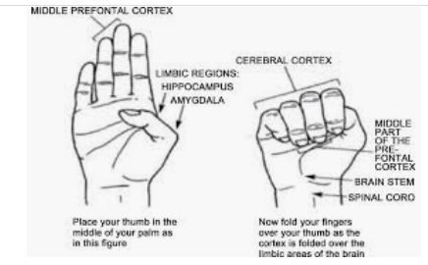
The hand model of the brain (Dan Siegel)

Slide 23
The hand model of the brain
Key message: the brain can’t panic and think effectively at the same time
Dan Siegel explaining his model:
https://www.youtube.com/watch?v=gm9CIJ74Oxw
Maths resilience version:
https://www.youtube.com/watch?v=7zW8w9kuu6E&t=7s
Notes:
Please feel free to make your own, or invite the learners to make one.

Slide 24
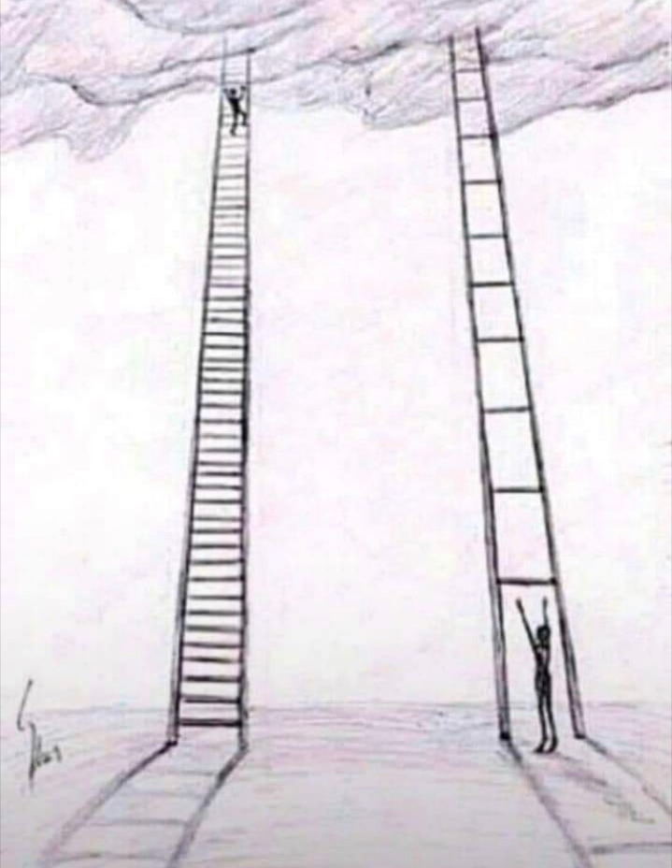
The ladder model
“I need
another
rung”
Notes:
Teachers listening to learner experience as ladder is invisible in maths

Slide 25
Using the growth zone model
Accept feeling of stupidity in red zone as temporary
How to get out of the red zone?
Building experience of being in and extending the amber/growth zone
Notes:
Cliff into beach

Slide 26
Getting out of the red zone
Relaxation response (Benson 2000)
Rest and digest
5/7 breathing
Focus on 5 things you can hear
Go for a walk
…
Don’t try to do maths whilst your brain is focused on the “maths monster”!
Notes:
Micromindfulness

Slide 27
Getting out of the red zone
Learn that the red zone is a “beach not a cliff”
Particularly relevant to panic in assessment conditions
Notes:
Micromindfulness

Slide 28
Building the amber/growth zone
Try a simpler example
Support each other
Recruit help
Use the Internet
Expect to get stuck
Expect to make mistakes
Use rough work
Take time
...

Slide 29
The growth zone involves …
growth mindset (Dweck, 2006)
struggle (persistence and perseverance) (Seligman and Williams)
value and autonomous motivation (Ryan & Deci, 2017)
support and relatedness (being enabled to recruit)

Slide 30
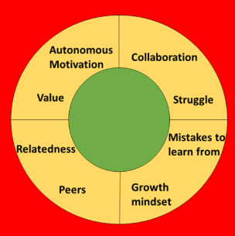
The enhanced growth zone model

Slide 31
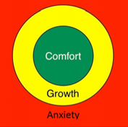
The growth zone model
a means to help learners understand and articulate their feelings when they are learning maths...
a means to safeguard the mathematical wellbeing of those involved in learning or supporting maths…
Notes:
Build a shared language for mathematical safeguarding, awareness, dialogue and action.
Red means stop talking and listen! This practice can take a while to develop as a maths teacher!
Some teachers give each learner a copy of the GZM to use with a coin as a marker

Slide 32
What happened when teachers introduced the GZM …
By talking and acknowledging that in order to learn we have to feel uncomfortable, this made a noticeable difference to the students asking for help or telling me when they did not understand.
The culture of the maths lessons became more about understanding process than getting to the correct answer.

Slide 33
What happened when teachers introduced the GZM …
Students can let me know when the work is too easy for them and they need me to give them something more challenging by simply telling me “these questions are all green for me, can I have some harder ones” and other students have been able to let me know when they are starting to find it too much:
“these are in my yellow but approaching my red Miss”.

Slide 34
Learning maths as an inclusive journey
Students are comforted by seeing that it is a process and journey through a particular element of learning and through the Growth zone, and that by continually being in green, although it is comfortable it is not growth.
Having students articulate this themselves and being able to see their own journey is a big success.

Slide 35
Anxiety-informed practice
It is necessary to adopt practices that raise awareness of anxiety, recognize MA in learners and seek to resist causing further harm;
It is necessary to establish a safer teaching environment promoting MR and enhancing achievement in mathematics.
Based on Homes & Grandison (2021)

Slide 36
Allowing people to heal and flourish in maths …
‘The mums were so relieved to hear that maths anxiety is “real”, and that they weren’t the only ones who felt physically sick before maths lessons, and made to feel stupid.
They loved the approach of safeguarding, and hadn’t previously thought about healing the maths trauma they had carried for decades.
Everyone needs to hear this vital message.’

Slide 37
Sue, it works!
Individual students and staff at Warwick
Nurses in Coventry Uni
FE students in Brazil
Adults returners in Lewisham
Teenagers in Turkey
…

Slide 38
The empathy – logic spectrum …
… and maturation

Slide 39
We can tackle the very real, invisible maths monster, together …
…building awareness, developing a shared language for mathematical safeguarding, enabling learner autonomy, encouraging learning communities that don’t leave people behind, building growth mindsets …

Slide 40
Further reading
The tools:
https://www.scirp.org/journal/paperabs.aspx?paperid=102510
At home:
https://www.scirp.org/journal/paperinformation.aspx?paperid=55378
https://www.mathsontoast.org.uk/how-talking-about-maths-suddenly-became-easier/
With a PhD student:
https://www.scirp.org/journal/paperinformation.aspx?paperid=85398
1 to 1 with an adult:
https://www.scirp.org/journal/paperinformation.aspx?paperid=112110
In class:
https://www.scirp.org/journal/paperinformation.aspx?paperid=123458
Background:
Siegel D (2011) Mindsight: The New Science of Personal Transformation
Benson H (2000) The Relaxation Response

