Slide 1
AMERICAN TRENDS IN TEACHING AND RESEARCH: A GLIMPSE OF THE FUTURE?
Barry J. Griffiths, Ph.D.
Department of Mathematics
University of Central Florida
November 2023

Slide 2
Personal Details
Born and raised in North Wales.
Moved to America for postgraduate study.
Worked in the UK, Italy, and the US.
Currently a Senior Lecturer at the University of Central Florida (UCF).
Research interests include undergraduate mathematics education and international education.

Slide 3

UCF Profile
Founded in 1963
70,000 students
$2 billion annual operating budget
350 undergraduate mathematics students
50 postgraduate mathematics students
50 mathematics faculty members

Slide 4
Outline of the Talk
In this talk I will look at how teaching and research in the United States are being affected by technology, the drive to educate an increasing number of students, the business of higher education, and the global academic community.
At the same time, I will draw parallels with the situation in the UK and how these issues might lead to future change.

Slide 5
Technology in Education
Classroom teaching has progressively followed technological developments for many decades, with the use of overhead projectors, calculators, and computer consoles being used since before the turn of the current century.
However, the Covid-19 pandemic forced educators around the world to quickly adapt their teaching style to incorporate distance learning and online technologies.

Slide 6
Technology in Education
Rather than being a short-term, emergency necessity, this increase in the reliance on technology in education is something that seems here to stay.
From online homework assignments and posted lecture notes to entire lectures, entire modules, and even entire degree courses, the past few years have witnessed a digital revolution that is almost certainly irreversible.

Slide 7
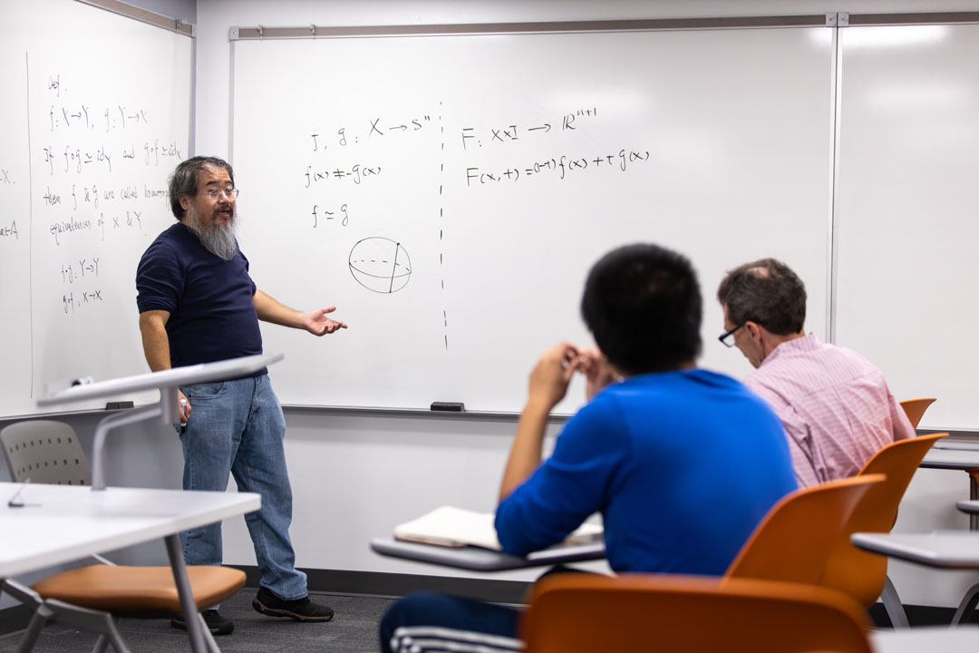
Teaching and Technology
After switching from blackboards to whiteboards, it is now increasingly common for instructors to project the notes rather than write them out.

Slide 8
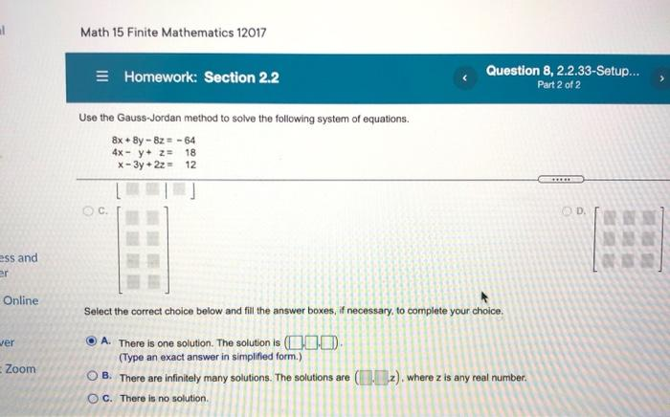
Teaching and Technology
Online homework is used in every precalculus course, calculus, ODE 1, and linear algebra 1 section at UCF.
Assignments are due every week.
Typically count for 10% of the overall course score.

Slide 9
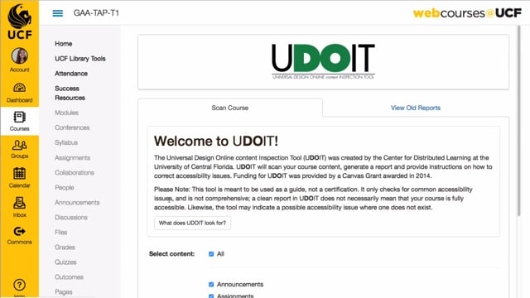
Teaching and Technology
An online system (Canvas) allows students to constantly monitor all their scores, check on upcoming assignments, send and receive messages from instructors and other students.

Slide 10
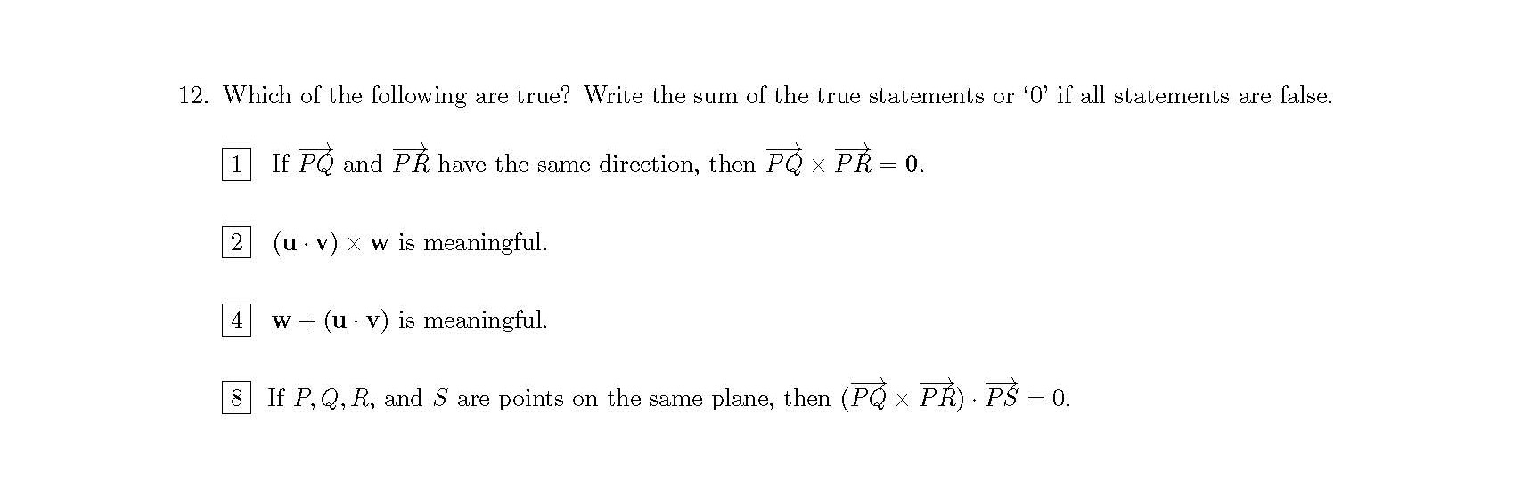
Teaching and Technology
• Such questions allow marking exams to be done more quickly.

Slide 11
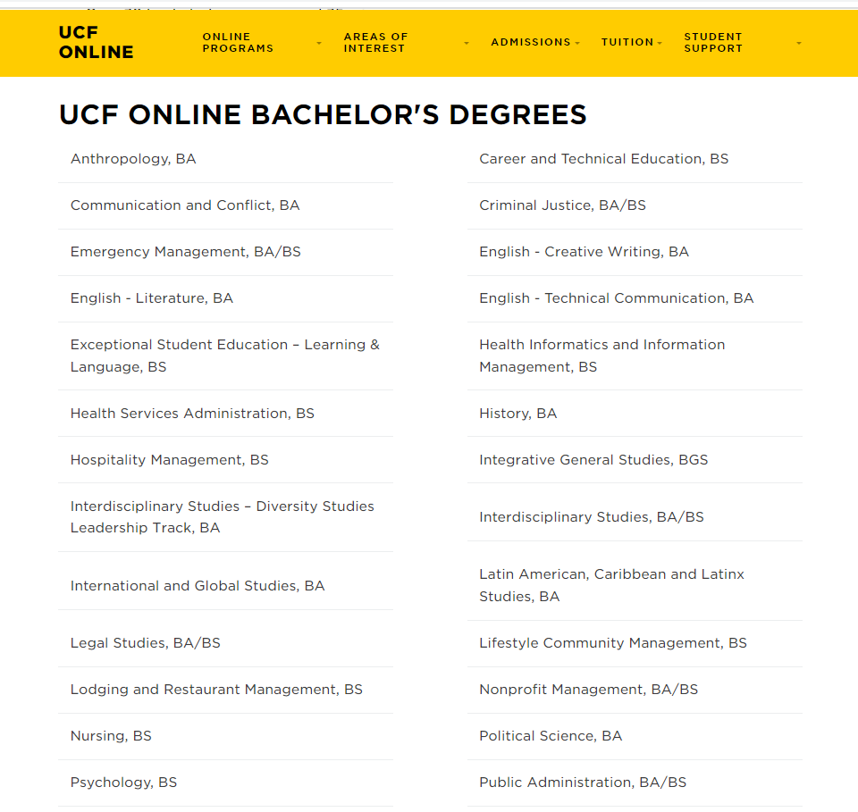
Teaching and Technology
UCF now offers entire degree courses online, with a third of all classes taught being fully online.

Slide 12
Technology in Education
There are many aspects of the new teaching modalities that students welcome and can take advantage of.
The ability to work from home rather than commuting to or living on campus.
The flexible scheduling is better for students with part-time jobs.

Slide 13
Technology in Education
However, while the rapid development of technology use in education has led to the benefits described, it has led to perhaps an equal number of problems.
A critical question is whether distance learning can achieve the same level of quality as traditional classroom instruction?
Certainly, it is difficult to mimic the level of interaction between students or between the students and the teacher.

Slide 14
Technology in Education
Motivation has often been described as an issue for students taking classes online, with the reduced interaction and limited physical resources causing students to feel isolated and fall behind.
Time management can be more difficult without the daily structure that in-person classes and a fixed timetable provide.
A significant issue to overcome on the part of the instructor is how to fairly administer tests.

Slide 15


Research and Technology

Slide 16
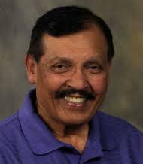
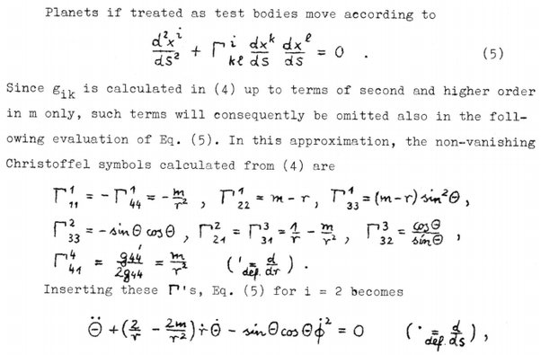
Research and Technology

Slide 17
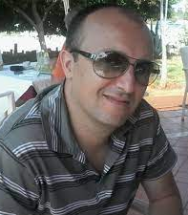
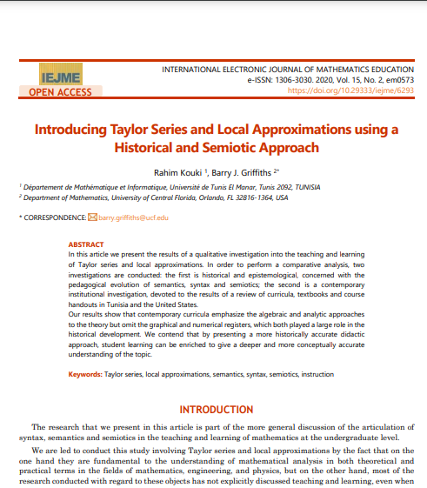
Research and Globalisation

Slide 18

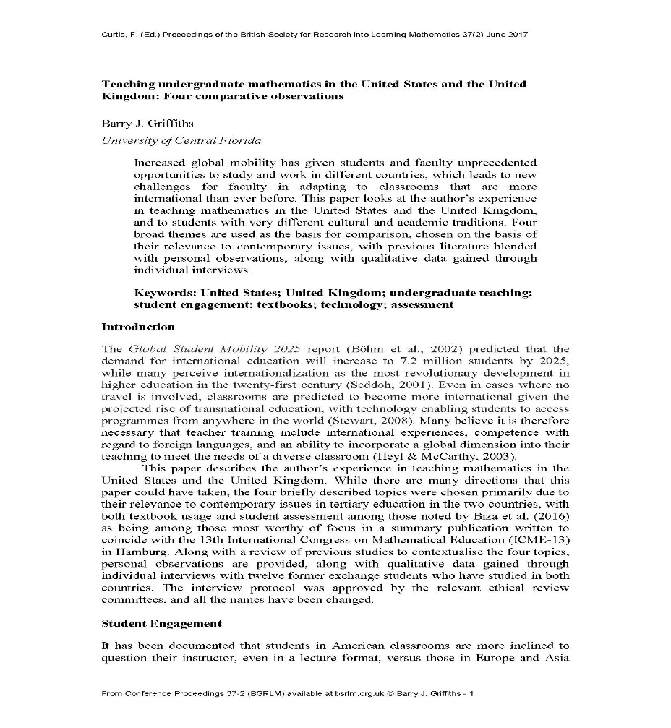
Research and Globalisation

Slide 19

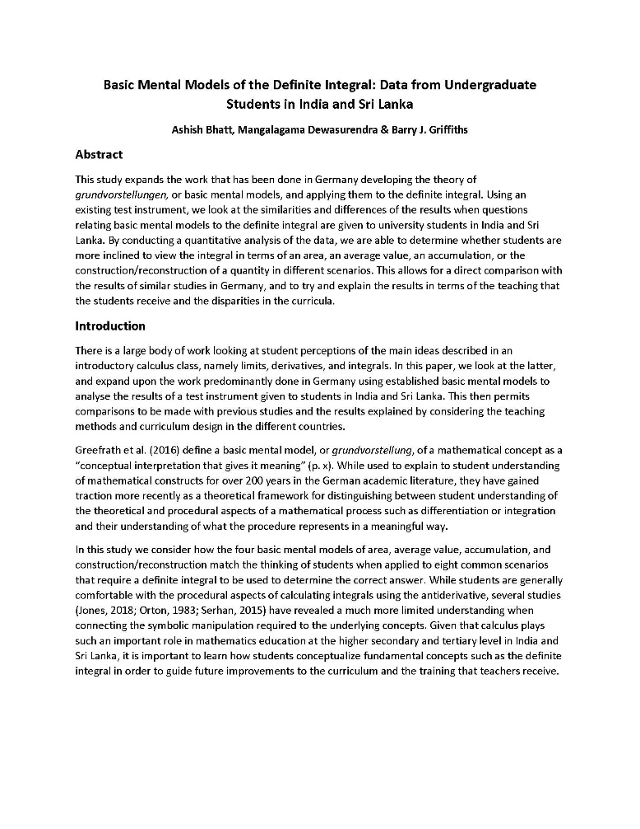
Research and Globalisation

Slide 20
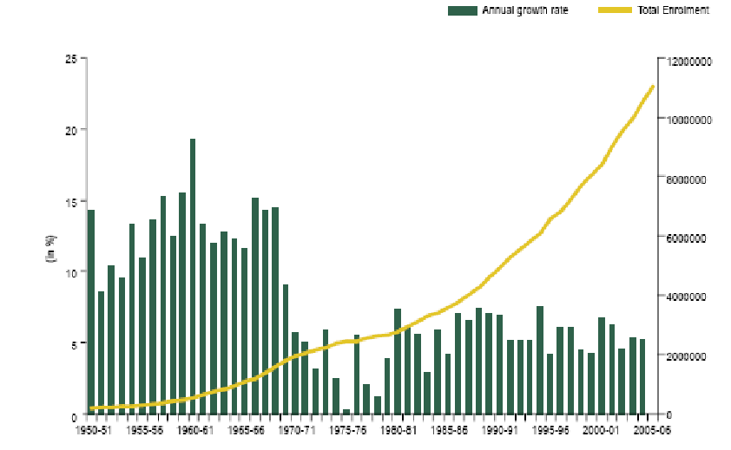
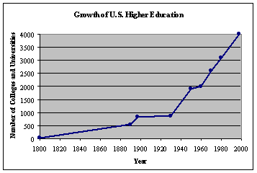
The Business of Education

Slide 21
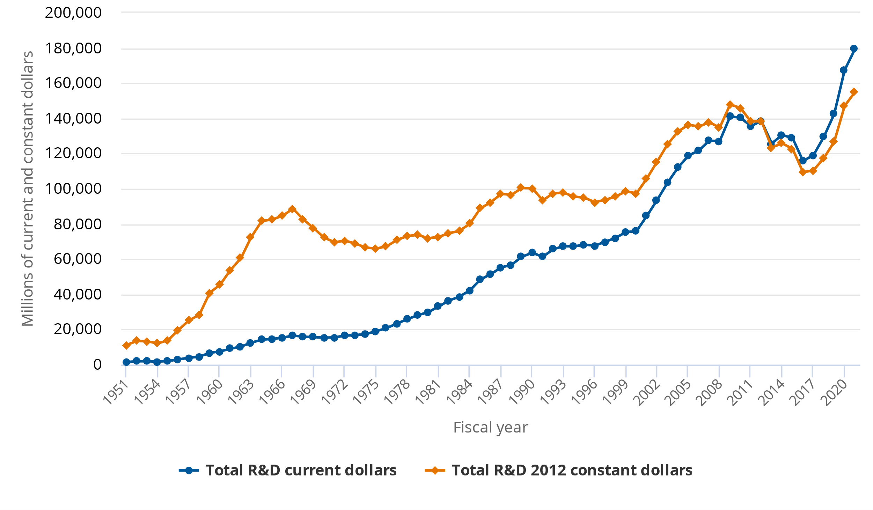
The Business of Education
• As a result of the increase in federal grants for research, universities like UCF greatly prioritize hiring faculty who have a proven ability to secure external funding.

Slide 22
The Business of Education
Hot topics in mathematics at UCF include:
Machine Learning & AI
Cybersecurity
Financial Mathematics
Big Data
Mathematical Biology
Multidisciplinary research

Slide 23
Taking Advantage of the New Normal
Digital literacy
National and global outlook
Broad networking
Hot topics
External funding
Advancement and job opportunities

Slide 24
Thank you for listening!
I would be happy to discuss these topics further and answer your questions.
E-Mail: barry@ucf.edu

