Slide 1



Careers Advice for Mathematics Graduates
‘Wanted: maths graduates…Mathematicians have a vast amount of roles open to them – and as the importance of data continues to grow across all sectors, graduates will be in ever greater demand’

Slide 2
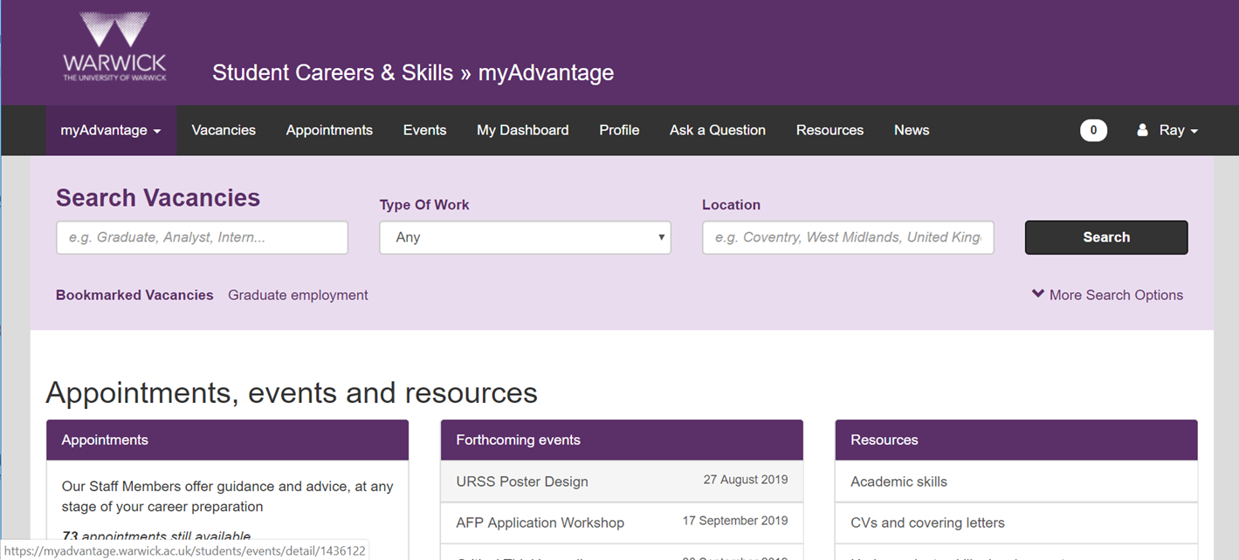

Ray Ryan (Careers consultant r.ryan@Warwick.ac.uk)
Careers@Warwick.ac.uk)

Slide 3



Number of graduate jobs has increased this year…

Slide 4




Want to gain more experience before looking for a graduate job?

Slide 5


Free online learning…

Slide 6

How mathematics is used in the workplace: some examples
https://web.microsoftstream.com/video/ed384d54-7509-4ec5-8bc3-98fee1513ab8?list=studio (Data analytics in Genetics)
https://web.microsoftstream.com/video/8609950c-a77b-4b46-8aa0-d296994444a4?list=studio (The maths & physics used in weather
forecasting)
https://web.microsoftstream.com/video/d296a424-ea44-4791-827c-d7524c9e3efb?list=studio (Data analytics in the retail industry)
https://web.microsoftstream.com/video/6ae3c4d6-e980-4668-a9da-d437dd495f6b?list=studio (Maths & Stats used in operational research)
https://web.microsoftstream.com/video/f21d195f-0577-4e90-98c2-50af0d95abcb?list=studio (Maths & Stats used in actuarial science)
https://careersblog.warwick.ac.uk/2017/04/18/if-you-are-a-mathematics-student-and-dont-want-to-work-in-finance-what-else-can-you-do/
https://www.prospects.ac.uk/careers-advice/what-can-i-do-with-my-degree/mathematics
Get in touch, we are here throughout the summer and for the next 2 years!
r.ryan@warwuick.ac.uk careers@Warwick.ac.uk

