Slide 1
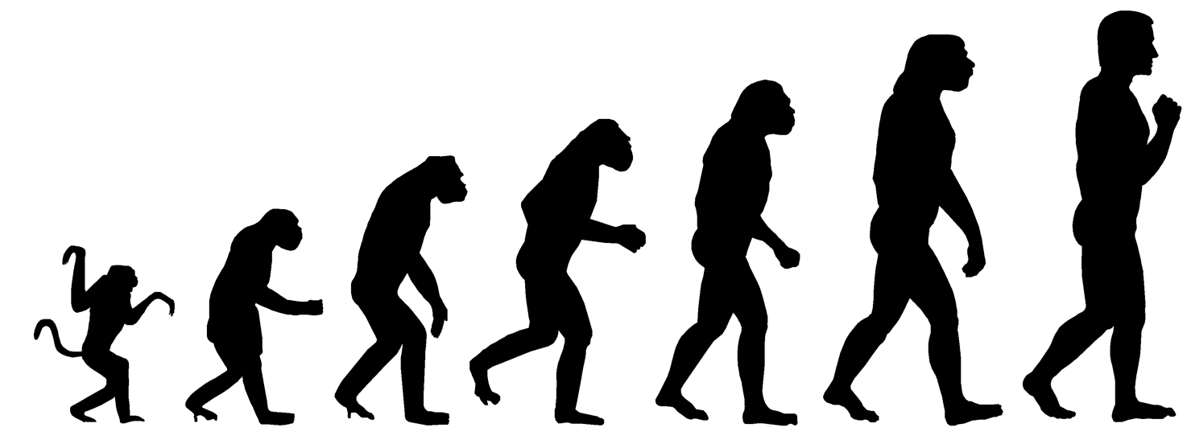
Evolution
Matt Keeling
MA 999: Topics in Mathematical Modelling
Tuesday 11-12
Thursday 2-4

Slide 2
Evolution
Lecture 1 Tuesday 6th 11-12
Introduction. Evidence for evolution. Fitness. Competition.
Lecture 2 Thursday 8th 2-3
Games & Genes.
Lecture 3 Thursday 8th 3-4
Computer-based practicals – example programs and questions.
Lecture 4 Tuesday 13th 11-12
Sex and Speciation. Sexual selection. Males as parasites. Why sexual reproduction? How do new species arise.
Lecture 5 Thursday 15th 2-3
Disease evolution. Why aren’t we all wiped out by killer infections?
Lecture 6 Thursday 15th 3-4
Computer-based practicals – example programs and questions.

Slide 3
Sexual Selection, Sex and Speciation
Sexual Selection.
Often we observe quite distinct differences between the sexes and some quite extreme behaviour – this is generally due to sexual selection.
Sexual Reproduction.
Why should organisms reproduce sexually? What is the advantage over producing a clone? Why 2 sexes and not 3?
Speciation.
How do new species arise? What kind of models and assumptions are needed to capture this behaviour.

Slide 4
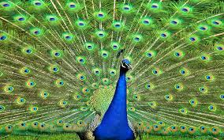
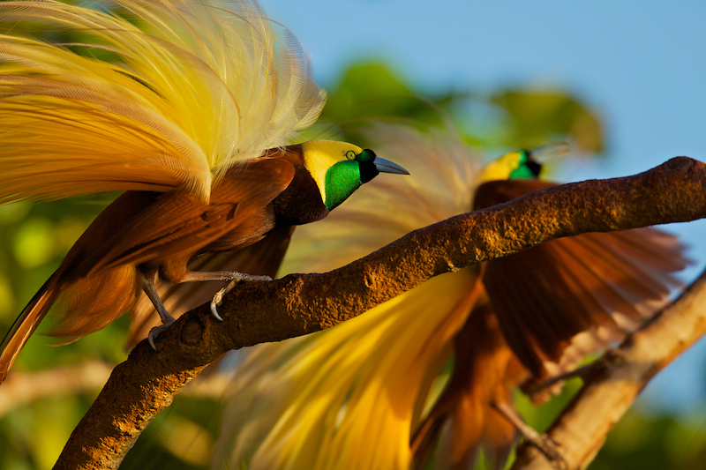
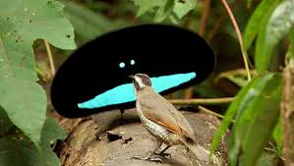
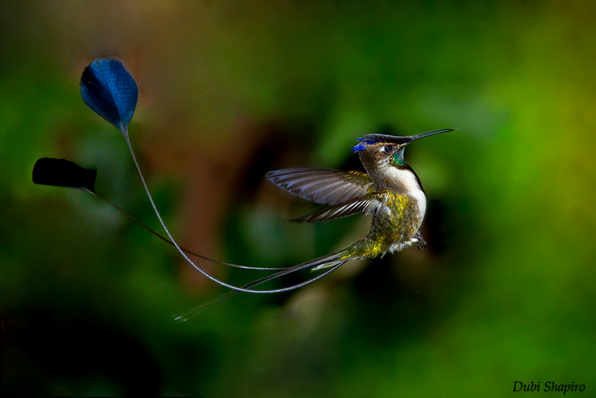
Sexual Selection
Often this is manifested as extreme ornamentation in males:
“if males do something that looks stupid its usually to impress the females”.

Slide 5
Sexual Selection
Lets look at tail-length as an example
Population of Males at the start of the year.
Tail Length

Slide 6
Sexual Selection
Lets look at tail-length as an example – a very long tail is obviously a handicap and leads to an increased death rate.
Probably of
survival.
Population of males at the start of the breeding season.
Population of males at the start of the year.
Tail Length

Slide 7
Sexual Selection
Lets look at tail-length as an example – a very long tail is obviously a handicap and leads to an increased death rate.
But females prefer to mate with males that have long tails
Probably of
survival.
Population of males at the start of the breeding season.
Population of males at the start of the year.
Tail Length

Slide 8
Sexual Selection
Lets look at tail-length as an example – a very long tail is obviously a handicap and leads to an increased death rate.
But females prefer to mate with males that have long tails
– and these produce the offspring of the next year.
So sexual selection can overcome extreme biases in death rates,
making what was unfit now high-fitness in terms of producing
new offspring
Probably of
survival.
Population of males at the start of the breeding season.
New population of males.
Tail Length

Slide 9
Sexual Selection: why choose long-tails
Costly Trait
Non-Costly Trait
Vigour
Lines of equal chance of survival
Vigour
Long Tail
Eye Colour
Here, vigour means how well suited you are to the environment – being healthy, able to avoid predators etc etc.

Slide 10
Sexual Selection: why choose long-tails
Costly Trait
Non-Costly Trait
Population
Vigour
Lines of equal chance of survival
Vigour
Long Tail
Eye Colour
The Population distribution is governed by the limits of vigor and the impact of having a long tail.

Slide 11
Sexual Selection: why choose long-tails
Costly Trait
Non-Costly Trait
Population
Vigour
Lines of equal chance of survival
Vigour
Long Tail
Eye Colour
Females preferentially select males with long-tails – which as a by-product selects males with higher vigour. These are the only ones that can maintain a long-tail.

Slide 12
Sexual Selection: why choose long-tails
Costly Trait
Non-Costly Trait
Population
Population
Vigour
Lines of equal chance of survival
Vigour
Long Tail
Eye Colour
In comparison, females that select on a non-costly trait, do not pick the more vigorous males, and therefore have weaker offspring.

Slide 13
Sexual Selection: why choose long-tails
So from an evolutionary point of view:
Males that match-up to the females’ demands are selected for (tails become longer, colours become brighter etc etc).
Females that select males based on a costly trait will pick the more vigorous males, and therefore have fitter offspring. Therefore there is selection on females to select costly traits.
The conclusion of this selection is that characteristics should become ever more extreme.

Slide 14
Sexual Reproduction
There are multiple hypotheses about why sexual reproduction evolved and how it is maintained.
Evolution
Most theories agree that males evolved as some kind of defector / parasite – passing on their genetic material to the next generation but not suffering the costs of having to produce offspring. You could view this as a two-player game.
Maintenance
Again there is general agreement that the advantage of sexual reproduction comes from the mixing of genes. In a clonal population genotypes (and hence phenotypes) remain fixed from one generation to the next, in sexual populations there is continual variety.
Two basic mechanisms lead to this variety being useful – rapid adaptation and parasite avoidance.

Slide 15
Sexual Reproduction: Rapid Adaptation
Year 1
Clonal population
Trait 2
Population of sexual individuals
Point of maximum fitness
Trait 1

Slide 16
Sexual Reproduction: Rapid Adaptation
Year 1
Clonal population
Trait 2
Population of sexual individuals
Year 2 -- offspring
Point of maximum fitness
Trait 1
Clonal offspring
Trait 2
Offspring of sexual individuals
Trait 1

Slide 17
Sexual Reproduction: Rapid Adaptation
Year 1
In a fixed environment the variability in offspring displayed by the sexual population is wasted – its better to be a well-adapted clone.
Clonal population
Trait 2
Population of sexual individuals
Year 2
Point of maximum fitness
Trait 1
Clonal population
Year 2 -- offspring
Trait 2
Population of sexual individuals
Clonal offspring
Trait 2
Offspring of sexual individuals
Point of maximum fitness
Trait 1
Trait 1

Slide 18
Sexual Reproduction: Rapid Adaptation
Lets run through that again, but assume that the environment is highly variable.
Year 1
Clonal population
Trait 2
Population of sexual individuals
Point of maximum fitness
Trait 1

Slide 19
Sexual Reproduction: Rapid Adaptation
Year 1
Clonal population
Trait 2
Population of sexual individuals
Year 2 -- offspring
Point of maximum fitness
Trait 1
Clonal offspring
Trait 2
Offspring of sexual individuals
Trait 1

Slide 20
Sexual Reproduction: Rapid Adaptation
Year 1
In a variable environment the variability in offspring displayed by the sexual population can be used to encompass the new optimum, whereas clones have to mutate to catch-up.
Clonal population
Trait 2
Population of sexual individuals
Year 2
Point of maximum fitness
Trait 1
Clonal population
Year 2 -- offspring
Trait 2
Population of sexual individuals
Point of maximum fitness
Clonal offspring
Trait 2
Offspring of sexual individuals
Trait 1
Trait 1

Slide 21
Sexual Reproduction: Parasite Avoidance
A similar effect can be seen with parasites. Often parasites (and pathogens) need to have a close match to the host genotype. This caused parasites to evolve towards the host – as those nearest the host are fitter.
A clonal host population will not be able to escape a rapidly specalising parasite/pathogen. This has been seen on many agricultural crops that are highly prone to specalised diseases.
Population of sexual individuals
In contrast, a sexually reproducing population will have sufficient variability to escape the parasite/pathogen and evolve to a new ‘disease-free’ region of genotype-space.
Trait 2
Parasite population
Trait 1

Slide 22
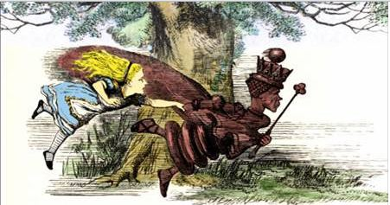
Sexual Reproduction: Parasite Avoidance
This is often known as the Red Queen hypothesis from Alice in Wonderland.
“Now, here, you see, it takes all the running you can do, to keep in the same place.”
This can be applied to the parasite and the host, that have to keep evolving but never reach their goal.
Trait 2
Parasite population
Trait 1

Slide 23
Sexual Reproduction: Parasite Avoidance
An alternative model is the ‘tangled bank’.
The host population is so diverse that the parasite can never truly adapt. The parasite cannot evolve to an “optimum” as it could encounter any variety of host in its life-span. Therefore the only solution is for the parasite to be a generalist, which reduces its potential.
Trait 2
Trait 1

Slide 24
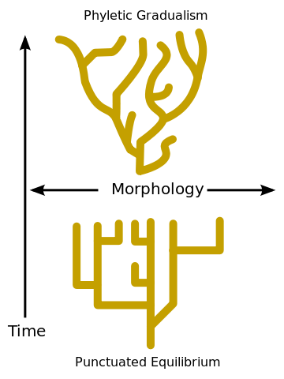
Speciation
Mathematical models for speciation are still in their infancy.
Two views of speciation exist:
One suggests that speciation is gradual with the common ancestor gradually splitting into two forms.
The other suggests that speciation is rapid (over evolutionary time-scales) with new species rapidly emerging to meet the changing demands of the environment.
It is likely that these sudden changes will generate a knock-on effect with many other species also adapting. ie changes in prey will require adaptation (or speciation) of the predator.

Slide 25
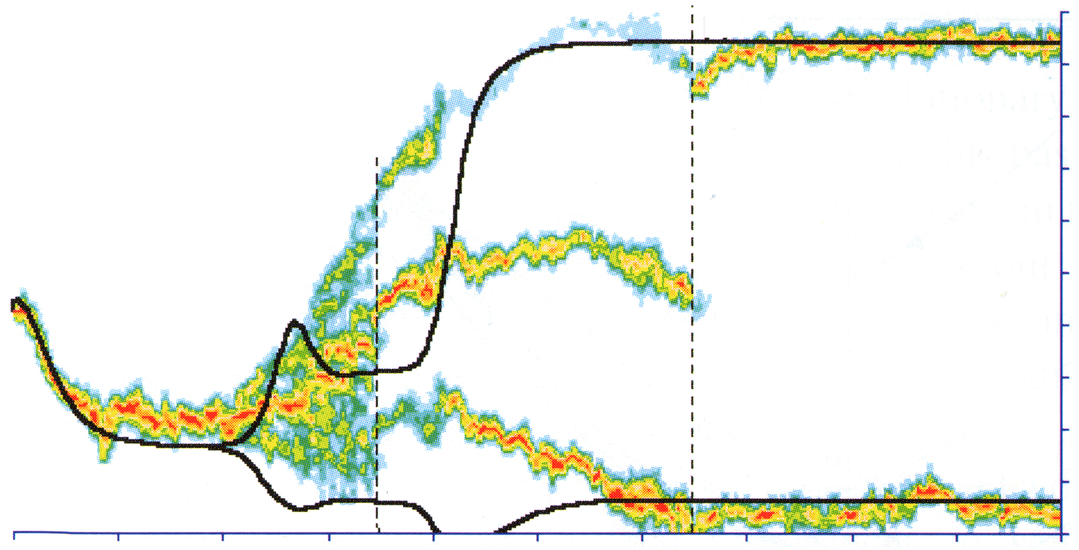
Speciation
Mathematical models for speciation are still in their infancy. But three elements are needed:
A Mechanism of Diversification. Both sexual reproduction and mutation could deliver this process
A Driver of Diversification. There needs to be some disadvantage for being average. This could be the bifurcation of the ESS into two, or it could be specialisation by parasites/pathogens/predators, or it could be intense competition.
Prevention of Recombination. Once two lineages start to diverge, there needs to be a mechanism to prevent recombination. Eventually this will be because the lineages have become different species (and so cannot produce viable offspring); but this needs to be included in the model.

Slide 26
Assignments
To be fair, I’m planning on releasing a list of possible papers to read and comment on later in the course – otherwise those doing an evolutionary project have longer than others.
However, if you’ve got a topic you’d like to write your project about, I’m happy to discuss this with you at any point…

