Slide 1
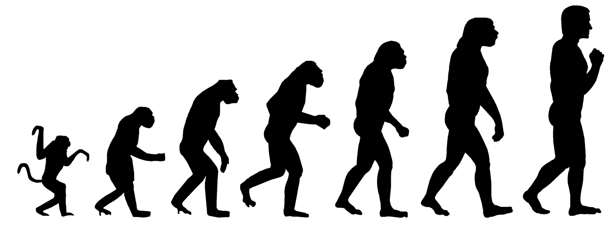
Evolution
Matt Keeling
MA 999: Topics in Mathematical Modelling
Tuesday 11-12
Thursday 2-4

Slide 2
Evolution
Lecture 1 Tuesday 6th 11-12
Introduction. Evidence for evolution. Fitness. Competition.
Lecture 2 Thursday 8th 2-3
Games & Genes.
Lecture 3 Thursday 8th 3-4
Computer-based practicals – example programs and questions.
Lecture 4 Tuesday 13th 11-12
Sex and Speciation. Sexual selection. Males as parasites. Why sexual reproduction? How do new species arise.
Lecture 5 Thursday 15th 2-3
Disease evolution. Why aren’t we all wiped out by killer infections?
Lecture 6 Thursday 15th 3-4
Computer-based practicals – example programs and questions.

Slide 3
Games and Genes
Genes.
Obvious, we all known now that our behaviour/fitness is largely governed by our genes. Here we’ll consider traits which are governed by two alleles at a single locus.
Games.
Two-player games provide a robust and easy mathematical framework to deal with the interaction (and competition) between individuals ‘playing’ different strategies. We’ll consider the mathematics and some classic examples.

Slide 4
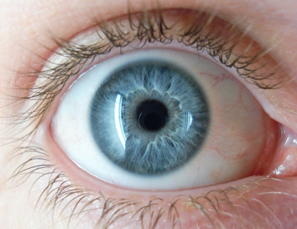
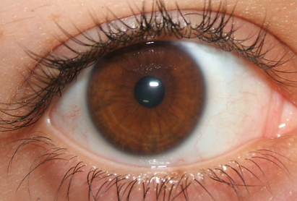
Genes
The classic example is eye colour. Blue and Brown eyes are (mostly) governed by a single locus. The colour of someone’s eyes is determined by the 2 genes they inherit from their parents.
In this example the Brown allele(Br) is dominant, and the Blue allele(bl) is recessive.
Father Br Br
Mother bl bl
Children Br bl
This example is easy – all children are Br bl and have brown eyes.
This shows the difference between genotype and phenotype.
(Please don’t ask about green eyes !! )

Slide 5
Genes
Other combinations.
Father Br bl
Mother bl bl
Children Br bl
Children Br bl
Children bl bl
Children bl bl
In this combination of Brown-eyed Father and Blue-eyed Mother there is a 50:50 ratio in the children.

Slide 6
Genes
Other combinations.
Father Br Br
Mother Br bl
Children Br Br
Children Br Br
Children Br bl
Children Br bl
This clearly illustrates the dominance of the Brown eye allele.

Slide 7
Genes
Finally the slightly odd one:
Father Br bl
Mother Br bl
Children Br Br
Children Br bl
Children Br bl
Children bl bl
So due to the fact that a Brown-eyed parent can be “hiding” a blue gene, it is possible for two Brown-eyed parents to have a Blue-eyed child.
Notice that there are always four ways of putting together the parents’ genes – even if often these lead to the same combination.

Slide 8
Genes
In general, we can use these caricatures to define population-level distributions.
If we assume that mating is random…
– that is blue-eyed individuals don’t preferentially partner other blue-eyed people
…then the Hardy-Weinberg Ratio says that
If X_{i} is the proportion of allele A_{i} in the population then the proportion of the population who are type A_{i} A_{j} is simply X_{i} X_{j}.
So if the proportion of blue-eye alleles in the population is b (and say b=0.2) then:
Br Br = (1-b)² = 0.64 Br bl = bl Br = b (1-b) = 0.16 bl bl = b² = 0.04
So only 4% of the population would have blue eyes.

Slide 9
Genes
Usually we don’t think of eye-colour as giving a substantial evolutionary advantage (although clearly there is some dependence on latitude). Let’s consider three different examples and their mathematical models:
Haemophilia. Recessive genetic disorder – individuals of type hh have problems producing blood clotting agents. (Note this gene is on the X chromosome, so affects males differently to females – but we’ll ignore this complication).
Harmful Mutation. What if there was a mutation that was dominant and gave a lower fitness?
Sickle-cell disease. Again this is recessive; type aa suffer from extreme anaemia, type Aa and AA do not – but type Aa has some level of protection against malaria.

Slide 10
Genes
Consider alleles of type A and a. The dynamics are described by:
Where the W terms are the reproductive fitnesses of each allele combination.
This allows us to experiment with different real-world examples.

Slide 11
Two-Player Games
A two-player game can be defined by a pay-off matrix; this gives the payoff an individual playing strategy s gains when playing against strategy s’.
Pay-off to strategy |  | s₁ | s₂
 | s₁ | A | B
 | s₂ | C | D
We then want to suppose that each strategy reproduces based on its pay-off matrix:

Slide 12
Two-Player Games
More generally, we would like to set P_{i} as the proportion of individuals playing strategy i, and set W to be the pay-off matrix.
In this case, the generalised model is:
If we then define the average fitness (per individual) within this populations to be:
then we find that if W is symmetric, then fitness always increases over time.

Slide 13
Two-Player Games: mixed strategies
Suppose now instead of playing pure strategies s₁ and s₂, the two players decide to randomly play a mixed strategy (ie playing s₁ a proportion p of the time). Setting P=(p 1-p)^{T} and Q=(q 1-q)^{T}, we have:
Pay-off to strategy |  | p | q
 | p | P^{T}WP | P^{T}WQ
 | q | Q^{T}WP | P^{T}WQ
The most famous example of this type of 2-player game is the hawk-dove model:
Where doves are peaceful and share a resource, whereas hawks are competitive and fight for a resource.
D
H
D
H

Slide 14
Two-Player Games: ESS
An Evolutionary Stable Strategy (or ESS) is a strategy (pure or mixed) that cannot be invaded. Mathematically this means that P is an ESS if:
That is, there is no other strategy (Q) that can invade a population of P’s.
Note:
An ESS does not optimise fitness, it is simply more fit than others in its own environment.
Multiple ESS can easily exist.
Often we can consider a local ESS, which is sufficient if mutation is short-range.
An ESS is strongly or continuously stable if it is also an evolutionary attractor:
That is, it can out-compete all other strategies.

Slide 15
Two-Player Games: Bishop-Canning theorem
If P is an ESS composed of pure strategies s₁, s₂, … s_{n}; then in an environment of all P the payoff to all pure strategies is equal to that of the ESS.
The proof of this comes from realising that P is a linear combination of the pure strategies; so if the equality does not hold, then some strategy will perform better than P, so it cannot be an ESS.

Slide 16
Invasion Plots
These provide an ideal means of rapidly visualising the evolutionary behaviour.
Resident strategy wins, invader has negative growth rate.
Invading Strategy
Invading strategy successful, invader has positive growth rate.
Resident Strategy
This form of invasion plot (or Pairwise invasibility plot) is associated with a strongly stable ESS. At the cross-over point, nothing else can invade (so its an ESS); also the strategy is able to invade any other strategy.

