Slide 1
Variational Inference
What it is
Intuition
Derivation
Applications

Slide 2
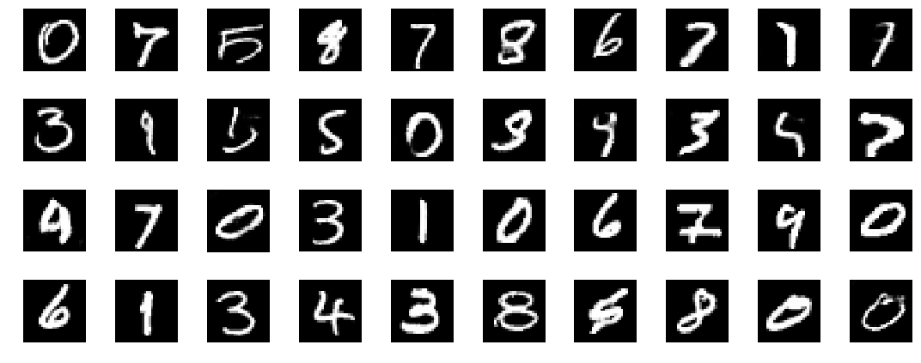
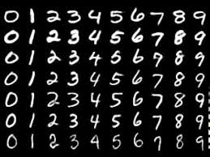
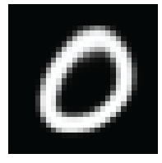
Variational Inference
What it is
VAEs are generative models
Like GANs
Unsupervised learning

Slide 3
Variational Inference
Intuition
Construct a probability distribution that generates samples that are similar to our dataset
Problem: The space in which we want to construct this distribution is often high-dimensional
e.g. For these digit images are 28x28 -> 784 dimensions
Solution: Assume there is a lower-dimensional latent space we can sample from instead

Slide 4
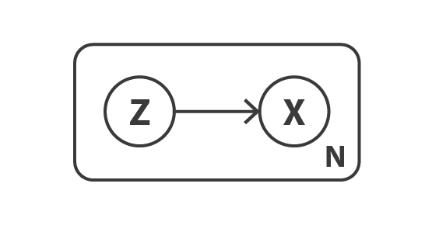
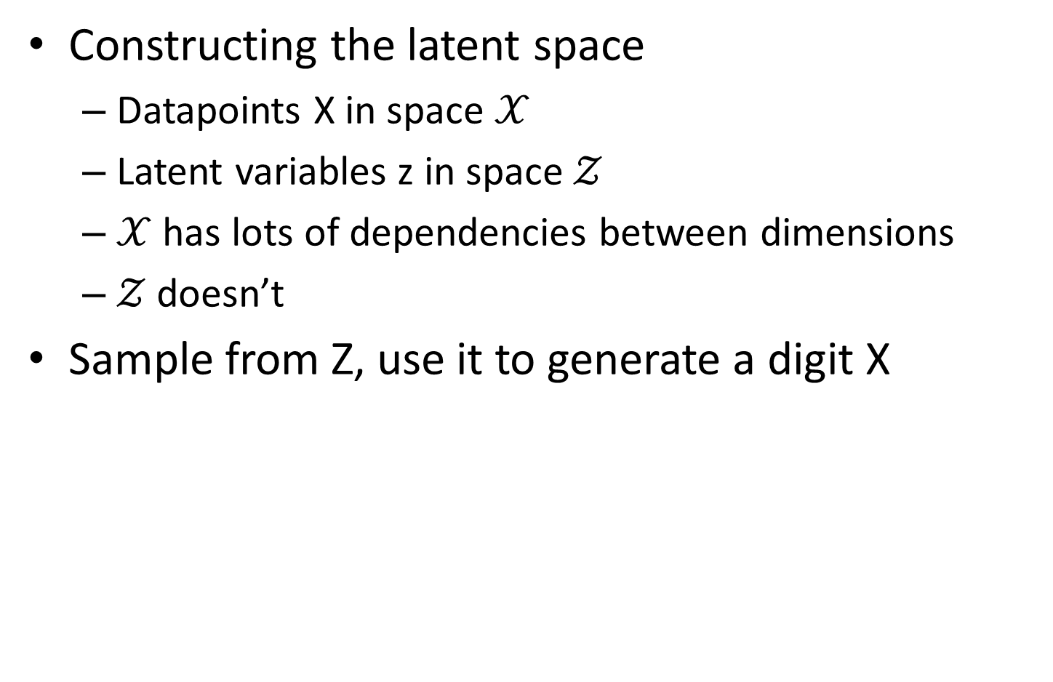
Variational Inference
Constructing the latent space
Datapoints X in space $𝒳$
Latent variables z in space $𝒵$
$𝒳$ has lots of dependencies between dimensions
$𝒵$ doesn’t
Sample from Z, use it to generate a digit X

Slide 5
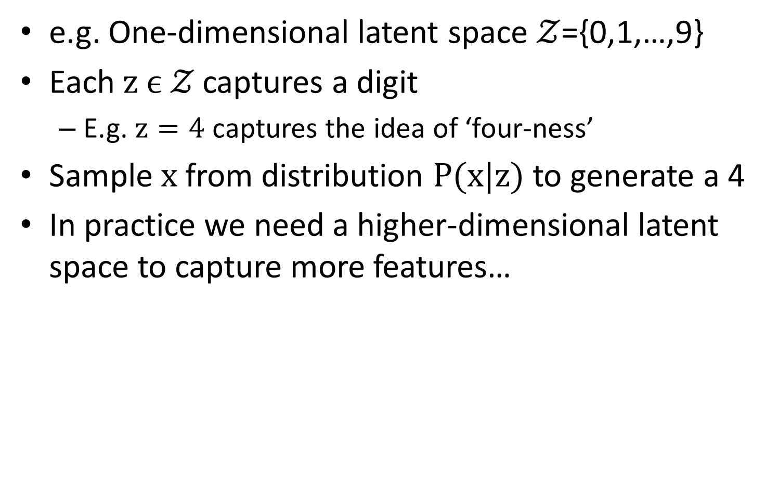
Variational Inference
e.g. One-dimensional latent space $𝒵$={0,1,…,9}
Each $z ϵ 𝒵$ captures a digit
E.g. $z=4$ captures the idea of ‘four-ness’
Sample $x$ from distribution $P(x|z)$ to generate a 4
In practice we need a higher-dimensional latent space to capture more features…

Slide 6
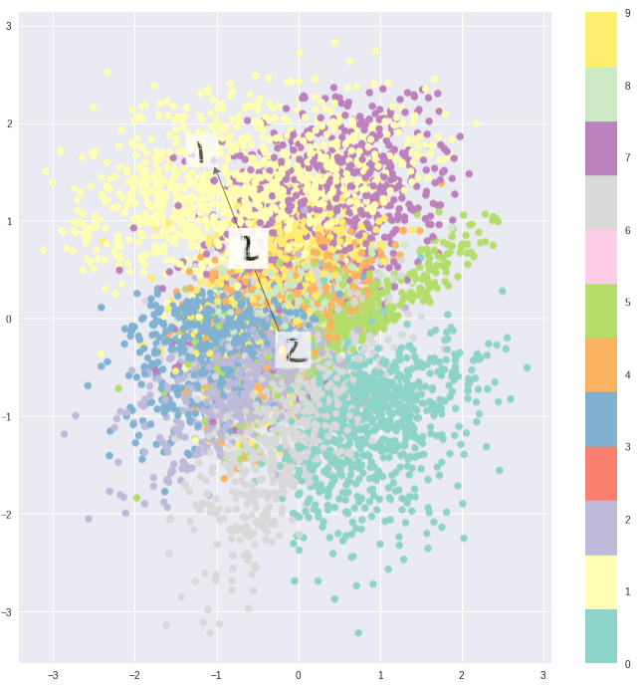
Variational Inference
In practice:

Slide 7
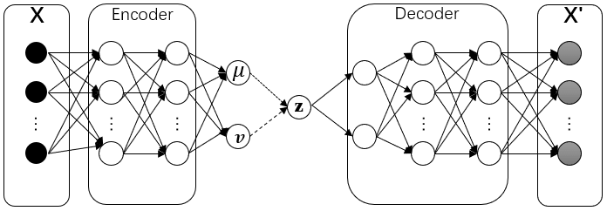

Variational Inference
A clever trick:
Don’t actually need to look for feature space!
(At least not directly)
Feature space
$$z\sim N(0,I)$$
Feature space

Slide 8
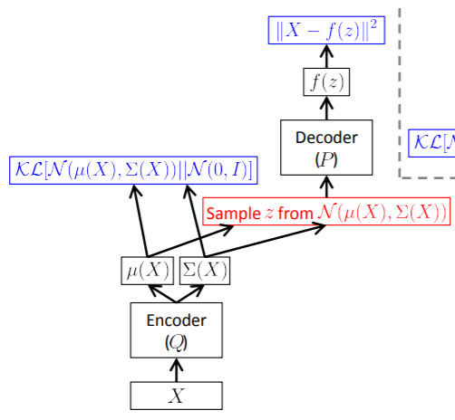
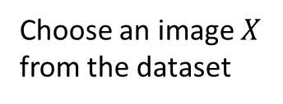
Variational Inference
Choose an image $X$
from the dataset

Slide 9

Variational Inference
$$Q_{θ}(z|X)$$
Use this (rather than $P(z)$ ) because for most $z$, $P\left(X | z\right)=0$
But we still want it to be close to $𝒩(0,1)$
Choose an image $X$
from the dataset

Slide 10
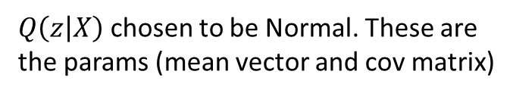
Variational Inference
$Q\left(z | X\right)$ chosen to be Normal. These are the params (mean vector and cov matrix)
$$Q_{θ}(z|X)$$
Use this (rather than $P(z)$ ) because for most $z$, $P\left(X | z\right)=0$
But we still want it to be close to $𝒩(0,1)$
Choose an image $X$
from the dataset

Slide 11
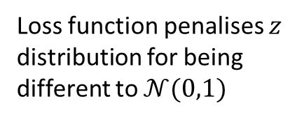
Variational Inference
Loss function penalises $z$ distribution for being different to $𝒩(0,1)$
$Q\left(z | X\right)$ chosen to be Normal. These are the params (mean vector and cov matrix)
$$Q_{θ}(z|X)$$
Use this (rather than $P(z)$ ) because for most $z$, $P\left(X | z\right)=0$
But we still want it to be close to $𝒩(0,1)$
Choose an image $X$
from the dataset

Slide 12

Variational Inference
$$P_{φ}(X|z)$$
Loss function penalises $z$ distribution for being different to $𝒩(0,1)$
$Q\left(z | X\right)$ chosen to be Normal. These are the params (mean vector and cov matrix)
$$Q_{θ}(z|X)$$
Use this (rather than $P(z)$ ) because for most $z$, $P\left(X | z\right)=0$
But we still want it to be close to $𝒩(0,1)$
Choose an image $X$
from the dataset

Slide 13
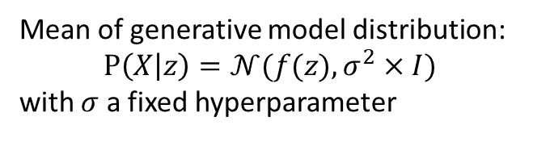
Variational Inference
Mean of generative model distribution:
$$P\left(X | z\right)=𝒩(f(z),σ^{2}×I)$$
with $σ$ a fixed hyperparameter
$$P_{φ}(X|z)$$
Loss function penalises $z$ distribution for being different to $𝒩(0,1)$
$Q\left(z | X\right)$ chosen to be Normal. These are the params (mean vector and cov matrix)
$$Q_{θ}(z|X)$$
Use this (rather than $P(z)$ ) because for most $z$, $P\left(X | z\right)=0$
But we still want it to be close to $𝒩(0,1)$
Choose an image $X$
from the dataset

Slide 14
Variational Inference
Loss function (reason for using MSE explained later)
Mean of generative model distribution:
$$P\left(X | z\right)=𝒩(f(z),σ^{2}×I)$$
with $σ$ a fixed hyperparameter
$$P_{φ}(X|z)$$
Loss function penalises $z$ distribution for being different to $𝒩(0,1)$
$Q\left(z | X\right)$ chosen to be Normal. These are the params (mean vector and cov matrix)
$$Q_{θ}(z|X)$$
Use this (rather than $P(z)$ ) because for most $z$, $P\left(X | z\right)=0$
But we still want it to be close to $𝒩(0,1)$
Choose an image $X$
from the dataset

Slide 15
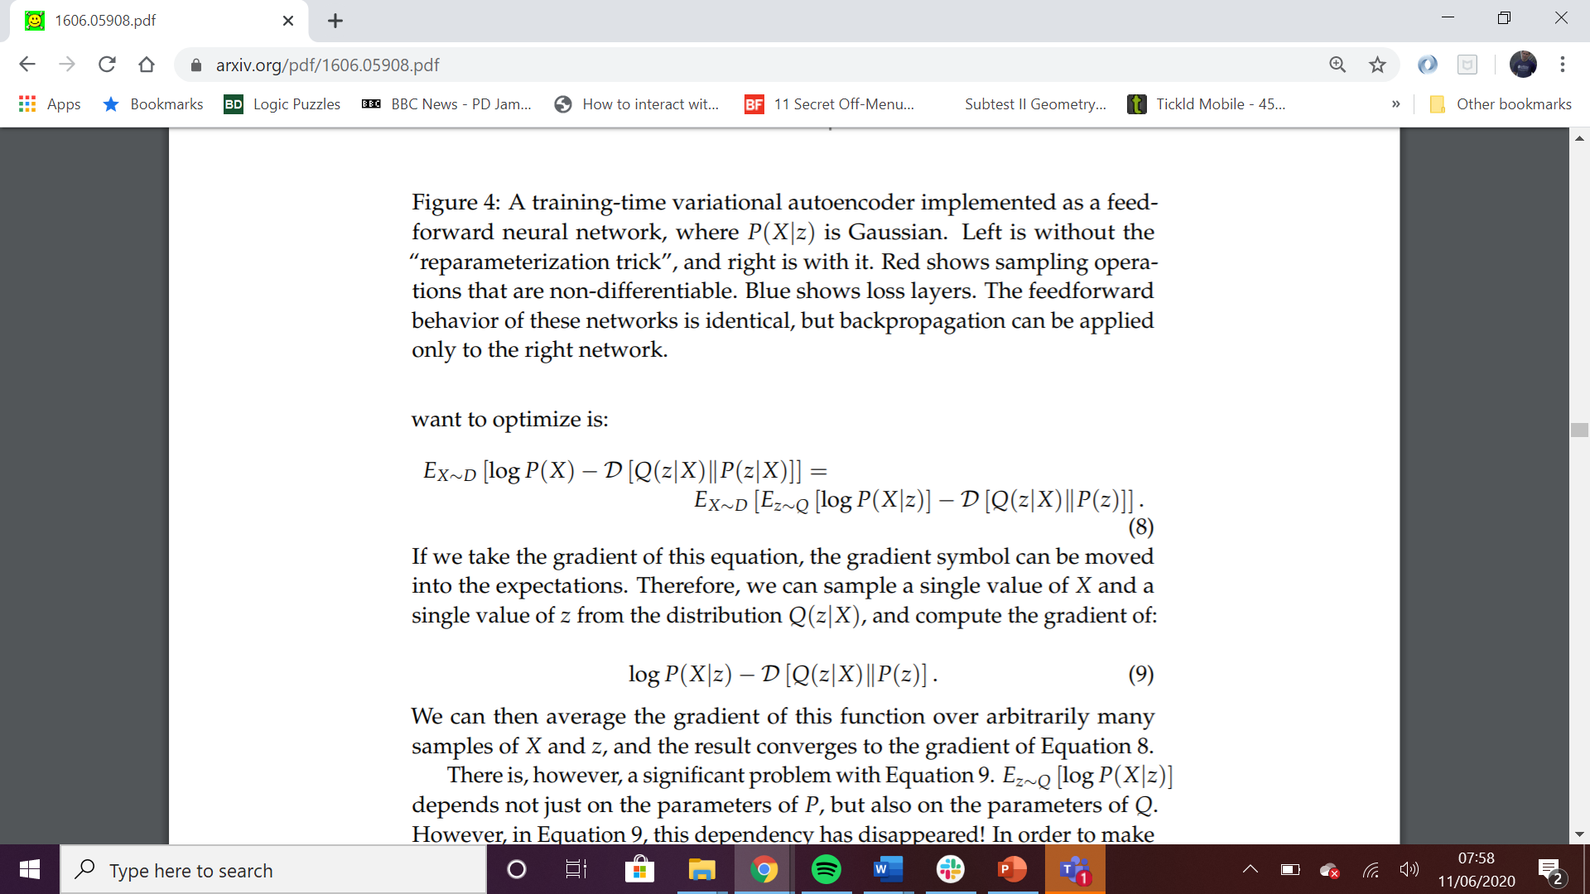

Variational Inference
The loss function
$$≥$$
ELBO (Evidence Lower Bound) / VLB (Variational Lower Bound)

Slide 16
Variational Inference
The loss function
ELBO/VLB
The other bit
$$≥$$
ELBO (Evidence Lower Bound) / VLB (Variational Lower Bound)
‘Reconstruction’ loss
‘Complexity’ loss

Slide 17
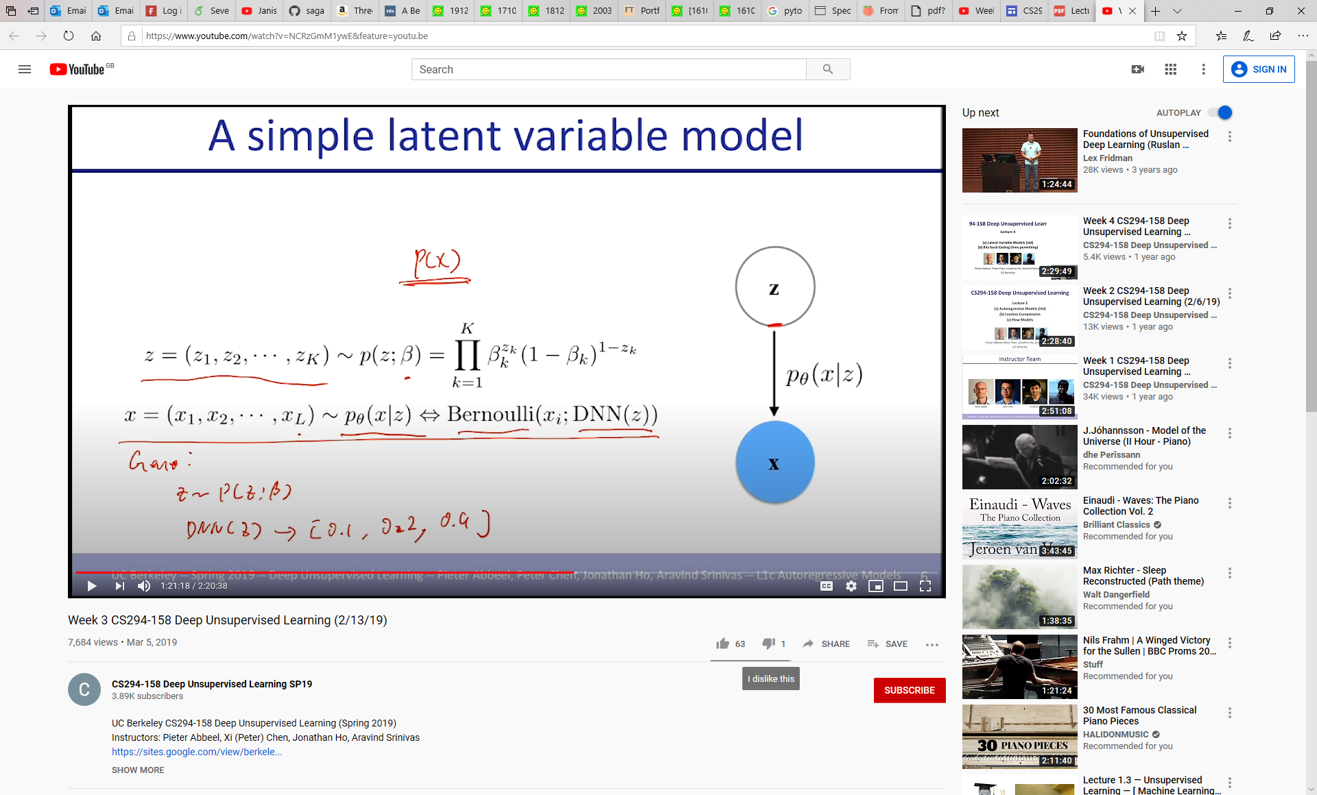
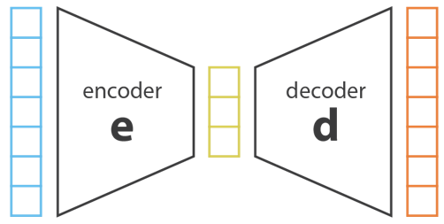
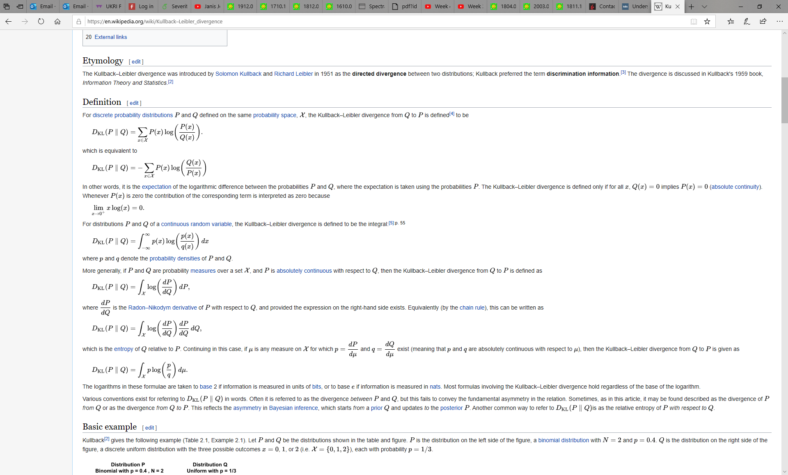
Inference
Reconstruction
q_{φ}(z|x)
Input Image
Reconstructed image
Bottleneck
Latent Space
MSE Pixel Loss
KL Divergence

Slide 18
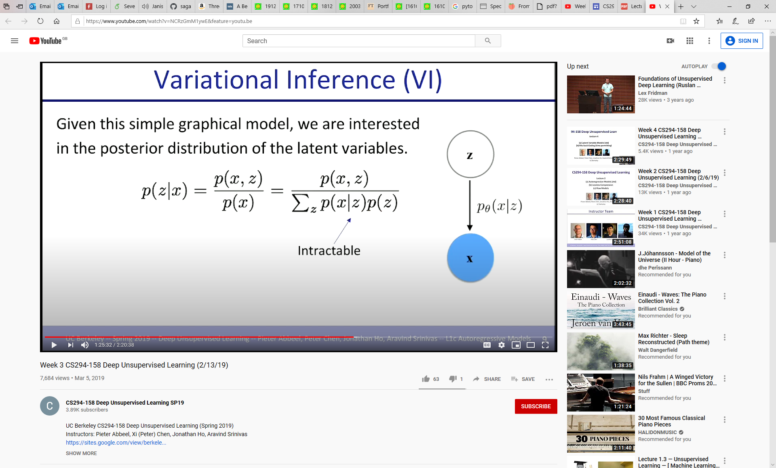
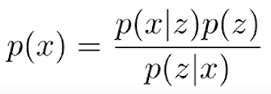
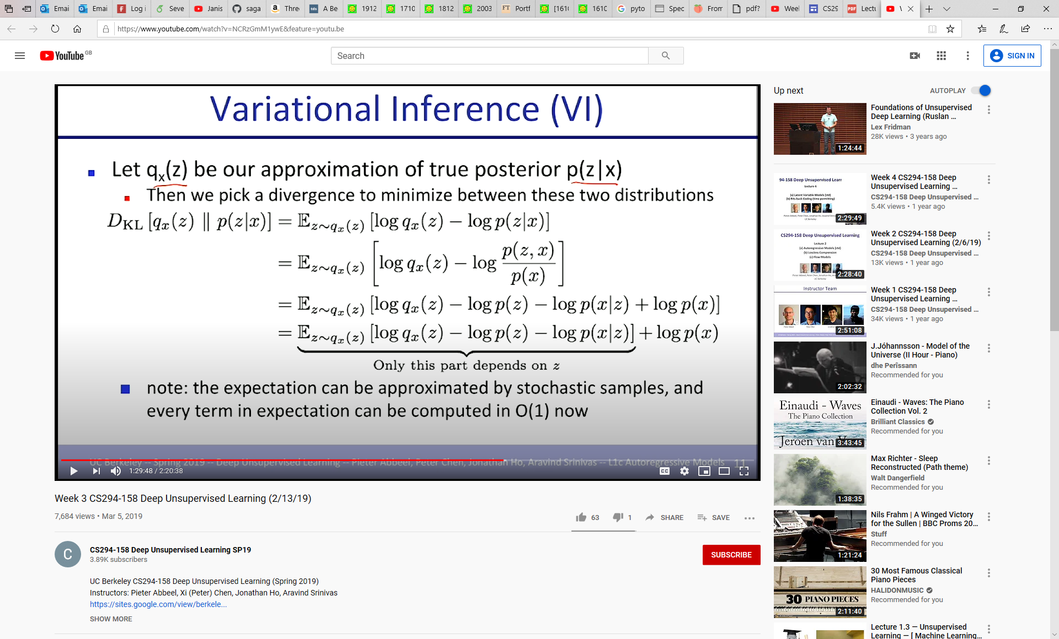
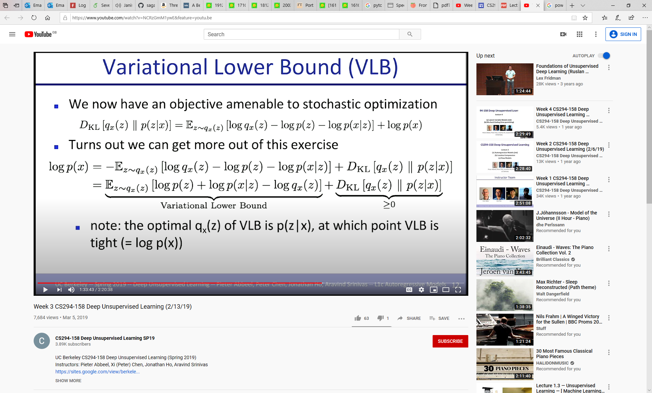
Variational Inference (material from UC Berkeley CS294-158 Deep Unsupervised Learning)
We have fast access to p(z) and p(x|z) and want to calculate p(x)
But!
q_{φ}(z|x)
So approximate p(x|z) with q_{x}(z):

Slide 19
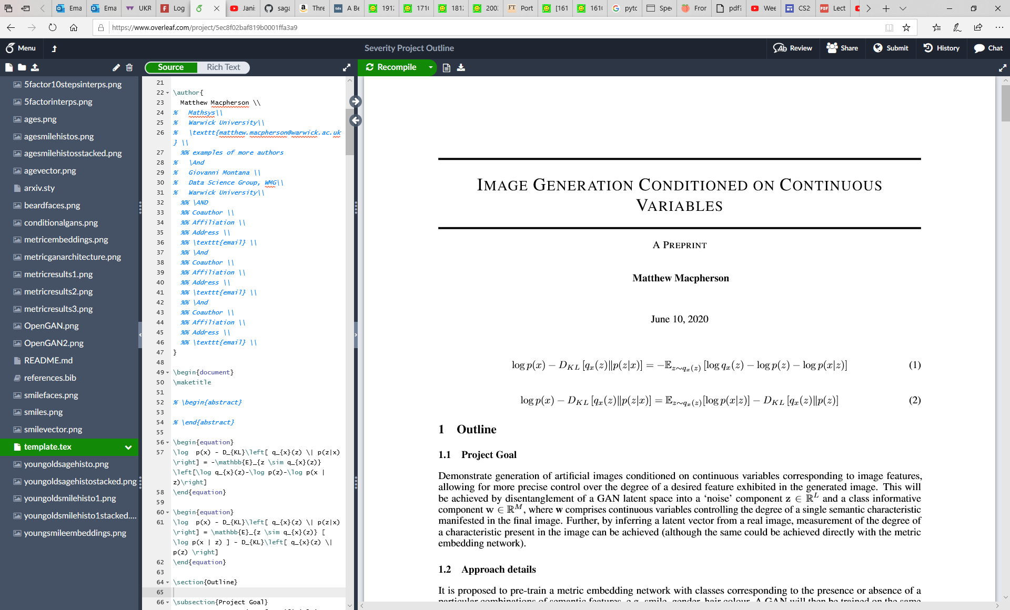
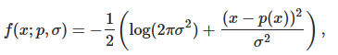
So…
Giving us the VAE objective. P(z) is usually taken as a unit Gaussian, regularizing the shape of the latent distribution (and computationally easy to work with).
NB in practice mean squared error reconstruction loss is used for training, since the log-likelihood with a Gaussian prior boils down to the squared differences of x and mu:

Slide 20
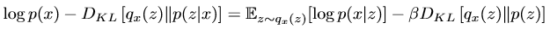
beta-VAE: Learning Basic Visual Concepts with a Constrained Variational Framework;
Higgins et al 2017
Understanding disentangling in β-VAE; Burgess, Higgins et al 2018
Beta-VAE aims to provide unsupervised discovery of meaningful semantic features in the dataset into disentangled representations in the latent space.
Tweak to the VAE objective function – Beta multiple on the KL Divergence.
Forces the latent distribution to be closer to a unit Gaussian, and so have a lower information capacity.
The authors posit that this leads to disentanglement of the latent space by forcing the highest information content semantic features into orthogonal channels.
Image reconstruction quality suffers since there is less information capacity in the bottleneck.

Slide 21
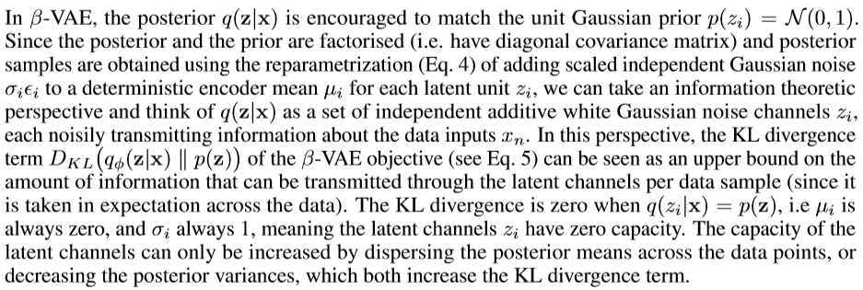
Burgess et al expound on the intuition behind this idea, taking an information theoretic approach relating the KL-divergence to the information capacity of the bottleneck.
Putting high-information semantics into orthogonal channels allows close packing of channel means which minimises KL-divergence with the unit Gaussian.
They propose starting with a very high beta and gradually lowering during training to ‘seed’ the latent space with separated features per channel before increasing the representation capacity, improving image quality.
The paper is mostly text, and well worth a read.

