Slide 1


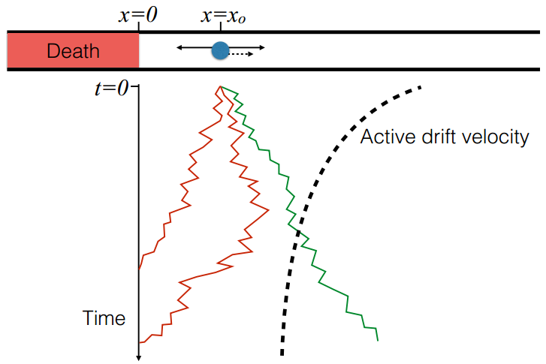
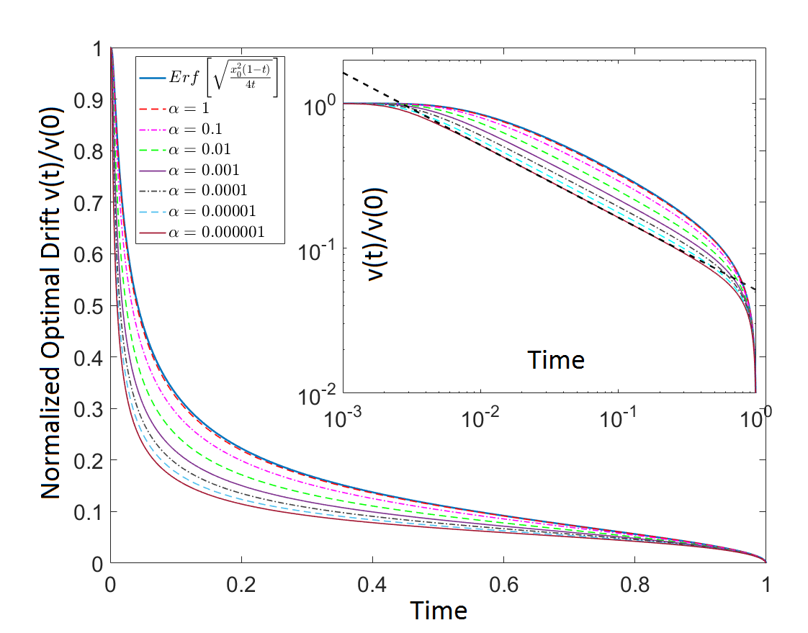
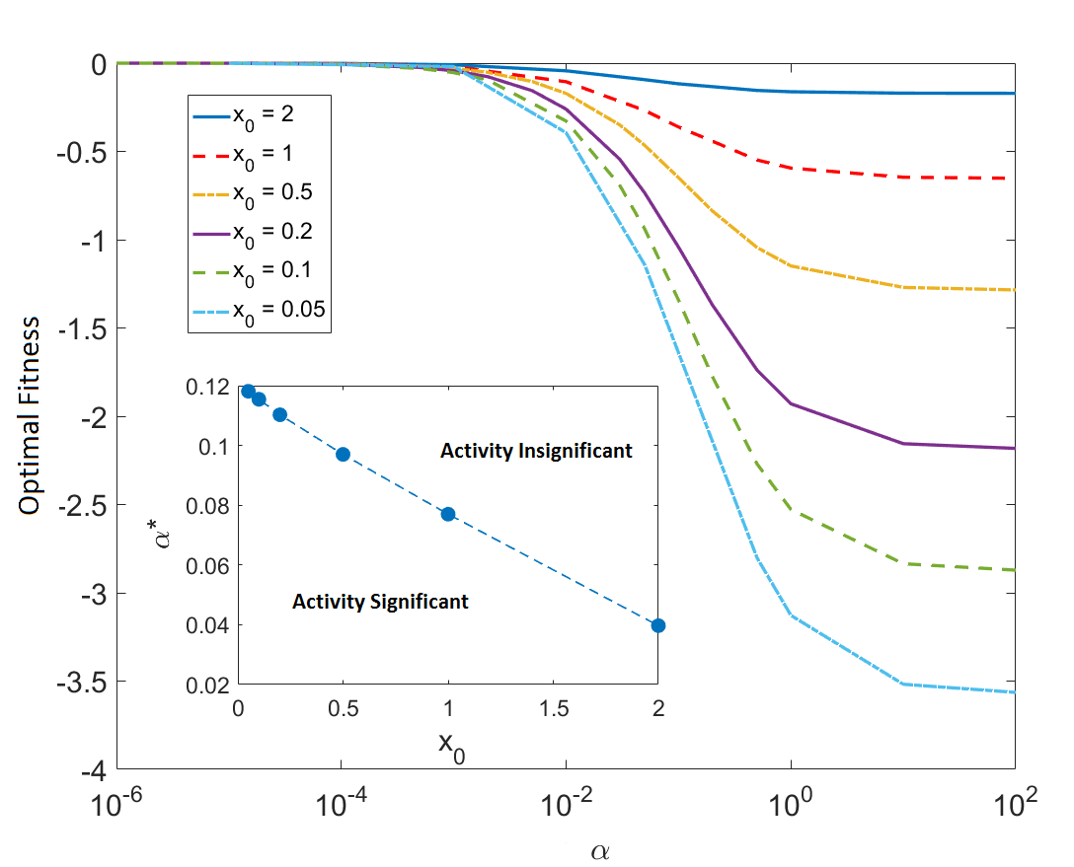
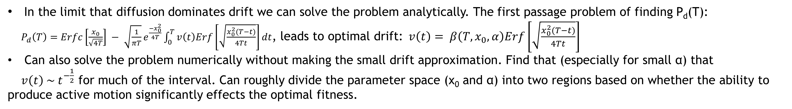
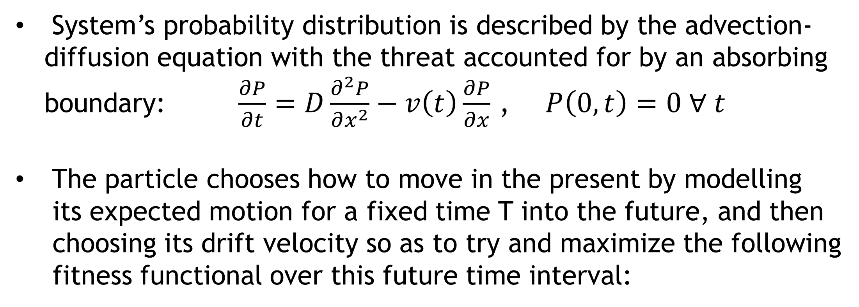
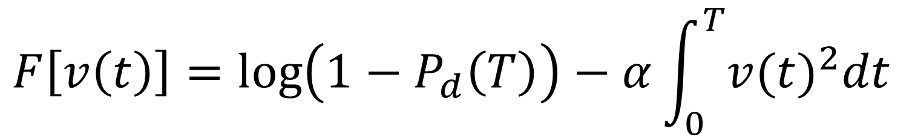
Threat Avoidance By Active Particles
Henry Charlesworth¹, Alex Rautu², George Rowlands², Matthew Turner^{1,2}
¹ Centre for Complexity Science, University of Warwick, UK
² Department of Physics, University of Warwick, UK
Contact: H.Charlesworth@warwick.ac.uk
Motivation
Description of System
In many situations it may be “intelligent” to move so as to maximize the number of possible states that can be accessed in the future.
Philosophy behind this is that in doing so an agent remains maximally in control of its environment. The idea has been formalized in the language of information theory with the concept of “empowerment”^{[1]} and thermodynamically with the concept of “causal path entropy”^{[2]}.
Very little analytical progress has been made,
and even numerically it is difficult to study
anything other than very simple problems,
particularly when the set of actions and state space is continuous.
So our motivation was to study a simple decision
making process loosely based on this philosophy
but for which analytic progress could be made.
An “Active” particle, i.e. a particle which undergoes
diffusion but can also exert control over its drift velocity v(t) chooses how to move so as to avoid a stationary threat in a way that balances the cost of using energy and the cost of death.
System’s probability distribution is described by the advection-
diffusion equation with the threat accounted for by an absorbing
boundary: $\frac{∂P}{∂t}=D\frac{∂^{2}P}{∂x^{2}}−v\left(t\right)\frac{∂P}{∂x}$ , $P\left(0,t\right)=0 ∀ t$
The particle chooses how to move in the present by modelling
its expected motion for a fixed time T into the future, and then
choosing its drift velocity so as to try and maximize the following
fitness functional over this future time interval:
$$F\left[v\left(t\right)\right]=\log\left(1−P_{d}\left(T\right)\right)−α\int_{0}^{T}{{v(t)}^{2}dt}$$
Probability of dying
“Fitness Parameter”
Energy cost
We argue that maximizing this “fitness functional” is a good
approximation of the particle maximizing its future path entropy.
It is also a sensible choice as it makes the particle sensitive to
both dying and its total energy usage, and imposes a particularly
strong cost to the entire ensemble going extinct.
Results
In the limit that diffusion dominates drift we can solve the problem analytically. The first passage problem of finding P_{d}(T):
$P_{d}\left(T\right)=Erfc\left[\frac{x_{0}}{\sqrt{4T}}\right] − \sqrt{\frac{1}{πT}}e^{\frac{−x_{0}^{2}}{4T}}\int_{0}^{T}{v\left(t\right)Erf\left[\sqrt{\frac{x_{0}^{2}(T−t)}{4Tt}}\right]dt}$, leads to optimal drift:$v\left(t\right)= β\left(T,x_{0},α\right)Erf\left[\sqrt{\frac{x_{0}^{2}(T−t)}{4Tt}}\right]$
Can also solve the problem numerically without making the small drift approximation. Find that (especially for small α) that
$v\left(t\right) \sim t^{−\frac{1}{2}}$ for much of the interval. Can roughly divide the parameter space (x₀ and α) into two regions based on whether the ability to produce active motion significantly effects the optimal fitness.
References
Conclusions
[1] “Guided Self-Organization: Inception,
M. Propenko (Springer, 2014)
[2] “Causal Entropic Forces”, A.D Wissner-Gross
and C.E. Freer, PRL 110, 168702 (2013)
Studied a very basic, continuous “intelligent” decision making process, based on the idea of moving so as to maximize future freedom to move.
In doing so, obtained a solution to the first-passage problem with time-dependent drift (only valid in the limit that diffusion dominates over drift).

