Slide 1
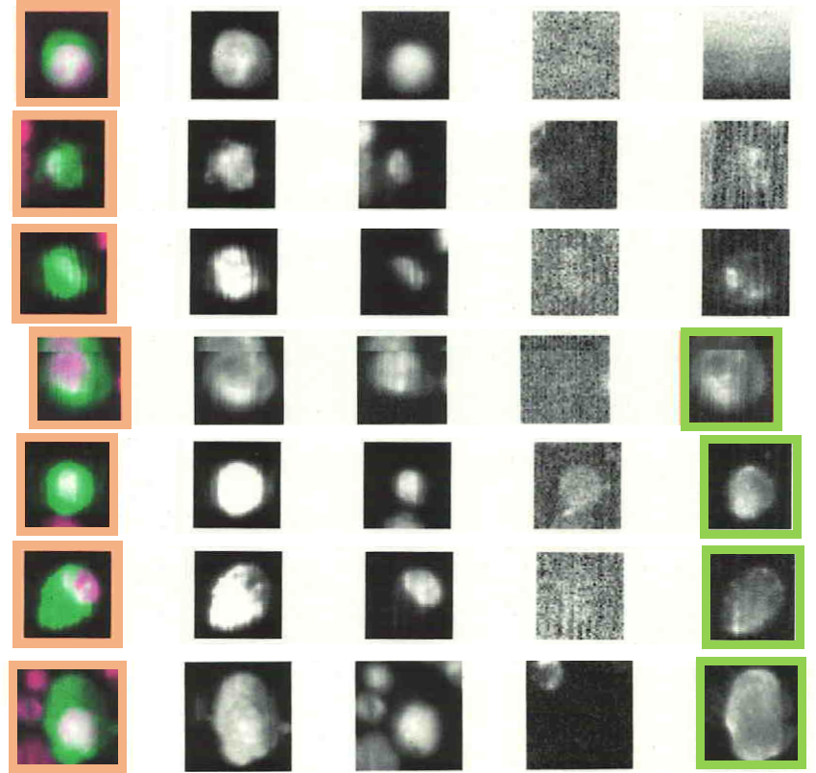
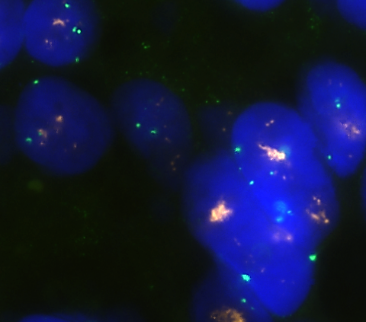
KER/DAPI KER DAPI CD45 HER2
A
B
0
1+
2+
C
3+
3+
3+
D
3+

