Slide 1

The ETATMBA Project in Malawi: Project overview and challenges faced developing a ‘Trial’ to evaluate the project
David Ellard
Senior Research Fellow

Slide 2
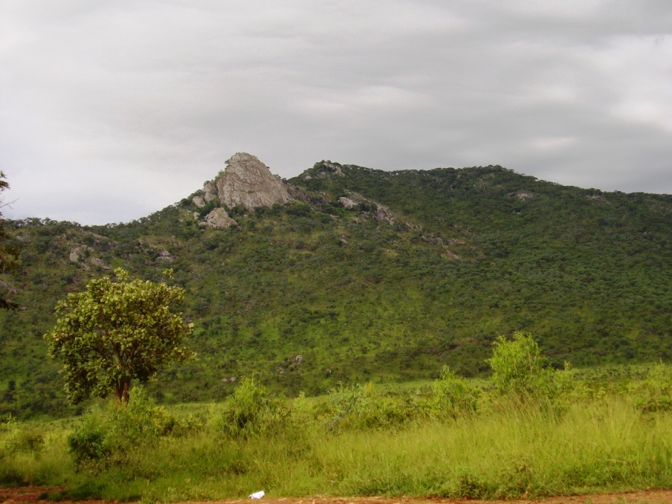
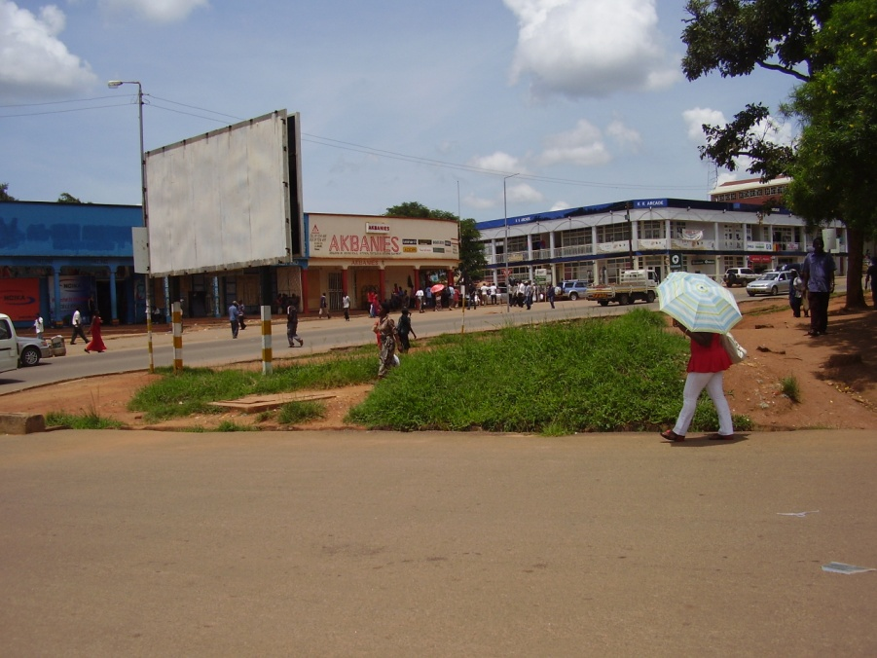
Overview
“Malawi, where is Malawi”?
Some facts about Malawi
    General
    Healthcare
Introduction to ETATMBA
  Project aims
Research project
    Aims & objectives
    Methods
    Challenges!
    The future

Slide 3
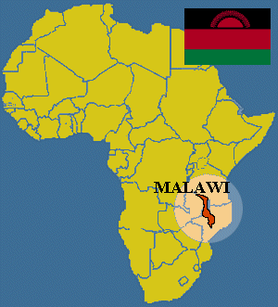
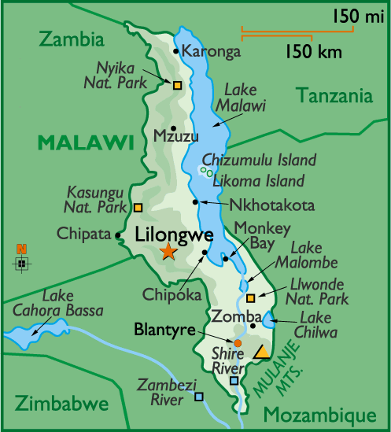
“The Warm Heart of Africa”

Slide 4
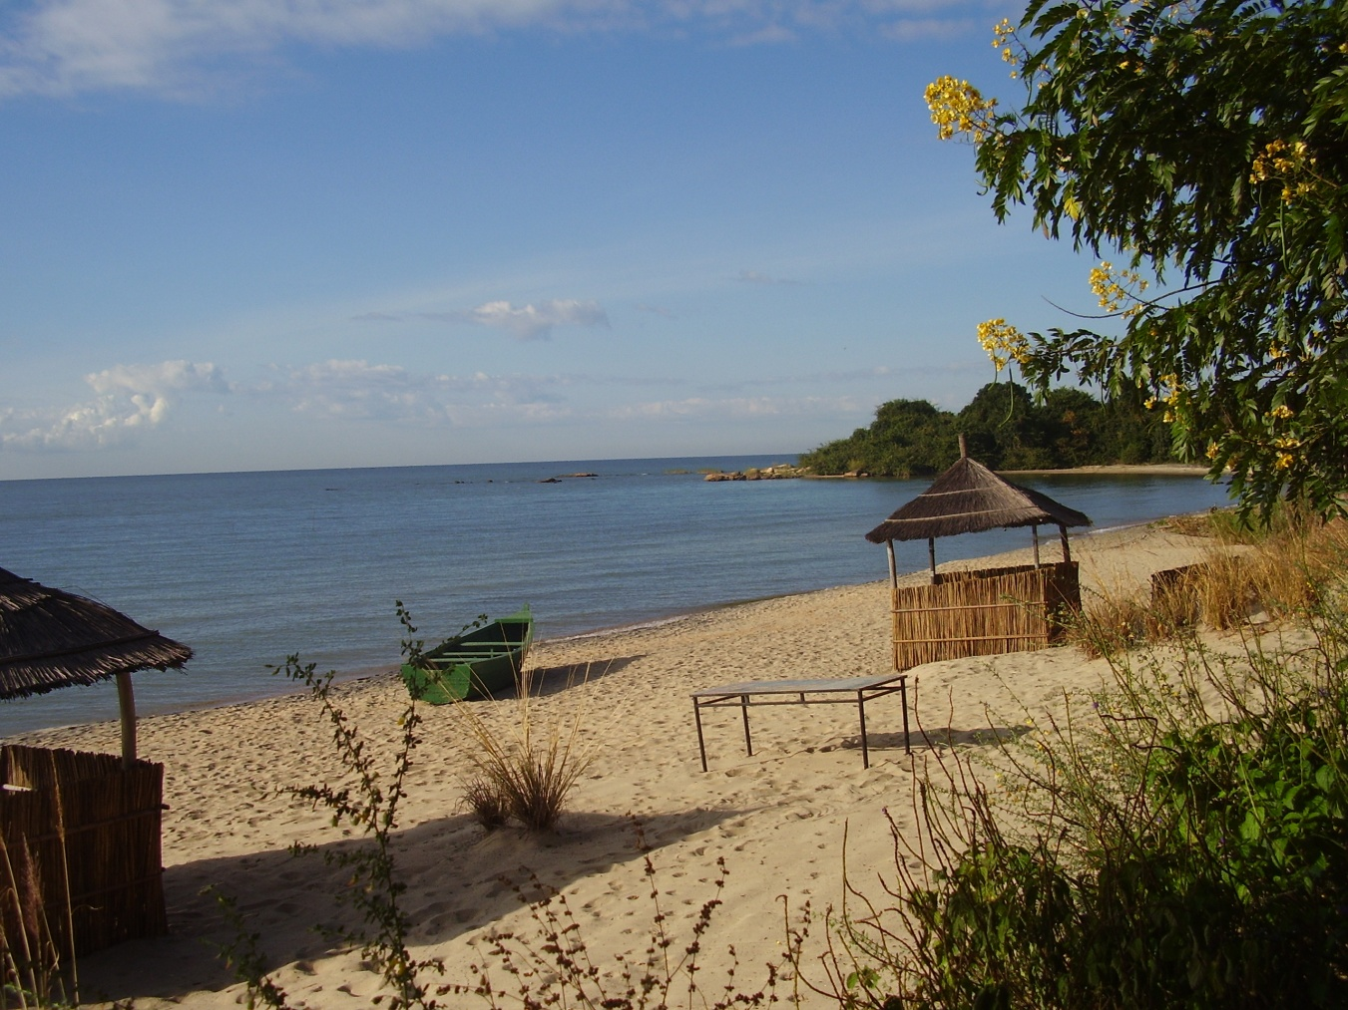

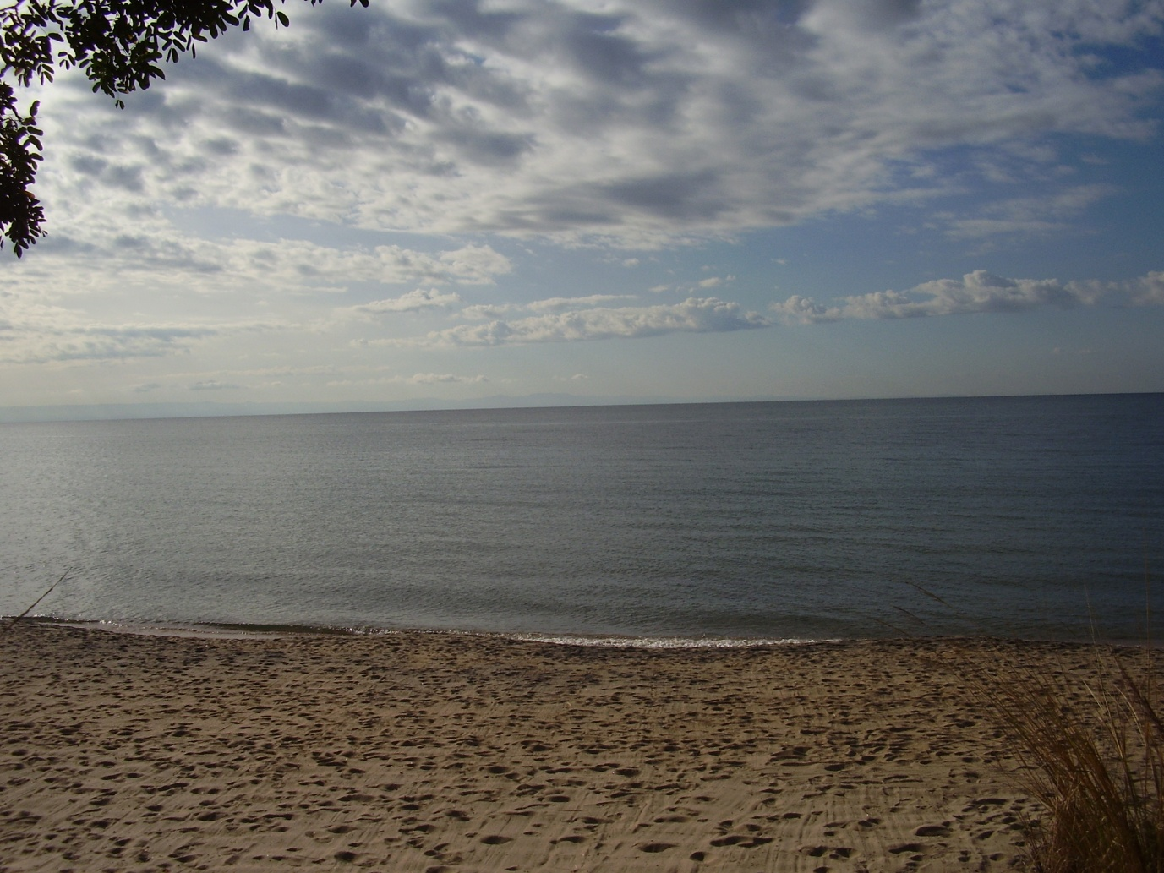


Slide 5
Facts about Malawi (General)
Malawi is 45.747² miles (118.483² km) in size
  England is 50.346² miles (130.395² km)
Malawi (formally Nyasaland)Was a British Colony until 1964
  Lake Malawi (Lake Nyasa) 3rd largest in Africa 8th in world
  Main language is English (and they drive on the left!)
Population is currently about 15 Million
  Predicted to rise to 45 Million by 2050
80% are Christian and about 13% Muslim
Education: Entitled to 5 years primary education (not compulsory)
  Uptake is low but improving
A resource poor country (some tobacco, sugar, tea etc…)
  Agriculture, Subsistence farming (Maize being main crop)
Notes:
Approx 51 million in England
3rd largest lake in Africa, 8th in the world 365 miles long 52 wide (calendar lake)
David Livingstones name for the lake was Lake Nyasa not realising that Nyasa meant ‘lake’ in the local language so ‘Lake Lake’

Slide 6
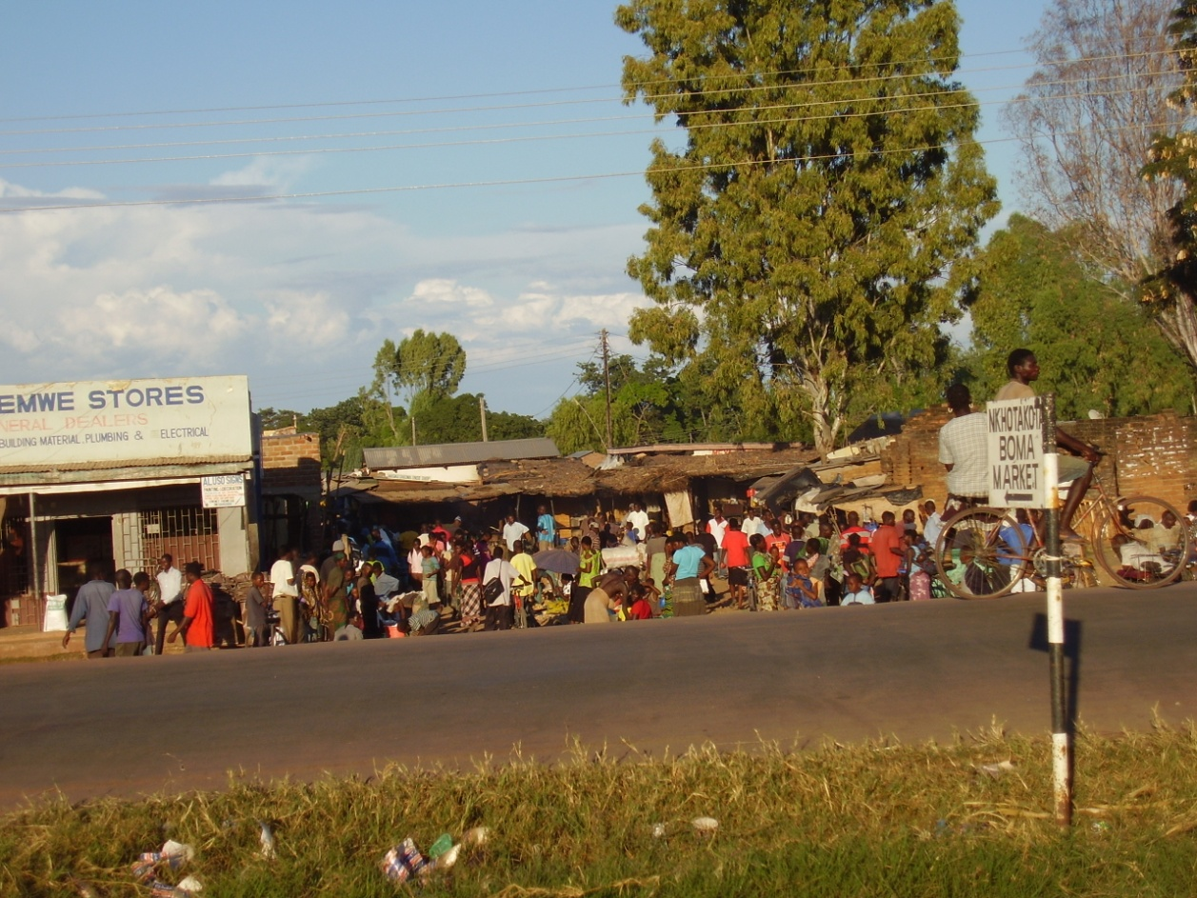
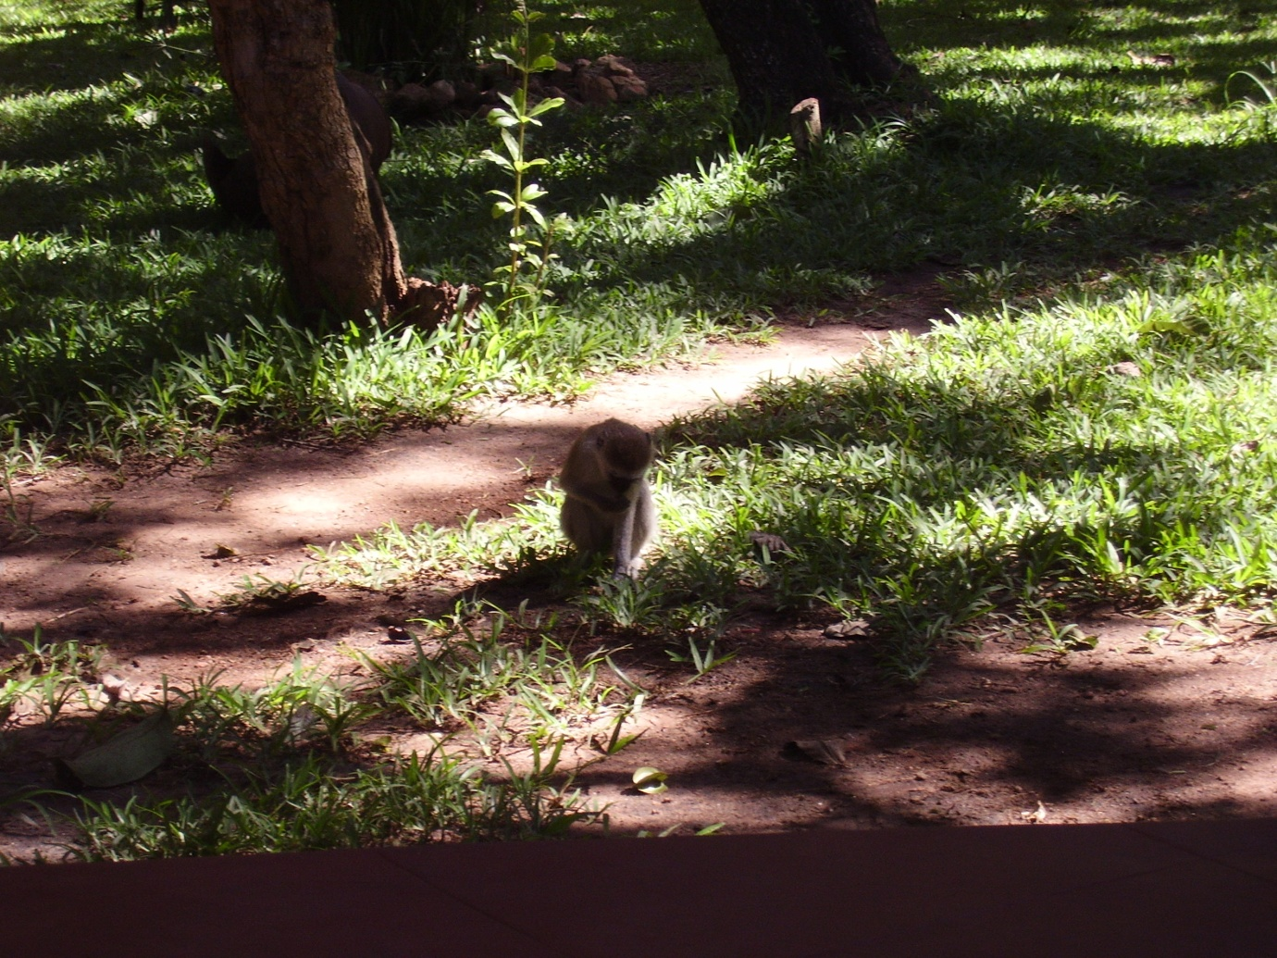
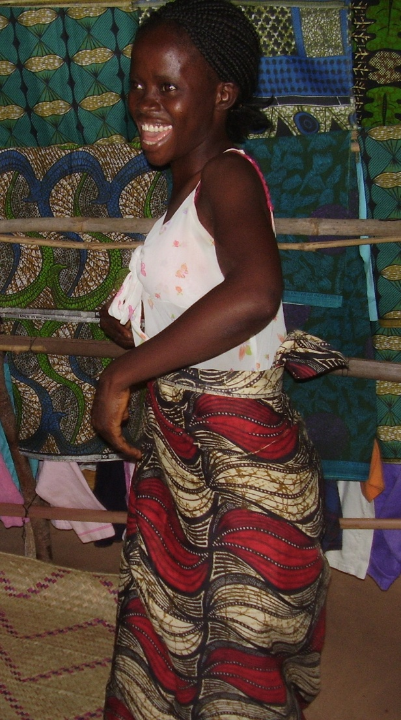
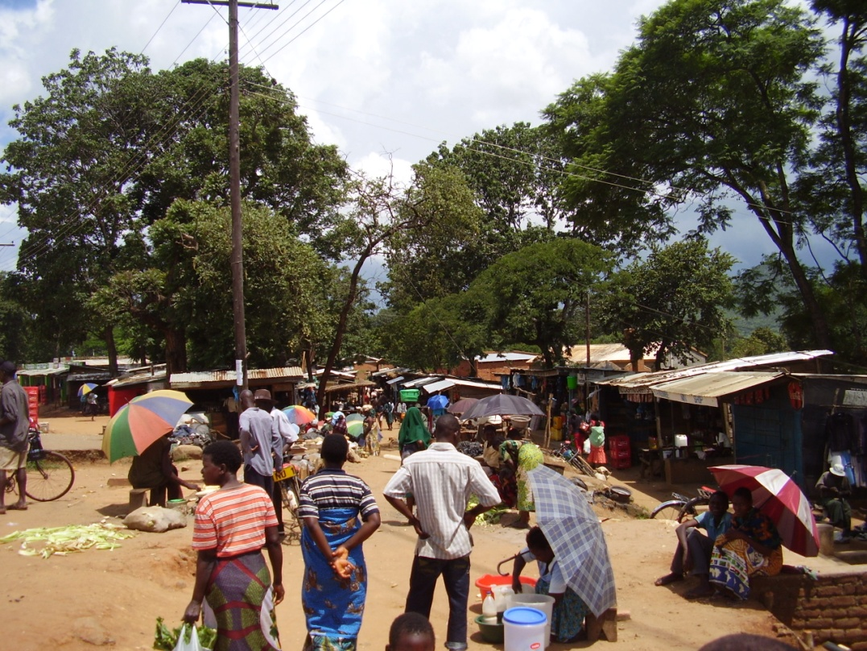
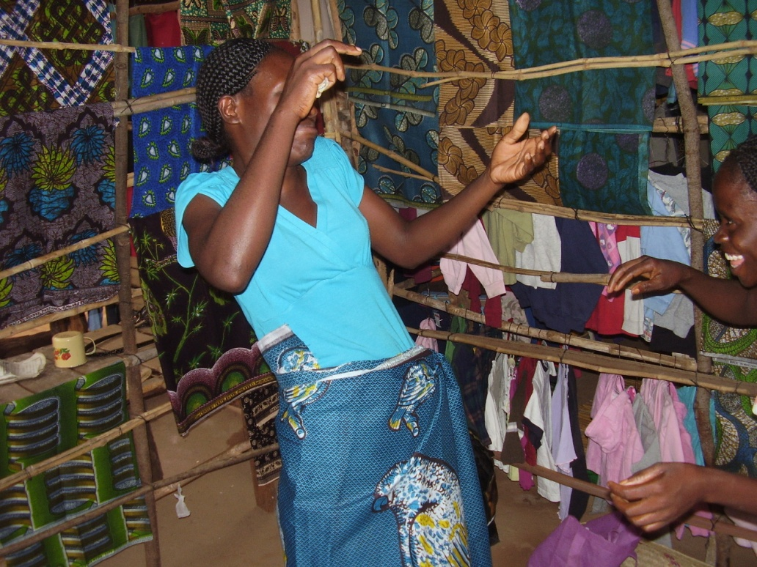

Slide 7
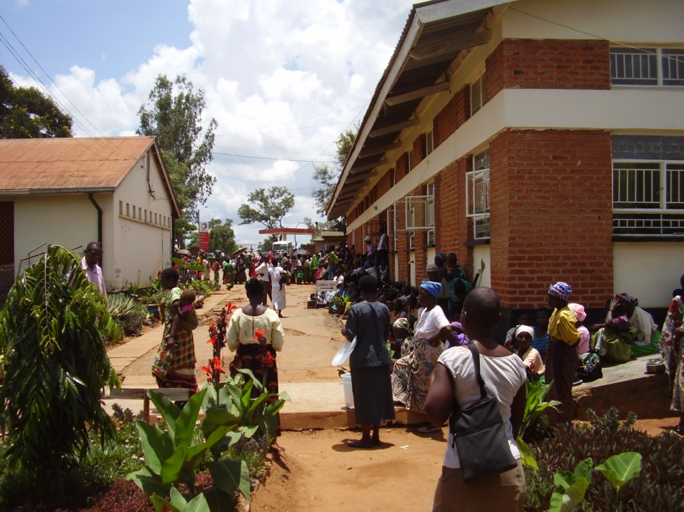
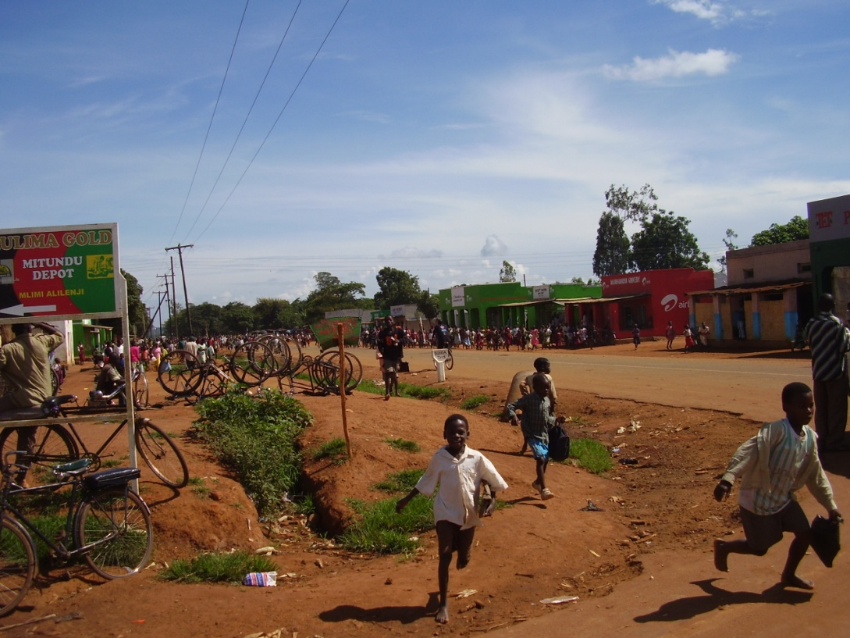
Main Health Issues
Life expectancy at birth:
Total population: 51.7 years
Male: 50.93 years
Female: 52.48 years
HIV/AIDS
  WHO suggest 13% of population but data from 2007 (Just under 1 Million people living with HIV/AIDS)
Malaria
Maternal and Neonatal Mortality
(2011 estimates WHO)

Slide 8



Healthcare Spend Per Capita (USD)
USA, $7,410*
UK, $3,399*
Malawi, $50*
*Source: WHO (Global Health Observatory, 2009)

Slide 9






ETATMBA: (Enhancing Training and Appropriate Technologies for Mothers and Babies in Africa)
ETATMBA is a European Commission FP7 funded project being delivered in Tanzania and Malawi
Partners:
The University of Warwick (UK)
Karolinska Institute (Sweden)
Ifakara Health Institute, Tanzania
The University of Malawi
The Ministry of Health (Malawi)
GE Healthcare (UK)
My Focus is on the work in Malawi

Slide 10
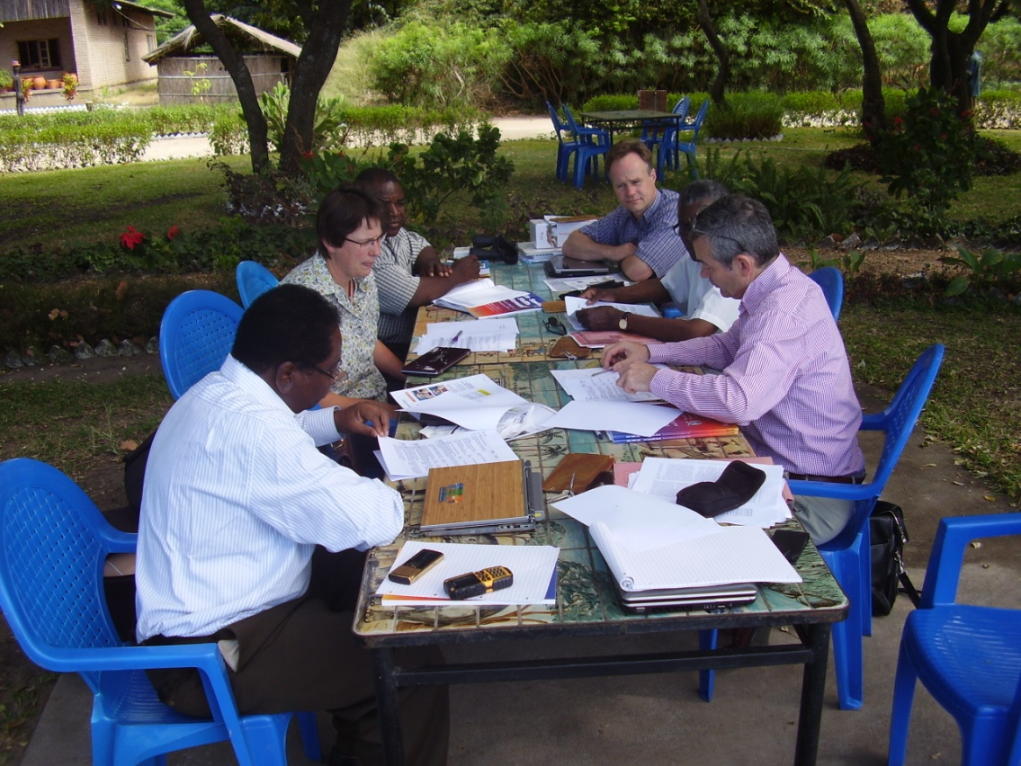
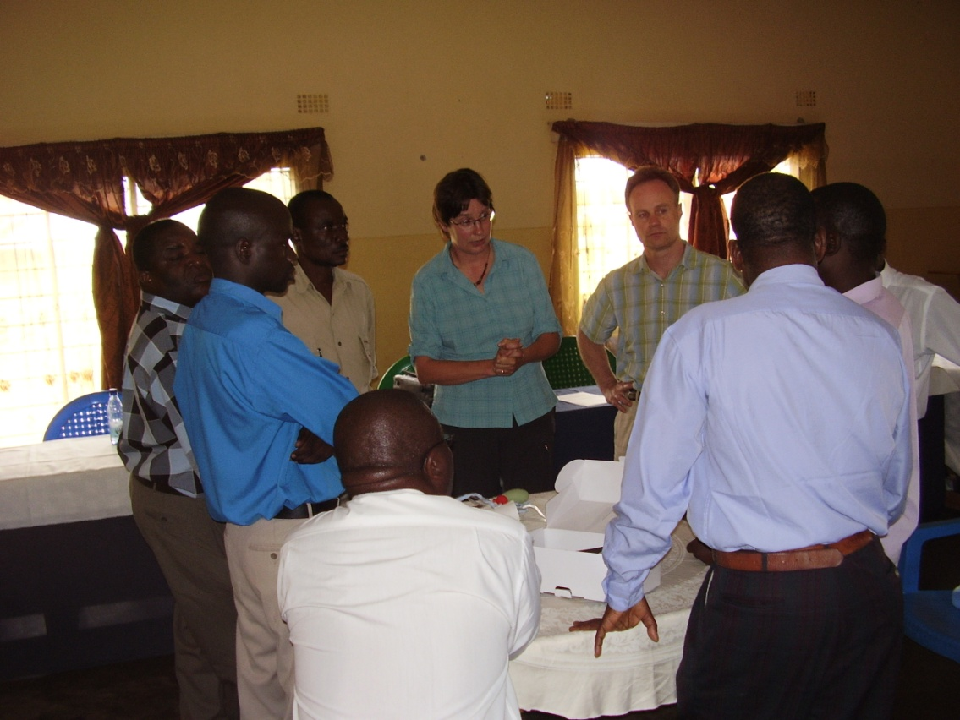
Project Team
Prof. Winstanley, University of Warwick, UK
Dr Paul O'Hare, University of Warwick, UK
Prof Siobhan Quenby, University of Warwick, UK
Dr Doug Simkiss, University of Warwick, UK
Dr Chisale Mhango, College of Medicine, Malawi
Dr Francis Kamwendo, College of Medicine, Malawi
Anne-Marie Brennan, University of Warwick (study Manager)
David Davies, University of Warwick
David Ellard, University of Warwick
Kandala Ngianga-bakwin University of Warwick (statistician)
And others…

Slide 11
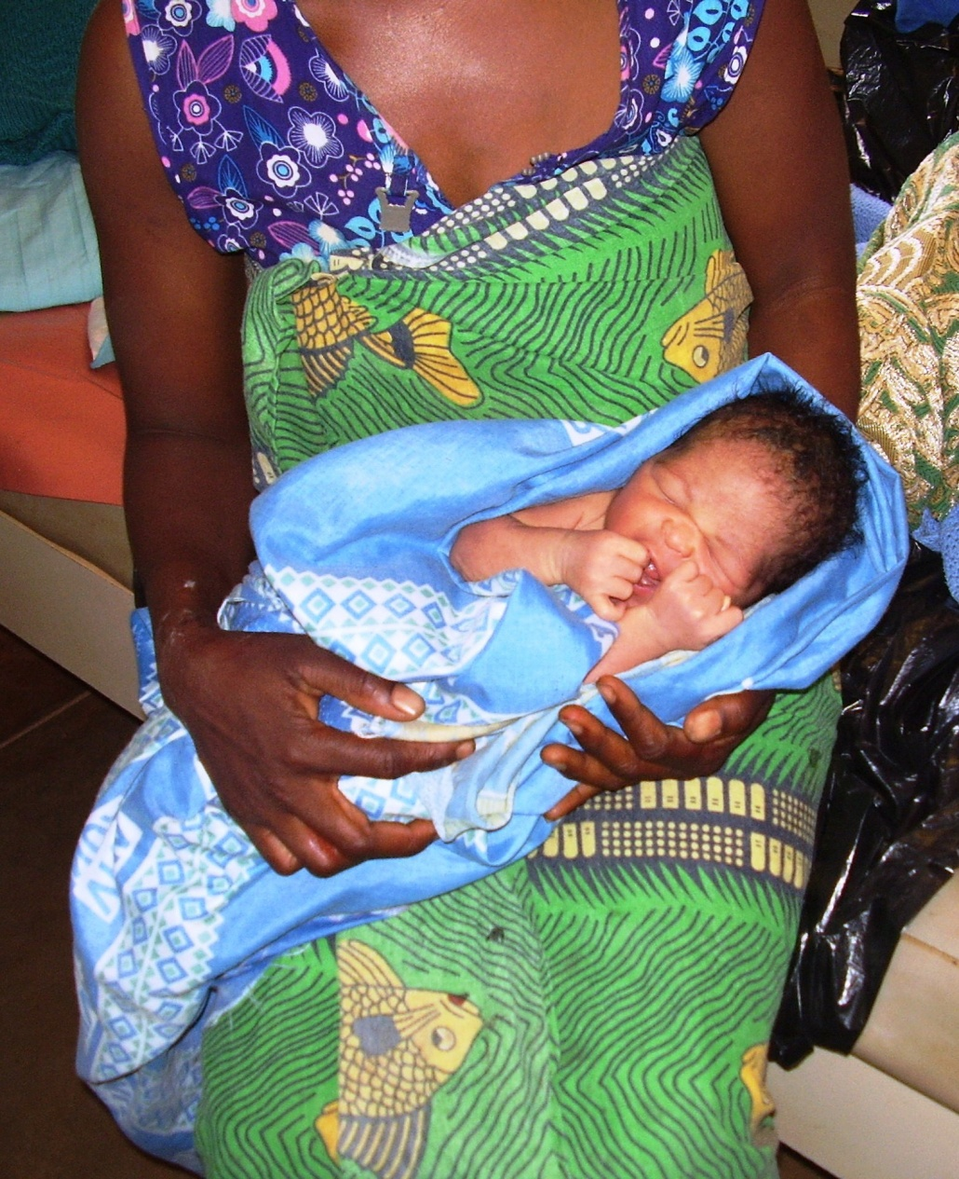
ETATMBA (Enhancing Training and Appropriate Technologies for Mothers and Babies in Africa)
Very few Medical Doctors in Malawi
  260* approximately 1 Medical Doctor per 50,000 people
Similar to other African Countries much of this work is done by:
Non-Physician Clinicians (NPCs)
*Data from 2009
Notes:
For comparison: Within ten miles of Coventry CC there are 134 GP practices (if you say an average of 2 doctors per practice, and this is conservative!) that is 268 GPs without counting all of the doctors in hospitals in the area.
Note there are midwives and nurses but very few medical doctors

Slide 12
Non-Physician Clinicians (NPC’s)
“The crisis in human healthcare resources disproportionately affects the poorest women in low income countries.”
“Are non-physician clinicians a substandard solution to the crisis in human resources for maternal health?”
“Evidence suggests that the answer is no.”
Bergström , BMJ 2011;342:d2499 doi: 10.1136/bmj.d2499
Notes:
Maternal and neonatal mortality and morbidity remain major challenges to improving health in Malawi. Malawi, for example, has a maternal mortality ratio of 675/100,000 and neonatal mortality rate of 30/1000 births. One way of dealing with this problem is to provide Emergency Obstetric and New born Care (EmONC). Malawi has a shortage of medical doctors who can offer EmONC. To compensate for this shortage, the Government introduced formal training of Non-Physician Clinicians (NPCs) known as Clinical Officers in Malawi in 1976 to offer such services. They are a major human resource for health in Malawi as far as clinical services are concerned and yet lack a clear professional support and supervision policy. Strengthening the position of NPCs has the potential to expand cost-effective, quality services to under-serviced areas, and thereby improve equitable access to care which will in turn reduce maternal and neonatal mortality and morbidity.

Slide 13
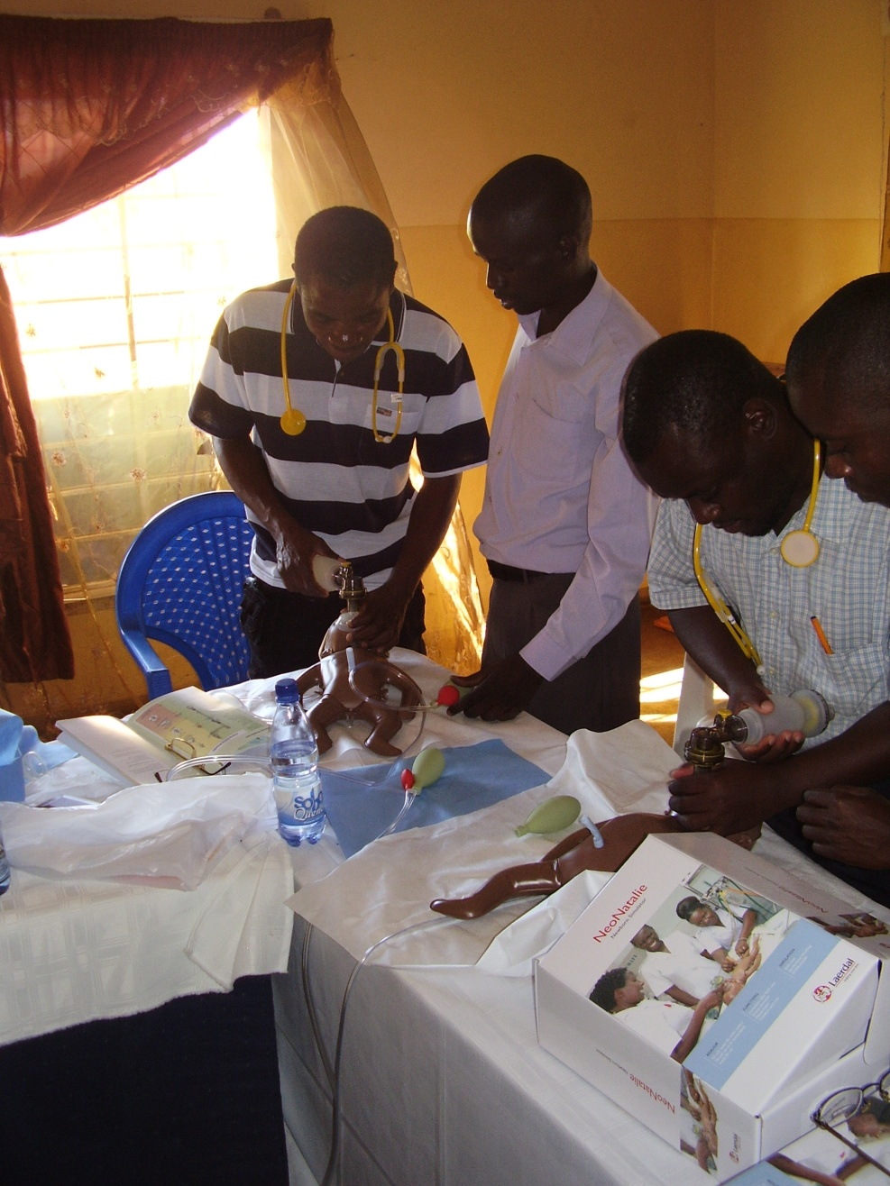
ETATMBA
The project is to train 50 Non-Physician Clinicians (NPCs) as advanced leaders providing them with skills and knowledge in advanced neonatal and obstetric care (over a 24 month period).
Training it is hoped that will be cascaded to their colleagues (other NPCs, midwives, nurses).
The aim of the project is to try and address the high levels of maternal and neonatal mortality.

Slide 14
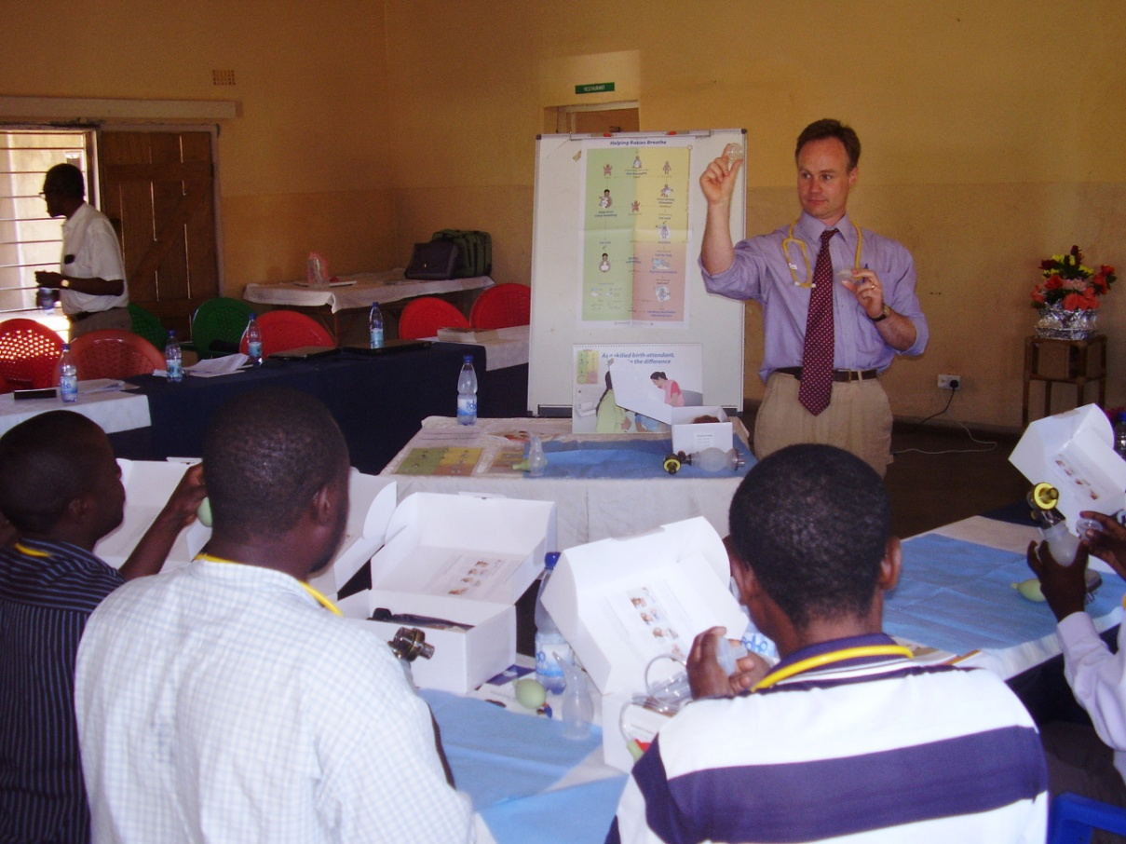
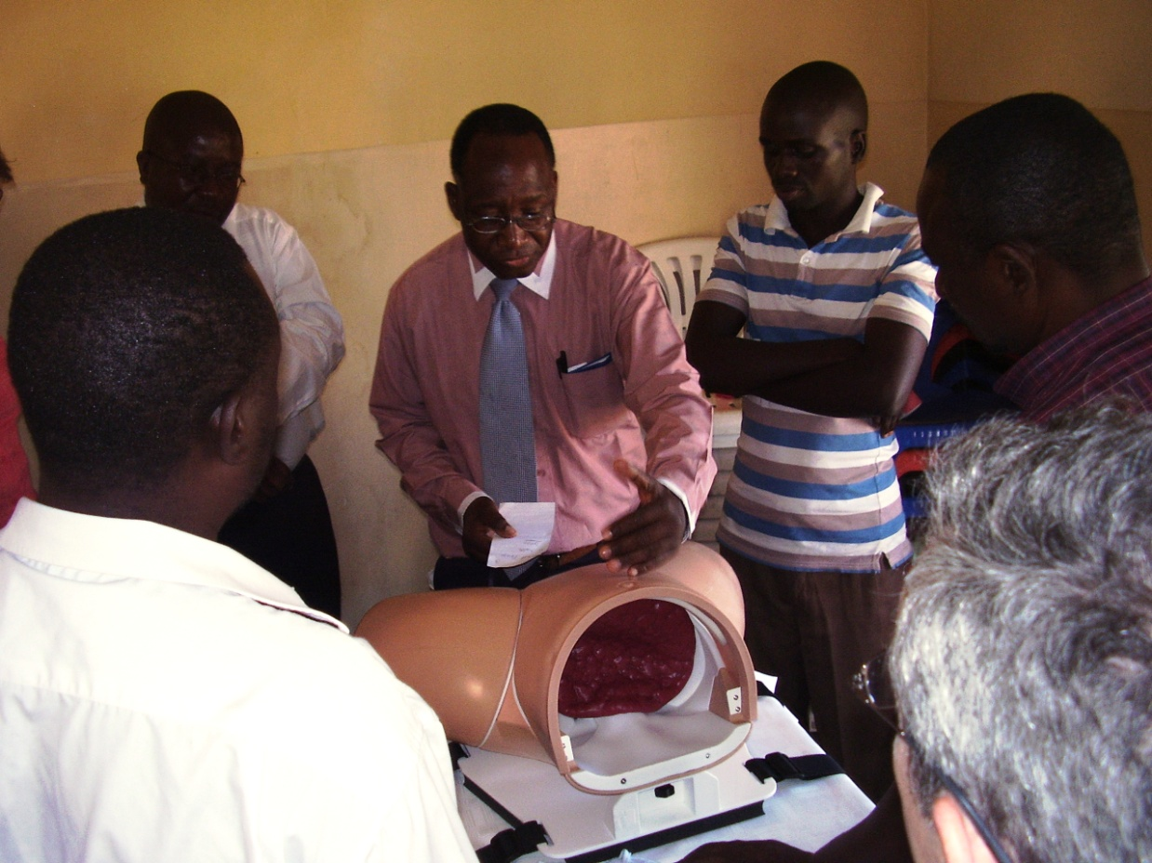
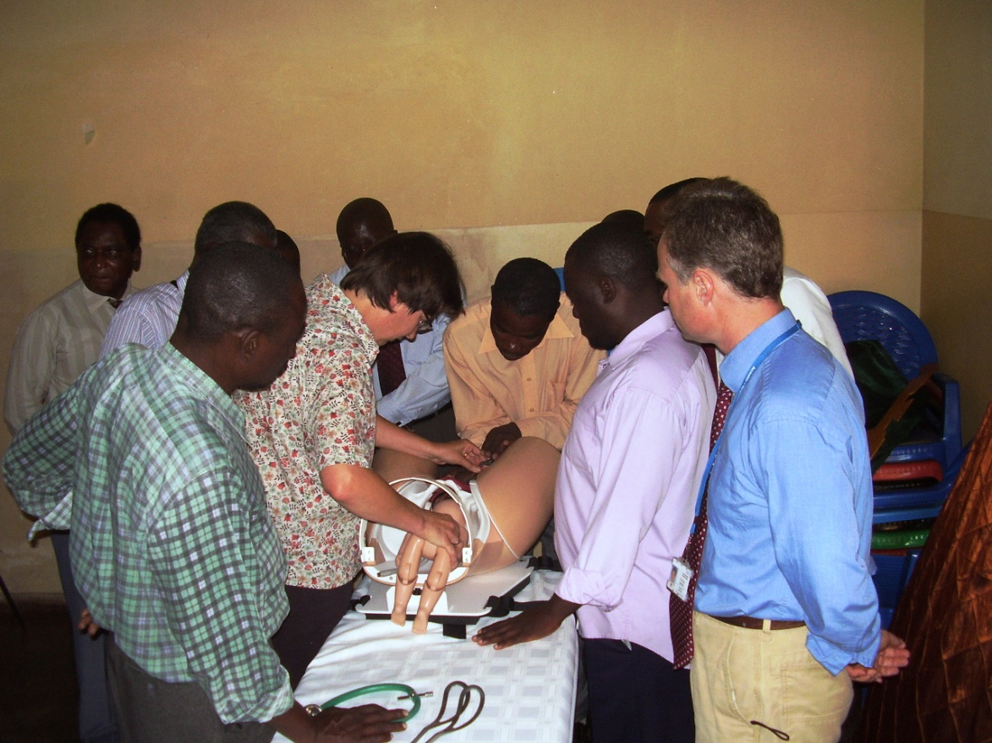
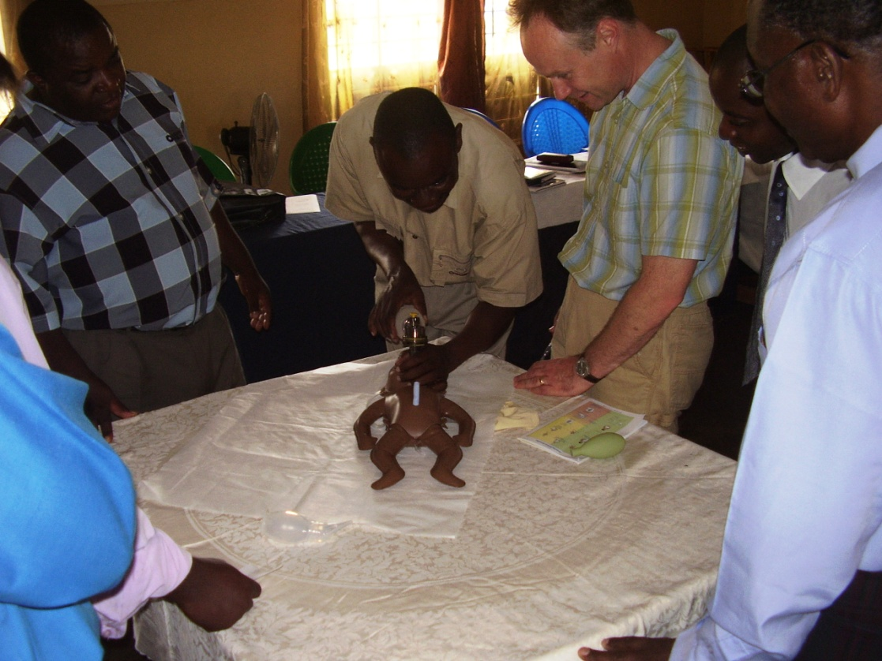

Slide 15
Evaluating the impact of ETATMBA
The aim of this study is to:
Evaluate the impact on healthcare outcomes of the ETATMBA training in Malawi.
OUTCOMES (Primary):
Perinatal mortality (defined as fresh stillbirths and neonatal deaths before discharge from the health care facility)
OUTCOMES (Secondary):
Maternal death rates;
Recorded data (e.g. still births, Post-Partum Haemorrhage, C Section, Eclampsia, Sepsis,
Neonatal resuscitation);
Availability of resources (e.g. are drugs/blood available);
Use of available resources (e.g. are drugs being used).

Slide 16
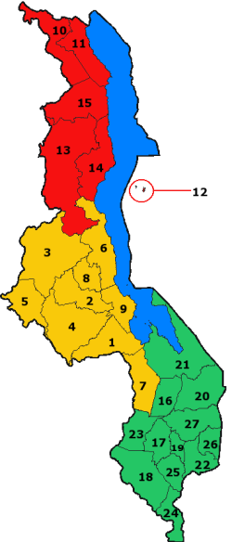
Design & Methods
Cluster Randomised Controlled Trial with a Process Evaluation
8 of the 14 districts from Central and Northern Malawi are randomised to the intervention
Methods (Mixed)
Quantitative (hospital outcome data)
Qualitative(interviews with key stakeholders)
Notes:
The study will be conducted in Districts within the central and northern regions of Malawi. There are a total of 14 districts in these regions which will be randomised to either intervention or control (Dedza, Dowa, Kasungu, Lilongwe, Mchinji , Nkhotakota, Ntcheu, Ntchisi , Salima, Chitipa, Karonga, Mzimba, Nkhata Bay , Rumphi). A pragmatic decision was made that as Lilongwe is such a large district it would be divided into two with one half randomised to intervention and the other to control making a total of 15 districts. Stratified randomisation of the districts, to ensure the two groups are comparable will be carried out by a statistician at the University of Warwick, UK who will then inform the study team of the outcome. There will be 8 intervention districts and 7 controls. Control districts will be offered the intervention at the end of the trial as part of a randomised waiting-list design.

Slide 17

Power & Sample Size
We computed a sample size for proportion in an unmatched study with 80% power, a one sided alpha of 0.05, and an ICC 0.0025. The current neonatal mortality rate in Malawi: is 30 per 1000 live births (source UNICEF) and assuming a minimum number of clusters of 14 in our sampled districts, the study was powered to detect a 20% difference between the two birth cohorts (intervention and control) in the proportion of live-born neonates delivered by NPCs or staff trained by them) surviving to hospital discharge.
With the allocation of 7 districts per arm with an estimated 700 births per NPC (or staff trained by them), 1028 births per study arm per district would provide sufficient power for a total of 2056 neonates per district. That is, a decline from 30 per 1000 live births to 24 per 1000 live births, rate ratio 0.20.

Slide 18
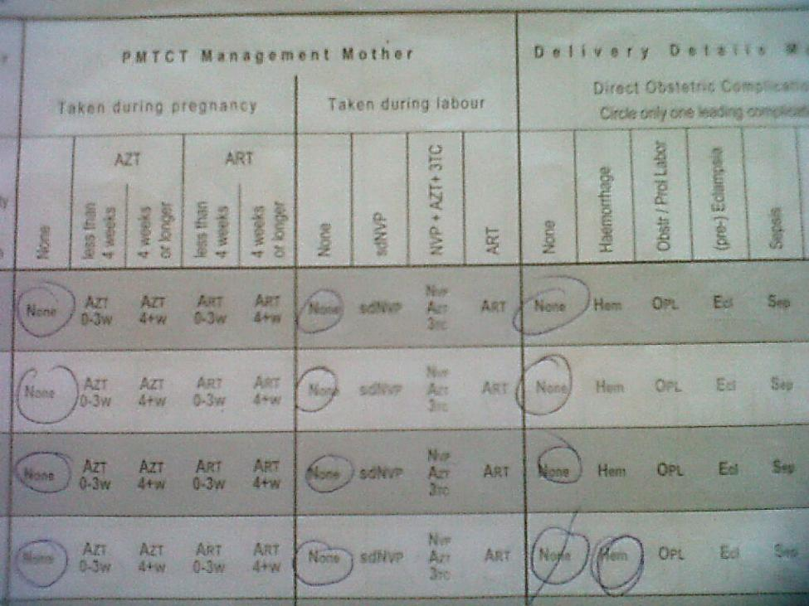
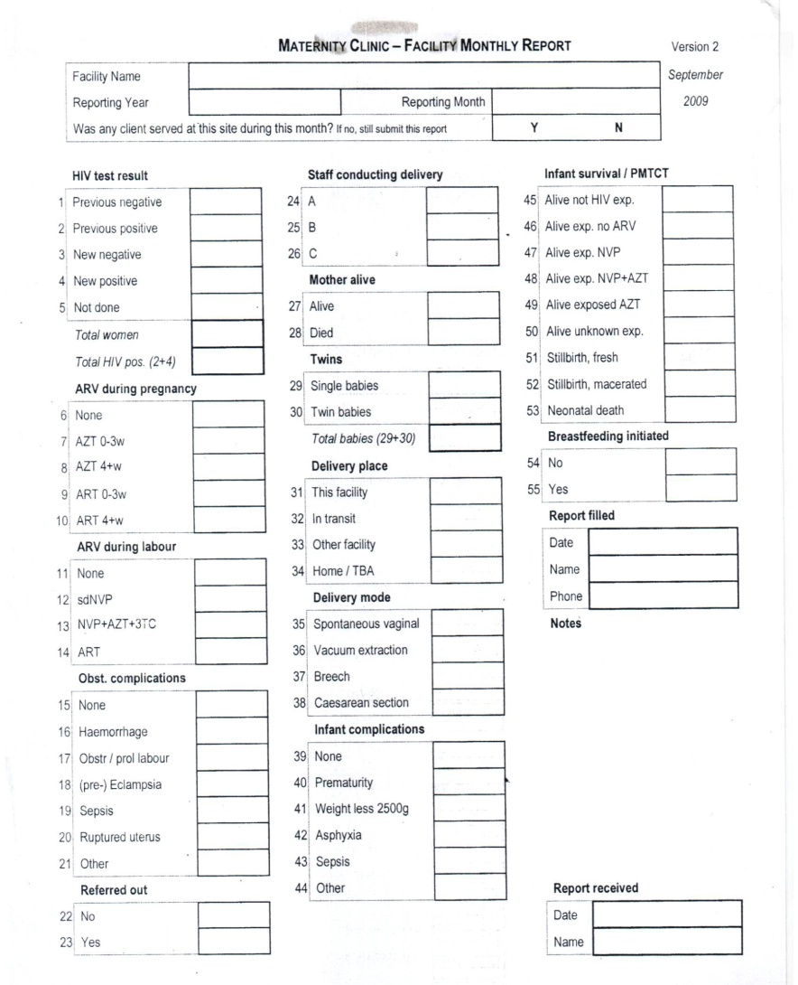
Quantitative data
Primary data will be extracted from the maternity log and or the summary reports at the district hospitals
All health facilities in a district return this data to the district hospital on a monthly basis
Data are to be collected retrospectively at three points in time:
For the 12 months leading up to start of project (Baseline)
At the end of the first year
At the end of the second year
Notes:
Primary data will be extracted from the maternity log (Malawi Ministry of Health Maternity Register, Ver. 2 (July 2008)) at the district hospital and rural hospitals in each district by the two research assistants monitored by the local and UK team. Other facilities within the district (e.g. health Centres) also complete the same maternity log book from which summary data is returned to the district hospital on a monthly basis. This data will also be gathered by the researchers and the combined data will make up a complete picture of the districts. Data will be collected at three points in time retrospectively (i.e. the year leading up to date). Baseline data will be collected on cases (from the maternity logs and summary logs) for the 12 months prior to the date the training was delivered with two follow-ups at 12 monthly intervals. A paper Case Report Form (CRF) will be produced to facilitate data collection. Data will then be transferred to an MS Excel spreadsheet for transfer to the study database.

Slide 19
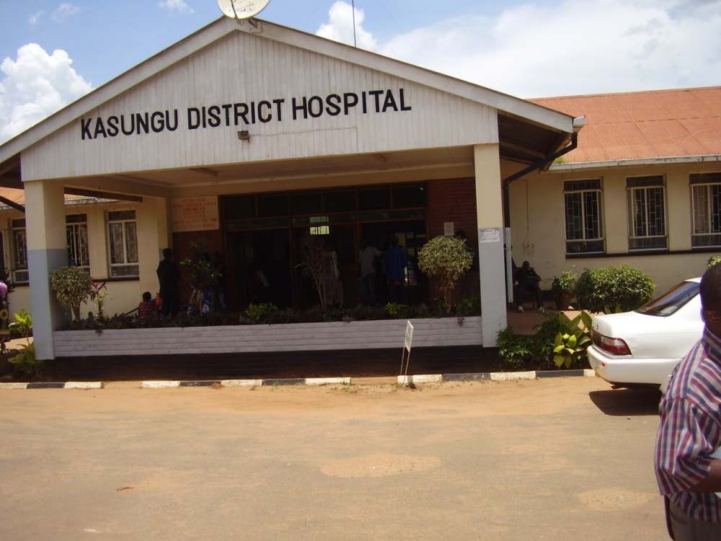
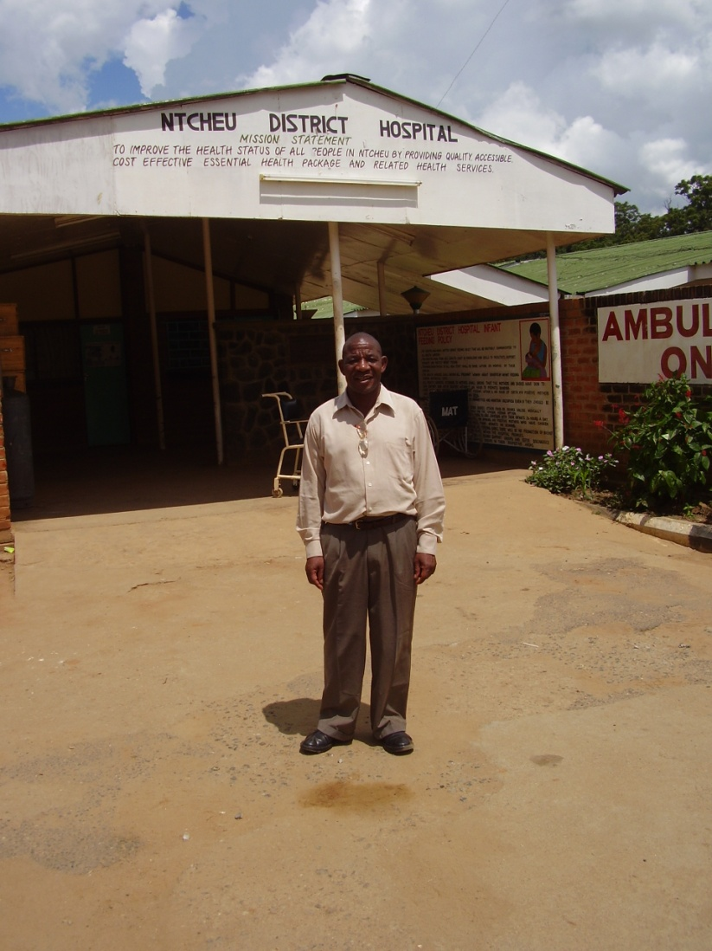
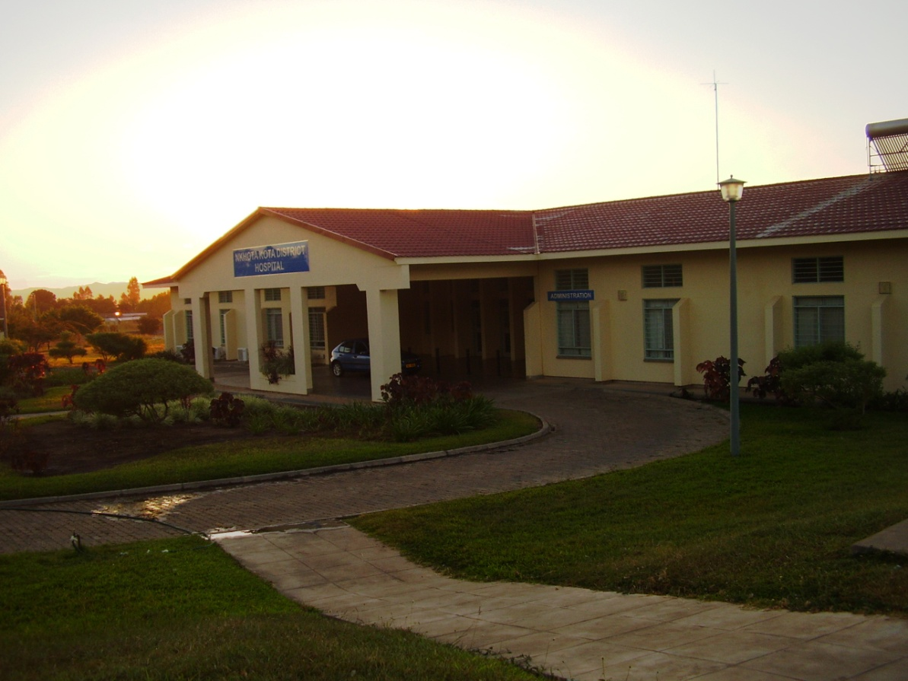
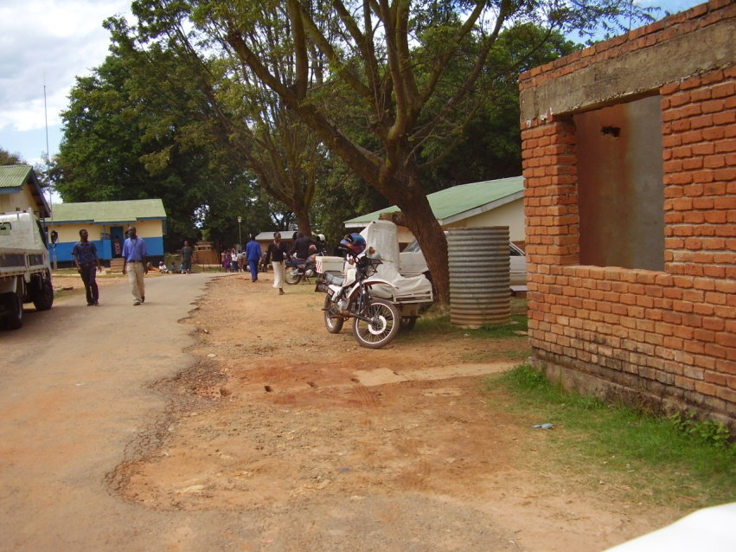
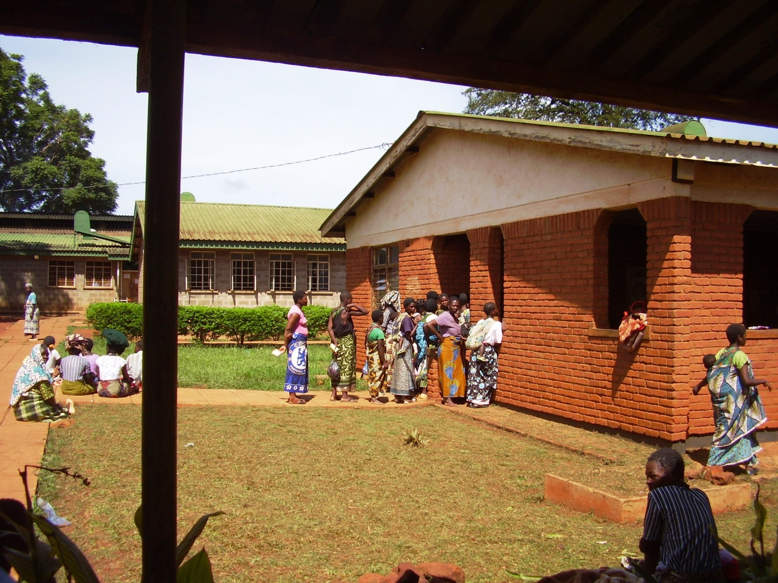
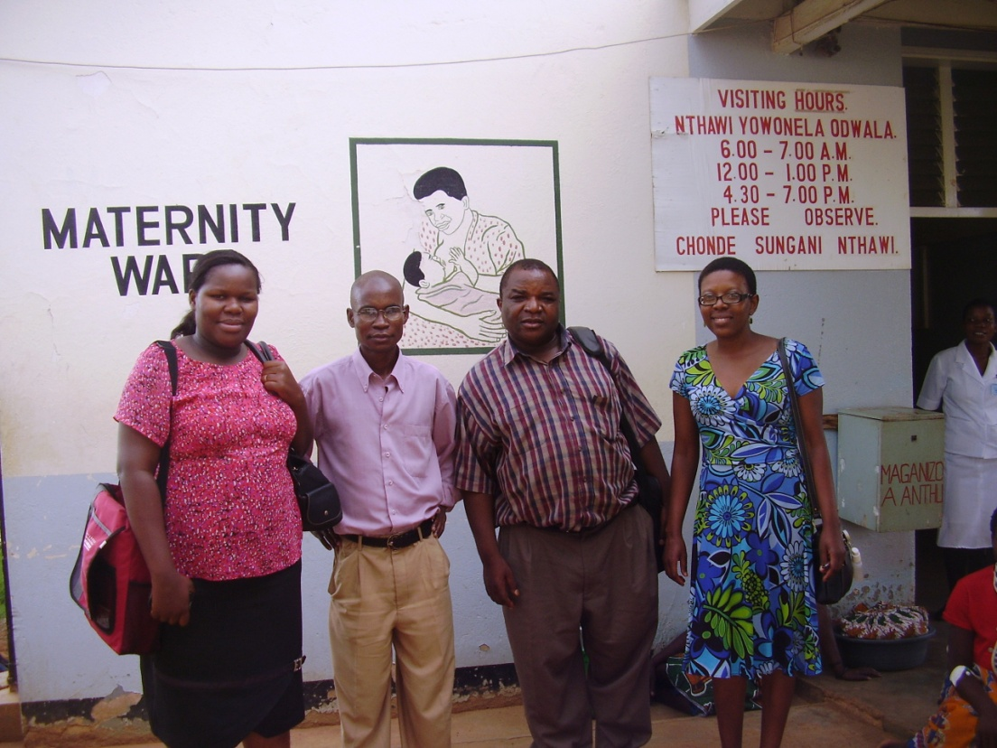

Slide 20
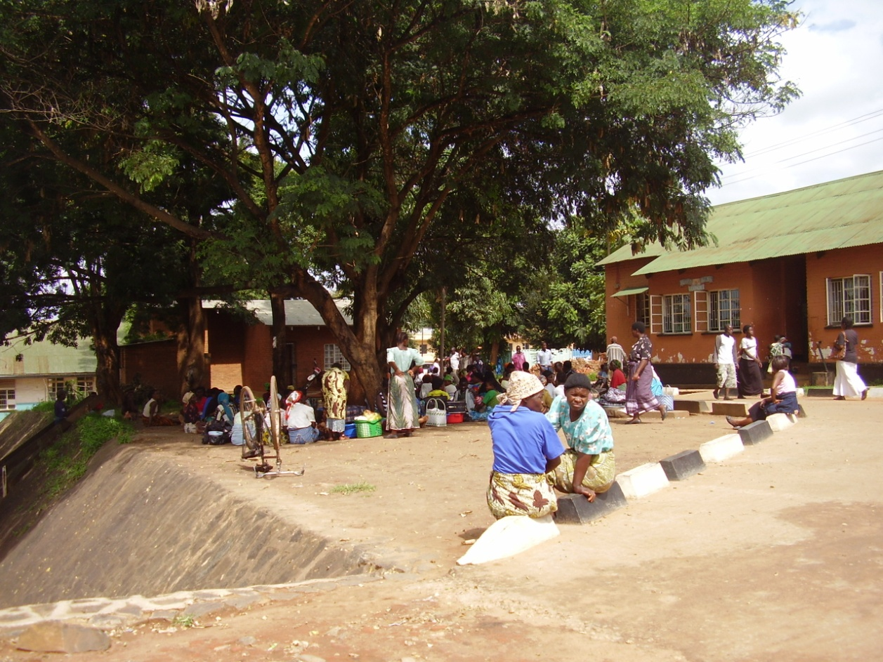
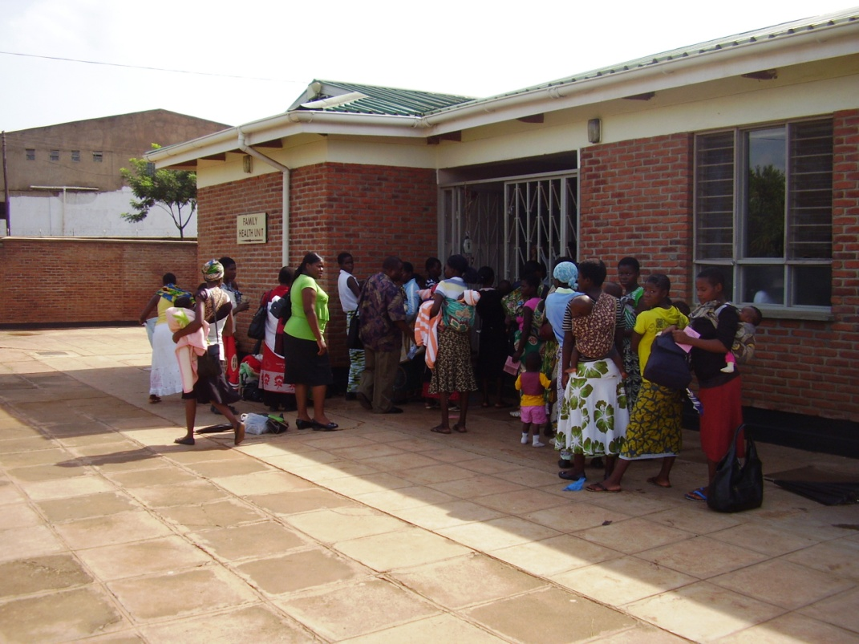
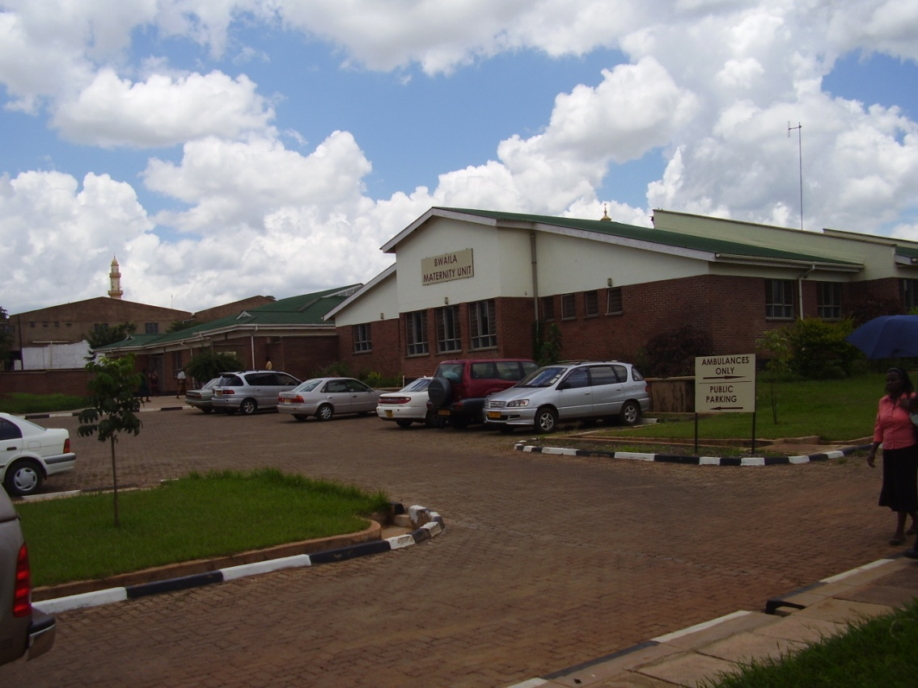
Qualitative data
Exploring attitudes and behaviours
Have we made a difference to practice?
In depth interviews with:
NPC’s
District Medical Officers
District Nursing Officers
Cascades' (who are trained by NPCs)
Supervisors and tutors
Baseline, 12 months and 24 months

Slide 21
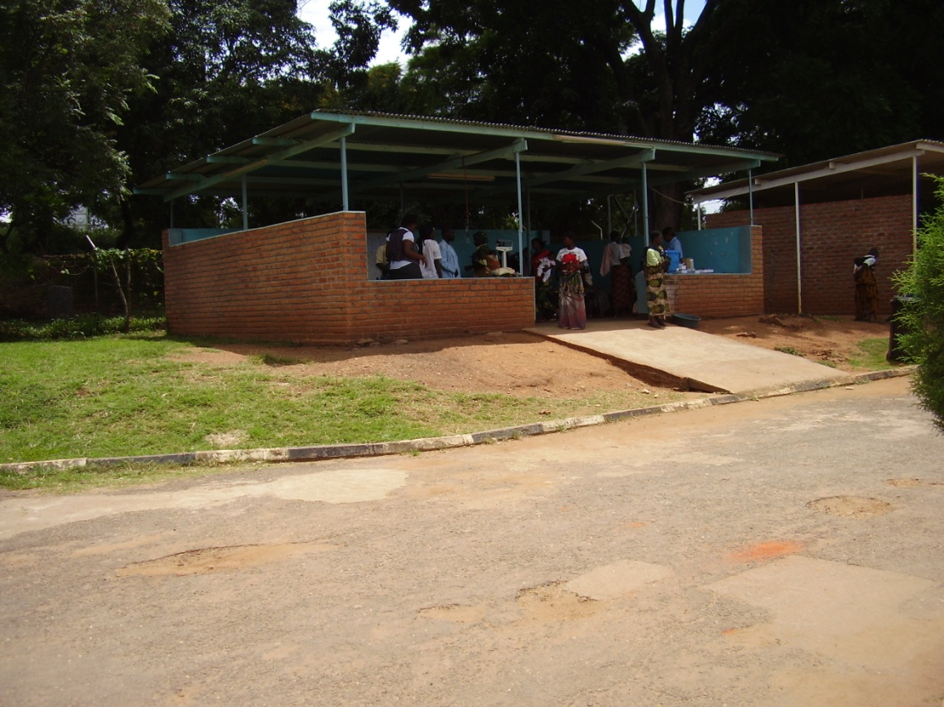
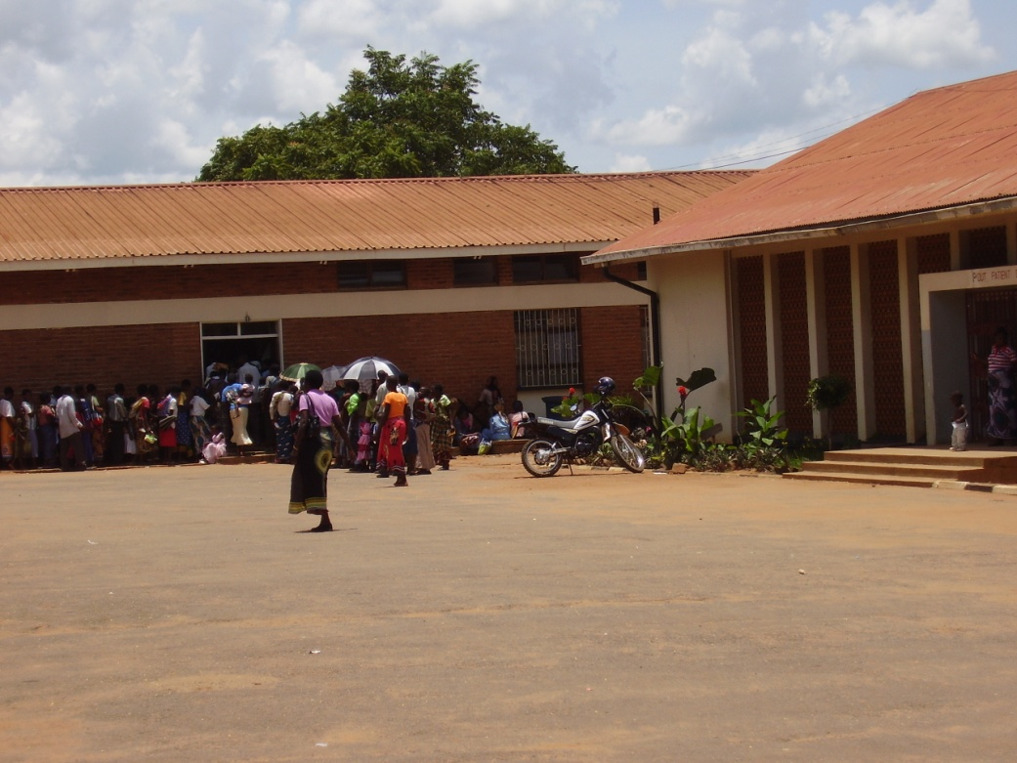
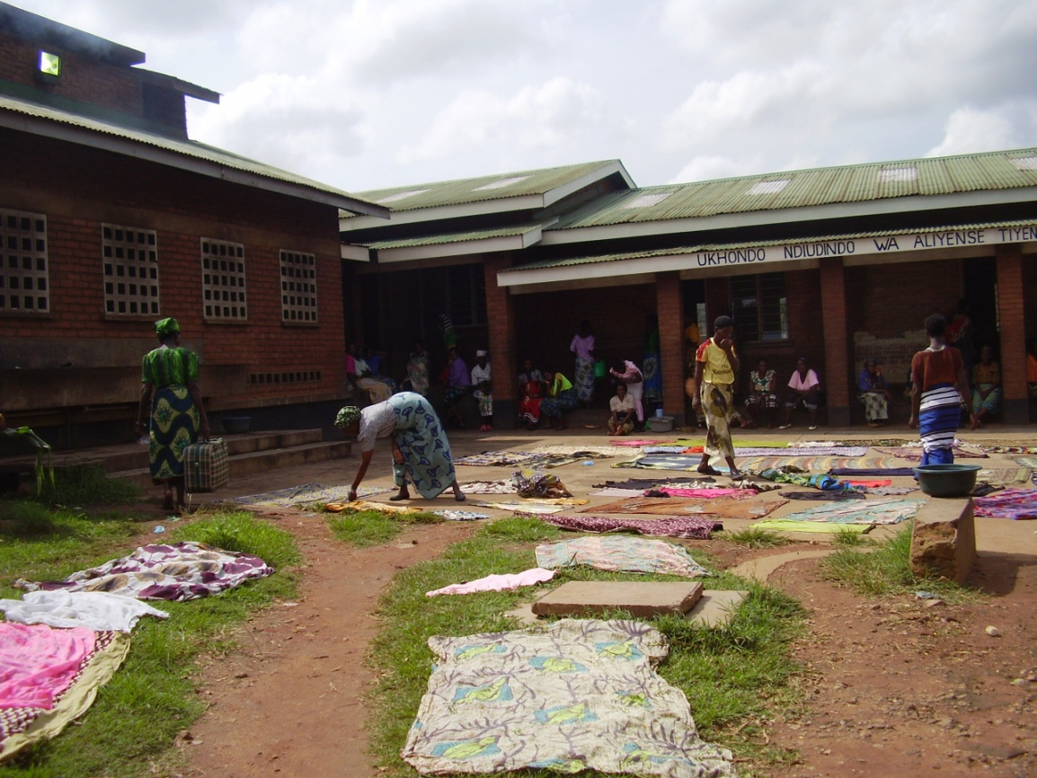
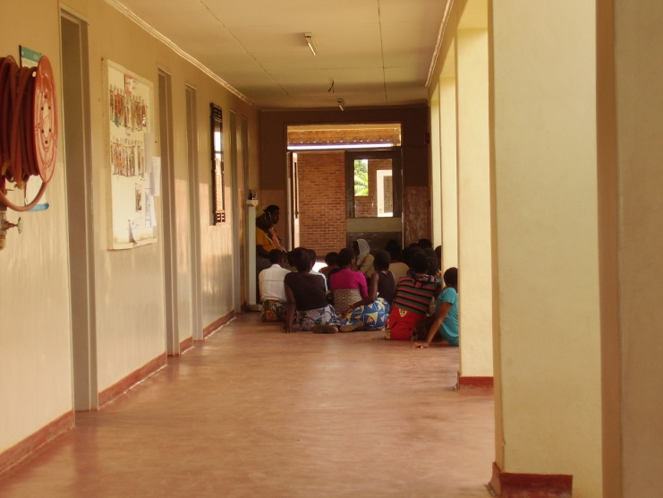
Challenges!
  Ethics and approvals
  Resources!
  Limited funds for research component
  Travel (distances)
  Electricity & Internet
  Access to data
  Oversight from a distance

Slide 22
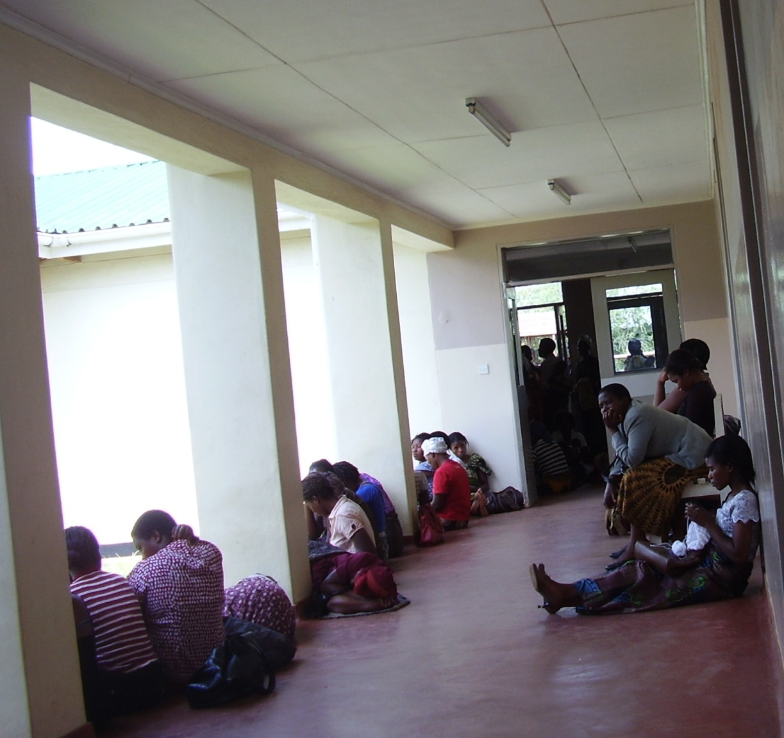
The future!
Exploring more cost-effective ways to collect primary data
To continue to gather interview data
More monitoring visits??
Research opportunities
Thank you for listening
Any Questions?

