Slide 1
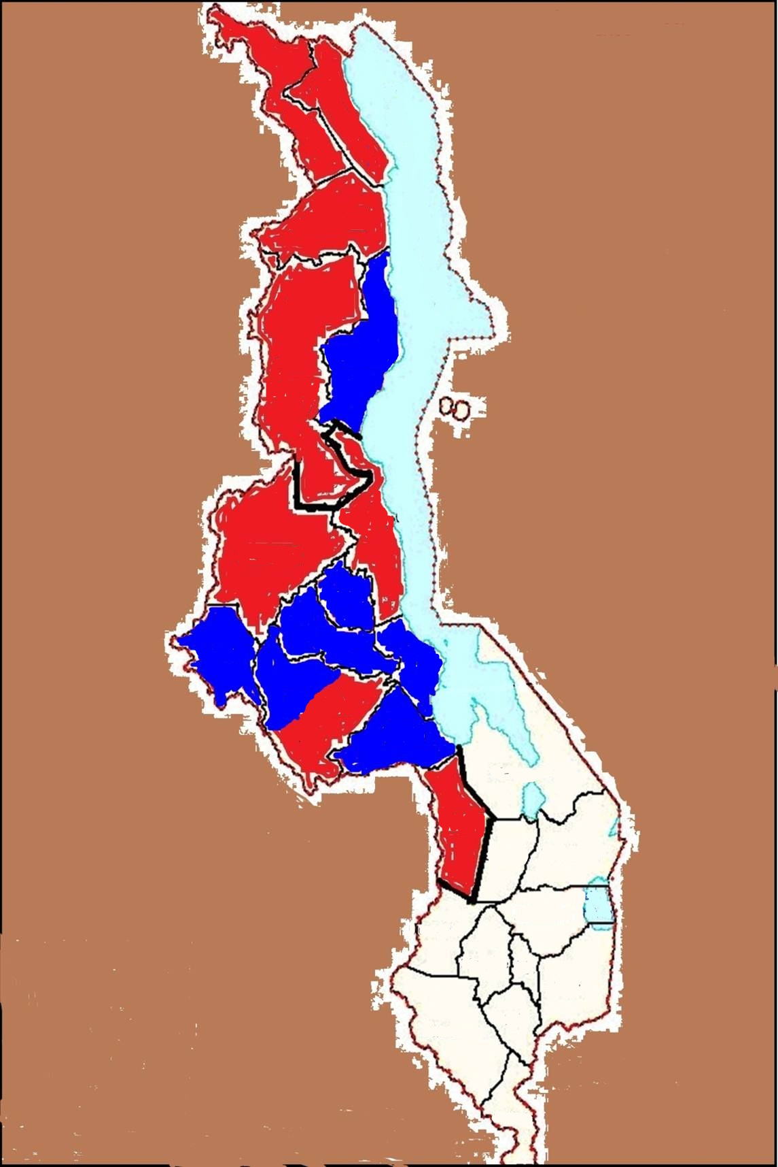
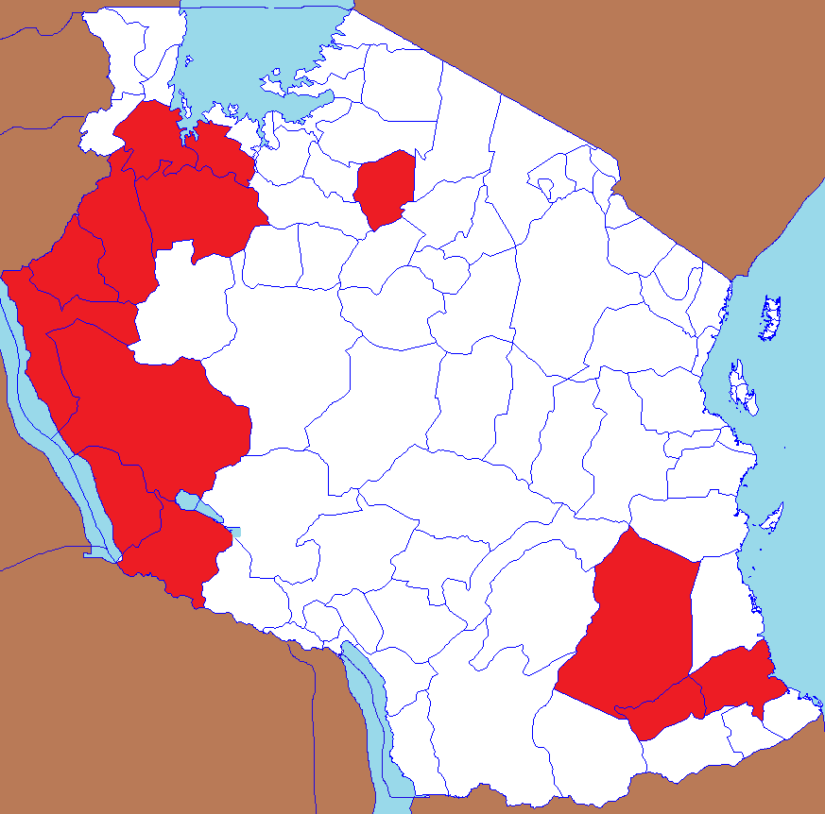
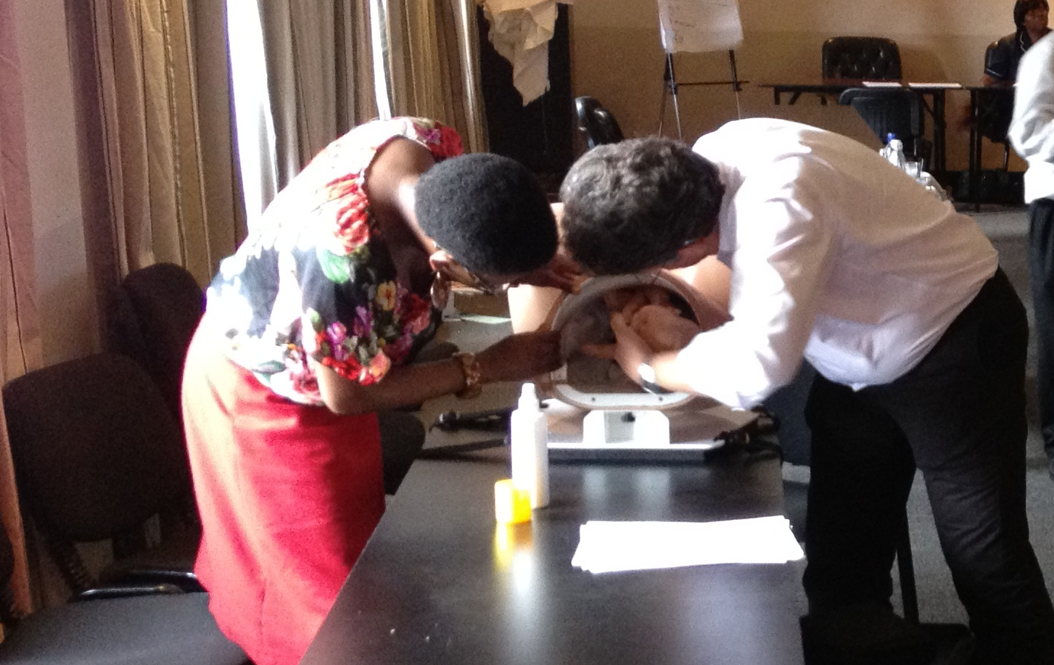



Evaluating the benefit of training Non-Physician Clinicians for Maternal and Newborn Care
Mselenge Mdegela MD, Mmed(Obs/Gyn)
Centre for Maternal and Newborn Health,
Liverpool School of Tropical Medicine
E-mail: mselenge@liverpool.ac.uk
1. Introduction
Sub Saharan Africa (SSA)contributes 56% of the global burden of maternal deaths ¹
Ironically the region has the slowest progress towards achieving MDG 4&5^{1,2}.
In Tanzania about 8,000 maternal deaths occur annually mostly from preventable causes. Women from poor families and rural areas constitute the majority. The figure in Malawi stands at about 2,600^{3,4}.
A significant perinatal loss parallel these maternal deaths ^{1,3,4}
In SSA, there is a serious shortage of physicians and midwives. The few available are more concentrated in urban areas. These cadre of staff require a relatively longer period of training but are poorly retained ².
Non-physician clinicians on the other hand require a shorter training time and majority are willing to work in rural areas.
However the basic training for NPCs does not equip them with all necessary skills needed to manage complications of pregnancy and childbirth⁵.
Through ETATMBA project, Non-physician clinicians (NPCs) from selected districts in Malawi and Tanzania have been trained on advanced neonatal, obstetric care and leadership skills. A follow up is being done in both countries aimed at mentoring trainees and collecting data.
It is expected that trained NPCs will not only provide better clinical care, but also improved leadership in their facilities. In addition they will cascade training to other health care providers.
Consequently this will lead to a sustained improvement in maternal and newborn health outcomes. Dissemination will ensure sharing of lessons learnt.
2. Aim and Objectives
4. Project Description
Aim
To evaluate advanced clinical obstetrics and leadership training for NPCs and its effect on their retention, roles and performance in sub Saharan Africa
Objectives
1. To describe training models available for NPCs in SSA
2. To assess effectiveness, suitability and sustainability of the available training models
3. To evaluate change in retention and assigned roles among NPCs following training
4. To evaluate clinical performance among NPCs after training
5. To evaluate organisational performance in terms of leadership and logistics
5. To assess maternal and newborn health outcomes in the target districts
6. To assess patients/clients and health care providers satisfaction for maternal and newborn health care in the target districts
Figure2: ETATMBA project target districts in Malawi and Tanzania
Modules
Haemorrhage
Eclampsia
Sepsis
Abortion
Obstructed labour
Leadership
3. Methods
Intervention districts
Control districts
This is a longitudinal follow up study. Mixed methods will be used to collect data based on methods employed in the ETATMBA study
A Qualitative approach will involve interviews with key informants, health care providers and clients/patients. Focused group discussions will also be done.
Quantitative data will be collected from facility registers and NPCs logbooks
A total of 100 NPCs have been trained, 46 in Malawi and 54 in Tanzania.
Training was organised in modules which addressed the following key areas:
Emergency obstetrics and neonatal care in resource-limited settings
Principles of leadership and service improvement
Basic principles of scientific research methods
Analysing scientific evidence and critical appraisal of a published articles
Essentials of clinical training in obstetric and neonatal care in a low resource setting
Field work, mentoring and supervision
Basic research questions
What models for up skilling NPCs are available in sub –Saharan Africa (SSA)?
Are these methods appropriate(fit for purpose), feasible and sustainable?
Does this training result in improved individual NPC and facility functionality?
In the long term, does it result in improved maternal and newborn health outcomes?
Collaborators: University of Warwick, UK. University of Malawi. Malawi Ministry of Health. Ifakara Health Institute, Tanzania. Karolinska Institute, Sweden.GE Healthcare, UK
Figure 1
NPC training in Malawi
ETATMBA Project (www.etatmba.org)
5. Plans &Perspectives
Tentative Plan in 2014
June/July 2014 - Orientation and planning visit, Tanzania
August/September – Initial reading, write up, registration
October – First Batch BSc graduates, University of Malawi
October - Orientation and planning visit, Malawi
November/December – Literature, tools, ethics.
Photo by David Davies
University of Warwick
6. Acknowledgements and References
Acknowledgements
Prof Paul Joseph O’Hare and Dr Anne-Marie Brennan, University of Warwick.
Prof Nynke van den Broek , CMNH - LSTM
References
1. Trends in maternal mortality: 1990 to 2010 WHO, UNICEF, UNFPA and The World Bank estimates. WHO 2012
2. World health statistics 2013.
3. National Statistical Office (NSO) and ICF Macro. 2011. Malawi Demographic and Health Survey 2010. Zomba,
Malawi, and Calverton, Maryland, USA: NSO and ICF Macro. National Bureau of Statistics (NBS) [Tanzania] and ICF Macro. 2011.
4. Tanzania Demographic and Health Survey 2010. Dar es Salaam, Tanzania: NBS and ICF Macro.
5. Ellard et al.: The impact of training non-physician clinicians in Malawi on maternal and perinatal mortality: a cluster randomised controlled evaluation of the enhancing training and appropriate technologies for mothers and babies in Africa (ETATMBA)project. BMC Pregnancy and Childbirth 2012 12:116.
6. www.etatmba.org (accessed May 2014)

