Slide 1
Abortion Seminar
Dr Chisale Mhango FRCOG
NPC Training in MNH
Notes:
Speaker’s notes:
Define abortion. i.e. Termination of pregnancy before foetal viability.

Slide 2
Outline
Introduction
Definition of unsafe abortion
Magnitude of Unsafe Abortion in Malawi
Legal situation
Case Fatality Rate
Availability of Safe Abortion
NPC Training in MNH
Notes:
Speaker’s notes
This presentation will focus on unsafe abortion, which is the 4th commonest cause of maternal mortality in Malawi.

Slide 3
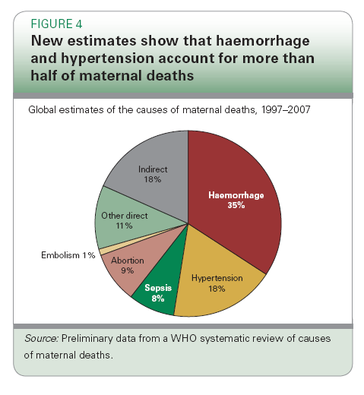
Causes of Maternal Mortality
Notes:
Speaker’s notes:
Between 1997 and 2007, complications of unsafe abortion were the third commonest cause maternal deaths after haemorrhage and PIH.
Source: WHO, UNICEF. Countdown to 2015 Decade Report (2000-2010): Taking stock of maternal, newborn and child survival. Geneva: World Health Organization and UNICEF, 2010. p. 11.

Slide 4
Causes of Maternal Deaths Worldwide
NPC Training in MNH
Source: US Agency for International Development
Notes:
Speaker’s notes:
Current data shows that abortion complications remain the third commonest cause of maternal deaths but the proportions have changed. Haemorrhage has come down from 35% to 24%, PIH has come down from 18% to 12%, but abortion has gone up from 9% to 13%.
Where abortion is legal and permitted on broad grounds, deaths from complications are rare, but where it is illegal in many circumstances, it is often fatal. For example, in South Africa, the incidence of infection resulting from abortion decreased by 52% after the abortion law was liberalized in 1996. [3]
Abortion deaths have been called ‘the preventable pandemic.’ Overall, unsafe abortion accounts for at least 13% of all maternal deaths – and the real number is likely higher, in that some portion of maternal deaths attributed to causes like hemorrhage and infection may well actually be due to complications of abortion (misreported due to stigma).
As with maternal health in general, it’s important to look not just at mortality but at morbidity – injury, illness, disability – as well. About 5 million women are hospitalized each year for post-abortion complications [source: Guttmacher]; millions more require but do not receive effective PAC, dying at home or living with disability and stigma. A range of research studies showed in the 1990s that in developing countries as many as 1% of women were hospitalized each year due to abortion complications – averaging around 20% of all women who had abortions in those countries.

Slide 5
Abortion Rates in the World
INCIDENCE AND RATES
Global and regional estimates of induced abortion, 1995 and 2003
Region and Subregion | No. of abortions (millions) |  | Abortion rate*
 | 1995 | 2003 | 1995 | 2003
World | 45.6 | 41.6 | 35 | 29
Developed countries | 10.0 | 6.6 | 39 | 26
Excluding Eastern Europe | 3.8 | 3.5 | 20 | 19
Developing countries† | 35.5 | 35.0 | 34 | 29
Excluding China | 24.9 | 26.4 | 33 | 30
Estimates by region
Africa | 5.0 | 5.6 | 33 | 29
Asia | 26.8 | 25.9 | 33 | 29
Europe | 7.7 | 4.3 | 48 | 28
Latin America | 4.2 | 4.1 | 37 | 31
Northern America | 1.5 | 1.5 | 22 | 21
Oceania | 0.1 | 0.1 | 21 | 17
*Abortions per 1,000 women aged 15–44 †Those within Africa, the Americas, excluding Canada and the United States of America, Asia, excluding Japan, and Oceania, excluding Australia and New Zealand.
Addressing Unsafe Abortion in Africa
Advocacy for Parliamentarians
Notes:
Speaker’s notes:
NB Abortion rates in Europe and Africa are approximately the same at 29/1,000, the difference is in the distribution between safe and unsafe procedures
With increasing use of contraceptives, abortion rates have been decreasing globally but even where contraceptives are universally available, abortion remains prevalent.
New Estimates from WHO
• 21.6 million unsafe abortions occurred in 2008.
• The highest rates—36 per 1,000 women—were in Eastern and Middle Africa.
• Between 2003 and 2008, the global unsafe abortion rate was unchanged at 14 per 1,000 women aged 15–44 years.
More than 95% of abortions in Africa and Latin America are performed under unsafe circumstances, as are about 60% of abortions in Asia (excluding Eastern Asia).[1]

Slide 6
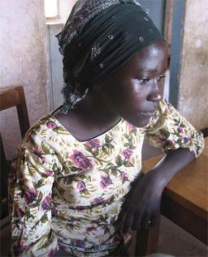
Access to contraceptives and family planning
An estimated 200 million women want to delay or avoid pregnancy but don’t use effective family planning.
Almost 40% of pregnancies worldwide are unplanned.
Nearly 50 million women resort to abortion each year, which are often done under unsafe conditions.
UNSAFE ABORTION
accounts for 13% of maternal mortality

Slide 7
More than half of abortions in the developing world are unsafe
Number of abortions (millions)
Addressing Unsafe Abortion in Africa
Source: Guttmacher Institute
Advocacy for Parliamentarians
Notes:
Speaker’s notes:
While well over 90% of abortions in the developed world are safe (and mainly legal), 19 million unsafe abortions take place in the developing world each year.
[Note: 9 million abortions per year are in China, almost all of them safe...which means that there about ¾ of the abortions that take place in the developing world, excluding China, are unsafe.]
Source: Sedgh G et al., Induced abortion: rates and trends worldwide, Lancet, 2007, 370(9595):1338–1345.

Slide 8
Global Maternal Deaths Estimates
Notes:
Speaker’s notes:
Joint WHO / UNICEF / UNFPA /World Bank estimates in 1980 there were 526,300 maternal deaths worldwide. In 2008 it was 342,900. A 34% decline; but a long way from the desired 75% decrease.
While maternal deaths dropped by 34%, abortion deaths fell by 16% only.

Slide 9
Definition of Unsafe Abortion
WHO defines unsafe abortion as:
a procedure for the termination of unwanted (intrauterine) pregnancy either by persons lacking the necessary skills or in an environment lacking the minimal medical standards, or both.
NPC Training in MNH
Notes:
Speaker’s notes:
SLIDE
As an example of a person lacking in the necessary skills, when I was a medical student in a country where abortion was legal (Zambia), a classmate while on night duty clerked his pregnant girl-friend as having incomplete abortion and performed a D&C on her, scraping out the intestines which ended in a colostomy.
Likewise, the law in Zambia required that the procedure be performed in a hospital. Private practitioners nonetheless performed abortions in their clinics which could not be properly and adequately equipped for fear of possessing incriminating evidence so were a frequent source of abortion complications equal to nonmedical abortionists.

Slide 10
Conditions under which abortion may 0ccur
 | LEGAL ABORTION | ILLEGAL ABORTION
SAFEST | Performed by trained and skilled persons in an environment not lacking in minimal medical standards | Performed by trained and skilled persons in an environment not lacking in minimal medical standards | SAFE
LESS SAFE | Performed by trained and skilled persons in an environment lacking minimal standards | Performed by trained and skilled persons in an environment lacking minimal standards | UNSAFE
UNSAFE | Performed by persons lacking necessary skills in an environment not lacking in minimal medical standards | Performed by persons lacking necessary skills in an environment not lacking in minimal medical standards | VERY UNSAFE
VERY UNSAFE | Performed by persons lacking necessary skills in an environment lacking in minimal medical standards | Performed by persons lacking the necessary skills in an environment lacking in minimal medical standards | MOST UNSAFE
NPC Training in MNH
Notes:
Speaker’s notes:
“Legal” and “illegal” abortion is legal language. Medical language is “safe” and “unsafe”. Generally speaking, abortion performed by trained medical people is safe, but most safe are those performed in a legal environment.
Least safe is abortion performed by untrained persons in an illegal environment.
SLIDE

Slide 11






WHERE SAFE ABORTION IS UNAVAILABLE, WOMEN SEEK UNSAFE ABORTIONS.
Alligator pepper, chalk and alum.
Cassava plant
Bahaman grass
Bleach
Quinine and other medicines
NPC Training in MNH
Notes:
Speaker’s notes:
Evidence from countries with restrictive laws shows that women use a large variety of methods to end unwanted pregnancies, including eating and drinking noxious substances, using herbs and roots, inserting sharp sticks, wires and branches into themselves, and taking overdoses of medications.
Other women use methods like hitting their bellies, jumping and falling on their stomachs.
Among the Maasai in Kenya the old women jump on the stomach of the pregnant girl or woman if a pregnancy is considered undesirable: such as from rape, incest, or too close to previous birth.

Slide 12
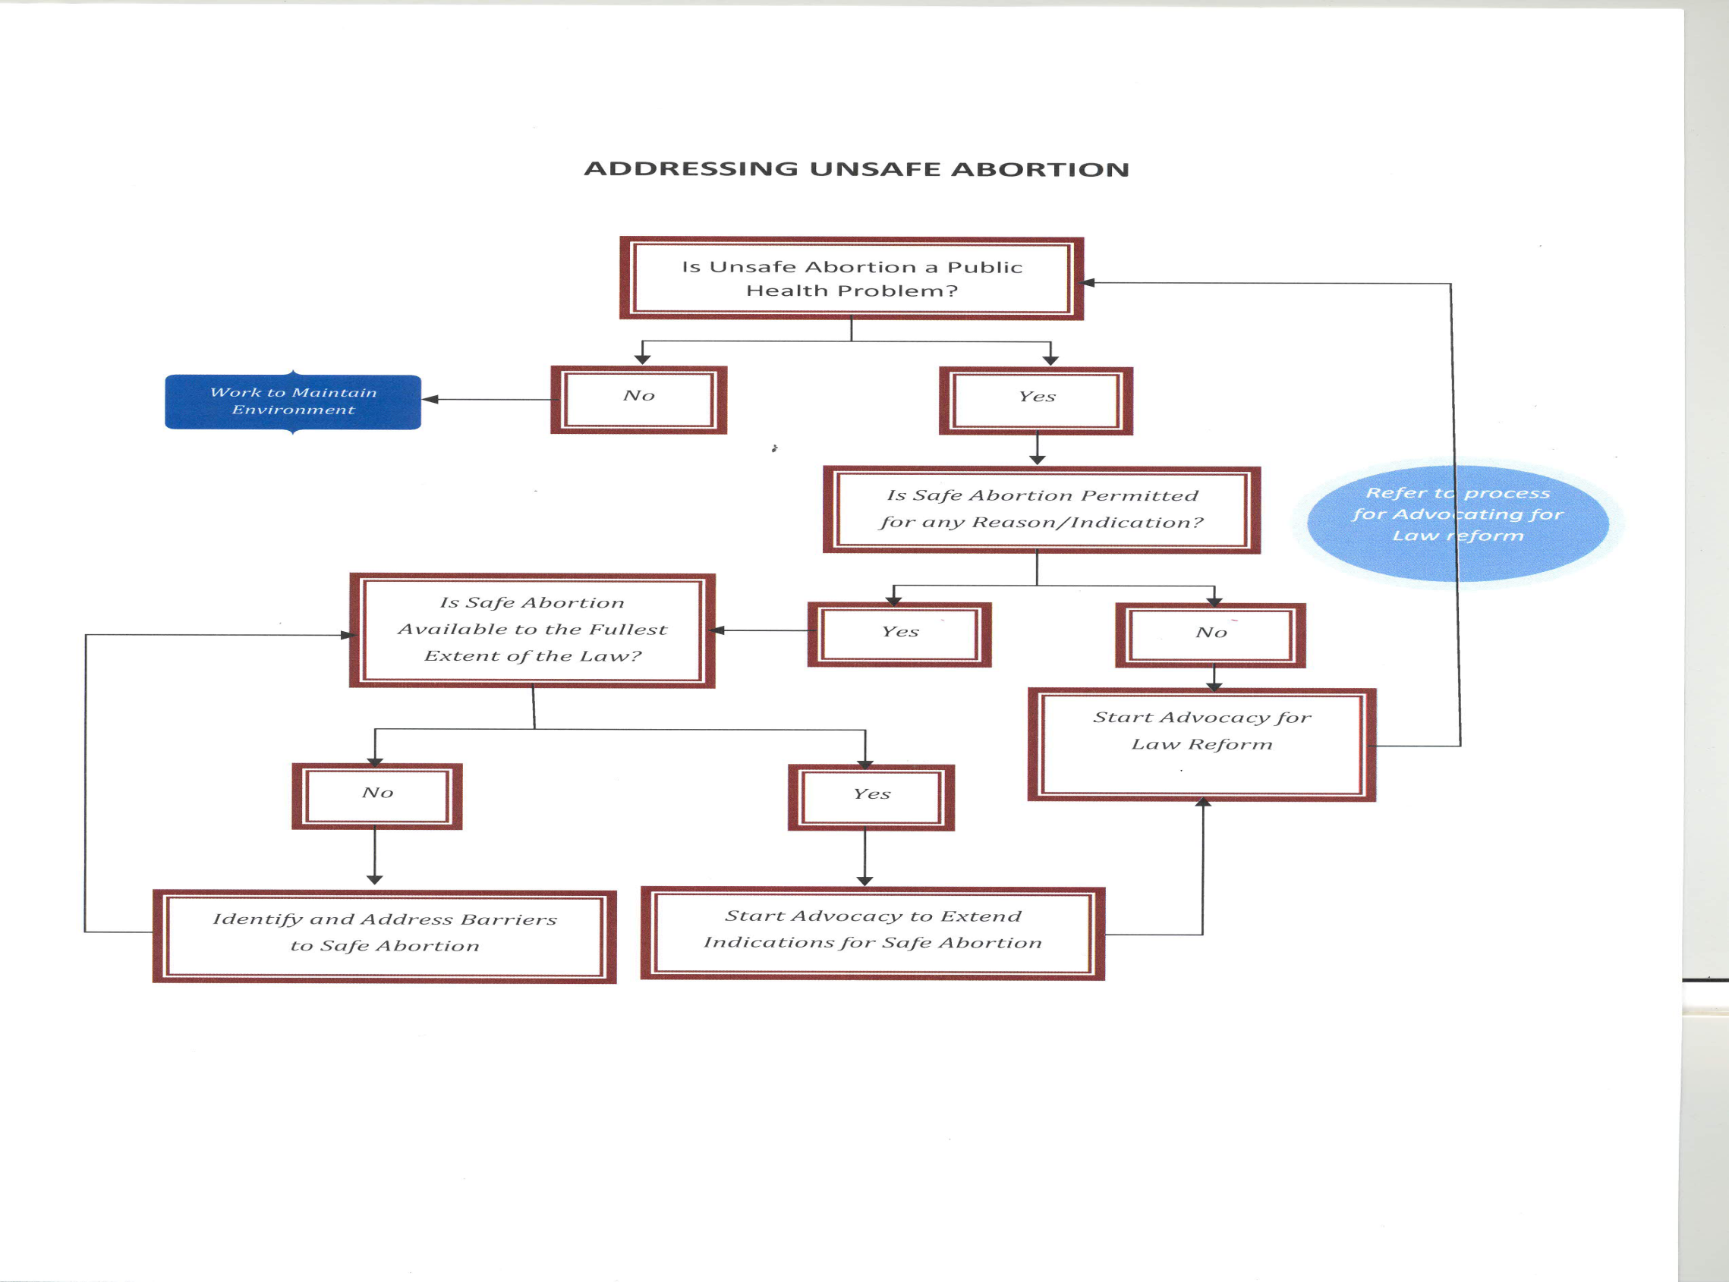
Notes:
Speaker’s notes:
This slide is a schematic assessment of unsafe abortion as a public heath problem and the need to address it.

Slide 13
Magnitude Study in Malawi
Interviews with 56 health professionals to estimate how many women access health care
Interviews with health centre managers to determine caseload and services provided
Capture of data on women presenting for post abortion care (PAC) for 30 days in a sampling of 166 health facilities in Malawi
NPC Training in MNH
Notes:
Speaker’s notes:
The study was very comprehensive and should therefore give us a reliable information on the magnitude of the unsafe abortion problem in Malawi.
SLIDE

Slide 14
Magnitude Study findings
For Post-Abortion Care cases:
One fifth (95% CI 18.5-22.1) had severe complications
6.6% (95%CI 5.6-7.8) had moderate complications
73.2% (95%CI 71.2-75.1) had low/no morbidity.
NPC Training in MNH
Notes:
Speaker’s notes:
Categories of abortion complication severity were adapted from previous studies in South Africa and Kenya. Severe complications included having (1) a temperature >37.9° C, (2) organ or system failure, (3) generalized peritonitis, (4) pulse >119 beats/minute, (5) evidence of foreign-body or mechanical injury, shock or death.
Moderate complications included a temperature between 37.3-37.9°C, localized peritonitis or offensive products.
SLIDE

Slide 15
Epidemiological Evidence of Abortion as a Public Health Problem in Malawi
QECH study revealed that abortion complications accounted for 68% of the admissions to the gynecological wards. (Mtimavyale et al, 1997).
QECH study in1999 and 2000 revealed that abortion complications were the cause of 23.5 % of the maternal deaths (Lema et al, 2000).
Village headman in Mulanje district, reported that five young girls had died from unsafe abortion between Jan. – June, 2009. Magnitude study report 2009
A chief in a village of Zomba reported that from January to June 2009, eight young girls in his 40,000 person administrative area had died of abortion complications. Magnitude study report 2009
Other community-based studies in Malawi between 1993 and 2003, (cited by Geubbels (2006)) shown that abortion complications constituted between 14-17% of maternal deaths.
Eastern and Middle Africa have the highest abortion rates in the world (36/1,000)[WHO2011], Malawi has a rate of 35/1,000
NPC Training in MNH
Notes:
Speaker’s notes:
SLIDE
A study done in 2004 revealed that among the 15-19 year olds 39% of the females and 35% of the males reported having a close friend or friends who had ever tried to end a pregnancy compared with 19% of females and 20% of the males aged 12-14 (Munthali et al, 2006).
About 25% unsafe abortions in Africa are among adolescents [Shah and Ahman (2004)]
One headmaster in Mangochi reported 54 girls dropped from primary school in 2009 in his one school alone.

Slide 16
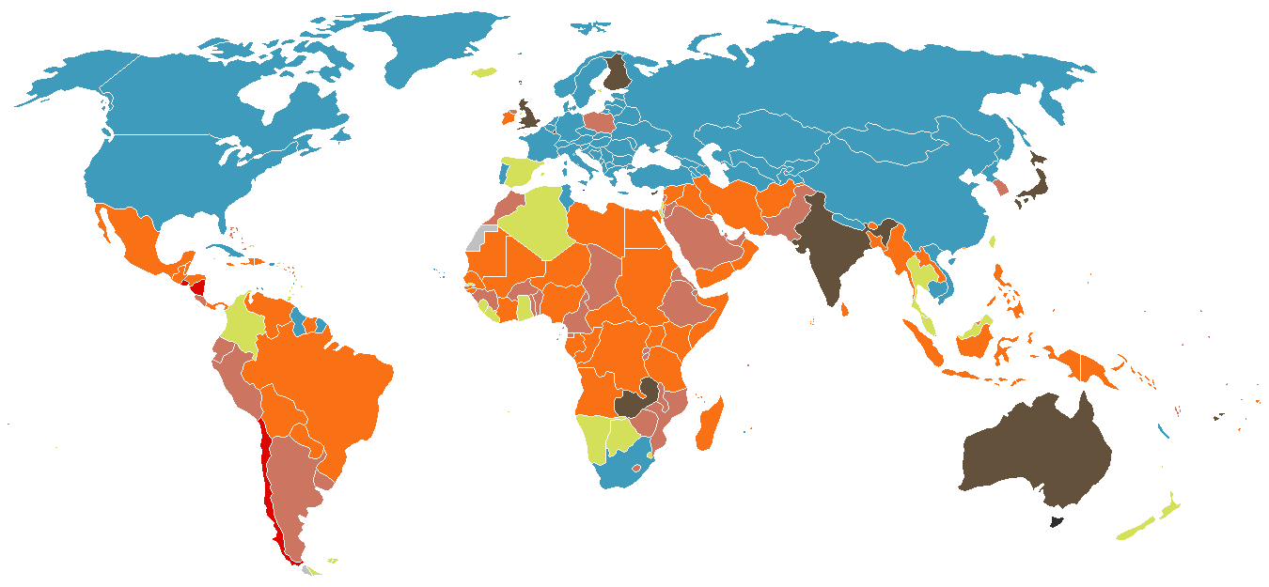
The world’s abortion laws
Without Restriction as to Reason - 56 Countries, 39.3% of World's Population
Socioeconomic Grounds (also life, physical health and mental health)-14 Countries, 21.3%
To Preserve Mental Health (also life and physical health) 23 Countries, 4.2%
To Preserve Physical Health (also life) 34 Countries, 9.4%
Could be Permitted to Save a Woman's Life - 66 Countries, 24.8%
Explicitly prohibited even to Save a Woman’s Life – 3 Countries, 1.1%
Data Source: Center for Reproductive Rights, 2007
NPC Training in MNH
Notes:
Speaker’s notes:
SLIDE
Only (1) Chile, (3) El Salvador and (3) Nicaragua have laws that explicitly prohibit abortion even when a woman’s life is threatened by the pregnancy.
Canada has no abortion law. It was repealed by the Supreme Court on the rationale that abortion is a medical issue and if govt does not regulate C/S by law why should there be a law on abortion. Abortion services are regulated by the Canada Health Act without legal restrictions.
For a list of countries’ abortion laws go to http://www.reproductiverights.org/pdf/pub_fac_abortionlaws.pdf

Slide 17
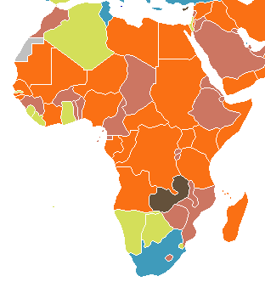
Abortion Laws of Africa
Without Restriction as to Reason
Socioeconomic Grounds
To Preserve Mental Health
To Preserve Physical Health
Legally Permitted to Save a Woman's Life
NPC Training in MNH
Notes:
Speaker’s notes:
SLIDE
Only in South Africa is abortion included in the criminal law. Most abortions are legal in Tunisia and South Africa.
In Ghana and Zambia, most abortions are legal under grounds of mental health.
A good abortion law must be accompanied by government effort to roll out safe services. This is happening in Ghana and Zambia.

Slide 18
Legal Situation of Abortion in Malawi
Malawi Penal Code:
Clause149: Imprisonment for 14 yrs. if guilty of felony for intent to procure a miscarriage
Clause150: Seven yrs. imprisonment for intent to self procure an abortion
Clause 151: Three yrs. imprisonment for providing means for procuring abortion.
Clause 231: Life imprisonment for preventing a child to live.
Clause 234: Not guilty if performed in good faith, to save the life of the mother.
Current practice:
Two doctors to agree that there is legal grounds for abortion based on ground to preserve the mother’s life (spouse consent required but often not sought)
NPC Training in MNH
Notes:
Speaker’s notes:
Inducing abortion is illegal in Malawi except where the life of the mother is threatened and at least 2 doctors are to certify that such a situation exists.
SLIDE

Slide 19
Abortion law and maternal mortality in Romania
NPC Training in MNH
Notes:
Speaker’s notes:
Here is an example of a politician who died for what he believed in. He however in the process made many women lose their lives.
Let us look at a practical example of the role of abortion in MMR
This graph shows the classic example of how unsafe abortion engendered by restrictive laws can affect maternal mortality. SLIDE
As you can see there was a steep and tragic rise in MMR mostly as a result of deaths from abortion etc. until 1989 when Ceausescu’s regime was overthrown
The abortion law was liberalized again leading to a dramatic fall in MMR
That is all it took to make a difference: LIBERALIZING THE LAW

Slide 20
Effective interventions for post-abortion care
Part 2
NPC Training in MNH
Notes:
Speaker’s notes:
Management of abortion is guided by the state in which the patient presents.

Slide 21
Abortion may present as
Threatened abortion
Complete abortion
Incomplete abortion
Septic abortion
Any of these may be spontaneous
or induced
NPC Training in MNH
Notes:
Speaker’s notes:
SLIDE
Where abortion is illegal, and because abortion has stigma attached to it, women will not volunteer information on induced abortion. In most induced abortions, there are no signs of interference.
It is not the duty of the health worker to find out as to whether the abortion was induced or not except for research purposes with a view to influence policy change.

Slide 22
Typical complications of unsafe abortion and their frequency of occurrence – Nigeria 2002-2003
COMPLICATION OF UNSAFE ABORTION | FREQUENCY OF OCCURRENCE
Retained products of conception | 50.3%
Haemorrhage | 33.6%
Fever | 34.4%
Sepsis | 23.5%
Pelvic infection | 21.4%
Instrumental injury | 11.4%
Shock | 4.3%
Death | 2.4%
NPC Training in MNH
Notes:
Speaker’s notes:
Complication rate is influenced by the skills of the performer, the method used, the environment under which the procedure is performed, and the gestational age of the pregnancy.
SLIDE

Slide 23
Long-term complications of unsafe abortion
Pelvic inflammatory disease
Tubal occlusion
Infertility
Ectopic pregnancy
Chronic pelvic pain
NPC Training in MNH
Notes:
Speaker’s notes:
Unsafe abortion has both medical and social consequences, including the orphanhood of children. Worldwide 200,000 children are orphaned each year, and economic consequences for the woman, the family and the State are enormous.

Slide 24
Abortion Case Fatality Rates
 | Estimated # unsafe abortions in 1,000s | Estimated # unsafe abortion deaths | Case fatality rate (%) [deaths/100 unsafe abortions]
World total | 20,000 | 78,000 | 0.4
Africa | 5,000 | 34,000 | 0.7
Asia | 9,900 | 38,000 | 0.4
Europe | 900 | 500 | <0.1
Latin America | 4,000 | 5,000 | 0.1
USA | 0 | 0 | 0.0
NPC Training in MNH
Source. World health Organization, 2004
Notes:
Speaker’s notes:
SLIDE (Define Case Fatality Rate)
Africa has the highest case fatality rate because women seek care late partly because of scarcity of services and partly because stigma associated with abortion and thereby not treating it as an emergency and with empathy.

Slide 25
National Service Guidelines on Management of Abortion
Post-abortion care
Empathy
Do not be judgmental
Maintain privacy and confidentiality
Screening for all possible complications of unsafe abortion
Retained POC
Tissue injury
Sepsis
Hypovolaemia/shock
Screen for other consequences of unprotected sex
{GC, syphilis rapid test, and HTC (HIV rapid test)}
Early MVA – unless contraindicated
FP to avoid repeat abortion
NPC Training in MNH
Notes:
Speaker’s notes:
Clinicians are expected to follow national guidelines on the management of abortion which take into account the legal environment and the resources available.
SLIDE
Greet patient respectfully and with kindness

Slide 26
What Interventions Work?
Cause of Death | % of Deaths | Known Successful Interventions
Haemorrhage | 24-35% of maternal deaths | - Oxytocin and Misoprostol are medications that can prevent or stop bleeding during and immediately following delivery. - Controlled cord traction and uterine massage are known techniques to stop postpartum bleeding. - Skilled attendants are necessary to administer medication or perform techniques.
Unsafe Abortion | 9-13% of maternal deaths | - Family planning information and access to contraceptives to prevent unintended and unplanned pregnancies. safe abortion services - Post-abortion care including emergency treatment for complications from spontaneous or induced abortion, follow-up and referral to other reproductive health services.
Infections (e.g. Sepsis, pneumonia, tetanus) | 8-15% of maternal deaths, 29-36% of newborn deaths, 46% of child deaths | - Antibiotics and immunizations are critical to treat infections in women and children. Hygienic delivery and postpartum care in a health facility can prevent infections in mothers and newborns. Treatment by a skilled health care provider near children’s homes.
Eclampsia & Hypertensive Disorders | 12% of maternal deaths | - Magnesium Sulphate can be administered by skilled attendants as an effective, safe and inexpensive medication that reduces the risk of eclampsia and maternal death caused by pregnancy-related hypertensive disorders.
Notes:
Speaker’s notes:
Management of unsafe abortion includes prevention and management of complications.

Slide 27
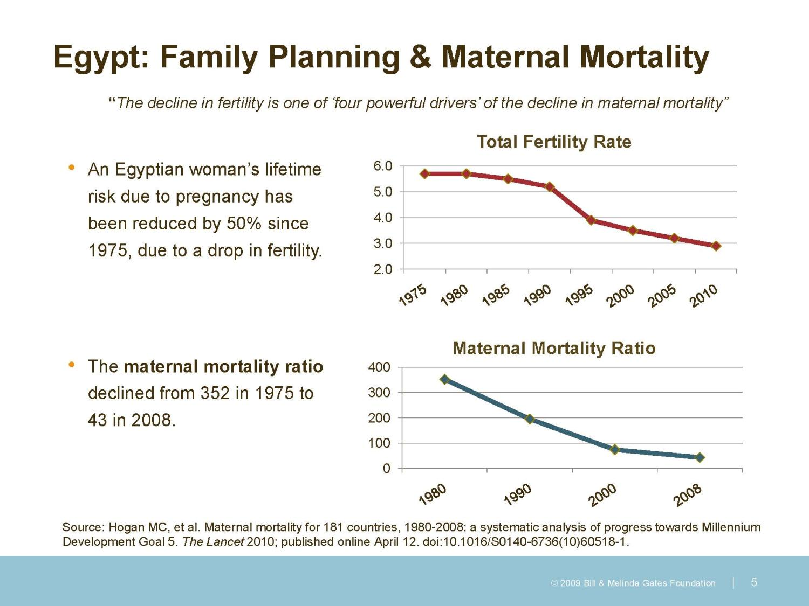
Notes:
Speaker’s notes:
FP influences health in 3 ways: reducing births that are too early or two late, reducing births that are too frequent, and reducing high birth order.
This slide shows that FP does reduce maternal mortality to a point by reducing unwanted pregnancy, increasing birth interval as well as reducing TFR

Slide 28
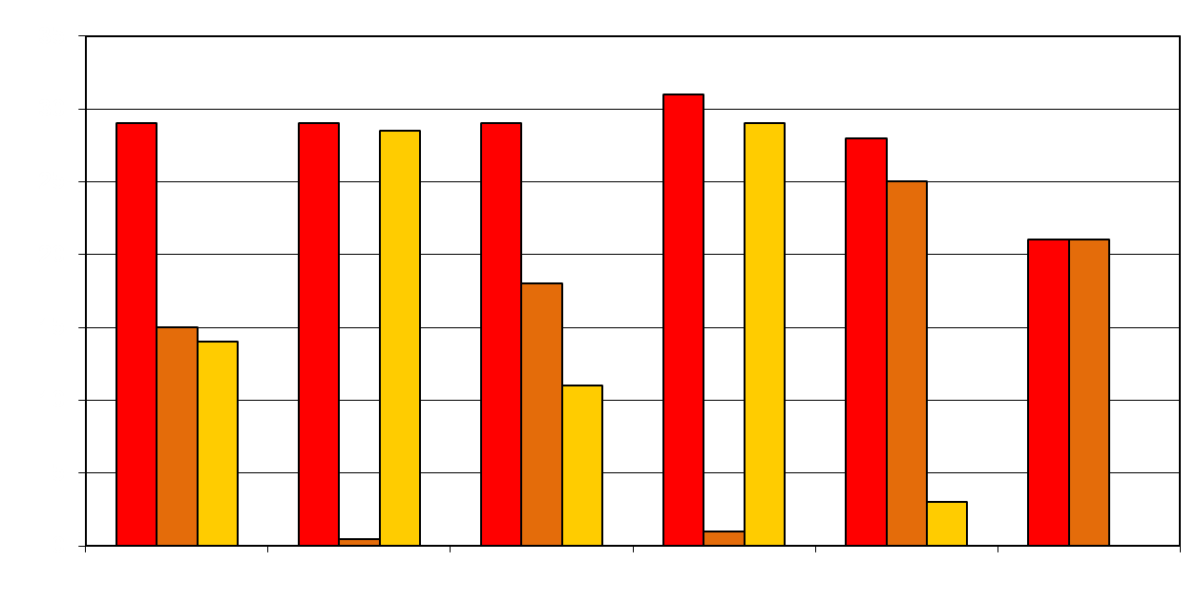
Abortion rates are similar, but safety varies dramatically
Abortion rate
Safe
Unsafe
-------------------------------------------
------------------------------------------
--------More restrictive--------
--Less restrictive--
World
Africa
Asia
Latin
America
Europe
North
America
NPC Training in MNH
(Sedgh et al., 2007)
Notes:
Speaker’s notes:
Studies also show that: Although abortion rates are similar worldwide, safety varies dramatically.
Globally nearly 50% of abortions are unsafe.
Nearly all abortions in Africa and Latin America are unsafe, which contrasts with the less restrictive regions of Europe and North America where nearly all abortions are safe.

Slide 29
1. Management of patient with complications of unsafe abortion
Good medical and social history – to detect all ill health and factors that may explain occurrence of abortion
Full physical examination – to illicit evidence of general ill-health
Pelvic examination to detect extent of complications (Speculum and then digital examination)
NPC Training in MNH
Notes:
Speaker’s notes:
Complication of abortion is an emergency that must be treated immediately.
Unless contraindicated, MVA is the standard and recommended treatment of unsafe abortion. It is cheaper and more patient friendly than D&C.
OPD management of unsafe abortion by MVA should always be promoted.
SLIDE

Slide 30
Life support and general measures
Life support and general measures – stabilise patient as necessary
Monitor pulse, BP, temperature and if in shock urine output and fluid balance
Hb, blood grouping and cross matching as necessary,
IV drip with Ringer’s lactate while awaiting blood transfusion where necessary to stabilise BP.
Prevention and management of infection
Observe aseptic technics – use sterile gloves, swab perineum with antiseptic, use sterile speculum for examination
Antibiotic prophylaxis or full triple antibiotic course where indicated
If fever present, exclude malaria (blood slide), and MSU for C&S
Culture and sensitivity if obviously septic
NPC Training in MNH
Notes:
Speaker’s notes:
Management of complications of abortion starts with stabilization of the patients and then specific treatment of the complications.
SLIDE
Inform the woman about her condition adequately and what you plan to do for her.

Slide 31
Manual Vacuum Aspiration
Perform bimanual exam to check uterine size and cervical dilatation to decide appropriate procedure
MVA if ≤ 12 weeks gestation
Curettage if ≥ 12 weeks gestation
NPC Training in MNH
Notes:
Speaker’s notes:
SLIDE
Ultrasound is not necessary in the management of abortion although it is routinely used in developed countries.
MVA need not be done in a theatre. Create a room in the unit for MVA
Train nurses to do MVA – every site should have more than one MVA provider to ensure continuous service.

Slide 32
Preparation for MVA(1)
Instruments for MVA
Single toothed tenaculum
Sponge-holding (ring) forceps
Bilabial speculum e.g. Cusco’s
MVA syringe and cannulae
Gallipot
Sterile gloves
Notes:
Speaker’s notes:
A health facility should have enough MVA sets to manage all the day’s patients in one sitting. Some times it is necessary to resterilize the earlier used sets as soon as they are used to use on the later patients.
For second trimester abortion, a ring (sponge) forceps is preferable, as it is less likely than the tenaculum to tear the cervix with traction and does not require the use of lignocaine for placement.

Slide 33
Preparation for MVA (2)
Give adequate information to the patient on what to expect during the procedure
Exclude allergies to all medication that you will use
Council woman to wash her perineum thoroughly and empty the bladder just before the procedure
Give paracetamol 500mg stat 30 mins. before the procedure (unless you are going to provide paracervical block).
Notes:
Speaker’s notes:
It is always necessary to provide analgesia to patients for MVA and D&C.

Slide 34
Preparation for MVA (3)
Prepare 20ml of 0.5% lignocaine for paracervical block
Combine:
lignocaine 2%, one part;
normal saline or sterile distilled water, three parts (do not use glucose solution as it increases the risk of infection).
or
lignocaine 1%, one part;
normal saline or sterile distilled water, one part.
Notes:
Speaker’s notes:
At the conclusion of the set of injections, wait two minutes and then pinch the cervix with forceps. If the woman can feel the pinch, wait two more minutes and then retest.
MVA allows OPD management of incomplete abortion
MVA allows patient to go home the same day which is patient friendly

Slide 35
Procedure for MVA (1)
Observe sterile technique (Wash hands, sterile gloves, sterile equipment)
Assemble the MVA syringe and create vacuum in the syringe
Give 10 units oxytocin or 0.2mg ergometrine IM before procedure to contract uterus and reduce risk of perforation.
Notes:
Speaker’s notes:
MVA need not be done in a theatre. Create a room in the unit for MVA
Train nurses to do MVA – every site should have more than one MVA provider to ensure continuous service.

Slide 36
Procedure for MVA (3)
Insert speculum and clean the vagina with antiseptic
Perform paracervical block
Remove POC from cervical os if present
Insert cannula slowly until fundal resistance is felt (should not be more than 10 cm.
Attach syringe and release vacuum
Move cannula back and forth while rotating around the uterine cavity. Avoid losing pressure
Notes:
Speaker’s notes:
As most patients tend to seek treatment late, endometritis is common – consider antibiotic cover after the procedure. If obviously infected on admission start triple antibiotics immediately but remember that MVA debulks the infected uterine contents.

Slide 37
Procedure for MVA (2)
Technique for paracervical block
Expose cervix with bilabial speculum
Inject 1 ml 0.5% lignocaine at 12 o’clock or 6 o’clock depending on where you plan to grasp the cervix with tenaculum or ring forceps (Insert the needle just under the epithelium.)
Grasp the cervix at 12 or 6 o’clock and apply slight traction (
Give paracervical block with 2ml 0.5% lignocaine at 3, 5, 7 and 9 o'clock (or at 10 and 2 o’clock) – not deeper than 3mm
Notes:
Speaker’s notes:
MVA need not be done in a theatre. Create a room in the unit for MVA
Train nurses to do MVA – every site should have more than one MVA provider to ensure continuous service.

Slide 38
Post-Procedure Management
Counsel for prevention of repeat unsafe abortion
Counsel on dangers of unsafe abortion
Counsel and provide effective contraceptive
Counsel on prevention of sexual violence
Provide date for family planning follow up
NPC Training in MNH
Notes:
Speaker’s notes:
SLIDE
Discuss family planning before the patient is discharged and provide her chosen method before discharge and arrange for follow up.

Slide 39
Questions
How should one manage threatened abortion when the woman does not want the pregnancy?
When would you provide safe abortion under the present law in Malawi?
What methods are available for safe abortion?
Who should provide safe abortion in Malawi?
NPC Training in MNH
Notes:
Speaker’s notes:
It is generally known that women seek abortion care late because they do not want to present with threatened abortion which clinicians will try to save.
Watch out for women who present with repeated threatened abortion.
SLIDE

Slide 40

Notes:
Speaker’s notes:

