Slide 2
Plan-Do-Study-Act
Clinical Systems Improvement

Slide 3

Is our patient journey wasteful?
Arrival
Registration
Nurse assessment
Does every step add value to our patient?

Slide 4
Waste that does not add value
Unnecessary movement of patients
Unnecessary motion (equipment and consumables not to hand)
Waiting
Unnecessary tests and investigations
Over processing (repeated history taking, examinations etc)
Errors
Overdurden of staff

Slide 5
Can you improve the patient’s journey?
Yes you can!
But it requires commitment and a more scientific approach from everyone in the team, and be open to new ideas.
You need to use data and involve all stakeholders to improve the patient’s journey
Plan-Do-Study-Act (PDSA) cycles
Small incremental improvements

Slide 6
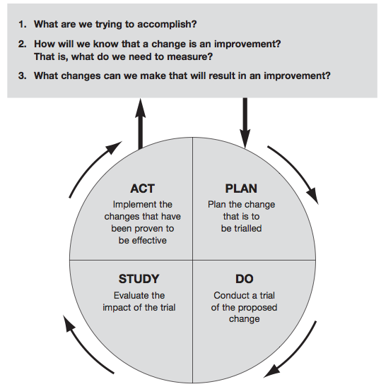

Slide 7
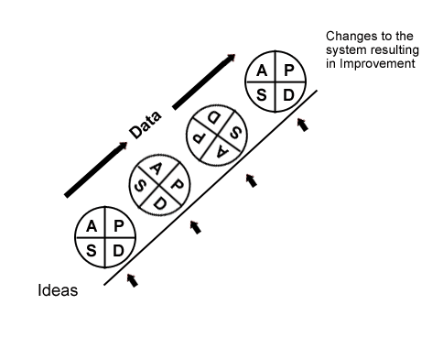
Modify then make standard practice
Trial new process with all patients
Modify then re-test with more patients
Change part of a system with a small group of patients

Slide 9
VSM patient journey summary
Patient focused
Sequential procedure steps
Time based
Uses simple tools: pen, paper, sticky tape
Map out current state using all stakeholders in the journey
Ideal states only uses steps that add value to patient journey
Use PDSA to experiment with improvements and remove waste
Maintain focus on the patient
Involve all stakeholders
Use your leadership qualities to lead the process

