Slide 1
Values-based practice
What are values?

Slide 2
Where do our values come from?
Customs
Traditions
Family
Our peers
Education
Community
Church
etc

Slide 3
Our values guide what we do
Values are principles and beliefs that guide our actions

Slide 4
But every human being is different
We share some values
We hold some values that are different

Slide 5
Clinicians operate in a framework of shared values
Shared between
Patient
Clinician
Family
Colleagues
Management
Society

Slide 6
Values-based practice clinical skills
Awareness of values including diversity of values
Knowledge of values including instinctual knowledge and knowledge derived from research
Reasoning about values including ethical reasoning (not simply deciding what is right)
Communication skills for discovering values

Slide 7
Knowledge of values

Slide 8
How do clinicians make decisions?
Evidence
Experience

Slide 9
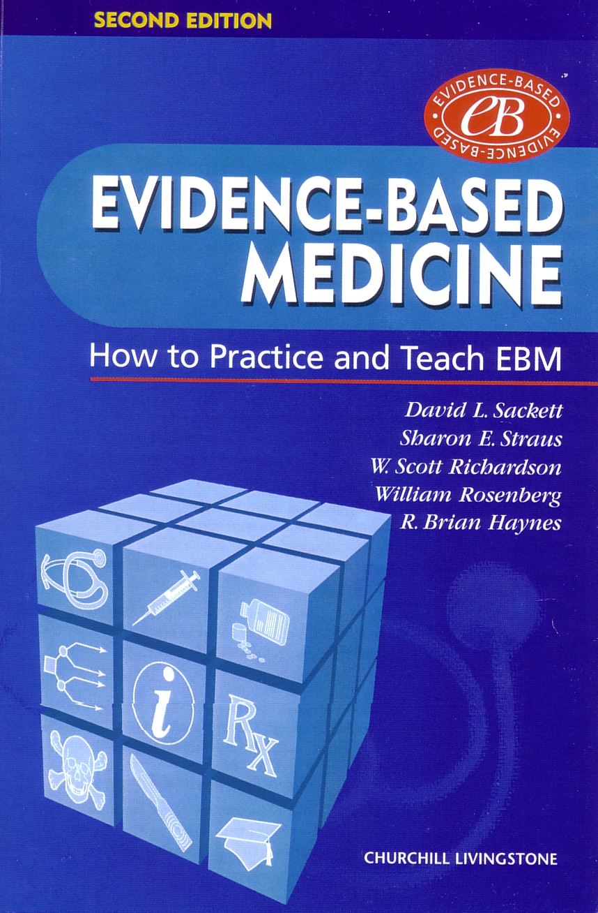

Slide 10
What is Evidence-Based Medicine?
… the integration of … ~ best research evidence ~ clinical experience ~ patient values

Slide 11
Making the best clinical decisions
The best clinical decisions are based on the best available scientific evidence, the experience of the clinician and on the values relevant to the individual patient situation
In Tanzania not all evidence is available yet…

Slide 12
Values-based practice and political democracy
Both start from the unique individual
“one person, one vote” in a political democracy
“one person, one unique set of values” in the values democracy of values-based practice.
Both rely on good process rather than preset “right outcomes” to guide decision-making
Notes:
Example, one decision the mother dies, another decision the baby dies

Slide 13
Was it a good decision?
Sometimes in clinical practice the best decision may have the worst outcome
But providing the decision making process was as good as it can be, you made the right decision

Slide 14
Why is this important?
Every individual is different
Experience guides when/how to use evidence

Slide 15
Some case examples
In each case a woman attends a health centre and tells the clinician that she is pregnant…

Slide 16
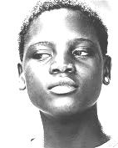
Mwajuma
Age 14

Slide 17
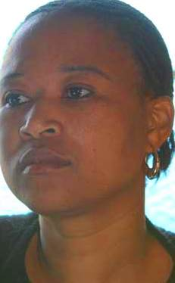
Elisabeth
Age 25 –
Known to have had difficulty conceiving

Slide 18
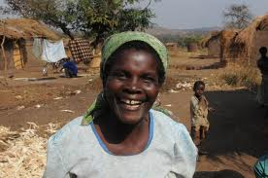
Mama Maganga
Age 42
Known to have 7 children and a very poor obstetric history with stillbirths

Slide 19
The first question
If you were the clinician who saw the patient when she first says she is pregnant, what would your first question be:
To Mwajuma?
To Elisabeth?
To Mama Maganga?

Slide 20
Every person is different
To establish the relationship with your patient you need to understand her values in order to plan her care
The more you understand and the more you interact with the patient, the better the decision

Slide 21
Self-awareness: our values
Think about the emotions you felt when you saw those images of 3 pregnant women
Use these feelings to help you uncover some of your own values about pregnancy
Be honest – this is not about judgements

Slide 22
Clinician values (1)
A woman who is 18 weeks pregnant is brought to your care, haemorrhaging PV
What are the values that underpin your immediate actions?

Slide 23
Clinician values (2)
As you prepare for curettage you discover the remains of a stick in her vagina
What values affect the way you act?

Slide 24
Case #2
You are off duty. You come across a man lying on the ground seriously injured. What are your values telling you to do?
But you have been to a party and had a few alcoholic drinks. Now what do you do?
You discover the man is a robber who has killed a home owner.

Slide 25
Case #3
A man comes to you with an STD. Do you treat him?
You find out he has had sex with children. Does your approach to the man change?

Slide 26
Values are action guiding
When in a dilemma, ask yourself “what is the essential aspect of a case?”
Your values guide your actions
Even when you have mixed emotions about a case
The quality of the decision is more important than the outcome

