Slide 1
Introduction to clinical education
David Davies
University of Warwick
Maria Chikalipo
Kamuzu College of Nursing

Slide 2
Your positive learning experiences
Which teacher has inspired you most?
What was the setting?
What did the teacher do or not do?
How did you feel?
15

Slide 3
Your negative learning experiences
When have you felt confused or unsure about what to learn?
What was the setting?
What did the teacher do or not do?
How did you feel?
15

Slide 4
Your own teaching experiences
Think about a recent time when you had to teach someone
What was the setting?
What did you do?
What went well?
What would you do differently next time?
How did you feel?
15

Slide 5
What are the leadership qualities of clinical teachers?
5

Slide 6
GUIDELINES FOR SCENARIOS
In small groups work on the given scenarios
Group 1 and 2 will work on scenario 1
Group 3 and 4 will work on scenario 2
Feed back will be given at the end of the discussion, one group member will facillitate while the rest are expected to give comments

Slide 7
SCENARIO 1
You are working in neonatal unit and statistics for the past 6 months indicate that neonatal sepsis is on the increase and has led to increased neonatal mortality. How would you manage this problem

Slide 8
SCENARIO 2
As an incharge of Labour ward you discover that resources are not enough most of the times particularly gloves and delivery packs. Sometimes deliveries are conducted using unsterile equipment. As a leader how would you ensure that resources are available and are used for the intended purpose

Slide 9
POINTS TO CONSIDER FOR SCENARIO 1
Situational analysis to identify cause and contributing factors
Work on the causes and contributing factors ie development of guidelines, laboratory investigations, ensure adequate resources for infection prevention, antibiotics etc

Slide 10
POINTS TO CONSIDER FOR SCENARIO 2
Involve everybody in and develop budget with justification
Justifications for the demands to management
Convince pharmacy people about the orders made
Lease with schools which are using the facility for training
Orient people on effective use of resources

Slide 11
LEADERSHIP IN THE CONTEXT OF INTERPROFFESSIONAL PRACTICE
BY
MARIA CHIKALIPO

Slide 12
LEARNING OUTCOMES
Describe leadership
Differentiate leadership from management
Discuss qualities of a leader focusing on team building
Discuss effective leadership management skills (POSCLEB)

Slide 13
DESCRIPTION
Leading people and it involves shared power, commitment and vision
Its associated with creativity, dynamism, change and risk taking
We are moving from management (Power over people to leadership)

Slide 14
DIFERENCES
Leaders gain power through their actions managers through positional power
Leaders are found throughout organization managers are found in organizations higher echelons
Leaders have followers who desire to be on the team. Managers have subordinates assigned to them

Slide 15
Ct
Leaders provide vision in terms of the real benefit to you managers use this is your job approach
Leaders have self conceived goals to better the organization, managers strive to meet the goals provided
Leaders strive to change the organization to best meet needs as they perceive them. Managers work to maintain the status quo of the organization

Slide 16
Ct
Leaders view rules and procedures as bureaucratic red tape, managers view them as as necessary controls to provide order
Leaders work for results managers follow directives

Slide 17
QUALITIES OF A LEADER AND TEAM BUILDING
Know yourself, institution ie why you exist, scope of practice, resources available and how systems work, job descriptions
Have a questioning mind always
Commitment and honest
Abilities of your fellow team members
Aim at being a servant and not to be served

Slide 18
Cont
Instil joint responsibility in your team members
Recognise other peoples talents and take them as partners not competitors
Should be competent
Able to train and coach others
Being respectiful

Slide 19
SUMMARY OF QUALITIES
Leaders are out front leading the charge
They see to it that people are trained
They like and respect people
Seek recognition for their people
They work for what is right for their people and organization

Slide 20
Cont
They confront problems to solve them
They admit mistakes
They empower people
They coach and mentor and support people
Ability to solve conflict

Slide 21
Ct
Good communication skills at all levels
As teams are built take into consideration changes taking place: Technology, political , economic and demographic
Leadership to bring internal satisfaction not external gratification
Should be pro active

Slide 22
REACTIVE VS PRO ACTIVE LEADERSHIP
Proactive means :Take charge in conscious and deliberate manner
Look a head and anticipating desired future
Planning for what will be accomplished
Strategizing to prevent potential problems and serve resources

Slide 23
Cont
Reactive means:
Spending time reacting to events after they have occurred
Fire fighting which can impede thinking
Waiting passively for things to happen and resolving problems that arise

Slide 24
ATTITUDES ASSOCIATED WITH REACTIVE LEADERSHIP
Avoid blame or responsibility
Sees reasons why things can not be done
Is limited by what worked in the past
Is blinded by problems and obstacles in a situation
Is problem oriented concentrates on finding weaknesses and problems to fix

Slide 25
ATTITUDES ASSOCIATED WITH PROACIVE LEADERSHIP
Takes responsibility for actions
Has a can do attitude
Focus on solution on results wanted
Seeks options and focuses on opportunities in a situation
Is opportunity oriented focuses on finding strengths and resources
Thinks in terms of new possibilities

Slide 26
EFFECTIVE LADERSHIP MANAGEMENT SKILLS
Planning
Organizing
Staff development
Controlling
Leadership
Evaluating
Budgeting

Slide 27
REFLECTION
Think of the scenarios and the way we acted
Did we work as a team
Can we isolate qualities of a good leader
Did we manage to net work
What are the benefits of good leadership

Slide 28
Self-leadership :
feeling confident to contribute and act
What is Shared Leadership?
Acts of leadership can come from any individual in the organisation, as appropriate, at different times
Leadership is not restricted to those who hold designated leadership roles
A dynamic, interactive influencing process among individuals in groups
There is a collective shared responsibility for success of the organisation and its services
Emphasises teamwork and collaboration;
objective is to lead one another to achieve group goals
10

Slide 29
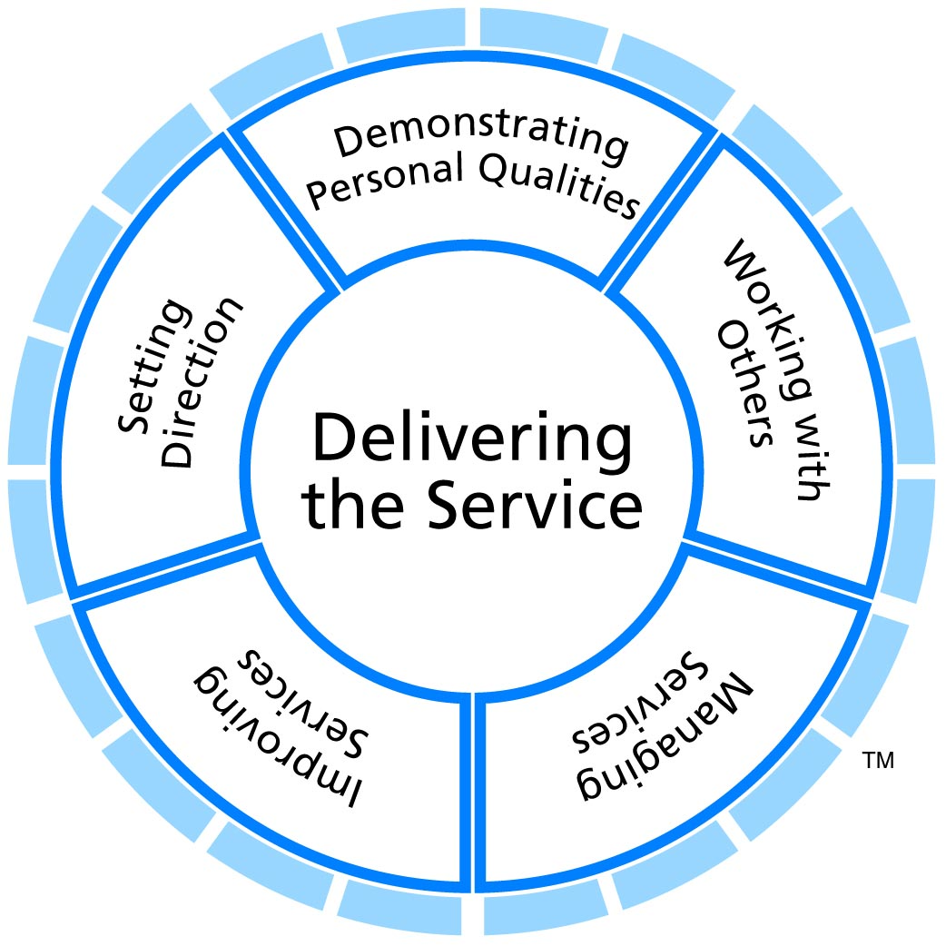
5+15+20

Slide 30
Leadership exercise
In your groups, consider which leadership qualities are relevant to the professional values of the clinician educator/trainer

