Slide 1

ANTE-PARTUM HAEMORRAGE (APH)
WONGANI ZGAMBO
ARNOLD MKANDAWIRE
DANIEL LEVITICUS

Slide 2
OBJECTIVES
By the end of this session participant should be able to
Define the term APH.
Explain the causes of APH.
Describe the clinical presentation of APH
Outline the management of APH

Slide 3
DEFINITION OF APH
.Bleeding from vagina at least at 22 weeks or more of pregnancy.

Slide 4
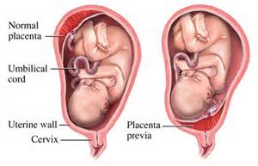
CAUSES
Many causes the major causes are
1– placenta previa
2-Abruptionlplacenta

Slide 5
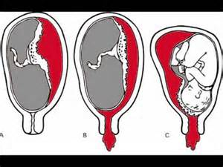
EXAMPLES OF PLACENTA ABRUPTUAL

Slide 6
CLINICAL PRESENTAION
PLACENTA ABRAPTUAL
Uterus is tender and hard(couvelaire uterus)
Heavy bleeding lead to hypovolemic shock.
PLACENTA PREVIA
Painless vaginal bleeding.

Slide 7
RISK FACTORS
Previous C/s scar
Uterine abnormality
Previous curettage
Multiparity
Multiple pregnancy

Slide 8
MANAGEMENT OF APH
Admit the patient
Management follow the ABC principle
If severe bleeding
Iv line ringers lactate or N/S
Grouping and X-match
Delivery irrespective of the gestation age usually c/s.

Slide 9
MANAGEMENT CONT……
LIGHT BLEEDING/ BABY PREMATURE
Keep the woman in hospital until delivery
Correct anaemia
Ensure blood is available for transfusion if required

Slide 10
INVESTIGATIONS
USS
Haemoglobin level.
Grouping and cross match.

Slide 11
COMPLICATION OF APH
Disseminated intravascular coagulation
Haemorrhagic shock which can lead to death.
Convulaire uterus which can lead to hysterectomy
Premature delivery/ FSB

