Slide 1


Tuberculosis
Dr Gregg Eloundou
Dr Ricky Jones

Slide 2
What is TB?

Slide 3
Tuberculosis is a disease caused by tiny germs that enter your lungs when you breathe them in
TB germs are most commonly found in the lungs, but sometimes they can move to other parts of the body
When you have TB disease of the lungs, you can spread it to other people

Slide 4
Common Symptoms of TB
Cough (2-3 weeks or more)
Coughing up blood
Chest pains
Fever
Night sweats
Feeling weak and tired
Losing weight without trying
Decreased or no appetite
If you have TB outside the lungs, you may have other symptoms

Slide 5
When you take your eye off the ball
Development of Multi drug resistant TB
Mass population shifts - Rapid urbanisation
Social risk factors still contribute to 1/10 cases (homelessness, drugs, alcohol or prison)
The rise of HIV and its association with TB
Antiretroviral treatment causes new problems….interactions with TB drugs and immune reconstitution

Slide 6
Obligate aerobe
Droplet spread, high virulence
Reach alveoli, enter and kill macrophages > cytokines > CASEATING GRANULOMA
Susceptibility either genetic or acquired (malnutrition, HIV, age, steroids, TNF blockade)
Haematogenous, lymphatic or endobronchial spread
5-10% develop active infection over lifespan. 50% of these within the first 3 years of infection…….PRIMARY disease.
Most common risk factor for death in low prevalence countries is failure of diagnosis

Slide 7
Primary infection
Progressive primary disease: Haematogenous (milliary), lymphatic, endobronchial or local spread
Lymphatic spread
Spontaneous resolution
Outline of the natural history
of Tuberculosis
Latent disease
Post primary disease
Reactivation of quiescent disease
at any site, re-infection or
Haematogenous spread (milliary)
Clinical disease
Treatment outcome

Slide 8
Global Problem
WHO declared TB a global emergency 1993
1/3 world population are infected
Major problem with affordable therapy in some countries
Issue of generic drug manufacture
American attack on pharmaceutical factory in Somalia removed the only source of available medication

Slide 9
Global TB
8 million new cases every year
1.3 billion infected
9 million have active disease
2 million die annually
Sub Saharan Africa 300/100,000
Fatality rate - 23%
Fatality rate (HIV+TB) - >50%

Slide 10
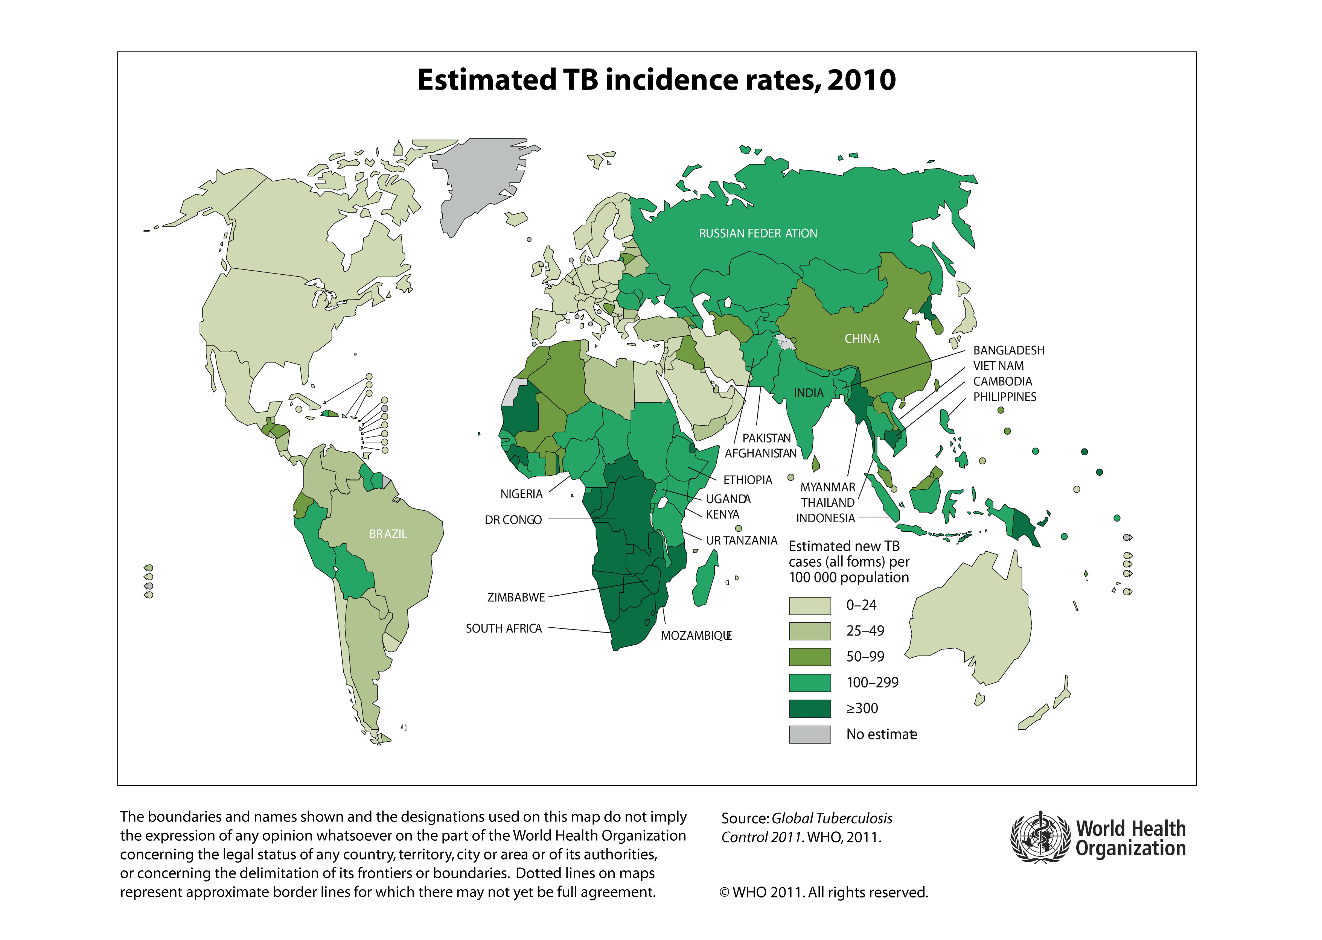

Slide 11
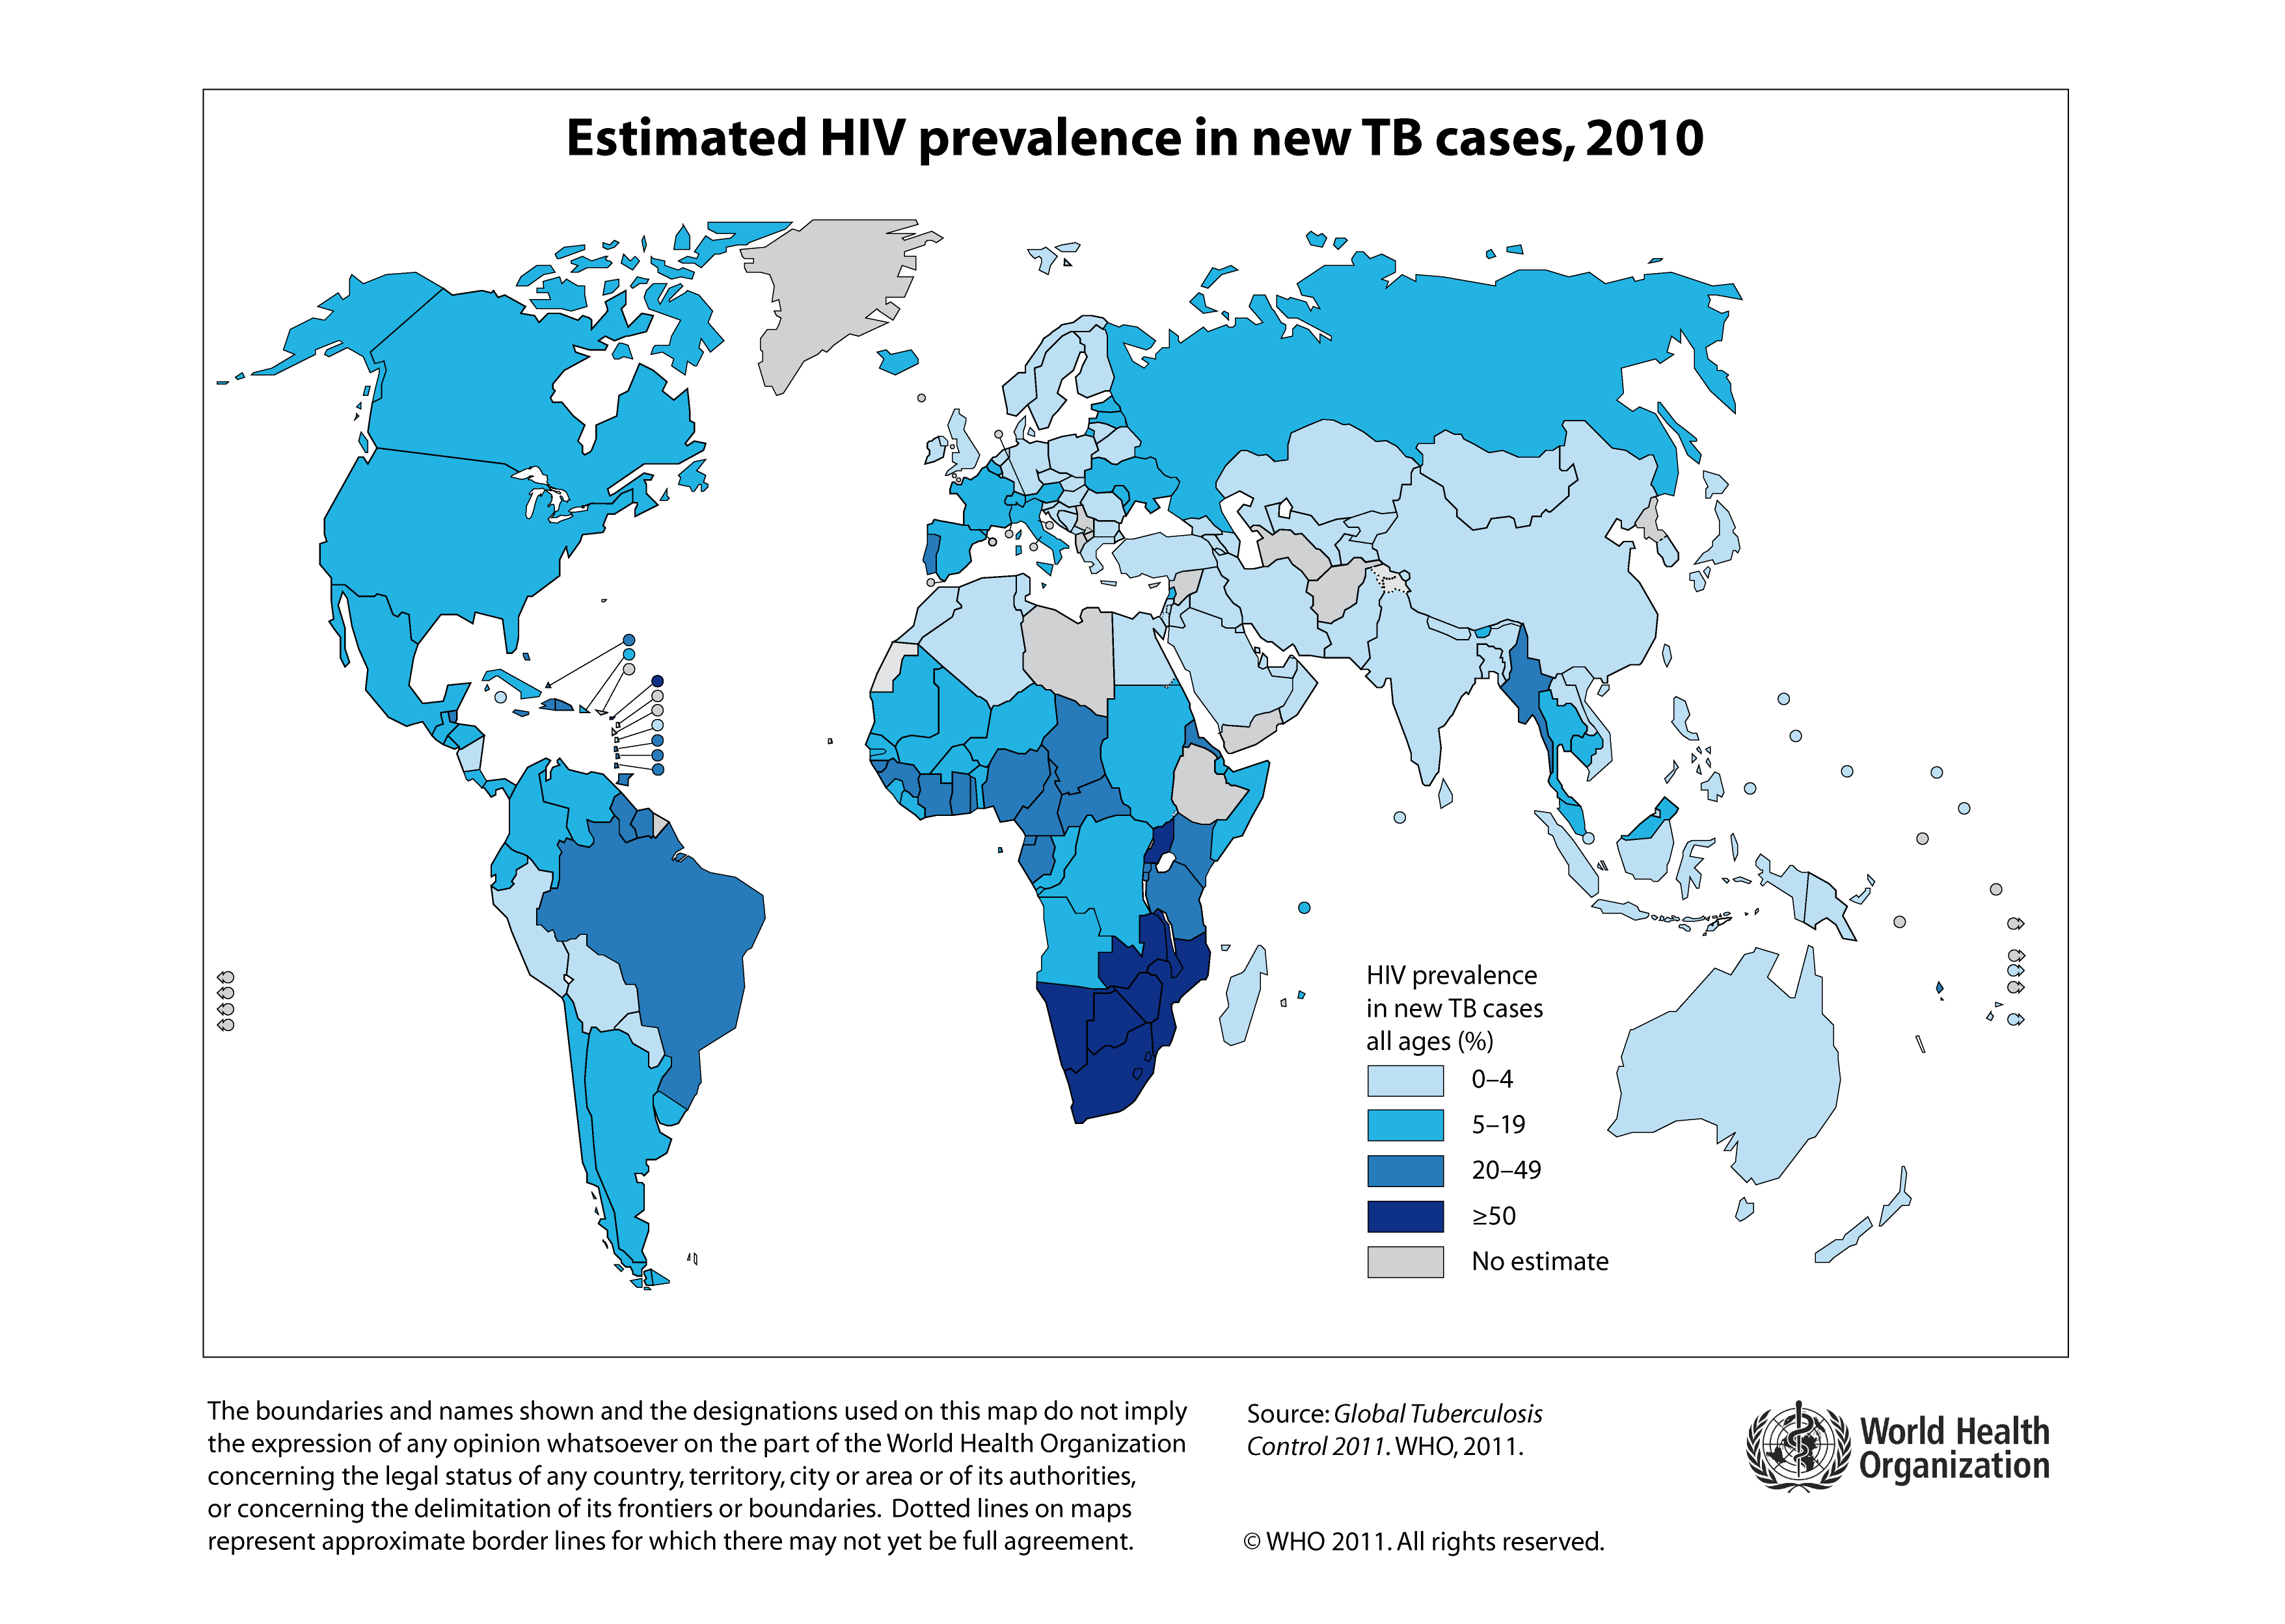

Slide 12
Primary Tuberculosis
Primary complex + lesion + draining gland
  usually asymptomatic
  Skin test conversion
- Post primary pulmonary tuberculoses
  Local spread – Pneumonia
  Haematogenous spread – Milliary
    Spread to bones and joints
    Spread to kidneys
  Reactivation
  Exogenous re-infection

Slide 13
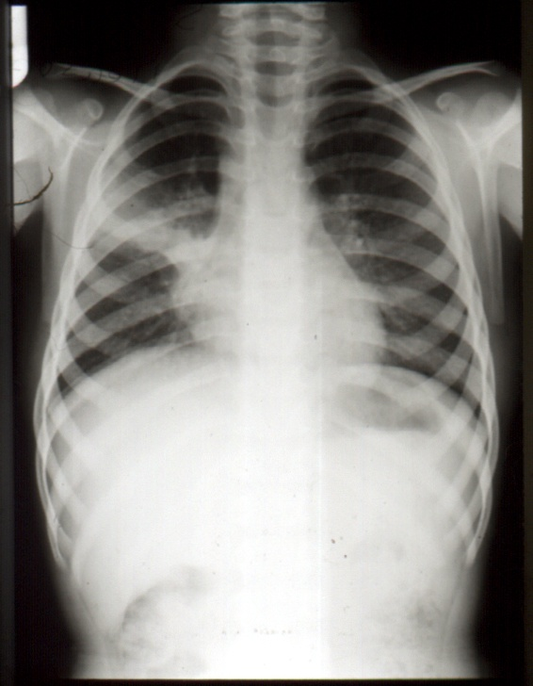
Primary
Disease

Slide 14
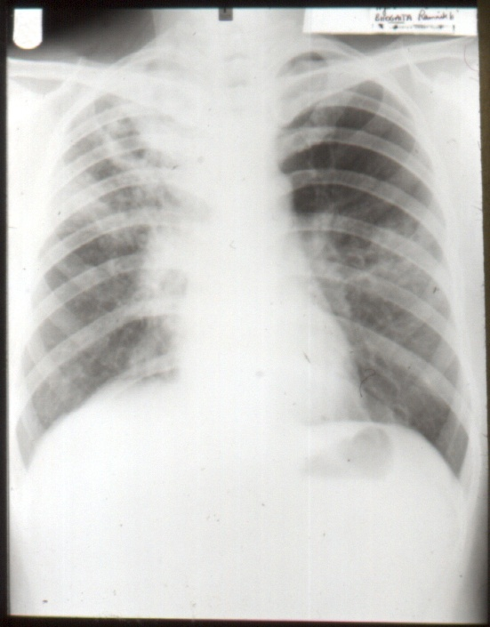
Lobar
Pneumonia

Slide 15
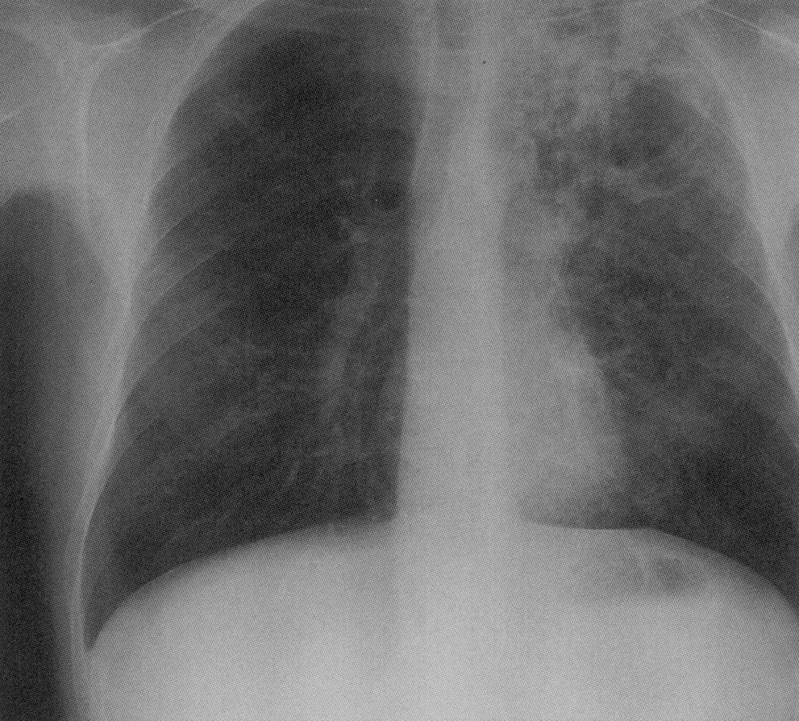
Upper lobe
cavitatory
disease

Slide 16
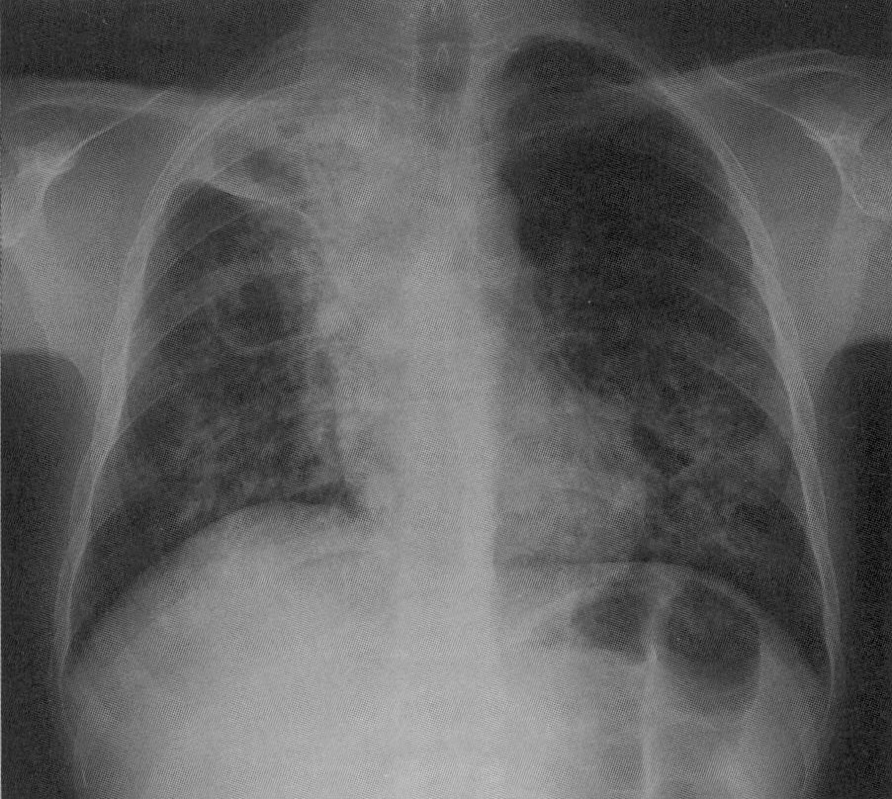
Bronchopneumonia

Slide 17
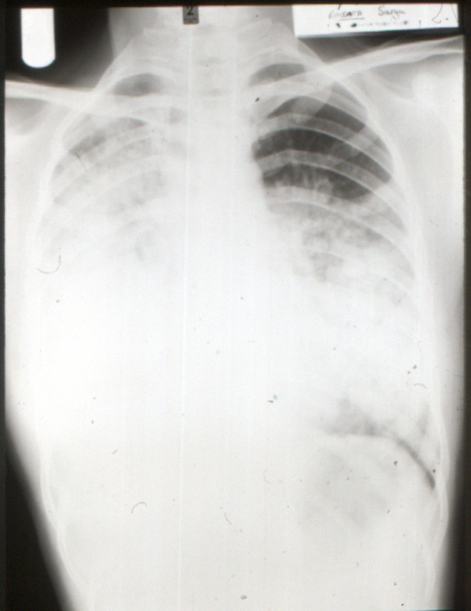
Fatal
Bronchopneumonia

Slide 18
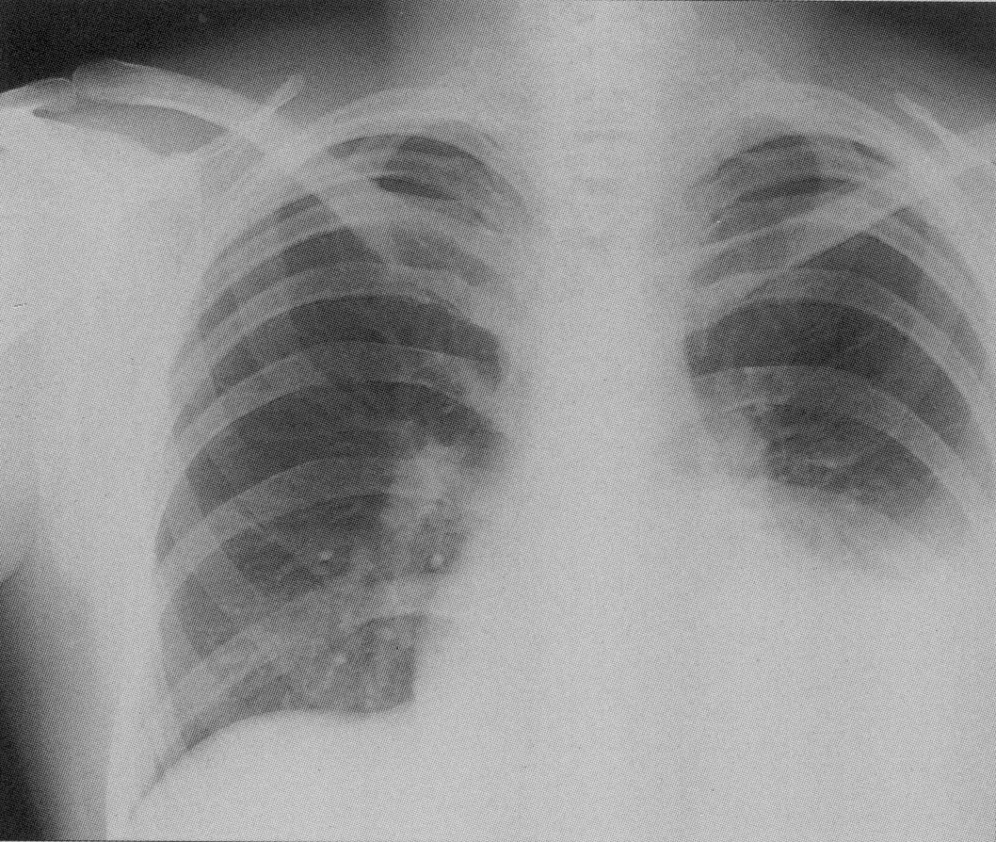
Pleural Disease

Slide 19
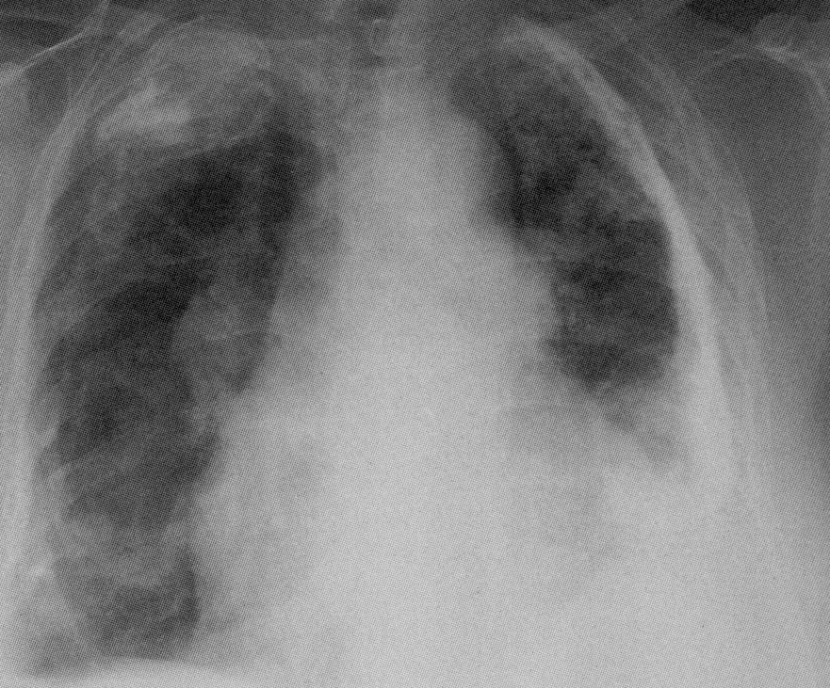
Previous
Pleural
Disease

Slide 20
Milliary Tuberculosis
Uncontrolled haematogenous dissemination
Progressive primary or reactivation
Requires impaired immunity thus 50% in infants, elderly and HIV+
Clinical course variable; fuminant to subacute
Non specific presentation; failure to thrive, aesthenia, night sweats, pyrexia, ARDS
Difficult to diagnose, 20% post mortem
Hepatomegaly, ascites, deranged liver function
Meningeal disease in 15 – 20%

Slide 21
Miliary Disease

Slide 22
Other Sites
- Lymph node
Skin
Meninges
Renal tract
Pericardial
Hepatic and GI
Bone
Reproductive system
Eye

Slide 23
Microbiological Diagnosis
Ziell Neilsen (acid fast) or Auramine stain.
Others
Lowenstien Jensen culture
Automated test - Radiometric culture C¹⁴
PCR and other nucleic acid amplification tests
Nucleic acid probes for various mycobacteria

Slide 24
Notification
TB is a notifiable disease
Contact tracing
  -Who was the source?
  - Has the current patient been a source?
- Outcomes
  - Not infected………….discharge
  - Seroconversion but no clinical disease ……..chemo-prophylaxis
  - Active disease………..treatment

Slide 25
Current BTS Treatment Guidelines
- Respiratory TB
  2 months Rifampicin, Isoniazid, Pyrazinamide, Ethambutol
  4 months Rifampicin, Isoniazid
  Pyridoxine
- Now given as combination drugs
  Rifater
  Rifinah
- Sensitivity patterns important

Slide 26
Pregnancy
- No increased risk of TB
- Women with TB should be advised against becoming pregnant until Rx completed
- Low dose combined OCP is less effective (RMP enhances metabolism of oestrogen)
- Rifampicin, Isoniazid, Pyrazinamide, Ethambutol – standard dose
- Streptomycin (8th nerve) and Ethionamide - avoid

Slide 27
HIV and TB
- Nearly 40 million HIV+ 70% in sub-Saharan Africa
- 23/24 countries with prevalence of >5%. are in sub-Saharan Africa
- 12-13 million have HIV + TB
Annual risk of clinical TB if HIV+ is about 10% (compared to 10% lifetime risk if HIV-)
Both diseases worsen each others outcome
Presentations can be similar
  (Weight loss, Lymphadenopathy, Fevers sweats)

Slide 28
Some take home messages
- Primary tuberculosis is usually asymptomatic
- High degree of suspicion required to diagnose pulmonary tuberculosis
- Radiology helpful but diagnosis ultimately rests on cultured samples, Newer diagnostic methods are being developed
- Mortality appreciable despite drug treatment which is lengthy and requires skilled supervision
- Notification, contact tracing and follow up essential

Slide 29
Any Questions??

