Slide 1
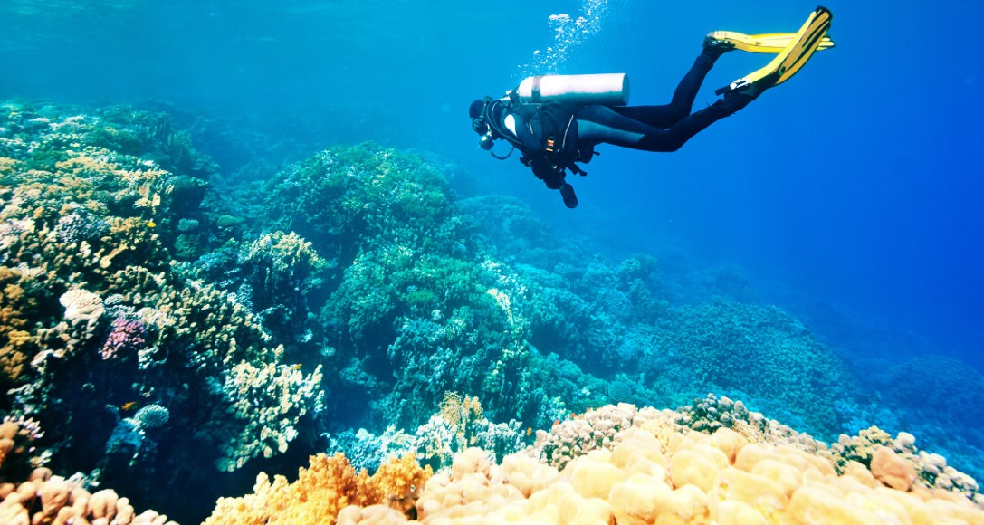

‘A deep dive into diversity, complexity and (de)coloniality’ – towards a wisdom-based pedagogy’.
Anti-Racism Pedagogy and Processes Conference
Friday 30 June 2023, University of Warwick.
Dr Gurnam Singh, Associate Professor of Sociology (Hon), University of Warwick and Fellow in Race and Education, UAL. @gurnamskhela. gurnam.singh.1@warwick.ac.uk
Notes:
Most mission statements of large complex corporations and organisations, including universities are infused with references to diversity and inclusion. Some even highlight commitments to decolonisation. However, though these ideas are indeed important, they are often misunderstood or associated with surface level change and of secondary level importance.
This presentation will argue that, fully understood, both diversity and decoloniality can become powerful ideas are mission critical for transforming the university into a socially just, dynamic, and competitive institution, whilst an inability to do so could be disastrous.
In advocating an approach that embraces deep diversity and decoloniality, this presentation will explore what this means for pedagogical practices. In doing so, a case will be made moving away from knowledge to wisdom centred pedagogy.

Slide 2
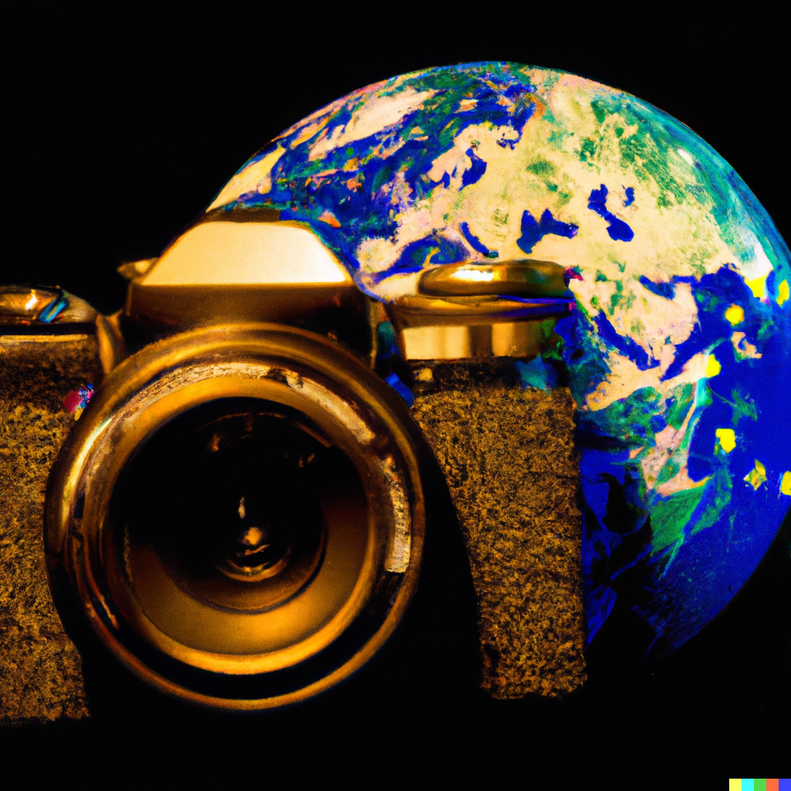
What is a decolonial lens in education?
Draws attention to the continuation of colonial legacies, both philosophical and material, that contribute to the production and reproduction of unequal outcomes in relation to access, retention, awarding and employment. It also highlights. resistances to coloniality.

Slide 3

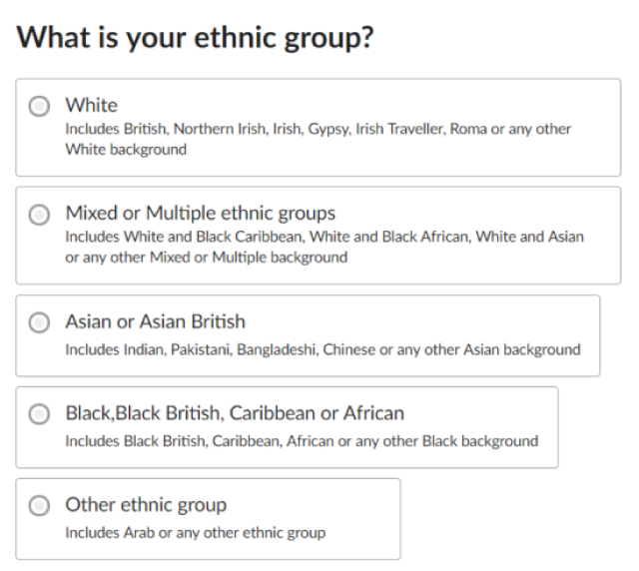
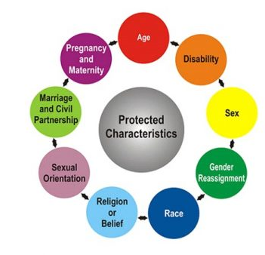
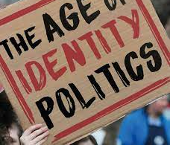
The social construction of surface diversity as identity

Slide 4
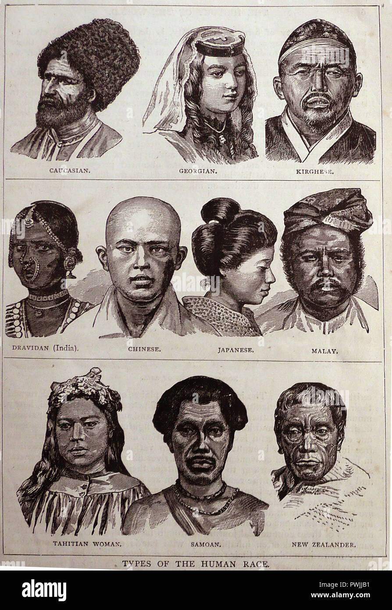

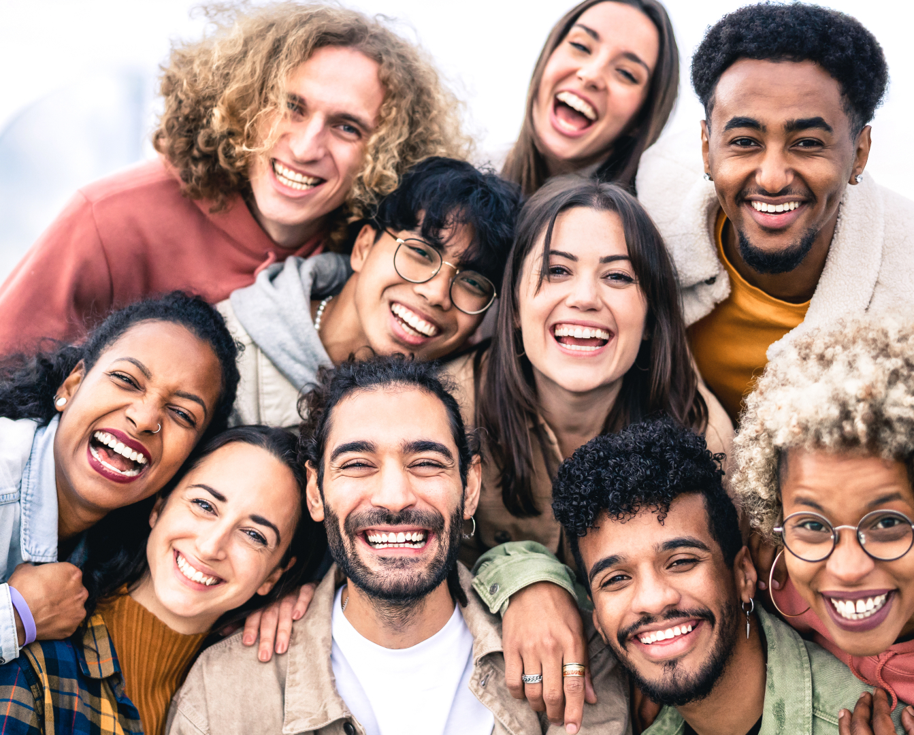

Problematising surface diversity?
Focus on observable external perception of difference, such as age, color, race, gender, sexuality, visible disability, physical size are just a few examples.
It might be rooted in a positive affirmation of difference, but also can be a source for stereotyping in prejudice behaviours.
Surface diversity can result in:
punitive and/or tokenistic activities
politics of entitlement,
Reinforcing binary oppositional identities
Feeding racialisation

Slide 5
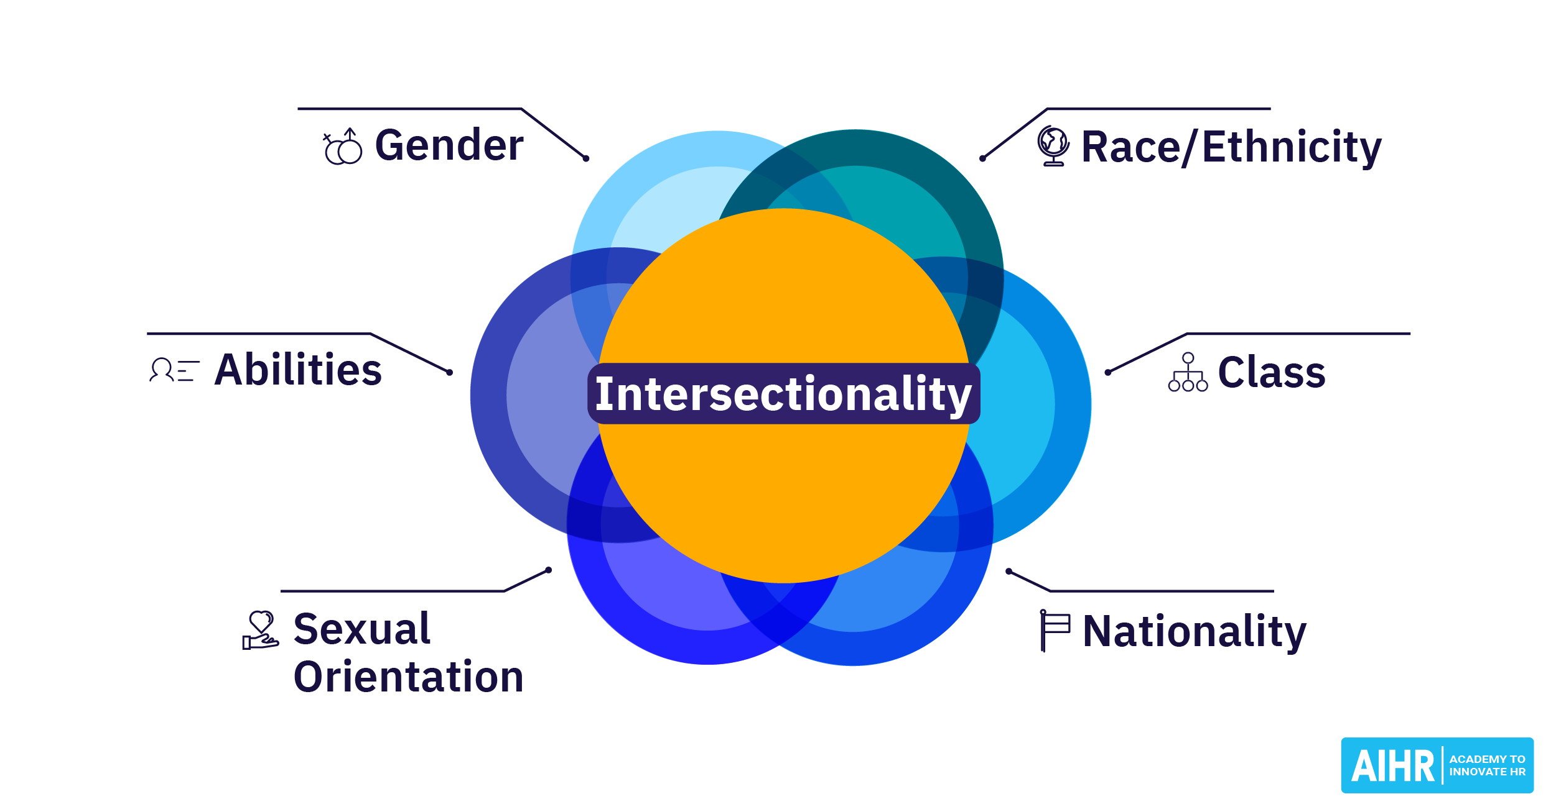
From surface to deep diversity
Intersectionality:
More than the sum of the parts – creates ‘chemical reactions to produce complex identities’.
Recognizes that individuals hold multiple social identities that intersect and shape their experiences of privilege and oppression.
Emphasis on the need to understand and address the complex ways in which different forms of oppression can intersect and compound one another.
(Collins, P. H. (2015). "Intersectionality's definitional dilemmas." Annual Review of Sociology, 41, 1-20.)

Slide 6
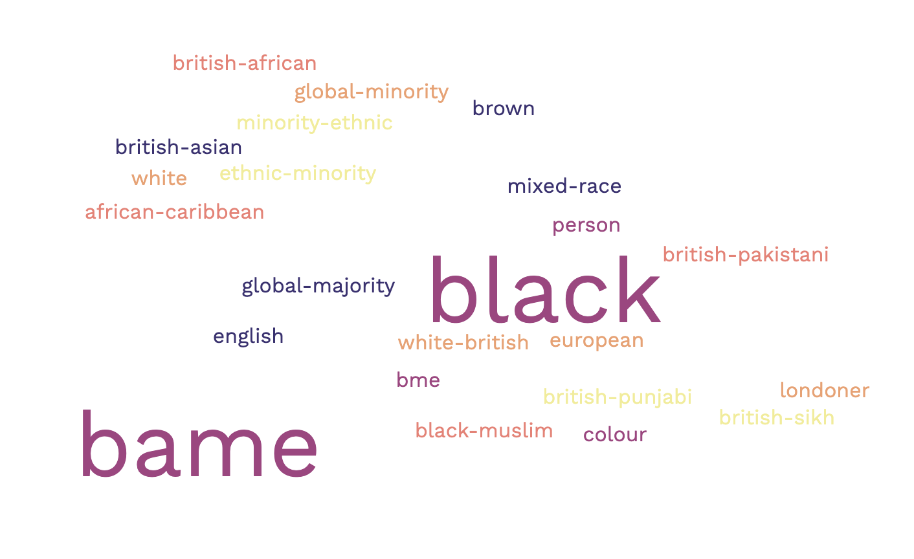
Diversity, Identity and complexity
Product of discourses: identities are not inherent or natural but are constructed through discourses and cultural practices.
Site of struggle and negotiation: identities are not static or unified; multiple, overlapping identities can with power dynamics in oppression and resistance
Process of identification: certain that resonate with their experiences and aspirations. Through cultural practices, symbols and ideologies, we construct a sense of self and belonging.
Difference and diversity: Identity categories are not fixed nor whole, but multiple. Hybrid and diverse.
(Stuart Hall (1996), "The Question of Cultural Identity”)

Slide 7
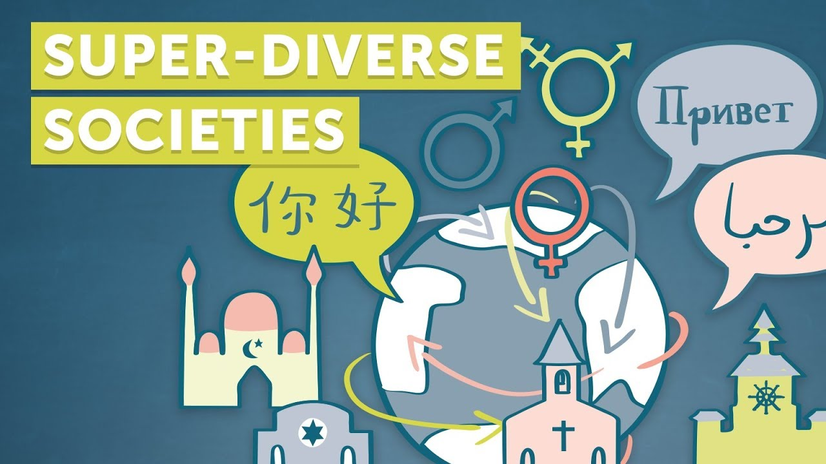
Diversity as a conceptualization of super diverse population dynamics.
Super diversity or diversity within diverse populations challenges traditional notions of diversity that focus on singular bounded conceptions of ethnicity.
Includes differences in language, religion, education, migration status, and other factors that shape people's identities and experiences.
Impacts policy in terms of how we think about integration and social cohesion.
a more dynamic policy model needed that takes into account the complexity and fluidity of identities in superdiverse societies.
Vertovec, S. (2007). "Super-diversity and its implications." Ethnic and Racial Studies, 30(6), 1024-1054.

Slide 8
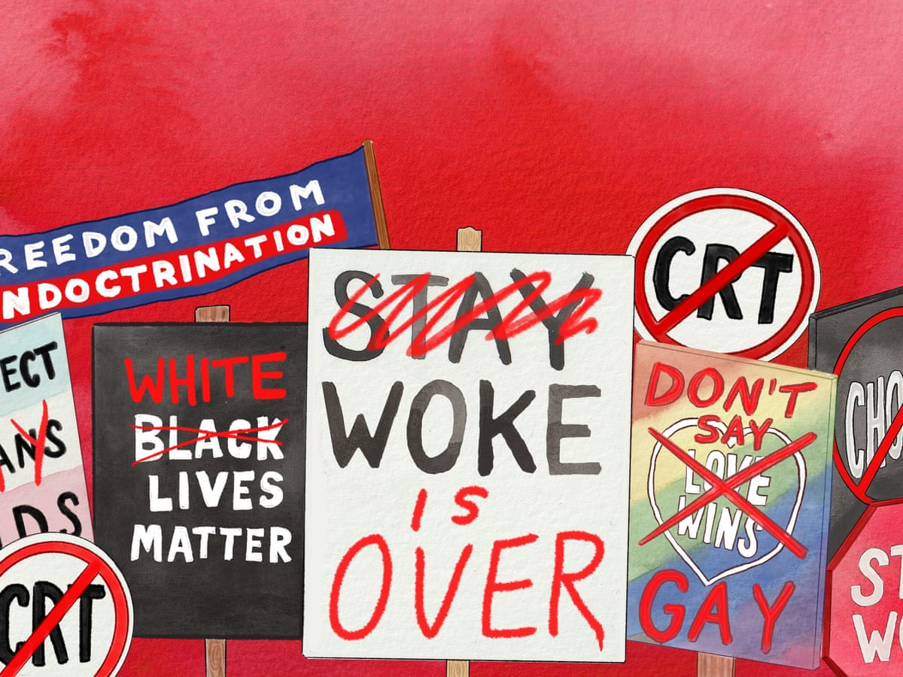
But promoting deep diversity is a complex challenge! Why?
The concept of deep diversity is complex i.e. is has unstable meanings, socially constructed and politically charged.
However, being a complex challenge does not mean there are no solutions, but it does mean solutions will need to be disruptive, innovative and novel
Thinking out of the box and reframing is a good starting point.
For example, shifting the discourse from ‘BAME attainment gap’, to ‘BAME awarding gap’, to ‘Disparities in degree warding’.

Slide 9
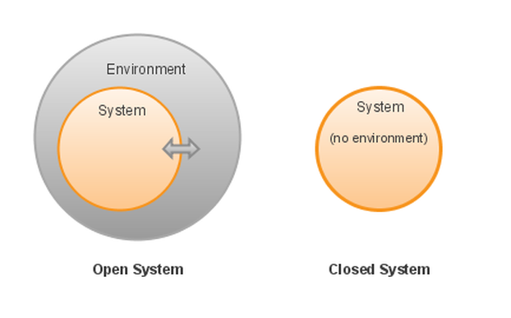
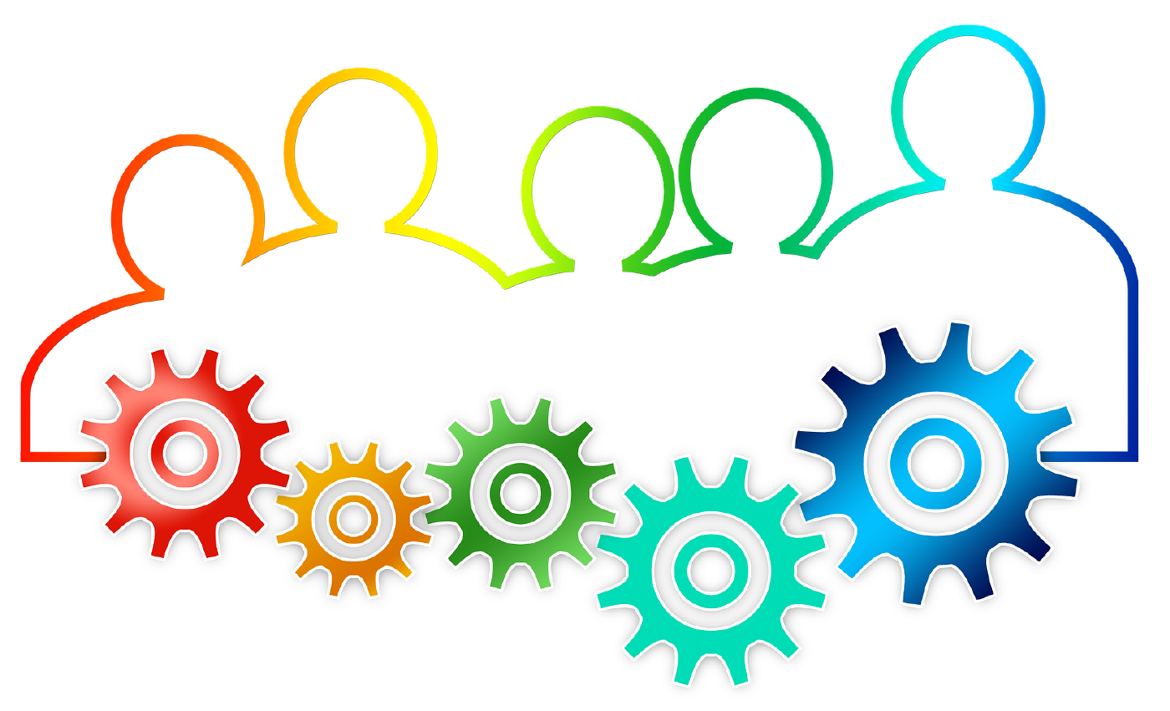
Deep diversity is critical for long term survival?
In closed equilibrium systems diversity often produces variation around the mean for performance measures, and therefore needs to be avoided/minimised.
But diversity plays a different role in a complex system than it does in a closed system.
By their very nature, complex systems are vulnerable to all kinds of shocks.
In complex adaptive systems, diversity makes fundamental contributions to system performance.
It underpins system level robustness allowing for multiple responses to external shocks and internal adaptations;
it drives novelty and innovation.
(Ref: Scott Page(2010). Diversity and complexity. Princeton University Press)
What does this mean?
Whether one is talking about organisations or animal and plant species, diversity leads to increased chance of success and survival.
Why? Because limited variety leads to diminished chances of coping with variability compared to a organisations and species with greater diversity.

Slide 10
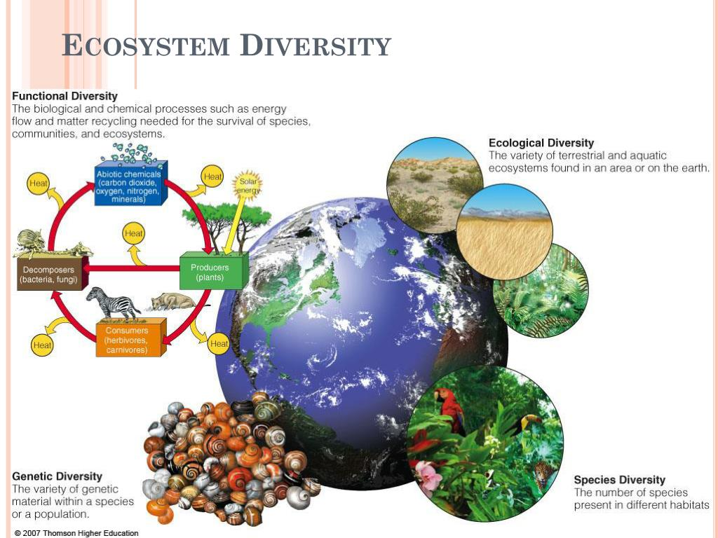
Deep diversity, complexity and survival
“Contrary to what the politicians and religious leaders would like us to believe, the world won’t be made safer by creating barriers between people. Cries of “They’re evil, let’s get ‘em” or “The infidels must die” sound frightening, but they’re desperately empty of argument and understanding. They’re the rallying cries of prejudice, the call to arms of those who find it easier to hate than admit they might be not be right about everything. Armageddon is not around the corner. This is only what the people of violence want us to believe. The complexity and diversity of the world is the hope for the future.”
Source: Michael Palin "Letter from London" (18 September 2003) https://www.palinstravels.co.uk/static-51?topic=1752&forum=12

Slide 11
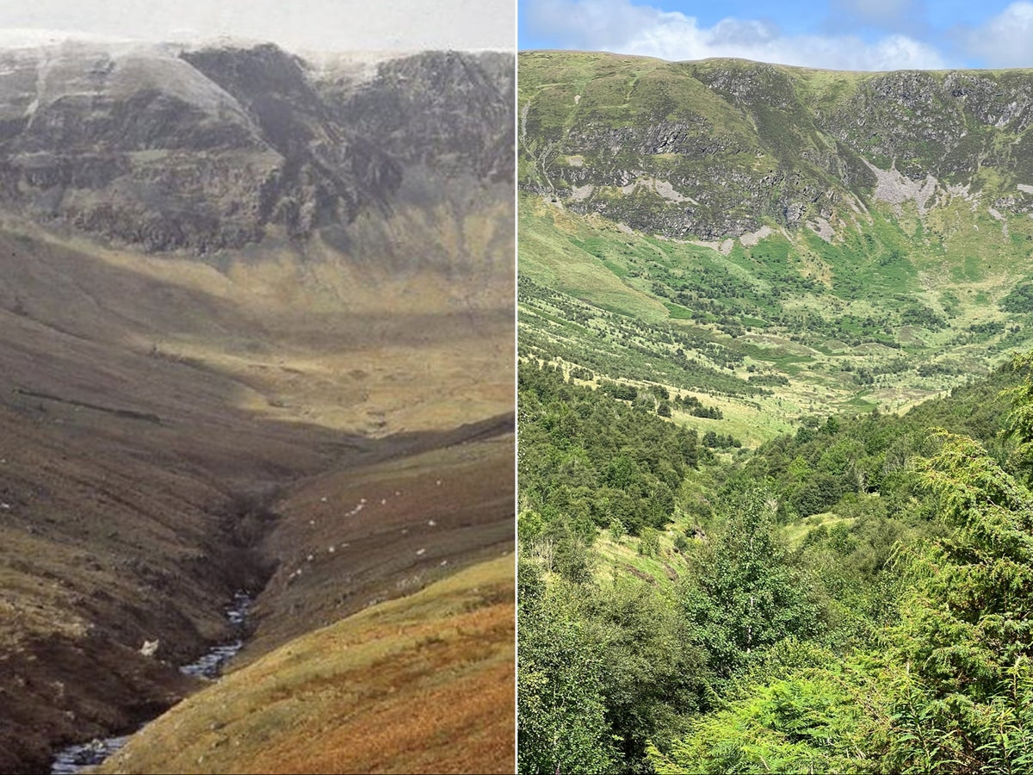
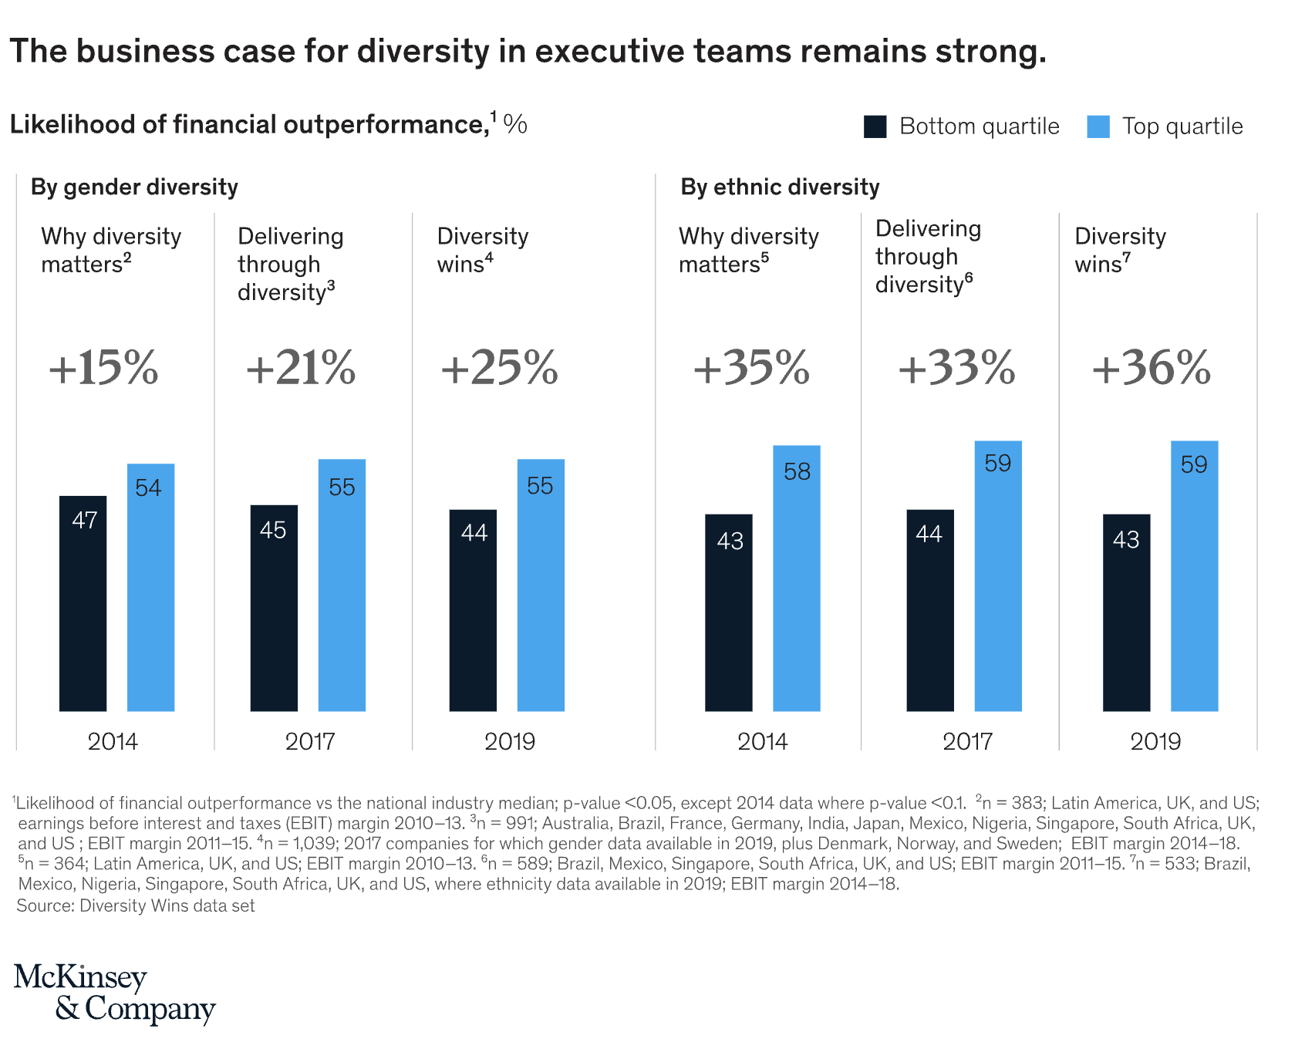
Deep diversity is essential for life and society because is enables complex systems to flourish.
Diversity of micro-organisms in your gut: better health
Biodiverse diets are better for health/ lack of diversity (e.g. vitamins) in diet leads to ‘malnutrition.’
High diversity ecosystems are more resilient, productive and carbon adsorbent.
Institutions flourish with higher diversity of human resources.
In terms of business development, a diverse portfolio for better economic returns and longer-term survival.
Generally, people find diverse environments and communities more desirable.

Slide 12

Deep diversity – implication for Higher Education and Social Justice.
“Since scientific knowledge is not distributed in a socially equitable way, its interventions in the real world tend to serve the social groups having more access to such knowledge. Ultimately, social injustice is based on cognitive injustice. However, the struggle for cognitive justice will never succeed if it is based only on the idea of a more equitable distribution of scientific knowledge.
Beyond the fact that such a distribution is impossible under the conditions of global capitalism, scientific knowledge has intrinsic limits concerning the kind of interventions it furthers in the real world. In the ecology of knowledges, finding credibility for nonscientific knowledges does not entail discrediting scientific knowledge.
It implies, rather, using it in a broader context of dialogue with other knowledges. ecology of knowledges permits not only the overcoming of the monoculture of scientific knowledge but also the idea that nonscientific knowledges are alternatives to scientific knowledge.” (Santos, 2014 p 296-7)
https://unescochair-cbrsr.org/pdf/resource/Epistemologies_of_the_South.pdf

Slide 13
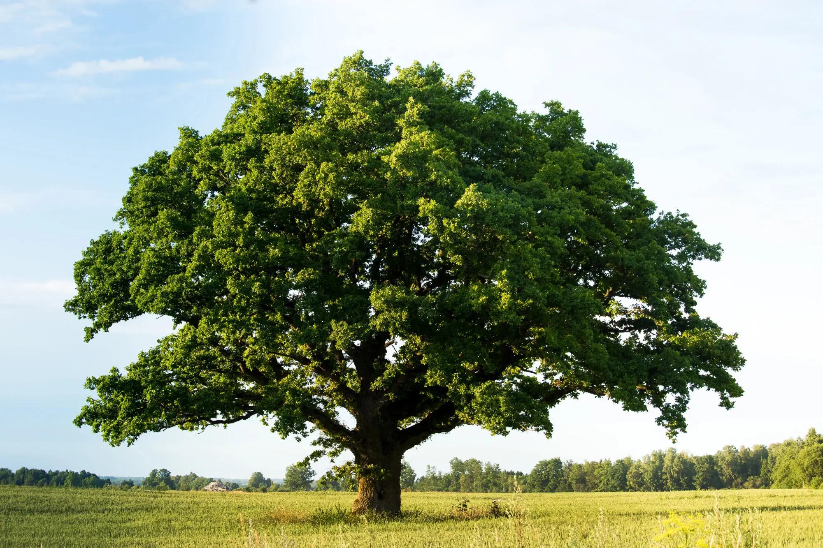
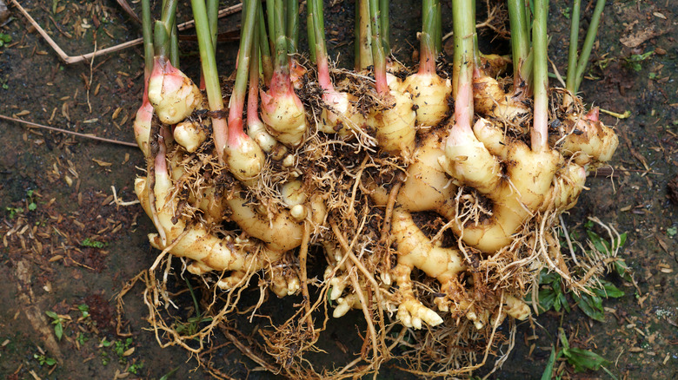
Deep Diversity: Shifting from arborescent (hierarchical) to rhizomatic (networked) was of thinking and producing. Deleuze, G and Guattari, F (1987)A Thousand Plateaus: Capitalism and Schizophrenia. Translated by Brian Massumi. University of Minnesota Press.
Notes:
Arborecent and Rhizomic
"arborescent thought" and "rhizomatic thought" as two contrasting modes of thinking and ways in which knowledge, systems, and structures can be organized.
Arborescent thought refers to a hierarchical, tree-like mode of thinking.
It is characterized by a central point or origin, fixed hierarchies, linear causality, and binary oppositions.
Arborescent thought seeks to establish clear and stable structures, categorizations, and boundaries.
It aims for organization, stability, and control.
this mode of thinking can be seen in various domains, such as traditional Western philosophy, scientific disciplines, and bureaucratic institutions.
Rhizomatic thought, on the other hand, proposes a non-hierarchical, interconnected, and nomadic mode of thinking.
It takes inspiration from the rhizome, an underground plant structure that spreads horizontally, without a central root.
Rhizomatic thought is characterized by multiplicity, non-linearity, connectivity, and a network-like structure.
It emphasizes the fluidity of connections, the interplay between different elements, and the emergence of unexpected connections and possibilities.
Rhizomatic thought rejects fixed categories and embraces a more flexible and open-ended approach to knowledge and systems.

Slide 14
Deep diversity and human capabilities
Approach | Underpinning assumption | Pedagogy
Deficit modelling (e.g. Entity theory, Carol Dweck ) | Due to a complex range of biological, social and economic factors, some students are simply more able/more ‘intelligent’ than others. Such assumptions are underlaid by racial/gendered/caste/class based tropes. | Streaming of students in relation to ability. Targeted interventions to facilitate skills development and behavioral change.
Unequal distribution of cultural capital (Pierre Bourdieu) | ‘Elite’ students possess cultural knowledge, skills, and dispositions that are valued in education. Other students encounter barriers in education due to their limited cultural capital, which acts as a barrier to thriving within the dominant cultural framework. | Democratize access to culture, knowledge and growth opportunities. Enable students to develop an appreciation of ‘high culture’ as well as promoting a more diver curriculum!
Community cultural wealth (Tara Yosso) | highlights the diverse forms of cultural capital present within marginalized communities. (e.g. aspirational, linguistic, familial, social, navigational, and resistant) Challenges deficit-based perspectives by valuing and acknowledging the cultural assets and strengths of students. | Affirming and integrating students' unique cultural experiences into the curriculum. Cultivating an inclusive learning environment that encourages students to draw on their cultural wealth. Centring learning on wisdom

Slide 15
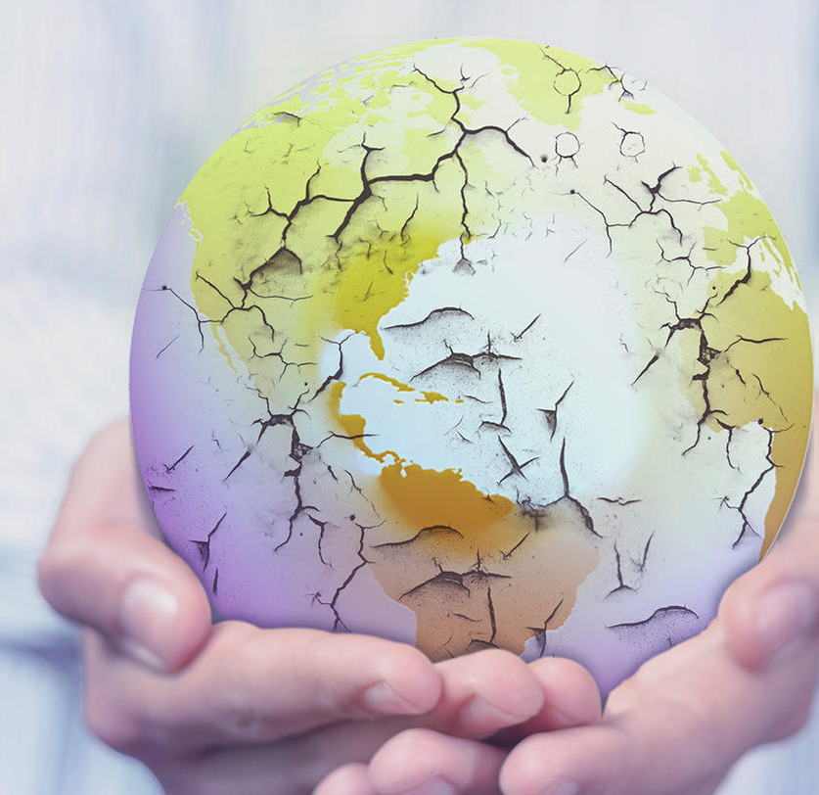
Impact of AI will be to make intelligence redundant.
“If intelligence is in part the ability to adapt to the environment, one might hope that increases in average IQ would help to make the world a more harmonious and understanding place…, but if people continue to destroy the world and the people in it, there may not be any people left to utilize the technology. We may have created a world in which people are smart, but not terribly wise.”(p372)
Sternberg, Robert J., and Judith Glück, eds. (2019) The Cambridge handbook of wisdom. Cambridge: Cambridge University Press

Slide 16
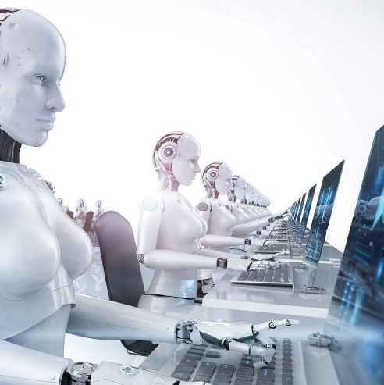
What AI will never be able to do?
Question: Are you wise?
Answer: As an AI language model, I don't possess wisdom in the sense that humans do. However, I am designed to provide information and insights based on the vast amount of data and knowledge that I have been trained on. My responses are generated by algorithms and statistical models, and I aim to provide accurate and helpful information to the best of my abilities.
(Chat GPT)
AI will never have intuition, creativity or common sense, which are all components of wisdom.

Slide 17
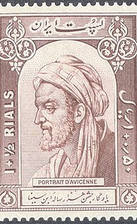
Wisdom based education is as old as humanity.
"wisdom (hikma) is the passage of the soul of man to the perfection possible for him within the two bounds of science and action." It includes, on the one hand, justice and, on the other, perfecting of the reasoning soul, in as much as it comprises the theoretical and practical.”
(Ibn Sina, in, A. M. Goichon, (1979) "Hikma" The Encyclopedia of islam, New Edition, ed. By B. Lewis, Vol. II!.)
Notes:
Ibn Sina,(980) commonly known in the West as Avicenna, was a polymath who is regarded as one of the most significant physicians, astronomers, philosophers, and writers of the Islamic Golden Age, and the father of early modern medicine.

Slide 18
Wisdom based education and human emancipation
“African-American women need wisdom to know how to deal with the “educated fools” who would “take a shotgun to a roach.” …This distinction between knowledge and wisdom, and the use of experience as the cutting edge dividing them, has been key to Black women’s survival. In the context of intersecting oppressions, the distinction is essential. Knowledge without wisdom is adequate for the powerful, but wisdom is essential to the survival of the subordinate.” (Hill-Collins (2000) 257)
Hill-Collins, P (2000) Black Feminist Thought: Knowledge, Consciousness, and the Politics of Empowerment 2nd Ed. London, Routledge.

Slide 19
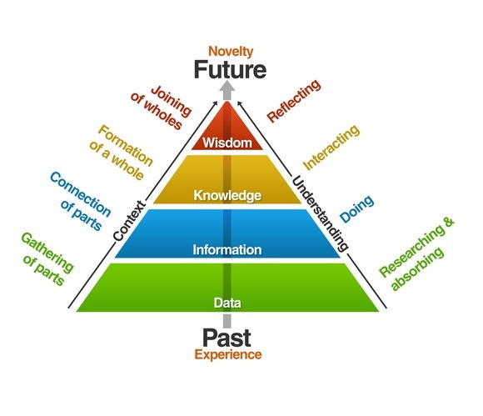
Situating wisdom
Cultural interpretations – the qualities of a wise person – associated with age!
Wisdom is often associated with virtues and a way of life.
It can be differentiated from Knowledge, Information and Data. (DIKW Pyramid)
Represents holistic thinking.
Incorporates reflexivity, complexity and systems thinking.
Rowley, Jennifer (2007). "The wisdom hierarchy: representations of the DIKW hierarchy". Journal of Information and Communication Science. 33 (2): 163–180.

Slide 20
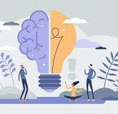
What has a wisdom-based education have to offer?
In a world dominated by “artificial intelligence” and ‘knowledge ubiquity” we need to shift the emphasis away from transmission and towards transformation.
A focus on wisdom wisdom involves using both one’s intelligence, creativity, knowledge base, experience and ethical awareness for a common good.
Addresses some of the critiques of the limitations and violence's of European Enlightenment Rationalism made by anti-colonial scholarship.
Offers the possibility of developing new epistemological frameworks that can reconcile ethics and the blind pursuit of knowledge.

Slide 21
Concluding thoughts
Being and ‘anti-racist’ is half the equation; we need to discover what we are for?
Coloniality, racism and capitalism have been instrumental in the destruction of human and non-human diversity, and we are now paying the price.
Can you imagine human existence without diversity – our survival as a species is predicated on diversity, hence we need to be serious about diversity.
Our contemporary education systems were not designed for or to promote diversity, but the opposite!
Widening participation and internationalisation has led to a very diverse student body trying to survive in hostile and alienating environment - we need a complete redesign.
In terms of curriculum and pedagogy nothing short of a paradigm shift centred, not on knowledge production, though this will remain important, but wisdom, criticality, ethics, caring and healing.

