Slide 1
Challenging Racism
Kaldora Ibekwe & Isabelle Gallier-Birt
Managing inclusive groups: an experiential guide for facilitators

Slide 2
Today's Session: ARPP Learning Circle
This workshop will give participants an insight into how virtual reality can be integrated into medical education – a blended learning approach
View
In this session, you will view 1 virtual reality scenario via a VR headset or device
Discuss
In small groups you will discuss the scenario and work through a series of prompt questions
Share
Themes and ideas shared with whole group
Understand
Learning points, reflection and feedback
Introduction
We will provide an insight into how this project came about, and the aims of the session

Slide 3
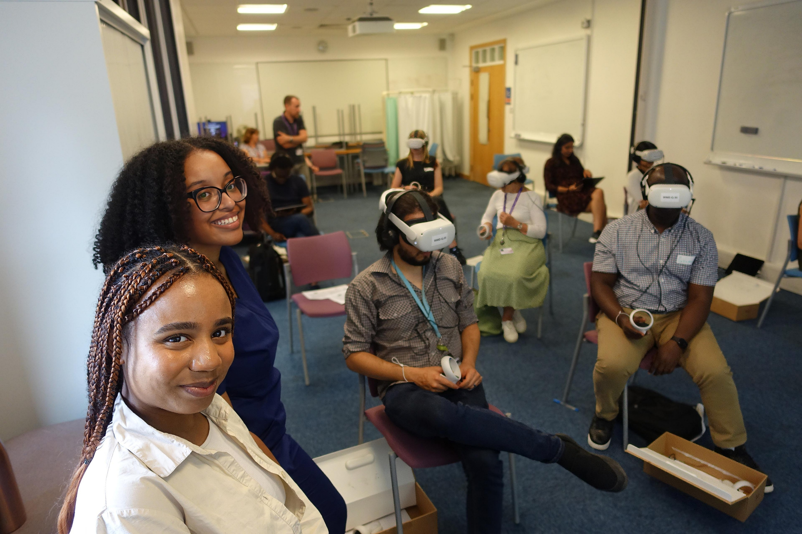
Introduction to Challenging Racism
Who we are:
Kaldora and Isabelle
Phase II Medical Students at Warwick Medical School.
Eager to discuss and improve how the medical school supports students from diverse backgrounds.
Why has this training been created?
Anti-racism training does not always consider the nuances of small group working.
Using virtual reality, we will explore realistic scenarios and provide practical strategies.
Students have reported uncomfortable experiences during CBL cases when discussing issues surrounding race
Facilitators should be given the tools to confidently navigate these conversations and advocate for students within CBL groups

Slide 4

What is CBL?
Case-Based Learning (CBL) is a key component of the MBChB curriculum.
  CBL groups consist of 8-10 students, guided by a facilitator.
  Each case follows a specific patient and explores their medical history and socioeconomic concerns.
  The patient's journey includes structured questions which encourage students to develop differential diagnoses and management planning.
  Discussion is student-led, but the CBL facilitator ensures all the learning objectives for each session are met.
  CBL acknowledges that students have existing knowledge and experience which they can draw upon when working through the case.
CBL is a learning tool used in other UK medical schools, and also plays an important role in the BSc Health and Medical Sciences at Warwick Medical School

Slide 5
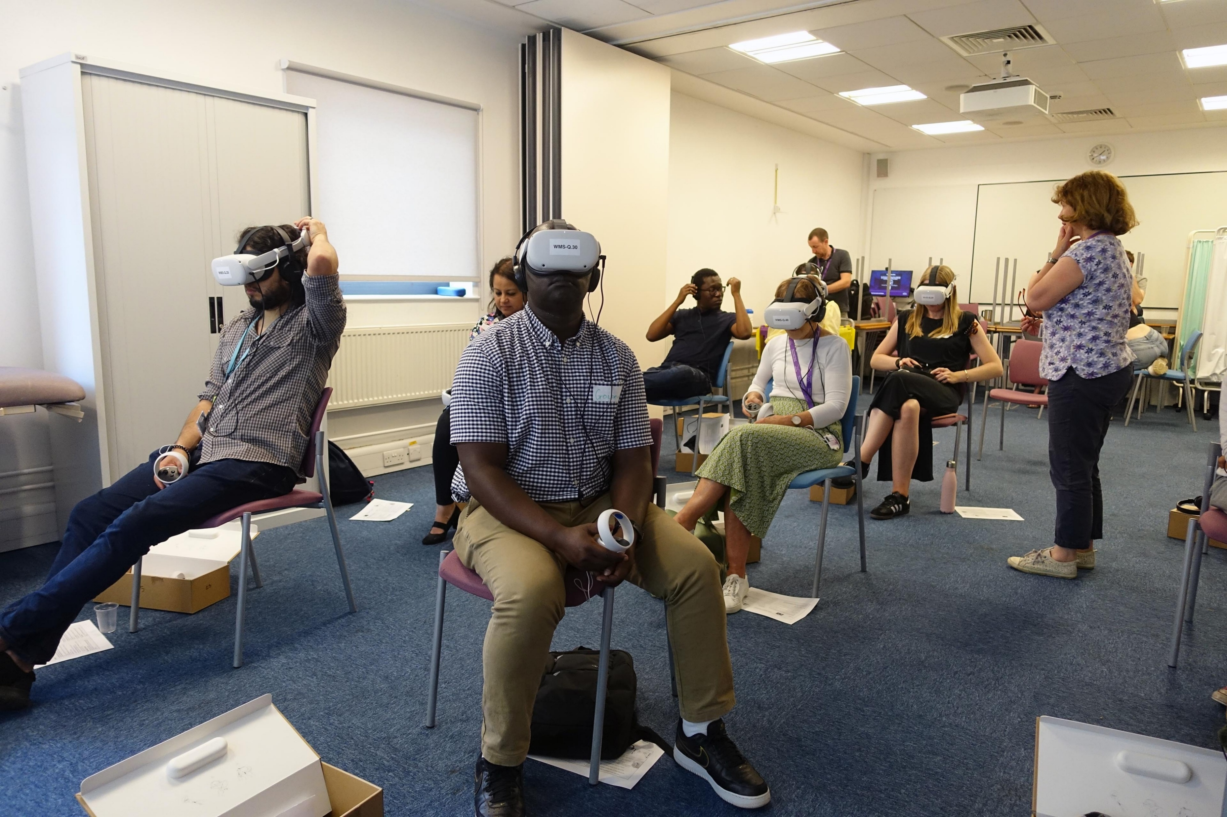
Why did we use Virtual Reality?
Microaggressions
Student Burden
Facilitator Uncertainty
Anti-racist pedagogy
Virtual reality is documented to improve participant viewpoints about marginalised groups due to the induced perspective. ​
It is a versatile tool, currently used within healthcare to improve doctor-patient interactions, and its integration into medical education is within its early stages​
An online resource will be available for use across the wider university. We suggest that this would form an experiential adjunct to existing anti-racism training.​
Aims to aid professional development and improve the experience of minoritized students.
The project will contribute to the University’s Strategy of eliminating the awarding gap.
Notes:
Students have reported that when in small group sessions, facilitators did not always intervene when either microaggressions occurred or cultural explanations were requested of students.
Students further expressed this placed a unique burden alongside the learning experience - potentially a contributory factor in the awarding gap discourse
Facilitators also reported uncertainty and a lack of guidance on how to appropriately navigate such scenarios as barriers to intervention.
We decided a training package using virtual reality and sound pedagogical principles to help facilitators understand the impact on students and support their development in this area

Slide 6
Methodology
BSREC ethics approval via WIHEA
Storyboarding cases based on real student/facilitator feedback
Script read-throughs and draft development
Actor recruitment
Filming and editing
Pilot session with CBL facilitators and feedback

Slide 7
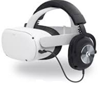
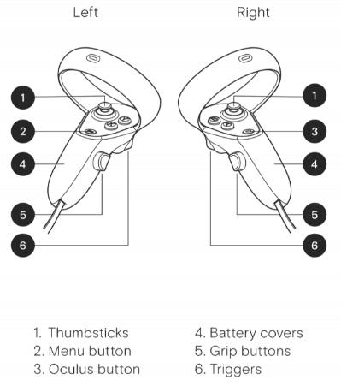
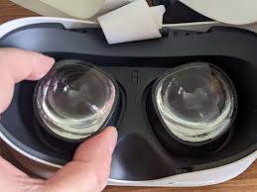
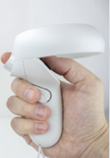
Meta QUEST 2 Headsets
Key Points
Keep headsets out of direct Sunlight – DO NOT LEAVE with lenses pointing at windows. Sunlight can permanently damages lenses.
If you feel any discomfort STOP, wait until you feel better and try again later.
Keep the numbered paired controllers with your headset, please don’t mix them up!
Clear enough space around you to stretch your arms sideways and above your head.
Stay seated using the headset
Clean the headset before use with the wipes provided.
AVOID touching and cleaning the glass lenses
If necessary you can use a DRY cloth to clean them.
If you need to wear glasses collect a Glasses spacer and review the detailed version of instructions.
Getting Started
Adjust the headset to fit
  Widen the headset – turn the wheel LEFT
  Put the headset on front first and then lower the back
  Tighten by turning the wheel RIGHT
  Unzip and adjust the Velcro strap on top of your head
Wear headphones on top of the headset, plug in.
Use the volume switch underneath to adjust volume
Hold both Controllers and wrap straps around wrists for security.
Thumb on black pad, forefinger on back Trigger, middle finger on Grip button
Squeeze the trigger with your forefinger when you need to select\click.
Turn the headset ON via the Power button on the right of the headset for 2 seconds.
On the Apps menu point at the 3DVista App, and then click on the LAUNCH button.
Click on the words “end of life consultation” when ready select scenario 2.
Blurry image or tired eyes?
Check the headset is adjusted.
Adjust the lenses according to your Interpupillary Distance (IPD).
Push a lens gently to the left or right to move between three IPD settings.
Notes:
This work is licensed under a Creative Commons Attribution 4.0 International License.

Slide 8
Learning Objectives
To engage with a virtual reality simulation in order to understand the importance of effective facilitation in CBL.
To understand the role of the CBL facilitator and how small group work can benefit from facilitation
To recognise examples of appropriate and inappropriate practice of CBL facilitators from given examples
To identify and understand some of the challenges which can occur during the facilitation of small group teaching
To correctly identify opportunities where a student in a CBL group may require support
To consider the thoughts and feelings of students during challenging situations
To understand how group dynamics can impact the ability of students to enjoy a safe and equitable learning environment
To reflect on and discuss the situations encountered and consider how learning points can be integrated into own practice

Slide 9
Disclaimer
This can be a difficult topic to navigate, both in today's session and in CBL itself. It is ok to feel uncomfortable or uneasy. It’s important to have a non-judgmental, sensitive approach.
The scenarios follow a fictional CBL group, with student actors. The scenarios were created as part of the project, and do not depict real-life events
This training exercise is part of the WIHEA project, "Managing inclusive groups: a guide for facilitators" and has BSREC ethics approval.

Slide 10
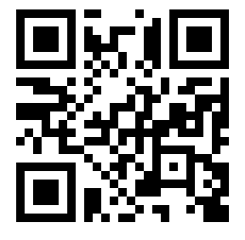
Scenario 1

Slide 11
Small Group Discussion 1
10 minutes - Reflect on this scenario and its potential areas of concern
Can you think of any reasons why knowing a patient's race would be important?
Why might Oli have made these comments?
If you were a facilitator, what would you do? How might you intervene to make the discussion more inclusive?
Reflect on what Andrea did differently in the second part of this scenario and how this might have been helpful.

Slide 12
Whole Group Discussion 1
5 minutes - Reflect on this scenario and its potential areas of concern
Can you think of any reasons why knowing a patient's race would be important?
Why might Oli have made these comments?
If you were a facilitator, what would you do? How might you intervene to make the discussion more inclusive?
Reflect on what Andrea did differently in the second part of this scenario and how this might have been helpful.

Slide 13
You might have said...
Why might Oli feel this way?
They might not think that race/ethnicity is important to patient care - we should treat everyone the same way
They don’t see colour - it’s just another way to unnecessarily divide people
They feel uncomfortable speaking about race - perhaps they don’t want to offend?
We should treat everyone with respect and dignity, regardless of race, but we must remember that ethnic backgrounds matter
“Colour blindness” might be well intentioned, but talking about race is one of our most powerful tools to empower people and to identify and correct our own biases
Facilitators should take the opportunity to encourage a conversation about why knowing a patient’s race/ethnicity would be important
Notes:
Can you think of any reasons why knowing a patient’s race would be important for CBL?
Awareness of potential health inequalities they might face - Remember Scenario 1?
Prescribing differences - calcium channel blockers, rather than ACE inhibitors for cardiac problems
Having diversity within CBL cases is important - representation makes people feel seen
Knowing demographics is valuable for research and improving people’s experiences

Slide 14

Rest Break
10 minutes

Slide 15
Scenario 2

Slide 16
Small Group Discussion 2
10 minutes - Reflect on this scenario and its potential areas of concern
How might this situation have made Izzy feel?
If you were a facilitator and this scenario occurred, what would you do? Alternatively, what might stop you from speaking out?
Reflect on what Andrea did differently in the second scenario and how this might have been helpful.
Are there any methods you could use in your future practice as a facilitator?

Slide 17
Whole Group Discussion 2
5 minutes - Reflect on this scenario and its potential areas of concern
How might this situation have made Izzy feel?
If you were a facilitator and this scenario occurred, what would you do? Alternatively, what might stop you from speaking out?
Reflect on what Andrea did differently in the second scenario and how this might have been helpful.
Are there any methods you could use in your future practice as a facilitator?

Slide 18
You might have said...
While the intention behind Benny's treatment of Izzy might not be evident, it is an example of a microaggression:
"a statement, action, or incident regarded as an instance of indirect, subtle, or unintentional discrimination against members of a marginalized group such as a racial or ethnic minority"
We do not know if Benny is purposely excluding Izzy or is acting as a result of unconscious bias
However, both reasons may discourage Izzy and reduce the confidence she feels about her contributions.
Notes:
Can you think of any reasons why knowing a patient’s race would be important for CBL?
Awareness of potential health inequalities they might face - Remember Scenario 1?
Prescribing differences - calcium channel blockers, rather than ACE inhibitors for cardiac problems
Having diversity within CBL cases is important - representation makes people feel seen
Knowing demographics is valuable for research and improving people’s experiences

Slide 19
What could you do?
It is important as a facilitator to diffuse this situation in a safe, respectful way.
At the start of the next CBL session, reiterate the responsibility of every member of the group to pay attention to all contributions
As Andrea did, acknowledge a student if they have been ignored e.g. "yes, that is correct as Izzy said earlier".
Check-in with students at the end of the session, if appropriate, to find out how they feel about the group dynamics

Slide 20
Rest Break
10 minutes

Slide 21
More Resources
Racism in Higher Education
Academic Paper - Student perspectives on barriers to performance for black and minority ethnic graduate-entry medical students: a qualitative study in a West Midlands medical school https://bmjopen.bmj.com/content/bmjopen/9/11/e032493.full.pdf
List of Warwick anti-racism resources https://warwick.ac.uk/services/socialinclusion/projects/learning/antiracismresources
Racial Inequality in Medicine
Article - Black women in UK four times more likely to die in pregnancy and childbirth https://www.theguardian.com/society/2021/nov/11/black-women-uk-maternal-mortality-rates
Article - Organ transplants: Black people wait up to six months longer, NHS figures show https://www.bbc.co.uk/news/uk-64235369
Article - How African Caribbean background can affect your heart health https://www.bhf.org.uk/informationsupport/heart-matters-magazine/medical/african-caribbean-background-and-heart-health
Article - GRT and Health Inequality https://www.gypsy-traveller.org/our-vision-for-change/health-and-social-care/
Article - Ethnicity and COVID-19 https://www.ukri.org/news-and-events/tackling-the-impact-of-covid-19/understanding-coronavirus-covid-19-and-epidemics/covid-19-and-ethnicity/
Societal Attitudes to Race
Article and Video - Why saying “I don’t see race at all” just makes racism worse https://ideas.ted.com/why-saying-i-dont-see-race-at-all-just-makes-racism-worse/
Virtual Reality in Healthcare and Education
Academic Paper – VR Simulation in empathy and attitudes to schizophrenia https://www.ncbi.nlm.nih.gov/pmc/articles/PMC9116500/
Academic Paper - VR for Inducing Empathy and Reducing Prejudice Towards Stigmatized Groups https://www.researchgate.net/publication/324788630_Virtual_reality_for_inducing_empathy_and_reducing_prejudice_towards_stigmatized_groups_A_survey

Slide 22
Final thoughts
Thank you for attending this training, we appreciate your attention and engagement
As learners, educators and academics you can feel empowered to play an active role in discussions around race and ethnicity.
Differences in opinion are a natural part of the discourse, however they should be expressed in a respectful way that takes full consideration of the facts.
CBL can go a long way in challenging the way we think about health inequalities, however, this is most effective when each member is encouraged to take part in a safe learning environment

Slide 23

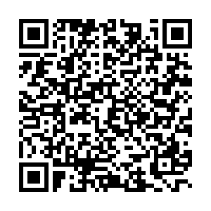
Feedback questionnaire
Please scan the QR code to fill out a short feedback questionnaire
Thank you, your feedback is appreciated.

Slide 24
Acknowledgments
Our sincere thanks to:
Project leads: Leda Mirbahai and Kate Owen
Staff: Jess Humphries, Helen Nolan, Louise Davis, Catherine Fenn, Olanrewaju Sorinola and Raghu Adya
Our colleague: Will Opoku-Asamoah, BSc Health and Medical Sciences student
MBChB Student Actors: Oliver O'Neill, Benedict Richards, Charlotte Pemberton, Shikriti Mandal, Abi Bickerton and Alice Anderton
Simulation Facilitator: Andrea Cobham
Production: Nick and Sue Moseley of Moseley Multimedia Ltd and the WMS IT Team
And everyone at the ARPP Learning Circle

Slide 25
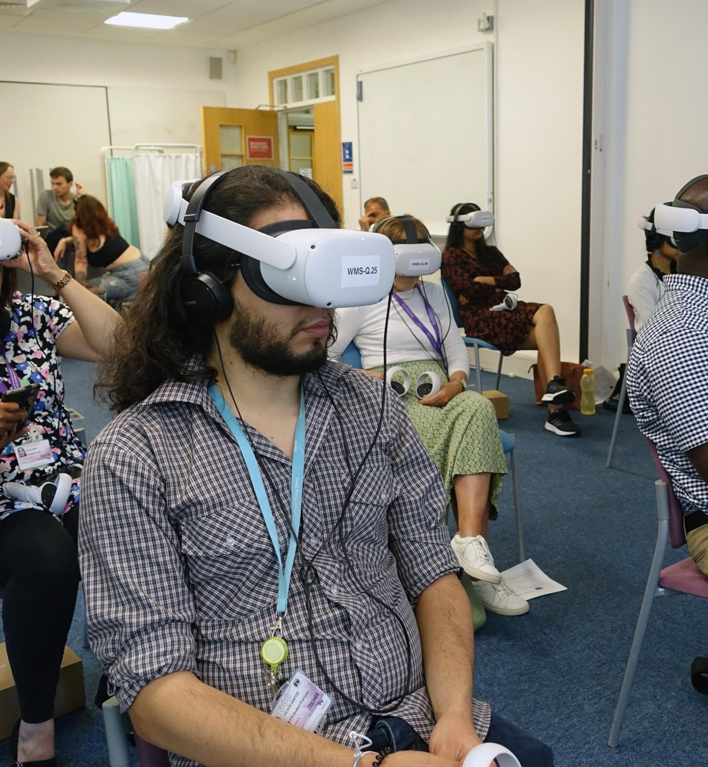
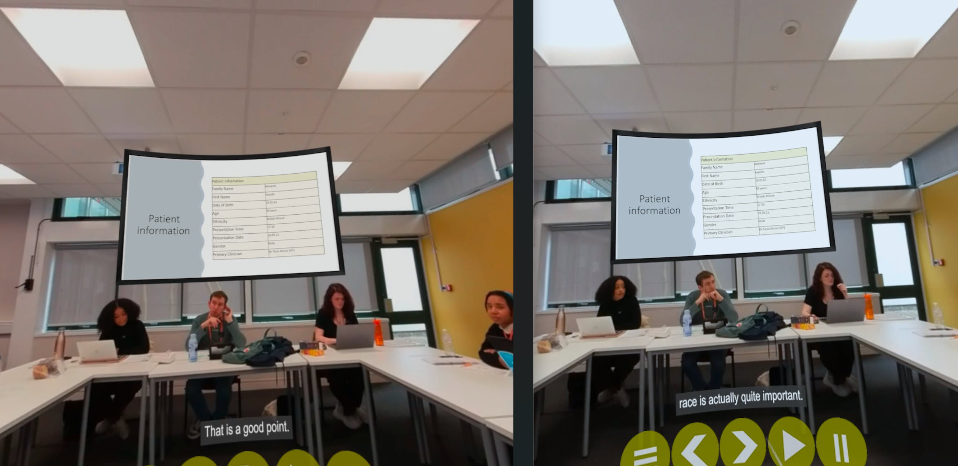
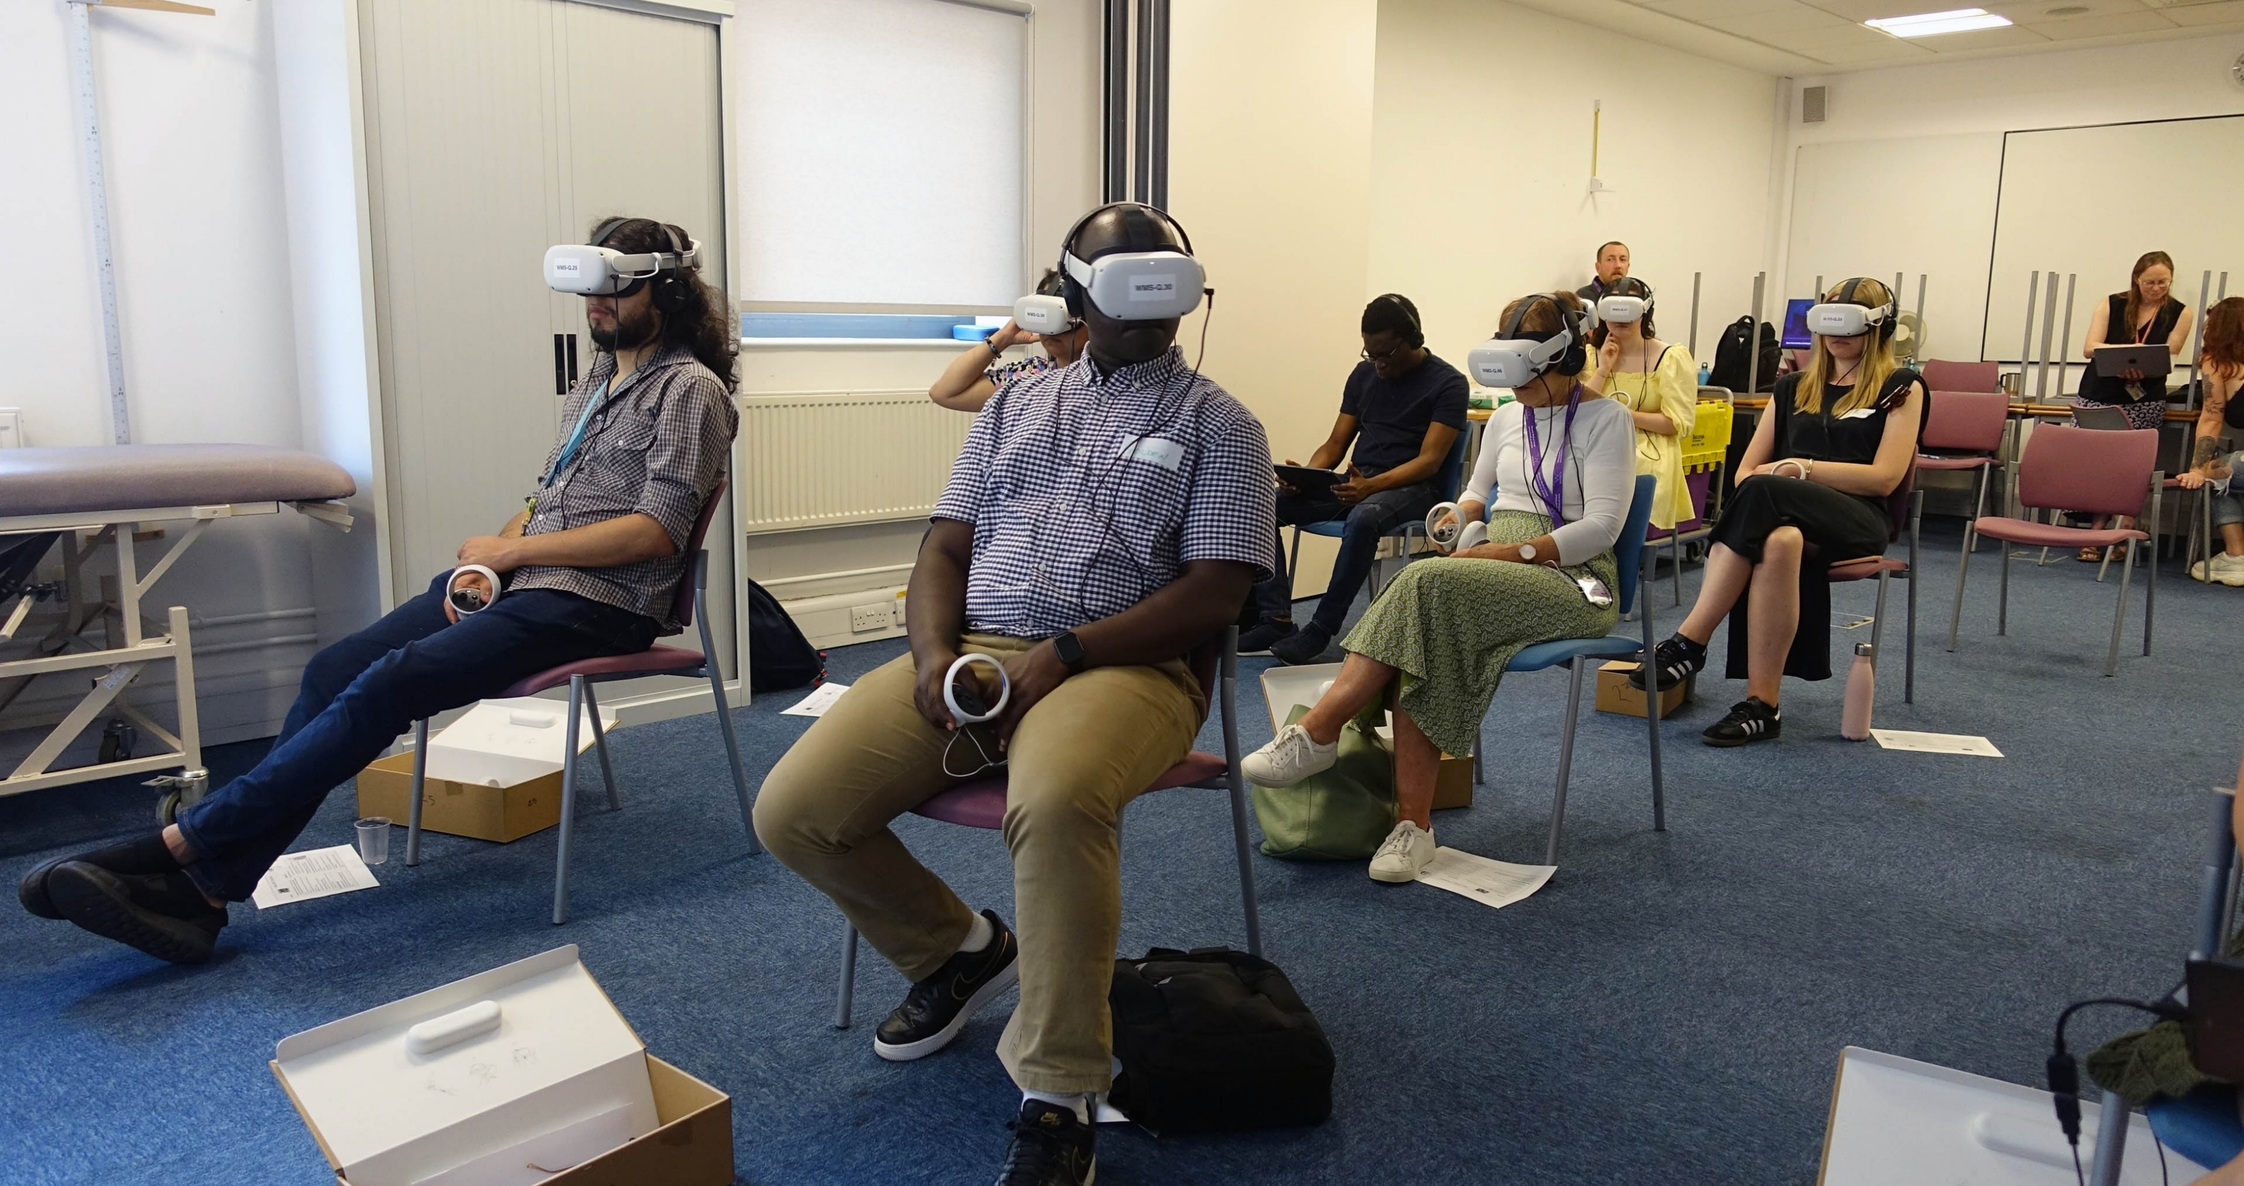
Pilot Session, 15th June 2023

