Slide 1
Warwick University Deans Distinguished Lecture
Women's health: crisis, progress, and possibility
Kate Lancaster
RCOG Chief Executive Officer

Slide 2
The reality of women's health
The research and data gap

Slide 3
How many available medications have been adequately monitored, tested and labelled with safety information for use in pregnant and breastfeeding women?

Slide 4
5%

Slide 5
What % of global healthcare research and innovation funding goes to female-specific conditions beyond cancer?

Slide 6
1%

Slide 7


What does the data tell us?
Gynaecology

Slide 8
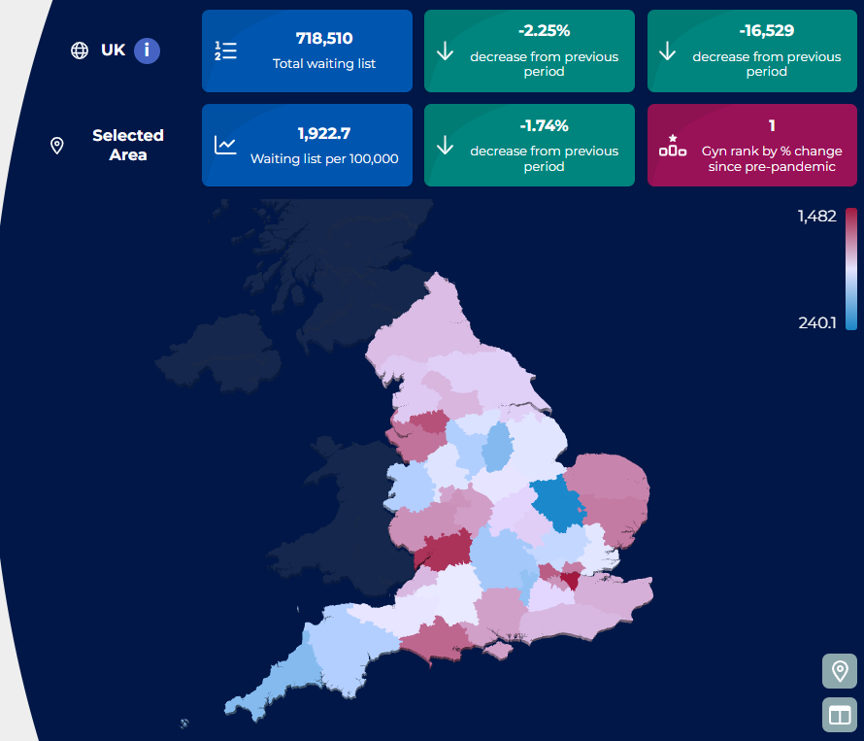
In March 2020 – 275,000
Today –
over 560,000

Slide 9

750,000+ women waiting in 2024
We calculated that if these women were to stand shoulder to shoulder in a queue, they would be queuing from London to Exeter.
718,000 women waiting today
If these women were to stand shoulder to shoulder in a queue, they would be queuing from here in Warwick, to Middlesbrough.

Slide 10
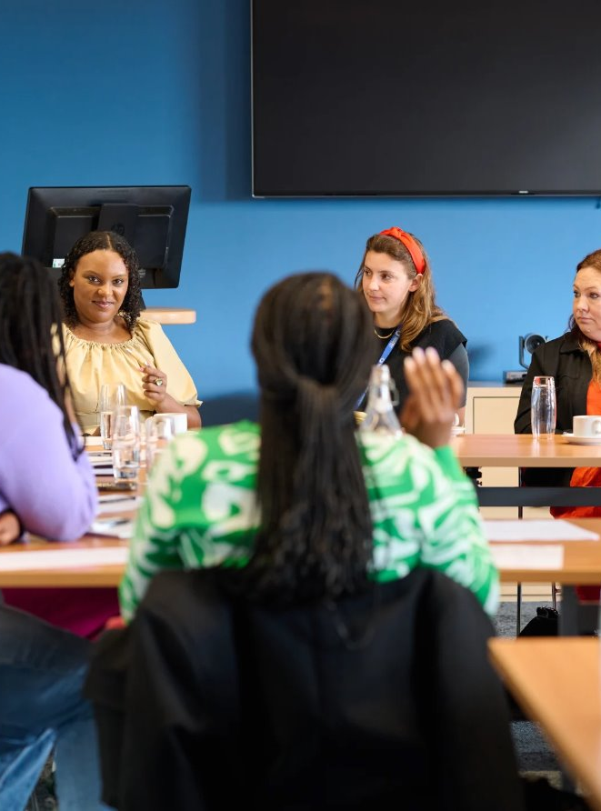
"I feel so fatigued and drained"
"As the bleeding was untreated, it led to anaemia and a hospital admission for a blood transfusion"
"Everything has worsened so much that I have had to leave my job"
"I have taken so many sick days, I fear I will be fired"
"At one point, I didn't care if I lived or died"

Slide 11
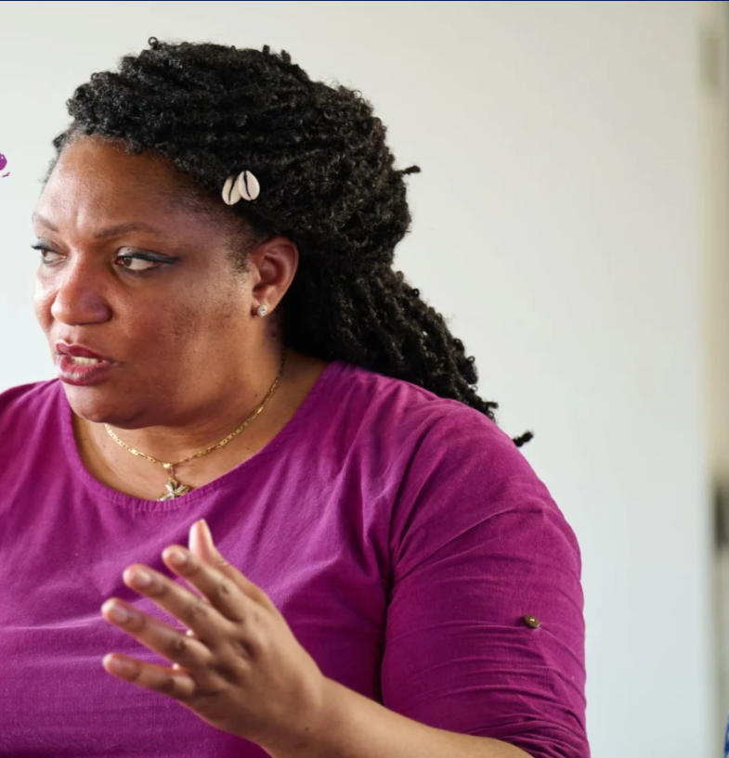
Six in 10 women we surveyed said their physical health had worsened as a result of waiting for care.
A quarter of women needed to attend A&E or an emergency department.
Seven in 10 said their mental health had worsened and their ability to work had been impacted.

Slide 12
How long on average does it take for women in the UK to be diagnosed with endometriosis?

Slide 13

9 years and 4 months
an increase since 2020, where the average was 8 years.
11 years
on average for women from ethnically diverse communities.

Slide 14

Sexual health and abortion
164 million women worldwide had an unmet need for contraception.

Slide 15
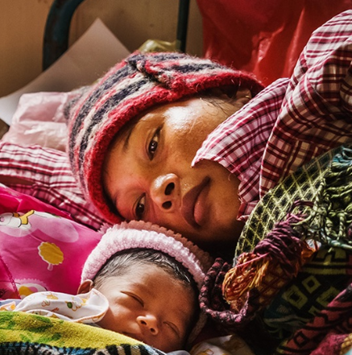

Maternity
In 2023, a maternal death occurred every 2 minutes.
Women in the UK from Black or ethnic backgrounds are three times more likely to die during or shortly after pregnancy compared to white women.
Notes:
Source of image World Health Organization: New evidence shows significant mistreatment of women during childbirth

Slide 16
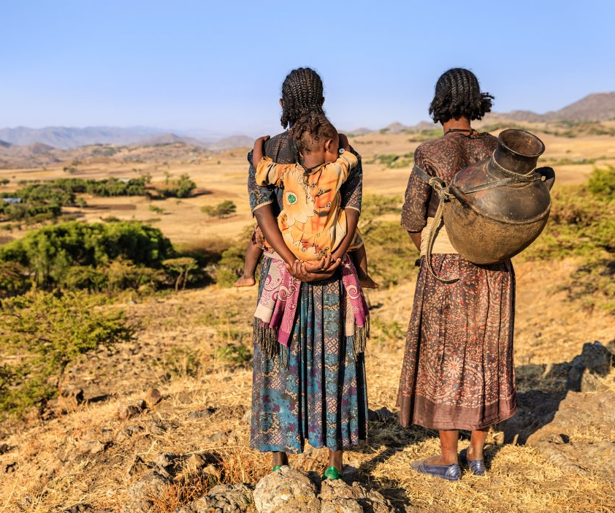
Poverty and deprivation
In 2024, women in England made up over 60% of all jobs paying below the real Living Wage.
Globally, 10% of women are living in extreme poverty. 351 million women and girls could still be trapped in poverty by 2030.

Slide 17
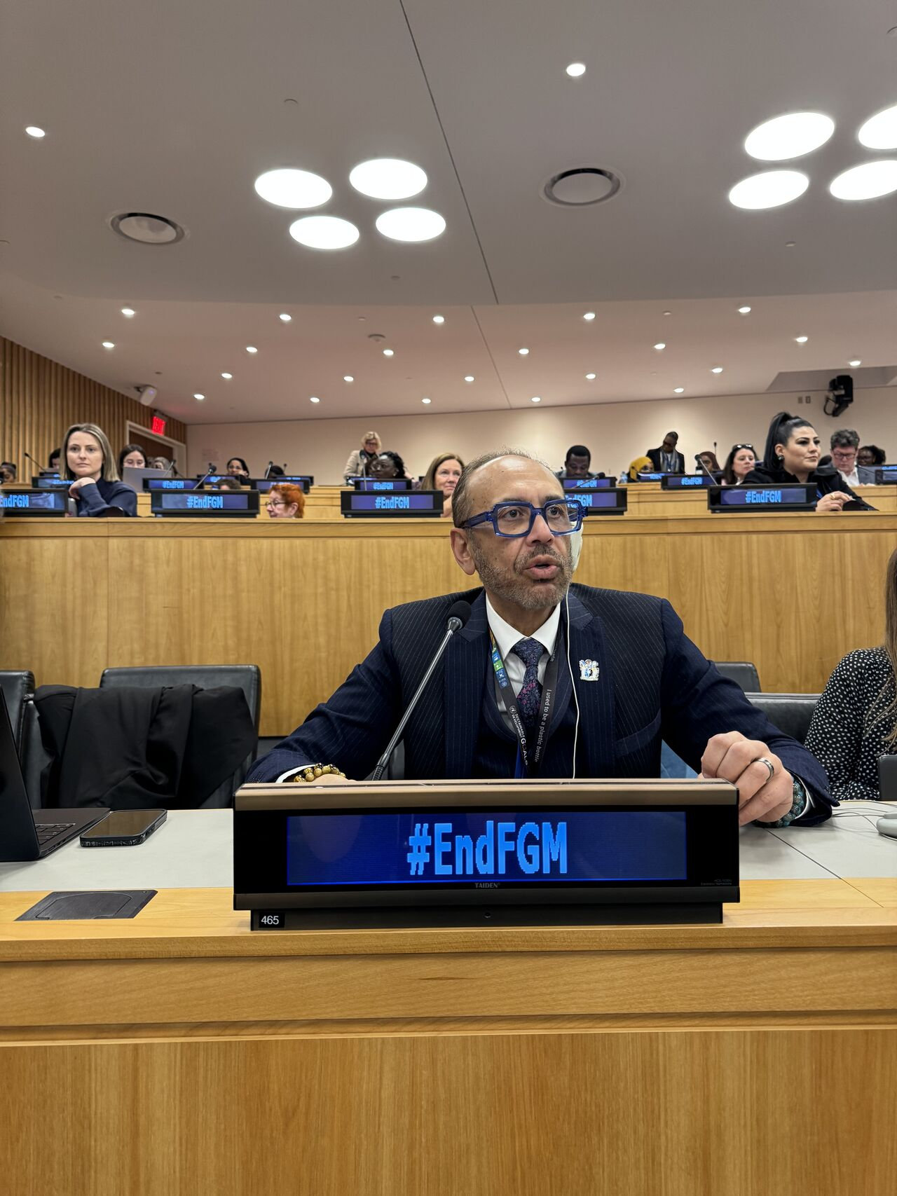
Violence against women and girls
1 in 3 women across the world will experience gender-based violence in their lifetime.
In the UK, there has been a 264% increase in the number of police-recorded rape and sexual assault offences during 2009-2024.

Slide 18
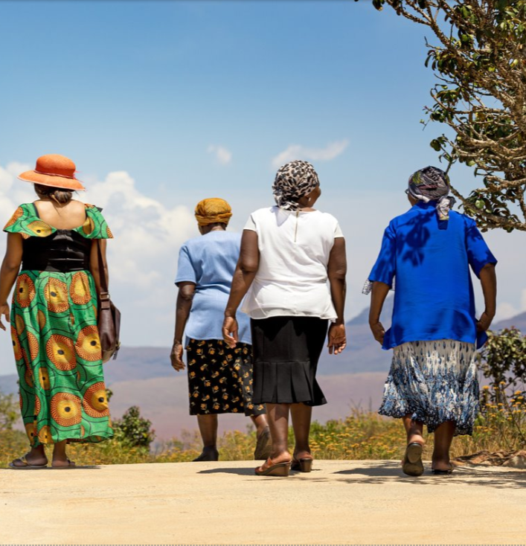
Climate change and global conflict
676 million women are living within armed conflict in 2024, up from 253 million in 1990.
80% of people displaced by climate change are women.

Slide 19
We are seeing the impact of the gender health gap in emerging data.
Hologic global women's health index
Health Foundation
£1.5 billion women had no testing at all for issues like cancer and diabetes
Research shows a reduction in life expectancy and healthy life years for women in the UK.
40% of women globally reported they couldn't afford food at times a third struggled with housing

Slide 20
Women on average spend a whole quarter of their lives in poorer health compared to their male counterparts – the equivalent of 75 million years of women's lives being lost.

Slide 21
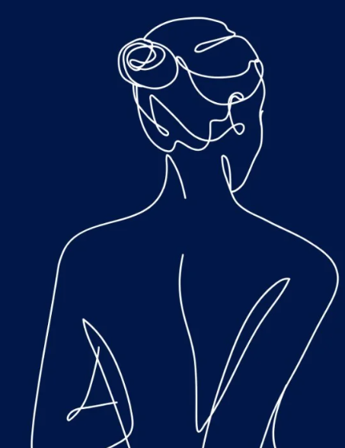
Why is this still the reality
for women today?

Slide 22
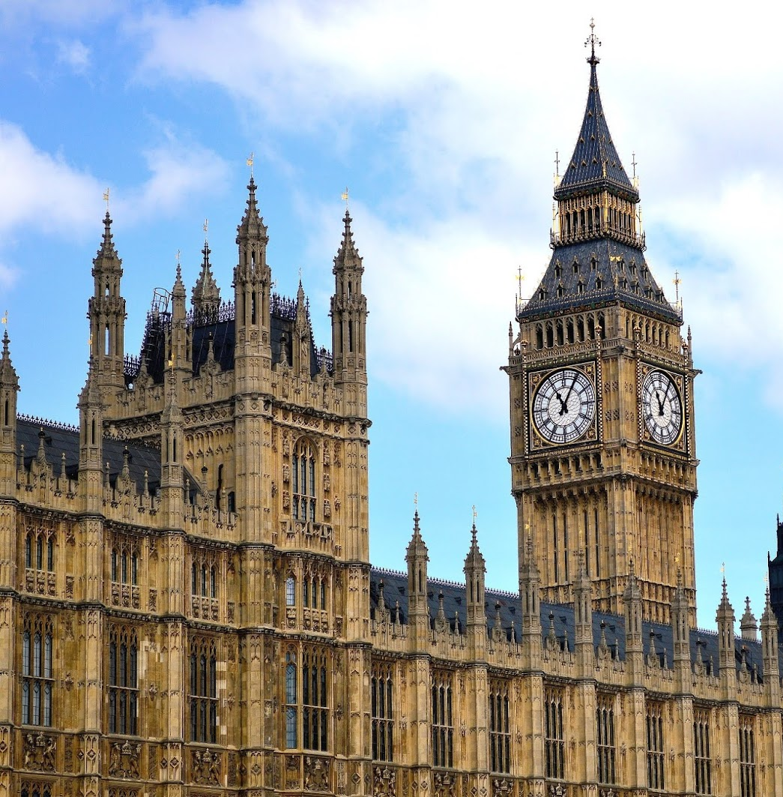
Funding
Lowest share of UK overseas development aid (ODA) funding in 18 years.
10 Year Health Plan shifts lack sustainable funding and ICBs have been asked to cut budgets by 50%.

Slide 23

Workforce pressures
The WHO estimates a projected shortage of 11 million health workers by 2030.
Women make up around 70% of our global workforce.

Slide 24

Reasons to be hopeful
Policy progress and growing political attention

Slide 25
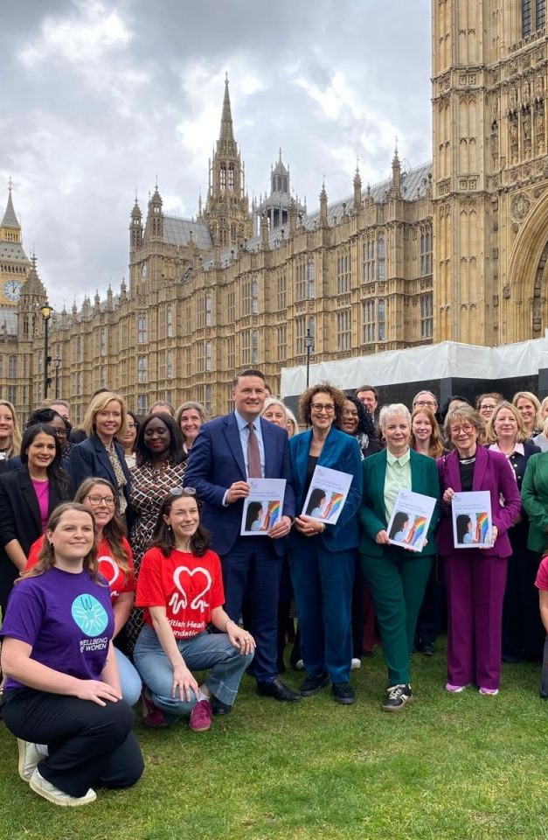
Greater political attention and strategies

Slide 26
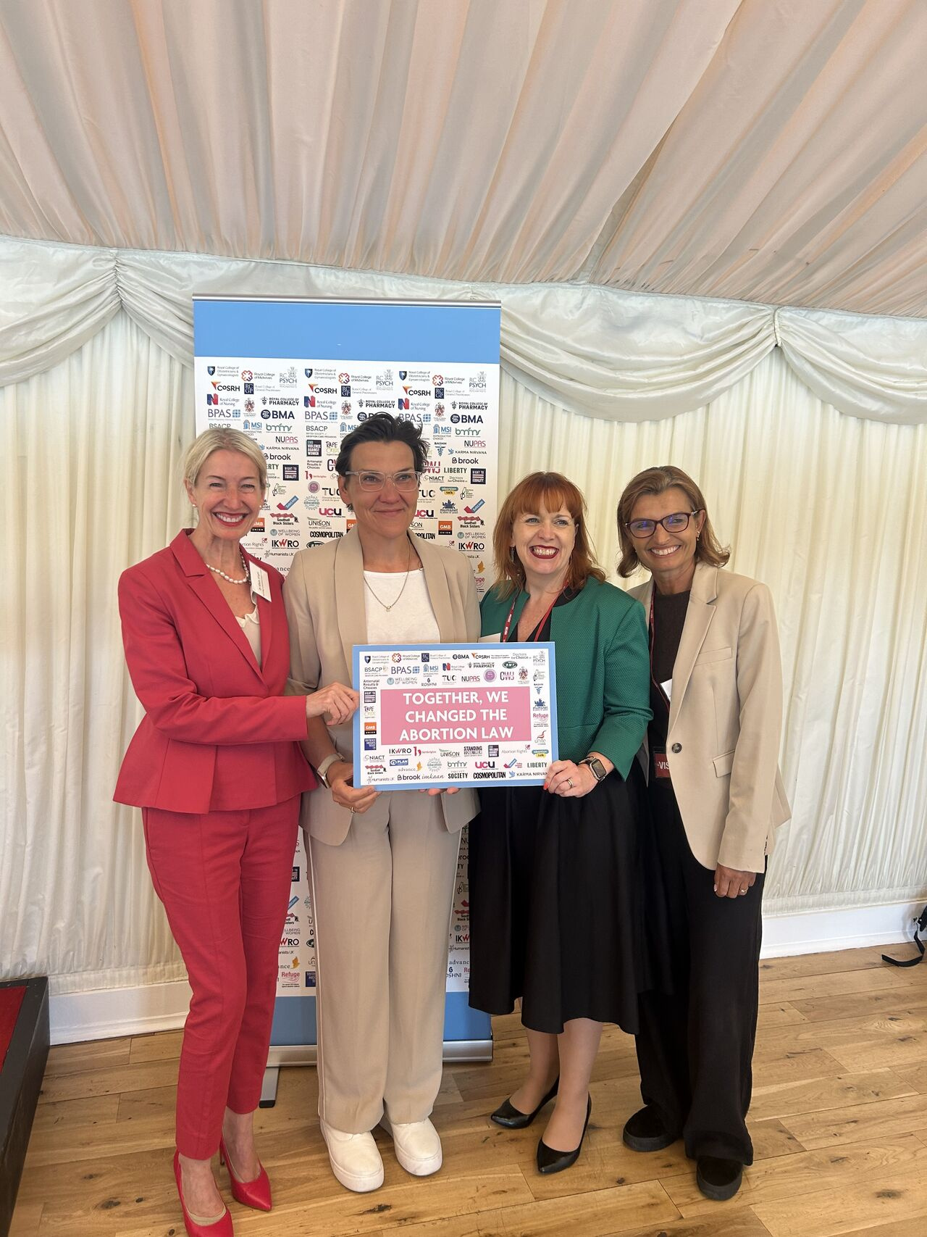
Legislative policy changes

Slide 27
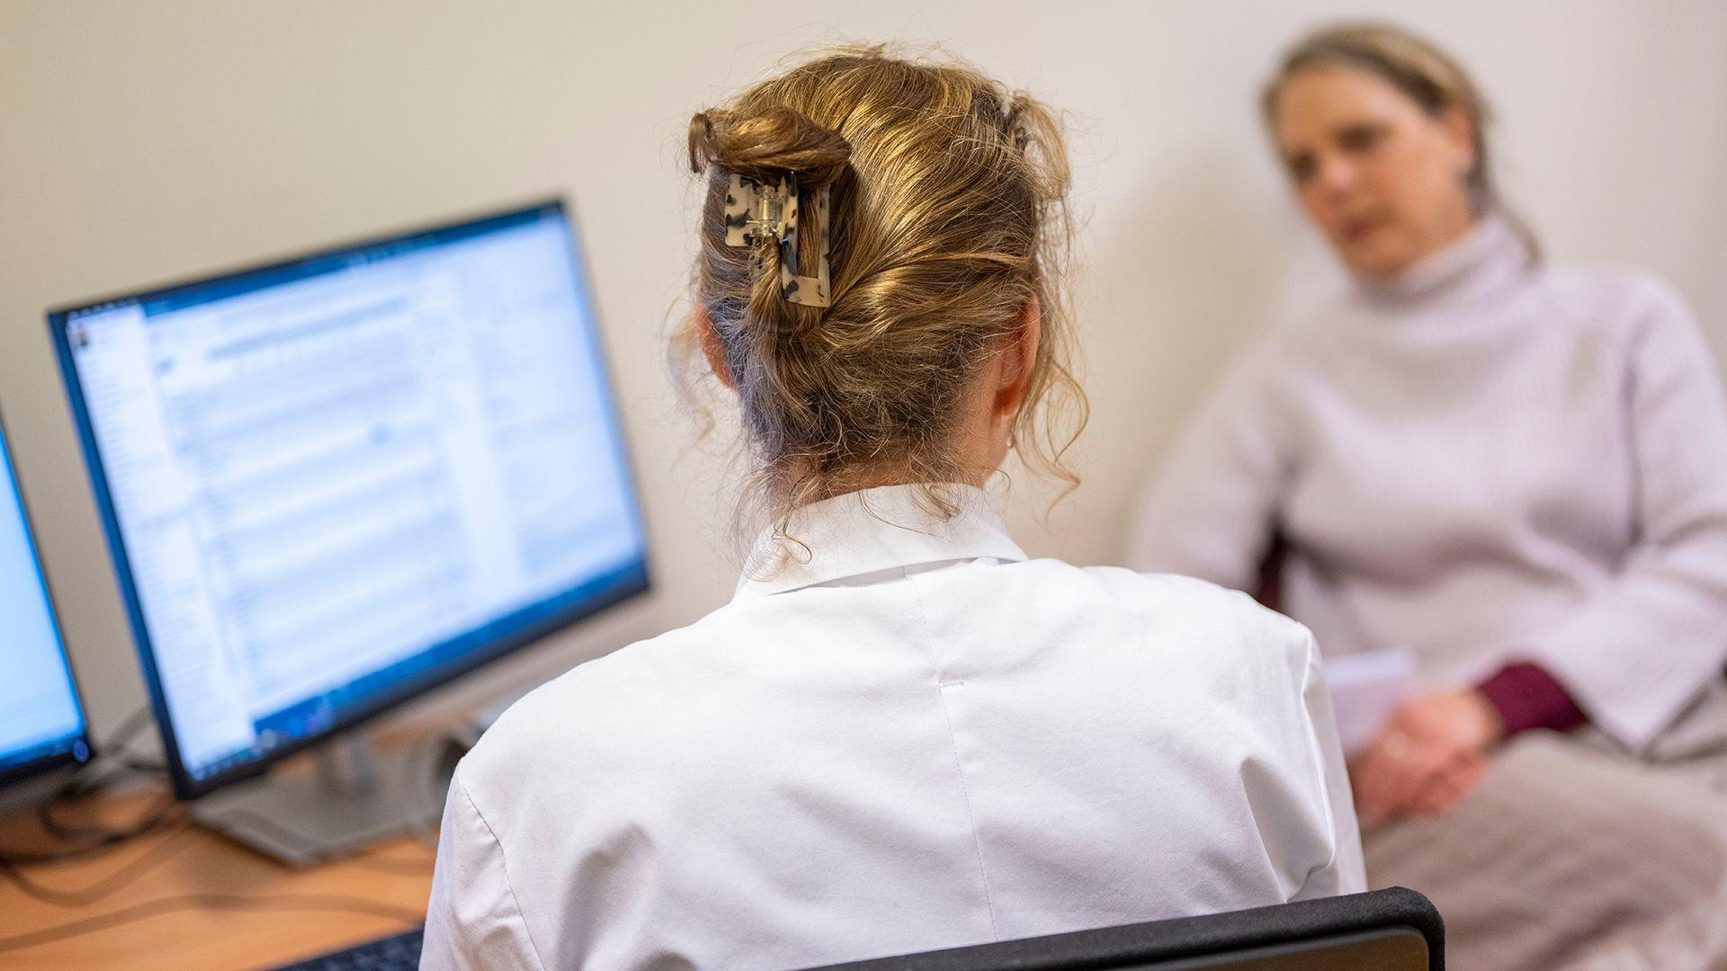
Improvements in care and tackling taboo

Slide 28

The solutions
What do we need to do to address these challenges and improve women's health?

Slide 29
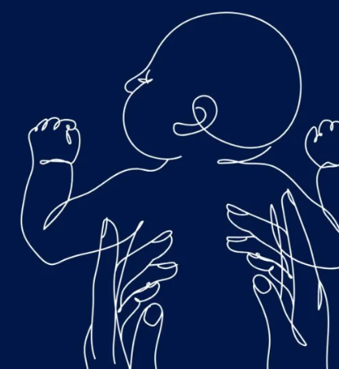
Acknowledge the investment opportunity, and invest.
Menstrual problems cost the UK economy almost £11 billion every year.
Closing the women's health gap could boost global GDP, adding at least $1 trillion annually by 2024.

Slide 30

Move from strategy to delivery, driving the whole life course approach
Ensure teams delivering strategies have the support and funding to deliver on ambitions set to improve women's health.

Slide 31

Support our workforce
We must give greater support to our health workforce by tackling workforce shortages, protect wellbeing, reduce burnout and protect time for training, leadership and development.

Slide 32

Close the women's health research gap and fund co-design
When we listen to women, fund meaningful co-design, and invest in the evidence base – we improve the quality, safety and effectiveness of healthcare for everyone.

Slide 33

Greater support for innovation and collaboration
We must ensure women are not simply the beneficiaries of innovation, but the architects of it, and that we create an environment in which innovation can thrive.

Slide 34
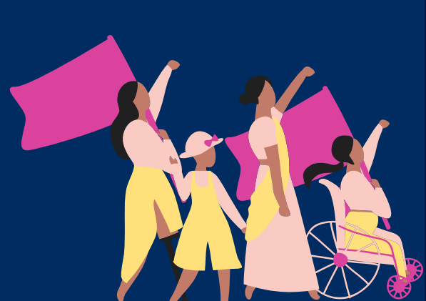
Calls to action
1
Place women at the heart of local, national and international government strategies
2
Close the women's data and research gap
3
Partners in industry must play their part

Slide 35


What action can you take?
Action in your spheres of influence
Action on an individual level
Action in corporate environments

Slide 36

"Women are not dying because of diseases we cannot treat, they are dying because societies have yet to decide their lives are worth saving."
Professor Mahmoud Fathalla

