Slide 1




AIRWAYS-3 SIV Training
V1.3 17 October 2023

Slide 2
Background
The estimated incidence of in hospital cardiac arrest (IHCA) in the UK, as captured by the National Cardiac Arrest Audit (NCAA), is 1 patient per 1000 hospital admissions, although the true figure is likely to be higher as the NCAA includes only those patients who are attended by a resuscitation team in response to a 2222 call
Current survival to hospital discharge following resuscitation for IHCA in the United Kingdom (UK) is approximately 24%, however additional UK data collected by members of our research team suggest that survival is closer to 10% in those patients who require advanced airway management
Notes:
Clinician to present

Slide 3
Aim of the AIRWAYS-3 trial
Conduct an internal pilot study to confirm the feasibility of the large-scale multi-centre trial.
Determine the clinical effectiveness of SGA versus tracheal intubation, for adults with in-hospital cardiac arrest, in terms of survival with a favourable functional outcome and health-related quality of life.
Estimate, in an integrated economic evaluation, the cost-effectiveness of SGA compared with tracheal intubation.
Notes:
Clinician to present

Slide 4
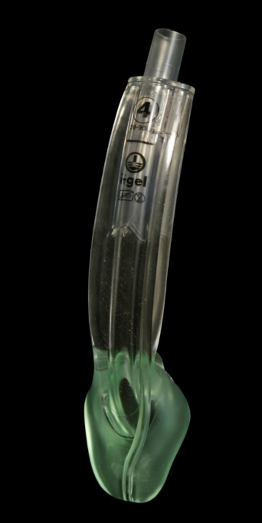
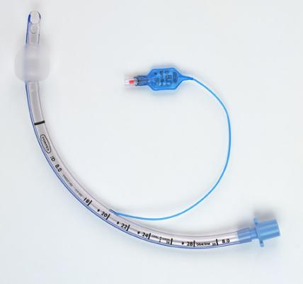
Airway interventions
Supraglottic airway (e.g. laryngeal mask airway [LMA], i-Gel)
Tracheal Intubation
Notes:
Clinician to present

Slide 5
[AS1]Should this date be updated?
[SM2]Could you please update this to reflect current expected trial period June 2022 to ? [Date]
Trial design
Design | Randomised trial of the clinical and cost effectiveness of a supraglottic airway device versus tracheal intubation during in-hospital cardiac arrest (AIRWAYS-3)
Population | Adult IHCA requiring a 2222 call and advanced airway management
Intervention | Supraglottic airway device (SGA) of the type routinely used in that hospital
Control | Tracheal intubation (TI)
Outcome | Functional status at hospital discharge or 30 days following IHCA as measured by the modified Rankin Scale (mRS) Survival status and Health Related Quality of Life Cost effectiveness of SGA vs tracheal intubation
Setting | Hospitals in the UK (pilot in England and Wales)
Sample size | 420 participants from c.40 hospitals (Dec 22 – Dec 23) 4190 participants (incl. pilot) from c.120 hospitals (Jan 24 – Dec 24*)
Notes:
Scott to present?

Slide 6
[AS1]Should this date be updated?
[SM2]Could you please update this to reflect current expected trial period June 2022 to ? [Date]
Trial flow diagram
IHCA in 120 participating hospitals over study period
Assessed for eligibility
Randomised
Supraglottic Airway Device (SGA)
Received SGA
Did not receive SGA/reasons
Tracheal Intubation (TI)
Received SGA
Did not receive SGA/reasons
Patients who have taken part in national data opt out are withdrawn
(following collection of primary outcome)
Consent & follow-up for survivors
Data collected for non-surviving patients
Data collected for non-surviving patients
Consent & follow-up for survivors
Follow-up questionnaire
3 & 6 months
Follow-up questionnaire
3 & 6 months
Data Analysis)
Notes:
Scott to present?

Slide 7

Eligibility Criteria
Adult (known or believed to be age >=18 years).
In-hospital cardiac arrest, attended by the hospital cardiac arrest team in response to a cardiac arrest call (2222 or equivalent), and when a clinician permitted to undertake both tracheal intubation and supraglottic airway placement (so that either intervention can be delivered) is present.
Undergoing resuscitation and requiring advanced airway management in the opinion of the trained clinician responsible for randomisation.
Patients in the emergency department.
Patients who have a cardiac arrest outside hospital and who are transported to the hospital in ongoing cardiac arrest
People who are not a hospital inpatient (e.g. visitor, relative, staff or outpatient).
Patients who are already tracheally intubated at the time of eligibility assessment.
Patients known to be pregnant.
Patients with a functioning tracheostomy
Notes:
Scott to present?

Slide 8
All eligible patients should be randomised
Patients must only be randomised when randomising clinician is at patient side and has confirmed eligibility
If a patient meets the eligibility criteria they should be enrolled and randomised accordingly.
Inline with protocol, the eligible patient should be randomised, even if there is a circumstance where the clinician feels strongly against delivering one of the treatment arms.
Where a clinician feels strongly that the protocol should not be followed, they should act in the patient's best interests and record the reasons subsequently.
Notes:
Scott to present?

Slide 9
Randomisation
Patients are enrolled into the trial by a research-trained clinician who attends the cardiac arrest following a 2222 call.
Randomised in a 1:1 ratio to either Supraglottic Airway Device or Tracheal Intubation following below pathway:
Requirement for advanced airway management?
Assessed by airway-trained clinician
Patient eligible for trial?
Assessed by research-trained randomising clinician
Randomisation
Patient randomised to either SGA or TI
YES
YES
  To perform randomisation you must use the progressive web application (PWA)
  The randomisation MUST only be performed at the point the patient is determined eligible.
  The randomisation MUST only be performed by someone who has completed the training and is recorded on the delegation log.
Notes:
Scott to present?

Slide 10
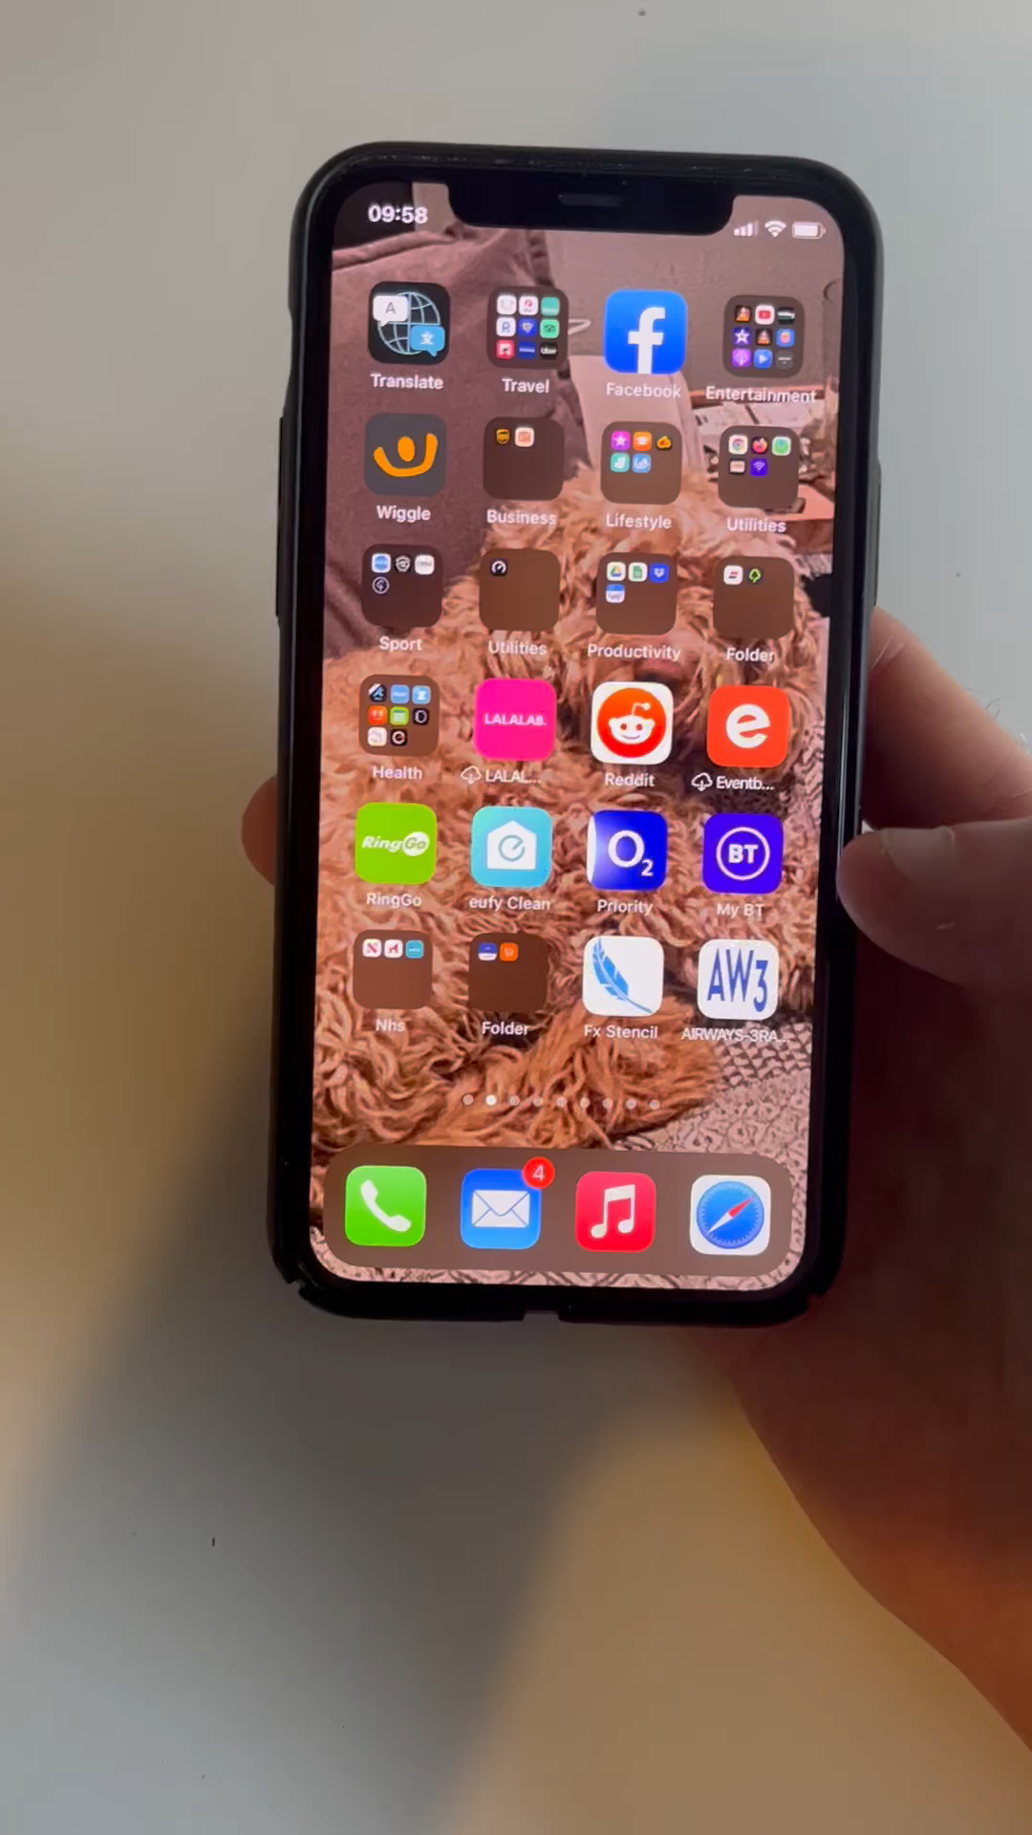
Randomisation method
WCTU programming team took our brief and have designed a bespoke Progressive Web App (PWA), designed to work both online and offline, to randomise patients quickly and easily across all sites.
Training version of PWA:
AIRWAYS-3 RAND APP (warwick.ac.uk)

Slide 11
Trial Intervention
The treating clinician MUST deliver the intervention stated on the progressive web application (PWA), unless this would be harmful to the patient
1st attempt- airway management
Use the approach stated on the progressive web application (PWA)
Provide advanced airway management
Successful
Unsuccessful
Provide advanced airway management
2nd attempt- airway management
Use the approach stated on the progressive web application (PWA)
Successful
*If, due to a technical or other failure, the PWA does not display an allocation within five seconds the patient should be treated according to usual care and the clinical judgement of the cardiac arrest team.
*If a functioning SGA has already been placed at the point of randomisation, and the patient is randomised to SGA, this device may be left in situ. If, however, the patient is randomised to tracheal intubation, the SGA should be removed and tracheal intubation attempted.
Unsuccessful
3rd /subsequent attempts
Based on clinical judgement

Slide 12
Roles in AIRWAYS-3
PI oversees trial activity and delegation log
PI's will receive a database login
If randomising, PIs will receive a PWA login
Randomising clinician
This is someone (usually an anaethetist) who attends the arrest, has the PWA downloaded onto their device and will randomise
Some trainees may be eligible to take part in the Associate PI Scheme
Research Team
This is the research nurses, trial coordinators, research assistants, data managers and those who manage research at your site
They will be consenting patients, collecting small amounts of data and reporting onto the database
There is also a short form on the PWA to complete regarding the details of the arrest
They will be reporting safety and compliance to trial team, and randomising clinicians must report any concerns to them
Randomising clinicians will receive a PWA login
Relevant members of the research team will receive a database login
We will be working with each site to create a practical procedure to ensure all randomisation details are reported from randomising clinician to research team for possible consent and follow up quickly, as each site will be different

Slide 13
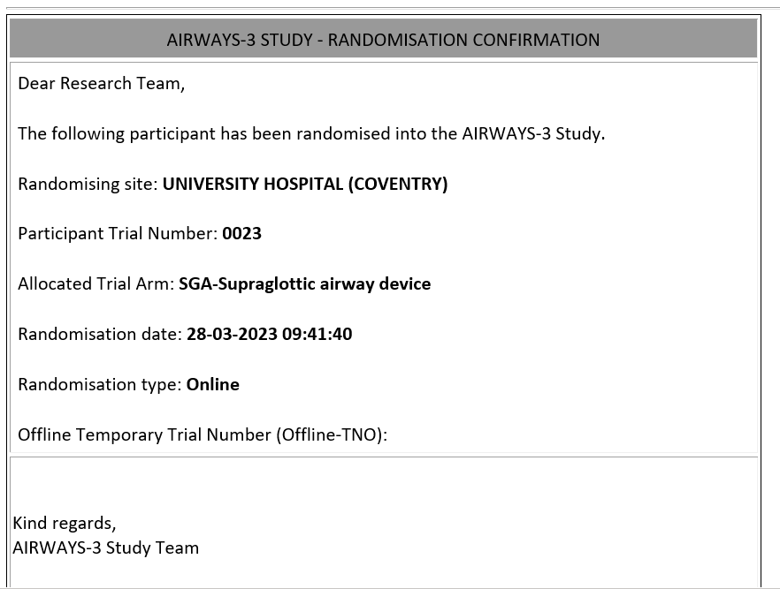
Randomisation Confirmation
Confirm with trial team what email(s) you’d like randomisation confirmations to go to
No PID collected on PWA – outline how you will locate patients in randomisation SOP in set up
These can sometimes be sent to junk folder – if this happens you may need to make airways3@warwick.ac.uk a safe sender with your IT team

Slide 14
Consent process
At the time of eligibility assessment, patients will be unconscious, mentally incapacitated and require time-critical treatment.
The NHS Research Ethics Committee has approved a deferred consent model, in accordance with the Mental Capacity Act 2005.
Patient survives
Patient does not survive cardiac arrest
Approach patient post ICU discharge in hospital for consent
Do not contact consultee for consent. Information provided to the public using more general methods managed by WCTU
Notes:
WCTU to present?
As in other cardiac arrest studies, we are using the deferred consent model when recruiting patients into AIRWAYS-3 as it is not possible to consent before the treatment is given.
We know that surviving patients capacity following a cardiac arrest will fluctuate, especially shortly after when they are still very unwell. We ask that patients are approached following discharge from intensive or high dependency care when they have had time to recover.
For patients that do not survive we will not be approaching any consultee for consent or informing any loved ones about the randomisation. We do not want to cause any extra distress, and information for the public will be carefully managed and shared in more passive methods.

Slide 15
Consent in patients with mental capacity
If the patient survives cardiac arrest and regains capacity, they should be given the option to consent to follow up.
If the patient is physically incapable of completing the consent form or where there are concerns regarding risk of infection transmission, verbal consent only will be sought from the participant and documented on a consent form. This can also occur over the telephone.
Patient has mental capacity
Approach post ICU discharge when practical and reasonable
Explain trial
Provide verbal explanation and PIS
Consent
Participant consents to data collection and signs consent physically or digitally

Slide 16
Consent in patients lacking mental capacity
If the patient survives cardiac arrest but lacks mental capacity, a consultee opinion will be required.
A personal consultee must be approached first.
If not available a professional consultee (someone who is medically qualified but not connected with the conduct of the trial) should be approached.
  If a personal consultee later becomes available, their consent must be sought.
If the participant regains mental capacity, the participant’s consent should be sought.
Patient lacks mental capacity
Explain trial
Provide verbal explanation,
PIS and cover letter
Consent
Consultee consents to data collection for participant and signs consent physically or digitally
Approach consultee when practical and reasonable

Slide 17
Consent following hospital discharge
Participant/consultee consent may not be possible before hospital discharge
Researcher will need to contact participant or consultee (if participant lacks mental capacity) at their home address.
Cover Letter Patient Post Discharge to be used.
*Up to 3 contacts attempt to be made within 28 days of first contact
If no response within 28-days of the first contact, assume they do not agree to collection of patient-reported outcome measures
Make initial contact
By post or email to assess participant/consultee willingness to be contacted
Second contact
Phone call if no reply received*
Consent
Obtain participant or consultee consent as previously described

Slide 18
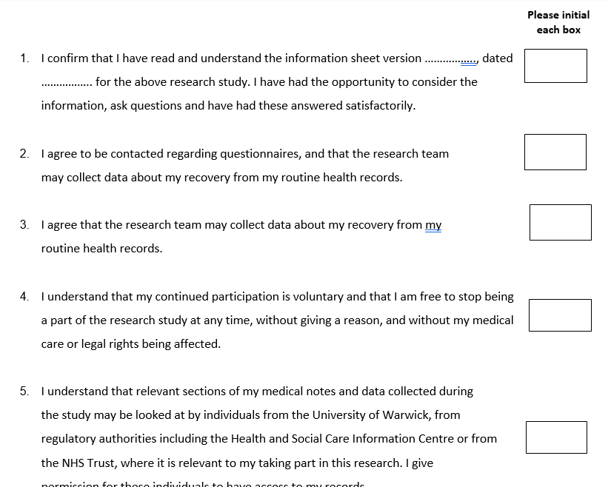
Consent form
When approached for consent patients have three choices detailed in the Patient Information Sheet:
Agree to complete questionnaire booklets three months and six months after their cardiac arrest, and allow the research team to collect relevant data
Only agree to allow the research team to collect relevant data (no questionnaires)
Let us know that they do not wish to take any further part in the research.
For option 1 they must tick all boxes.
For option 2, they do not have to select box 2 on consent form. All other points must be agreed.
If they do not want to take part, no consent will be signed.
Notes:
We recommend that the process of approaching and informing surviving patients and relatives about the study is tailored to the individual and completed over a period of time at a pace dictated by the patient’s recovery and requirements.

Slide 19
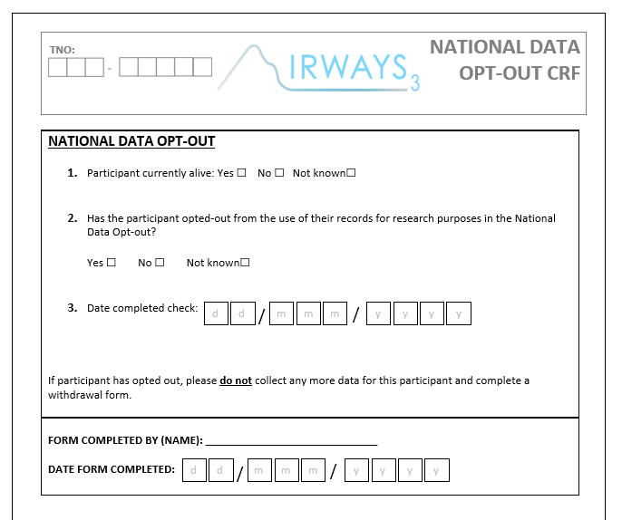
National Data Opt-Out
Patients who have opted-out from their confidential patient information being used for research and planning will be withdrawn from the study and not followed up.
Surviving patients who have opted out will not be approached for consent.
Please check the National Opt-Out register
BEFORE approaching for consent

Slide 20
Data collection and outcomes
Primary outcome: Modified Rankin Score (mRS) at hospital discharge /30 days post-randomisation if the participant remains in hospital - collected with NCAA with data set from linkage
Secondary outcomes: Data will be collected immediately after the cardiac arrest using the Progressive Web App (PWA) by the randomising clinician. This will include:
Initial ventilation success
Regurgitation and aspiration
Return of spontaneous circulation (ROSC) > 20 minutes
Other outcomes: Some extra data is to be collected (mostly at discharge/30 days) directly onto the database by the research team such as:
Participant details
Survival status
Comorbidities
National Data Opt-Out (any patient who opts out is completely withdrawn and data removed)
Long term follow up:
3 and 6 month questionnaires for surviving patients are coordinated and collect by WCTU
Other outcomes and datasets will be collected via data linkage with NCAA (as mentioned above), ICNARC, ONS and HES

Slide 21
Safety reporting
SAEs are reportable to WCTU if they are:
UNEXPECTED in patients undergoing resuscitation
occur between the time of randomisation and hospital discharge
possibly, probably or definitely related to the study interventions
Enter SAEs directly into the SAE eCRF on the database within 24 hours of becoming aware of the event.
Events that do NOT need to be reported as SAEs in AIRWAYS-3:
  Death
  Hospitalisation
  Persistent or significant disability or incapacity
  Organ failure
  Dislodgment / misplacement of interventions
  Events related to the patients underlying disease or condition
Examples of events that may be SAEs in AIRWAYS-3 are;
Use of one of the interventions causing a new injury that endangers the patient
Unrecognised oesophageal intubation
Notes:
As a cardiac arrest is very severe and most lead to at least one of the criteria's for a serious adverse event, we are not asking you to report every case of that fits. We ask you to report anything that would not be expected during or following a resuscitation up to hospital discharge possibly, probably or definitely related to the use of SGA or TI. The PI at your site will be asked to assess causality and all of this will be reported through the database. SAEs must be reported within 24 hours of becoming aware of the event or as soon as practicable.

Slide 22
Protocol non-compliance
Protocol non-compliance is when an activity deviates from what is outlined in the protocol approved by the study sponsor and ethics.
Examples of non-compliances:
Crossover of intervention treatment without suggested number of attempts or clinical reason
Patient is ineligible.
Recruiting healthcare professional not trained on the trial.
No active effort to follow up patients to obtain retrospective consent if they regain capacity or to approach consultee for consent.
Late reporting of safety issues.
​
Report any non-compliances immediately to Warwick CTU straight onto online database (within 24 hours of becoming aware), or to someone who has database access to do so.
Please note this list is not exhaustive
Notes:
Non-compliance is any action that goes against the protocol, with some examples shown on the screen. Please report any suspected non-compliance directly through the database within 24 hours of becoming aware.

Slide 23
Training requirements
All site research staff working on the trial must complete the training slides hosted on Warwick CTU website, and sign the training logs.
The training slides are available on the trial website and via the CTU trial team.
Principal Investigator (PI) to ensure that all staff have the appropriate knowledge and understanding of the trial.
Copy of PI CV and good clinical practice (GCP) certificate is required prior to study commencing.
Notes:
NOTE TO SCOTT – We could put the information on this slide at the top of the webpage we’re hosting the training, and reiterate in email correspondence about training? So possible no need for slide

Slide 24
Greenlight items
A copy of the Principal Investigator's short curriculum vitae (CV) and Good Clinical Practice (GCP) certificate – must be clearly dated, full GCP and CV needed only for PI
Site Agreement signed by all parties:
  Tracked changes version of mNCA sent to airways3@warwick.ac.uk with target
  Sponsor signature
  Site countersignature
Capacity and Capability Confirmation from Research and Development (R&D) Office
Appropriately signed Delegation of Responsibilities log – everyone who will be collecting data/consenting MUST be on the delegation log.
Those just randomising will just be required to complete the training and these will be confirmed with PI or API before being issued with a PWA login
All staff on delegation log trained – mandatory training online Airways3 training (warwick.ac.uk)
Randomisation SOP complete – details site process of informing team of PID
Localised documents – site file held on website (to be kept electronically) - Site File Trial Documentation (warwick.ac.uk)
Internet protocol (IP) received for database access - on your work PC google ‘what is my IP’ and send us this link of numbers – this will allow access on any PC in department (with appropriate login)

Slide 25
Extended Pilot until December 2023
All pilot sites continue to main trial – expanding internationally

Slide 26

“If you cant explain it simply
You don’t know it well enough
Questions?

