Slide 1


A journey through Associate PI tenure and beyond
James Penketh
API alumni
SpR Anaesthetics and Intensive Care

Slide 2
What we will cover
API scheme overview and how it works in practice
My experience of the API scheme – Airways 3
AIRWAYS-3 at the RUH Bath

Slide 3

Why Associate PI
To integrate clinical research into routine clinical training.
To provide a structure for junior doctors, nurses and allied health professionals to gain experience in local leadership of clinical trials, supported by mentors.
To recognise junior doctor, nurse and allied health professional engagement in a standardised and consistent manner across all NIHR portfolio trials.
Associate PI status endorsed by NIHR and Royal Colleges

Slide 4
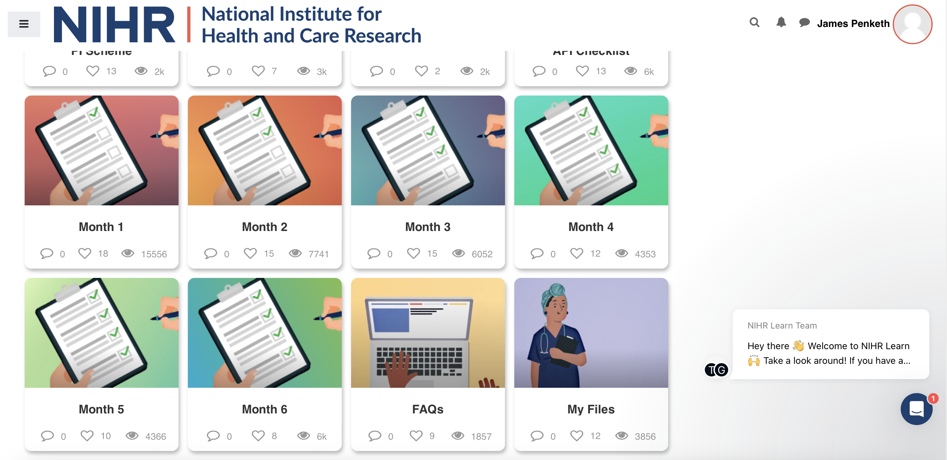

Slide 5
Associate PI checklist
Disseminating study
Engagement with the research team
Staff study training / info
Screening log reviews
Delegation compliance
Clinical Trials Unit engagement

Slide 6
Associate PI checklist
Disseminating study
Engagement with the research team
Staff study training / info
Screening log reviews
Delegation compliance
Clinical Trials Unit engagement
Who needs to know, wants to, probably should?
Get to know them, regular contact/meetings, be approachable
Who, when, how
Mechanism, have we missed any?
When to sign
Ask questions, PI/Associate PI eventss

Slide 7
Airways 3
Understand the study protocol
Start talking about the study early – work out who is key
‘Climb in their skin and walk around’
How can you achieve 24hr randomization
How will you screen
How can you embed training
Regular communication with research team and clinical trials unit

Slide 8
Tips / Learning points
Fantastic opportunity
Keep notes / logs – complete as you go along
Access the forum
Learn from you mentor
The more you put in the greater your experience and satisfaction
Know the study + be interested
Be prepared to adapt
Be approachable / available
Ask questions

Slide 9
Where next?
Continuing with Airways 3 support
PI
Continuing my own research interests alongside clinical work

Slide 10

Thank you – Questions?

