Slide 1


Exploring Mechanical CPR
Keith Couper
@keithcouper

Slide 2
Conflicts of interest
Employment: University of Warwick and University Hospitals Birmingham NHS Foundation Trust
Volunteer roles- International Liaison Committee on Resuscitation, European Resuscitation Council, Resuscitation Council UK
Research funding: NIHR funding for PARAMEDIC-3, AIRWAYS-3, COMPRESS
Associate editor, Resuscitation Plus (paid)
Notes:
Thank you to the College of Paramedics for hosting this exciting day and the opportunity to talk here.
Conflicts of interest

Slide 3
Overview of talk
Why?
When should we use mechanical CPR?
Optimising use in clinical practice
Notes:
Thank you to the College of Paramedics for hosting this exciting day and the opportunity to talk here.
Conflicts of interest

Slide 4
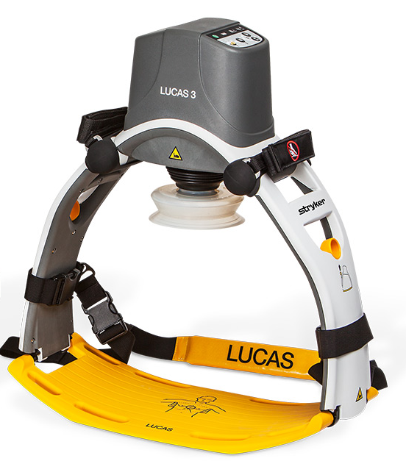
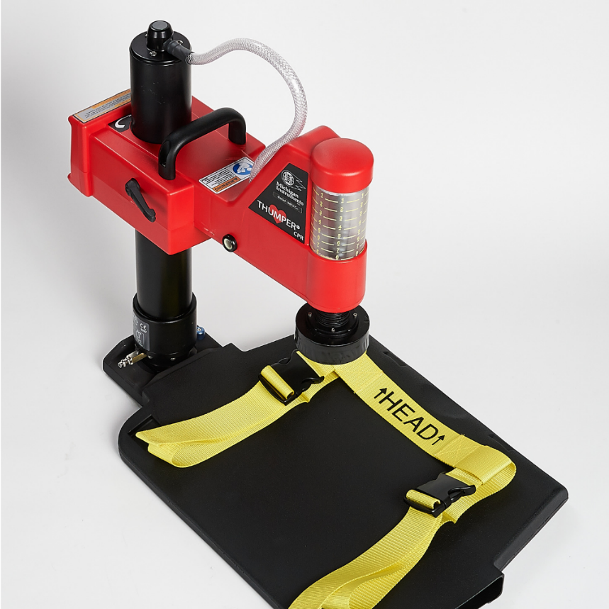
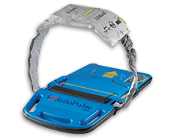
Not all devices are equal
https://www.lucas-cpr.com/; https://www.zoll.com/uk/products/automated-cpr/autopulse-for-hospital; https://www.michiganinstruments.com/automated-cpr/thumper/;
Notes:
Thank you to the College of Paramedics for hosting this exciting day and the opportunity to talk here.
Conflicts of interest

Slide 5
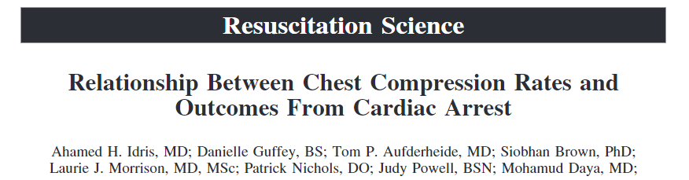
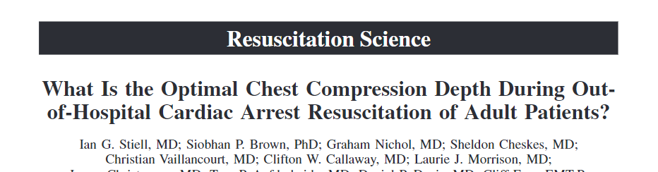
Why?
Notes:
Thank you to the College of Paramedics for hosting this exciting day and the opportunity to talk here.
Conflicts of interest

Slide 6


When?
Consider mechanical chest compressions only if high-quality manual chest compression is not practical or compromises provider safety.
When a mechanical chest compression device is used, minimise interruptions to chest compression during device use by using only trained teams familiar with the device.

Slide 7
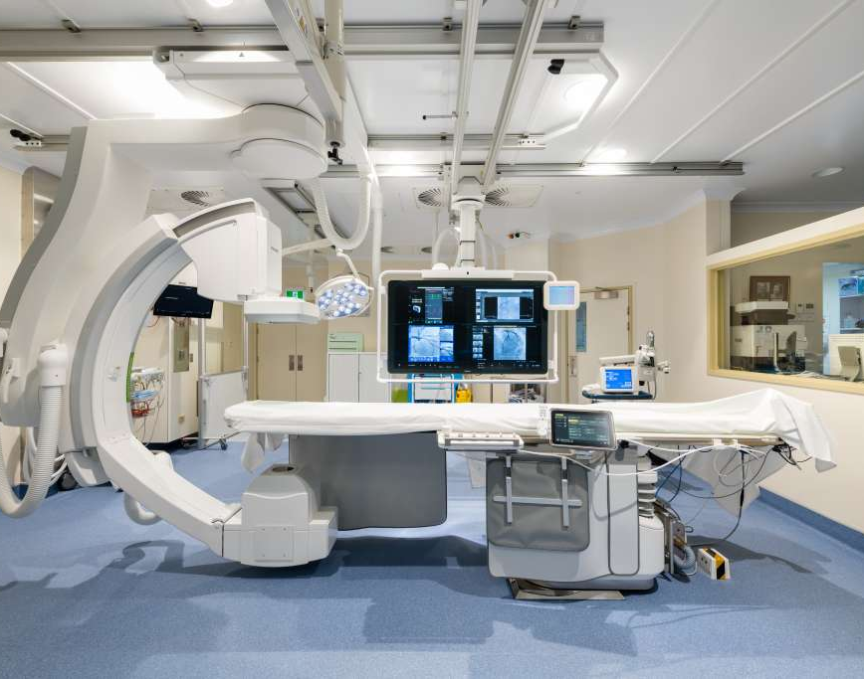
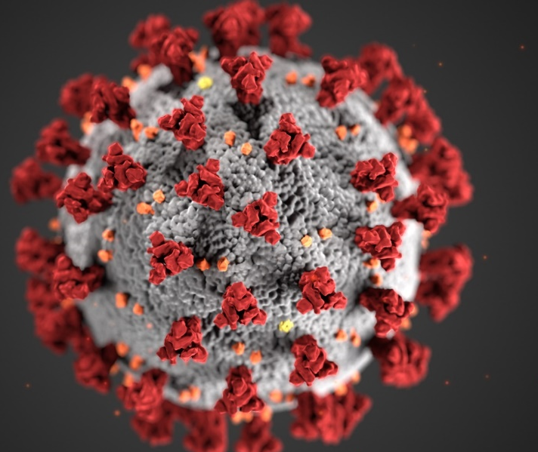
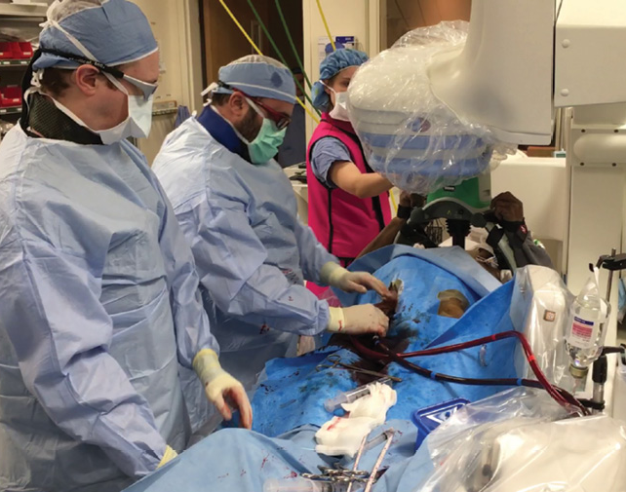
When?
https://www.sath.org.au/services/cardiac-catheter-laboratory/; https://www.jems.com/patient-care/ecmo-refractory-ohca/

Slide 8
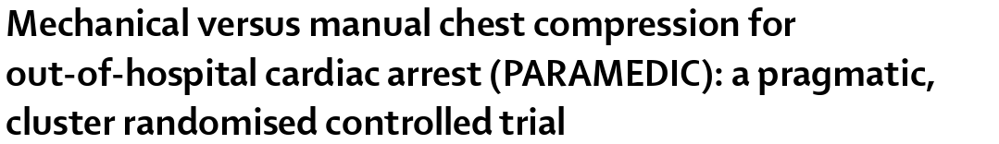
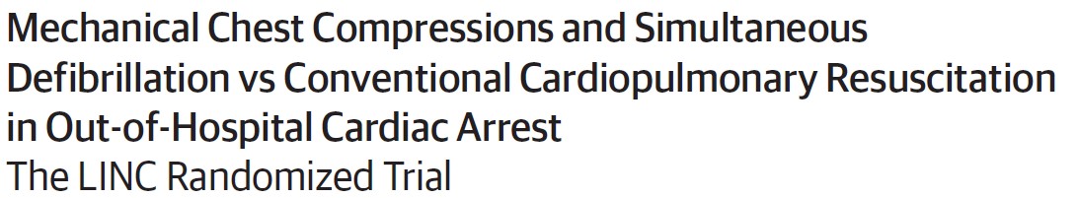
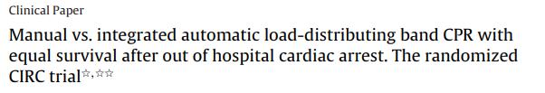
When?

Slide 9






Feasibility RCT: LUCAS v mechanical CPR
72 years
11
mins
60%
3%
28%
4%

Slide 10
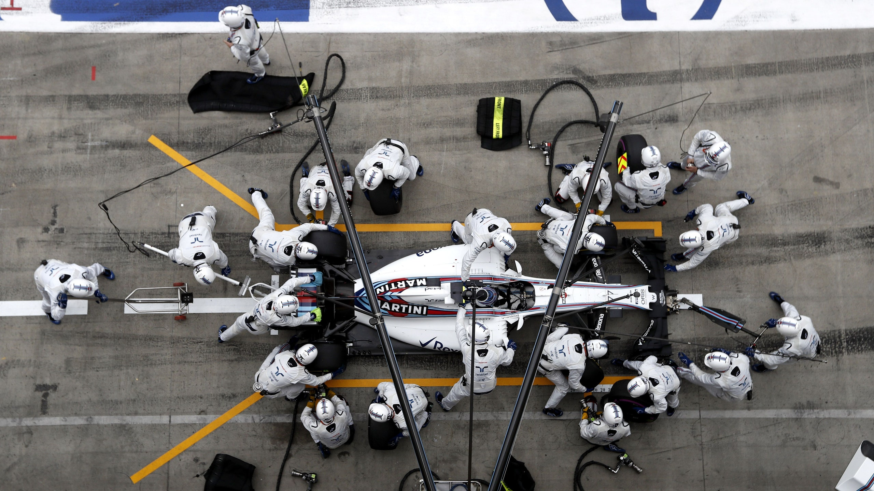
Optimising use in practice
- Minimise time off the chest
- Correctly positioned
- Audit performance
https://www.wired.co.uk/article/f1-pit-stop-times-record-williams

Slide 11
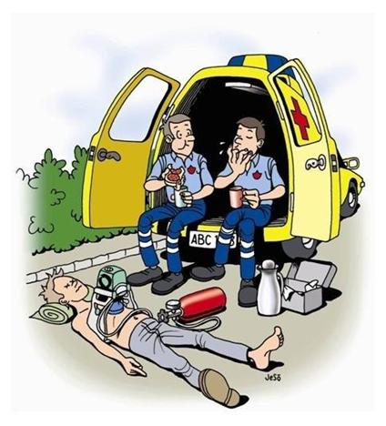
Optimising use in practice

Slide 12

Conclusion
Mech-CPR probably delivers better CPR
Potential role in some contexts
No evidence of improved outcomes
Need to carefully consider deployment
Notes:
Thank you to the College of Paramedics for hosting this exciting day and the opportunity to talk here.
Conflicts of interest

Slide 13
Thank you
@keithcouper

