Slide 1


Double-sequential defibrillation
Keith Couper
@keithcouper

Slide 2
Double-sequential defibrillation
Dual
sequence
Keith Couper
@keithcouper

Slide 3
Conflicts of interest
Employment: University of Warwick and University Hospitals Birmingham NHS Foundation Trust
Volunteer roles- International Liaison Committee on Resuscitation, European Resuscitation Council, Resuscitation Council UK
Research funding: NIHR funding for PARAMEDIC-3; AIRWAYS-3
Associate editor, Resuscitation Plus (paid)

Slide 4
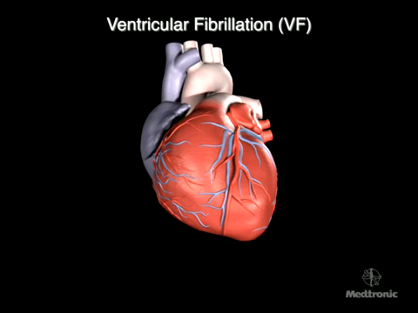


Slide 5
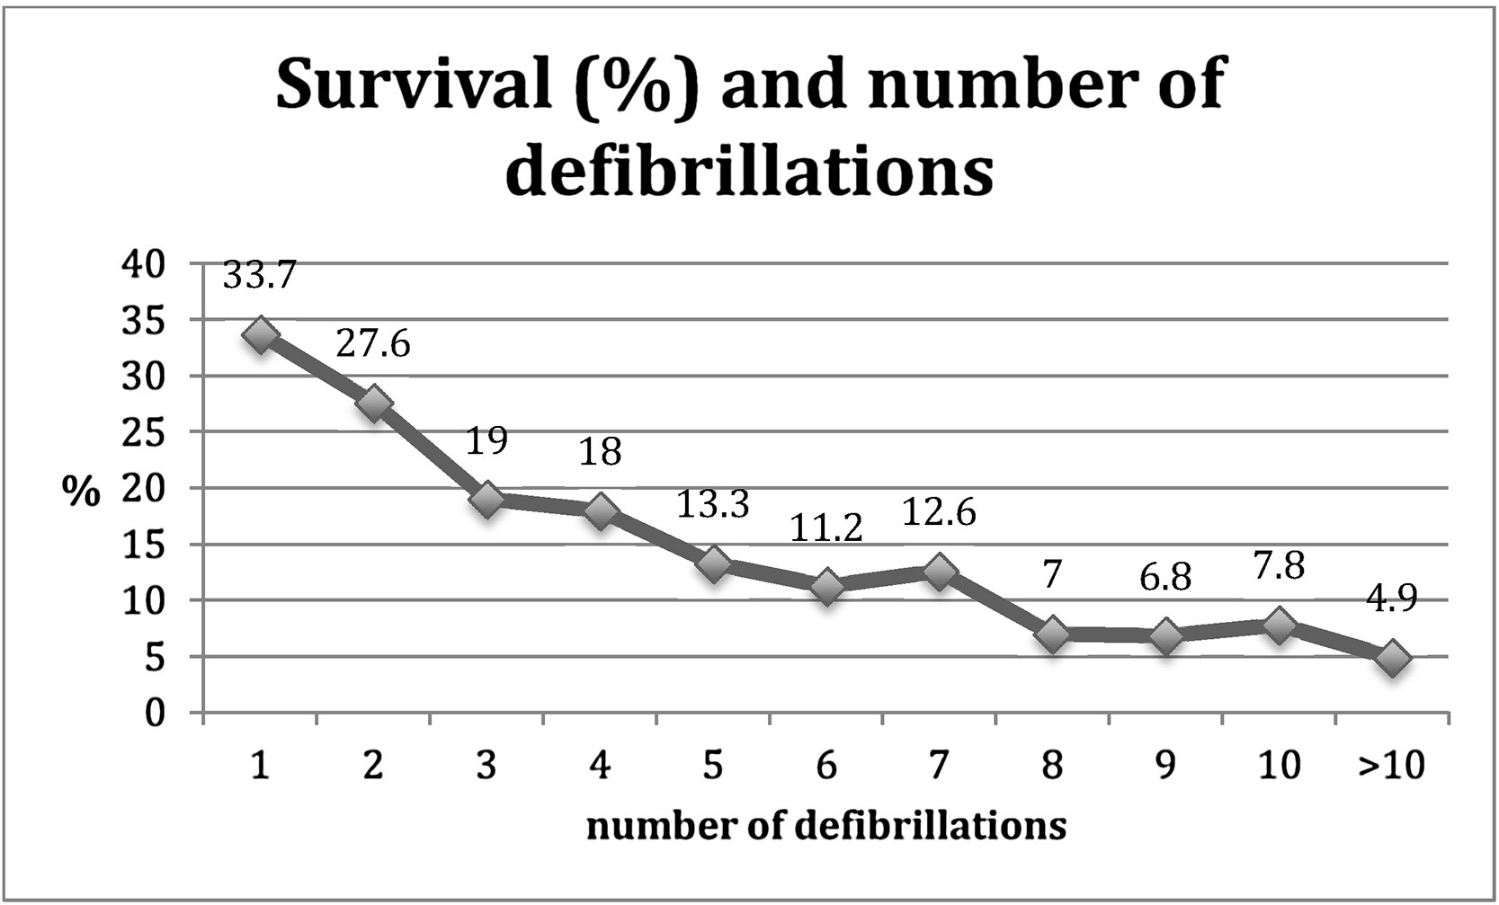
Holmen Resuscitation 2017

Slide 6
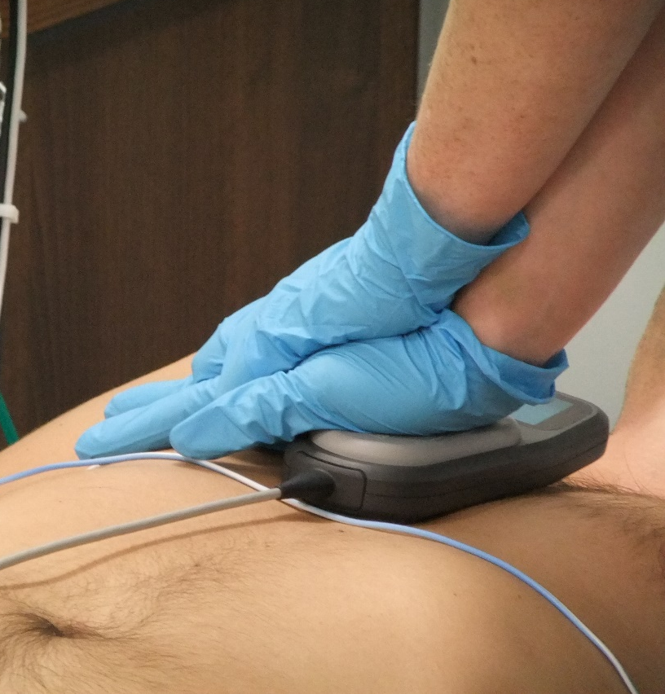
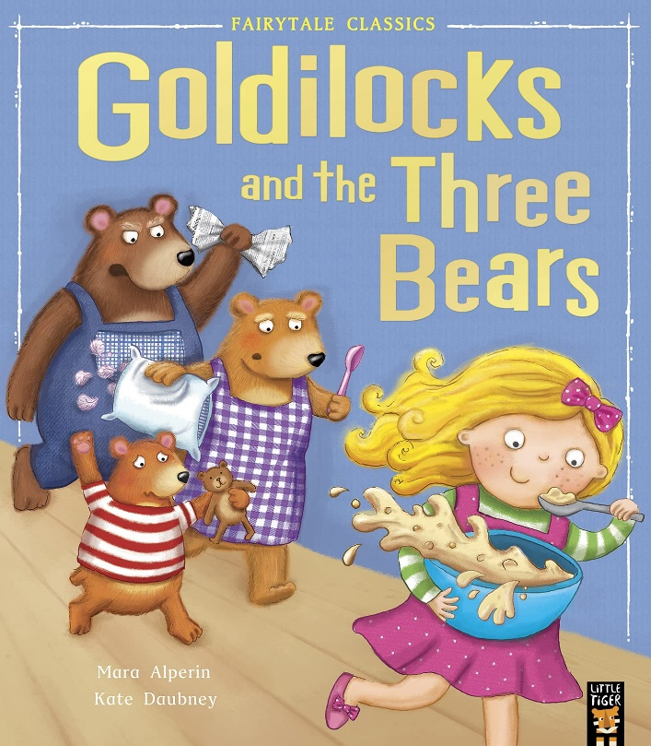

Making your first shock count

Slide 7

Making your first shock count
https://www.independent.co.uk/news/uk/home-news/london-attack-suspect-photo-picture-man-westminster-terror-incident-ambulance-a7644291.html; Soar et al 2021

Slide 8
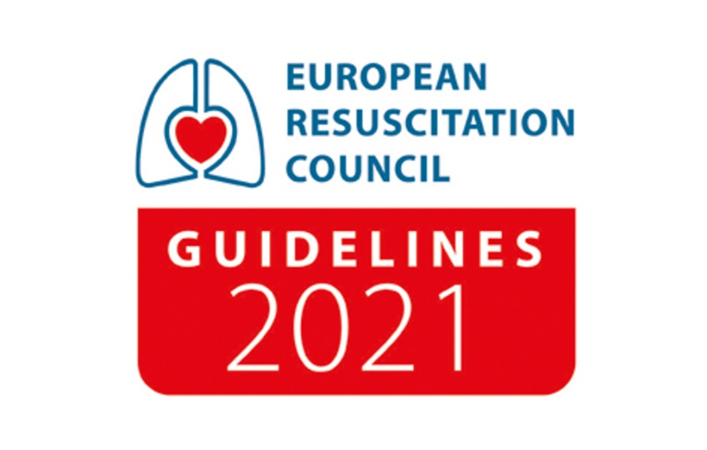

Guidelines for refractory VF
Consider escalating the shock energy, after a failed shock and for patients where refibrillation occurs
For refractory VF, consider using an alternative defibrillation pad position (e.g. anterior- posterior)
Do not use dual (double) sequential defibrillation for refractory VF outside of a research setting

Slide 9
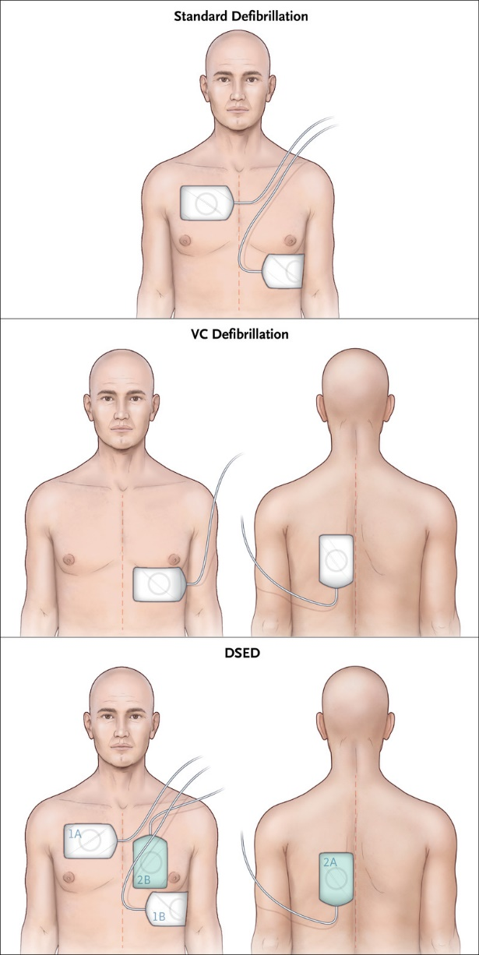
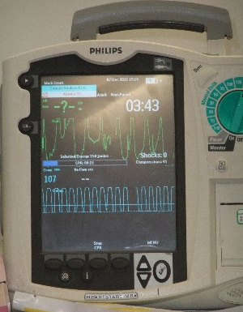
Alternative defibrillation strategies

Slide 10

Cheskes 2022 NEJM
Cluster RCT- Canada
405 adults with refractory VF/ VF (three shocks)
Standard care (Canada) v vector change v DSED
Stopped early due to COVID-19 pandemic

Slide 11


Cheskes 2022 NEJM
Defib 1
Defib 2
Time

Slide 12

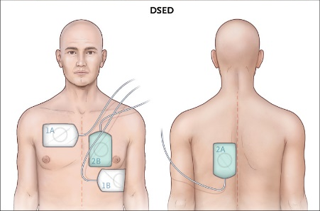



Cheskes 2022 NEJM
26.5%
35.4%
46.4%
13.3%
21.7%
30.4%
11.2%
16.2%
27.4%

Slide 13


Cheskes 2022 NEJM
26.5%
35.4%
46.4%
No comparison of vector change and DSED
13.3%
21.7%
30.4%
11.2%
16.2%
27.4%

Slide 14
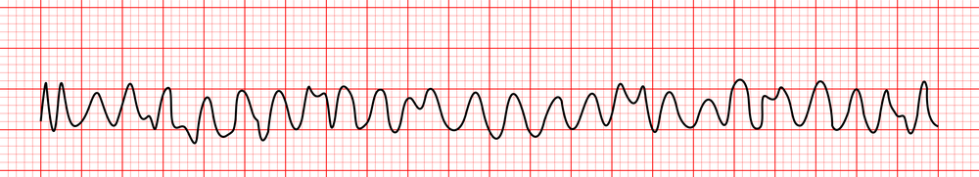
Recurrent or refractory ventricular fibrillation
?

Slide 15
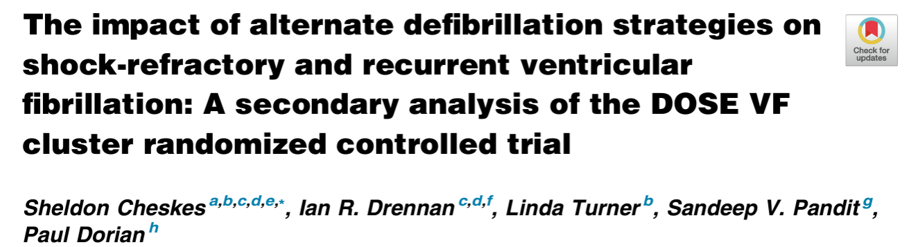
Recurrent VF
(n=285)
Refractory VF
(n=60)
Vector change
DSD
Vector change
DSD
40% v 31%
47% v 31%
23 v 8%
29% v 8%
23% v 17%
27% v 17%
9% v 0%
29% v 0%
18% v 14%
25% v 14%
5% v 0%
29% v 0%

Slide 16
Recurrent VF
Refractory VF
Vector change
DSD
Vector change
DSD

Slide 17
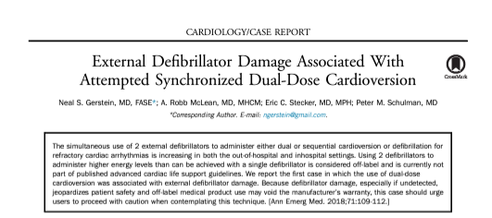
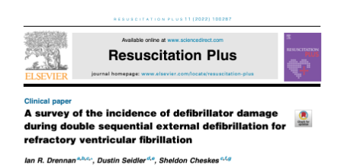

Slide 18

Defibrillation strategies- refractory VF
We suggest that a double sequential defibrillation strategy (weak recommendation, low certainty of evidence) or a vector change defibrillation strategy (weak recommendation, very low certainty of evidence) may be considered for adults with cardiac arrest who remain in VF/ VT after 3 or more consecutive shocks.

Slide 19
Thank you
@keithcouper

