Slide 1


Presentation title on two lines
Name
Title
Perioperative
Airway Complications
and
Cardiac Arrest
Jasmeet Soar
Southmead Hospital
North Bristol NHS Trust
@jas_soar
#NAP7
Airways 3 webinar
23 September 2024

Slide 2
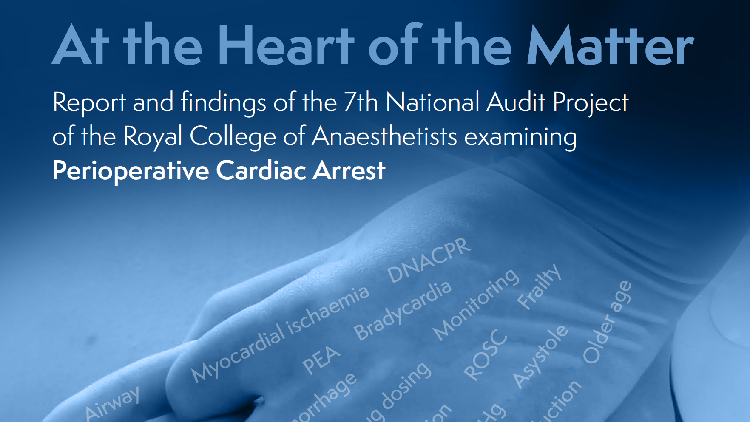

Jasmeet Soar
NAP7 Clinical Lead
@jas_soar
#NAP7

Slide 3
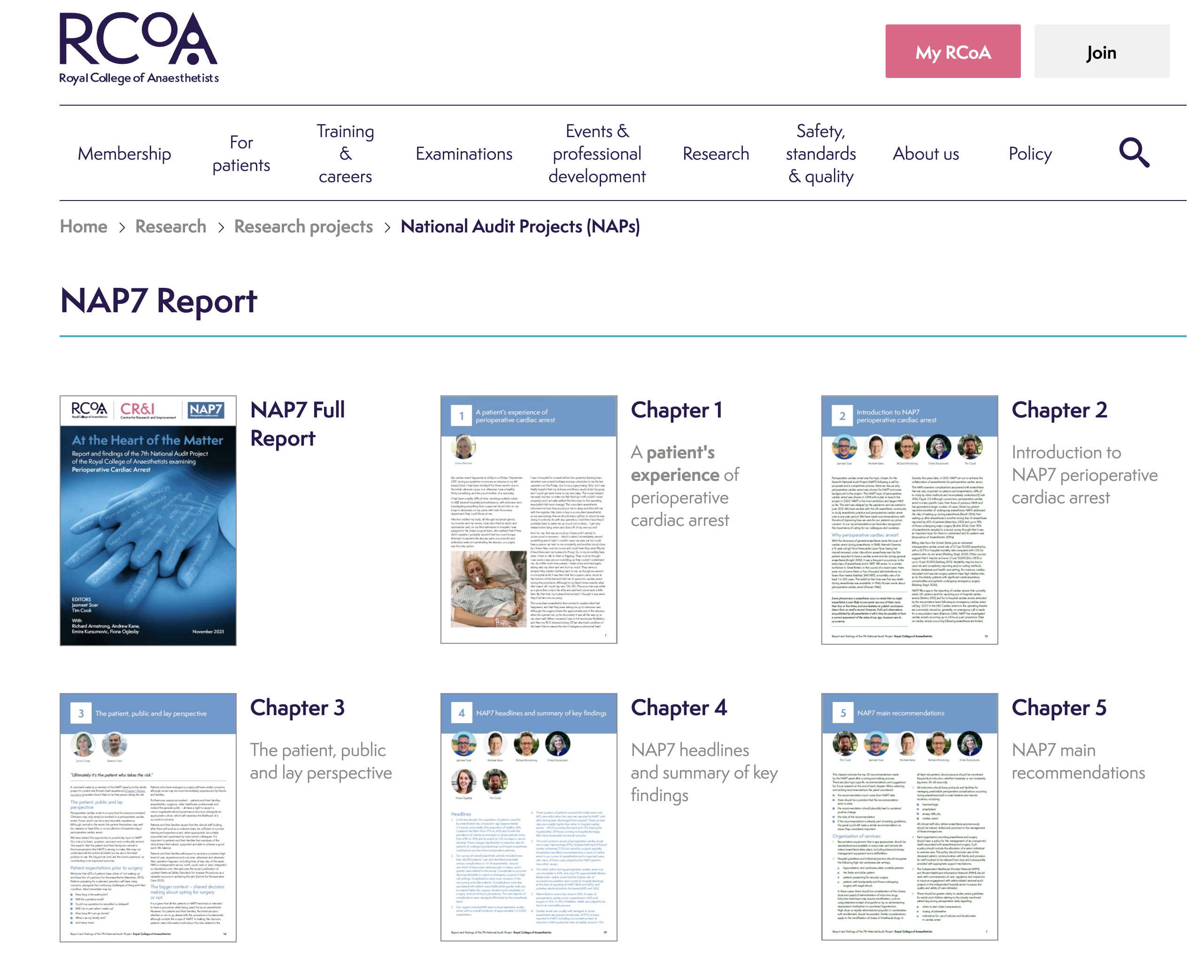

Slide 4
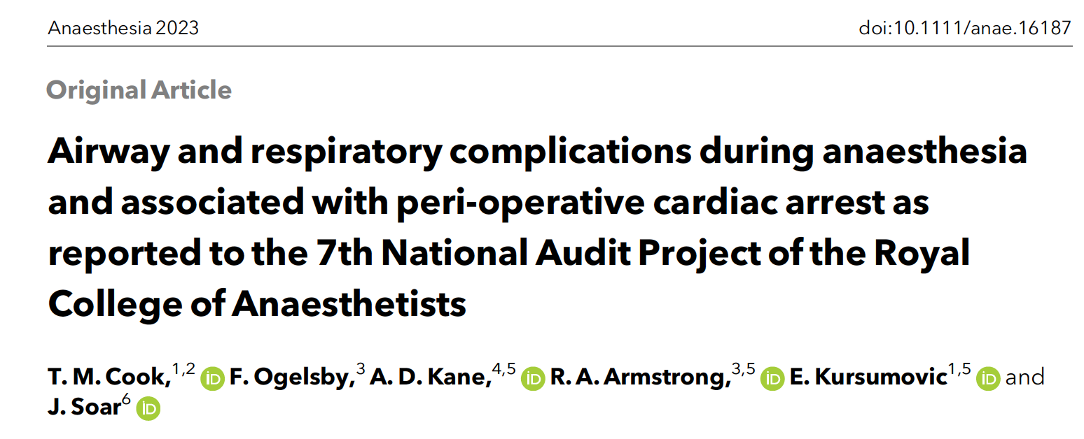

Slide 5
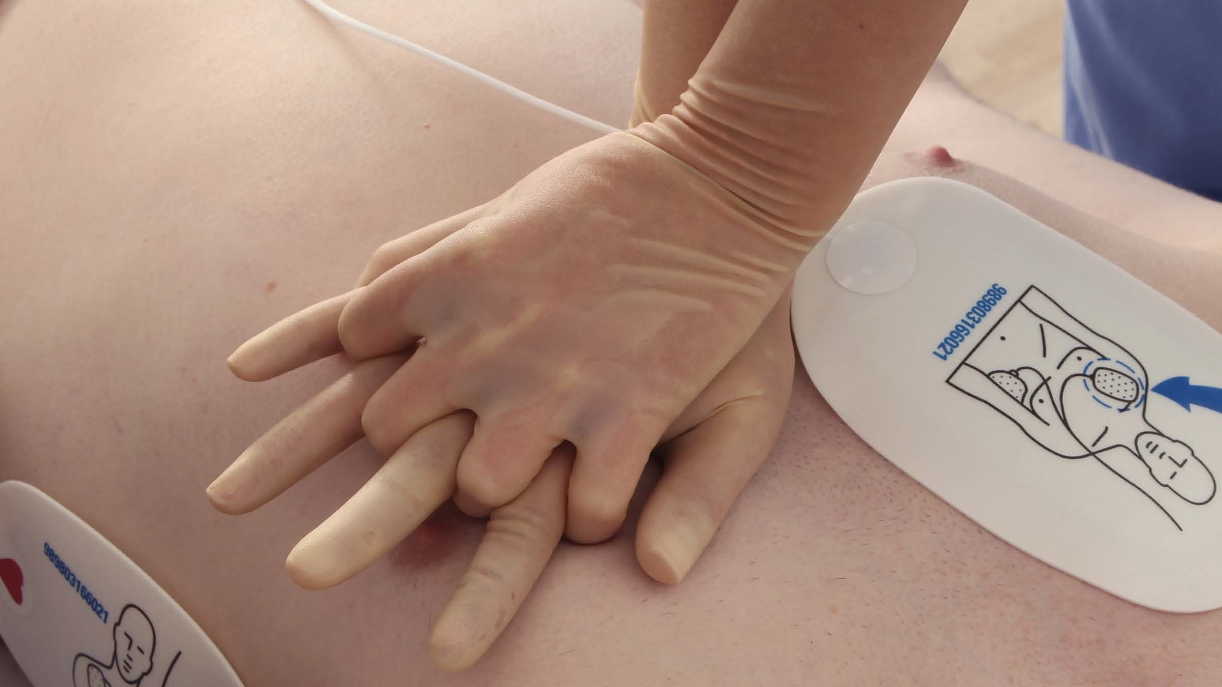
PERIOPERATIVE
CARDIAC ARREST

Slide 6
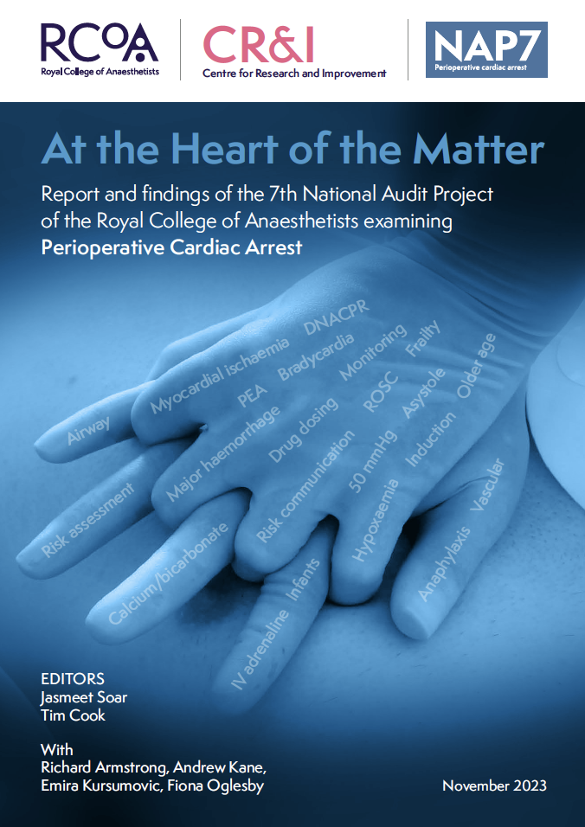
National Audit Projects
Notes:
National Audit projects have looked at events which are rare and potentially catastrophic,
those which are incompletely studied and have focused on events which are important to both patients and anaesthetists.

Slide 7
National Audit Projects
IMPORTANT TO PATIENTS
IMPORTANT TO ANAESTHESTISTS
POORLY
STUDIED
DIFFICULT TO STUDY
RARE
Notes:
National Audit projects have looked at events which are rare and potentially catastrophic,
those which are incompletely studied and have focused on events which are important to both patients and anaesthetists.

Slide 8
Complications
1 in 22,000
Death
1 in 181,000
Anaphylaxis
1 in 12,000
Cardiac arrest
1 in 78,000
Death
1 in 313,000
CVS collapse
/respiratory arrest
1 in 101,000
Notes:
National Audit projects have looked at events which are rare and potentially catastrophic,
those which are incompletely studied and have focused on events which are important to both patients and anaesthetists.

Slide 9
Complications
1 in 22,000
Death
1 in 181,000
Anaphylaxis
1 in 12,000
Cardiac arrest
1 in 78,000
Death
1 in 313,000
CVS collapse
/respiratory arrest
1 in 101,000
Notes:
National Audit projects have looked at events which are rare and potentially catastrophic,
those which are incompletely studied and have focused on events which are important to both patients and anaesthetists.

Slide 10
NAP4
2008-2009
Airway complications leading to death, brain damage, surgical airway, ICU admission
309 Hospitals
184 reports, 38 deaths, 18 Permanent harm

Slide 11
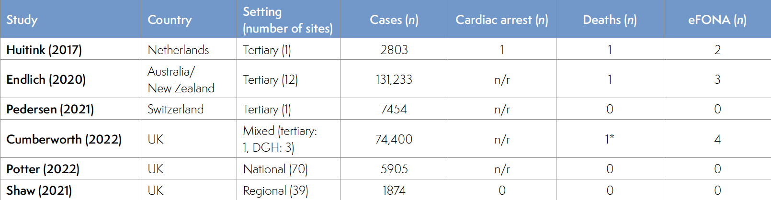
Studies since NAP4

Slide 12
Studies since NAP4
NAP4 (2011) UK 309 2.8 million 38

Slide 13
Studies since NAP4
NAP4 (2011) UK 309 2.8 million 38
NAP7 (2023) UK 385 2.71 million

Slide 14



ACTIVITY
SURVEY
During NAP7
4-day activity survey of all sites
‘Denominator data’
BASELINE
SURVEY
At start of NAP7
Departmental structures and processes
Personal experiences of perioperative cardiac arrest
CASE
REPORTING
1 year
Detailed case review form with panel review
‘Numerator data’
24,172
cases
10,746 anaesthetists
881
cardiac arrests

Slide 15
BASELINE
SURVEY
At start of NAP7
Departmental structures and processes
Personal experiences of perioperative cardiac arrest
10,746 anaesthetists

Slide 17
ACTIVITY
SURVEY
During NAP7
4-day activity survey of all sites
‘Denominator data’
24,172
cases

Slide 18
Annual
Anaesthetic
Workload
2.72
million cases

Slide 19
Practice changes – SGAs vs TTs
 | NAP7 | NAP4
SGA | 45% | 56%
TT | 52% | 38%

Slide 20
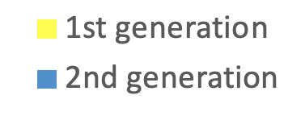
SGAs

Slide 21
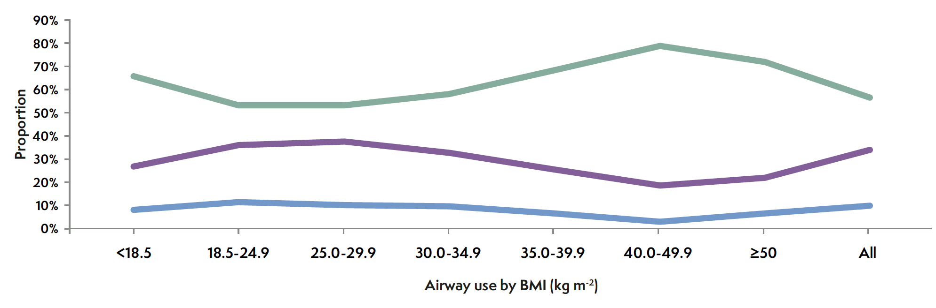
Airway by BMI
Tracheal tube
2nd gen. SGA
1st gen. SGA

Slide 22
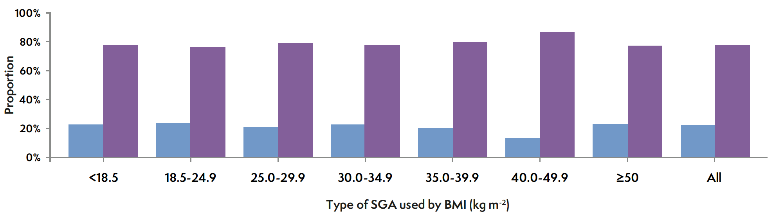
1st v 2nd SGA
Anaesthetists largely ignore BMI
in choosing 1st or 2nd generation SGAs

Slide 23
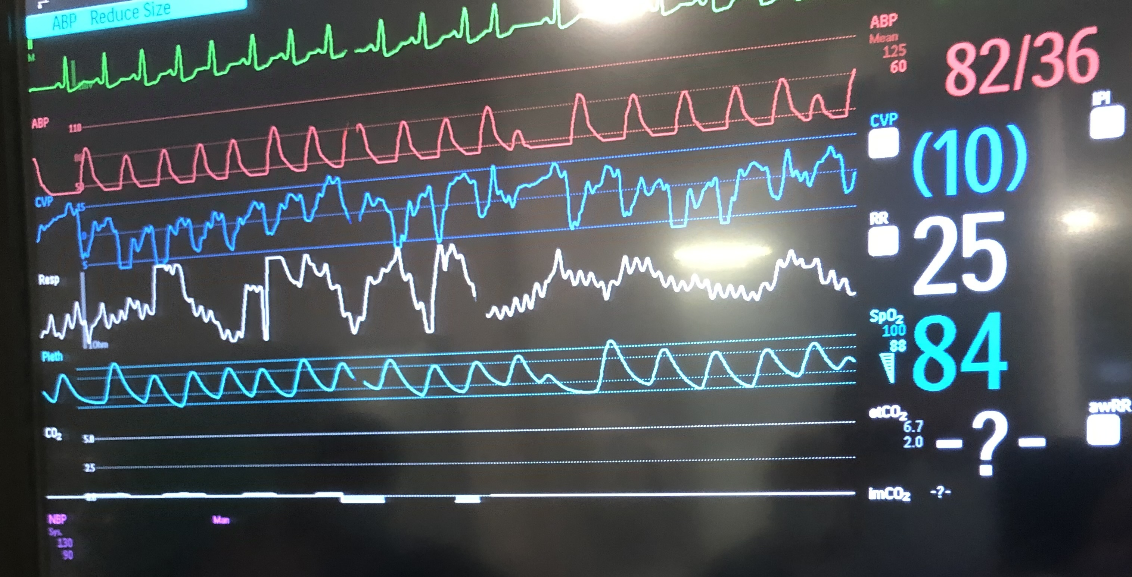
COMPLICATIONS

Slide 24
Potentially serious
complication
1 in 18

Slide 25
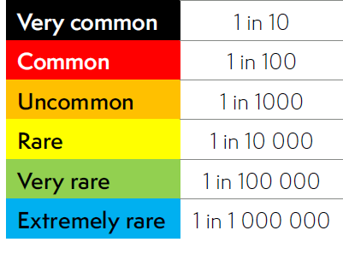
Potentially serious
complication
1 in 18

Slide 26
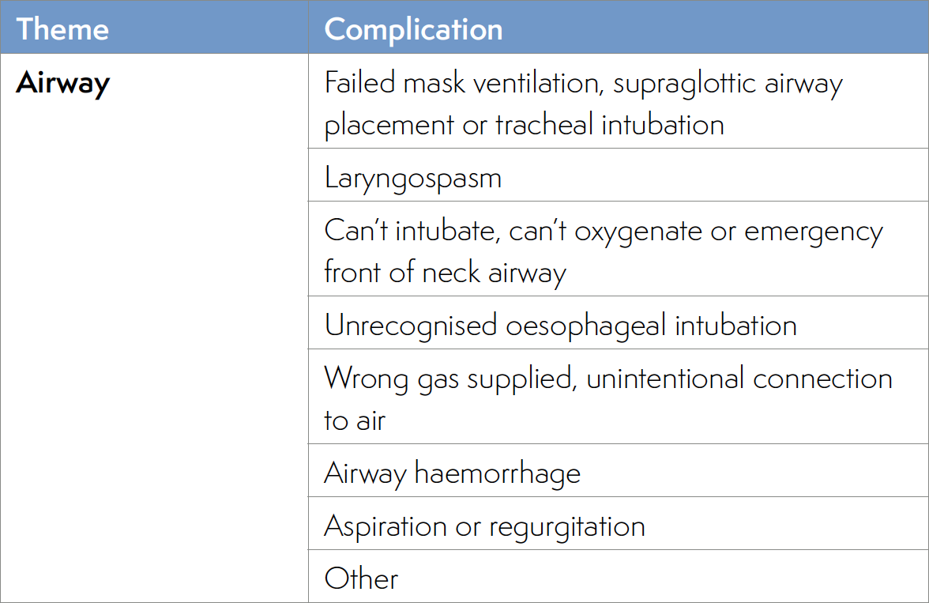

Slide 27
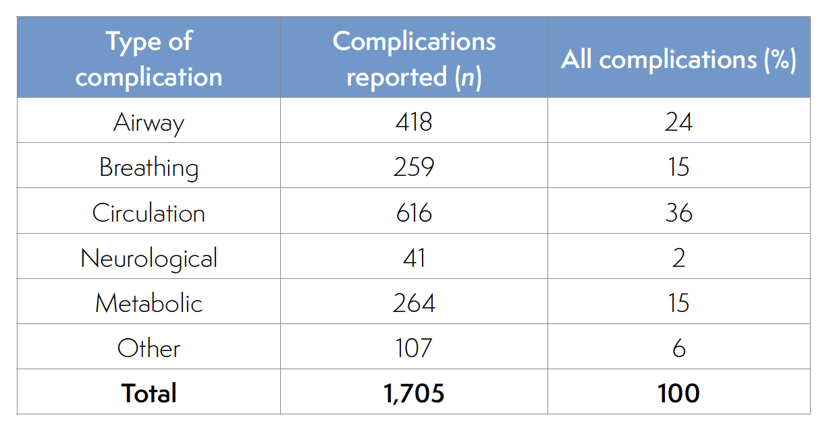
Notes:
NON-OBSTETRIC
1 in 50 cases

Slide 28
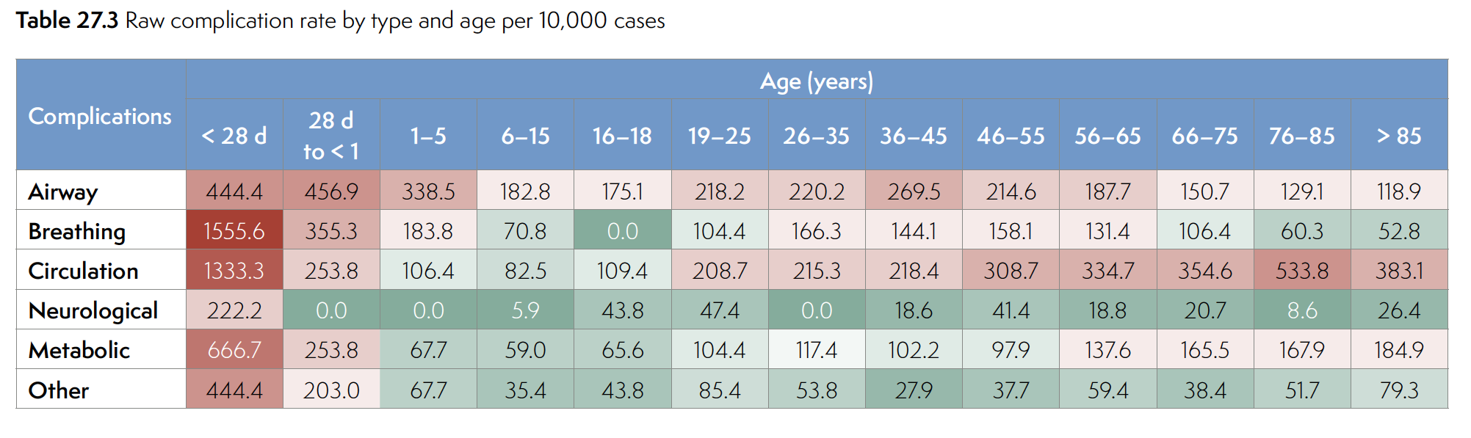
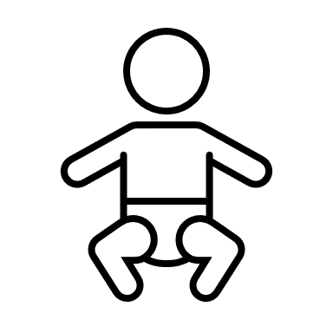

Slide 30
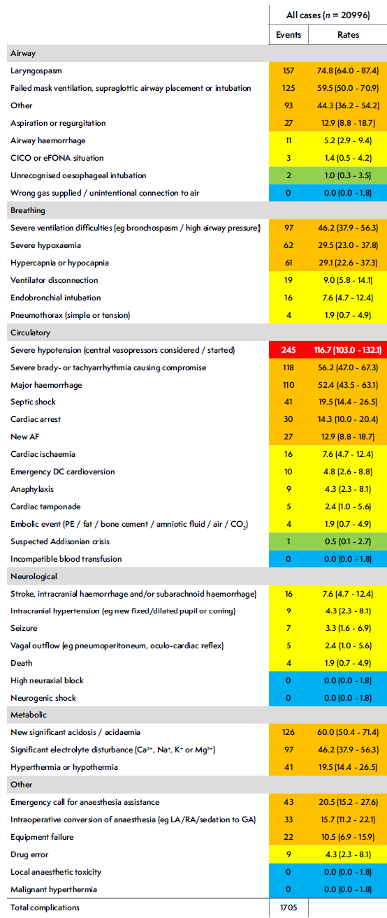
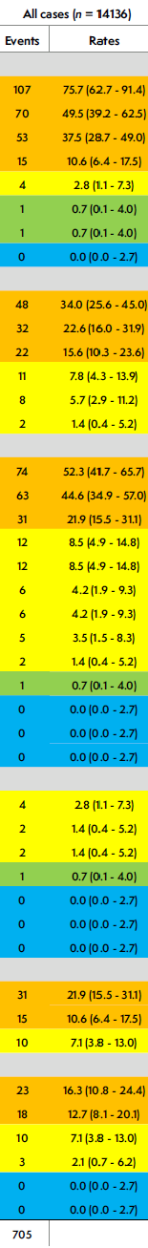
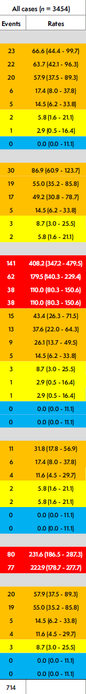
All cases
Elective
Emergency
Airway
Breathing
Circulation
Neurological
Metabolic
Other

Slide 31
All cases
Elective
Emergency
Airway
Breathing
Circulation
Neurological
Metabolic
Other

Slide 32
AIRWAY COMPLICATIONS
Rate per 10 000 cases

Slide 33
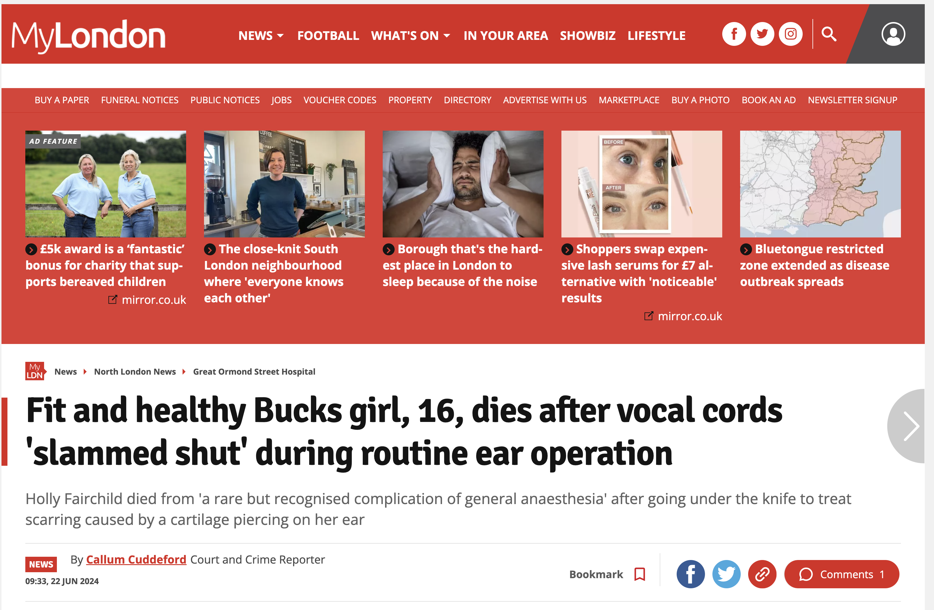
Coroner’s case
August 2023

Slide 34
AIRWAY COMPLICATIONS
CICO/eFONA
1 in 8,370
[95% CI 1 in 2,296 – 30,519]
Rate per 10 000 cases

Slide 35
AIRWAY COMPLICATIONS
1 in 1000
1 in 100
rare
‘uncommon’
common
Rate per 10 000 cases

Slide 36
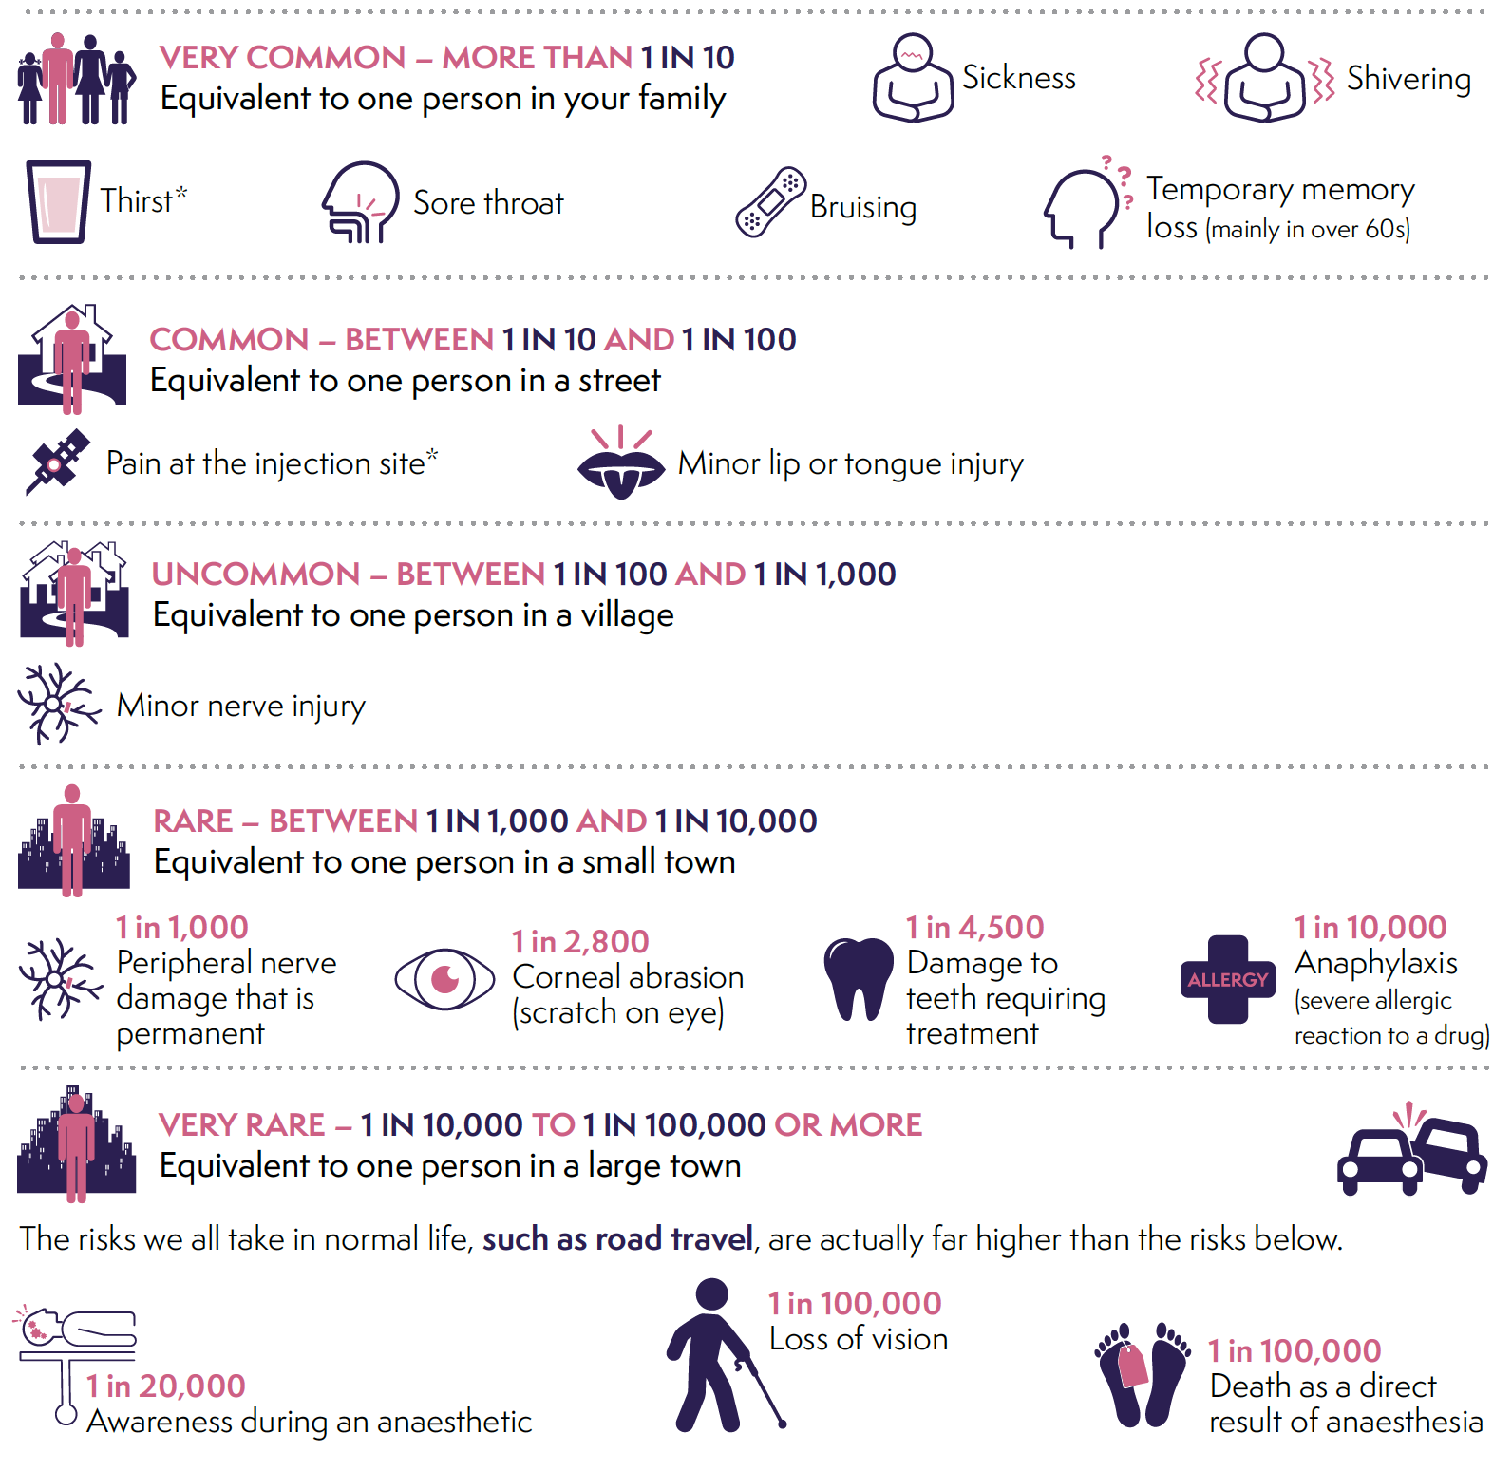
RISKS

Slide 37
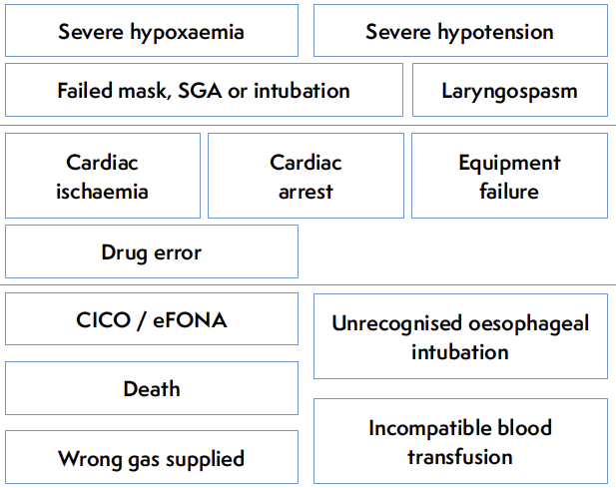
Notes:
elective routine surgery

Slide 38
CASE
REPORTING
1 year
Detailed case review form with panel review
‘Numerator data’
881
cardiac arrests

Slide 39

881
Perioperative
cardiac
arrest
cases
1in 3,000

Slide 40
Incidence by (low risk) patient group
 | Cardiac arrest 1 in… | Death 1 in…
All cases | 3,000 | 13,000
ASA 1 | 11,000 | 132,000
ASA 1-2 | 8,000 | 95,000
Elective cases | 7,000 | 94,000

Slide 41








Highest risk
Saturday/Sunday

Slide 42
71/881
perioperative
cardiac
arrest
cases
AIRWAY PROBLEM
1in 38,000

Slide 43
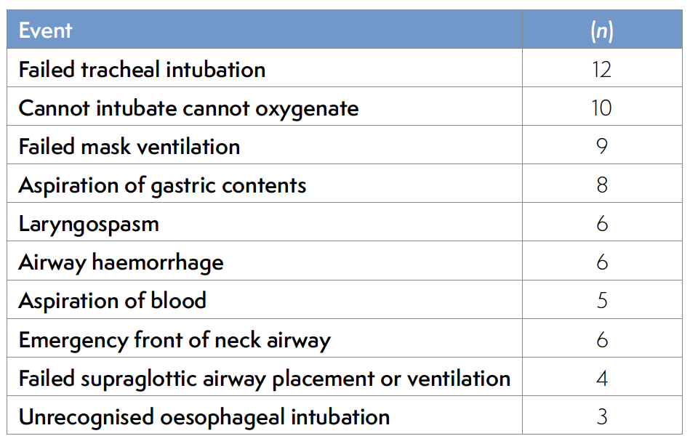
Notes:
2/3 did not have a predicted difficult airway

Slide 44


Most at induction
(25% post extubation)
36% out of hours vs 10% caseload
93% non-shockable
Risk factors – neonate/infants/obesity
82% survival to discharge
Notes:
Risk of death less than 1 in 200,000

Slide 45
Top airway tips (2024)
Never fail to be prepared for failure
Communicate
Do what you can but not what you cannot
Know and practice a wide range of techniques
Learn techniques you think you will never use
If it isn’t working do something different
Never forget the risk of oesophageal intubation – use capnography
Plan & prepare for failure
You are part of a team
Know who will do what you cannot do
Oesophageal intubation
  don’t rely on clinical signs
  know & use PUMA guidelines
It’s time for mandatory training

Slide 46

NAP7 Core Team
2019
Emira Kursumovic
Andrew Kane
Fiona Oglesby
Richard Armstrong
Tim Cook

Slide 47


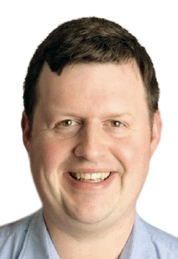




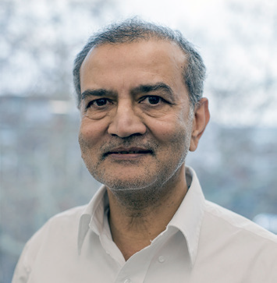
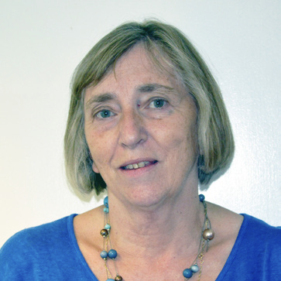

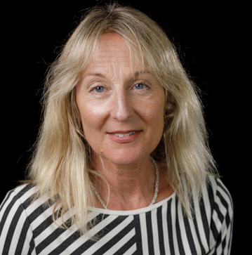



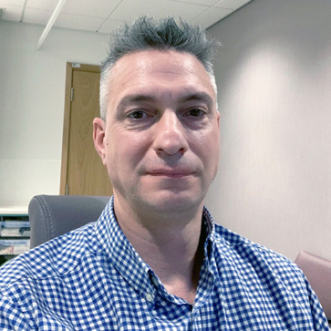
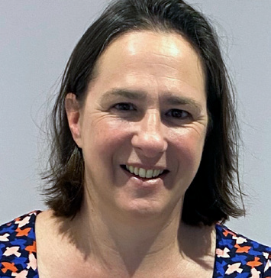
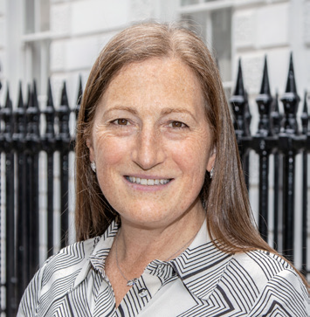
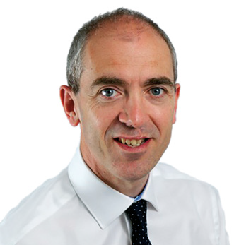
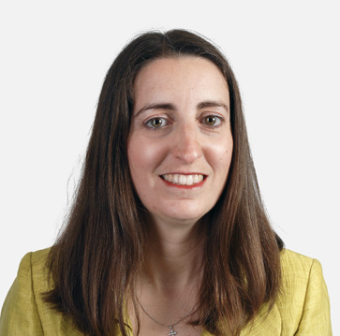



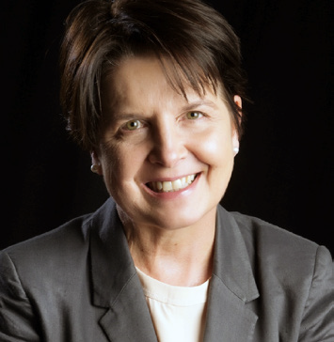
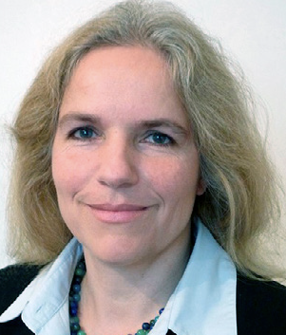
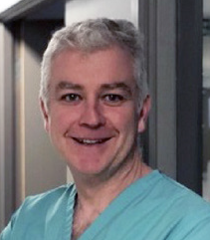




Notes:
+ College team

Slide 48
COLLABORATION
Anaesthesia UK
Notes:
indeed very single one of you is a collaborator on the NAP projects as they rely on anaesthetists sharing there experiences

Slide 49
Presentation title on two lines
Name
Title
Thank you
Jasmeet Soar
Southmead Hospital
North Bristol NHS Trust
@jas_soar
#NAP7
Airways 3 webinar
23 September 2024

