Slide 1
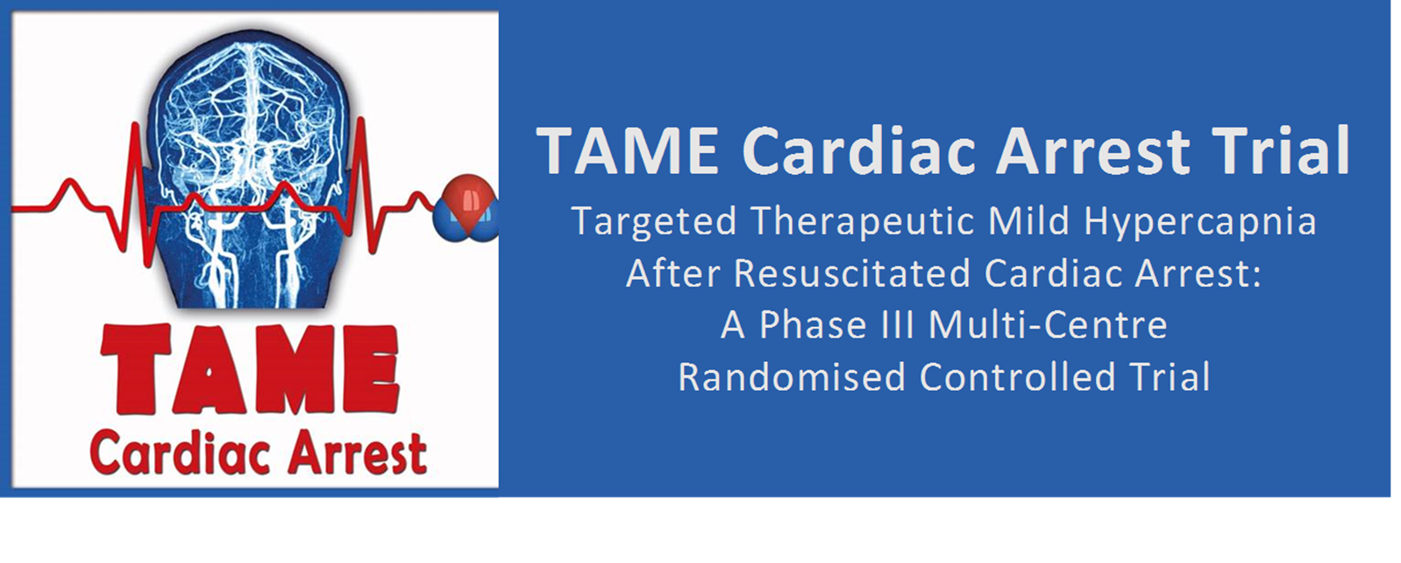








Slide 2
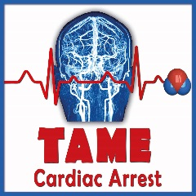


















Global connectedness & representation
TAME trial
= 63 sites from 17 Countries

Slide 3
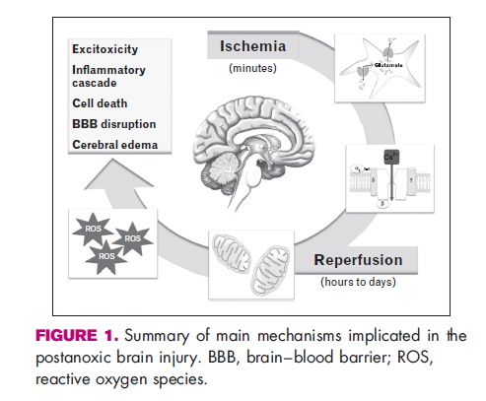
Cardiac Arrest
Cardiac arrest (CA) is a common and catastrophic event.
Hypoxic-ischaemic brain injury is the leading cause of death and disability among comatose adults resuscitated after out-of-hospital cardiac arrest.
As such, interventions to reduce the severity of brain injury after cardiac arrest are desperately warranted.

Slide 4
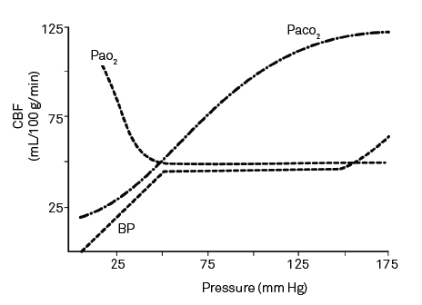
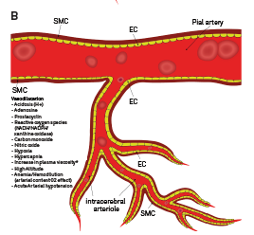

Arterial carbon dioxide
Arterial carbon dioxide (PaCO₂) is the major physiological regulator of cerebrovascular tone.
Hypercapnia markedly increases cerebral blood flow.
- for every 1 mm Hg increase in PaCO₂ there is up to 2% increase in cerebral blood flow.
Intra-cerebral arteriole dilation occurs during hypercapnia
.

Slide 5
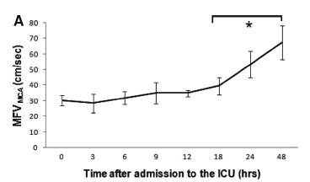
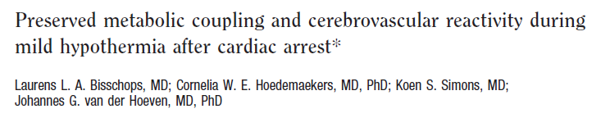

Arterial carbon dioxide post cardiac arrest
International guidelines recommend targeting normocapnia in comatose adults resuscitated after OHCA.
However, mild hypercapnia increases cerebral blood flow and may improve neurological outcomes.
Importantly:
Cerebrovascular reactivity to PaCO₂ appears preserved
after cardiac arrest.
PaCO₂ is a modifiable component of patient care,
particularly during mechanical ventilation.

Slide 6
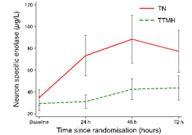
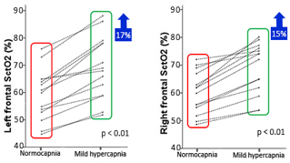

Research Program
Observational cohort study of PaCO2 after CA
Phase II pilot study – TTMH v TN
Prospective double crossover study –
Cerebral oxygenation
Phase III multi-national RCT
Targeted mild hypercapnia
 | OR (95% CI) | P value
HYPER vs Hypocapnia | 1.43 (1.22-1.69) | <0.001
2013

Slide 7
Design, hypothesis & sample size
In our international, open-label, randomised trial, we evaluated whether:
  Targeted mild hypercapnia would improve neurological outcomes at six months compared to targeted normocapnia in comatose adults resuscitated from out-of-hospital cardiac arrest.
Sample N = 1700
1624 patients = 90% power to detect or reject 8% difference in favourable neurological outcome
One DSMC meeting
at 50% recruitment time-point
Protocol & Statistical Analysis Plan published prior to recruitment completion

Slide 8
Inclusion criteria
1. Adult (age 18 years or older)
2. OHCA of a presumed cardiac or unknown cause
3. Sustained ROSC (≥ 20 mins. without chest compressions)
4. Unconscious (not obeying verbal command)
5. Eligible for ICU admission without restriction
6. Within three hours from ROSC (1st ≥ 20 mins.)

Slide 9
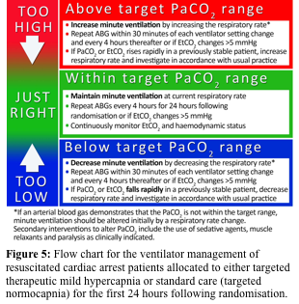
Trial intervention
PaCO₂ target
50 – 55 mm Hg or 35 – 45 mm Hg
(Targeted mild hypercapnia) (Targeted normocapnia)
Applied during mechanical ventilation for 24-hours
starting at the time of randomisation
Ventilation: ABG guided after adjustment to 37ºC (alpha-stat)
Sedation: Target ‘moderate’ to ‘deep sedation’ via RASS
Treating clinician: Could modify ventilation, sedation and paralysing agents
Other post-resuscitation care: As per hospital practices including ILCOR recommendations

Slide 10
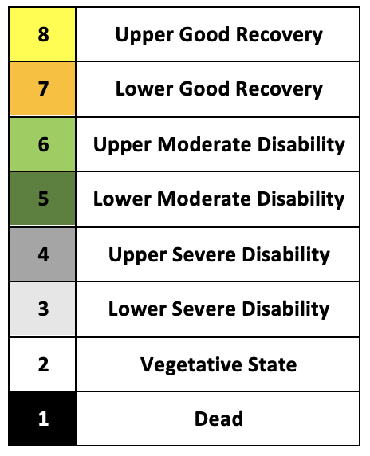
Primary outcome
Favourable neurological outcome defined as a score of 5 (‘lower moderate disability) or greater, using the 8-point Glasgow Outcome Scale Extended (GOSE) at six months.
GOSE scale
Favourable

Slide 11
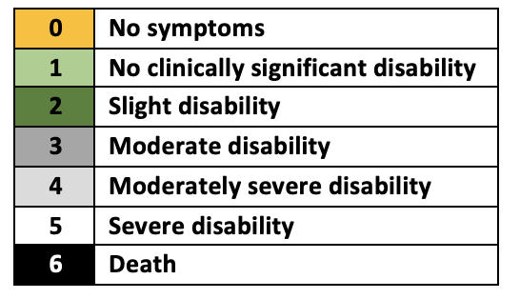
Secondary outcomes
Mortality
  Occurring within six months.
Poor functional outcome
  Defined as a modified Rankin Scale (score 4 to 6) obtained at six months.
Health-related quality of life
  Assessed via the visual-analogue scale on the EuroQol Group 5-Dimension Self-Report Questionnaire at six months.
Pre-defined subgroups
  Age above 65 years
  Male sex
  Time from cardiac arrest to return of spontaneous circulation above 25 minutes
  Shockable initial cardiac rhythm
  Presence of circulatory shock on admission to hospital
mRS
Subgroup evaluation:
Unfavourable GOSE (1 to 4)
&
Death at 6 month

Slide 12
Adverse events
Pre-specified adverse events
  Pneumonia
  Sepsis
  Bleeding (moderate or severe)
  Arrhythmia resulting in haemodynamic compromise
  Skin complications related to device used for targeted temperature management
  Suspected or confirmed raised intracranial pressure or seizures necessitating normocapnia

Slide 13
Data collection & Statistical analysis
Data collection
  Data entered by site research coordinators or outcome assessors
  Performed six-month outcome assessment with the participant (primary) or their proxy (secondary).
Statistical analysis
  Binary outcomes, including the primary outcome, assessed using Generalized linear mixed effects models with a binomial distribution and a log link to facilitate relative risks (95% confidence interval [CI]).
  Results reported as:
    n with percentages, mean ± standard deviations or median [interquartile range (IQR)], respectively.
    Primary outcome was determined using a two-sided hypothesis test with an alpha of 0.05.
    SAS statistical software version 9.4 (SAS Institute) and R version 4.0.235.

Slide 14

Results

Slide 15
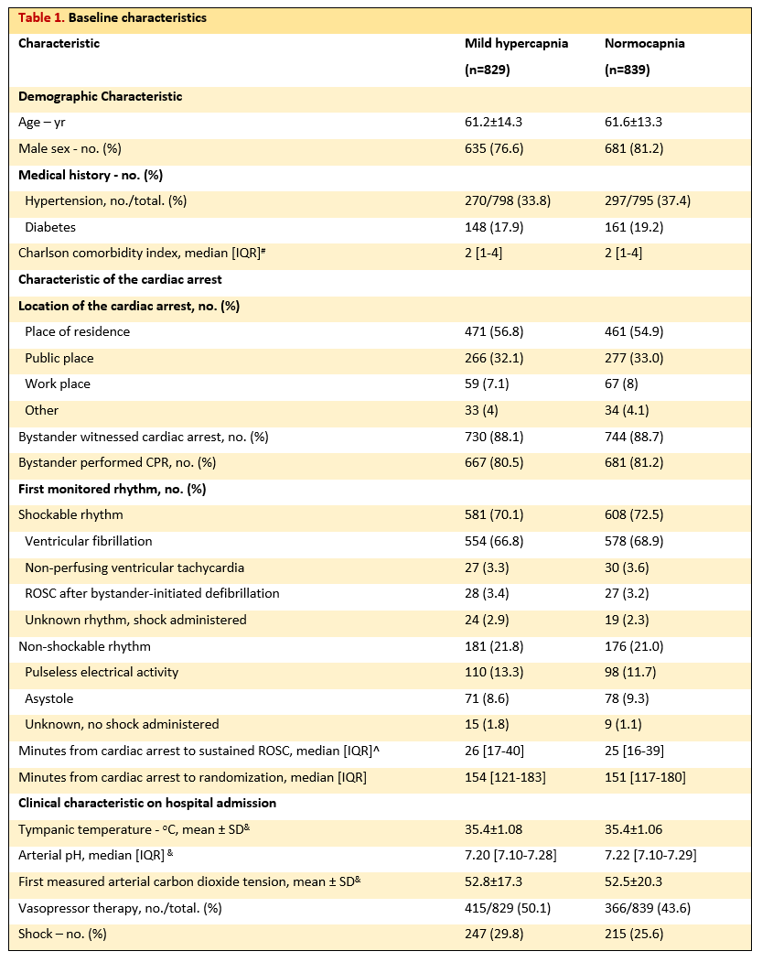

Participants & intervention
A total of 1700 comatose adults resuscitated after an OHCA of a presumed cardiac or unknown cause were enrolled at 63 ICUs in 17 countries.
370 co-enrolled with TTM2
Typical patient
  61 years of age
  Male
  Cardiac arrest at home and of a shockable rhythm
  Likely to have received bystander CPR
  Time to ROSC – 25 mins.
  Time to randomisation – 154 mins.
  First PaCO₂ on arrival to hospital – 52 mm Hg

Slide 16
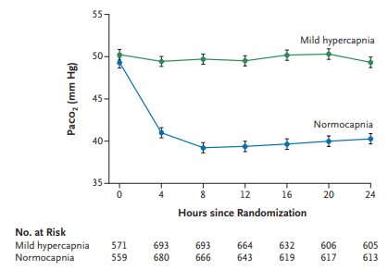
Separation in PaCO₂ values during the intervention period, mean ±95%CI

Slide 17
Primary & secondary outcomes
Primary and secondary outcomes

Slide 18
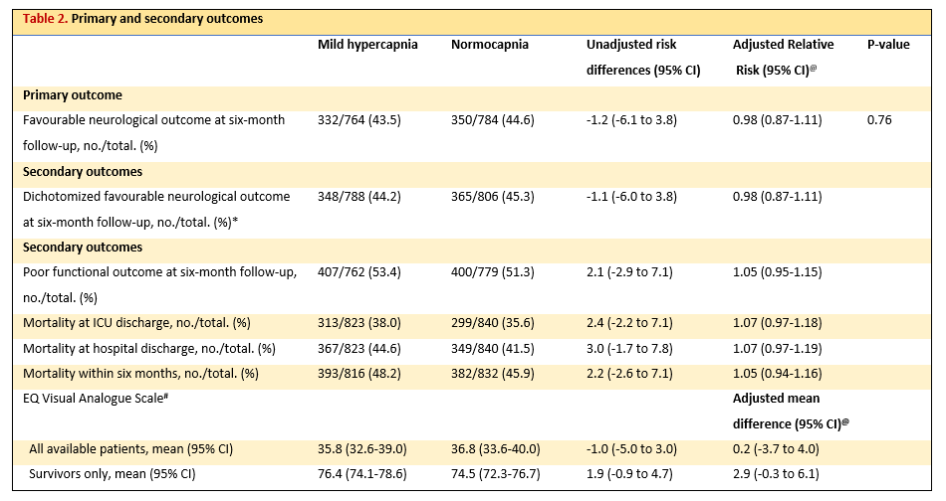
Primary & Secondary outcomes

Slide 19
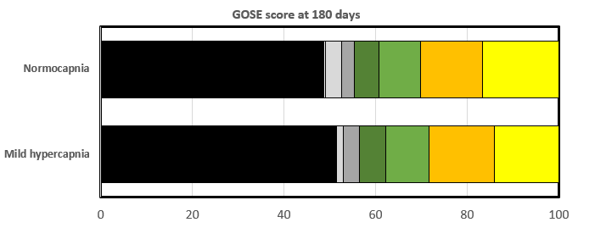
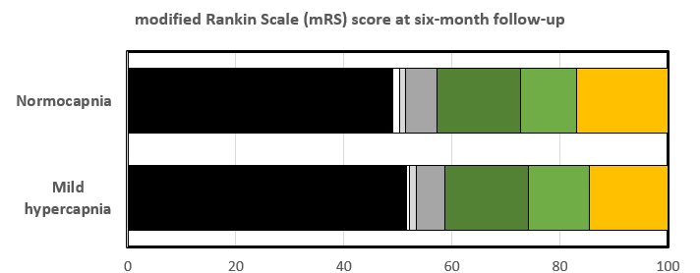
Primary & Secondary outcomes
GOSE – neurological outcome
Black band = Death
mRS – functional outcome
Black band = Death

Slide 20
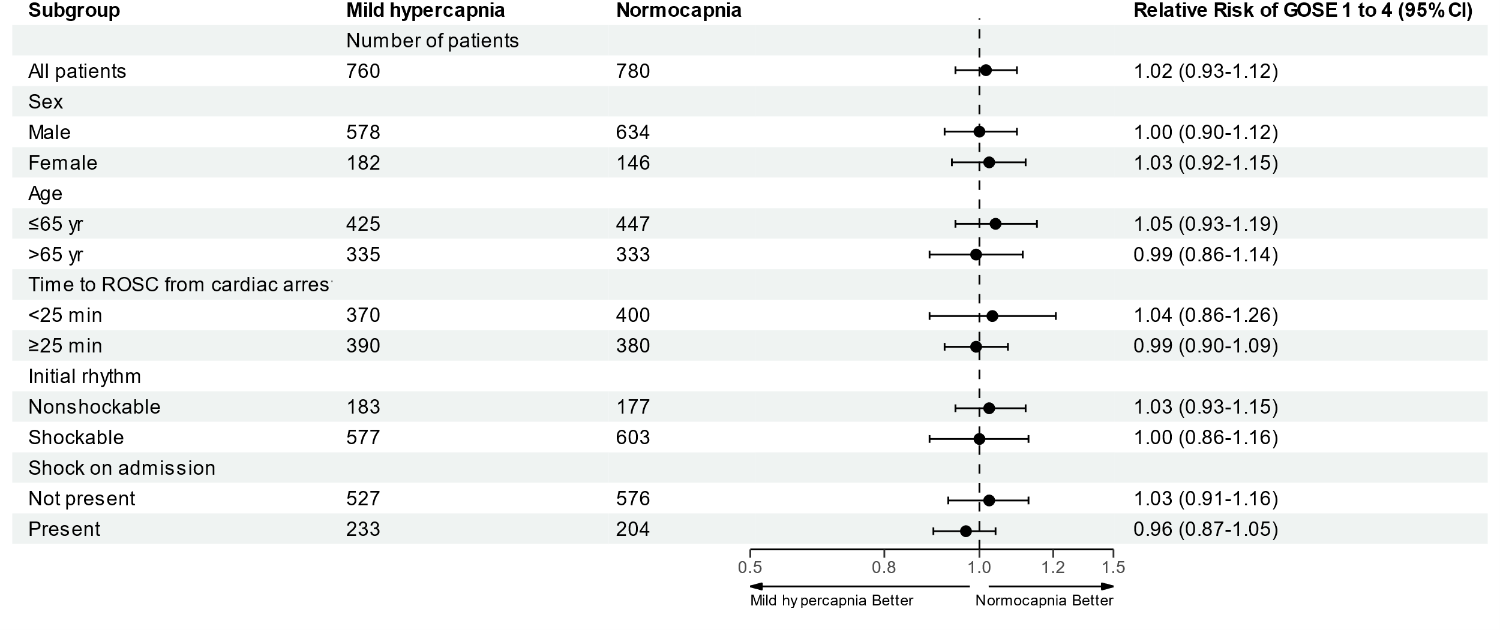
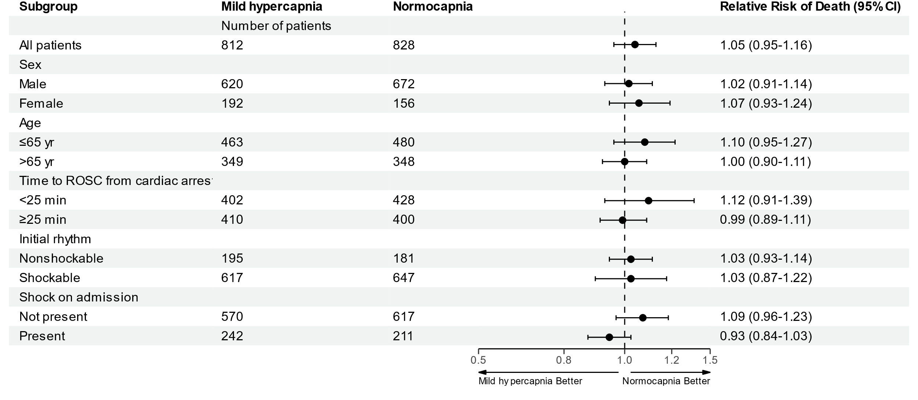
Subgroup analysis of unfavourable neurological outcome and death from any cause within six months
A Unfavourable neurological outcome (GOSE score 1 to 4) at six months
B Death from any cause within six months

Slide 21
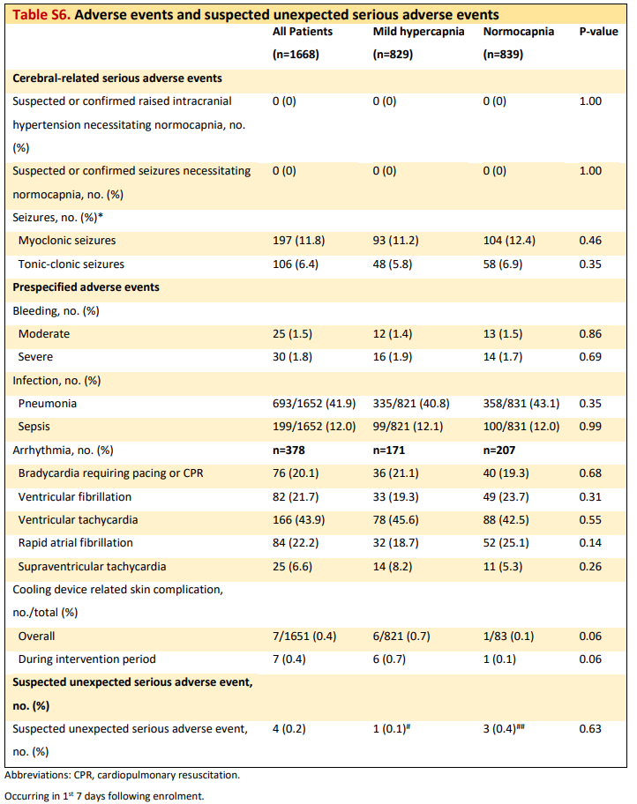
Adverse events
Cerebral-related
Pre-specified
Unexpected event

Slide 22
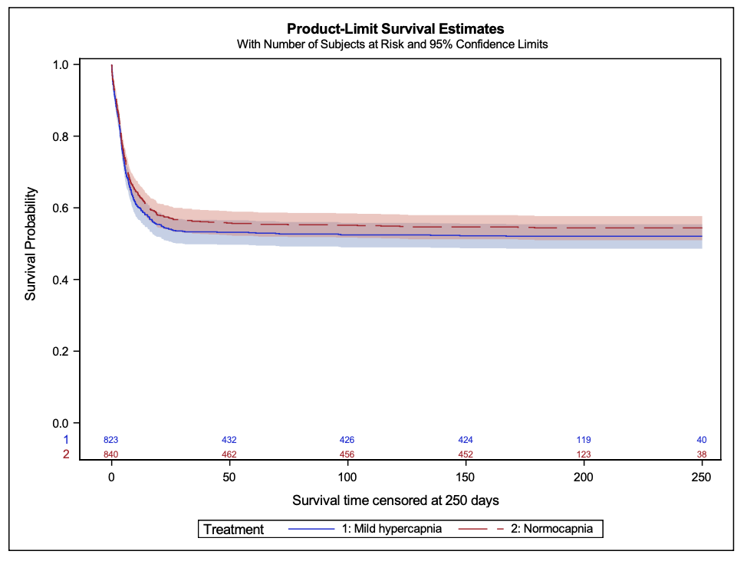
Time to event
Probability of survival from randomisation by treatment group
Kaplan Meier curves displaying patient survival censored at 250 days from randomization
(mild hypercapnia group vs normocapnia group Hazard Ratio 1.09 (CI 0.95-1.25)).

Slide 23
Result summary
Result summary

Slide 24
Result summary
In patients with coma following out-of-hospital cardiac arrest, targeted mild hypercapnia did not improve neurological outcomes at six months.
Death within six months and the distribution of scores for functional outcome were not statistically different between groups, nor was health-related quality of life.
Our findings do not support the hypothesis that targeted mild hypercapnia improves neurological outcomes at six months in such patients.

Slide 25
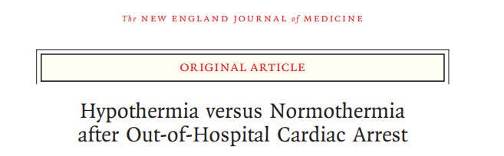

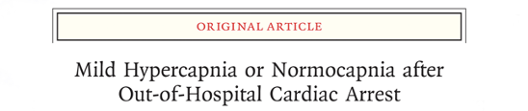
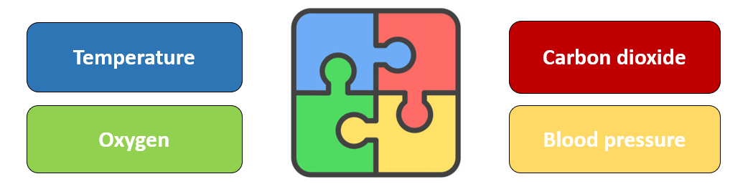
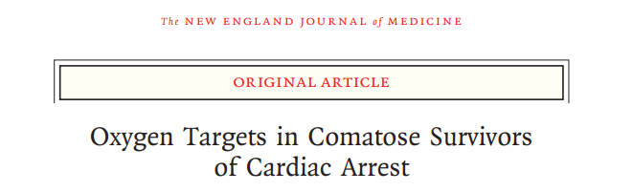
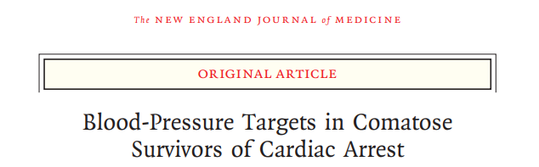
Physiological manipulation in ICU after CA

Slide 26
Key strengths & limitations
Strengths
Large sample size and pragmatic eligibility criteria.
Separation in PaCO₂ values & characteristics between groups.
Numerous hospitals and countries involved.
Limitations
Emergency Department and ICU staff were aware of the patient’s assigned intervention.
Mild hypercapnia was common at randomisation.
Limited ability to apply our findings to patients with non-cardiac causes of cardiac arrest (e.g trauma or anaphylaxis).

Slide 27
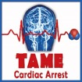
Result impact
Our findings support the current approach to CO₂ management in ICU for comatose adults resuscitated after OHCA.
Our trial findings will be added to international post-resuscitation care guidelines to support clinicians’ decision-making for future patients.

Slide 28
Exploring TAME data
Biobank
We are uniquely placed to:
Evaluate current practice.
Identify early neuro-prognostic indicators to improve patient selection for future cardiac arrest trials.
Gain new physiological insights to guide therapeutic target selection for cerebral protection interventions.
Renal
Pneumonia
Health economics
Quality of life
+ others

Slide 29
Conclusions
TAME
In comatose adults resuscitated after out-of-hospital arrest of a presumed cardiac or unknown cause, targeted mild hypercapnia did not improve neurological outcomes at six months compared to targeted normocapnia.
Beyond TAME
Obtain data-driven insights to identify and guide therapeutic interventions to protect the brain after resuscitation from cardiac arrest.

Slide 30
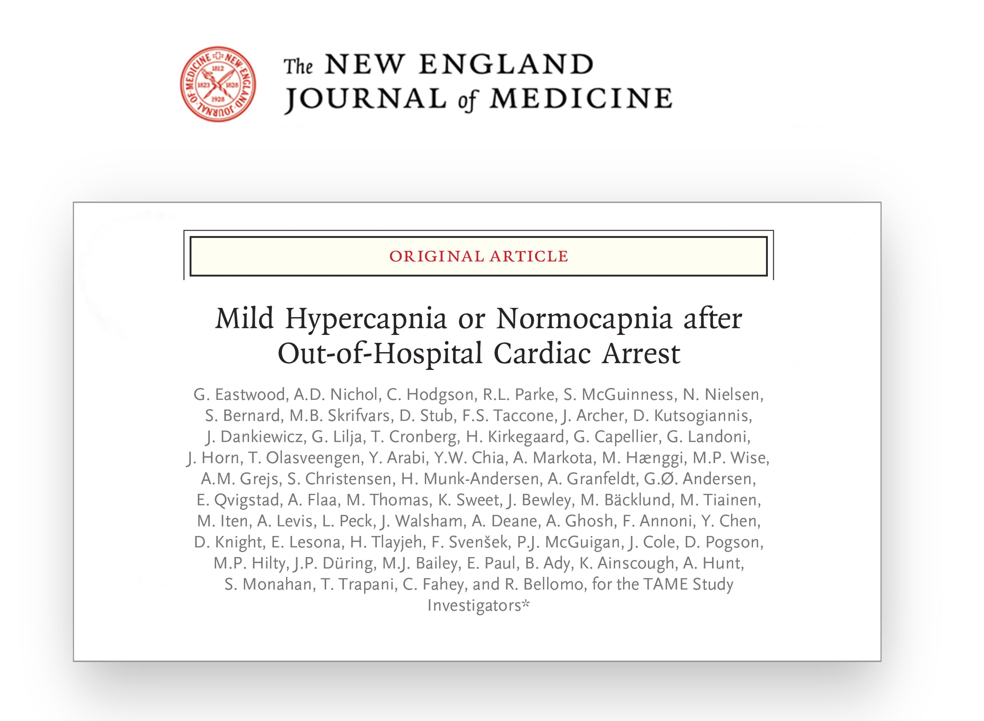

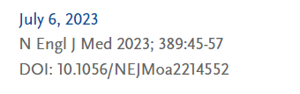
Publication
Dr Glenn Eastwood
PhD RN BN BN(Hons) GDipNurs(CritCare)
Senior Research Fellow
School of Public Health and Preventive Medicine
Monash University
Melbourne, Australia
glenn.eastwood@monash.edu

