Slide 1







Trial Overview and Recruitment
Update
Dr Lauren Ewington
Clinical Research Fellow

Slide 2

Topics
Need for a trial
Trial recruitment processes
Site set up
Current recruitment
How we can help

Slide 3
Need for a Trial

Slide 4
Need for a Trial
Various definitions of “big baby”
  Birth weight: >4000g, >4500g
  Birth weight: >90th, >95th, >97th percentile
Having a big baby is a risk factor for shoulder dystocia
  “Vaginal cephalic delivery that requires additional obstetric manoeuvres to deliver the fetus after the head has delivered and gentle traction has failed”
Shoulder dystocia can lead to
  Maternal: PPH, perineal tears, psychological trauma
  Neonate: Fractured clavicle and humerus, temporary or permanent brachial plexus injury, neonatal death
Royal College of Obstetricians and Gynaecologists. Green–top Guideline No. 42. Shoulder Dystocia. 2 ed. London, 2012

Slide 5
Need for a Trial
Complication from shoulder dystocia is a common reason for litigation in Obstetrics
  Settlement from 250 cases 2000-2010 >£100 million
  Approximately £400,000 per case
Hypothesised that inducing labour prior to 40⁺ weeks reduces the incidence of shoulder dystocia
What does the evidence say?
Royal College of Obstetricians and Gynaecologists. Green–top Guideline No. 42. Shoulder Dystocia. 2 ed. London, 2012

Slide 6
Need for a Trial – what does the evidence suggest?
Induction of
labour for suspected macrosomia
Boulvain M, Senat M-V, Perrotin F, et al. Induction of labour versus expectant management for large-for-date fetuses: a randomised controlled trial. The Lancet 2015;385(9987):2600-05
Boulvain M, Irion O, Dowswell T, et al. Induction of labour at or near term for suspected fetal macrosomia. Cochrane Database of Systematic Reviews 2016(5)

Slide 7
Need for a Trial – what does the evidence suggest?
Decreases
Shoulder dystocia
Fetal fracture
Induction of
labour for suspected macrosomia
Boulvain M, Senat M-V, Perrotin F, et al. Induction of labour versus expectant management for large-for-date fetuses: a randomised controlled trial. The Lancet 2015;385(9987):2600-05
Boulvain M, Irion O, Dowswell T, et al. Induction of labour at or near term for suspected fetal macrosomia. Cochrane Database of Systematic Reviews 2016(5)

Slide 8
Need for a Trial – what does the evidence suggest?
Decreases
Shoulder dystocia
Fetal fracture
Increases
Neonatal jaundice requiring phototherapy
3rd + 4th degree tears
Induction of
labour for suspected macrosomia
Boulvain M, Senat M-V, Perrotin F, et al. Induction of labour versus expectant management for large-for-date fetuses: a randomised controlled trial. The Lancet 2015;385(9987):2600-05
Boulvain M, Irion O, Dowswell T, et al. Induction of labour at or near term for suspected fetal macrosomia. Cochrane Database of Systematic Reviews 2016(5)

Slide 9


Need for a Trial – what does the evidence suggest?
But ….
No difference in long term fetal complications
Need to induce 60 women to prevent just 1 neonatal fracture
What do we do????????
Decreases
Shoulder dystocia
Fetal fracture
This Photo by Unknown Author is licensed under CC BY-NC-ND
This Photo by Unknown Author is licensed under CC BY-NC
Induction of
labour for suspected macrosomia
Boulvain M, Senat M-V, Perrotin F, et al. Induction of labour versus expectant management for large-for-date fetuses: a randomised controlled trial. The Lancet 2015;385(9987):2600-05
Boulvain M, Irion O, Dowswell T, et al. Induction of labour at or near term for suspected fetal macrosomia. Cochrane Database of Systematic Reviews 2016(5)

Slide 10

Need for a Trial – What do we do?
”Induction of labour does not prevent shoulder dystocia in non-diabetic women with a suspected macrosomic fetus”
Royal College of Obstetricians and Gynaecologists. Green–top Guideline No. 42. Shoulder Dystocia. 2 ed. London, 2012

Slide 11
Need for a Trial – What do we do?
”Induction of labour does not prevent shoulder dystocia in non-diabetic women with a suspected macrosomic fetus”
Montgomery vs Lanarkshire District Health Board
Royal College of Obstetricians and Gynaecologists. Green–top Guideline No. 42. Shoulder Dystocia. 2 ed. London, 2012

Slide 12
Need for a Trial – What do we do?
”Induction of labour does not prevent shoulder dystocia in non-diabetic women with a suspected macrosomic fetus”
Montgomery vs Lanarkshire District Health Board
Confused?
So what should we do?
What do we tell our patients?
Royal College of Obstetricians and Gynaecologists. Green–top Guideline No. 42. Shoulder Dystocia. 2 ed. London, 2012

Slide 13
Need for a trial
NIHR HTA : Call for research
“Does induction of labour at 38⁺⁰ – 38⁺⁴ weeks gestation, in pregnancies with large for gestational age fetuses, reduce the incidence of shoulder dystocia?”

Slide 14
Trial Recruitment Processes

Slide 15
Trial Recruitment Processes
Attends for Scan at 35⁺⁰ -38⁺⁰
Hand plotting just <90th, on the 90th, or >90th
Ask sonographers to give trifold information sheet
Sonographers to refer to the research team
Use the referral slips
Anybody any suggestions?
Research team check eligibility
Use the centile calculator
Doctor to confirm eligibility

Slide 16
Inclusion Criteria
Women ≥ 18
Fetus >90th customised fetal weight centile on ultrasound scan at 35⁺⁰ - 38⁺⁰
Cephalic presentation

Slide 17
Exclusion Criteria
Multiple pregnancy
Pregnancy in a breech or transverse lie position
Induction of labour contra-indicated
Fetus with known serious abnormality
Home birth or elective caesarean section already planned
Caesarean section or induction indicated due to health conditions such as cardiac disease or hypertensive disorders
Women taking medications and/or insulin therapy for diabetes or gestational diabetes; women with these conditions who are not taking medication are eligible
Current diagnosis of major psychiatric disorder requiring antipsychotic medication
Women unable to give informed consent e.g. learning or communication difficulties that prevent understanding of the information provided
Prisoners
Previous stillbirth or neonatal death ≤28 days
Current intrauterine fetal death

Slide 18
Trial Recruitment Processes
Consultant approval to enter the trial
Dr to sign in red box (essential recruitment document)
Discuss the trial with the woman
Use the full PIS

Slide 19
Trial Recruitment Processes
First
  Determine if the woman consents to be randomised to either:
Induction of labour at 38⁺⁰ – 38+4
Standard care

Slide 20
Trial Recruitment Processes
First
  Determine if the woman consents to be randomised to either
  What is standard care?
Induction of labour at 38⁺⁰ – 38+4
Standard care

Slide 21
Trial Recruitment Processes
If she is happy to participate in the RCT
Consent
RCT consent form
Randomise
Online or via the phone
If randomised to induction
Book induction between 38⁺⁰-38⁺⁴

Slide 22
Trial Recruitment Processes
If she does not wish to be randomised, but is still happy to take part in research ask if she would like to take part in the cohort study
There are two groups in the cohort study:
Women requesting elective caesarean section
Women opting for vaginal delivery

Slide 23
Trial Recruitment Processes
Once delivered collect the delivery information and input onto the database.
Women in the RCT and those requesting elective caesarean section in the cohort study will have follow up at 2 and 6 months post partum

Slide 24
Site set up

Slide 25
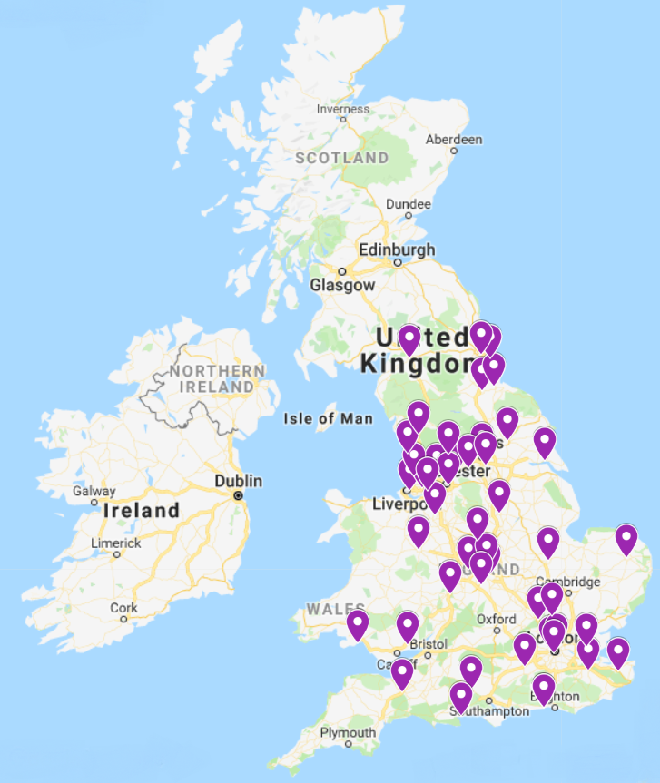
47 sites open for recruitment
  Midlands
    University Hospitals Coventry and Warwickshire
    Royal Shrewsbury and Telford
    Heart of England
    George Eliot Hospital
    South Warwickshire
    Sherwood Forest Hospital
    Worcestershire
    Derby and Burton
  North West
    Liverpool Women’s Hospital
    Penning Acute Hospitals
    Bolton Hospitals
    Mid Cheshire Hospitals
    Manchester University
    St. Helens and Knowsley
    East Lancashire Hospitals
    Southport and Ormskirk
    Blackpool
    Warrington and Halton
    North Cumbria
    Morecambe Bay
  East of England
    Norfolk and Norwich
    North West Anglia
  North East
    County Durham and Darlington
    Leeds Teaching Hospitals
    Calderdale and Huddersfield
    North Tees and Hartlepool
    City Hospitals Sunderland
    York Teaching Hospitals
    Hull and East Yorkshire
    Mid Yorkshire
    Gateshead
  South of England
    Frimley Health
    Maidstone and Tunbridge Wells
    Salisbury
    East and North Hertfordshire
    Luton and Dunstable
    Poole
    Taunton and Somerset
    Western Sussex
  London
    Imperial College Healthcare
    Whittington Health
    Chelsea and Westminster Hospital
    East Kent Hospitals University
    Basildon and Thurrock
  Wales
    Aneurin Bevan
    Abertawe Bro Morgannwg UHB
    Betsi Cadwaladr UHB

Slide 26
Site set up
Royal Free and Barnet
Yeovil
NHS Lanarkshire
NHS Ayrshire and Arran
Lancashire Teaching
Wirral University Teaching Hospital
Birmingham Women’s
Aiming to open 80 sites

Slide 27
Recruitment

Slide 28
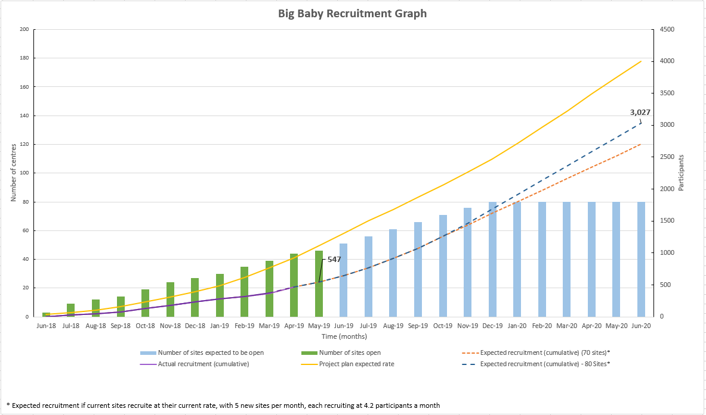
Current Recruitment

Slide 29
Current Recruitment
April
  96 RCT
  42 Cohort
May
  81 RCT
  41 Cohort

Slide 30
Current Recruitment
Rank | Trust Name | Date Trust Opened | Number of RCT recruits
1 | UHCW | 08/06/2018 | 67
2 | Manchester | 16/10/2018 | 40
3 | North West Anglia | 13/07/2018 | 31
4 | Norwich | 02/07/2018 | 30
5 | Sherwood | 10/08/2018 | 30
6 | Shrewsbury | 25/06/2018 | 27
7 | Liverpool | 02/07/2018 | 24
8 | Durham and Darlington | 20/08/2018 | 24
9 | Warwick | 06/07/2018 | 24
10 | Leeds | 17/09/2018 | 23
11 | East Lancashire | 16/10/2018 | 17
12 | Frimley | 15/10/2018 | 16
13 | Sunderland | 11/01/2019 | 16
14 | St Helens and Knowsley | 10/09/2018 | 14
15 | Northern Care Alliance | 09/07/2018 | 13

Slide 31
Current Recruitment
Rank | Trust Name | Date Trust Opened | Number of RCT recruits
16 | Calderdale and Huddersfield | 03/10/2018 | 13
17 | University Hospitals Birmingham | 05/07/2018 | 11
18 | Abertawe Bro Morgannwg UHB | 04/03/2019 | 10
19 | Bolton | 14/08/2018 | 9
20 | Aneurin Bevan UHB | 21/01/2019 | 8
21 | North Tees | 14/11/2018 | 8
22 | Western Sussex | 28/03/219 | 8
23 | Worcester | 26/10/2018 | 7
24 | Maidstone and Tunbridge Wells | 08/01/2019 | 7
25 | Mid Cheshire | 08/11/2018 | 7
26 | Chelsea and Westminster | 07/12/2018 | 6
27 | Gateshead | 07/05/2019 | 6
28 | Salisbury | 12/11/2018 | 6
29 | Southport and Ormskirk | 22/11/2018 | 6
30 | York teaching hospitals | 05/02/2019 | 5

Slide 32
Current Recruitment
Rank | Trust Name | Date Trust Opened | Number of RCT recruits
31 | Luton and Dunstable | 15/02/2019 | 5
32 | East Kent | 12/12/2018 | 5
33 | Derby and Burton | 10/04/2019 | 4
34 | Whittington | 27/11/2018 | 4
35 | Taunton and Somerset | 28/03/2019 | 3
36 | George Eliot | 22/06/2018 | 3
37 | Betsi Cadwaladr UHB | 23/04/2019 | 2
38 | Blackpool | 18/02/2019 | 2
39 | East and North Hertfordshire | 07/02/2019 | 2
40 | Hull and East Yorkshire | 21/02/2019 | 2
41 | Poole | 28/03/2019 | 2
42 | Basildon and Thurrock | 07/05/2019 | 0
43 | Imperial | 04/12/2018 | 0
44 | Mid Yorkshire | 23/04/2019 | 0
45 | Morecambe | 03/06/2019 | 0
46 | North Cumbria | 25/04/2019 | 0
47 | Warrington and Halton | 25/04/2019 | 0

Slide 33
How we can help with recruitment

Slide 34
How we can help with recruitment
Vouchers
  Awaiting ethics opinion
  £10 voucher to sonographers for referring 10 participants who recruit
Twitter
  @BigBabyTrial
Big Baby Website
  In the researchers section go to the forum

Slide 35
How we can help with recruitment
Alternate Month Teleconferences
  Discuss recruitment
  New protocol changes
  Anything you want to discuss in these?
Prizes
  Sent from the PNI

Slide 36
How we can help with recruitment
What do you think?
What will make things easier for you?
Any comments / queries?

Slide 37

Contacts
Warwick Clinical Trials Unit
Trial Team
Kirsten Harris
Ryan Griffin
Sara Wood
Bigbaby@warwick.ac.uk
02476 573341 / 02476 523858
Clinical Research Fellow
Lauren Ewington
L.ewington.2@warwick.ac.uk
Perinatal Institute
Research Midwives
Emily Butler
Kelly Fowler
bigbaby@perinatal.org.uk
01216070101

Slide 38


Thank you
Any questions?

