Slide 1
What worked for us
Big Baby in Manchester
Manchester University NHS
Foundation Trust
Meg Hyslop
PI: Prof. Ed Johnstone
Research Midwives:
Meg Hyslop, Linda Peacock, Michelle John, Sam Emery.

Slide 2
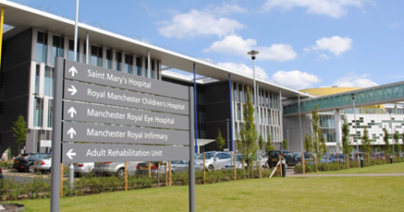


Research at St Marys
St Mary’s is now across two sites: Oxford Road campus and Wythenshawe Campus.
13,500 deliveries a year.
Tommy’s research centre specialising in Stillbirth and placental research.

Slide 3
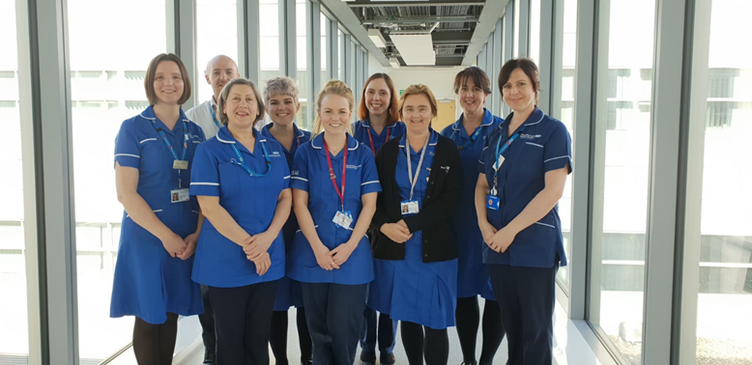
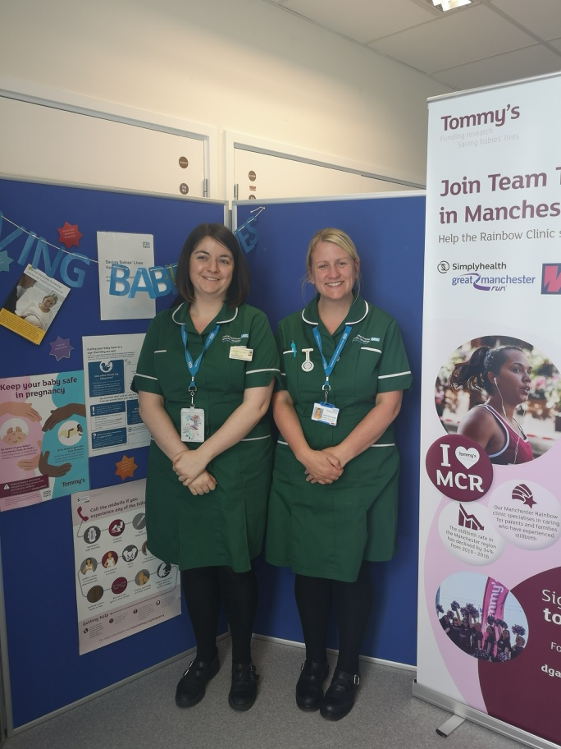
Team at St Marys

Slide 4
LGA guideline at Oxford Road Campus
A fetus with an EFW >4.5kg or over the 95th centile on the customised growth chart offer IOL between 39-40 weeks.
If below the 95th and not GDM then treat as normal care.

Slide 5


How do we communicate with clinical areas – gate keepers
Spoke to ANC Antenatal Assessment Unit (AAU) and Triage core huddles.
Posters in all clinical rooms where scans are reviewed with our contact details on.
PI emailed all the consultants explaining the trial, and discussed at consultants meetings.
Study presented at doctor’s induction days to welcome them into the trust and tell them about the trial.

Slide 6

What is working
Continuity - We asked staff to inform us of any babies over the 90th from 28 weeks so we could follow these ladies pregnancies.
Women met at serial growth scans. This gave the women time to understand the study, a chance to ask questions and a familiar face.
Wherever possible follow up, post delivery to congratulate and maintain the positive relationship with research, to ensure completion of two and six month surveys.
Notes:
We take the time to support and encourage normality in preparation for labour,e.g. discussing induction of labour, pain relief, feeding.

Slide 7

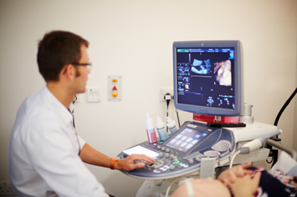
What is working well
We offer a research scan with the research midwives or consultants to help support the clinical area when women’s last scan in ANC is before 35 weeks e.g. 34+.
The clinical area is familiar with the maternal and fetal health research group, we are part of routine everyday practice.
We make sure we are accessible, leaving phone, email and bleep numbers.

Slide 8
Barriers
Discomfort with randomisation to Early Induction and/or increased intervention – Ensure that the conversation is honest that we don’t know the best time for when the best time is for IOL with a LGA baby. Offer Cohort.’
Staff anxiety regarding the early intervention. Concerns raised that increased intervention will increase rates of C/S and instrumental deliveries.
Continued support to staff to remind them the importance of research – that we need to practice according to the evidence which we are trying to understand.

Slide 9

In Summary
Overall the response from staff and women has been very positive.
We have screened 110 women and recruited over 60.
Staff incentives like free pens, post it notes and the set squares have helped to raise awareness.
Relieving pressure from busy clinical areas by discussing IOL, booking IOL, spending time with the women has helped with recruitment.
Work well as a team – ensure cover for annual leave/ clinical duties.

Slide 10


Any Questions?

