Slide 1






Big Baby - Trial Meeting
Serious Adverse Events, Corrective and Preventative Actions, Data Management
Ryan Griffin, Kirsten Harris, Sara Wood
6th June 2019

Slide 2
Agenda
Introduction
Serious Adverse Event Reporting
Review of SAE forms in the Site Initiation Visit
Current status
SA 06
Corrective and Preventative Action
Deviations, Violations and Serious Breaches
CAPA forms
Current status
Data Management
FAQ
Common errors
Changes to the CRF/Database

Slide 3
SAE Reporting

Slide 4
Adverse Events (AEs)
Definition -
Any untoward medical occurrence in a participant, which does not necessarily have a causal relationship with the research
AEs can be any unfavourable and unintended sign (including an abnormal laboratory finding), symptom, or disease that occurs between recruitment and discharge following labour.
The following do not need to be recorded as adverse events, if they are recorded as medical conditions on the Case Report Form at the start of the trial or as outcomes:
Pre-planned procedure
Pre-existing conditions found as a result of screening procedures
Data collected elsewhere in the CRF

Slide 5
When is an AE an SAE?
Results in death
Is life-threatening
Requires hospitalisation or prolongation of existing inpatients´ hospitalisation
Results in persistent or significant disability or incapacity
Is a congenital anomaly or birth defect
Requires medical intervention to prevent one of the above, or is otherwise considered medically significant by the investigator

Slide 6
What does this mean for Big Baby?
If an AE meets one of the conditions for SAE, it needs reporting unless it is already collected elsewhere on the CRF, e.g.
Mother: PPH>=1000mls, tears, sepsis
Baby: fracture, brachial plexus injury
However if the woman/baby was re-admitted to hospital (overnight) or had a prolongation of existing hospitalisation for a condition already captured in the CRF, it classifies as an SAE

Slide 7
Expectedness
‘Unexpected’ – that is, the type of event is not listed in the protocol as an expected occurrence.
Any event that is already documented in the protocol or other trial related material is expected.

Slide 8
Serious Adverse Events (SAEs)
Reporting SAEs
Need to send to Warwick Clinical Trials Unit
Not required for cohort participants
Please report within 24 hours of becoming aware, even if data is incomplete
Complete follow-up form
Yes
Serious adverse event form faxed to
02476 150549 or emailed to uhc-tr.bigbaby@nhs.net
Serious adverse event identified
Within 24 hours PI completes serious adverse event form
Updates to data required / SAE unresolved?
No
Serious adverse event form complete

Slide 9
SAEs- things to watch out for
1. Late Reporting
All potential SAEs need to be scanned to uhc-tr.bigbaby@nhs.net within 24 hours of your becoming aware of the event. Even if this is really minimal data
2. Complete each of the Yes/No boxes
3. Date event deemed serious
This is the date that the AE met one or more of the criteria to be classified as an SAE
4. Signature of reporting clinician
Please make sure there are enough doctors on the delegation log allocated to this role in case the PI is not available
1.Event Type (please confirm ‘Yes’ or ‘No’ for each category
Death | No |  | Yes
Is immediately life threatening | No |  | Yes
Hospitalisation or prolongation of existing hospitalisation | No |  | Yes
Persistent or significant disability/incapacity | No |  | Yes
Congenital abnormality/birth defect | No |  | Yes
Other reason (please specify below) | No |  | Yes

Slide 10
SAE overview (1st May 2019)
As of 1st May 2019 there have been 77 SAEs.
50 SAEs from the baby: 27 SAEs for the Mother:
Category | Number |  | Category | Number
Weightloss/poor feeding | 7 |  | Wound infection | 4
Weightloss and Jaundice | 5 |  | Pyrexia | 2
Jaundice | 4 |  | PPH | 4
Respiratory Tract Infection | 8 |  | Influenza/RTI | 3
Urinary Tract infection | 4 |  | Mastitis | 1
Suspected sepsis | 4 |  | Suspected Sepsis | 4
Congenital | 2 |  | Other | 9
Other | 16

Slide 11
Protocol version 6.0
We are working to reducing the number of SAE that need reporting
Protocol amendment 6.0 has been submitted
Changes
Collect only AEs that are potentially related to the pregnancy/ delivery/care of the neonate
Reduce SAE reporting period to 30 days post discharge following delivery
Re-clarification of which SAEs will need reporting
Not reporting congenital abnormalities

Slide 12
Corrective and Preventative Action

Slide 13
Deviations, Violations and Serious Breaches - Definitions
A deviation is a change or departure from the protocol and/or GCP that does not result in harm to the participants or significantly affect the scientific value of the reported results of the study
A violation is a serious non-compliance within the approved protocol resulting from error, fraud, or misconduct.
A serious breach is a non-compliance that is likely to affect to a significant degree either the safety or physical or mental integrity of the participants of the study, or the scientific value of the study.

Slide 14
Deviations- Examples from Big Baby
As of 1st May 2019 there are 11 deviations, the most common are:
Incomplete redaction of delivery notes
Late completion of baseline data
Incorrect version of Informed Consent/PIS used (minor update)
Informed Consent Form not dated

Slide 15
Violations- Examples from Big Baby
As of 1st May 2019 there are 22 Violations, the most common are:
Participant did not meet eligibility criteria
Late Reporting of an SAE
Incorrect version of Informed Consent/PIS used (major update)
Implementation of Amendment ahead of approval
No/minimal attempt at redaction of delivery notes
Trial tasks performed by staff not given the role on the Delegation Log

Slide 16
What happens if you suspect a Deviation/Violation
DON’T PANIC
Contact the Big Baby Team at WCTU
You will be asked to email Big Baby at WCTU explaining what has happened
You may be asked to complete a CAPA form (Corrective and Preventative Actions)
If the Trial Management Team complete a CAPA form we will send it to you to review
Once the CAPA form is finished you will be sent a copy for your files
You will need to confirm that the corrective and preventative actions have been implemented at your site if applicable

Slide 17
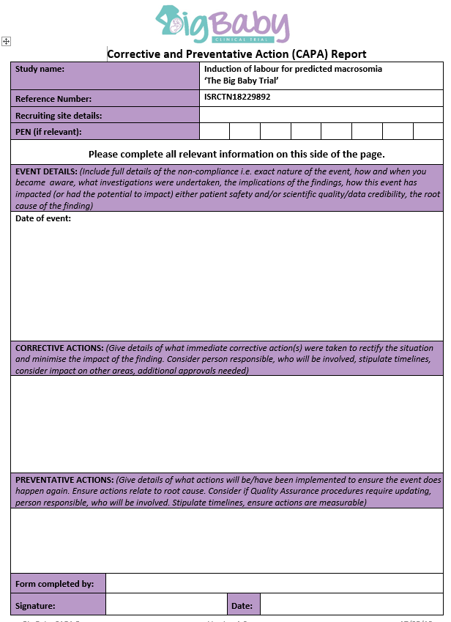
CAPA Form

Slide 18
Data Management

Slide 19
Current Status
Current status yesterday:
RCT recruited:
Cohort recruited:
Data Return (over 2 weeks outstanding):
Thank You

Slide 20
Importance of Screening Logs
Assess what is hindering recruitment
Expected to contain participants over 28 weeks gestation who were expected to have a baby over the 90th centile
Ensure all recruited participants are present on the Screening Log
If the woman is not eligible, provide a code why not, please use the codelists
If the woman chooses to be in the cohort/ not be recruited, please indicate why

Slide 21
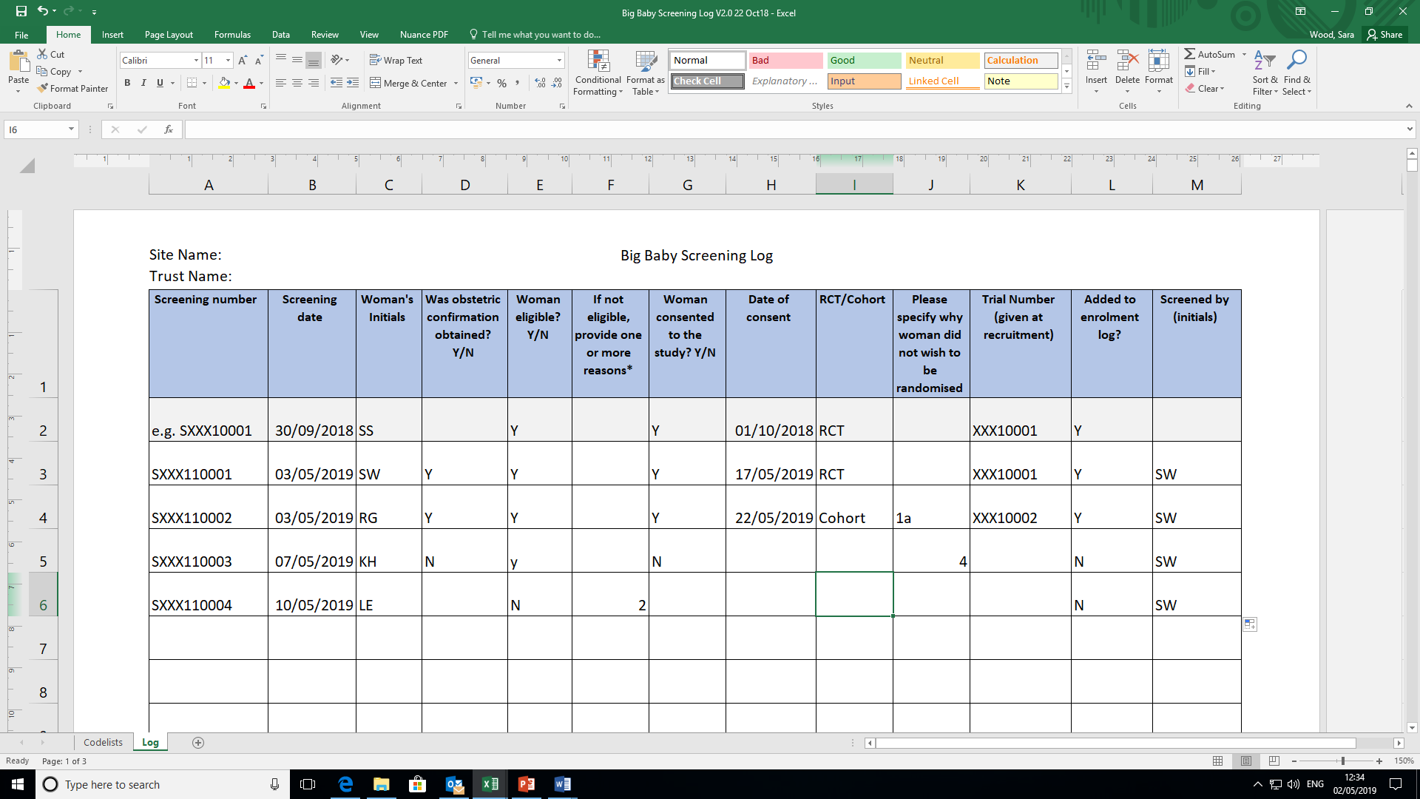
Screening Log

Slide 22
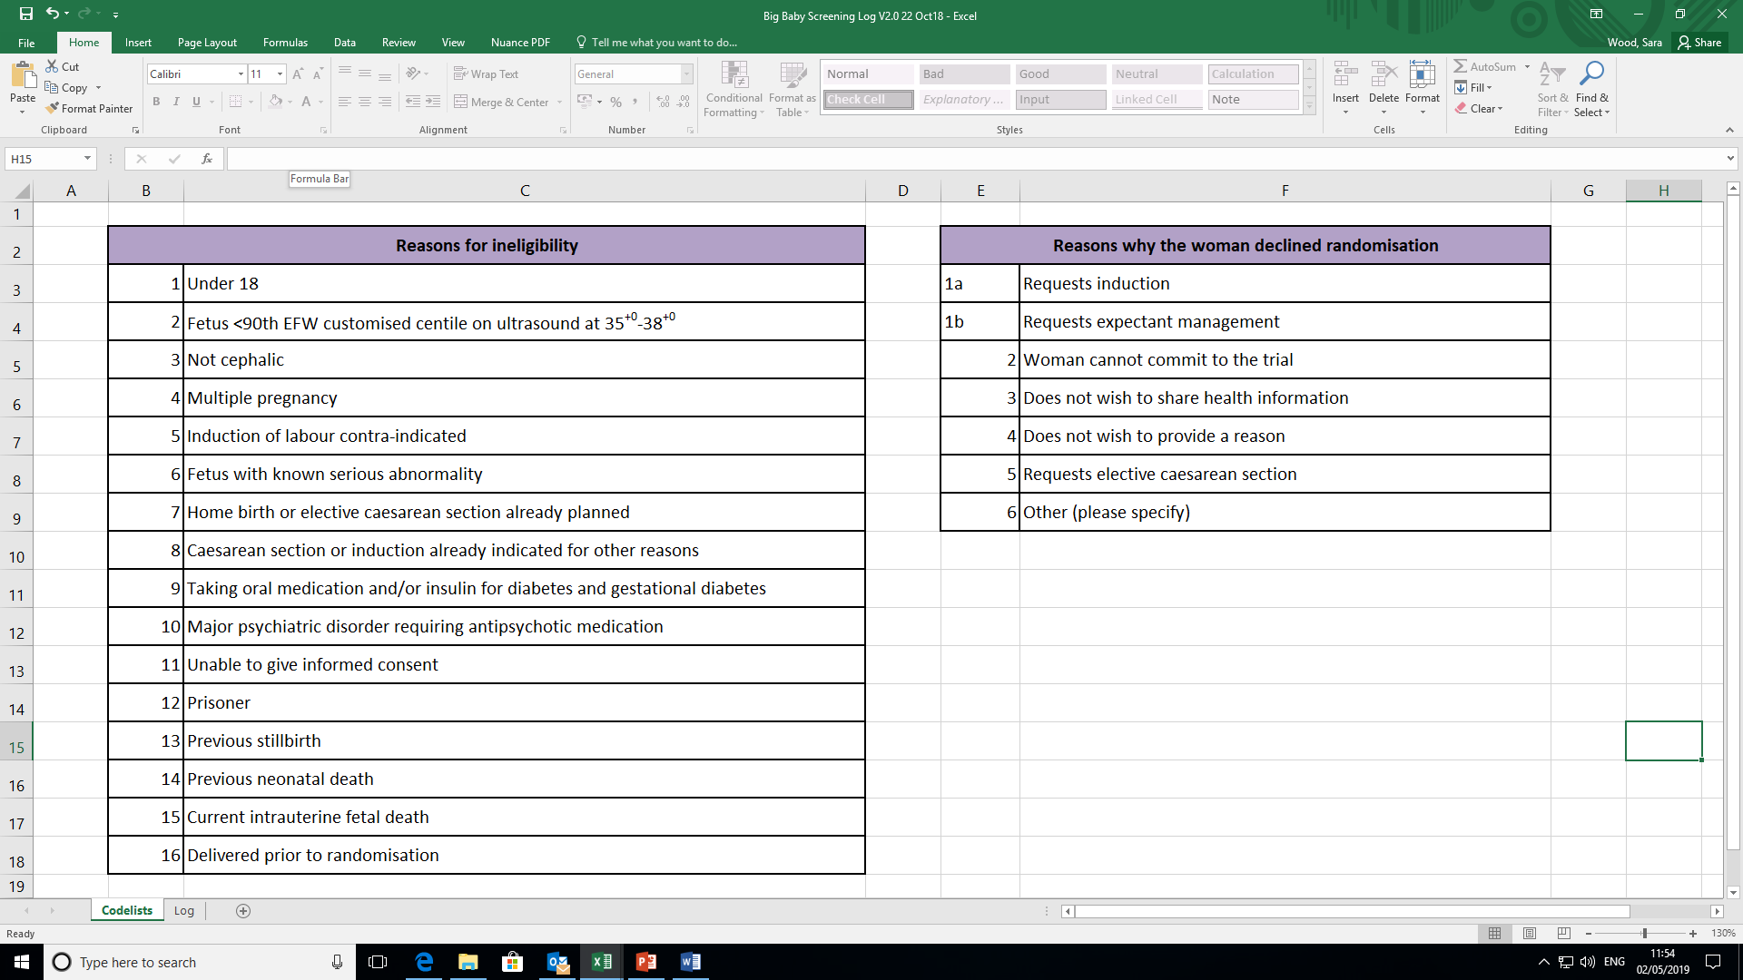
Screening Log Codelist

Slide 23
Database – what we require
Data should be entered within 2 weeks of the scheduled timepoint if possible
30 Day Follow-up can be entered at the 7 week timepoint
The database shows you which forms to enter
 | RCT | Cohort - requesting planned C-Section | Cohort – NOT requesting planned C-Section
 | CRF pages 1-4 (eligibility) | CRF pages 1-4 (eligibility) | CRF pages 1-4 (eligibility)
 | Baseline Questionnaire (we will enter this) | Baseline Questionnaire (we will enter this)
 | Redacted head to full body delivery notes

Slide 24
Common questions
Where do I find a previous Birth Centile
On the woman’s GROW chart – collect the data at recruitment if it is not typically stored in the medical notes
How do I complete the visit date
Visit date is the date the woman was seen, or the date up until the data were reviewed (Baseline, Unscheduled prior to delivery, Intra/post partum unscheduled 30 day)
What needs to be recorded as an unscheduled visit
Any hospital visit that was not planned
Where do I include prophylactic Mc Robert’s
Currently not possible
How do I complete Pain Medication (epidurals)
Do not complete dose and unit, just the number of times sited
What types of medication should be recorded as Regular Medication
Any prescribed medication the woman or baby took between randomisation and discharge from hospital that is not already captured elsewhere, excluding Vit.K

Slide 25
Common errors
Woman or baby transferred to a ward
Reason for transfer and/or number of nights transferred blank
Non-completion of the Unscheduled visits
We request these to be completed even if the woman/baby did not have an unscheduled visit
Non-completion of the End of trial forms
Sites do not need to enter the Baseline questionnaires, we will do this for you
Status field is ‘Clean’ although data points are missing

Slide 26
Simplifying the Database
We have taken on board that the CRF is very time consuming to complete and have simplified the data collection
Vastly reduced the amount of data collected for Cohort participants (Non C-Section)
Reduced the amount of baseline data collection
Removed collection of dose and units for pain medication and antibiotics
Moved the data collection for mother/baby transfer to a different hospital following delivery to a separate optional page
Moved the End of Trial page for completion only if the woman/baby withdraws from the trial
Hopefully due Q3 2019

Slide 27
Thank you
Any Questions?
BigBaby@Warwick.ac.uk
www.warwick.ac.uk/bigbaby

