Slide 1


The Big Baby Trial
Site Initiation Visit

Slide 2

Topics
Background
Trial design
  Objectives
  Intervention
Study information
Recruitment
  Timeline
  Participant identification
  Consent
  Registration
  Randomisation
  Follow up
  Withdrawals
Outcomes, AE, SAE, non-compliances
Responsibilities
  Training and Delegation Log
Data management
  Screening, Case Report Form
  Site File
Monitoring procedures
Archiving
Questions + Outstanding documentation

Slide 3
Background

Slide 4
Background
Shoulder dystocia:
  “vaginal cephalic delivery that requires additional obstetric manoeuvres to deliver the fetus after the head has delivered and gentle traction has failed”
Maternal | Fetal
Haemorrhage | Fracture clavicle / humerus
Perineal tears | Temporary / Permanent brachial plexus injury
Psychological trauma | Hypoxic ischaemic encephalopathy
 | Neonatal Death

Slide 5
Background
Complications from shoulder dystocia one of the most common reasons for litigation
  Settlement 250 cases 2000-2010 >£100 million
  >£400,000 per case
Most cases occur in macrosomic fetuses
  >90th centile on customised GROW chart
  RCOG: >4.5kg
  Customised charts identify more cases of LGA in comparison to a 4.5kg cut off
    GROW better predictor for shoulder dystocia – considers maternal characteristics
Early delivery should reduce the baby's weight at birth and hence mitigate the risk of shoulder dystocia
Anderson A. Ten years of maternity claims: an analysis of the NHS Litigation Authority data – key findings. Clinical Risk 2013;19(1):24-31.
Royal College of Obstetricians and Gynaecologists. Green–top Guideline No. 42. Shoulder Dystocia. 2 ed. London, 2012

Slide 6
Background – Current Evidence
Boulvain RCT, The Lancet 2015
  800 women >95th centile
    Not customised
  Randomised to induction at 37⁺⁰ – 38⁺⁶ or expectant management
    37 weeks known to increase neonatal problems
  Primary outcome composite significant shoulder dystocia, fractured clavicle and long bones, brachial plexus injury, death, intracranial haemorrhage
    2% in the induction arm 6% in the expectant management arm RR 0.32 (95% CI 0.15-0.71)
  Shoulder dystocia
    4% in the induction arm 8% in the expectant management arm RR 0.47 (95% CI 0.26-0.86)
    Shoulder dystocia incidence higher than UK average
  No statistical significant difference in
    Neonatal fractures, brachial plexus injury, intracranial haemorrhage, APGARS, admission to NICU
    Mode of delivery, perineal tears, blood transfusion, haemorrhage, retained placenta, sepsis
  Significantly more babies required phototherapy in the induction group
  Conclusions
    “Despite the benefits of early induction of labour in prevention of shoulder dystocia and fracture, a policy of this procedure raises questions”
Boulvain M, Senat M-V, Perrotin F, et al. Induction of labour versus expectant management for large-for-date fetuses: a randomised controlled trial. The Lancet 2015;385(9987):2600-05

Slide 7
Background – Current Evidence
Magro-Malosso Systematic Review and Meta-Analysis
(BJOG 2016)
4 RCTs (1190 women)
When induction was compared with expectant management:
Shoulder dystocia RR 0.57 (0.30-1.08)
Fetal fractures RR 0.17 (0.03-0.79)
Brachial plexus injury RR 0.21 (0.01-4.28)
Neonatal phototherapy RR 1.68 (1.07-2.66)
Boulvain Cochrane Review
(2016)
4 RCTs (1190 women)
When induction was compared to expectant management:
Shoulder dystocia RR 0.60 (0.37-0.98)
Brachial plexus injury RR 0.21 (0.01-4.28)
Fetal fracture RR 0.20 (0.05-0.79)
3/4th degree tears RR 3.70 (1.04-13.17)
Need to induce 60 women to prevent one neonatal fracture
“Further trials of induction shortly before term for suspected fetal macrosomia remain justified”
Boulvain M, Irion O, Dowswell T, et al. Induction of labour at or near term for suspected fetal macrosomia. Cochrane Database of Systematic Reviews 2016(5)
Magro-Malosso ER, Saccone G, Chen M, et al. Induction of labour for suspected macrosomia at term in non-diabetic women: a systematic review and meta-analysis of randomized controlled trials. BJOG: An International Journal of Obstetrics & Gynaecology 2016:[Epub ahead of print]

Slide 8
Background – Current Evidence
RCOG Green-top Guideline No. 42 (March 2012)
Induction of labour does not prevent shoulder dystocia in non-diabetic women with a suspected macrosomic fetus”
NICE guideline NG207 (Nov 2021)
“There was some evidence of both benefits and harms for induction of labour and for expectant management in women without diabetes with suspected fetal macrosomia, but there was uncertainty around this evidence, particularly relating to the risk of perineal tears. As there was not enough evidence to recommend one method over another, the committee recommended that women should be provided with information about different modes of birth so they can make an informed decision, and that recruitment into relevant clinical trials should be supported
Support recruitment into clinical trials, if available. [2021] “
Royal College of Obstetricians and Gynaecologists. Green–top Guideline No. 42. Shoulder Dystocia. 2 ed. London, 2012

Slide 9
Background – Current Evidence
HSIB (Feb 2021)
Highlights LGA babies at an increased risk of shoulder dystocia and there is lack of national consistency across maternity services in how LGA babies are identified and managed.
Current clinical equipoise which needs to be investigated in the UK, before practice based on limited evidence is adopted

Slide 10
Research Question
“Does induction of labour at 38⁺⁰ – 38⁺⁴ weeks gestation, in pregnancies with large for gestational age fetuses, reduce the incidence of shoulder dystocia?”

Slide 11
Objectives
Primary Objective
  To determine the effectiveness of induction at 38⁺⁰ – 38⁺⁴ weeks gestation in reducing the incidence of shoulder dystocia
Secondary Objectives
  To evaluate whether:
    Standard care increases the risk of neonatal birth injury
    Induction increases the risk of infant complications related to prematurity
    Induction increases the risk of birth injury to the mother

Slide 12
Study Information

Slide 13
Study Information
Chief Investigators: Professor Siobhan Quenby
Professor Jason Gardosi
Funder: National Institute for Health Research – HTA
Sponsor: University Hospitals Coventry and Warwickshire NHS Trust
Collaborators: Warwick Clinical Trials Unit
  Perinatal Institute

Slide 14
Start 1st Jan 2018
Recruiting 4000 women May 2018 – December 2022
Final report December 2022
HTA commissioned call
Study Information

Slide 15
Power Calculation
In Boulvain RCT incidence shoulder dystocia 3.9% control arm
Aim for a 50% reduction in incidence in intervention group (5% significance, 90% power)
Sample size 3252 women
7% spontaneous labour pre-IOL
Therefore sample size in RCT 4000

Slide 16
Trial Design
Inclusion Criteria
Women ≥ 18
Fetus >90th customised fetal weight centile on ultrasound scan at 35⁺⁰ - 38⁺⁰
Cephalic presentation

Slide 17
Trial Design
Exclusion Criteria
Multiple pregnancy
Pregnancy in a breech or transverse lie position
Induction of labour contra-indicated
Fetus with known serious abnormality
Home birth or elective caesarean section already planned
Caesarean section or induction indicated due to health conditions such as cardiac disease or hypertensive disorders
Women taking medications and/or insulin therapy for diabetes or gestational diabetes; women with these conditions who are not taking medication are eligible
Current diagnosis of major psychiatric disorder requiring antipsychotic medication
Women unable to give informed consent e.g. learning or communication difficulties that prevent understanding of the information provided
Prisoners
Previous stillbirth or neonatal death ≤28 days
Current intrauterine fetal death

Slide 18
Trial Design
Randomised
Booking of induction of labour at 38+⁰ to 38+⁴ weeks
Standard Care
Parallel Qualitative Study
n=10-15 2months
n=25-30 6months

Slide 19
Outcomes
Primary Outcome
Shoulder dystocia

Slide 20
Outcomes
Secondary Outcomes
Birth trauma
Fractures
Haemorrhage
Caesarean section rate
Neonatal asphyxia
Length of stay
Maternal experience
Health economic analysis
Composite outcomes: intrapartum birth injury, prematurity associated problems and maternal intrapartum complications
Notes:
What works and is cheaper – why there is lots of questions

Slide 21
Recruitment

Slide 22
Site Recruitment
Planned Site Initiation Visit:
Recruitment end:
Recruitment target:

Slide 23
Recruitment
Routes which Potential Participants may be Identified
Refer to a person delegated to discuss the trial
Antenatal Clinic
(Diabetic clinic if diet controlled)
Attend from triage
Straight from sonographers
Low risk attends for scan
Fetal assessment unit

Slide 24
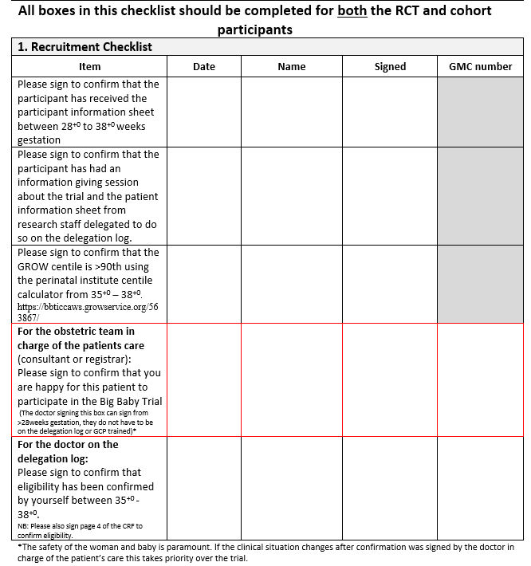
Essential Recruitment Document
All boxes in the essential recruitment document must be completed and signed prior to proceeding
Please keep this document as your source data

Slide 25
Recruitment
Participant information sheet discussion
  Can be done by a member clinical staff who is on the training and delegation logs
  This should last approximately 1 hour
  Answer any questions the participant may have
  Document in the source data
    That this discussion has taken place
    Version of the participant information sheet given

Slide 26
Recruitment
Participant information sheet discussion should include:
Variation in current practice
Why we are doing the study
What the study involves
Trial Arms
Risks involved with induction / vaginal delivery / caesarean section
Reassurance that if there was any clinical reason that delivery would need expediting this would happen
Inaccuracies with scan (next slide)
How their personal information is stored
Who to contact for further information
The participant can opt out at any time

Slide 27
Recruitment
Scan as predictor of LGA at birth
  Little if any evidence in the literature
  West Midlands database, 2009-12 (unpublished data):
  N=26,966 pregnancies with a scan between 35⁺⁰ – 38⁺⁰ weeks (indications for scan not recorded – included ?SGA, presentation etc.)
  N=2160 (8.0%) of this cohort were LGA at birth
Sensitivity (= detected: Bwt >90th, EFW>90th cust. centile) | 64.4%
False negative (= missed: Bwt >90th, EFW not >90th centile) | 35.6%
Specificity (EFW and Bwt not >90th) | 91.6%
False positive (EFW >90th but Bwt not >90th) | 8.4%
Positive Predictive Value (PPV) | 40.1%
Negative Predictive Value (NPV) | 96.7%
Notes:
1. Sensitivity / detection rate relates to pregnancies which had a scan for whatever reason. It will be lower for the whole population BUT there was no LGA screening programme in place.
2. LGA rate is higher in this (scanned) cohort (8%) than in the overall population (7%). So although we don’t have all indications for the scans, some must have been selected for ‘?LGA’.

Slide 28
Recruitment
Professional translators will be required for all women with limited English language skills
The participant information sheet is available in Polish, Romanian and Urdu, and the patient should receive a participant information sheet in a suitable language

Slide 29
Recruitment
Clinical Confirmation
For all women who participate in the
Big Baby Trial:
  A consultant obstetrician, or doctor acting on behalf of the consultant in charge of the participant’s normal care must confirm they are happy for the woman to participate
  They will then have to sign the essential recruitment document, adding their name, GMC number and date permission was granted

Slide 30
Recruitment
Eligibility
  For every patient you need to calculate a centile, using the Perinatal Institute individual centile calculator (ICC)
  Check the prepopulated fields are correct
  Maternal Height
  Maternal booking weight
  Ethnicity
  Parity at booking (previous pregnancies with a duration of ≥ 24 weeks)
  EDD
  Ensure all data fields are entered correctly
    Gestation: should be the day the USS was performed
    Estimated Fetal Weight (EFW) based on USS
  This can be used to calculate gestational age
https://bbticcaws.growservice.org/563867/

Slide 31
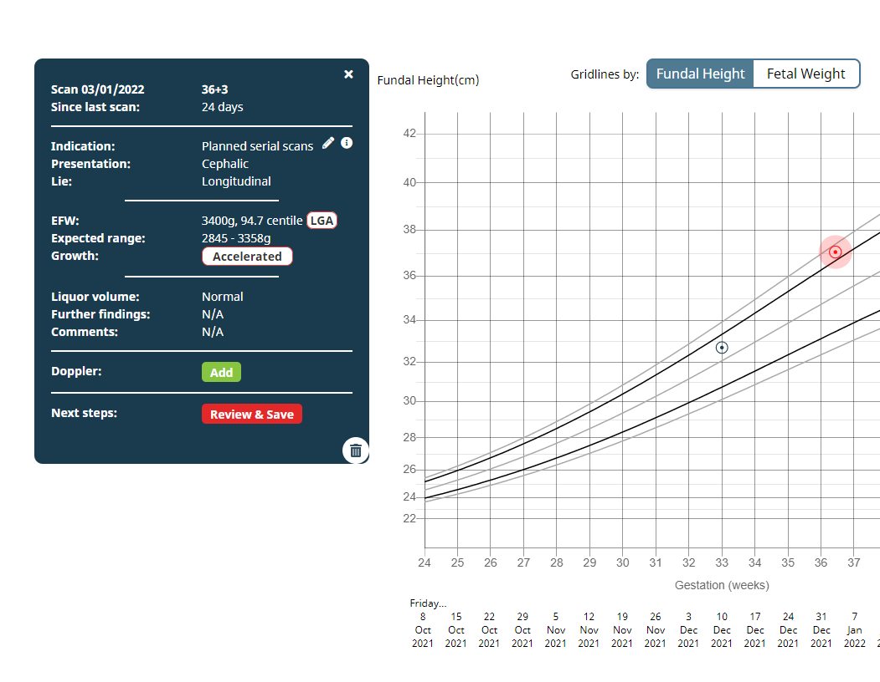
Recruitment
Eligibility
GROW 2.0 simplifies checking of centiles as they will display automatically, and alerts the clinician to concerns with the growth trajectory.

Slide 32
Recruitment
Eligibility
  The centile has to be >90th on customised GROW from 35⁺⁰ – 38⁺⁰
    90.0 → not eligible
    90.1 → eligible
  Add the centile to page 2 of the CRF
  Eligibility needs to be confirmed by a doctor with GCP on the delegation log.
    That doctor must:
    Sign page 3 of the CRF (has all the inclusion and exclusion criteria) this is then sent to the Clinical Trials Unit
    Sign the eligibility section of the essential recruitment document this is source data to keep with you
  If a participant is enrolled on another study please contact the trial team to confirm co-enrolment in the Big Baby Trial is permitted

Slide 33
Recruitment – Informed Consent
Person taking informed consent must be authorised to do so on the delegation log
Participant must initial all the boxes on the consent form
Participant and the investigator/midwife must sign the consent form together on the same day
Consent
  Must be between 35⁺⁰ and 38⁺⁰ gestation to consent
  Only doctors and midwives on the delegation log can consent

Slide 34
Recruitment
This describes the pathway recruitment
On completion of the essential recruitment document, if the participant consents to the RCT:
Consent for the randomised controlled trial
Collect baseline data and the baseline questionnaire data
Randomise
If randomised to induction of labour, book induction to start between 38⁺⁰-38⁺⁴

Slide 35
Recruitment
For non-English speakers
  This must be undertaken with an official hospital translator
  The use of a translator to obtain consent must be documented in the source data
  Consent forms will be available in other languages
Consent is an on-going process
  Consent does not end when consent is obtained at the start of the trial
  Continual process throughout
  Should be documented in source data
  Especially important for the 2 and 6 month follow up visits
  Please complete withdrawal form if the participant wants to withdraw

Slide 36
Recruitment
Collect baseline data
  Page 5 and 6 of CRF
  Includes past obstetric history
Ask the participant to complete the baseline questionnaires
  Separate booklet containing the EQ5D quality of life score, ICIQ-UI incontinence survey and Edinburgh post natal depression score
  Please scan and send this to the clinical trials unit as we do not require you to enter it into the database

Slide 37
Recruitment
Baseline questionnaires
  Please score the Edinburgh post natal depression score prior to the participant leaving the visit
If the Edinburgh post natal depression score:
Scores ≥13 OR
Question 10 – anything other than never
Inform the PI and clinician in charge of her care
Clinical decision as to how this is managed

Slide 38
Recruitment
Randomisation
  Complete recruitment form (page 4 of the CRF)
Telephone
Warwick Clinical Trials Unit
024 76 150402
Mon-Fri 9:00 – 17:00
Online
Available 24/7

Slide 39
Recruitment
Standard Care
Await outcomes
Induction
Book induction
To start between 38⁺⁰ – 38⁺⁴
The woman must be given a date for the induction
Add allocation to the CRF
Confirmation of allocation will be sent within 24 hours – file in the participant’s research file

Slide 40
Recruitment
Overview of pathway
Consent on the RCT consent form
Collect baseline data
Complete recruitment form / online recruitment wizard and randomise
Ask participant to complete baseline questionnaires
Check Edinburgh post natal depression score
If randomised to induction of labour book the induction between 38⁺⁰ to 38⁺⁴

Slide 41

Remote Informed Consent

Slide 42
Recruitment
Documentation
  GP letter to be sent to the GP
  Copy of the participant information sheet, GP letter and informed consent form to be:
    Filed in the participant’s hospital notes
    Filed in the participant’s maternity notes
  Original copy of the consent form to be filed in the investigator site file
  Participant to receive a copy of the:
    Participant information sheet
    Informed consent form
  Place a Big Baby sticker on the maternity notes
    This will alert the labour ward midwives to contact the research team after delivery so the notes can be collected and delivery data entered onto the CRF

Slide 43
Post delivery
Once the woman has given birth collect /access delivery notes
  Enter delivery details into the database
  Please scan the delivery notes from delivery of head to body
  The woman’s personal information needs to be redacted and replaced with study number (including the text throughout the notes). Also redact any reference to medical personnel
    Can photocopy delivery notes, cover personal information, add study number, photocopy again, then send
    Failure to redact correctly will be a breach of GDPR
  Send the redacted scan / photocopy to:
  Will need to be done within 2 weeks of delivery
uhc-tr.bigbaby@nhs.net

Slide 44
Post delivery
When adding details post delivery for baby If the USS or MRI is abnormal and it appears that the baby may have hypoxic ischaemic encephalopathy:
  Contact the consultant neonatologist in charge of the baby’s care to confirm the severity score
  Document this in the participant’s medical notes and on the database

Slide 45
Follow up
30 day readmission
  Need to check hospital database to review any 30-day post discharge for delivery hospital readmissions for participant and baby
  Complete this on the database
  Any overnight 30 day hospital readmissions for mum and/or baby need to have a SAE form completing and sending to the Warwick CTU

Slide 46
Follow up - Questionnaires
Each week, WCTU will contact site staff at the relevant sites to check the status of mother and baby before sending out the appropriate questionnaire to the mother (A or B).
If the Two Month Questionnaire has not been received at the Six Month timepoint, as combined 2 and 6 month questionnaire will be sent to the participant
For the Edinburgh post natal depression score
-If the score comes back to us as ≥13 or question 10 is anything other than never, we will contact you and ask you to action this as appropriate.

Slide 47
Withdrawals
Various reasons for withdrawals
If the woman withdraws following randomisation, determine if:
Further guidance on withdrawals is available in the protocol
Withdraws from intervention
Continue follow-up
Withdraws from study completely
Cannot continue follow-up

Slide 48
Outcomes, Adverse Events, Serious Adverse Events and non-compliances

Slide 49
Outcomes
Some events that meet the definition of SAE do not require immediate reporting as they are classified as study outcomes
The protocol will provide a list of those SAEs which do not require immediate reporting

Slide 50
Adverse Events (AEs)
An adverse event is defined as ‘any untoward medical occurrence in a participant which does not necessarily have a causal relationship with this treatment/intervention’
If the woman or infant experiences an adverse event that is not already captured in the CRF please complete:
  Adverse Event form on the Big Baby Database

Slide 51
Serious Adverse Events (SAEs)
Below are examples of SAEs which do require immediate reporting within 24 hours of being made aware of the event:
Mother | Baby
Maternal death | Stillbirth
In-patient overnight admission and/or readmission* to intensive care or high dependency unit at any time during pregnancy/postnatal period | Neonatal / infant death
Re- admission to hospital within 30 days of initial post-natal discharge unless listed in Protocol Table 10 | In-patient re- admission to hospital within 30 days of initial postnatal discharge, except for conditions noted in Protocol Table 10.
Antenatal hospital admission not related to pregnancy | Admission to neonatal unit
Transfer out of the maternity unit for further inpatient care
Admission to a mental health unit
Symphysiotomy
Any other event that meets the definition of an SAE and isn’t listed in Protocol Table 10

Slide 52
Serious Adverse Events (SAEs)
Below are examples of SAEs which do not require reporting as SAEs (you can find this on table 10 in the protocol)
Mother | Baby
Antenatal hospital admission related to pregnancy or admission to hospital for delivery | Humeral fracture/Clavicle fracture/Brachial plexus injury
Third degree tear | Congenital abnormalities or birth defects
Fourth degree tear | Hospitalisation/prolongation of hospitalisation for respiratory tract infections
Cervical laceration | Hospitalisation/prolongation of hospitalisation for jaundice
Sepsis in labour | Hospitalisation/prolongation of hospitalisation for urinary tract infections
Post-partum haemorrhage at delivery ≥1000ml | Hospitalisation/prolongation of hospitalisation for weight loss lasting less than 5 days
High EPDS, a score of 13 or over | Hospitalisation/prolongation of hospitalisation for reflux or constipation

Slide 53
Serious Adverse Events (SAEs)
Reporting SAEs
  Need to send to Warwick Clinical Trials Unit
  Events occurring between randomization and 30 days post initial discharge following delivery
  Please report within 24 hours of becoming aware, even if data is incomplete
Complete follow-up form
Yes
Serious adverse event form emailed to
uhc-tr.bigbaby@nhs.net
Serious adverse event identified
Within 24 hours PI completes serious adverse event form
Updates to data required / SAE unresolved?
No
Serious adverse event form complete

Slide 54
Non-compliances
Any non-compliance to the procedures in the protocol or GCP should be relayed to the trial office as soon as you become aware of the event
Non-compliance with the protocol does occur and this is normal in trials
  Should not be considered as negative
  Important that the trial team know of all incidences as it can indicate a change in procedures.
Informing the trial team of any non-compliances is an essential part of the monitoring process to ensure safety and integrity

Slide 55
Non-compliances
If there have been any non-compliances please contact the Big Baby Trial team
Sometimes as a result of a non-compliance there will be a need to put corrective and preventative actions in place, if this is the case, the trial team will communicate this and work with the site to action and document
Email
BigBaby@warwick.ac.uk
Telephone
02476 523858

Slide 56
Responsibilities

Slide 57
Training Log
Only staff on training and delegation log will be able to take part in research activity.
All staff on the delegation log will need research CVs and GCP certification
Lead trainer(s) delegated at each site who will train further staff prior to adding them to delegation log
We will leave you a copy of these slides

Slide 58
Delegation Log
Can be completed now
For further research staff to be added to the delegation log they must undergo training either by a member of the Big Baby Study Team or by the lead site trainer. They must then sign the training log.

Slide 59
Data Management

Slide 60

Screening Log
Should be sent to the WCTU every month
Please include women the research team are informed about that may have a big baby and have received a PIS

Slide 61
CRF
There will be detailed CRF completion guidelines
Contact the WCTU trial managers for clarification
When not in active use, CRFs and related trial material must be:
Stored in a secured location
Accessible only to authorised trial staff on the delegation log
Accessible for monitoring visits/audits

Slide 62
Investigator Site File Maintenance
When not in active use, the ISF and related trial material must be:
  Stored in a secured location
  Accessible only to authorised trial staff on the delegation log
  Accessible for monitoring visits/audits
On an on going basis the ISF must be kept up-to-date with:
  Filing of study related documents such as completed informed consent forms and case report forms
  Most recent versions of the protocol, information Sheets, informed consent forms and other related study documents
  Accurate delegation log and training log (especially important for the Big Baby trial as this will be needed for Big Baby System access)

Slide 63
Version Control
Your ISF contains the current versions of all documents
The most current versions of documents can be found on the Big Baby website
  Click on Researchers in the box on the right hand side of the screen
  The password is bigbabytrial
As versions are superseded:
  WCTU will forward the new versions to you along with a new version log
  ISF: cross out the old documents and write ‘superseded’ on these documents
  ISF: file the replacement documents on top of the superseded documents
  Keep up to date versions on the server, and print them off when required

Slide 64
Trial Paper Work
Any trial related paperwork that needs to be forwarded to the coordinating centre can be sent to:
This may include, but are not limited to:
  Screening logs (monthly)
  Updated delegation logs – as soon as completed
  CRFs - pages 1-3
  Delivery note copies
  Baseline Questionnaires
uhc-tr.bigbaby@nhs.net

Slide 65
Trial Paper Work
Data return expectations:
  Return forms/enter data online within 2 weeks of events for central safety check
  Use CRF Completion Guides and Data Entry Guidelines
  Contact WCTU for further advice

Slide 66
Big Baby Database
Prior to your site receiving the Green Light to start study activities, a member of the Trial Management Team will contact you:
  to arrange a date and time for database training – via telephone
  to confirm your IP address
  to confirm the site staff who will require access to the database

Slide 67
Documenting Research Visit
It is vital to document ALL participant research contacts (including telephone contacts) in the source data in sufficient detail that we are able to reconstruct the trial and verify the CRF
  The provision of study information and study explanation / discussion
  The informed consent contact
  Randomisation contact
  Follow up contacts
Please document in the maternity notes that you have also had this discussion with the woman, what she has consented for and, if applicable, her randomisation allocation

Slide 68
Amendments to Trial Paperwork
We will send any updates to trial paperwork to the lead research midwife with a description of what has been changed
Please update your site file and document pack to reflect these changes
If you would like paper copies of updated documents please inform us so we can send these in the post
Please reply to our email by the date stated to inform us that you have received the documents and implemented the changes

Slide 69
Monitoring

Slide 70
Monitoring
A random selection of 10 percent of sites will be monitored
  Sites will be given reasonable notification prior to a visit taking place
  It is likely that the monitoring visit will be remote, and will likely consist of a self-checklist and a video call with the monitor
  A report will be sent to the site following the monitoring meeting, if any actions are identified, a timeline for response will be provided in the report
Further visits will be proportionate to risk. Potential triggers for further visits may include, but not limited to:
  Protocol non-compliance trends e.g. consistent use of incorrect document versions
  Failure to report SAEs / high level SAE reporting
  Persistent non-return of data
  In the response to an issue previously identified and monitoring plan was agreed by the TMG
  If the site requests a visit a monitoring visit may be considered

Slide 71
Monitoring
Please ensure the following documents are available for on site monitoring visits:
  All trial related documentation: investigator site file, CRF, consent forms etc.
  Source data documentation for verification of data entered onto the CRF
    Please ensure that all trial data and information is recorded in the patient hospital notes and maternity notes to ensure source data verification. This should include documentation of on going consent
  Access to any electronic source documentation including the GROW system
  PI and trial staff

Slide 72
Archiving

Slide 73
Archiving
Trial documentation, data and source documents will be archived for 25 years after completion of the trial
The PI or designee must maintain adequate and accurate records to enable the conduct of the trial to be fully documented and the trial data to be subsequently verified
The WCTU will maintain specific trial related documents
The WCTU will authorise and advise of the archiving requirements as part of the site closure process (on behalf of the sponsor)

Slide 74
To open
In order to get you open as a site and start screening and recruiting we need:
  Confirmation of capacity and capability
  Site agreement signed by all parties
  Completed site signature and delegation log
  CV and evidence of GCP training for all staff listed on the delegation log
  Completed SIV training log and site attendance log
Once these essential documents have been received by the coordinating centre, an email will be sent to site to provide the green-light for you to commence recruitment. Trial activities cannot commence at site until you have received this email from the coordinating centre

Slide 75

Contact
Warwick Clinical Trials Unit
Trial Team
Sara Wood
Bigbaby@warwick.ac.uk
02476 523858
Perinatal Institute
Research Midwife
Hanna Jones
bigbaby@perinatal.org.uk
01216070101

Slide 76

Thank you
Any questions?

