Slide 1

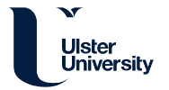


Database Training
Completion of this training will allow you to undertake eCRF completion should you be delegated this responsibility by the trial PI
Warwick Clinical Trials Unit |
iRehab_DatabaseTraining_v1.3_22Jun2023

Slide 2
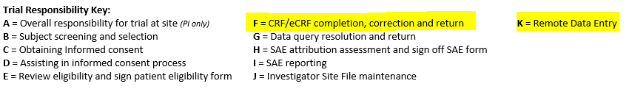
Step 1 – Request for access
To enable Warwick CTU to grant access the database we will need the following information sent by email:
Name
Role
Email Address
Copy of the delegation log with responsibility F & K assigned
IP address (usually 1 per site will be satisfactory)
Notes:
Delegation Log is found in the ISF section (X)
A copy of the delegation log can also be found on the iRehab websites
Details on how to obtain Ip address can be found on slide 4

Slide 3
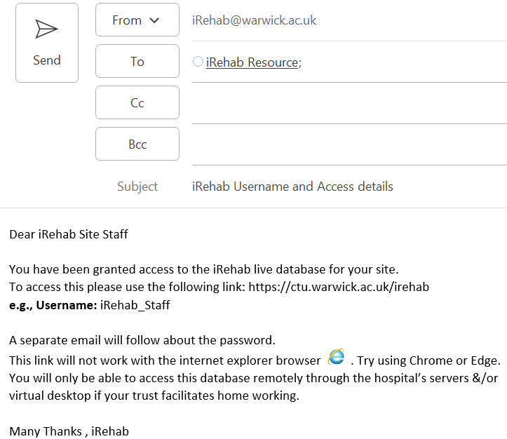
Step 2- Allocation of Username and Password
Upon allocation of your username and password you will be sent 2 emails
Email 1: Allocation of Username
and Database link
Notes:
Once we have receipt of the delegation log we will provide the individuals who require access with a username and instructions on how to set their password
Email 1 will give the username and details of the url
Email 2 will outline the procedure on how to set the password using the forgotten password link
Slide 4 shows this in more detail

Slide 4
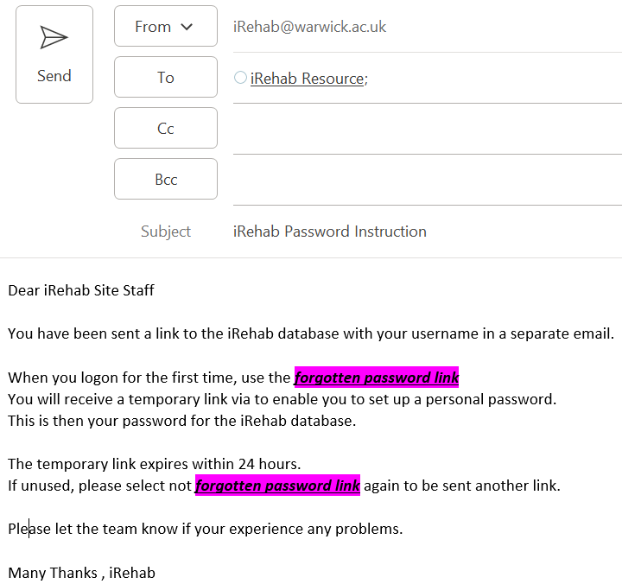
Step 2- Allocation of Username and Password cont
Upon allocation of your username and password you will be sent 2 emails
Email 2: Allocation of Password
Notes:
Once we have receipt of the delegation log we will provide the individuals who require access with a username and instructions on how to set their password
Email 1 will give the username and details of the url
Email 2 will outline the procedure on how to set the password using the forgotten password link
Slide 4 shows this in more detail

Slide 5
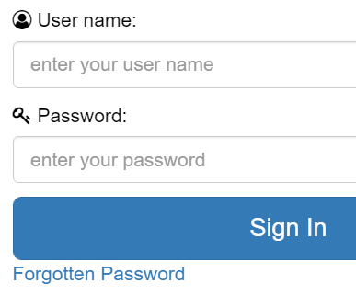
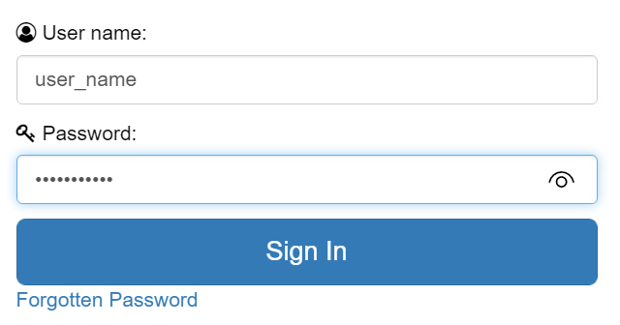
Step 3- Log In
Step 3a) On your first log in use the forgotten password link to set your personal password
Use the temporary link in your inbox to set your password
Step 3b) On all subsequent Logins use the username as designated by WCTU. Use your own personal password and click sign in
Notes:
Initial log in requires setting up of a password using the link, this will send a temporary link to rhe email provided with instructions on how to create the password
This link will last for 24 hrs
If unused you will have to go through the forgotten link process once more
Once the password has been set you can continue into the database using your username and password
401 errors can occur- in the first instance please provide us with your Ip address as per the instruction on the slide- if this doesn’t resolve the issue. Programming will help us to resolve the issue

Slide 6
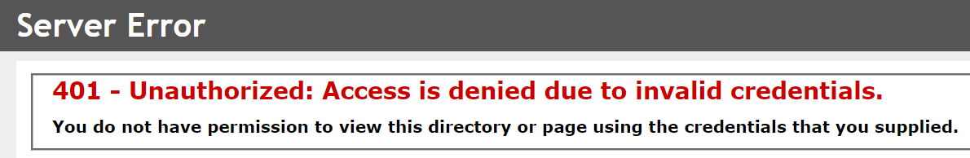
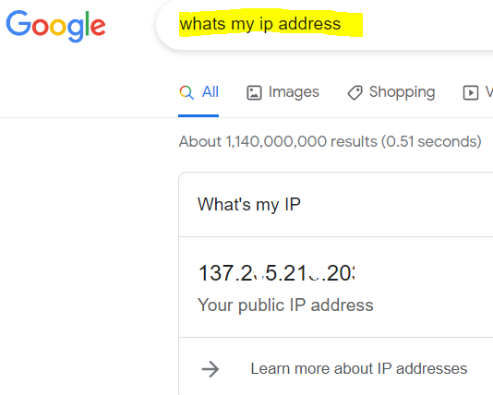
Step 3- Log In cont.
If you receive the following error, this is because the Warwick server doesn’t recognise your device/site:
To resolve please send us your public IP address:
Access Google & Type ‘What is my IP address’
Screenshot or make a note of the series of digits
Send to the iRehab trial team to resolve
Notes:
Initial log in requires setting up of a password using the link, this will send a temporary link to rhe email provided with instructions on how to create the password
This link will last for 24 hrs
If unused you will have to go through the forgotten link process once more
Once the password has been set you can continue into the database using your username and password
401 errors can occur- in the first instance please provide us with your Ip address as per the instruction on the slide- if this doesn’t resolve the issue. Programming will help us to resolve the issue

Slide 7
IMPORTANT!
Your user account will get locked if the incorrect password is entered 5 times
If you cannot recall or remember your password or if your password doesn’t seem work after the first few attempts please reset password using the forgotten password link.
Note: if your account is locked, please contact the trial management team on irehab@warwick.ac.uk to resolve. Please be aware that resolution is not instant and requires programming support
Notes:
If in doubt, please reset your password. Unlocking accounts can take time and we want to ensure you have access to the database at all times. This is the best way to prevent any issues is to reset the password if your are having difficulties!

Slide 8
Data & Data Entry
 | Pre-randomisation |  | Post-randomisation
 | Screening | Baseline | Intervention | Follow Up
Weeks ± No. Days | 0-12 |  | 1-6 | 8 | 26
Check eligibility | ü | ü
Consent participant |  | ü
Registration by Site (Post-eligibility check and consent)
Patient Contact Details |  | ü
Patient Clinical Data: APACHE II score Medical history Co-morbidities Pre-ICU admission functional status Duration of ventilation Length of ICU & Hospital stay |  | ü
Participant data collection facilitated by WCTU (Post registration – 100% completion needed)
Questionnaires: EQ5D, BIPQ, FACT-F, HADS |  | ü |  | ü | ü
30sec Sit-to-Stand |  | ü |  | ü | ü
Health and Social Care Use |  |  |  | ü | ü
Process Evaluation interviews |  |  |  | ü
Participant data collection facilitated by Intervention Team (Post-randomisation) |  |  | ü
Intervention delivery |  |  | ü
Other/ Ad Hoc (completed by Site, WCTU, Intervention Team)
SAEs &/or AE’s |  | ü | ü | ü | ü
Withdrawal &/or Readmission &/or Notification of Death |  |  | ü | ü | ü
Note to File/Protocol Non Compliance | P | P | P | P | P
Key:
Lilac: Trial Site
Orange: WCTU
Blue: Ulster Intervention Team
No Colour: Trial Sites, WCTU and Ulster Intervention team
Notes:
This slide is to highlight the CRFs you are going to see on the database for your completion.
This is taken from the SIV and is also outlined in the protocol.

Slide 9
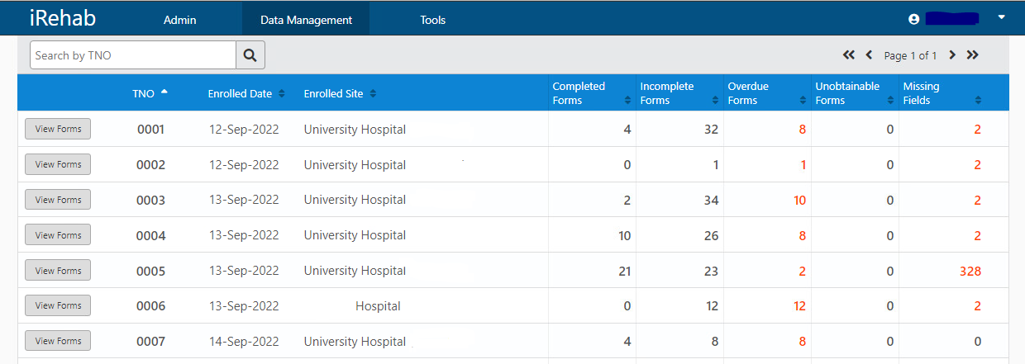
Landing Page –
Participant Manager (in the Data Management tab)
TNO - can be sorted ascending to descending and visa versa. Here you see all your participants. Past & Present
Questions?
Contact: (E) irehab@warwick.ac.uk | (T) 024 761 51367
To view, amend and create e-CRFs for a participant select the view forms buttons
Using the Status bar you can sort your participants based on e-CRF status to help with data completion and organisation

Slide 10
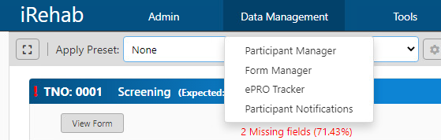
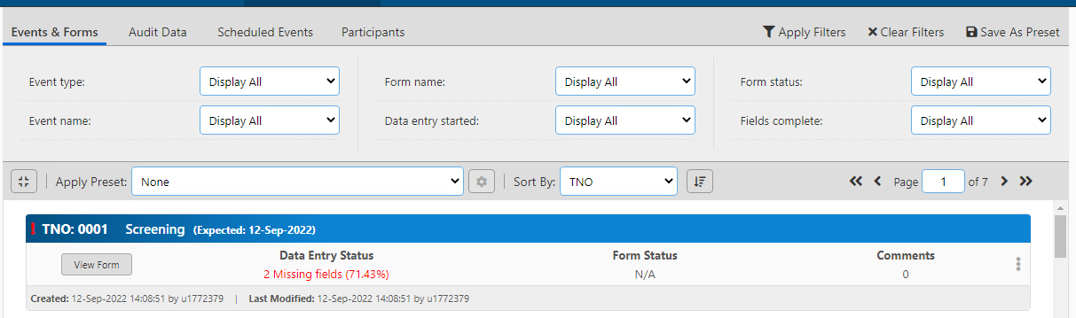
Data Management Tab - Form Manager
Using the Data Management tab you can also view your e-CRFs in the Form Manager tab. This allows you to see all CRFs for all participants in chronological order
By selecting the toggle in the upper left hand screen you can open up the filters for your CRFs to filter and view based on your needs.

Slide 11
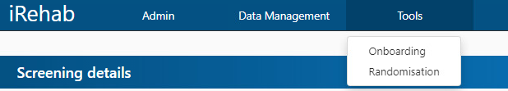
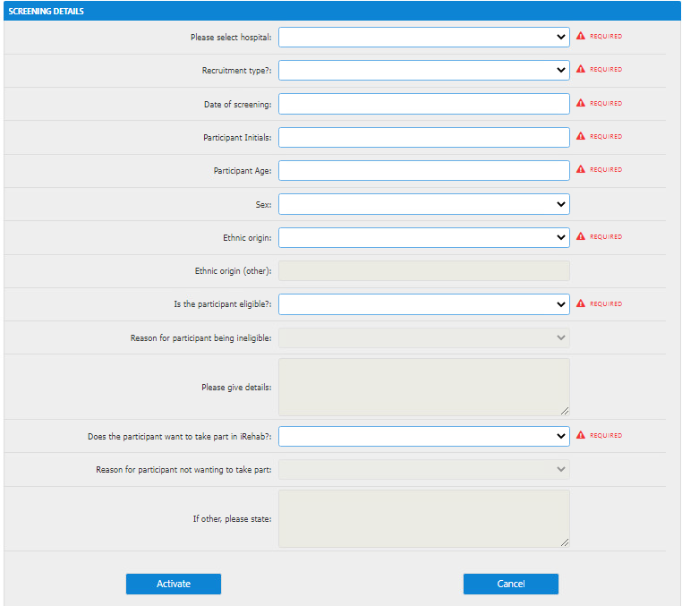
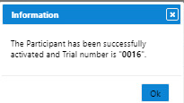
Onboarding/Generating a TNO (3 Step process)
1
To onboard a patient you must select
Tools
And then you must select
Onboarding - adds patient onto the electronic screening log
NOTE: Only WCTU will have access to the randomisation Wizard
2
Once You have selected the onboarding tab, the Screening eCRF will open.
There are a series of required fields as per the image on the right which you are necessary for you to complete in order to Onboard and Activate the patient
3
Once Activated the patient will be assigned a TNO

Slide 12
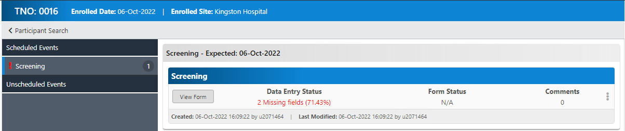
CRF Completion
Once your patient has been onboarded and assigned a TNO, you can start to complete the scheduled and unscheduled e-CRFs as per the Schedule on slide 8.
To view, create and edit forms for a participant you must select the View Forms button (see slide 9).
If you have just onboarded a patient, the patient must want to join iRehab before you can access any other eCRFs. All eCRFs for the patient can be seen in the left-hand column of the database.

Slide 13
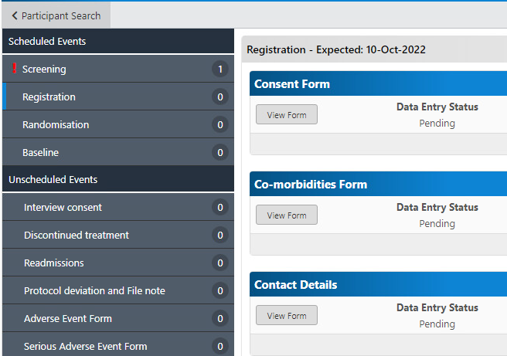
CRF Completion
To view and edit the CRF (in this example the Screening form) select form type from the left-hand column and select view form to open the CRF.
2.
1.
This is how you will create, open, enter and edit ALL CRFS
Example 2

Slide 14
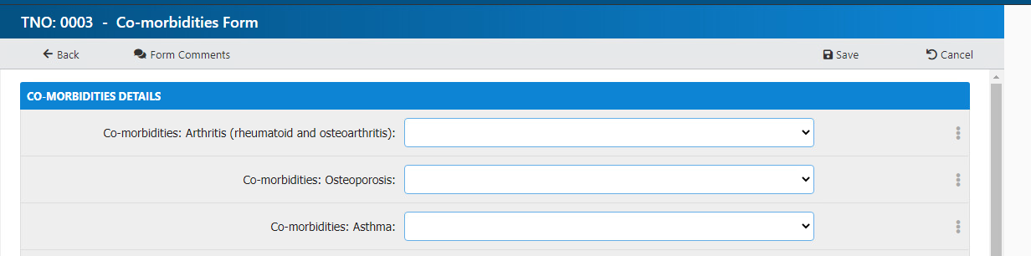
CRF Completion
Once a CRF has been completed you will need to save
If you do not want to save the document/ changes you will need to cancel

Slide 15
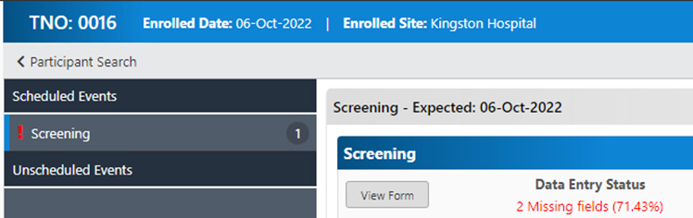
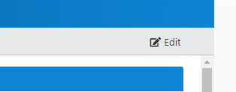
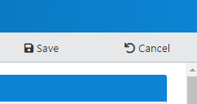
Data deletion and editing
Depending on the CRF, you may be able to access the eCRF and edit should this be required. You will follow the same process as slide 12 & 13 describe
Select Participant using the View Forms button
Select the CRF in the left-hand side panel and click view form button
Edit (top right of CRF) & save (or cancel to revert changes)
You cannot delete CRFs. Any CRF deletions will have to be authorised and actioned through the WCTU trial management team.

Slide 16
For information relating specifically to CRF completion, please consult the CRF completion guidelines as per the ISF in the first instance
For any questions relating to the trial please consult the FAQs sheet as per the ISF in the first instance
For any other questions relating to the trial, processes &/or training please contact the iRehab team using the details below:
Contact: (E) irehab@warwick.ac.uk | (T) 024 761 51367

