Slide 1

iRehab Training Slides: Screening Logs
3rd April 2023
Notes:
This short training video will help you to identify, screen and record information about potentially eligible patients for the iRehab trial.

Slide 2
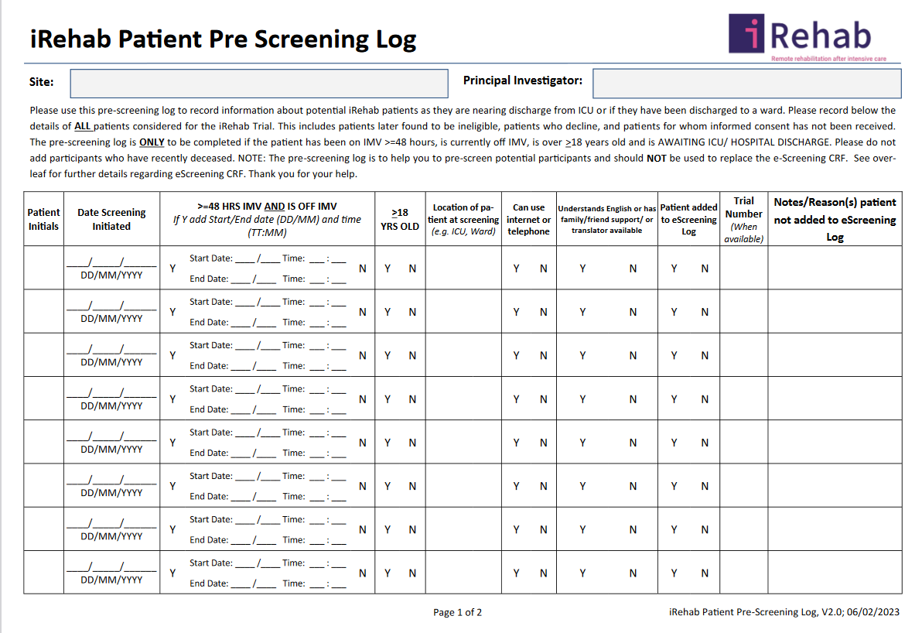
Pre-screening log: local record to be completed for all patients discharged from ICU who appear to satisfy the iRehab inclusion criteria
Notes:
There are two different forms for screening iRehab patients. Firstly the Pre-screening log pictured here. This is a local record to be completed for all patients discharged from ICU who appear to satisfy the iRehab inclusion criteria. Enter patients onto the pre-screening log as they are about to be discharged from ICU or if they have been discharged from ICU onto the ward.

Slide 3
Please record below the details of ALL patients considered for iRehab who have been
- Been on IMV>=48 hours
Currently off IMV
Aged>=18 years old
Are awaiting ICU/ hospital discharge
Please do not add participants who are recently deceased.
Notes:
Patients who meet the following criteria should be entered onto the log.
Patients should not be on IMV at the time of screening. Patients who have been on invasive mechanical ventilation for more than or equal to 48 hours.
They must be 18 years or over and are awaiting ICU or hospital discharge.
We are only interested in recording information about patients whose condition is improving and as they become potentially eligible to join the trial. In general, please do not add participants who are recently deceased. You can add patient is deceased as a final screening outcome, as appropriate.

Slide 4
Notes:
I will now take you through in more detail the information that should be recorded. Instructions how to fill out the log are also found on the back of the from.
The first column is to insert patient initials in 2 or 3 letter format. The next column we request you to fill out is the date the patient is screened. Thirdly, we ask you to record the time of mechanical ventilation. This should be details of the last period the patient was mechanically ventilated. You should confirm the age of the patient is over 18 by circling yes.
We would like you to record the location of ht epatient when on the date of screening ie ICU/ ward.
We also need you to confirm he patient has access to a phone or internet to take part in the study. Finally, we request you to confirm the patient has been entered onto the eScreening CRF.
If the patient has not been entered onto the escreening CRF for any reason, please note this here.
The pre-screening form is primarily for local records but data may also be requested for training and monitoring purposes. If you have any questions, please contact Warwick CTU by email.

Slide 5
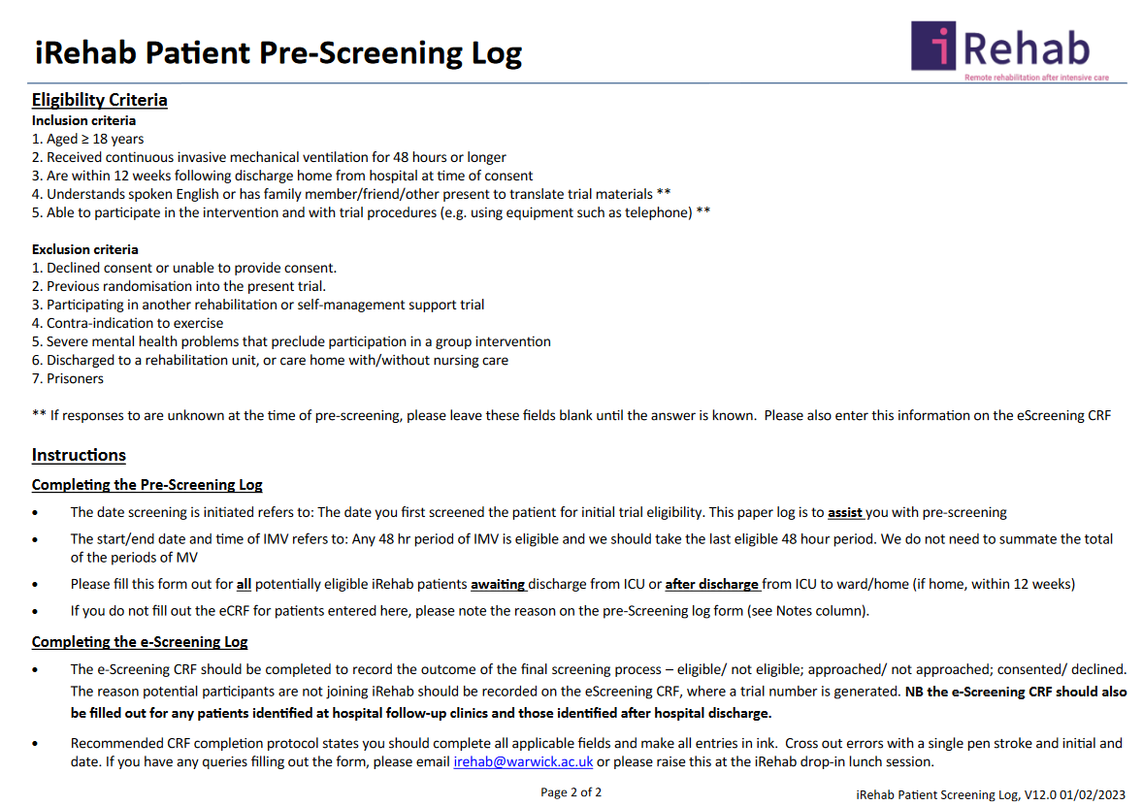

Slide 6
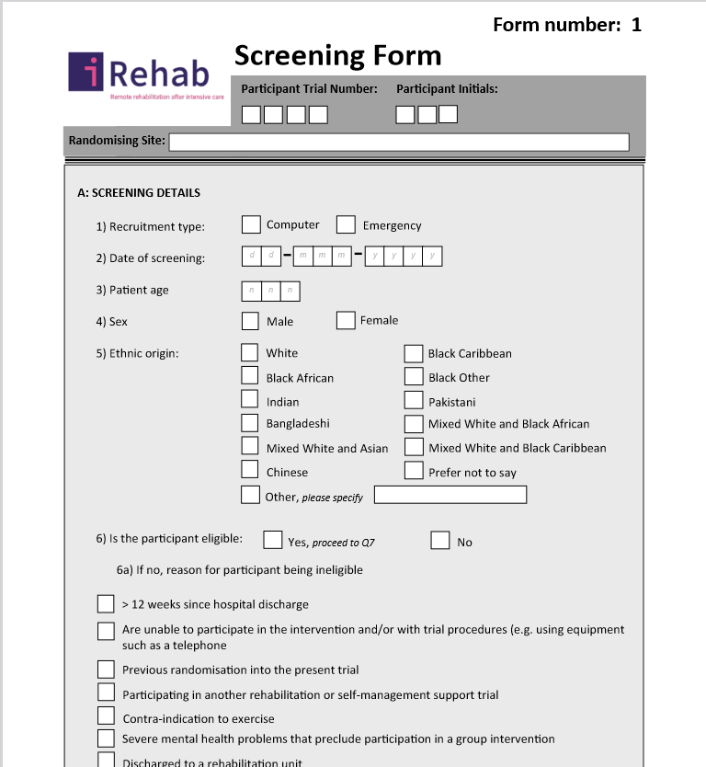
The eScreening form is found on the iRehab database.
Please fill out the eScreening form to record the screening outcome for patients considered for iREhab. This may include:
Patients identified while in ICU/ post-ICU discharge to ward
Patients identified at follow-up clinics (0-12 weeks post-hospital discharge)
Patients discharged home who satisfy inclusion criteria
We use screening log data to monitor and improve trial recruitment so please keep screening records up to date.
Thank you for all your support screening and recruitment to iRehab.
Notes:
Once you have filled out the pre-screening log, please enter all screening data onto the eScreening form to share screening records with CTU. The eScreening form records the screening outcome for all patients considered for trial participation. This will include patients identified while in ICU/ Ward. It may also include patients who you have identified at follow-up clinics as along as they are still 0-12 weeks post-hospital discharge and patients who have been discharged home who satisfy the inclusion criteria.
We use screening log data to monitor and improve trial recruitment, so please keep screening records up to date.
Thank you for listending and for all your support with screening and recruitment to the iRehab trial.

