Slide 1

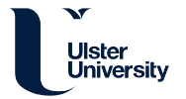


Site Initiation Visit
Remote Rehabilitation After Intensive Care (iRehab)
PILOT
Remote multicomponent rehabilitation compared to standard care for survivors of critical illness after hospital discharge: a randomised controlled assessor-blind clinical and cost-effectiveness trial with internal pilot
Warwick Clinical Trials Unit | iRehab_SIV_v0.2_25Jul2022
Notes:
Introductions and Housekeeping

Slide 2



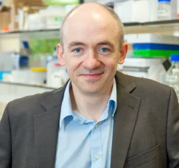



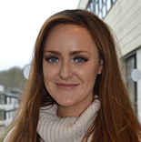
Introductions & Main Contact Details
Dr Brenda O’Neill
Chief Investigator
Professor Danny McAuley
Co-Chief Investigator
Professor Julie Bruce
Warwick CTU Lead
Jess Smith
Senior Project Manager
Kerry Raynes
Trial Manager
Raegan Barrows
Trial Manager
Louisa Edwards
Trial Coordinator
Katherine Jones
Research Fellow
Sponsor: Ulster University | Funder: NIHR
Contact: (E) irehab@warwick.ac.uk | (T) 024 761 51367

Slide 3
Background
~129,000 patients surviving critical illness discharged from acute hospitals in United Kingdom over 1 year.
1 in 4 experiencing unplanned admissions over a 3 month period.
Consequences of critical illness are substantial and multifactorial such as:
  Physical deconditioning,
  Respiratory and swallowing problems
  Cognitive and mental health impairments
  Reduced activities of daily living & fatigue
  Declined quality of life (HRQoL)
  Failure to return to work after 12 months (1 in 2)
  Increased burden on social support
There is a requirement improve long term health outcomes of this patient population

Slide 4
Study Aims
No evidence to support remote rehabilitation to broader population of survivors of critical illness, despite its use and anecdotal evidence of acceptability.
First trial to systematically test a technology-driven remote approach to evaluate the clinical and cost-effectiveness of a rehabilitation intervention in patients recovering from critical illness after ICU care
Aims: Examine the clinical and cost effectiveness of a remote multicomponent rehabilitation intervention compared to standard care in survivors of critical illness following discharge from hospital after an Intensive Care Unit admission (ICU) on health-related quality of life at eight weeks post-randomisation.

Slide 5
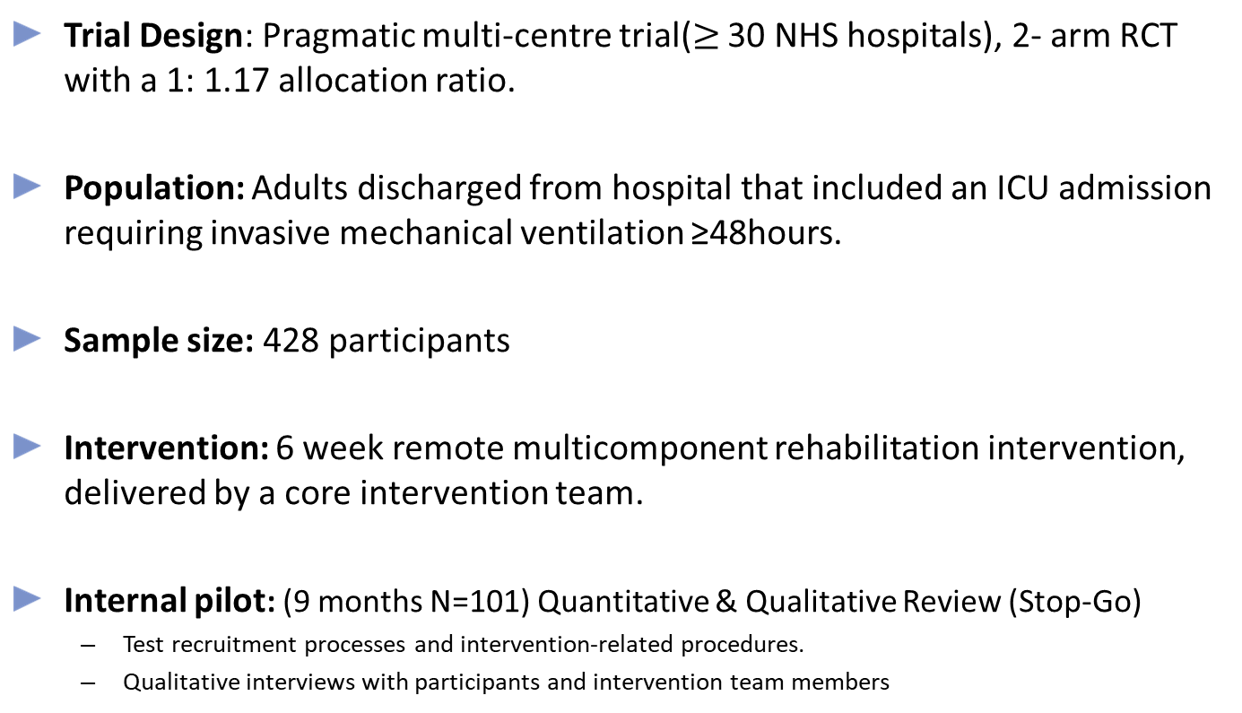
Study Design – Overview
Trial Design: Pragmatic multi-centre trial($≥$ 30 NHS hospitals), 2- arm RCT with a 1: 1.17 allocation ratio.
Population: Adults discharged from hospital that included an ICU admission requiring invasive mechanical ventilation ≥48hours.
Sample size: 428 participants
Intervention: 6 week remote multicomponent rehabilitation intervention, delivered by a core intervention team.
Internal pilot: (9 months N=101) Quantitative & Qualitative Review (Stop-Go)
  Test recruitment processes and intervention-related procedures.
  Qualitative interviews with participants and intervention team members

Slide 6
Time Lines
Study Time Line
MAR 24
Main Phase
End
Total 428 Participants Recruited
APR 24
Trial Follow Up Phase
Start
SEPT 24
Trial Follow Up Phase
End
Final Patient 6 month Outcomes Collected
JUN 23
Pilot Ends
101 Patients Recruited
OCT 22
Pilot Starts
JUL 23
Main Phase
Starts
JUN 23
Stop-Go Criteria Assessed
JULY 24-DEC 24
Analysis
Participant Time Line
WK0
Patient receives baseline Information
WK0
Patient Discharged
WK 1- 8
Intervention Phase
WK 9- 26
Participant Follow Phase
WK0 – WK 12
Patient Consented
WK1 – WK3
Patient Randomised
WK 8/ 2 Month
Data
Collection
WK 26/ 6 Month
Data
Collection

Slide 7
Summary of Trial Processes (i)
Patient has received ≥48hrs invasive mechanical ventilation
Patient is screened by the Site Research Team and Eligibility Assessed. Screening can be completed prior to, or post hospital discharge (Patient must consent by WK 12 post discharge)
Site Research Team complete screening logs in CDMS for both eligible and ineligible patients.
Patient is provided with a trial invitation letter and Personal Consent is obtained (in person or via telephone)
(Additional consent may be obtained for qualitative interviews by WCTU)
Site Research Team register the Patient & Site Research Team to send a copy of the consent form to the Patient
Patient receives Baseline information/Form
Notes:
KEY:
Purple- Site Teams/ Research Champion
Orange-WCTU
Blue- Ulster University

Slide 8
Summary of Trial Processes (ii)
WCTU follow patient from Registration- Week 3 post Registration (Baseline, Sit to Stand EQ 5D 5L, etc.)
WCTU Randomise patient & send relevant documentation
Site Research Team send letter to the GP & consultant at treating hospital.
Internal 9 month pilot
Open 16 sites, N=101
6 week Intervention Delivery
Standard Care N=197
Rehabilitation Intervention N=231

Slide 9
Summary of Trial Processes (iii)
8 Week Data Collection: WCTU, Online or Telephone
Primary: Health-related quality of life: EQ-5D-5L
Secondary: physical function (30s Sit to Stand Test), Brief illness perceptions (BIPQ), fatigue (FACIT-F), anxiety and depression (HADS), health utilisation
6 Month Data Collection: WCTU, Online or Telephone
Primary: Health-related quality of life: EQ-5D-5L
Secondary: physical function (30s Sit to Stand Test), Brief illness perceptions (BIPQ), fatigue (FACIT-F), anxiety and depression (HADS), health utilisation process and Health Economic Evaluation

Slide 10
Data & Data Entry
 | Pre-randomisation |  | Post-randomisation
 | Screening | Baseline | Intervention | Follow Up
Weeks ± No. Days | Wks 0-12 |  | Wks 1-6 | Wk 8 | Wk 26
Check eligibility | ü | ü
Consent participant |  | ü
Data collection by Site
Registration- Patient Contact Details |  | ü
Registration- Patients Clinical Data: APACHE II score Medical history Co-morbidities Pre-ICU admission functional status Duration of ventilation Length of ICU & Hospital stay |  | ü
Patient data collection by WCTU (Post clinical data collection and consent, WK 0 post registration)
Assessment Information |  | ü |  | ü | ü
30sec Sit-to-Stand |  | ü |  | ü | ü
Randomisation |  | R*
Patient data collection by WCTU (Post clinical data collection and consent, WK 0 post registration) |  |  | ü
Intervention delivery |  |  | ü
Other/ Ad Hoc (All)
SAEs &/or AE’s |  | ü | ü | ü | ü
Withdrawal &/or Readmission &/or Notification of Death |  |  | ü | ü | ü
Note to File/Protocol Non Compliance | P | P | P | P | P
Standard WCTU web-based application for trial management to record participant data in accordance with the trial protocol.
Various methods will be used to track missing data including phone, text, and email.
Data will still be collected for participants who discontinue or deviate from the protocol, unless they withdraw their consent

Slide 11
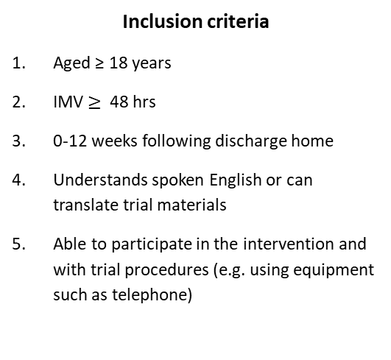
Eligibility & Screening
Patient Received Invasive mechanical ventilation for 48 hours or longer during an ICU admission are eligible to participate.
Consent within 12 weeks of hospital discharge after care in ICU requiring at least 48 hours mechanical ventilation.
    Inclusion criteria
Aged ≥ 18 years
IMV $≥$ 48 hrs
0-12 weeks following discharge home
Understands spoken English or can translate trial materials
Able to participate in the intervention and with trial procedures (e.g. using equipment such as telephone)
    Exclusion criteria
Declined consent/ unable to provide consent.
Previous randomisation into iRehab.
Participating in another rehabilitation or self-management support trial
Contra-indication to exercise
Severe mental health problems that preclude participation in a group intervention
Discharged to a rehabilitation unit, or care home
Prisoners
Only clinical team members appropriately trained and delegated the responsibility E on the delegation log can confirm patient eligibility
Screening via Database
Screening based on SEAR framework- must ensure complete and accurate Screening Logs
Notes:
Using SEAR Framework to review this periodically so important to use the drop downs when provided to add reason for EC- The Screened, Eligible, Approached, Randomised (SEAR) framework supports the collection of data as a tool to map the recruitment process and identify barriers to recruitment. It can be particularly helpful in pilot or feasibility studies, to assess feasibility and inform recruitment strategies for a main tria
Examples of mental health problems:
Psychosis - schizophrenia, bipolar disorder
Substance misuse
Cognitive impairment/neurological disorders - e.g.: dementia, brain injuries, severe/profound learning disability
Examples of CI to exercise
Whether these are absolute/relative Cis will depend on the situation and whether the symptom(s) is under control or not so may need to discuss with PI:
Unstable angina
Uncontrolled high blood pressure (at rest: systolic BP ≥200 mmHg; diastolic BP ≥ 110 mmHg)
Recent myocardial infarction
Symptomatic arrythmias (uncontrolled/still under-investigation)
Potentially some cardiac-specific acute inflammatory conditions (e.g. pericarditis) (may not pose issue if physical stress isn't of a high strenuous nature)
Uncontrolled asthma
Unstable/poorly controlled blood glucose (more relative)
Sometimes patients are unable to provide consent due to temporary delirium and so they would usually be followed until this clears.

Slide 12
Eligibility & Screening
Screening information must be completed and input into the database where a TNO is generated by the database for the patient.
A paper eligibility form will be provided to help screening process, however all screening data must be put into the CDMS system as soon as physically possible
Patient is pre screened by the Site Research Team and added to the Screening Log:
Aged ≥ 18 years
Received invasive mechanical ventilation for 48 hours or longer
Site continue to complete screening log
Patient deemed eligible as per screening logs and eligibility checks
Patient approached and provided with written information about the trial if screened whilst an inpatient or at a follow up clinic
Patient will be given:
Time to read the information and opportunity to ask questions if approached whilst an inpatient or at a follow up clinic
A follow up call and opportunity to ask questions if approached post discharge
Note: Any information on eligibility criteria not captured routinely in patient notes must be documented in the source data.
Note: Screening data will be reviewed monthly throughout the pilot and main trial phase
Notes:
Patients should be added to the Screening Log C met for age and MV>48hrs
Continue to screen until either EC met or recruited'
KEY:
Purple- Site Teams/ Research Champion
Orange-WCTU
Blue- Ulster University
Green-Patient

Slide 13
Consent & Registration
Personal consent to join the trial will usually be taken, by telephone or video call, once the patient has returned home. Consent will be taken by an appropriately delegated member of the research team. Proof of consent MUST be documented in the Patients medical notes.
Additional consent may be sought for optional qualitative study by WCTU
Site Research Team register the patient (Clinical Data Management System/CDMS)
Site Teams complete Baseline Info (1)
Contact Details
Demographics &
medical history.
APACHE II score
Co-morbidities
Patient receives Baseline Assessment Trial Pack:
Baseline Questionnaire
Pulse Oximeter
Instruction Manuals
Pre-ICU admission functional status
Duration of Invasive Mechanical Ventilation
Duration of ICU and hospital stay
Notes:
Just a note for possible edits in the future – Site Teams complete Baseline Info (1) – I think we should add the correct names of the eCRFs once confirmed to avoid any confusion
KEY:
Purple- Site Teams/ Research Champion
Orange-WCTU
Blue- Ulster University
Green-Patient
Consent in participant folder in isf, medical notes and copy in

Slide 14
Baseline & Randomisation
Participant receives Baseline Assessment Trial Pack, Pulse Oximeter & Baseline Assessment Questionnaire (Auto-generated)
Participant completes Baseline Assessment Questionnaire (EQ5D as a minimum by WK3 post registration)
WCTU complete baseline sit-to-stand test
EQ5D not completed by WK 3 post registration. Participant NOT randomised
Participant Randomised
Participant, Site Team, WCTU team and Intervention delivery team notified
Site Research Team to send a copy of the consent form to the Participant via email or post and a letter sent to the GP consultant at treating hospital
Notes:
KEY:
Purple- Site Teams/ Research Champion
Orange-WCTU
Blue- Ulster University
Green-Patient
If Participant completes Baseline Assessment Questionnaire online or via telephone within 1 week of registration and then complete baseline sit-to-stand test they will be Randomised
If Participant hasn't completed Baseline Assessment Questionnaire online or via telephone within 1 week of registration WCTU will follow up with patient to complete baseline sit-to-stand test & Baseline Assessment Questionnaire
At Week 2 post registration if Baseline Assessment Questionnaire hasn’t been completed WCTU will resend
At Week 3 post registration if EQ5D hasn’t been completed patient will not be randomised
At Week 3 post registration if only the EQ5D has been completed patient will be randomised

Slide 15
Intervention
Participant Randomised to Standard Care or Rehabilitation Arm
Rehabilitation arm will be delivered by a trained team from Belfast Health and Social Care Trust & Ulster University over 6 weeks
Standard Care N=197
Rehabilitation Intervention N=231
No rehabilitation other than usual NHS care
Data Collection: TNO, Registration Form, Baseline Assessment & Baseline Questionnaire
6 week Intervention Delivery: Remote delivery facilitated by online platforms i.e. Microsoft Teams or Zoom, supported with video platform BEAM© or via telephone
Data Collection:
TNO
Registration Form
Baseline Assessment
Baseline Questionnaire
Wk | Session
1-6 | 1-to-1 appointment (online), Independent or online group/recorded exercise session & Online peer support group (iRehab café)
6 | Final 1-to-1 weekly session to include review and discharge
Qualitative Interviews
Notes:
KEY:
Purple- Site Teams/ Research Champion
Orange-WCTU
Blue- Ulster University
Green-Patient

Slide 16
Follow Up
8 Week Data Collection by WCTU: Participant online or Telephone follow up from WCTU contact
(Process Evaluation at 8 weeks)
Primary: Health-related quality of life: EQ-5D-5L
Secondary: physical function (30s Sit to Stand Test), Brief illness perceptions (BIPQ), fatigue (FACIT-F), anxiety and depression (HADS), health utilisation
6 Month Data Collection by WCTU: Participant online or Telephone follow up from WCTU contact
Primary: Health-related quality of life: EQ-5D-5L
Secondary: physical function (30s Sit to Stand Test), Brief illness perceptions (BIPQ), fatigue (FACIT-F), anxiety and depression (HADS), health utilisation
Process and Health Economic Evaluation
Notes:
KEY:
Purple- Site Teams/ Research Champion
Orange-WCTU
Blue- Ulster University
Green-Patient

Slide 17
Unscheduled Events (Ad hoc)
WCTU
Site
Readmission CRF
Withdrawal CRF
Notification of death CRF
AE CRF
SAE CRF
Note To File CRF
Protocol non compliance CRF

Slide 18
Withdrawals, Discontinuation, Readmissions & Notification of Death
WCTU Assessment team, Intervention Teams & Site Teams have a delegated responsibility to ensure they record and report Withdrawals, Readmissions & Notification of Death.
All records will be available to view from the database.
Withdrawals:
  a) discontinuation from the intervention only where the participant continues with follow-up data collection (Discontinuation eCRF)
  b) complete withdrawal from the trial without further data collection (Withdrawal eCRF)
  Participants may be discontinued from the trial intervention or be withdrawn from the sit-to-stand element at the discretion of the CI &/or intervention team
Readmission
  Readmission data will be added via an eCRF
  This will include date of readmission
  Date of discharge
  Type(s) of ward admitted to
Notification of Death
  Notification of death will be added via an eCRF
  This will include date of death
  Cause of Death

Slide 19
Adverse Event (AE) & Serious Adverse Event (SAE)
procedures
WCTU Assessment team, iRehab Intervention Teams & Site Research Teams have a delegated responsibility to ensure they record and report all AEs and SAEs (where events are usually within 48 hours of the assessment appointment).
All SAEs should be initially reported on the SAE Form and a scanned copy sent to the following for initial review:
  WCTU trial team (irehab@warwick.ac.uk)
  WCTU QA Team (wctuqa@warwick.ac.uk)
Sites will be notified of any SAEs submitted by WCTU and Ulster Intervention teams if appropriate.
  AEs exempt from recording SAEs exempt from recording
Events
Breathlessness
Light headedness/dizziness
Muscle stiffness/soreness
Tiredness/fatigue
Oxygen desaturation (that resolves with appropriate management e.g. rest, breathing exercises, inhaled medications)
Events
Hospitalisation, or death, for pre-existing conditions e.g. respiratory exacerbation and infection, or a complication related to the initial ICU admission
Treatment, which was elective or pre-planned, for a pre-existing condition, not associated with any deterioration in condition
General care, not associated with any deterioration in condition

Slide 20
Training, Responsibilities & Study Oversight (i):
PI will have complete oversight of the study and the authority to delegating trial responsibilities appropriately and supervise
All site staff are required to:
  Have up to date GCP training
  Read the Protocol
  Attend SIV training (go through SIV slides if delegated post greenlight)
  Database Training
  ISF maintenance
  Have appropriate sign off by PI on the delegation and training logs
WCTU require a copy of the PI’s GCP certificate and CV only
All other trial staff should have an up to date copy of their GCP an CVs stored in their ISF (electronic)
GCP certification should be in line with your trusts SOP on GCP training and frequency

Slide 21
Training, Responsibilities & Study Oversight (ii):
Site Research Champion
    2hrs @ £25ph
    Actively Recruiting to iRehab
    Invoiced Quarterly
    Trial Promotion
    Trial support with research team e.g. help follow up potential participants (if needed), outreach, obtain consent.
    Point of Contact for queries or escalation of care from Intervention Teams
    Check participants communication details
    Help with data queries and general queries at site
  Site Research Team:
    Eligibility Checks
    Screening and Identifying Patients
    Remote monitoring
    Consent
    CRF Completion & Querying
    Medical History/Baseline Information
    Review and report AE(s)/SAE(s)
    Review and report Readmissions, Notifications of Death and Withdrawal
    Archiving (1 off event- with R&D)
    The site research champion is a role which is designed to work for the sites structure, there is no defined job role, so long as the individual is able to carry out the responsibilities of the research champion

Slide 22

API Scheme
iRehab is registered on the Associate PI Scheme
The API Scheme is a opportunity for Healthcare Professionals to engage in research where research isn’t a core aspect of their job role.
Benefits to the study:
  Local understanding of patient pathways
  More opportunities for patients
  Improved engagement with the study
  Dedicated point of contact
How:
Search on ODP > Gain Local PI Approval> Complete Application Form for NIHR approval
Associate Principal Investigator (PI) Scheme | NIHR
CPMS: 53647
  Increased Capacity
  Increased Recruitment
  Improved data completion
  Resilience for future studies

Slide 23
Protocol non-compliance (deviations/violations) notification process
Protocol non compliances will be recorded via eCRF
WCTU will monitor non compliances and categorise
WCTU will escalate deviations where necessary with WCTUQA
  It is expected a protocol non compliance will be recorded in real time, or as soon as feasibly possible once identified
  Escalations of non compliances will be as per Warwick SOP
Monitoring procedures/plans
Sites will be monitored on multiple factors and trends including data collection, eligibility and consent, protocol deviations and adverse event reporting
Any concerns in trends or reporting may trigger further monitoring (Remote or On Site)
DMC and TSC will be monitoring bi-annually and will make recommendations

Slide 24
Co-enrolment
Participants in this trial may be eligible for co-enrolment in other studies
Co-enrolment agreements will be decided on a case-by-case basis by the Chief Investigator and TMG of iRehab and any respective studies.
Current Co-enrolment List can be found at www.warwick.ac.uk/iRehab*
Notes:
*pending release to public domain

Slide 25
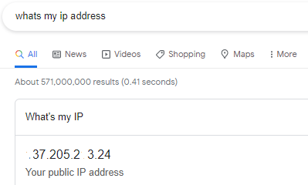
Next Steps Site:
SIV attendance Log
Training Log
Delegation Log
IP address for database
Details of staff who need database access
(name & email)
Issue C&C
Register API (if applicable)
Next Steps WCTU:
Send summary email, SIV Slides and next steps
Send ISF via MyFiles*
Add details into the database
Complete Greenlight checklist
Notes:
*pending finalisation

Slide 26
Stop-go Criteria/ Pilot Phase
After completion of pilot phase (9 months), summary reports will be presented to oversight committees.
The stop-go decision will be made by the funder (NIHR), following consultation with the trial TMG, TSC and DMC.
The recommended traffic light system will be used, based on pilot recruitment data, based on an average recruitment rate of 0.8 participants per centre/ per month:

Slide 27
Questions?
Contact: (E) irehab@warwick.ac.uk | (T) 024 761 51367

