Slide 1

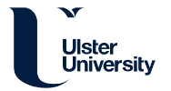


Site Initiation Visit
Please can you add your name and role to the chat function on joining the meeting
Warwick Clinical Trials Unit | iRehab_SIV_v4.3_22Jun2023
Notes:
Welcome – you are here for the iRehab SIV and database training

Slide 2
Site Initiation Visit
Remote Rehabilitation After Intensive Care (iRehab)
FULL TITLE: Remote multicomponent rehabilitation compared to standard care for survivors of critical illness after hospital discharge: a randomised controlled assessor-blind clinical and cost-effectiveness trial with internal pilot
Warwick Clinical Trials Unit | iRehab_SIV_v4.3_22Jun2023
Notes:
Introductions and Housekeeping
LE – Recruitment ends March 2024, Follow-up ends Sept 2024.

Slide 3



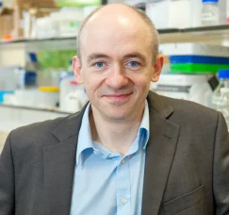
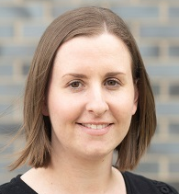

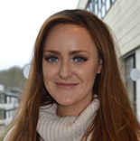
iRehab Team
Professor Brenda O’Neill
Chief Investigator
Professor Danny McAuley
Co-Chief Investigator
Professor Julie Bruce
Warwick CTU Lead
Rowena Williams
Senior Project Manager
Kerry Raynes
Trial Manager
Dr Louisa Edwards
Trial Coordinator
Dr Katherine Jones
Research Fellow
Sponsor: Ulster University | Funder: NIHR
Contact: (E) irehab@warwick.ac.uk | (T) 024 761 51367

Slide 4
Background
Over 100,000 patients surviving critical illness are discharged from acute hospitals in UK each year
  Quarter have unplanned readmissions within 3 months
Many consequences of critical illness:
  Physical deconditioning
  Respiratory/swallowing problems
  Cognitive/mental health impairments
  Reduced activities of daily living & fatigue
  POOR QUALITY OF LIFE
  Failure to return to work after 12 months (1 in 2)
  Increased burden on social support
Need to improve long term health outcomes
Notes:
I am sure you are well aware but…
Over 100,000 pts surviving/discharged in 1 year.
Quarter readmitted within 3 months.
Many serious consequences but iRehab focusses on DECLINED QUALITY OF LIFE (using EQ5D)

Slide 5
Rationale
First trial to systematically test the effectiveness of a technology-driven remote multicomponent rehabilitation intervention in terms of:
  Clinical effectiveness
  Cost effectiveness
  … on health-related quality of life (8 weeks post-randomisation) in patients recovering from critical illness after ICU care

Slide 6
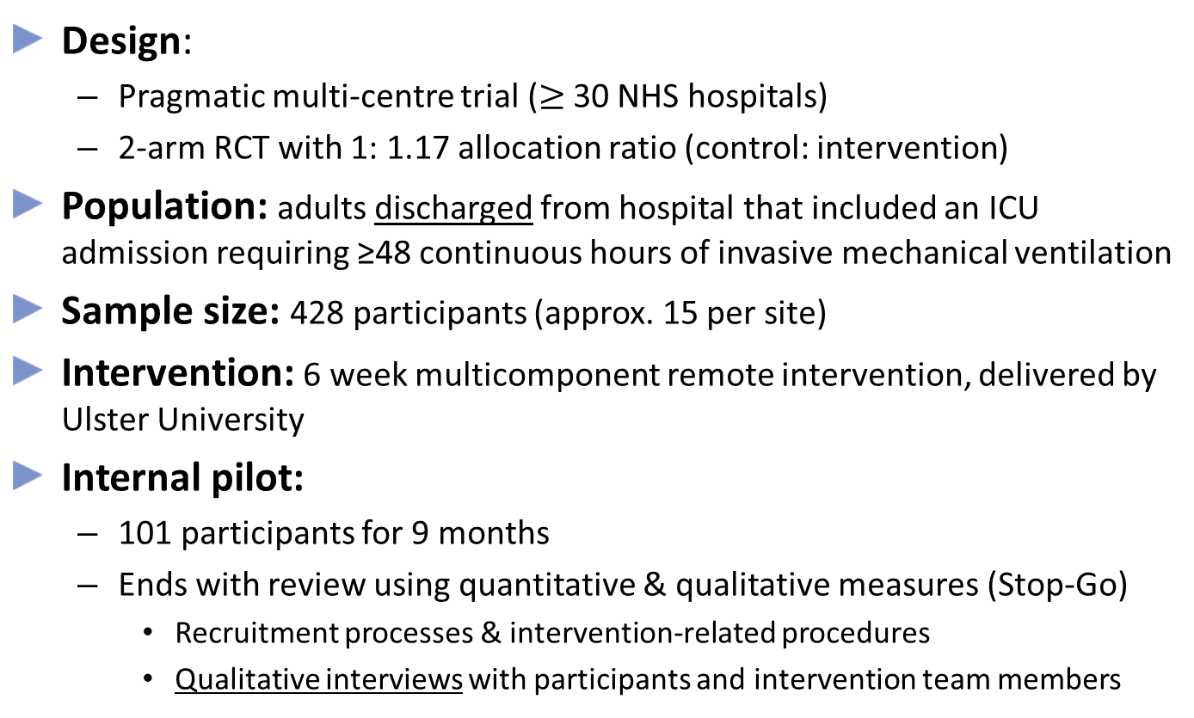
Design Overview
Design:
  Pragmatic multi-centre trial ($≥$ 30 NHS hospitals)
  2-arm RCT with 1: 1.17 allocation ratio (control: intervention)
Population: adults discharged from hospital that included an ICU admission requiring ≥48 continuous hours of invasive mechanical ventilation
Sample size: 428 participants (approx. 15 per site)
Intervention: 6 week multicomponent remote intervention, delivered by Ulster University
Internal pilot:
  101 participants for 9 months
  Ends with review using quantitative & qualitative measures (Stop-Go)
    Recruitment processes & intervention-related procedures
    Qualitative interviews with participants and intervention team members

Slide 7
Study Time Line
Mar 24
Main Phase
End
Total 428 Participants Recruited
Apr 24
Trial Follow Up Phase
Start
Sept 24
Trial Follow Up Phase
End
Final Patient 6 month Outcomes Collected
Jul 23
Pilot Ends
101 Patients Recruited
Aug 23
Main Phase
Starts
Nov 22
Pilot Started
Jul 23
Stop-Go Criteria Assessed
Jul 24-Dec 24
Analysis

Slide 8
Participant Time Line
Registration – WK 26 Follow-up
Site checks for patient readmission/death
WK 12
Consent Deadline
0–12 WK
Consent Window
16 WK
Discharge-Randomisation Window
WK 0- 8 Post-Rand
Intervention Phase
WK 9- 26 Post-Rand
Follow Up Phase
6 WK. Intervention
1. Consent
2. Registration
3. Baseline Data Collection
4. Randomisation
Discharge from Hospital
WK 16
Randomisation Deadline
Data Collection
WK 8 Post-Rand
Data Collection
WK 26 Post-Rand
KEY:
Site
CTU
Intervention Team
Participant
Notes:
Notes:
1. Register participants as soon as possible after consenting them.
2. Site confirms if a pt is readmitted/died prior to follow-ups at 8 and 26 wks.

Slide 9
Screening - Registration Overview
Patient received ≥48hrs invasive mechanical ventilation
Patient screened by site and eligibility assessed:
Site team complete “Screening” form in iRehab database (for eligible & ineligible patients)
Eligible patient approached (at site or post-discharge) and provided with written information about iRehab
Consent and Registration
  Site team obtain paper consent in person or via telephone within 12 wk. hospital discharge
  Site sends copy of completed consent form to participant
  Site complete “Registration” form in iRehab database: consent, comorbidities and contact details forms - to finish registration
Once registration is complete participant sent baseline information pack by CTU
KEY:
Site
CTU
Intervention Team
Participant
Notes:
KEY: Purple- Site Teams/ Research Champion; Orange-WCTU ; CDMS – online database
Pre-screen (onboarding form in database) – logs potential pts so they can be followed at site (but can keep own log).
Information pack (participant invite letter incl. pt. info sheet and consent form)
Consent (post discharge, at home, family/friends can assist)
Registration
Then over to us…

Slide 10
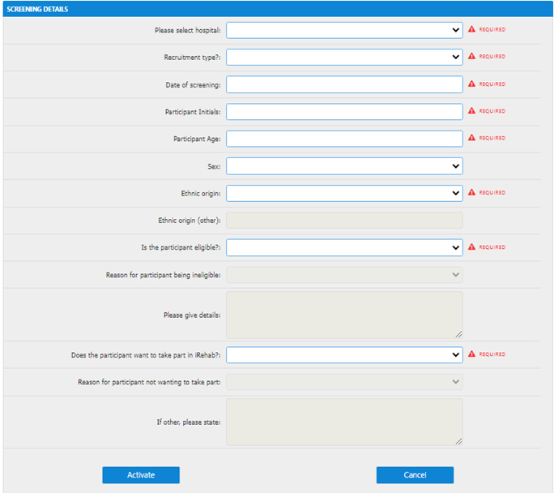
Screening
Screening is recorded in iRehab database “Screening” form (also called “onboarding” in the database).
Screening form used to:
  Pre-screen: keep a list/track potential recruits
  Check eligibility
Can use form before or after hospital discharge
Please update form as patient moves through their hospital/discharge journey (before or after discharge; up to 12 wks. post-discharge)
Notes:
SEAR Framework (encouraged by NIHR) used to map the recruitment process and identify barriers to recruitment - helpful in pilot or feasibility studies, to assess feasibility and inform recruitment strategies for a main trial.

Slide 11
Screening
Does and Don'ts:
  Don’t screen patients known to be ineligible (e.g., passed away)
  Do wait until patient is off mechanical ventilation before using screening form
  Do ensure complete and accurate logs
Notes:
  Each patient entered “onboarded” on database gets a Trial Number (TNO)
  Screening questions based on SEAR framework (to assess feasibility/inform recruitment strategies for main trial)
  Screening data reviewed monthly

Slide 12
Eligibility
    Inclusion criteria
Aged ≥ 18 years
Received continuous invasive mechanical ventilation for 48 hours or longer
Are within 12 weeks following discharge home from hospital at time of consent
Understands spoken English or has family member/friend/other present to translate trial materials
Able to participate in the intervention and with trial procedures (e.g. using equipment such as telephone)
    Exclusion criteria
Declined consent/ unable to provide consent.
Previous randomisation into iRehab.
Participating in another rehabilitation or self-management support trial
Contra-indication to exercise (see next slide)
Severe mental health problems that preclude participation in a group intervention
Discharged to a rehabilitation unit, or care home with/without nursing care
Prisoners
Notes:
Understanding English – must have capacity for informed consent (no assent option), KJ will also assess capacity. If another person is needed for translation, they must be present to help out at each appointment/data collection point.
CI to exercise - whether absolute/relative will depend on the situation and whether the symptom(s) is under control or not so may need to discuss with PI:
Unstable angina
Uncontrolled high blood pressure (at rest: systolic BP ≥200 mmHg; diastolic BP ≥ 110 mmHg)
Recent myocardial infarction
Symptomatic arrythmias (uncontrolled/still under-investigation)
Potentially some cardiac-specific acute inflammatory conditions (e.g. pericarditis) (may not pose issue if physical stress isn't of a high strenuous nature)
Uncontrolled asthma
Unstable/poorly controlled blood glucose (more relative)
…Sometimes patients are unable to provide consent due to temporary delirium and so they would usually be followed until this clears.
Mental health problems: Psychosis (schizophrenia, bipolar disorder), substance misuse, cognitive impairment/neurological disorders (e.g.: dementia, brain injuries, severe/profound learning disability)

Slide 13
Contra-indication to Exercise
Contraindications to exercise/exercise testing in accordance with the American College of Sports Medicine [2017]:
A recent significant change in the resting electrocardiogram suggesting significant ischemia, recent myocardial infarction (within 2 d), or other acute cardiac event
Unstable angina
Uncontrolled cardiac dysrhythmias causing symptoms or hemodynamic compromise
Symptomatic severe aortic stenosis
Uncontrolled symptomatic heart failure
Acute pulmonary embolus or pulmonary infarction
Acute myocarditis or pericarditis
Suspected or known dissecting aneurysm
Acute systemic infection, accompanied by fever, body aches, or swollen lymph glands
Are very few conditions where exercise/ physical activity is not recommended
To help identify individuals who should not be considered for iRehab, please use the recognised absolute contraindications to exercise/exercise testing in accordance with the American College of Sports Medicine (2017) – see table, right
Rehabilitation is mostly safe, feasible and acceptable for people following surgery and can be beneficial for many other chronic conditions.
The physical activity/exercise component in iRehab is tailored according to individual ability, symptoms, comorbidities

Slide 14
Eligibility
Only clinical team appropriately trained and delegated responsibility E on delegation log should confirm eligibility
If you are unsure or would like further advice
  Discuss with your site PI
  and/or iRehab study team
Any information on eligibility criteria not captured routinely in patient notes must be documented in source data
Question: Will the person confirming eligibility for each potential participant be noted somewhere, e.g., patient notes?
KEY:
Site
CTU
Intervention Team
Participant

Slide 15
Approaching potential participants
Eligible patient may be approached at site or post-discharge and provided with written information about iRehab
Information Pack:
  Trial invitation letter
  Information sheet
  Blank consent form
Pack can be posted or given to them in person (pre or post discharge)
Approached at site (pre- or post-discharge; follow-up clinic): please give patient time to read the information and opportunity to ask questions
Approached using posted information (post-discharge): please give patient a follow up call and opportunity to ask questions

Slide 16
Consent & Registration
Obtaining Consent:
Is consent to register participant on iRehab database
Taken after discharge: preferably once patient is home (by phone, video call), but can be on hospital premises
Taken by appropriately delegated member of the research team within 12 weeks of hospital discharge.
Evidence of consent MUST be documented in patients medical notes and ISF.
Copy of completed consent form sent to participant via email or post
Additional consent may be sought for optional qualitative study by WCTU
Site team input participant details on iRehab database to complete registration as soon as possible after consent is obtained. Registration eCRF includes:
Consent: including details on ICNARC, duration of invasive mechanical ventilation, duration of ICU and hospital stay, APACHE II score.
Co-morbidities
Contact Details
When all registration forms are 100% complete, WCTU sends patients Baseline Assessment Trial Pack:
Baseline questionnaire: Reference only baseline questionnaire and questionnaire link is triggered (if postal questionnaire is required, this will be sent with a stamped SAE instead)
Pulse oximeter
Instructions (pulse oximeter, site-to-stand)
KEY:
Site
CTU
Intervention Team
Participant
Notes:
Contacting pts: use judgement (in line with GCP)
Consent in participant folder in isf, medical notes

Slide 17
Baseline & Randomisation
Participant completes Baseline Questionnaire
(EQ5D as a minimum by within 16 weeks discharge)*
WCTU complete baseline physical assessment with participant (sit-to-stand test)
*EQ5D not completed by 16 weeks post hospital discharge participant NOT randomised
Participant Randomised (up to 16 weeks post discharge)
Participant, Site Team, WCTU team and Intervention delivery team notified (via email/letter)
Site team sends letters to:
  Participant’s GP
  Participant's consultant at treating hospital
KEY:
Site
CTU
Intervention Team
Participant

Slide 18
Randomisation
WCTU randomise participants
Deadline is 16 weeks after hospital discharge.
  Thus randomisation may occur up to 16 weeks post-discharge
  However we aim to randomise before this
Time from hospital discharge to randomisation is affected by:
  Week of consent (0-12) and registration
  Time for postal baseline pack to be sent/arrive (approx. 1 wk.)
  Delays in participant completing baseline questionnaires (inc. EQ5D)
  Delays organising/completing STS test
  After EQ5D completion we can wait a max of 4 wks. to obtain other questionnaires/STS
    E.g., if EQ5D is completed in wk. 4, we will randomise at wk. 8 if further data collection is unsuccessful (not wait to wk. 16)

Slide 19
Intervention
Participant randomised to ‘Standard Care’ or ‘Rehabilitation’ arm
Randomisation
Standard Care N=197
No rehabilitation beyond usual NHS care
Rehabilitation Intervention N=231
Rehabilitation arm delivered by team at Ulster University over 6 weeks
Remote delivery facilitated by online platforms i.e. Microsoft Teams or Zoom, supported with video platform BEAM© or via telephone
8 wk. then 26 wk. follow-up data collection
Optional Qualitative Interviews
KEY:
Site
CTU
Intervention Team
Participant
Notes:
Pt can control elements of intervention to participate in
We can discontinue elements
Intervention team may call sites to advise on a referral.
1-2-1 can be up to 1 hr.

Slide 20

iRehab Intervention (6 weeks)
Weekly 1:1 appointment with intervention team:
  Online, ≤1 hr
  Discuss any problems participants have
  Create individual symptom management plan
  Each session is supported by a Recovery Manual
Weekly remote exercise sessions
  Independent or online group/recorded exercise session
  Supported by an Exercise Manual
Weekly Peer Support via iRehab Café
  Meet & listen online to other people’s experience of ICU & recovery post critical illness
The intervention is individualised to suit the participants needs and preferences
Notes:
These components are embedded in iRehab
At each weekly consultation patients will identify particular symptoms of relevance to them in their recovery, and an appropriate personalised management plan will be set. Examples of common symptoms include dysphagia, breathlessness, fatigue, and reduced appetite.
We have planned intervention strategies to address each of these
Patients will be supported to manage any psychological symptoms e.g. anxiety, or low mood, by undertaking a wellbeing activity such as relaxation or a specific taught strategy incorporated into a weekly patient held action plan.
Commencing as soon as possible, patients will be supported to undertake progressive exercise and/or physical activity to manage e.g. physical weakness, deconditioning, reduced function. Exercise and activity will be incorporated in a weekly patient held action plan (steps to take to achieve exercise goals and overcome barriers).
These sessions may be delivered individually and/or group based from week 1.
Based on individual needs and/or preference patients will be provided with information, and ongoing peer support e.g. via virtual support group – the iRehab cafe.

Slide 21
Follow up
Site to check readmission/death on a monthly basis and prior to follow-up data collection
8 Week Data Collection: Online or Telephone
Primary: Health-related quality of life: EQ-5D-5L
Secondary: physical function (30s Sit to Stand Test), Brief illness perceptions (BIPQ), fatigue (FACIT-F), anxiety and depression (HADS), health utilisation
6 Month Data Collection: Online or Telephone
Primary: Health-related quality of life: EQ-5D-5L
Secondary: physical function (30s Sit to Stand Test), Brief illness perceptions (BIPQ), fatigue (FACIT-F), anxiety and depression (HADS), health utilisation process and Health Economic Evaluation
KEY:
Site
CTU
Intervention Team
Participant
Notes:
Follow-up at 2 points: 8 wks. and 26 wks. – the measures are the same except addition of Health Economic Evaluation at 26 wks.
Site input – to check for participant readmissions/deaths. CTU aims to prompt sites with a monthly email.

Slide 22
Data & Data Entry
 | Pre-randomisation |  | Post-randomisation
 | Screening | Baseline | Intervention | Follow Up
Weeks ± No. Days | 0-12 |  | 1-6 | 8 | 26
Check eligibility | ü | ü
Consent participant |  | ü
Registration by Site (Post-eligibility check and consent)
Patient Contact Details |  | ü
Patient Clinical Data: APACHE II score Medical history Co-morbidities Pre-ICU admission functional status Duration of ventilation Length of ICU & Hospital stay |  | ü
Participant data collection facilitated by WCTU (Post registration – 100% completion needed)
Questionnaires: EQ5D, BIPQ, FACT-F, HADS |  | ü |  | ü | ü
30sec Sit-to-Stand |  | ü |  | ü | ü
Health and Social Care Use |  |  |  | ü | ü
Process Evaluation interviews |  |  |  | ü
Participant data collection facilitated by Intervention Team (Post-randomisation) |  |  | ü
Intervention delivery |  |  | ü
Other/ Ad Hoc (completed by Site, WCTU, Intervention Team)
SAEs &/or AE’s |  | ü | ü | ü | ü
Withdrawal &/or Readmission &/or Notification of Death |  |  | ü | ü | ü
Note to File/Protocol Non Compliance | P | P | P | P | P
Standard WCTU web-based application to record participant data
Missing data will be chased by phone, text and email.
Data will be collected for participants who discontinue or deviate from protocol, unless they withdraw consent
KEY:
Site
CTU
Intervention Team
Participant
Notes:
Notes:
We need 100% completion for the CRFs
Detail on ventilation: (a) take most recent 48 hrs. (b) no time limit between ventilation & discharge.
The “Other” section: we are all responsible for completing these CRFs.

Slide 23
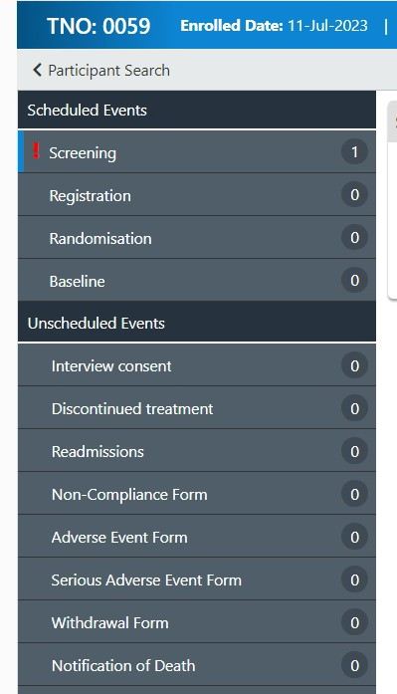
Unscheduled Events (Ad hoc)
Site
WCTU
Intervention Team
Readmission CRF
Withdrawal CRF
Notification of death CRF
AE CRF
SAE CRF
Note To File CRF
Protocol non-compliance CRF
KEY:
Site
CTU
Intervention Team
Participant
Notes:
Discussed in next few slides…

Slide 24
Withdrawals, Discontinuation, Readmissions & Notification of Death
Everyone (Site Team, WCTU, Intervention Team) is delegated responsibility to record and report withdrawals, readmissions & notification of death
Recorded via associated eCRF on iRehab database
Withdrawals – two types:
  Discontinuation: from intervention only, the participant continues with follow-up data collection (use eCRF).
    Note: Participants may be discontinued from the trial intervention or withdrawn from the sit-to-stand element at the discretion of CI or intervention team
  Withdrawal (use eCRF): complete withdrawal from trial without further data collection (or can ask for previously collected data to be deleted)
Readmission: including date of readmission, date of discharge, type(s) of ward admitted to (use eCRF)
Notification of Death: including date and cause of death (use eCRF)
If intervention team or WCTU receive Withdrawals/Death notification we will forward that email notification to sites
Notes:
All teams have this responsibility to report – on the database
Withdrawals – likely CTU or intervention team
Discontinuation: from intervention – discontinuation form
Withdrawal: from study. Standard to keep all data until withdrawal date unless participant explicitly asks for data to be deleted.
Readmission – likely sites
Death – likely sites
We may ask for causality info
We will ask sites to check for readmission and death prior to us contacting pt for FU (8w/26w).

Slide 25
Adverse Event (AE) & Serious Adverse Event (SAE) procedure
All teams (WCTU, Intervention, Site) are responsible for ensuring AEs/SAEs are recorded/reported
Events usually within 48 hrs of participant’s last trial activity (e.g., sit-to-stand test, completing questionnaires, intervention participation)
Likely uncovered at intervention appointment or from hospital admission forms, etc.
We will inform you if we think it’s an SAE, after checking timing of trial activities
All AEs/SAEs occurring from time of consent to 8 wks. post-randomisation, plus during 8 wk./6 m data-collection appointments, must be recorded/reported
Sites are notified of SAEs submitted by WCTU & Intervention teams, if appropriate
Use AE and SAE eCRFs in iRehab database
Notes:
How this is likely to involve sites:
When a readmission form is filled out at site – we check timings with iRehab activities to assess for SAE – may ask sites to complete an SAE form.
If you become aware.

Slide 26
Events Exempt from Recording/Reporting
AEs Exempt from Recording
SAEs Exempt from Reporting
Events
Breathlessness
Light headedness/dizziness
Muscle stiffness/soreness
Tiredness/fatigue
Oxygen desaturation (that resolves with appropriate management e.g. rest, breathing exercises, inhaled medications)
Events
Hospitalisation, or death, for pre-existing conditions e.g. respiratory exacerbation and infection, or a complication related to the initial ICU admission
Treatment, which was elective or pre-planned, for a pre-existing condition, not associated with any deterioration in condition

Slide 27
Training, Responsibilities & Study Oversight (i):
PI has (a) oversight of the study and (b) authority to delegate trial responsibilities appropriately and supervise
All site staff are required to :
  Have up to date GCP training (in line with your trust’s SOP)
  Read the Protocol
  Attend SIV training (go through SIV slides if delegated post greenlight)
  Undergo database training
  Maintain the eISF
  Be appropriately signed off by the PI on delegation and training logs
WCTU only require PI’s GCP certificate and CV
Other trial staff should store up-to-date GCPs and CVs locally in line with local policy. If not in eISF then use a file note to identify location of documents

Slide 28
Training, Responsibilities & Study Oversight (ii):
Site Research Champion
  Finances:
    2hrs @ £25ph
    Initiated by 1st randomisation
    Invoiced Quarterly
  Responsibilities:
    Trial Promotion
    Research team support (help follow-up potential participants, outreach, consent)
    Point of contact for intervention team (queries, escalation of care)
    Check participant communication details
    Help with data/general queries at site
  Site Research Team
    Eligibility Checks
    Screening/identifying patients
    Remote monitoring
    Consent
    CRF Completion/querying
    Medical History/baseline Information
    Review and report:
      AE(s)/SAE(s)
      Readmissions
      Notifications of Death
      Withdrawal
    Archiving (1 off event - with R&D)
    The research champion role is designed to work for the sites’ structure, so there is no defined job role, as long as the individual can carry out the research champion responsibilities
Notes:
Specify staff with R. Champ responsibility on the delegation log.
Number of champions relates to individual sites set up.
2 sites with separate targets and research teams = 2 Champs.

Slide 29

API Scheme
iRehab is registered on the Associate PI Scheme
Opportunity for healthcare professionals to engage in research where research isn’t a core aspect of their job role
Benefits to the study:
  Local understanding of patient pathways
  More opportunities for patients
  Improved engagement with the study
  Dedicated point of contact
How:
Search on ODP > Gain Local PI Approval> Complete Application Form for NIHR approval
Associate Principal Investigator (PI) Scheme | NIHR
CPMS: 53647
  Increased Capacity
  Increased Recruitment
  Improved data completion
  Resilience for future studies

Slide 30
Protocol non-compliance (deviations/violations) notification process
Protocol non-compliances should be recorded via eCRF
WCTU will monitor non-compliances and categorise
WCTU will escalate non-compliances where necessary with QA
  A protocol non-compliance should be recorded in real time, or as soon as feasibly possible once identified
  Escalations of non-compliances will be as per Warwick SOP

Slide 31
Monitoring
Trials are monitored to ensure:
  Rights and well-being of patients are protected
  Trial data are accurate, complete and verifiable
  Trial conduct is in compliance with the protocol, GCP and applicable regulatory requirements
Central Monitoring
In-built trial management activities
No/limited input from sites
On-site Monitoring
At participating site
Input and availability from sites
Remote Monitoring
At CTU or sponsor office
Input from sites
Recreate elements of an on-site visit
At WCTU

Slide 32


Monitoring Types
On-site/Remote Monitoring
Format:
Discuss trial procedures with local team
Review will depend upon the scope of the visit: review of ISF, consent procedure, eligibility, outcome data, safety reporting
If an on-site visit is needed, sites will be guided through the process, requirements and timelines
For remote visits, IT requirements will be discussed prior to the visit
Central Monitoring
Examples (not exhaustive!):
Validation within the trial database
Review of delegation logs, consent form data, eligibility data, safety data

Slide 33
Monitoring in iRehab
Risk-based proportionate monitoring approach
Monitoring predominantly central and remote
Sites monitored on multiple factors/trends, including: data collection, eligibility, consent, protocol deviations, adverse event reporting
DMC/TSC will have oversight and make recommendations, as appropriate
Concerns in trends or reporting may trigger further monitoring (remote or on-site)
On-site visits may be arranged to support sites if necessary or if triggered by a specific issue
Ensure trial activities are clearly/consistently recorded in source documents – source documents may be reviewed against submitted data, and verification may be required if queries arise
Source Data
Information in original records/certified copies of clinical findings, observations and/or activities necessary for the reconstruction and evaluation of the trial. This may be electronic and/or paper and will vary across sites. The Case Report Form can be considered to be source data for iRehab
Notes:
The case report form can be considered as source data where the data has not been extracted from medical notes.

Slide 34

Stop-go Criteria/ Pilot Phase
Following Pilot (9 m) summary reports will be presented to oversight committees
The stop-go decision will be made by the funder (NIHR), following consultation with trial TMG, TSC and DMC.
The recommended traffic light system will be used based on pilot recruitment data (based on an average recruitment rate of 0.8 participants per centre/ per month)

Slide 35
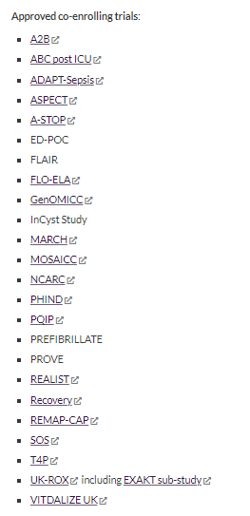
Co-enrolment
Participants may be eligible for co-enrolment in other studies
Co-enrolment agreements will be decided on a case-by-case basis by the Chief Investigator and TMG of iRehab and any respective studies
Current co-enrolment list can be found at www.warwick.ac.uk/iRehab
Please tell us about any trials you want us to co-enrol with

Slide 36
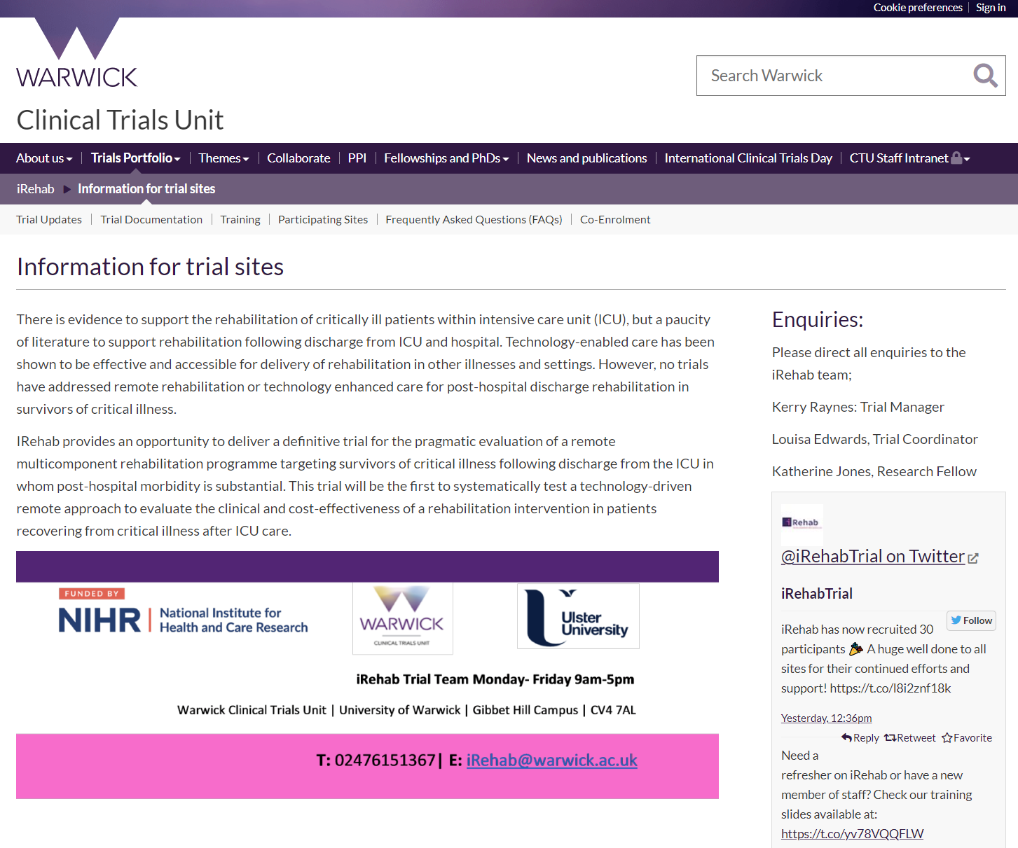
Helpful iRehab Resources
Monthly newsletter
Website:
  Trial updates
  Trial docs
  Training
  Participating sites
  FAQs
  Co-enrolment
Lunchtime site drop-in clinics
Twitter

Slide 37
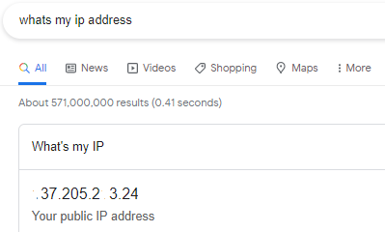
Next Steps - Site:
SIV attendance Log
Training Log
Delegation Log
IP address for database
Details of staff who need database access (name/email)
Issue C&C
Register for API scheme (if applicable)
Letters of Access (if applicable)
Next Steps - WCTU:
Send summary email, SIV slides and next steps
Send ISF
Add details to database
Complete Greenlight checklist

Slide 38
Questions?
If you think of something later:
Check the website: https://warwick.ac.uk/fac/sci/med/research/ctu/trials/irehab/health/
Email us: irehab@warwick.ac.uk
Phone us: (T) 024 761 51367
Come to a monthly lunchtime site drop-in clinic

