Slide 1
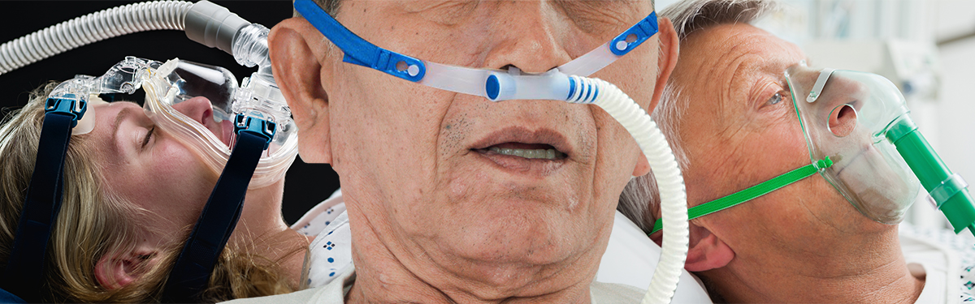





Slide 2
AIM:
To determine if CPAP or HFNO is clinically effective compared to standard care (excluding CPAP or HFNO) in relation to intubation and mortality in patients with confirmed or suspected COVID-19

Slide 3

Agenda
Meet the RECOVERY-RS team
COVID-19 ICNARC data and lessons learnt so far
Information on RECOVERY-RS and how trainees can participate
Q&A session

Slide 4
Meet the Team
Chief Investigators | Prof. Gavin Perkins & Prof. Danny McAuley
Sponsor | University of Warwick
Funder | National Institute for Health Research
Co-ordinating Centre | Warwick Clinical Trials Unit
Contact | RECOVERY-RS@warwick.ac.uk
Website | www.warwick.ac.uk/recovery-rs

Slide 5
Non-invasive ventilation strategies

Slide 6
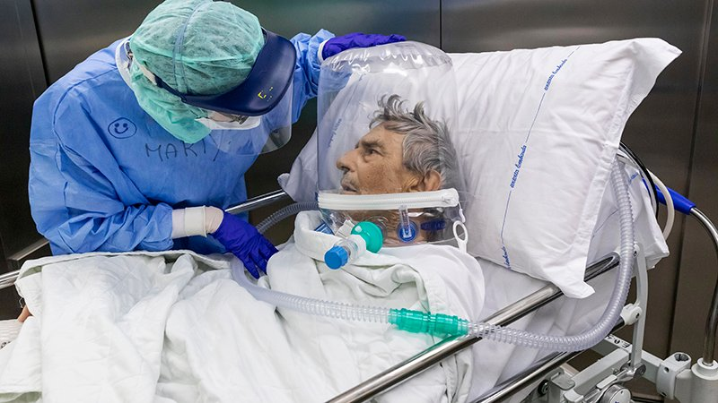
Advantages
Avoid need for sedation
Conscious and co-operative
Reduce self induced lung injury
Nurse : patient ratios
Equipment
Disadvantages
Compliance
Pressure ulcers
Gastric insufflation / Vomiting
Increase self induced lung injury
Oxygen flow / infrastructure failure
Aerosol generation

Slide 7
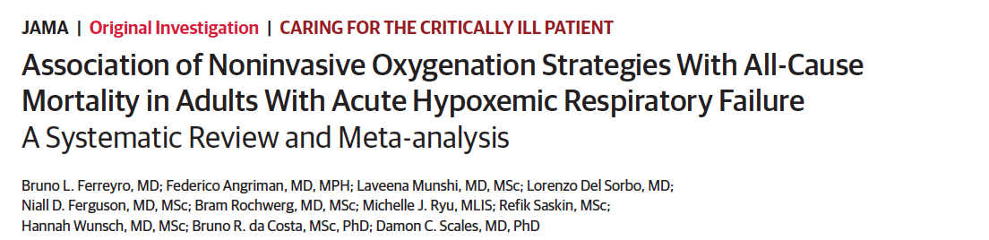
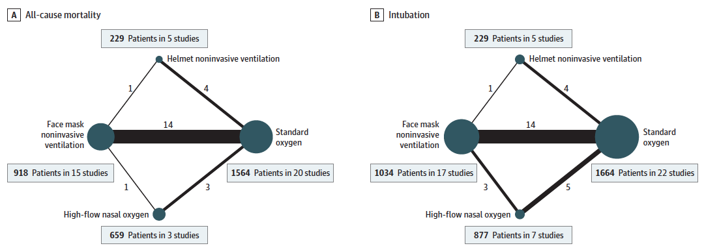
JAMA 2020; 324:1-12
Notes:
Toronto

Slide 8
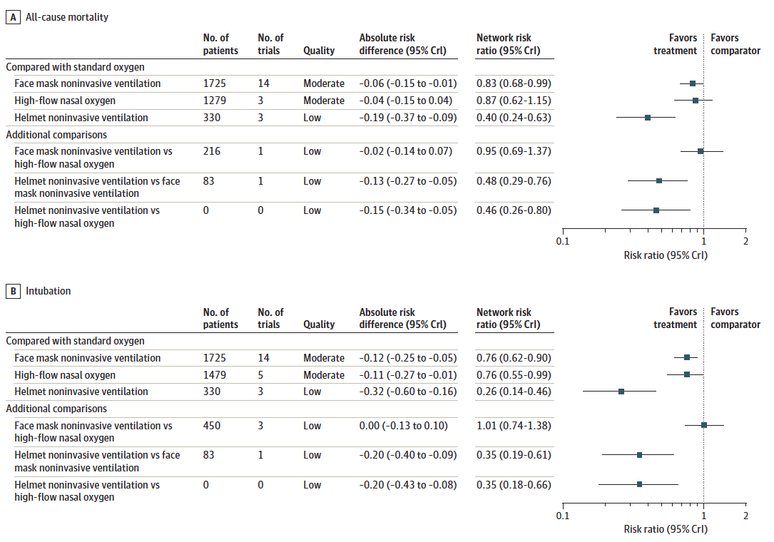
All cause mortality
Intubation

Slide 9
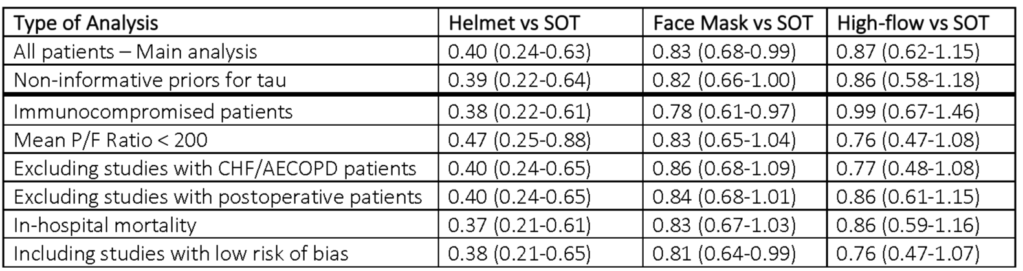
JAMA 2020; 324:1-12
Notes:
Patel editorial
Even though these overall findings suggest the potential benefits of noninvasive oxygenation support, there are nuances to these data, which are revealed in the various sensitivity analyses. The association of face mask NIV with lower mortality was no longer statistically significant among patients with severe hypoxemia (PaO2:FIO2 ratio ≤200) after excluding trials that included patients known to have established benefit from NIV, specifically those with chronic obstructive pulmonary disease, heart failure, and postoperative state. Furthermore, the association of face mask NIVwith rates of endotracheal intubation was also not statistically significantwhen noninformative priors were considered to account for the views of clinicians who may have greater confidence in HFNC than in face mask NIV. These analyses illuminate the controversial role of face mask NIV in the management of severe AHRF, as prior studies10,11 have suggested increased harm, possibly due to excessive tidal volumes, high transpulmonary pressures, and resulting patient selfinflicted lung injury.6 However, these sensitivity analyses did not alter the association of helmet NIV with reduced rate of intubation and reduced mortality, suggesting that any evaluation of the potential role in AHRF should incorporate the interface by which NIV is applied
The physiologic effects of helmet and face mask NIV may differ in AHRF.With face mask NIV, pressure support is often needed to reduce effort,12 potentially setting the stage for
excessive and thus injurious tidal volumes. In contrast, helmet NIV is able to deliver higher levels of positive endexpiratory pressure (PEEP) to improve oxygenation, reduce inspiratory effort,13 and possibly render spontaneous breathing noninjurious.14 However, the certainty of the evidence supporting helmet NIV compared with all other modes of noninvasive oxygen support is low due to the limited number of available published clinical trials and small number of participants.

Slide 10
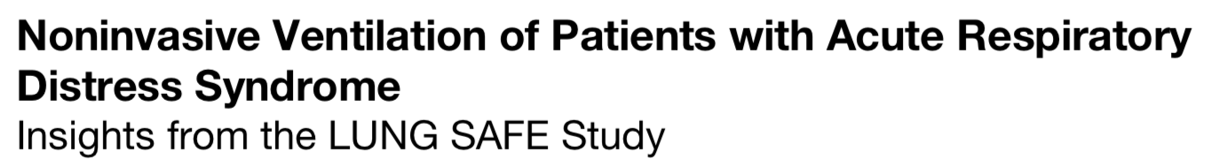

NIV used in 15% ARDS cases
50% failure rate moderate to severe ARDS
High mortality if NIV failure
Overall NIV use in moderate-severe ARDS associated with increased ITU mortality
Am J Respir Crit Care Med 2017;195:67-77

Slide 11
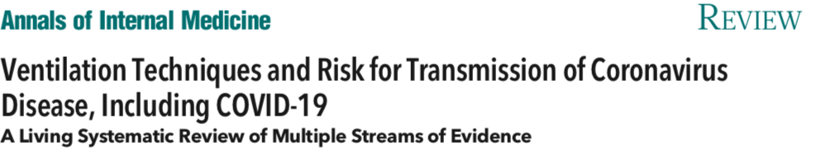
123 studies
28 relevant data
5 adjusted for confounders
38k records
Author | Population | Intervention | Comparator | Outcome | Key finding
Wang K 2020 (c) | COVID-19 (n=548) | NIV | IMV | 15d Mort | HR 1.61 [0.84 to 3.09]
Alraddadi 2019 (c) | MERS (n=302) | NIV | IMV | 90d Mort | OR 0.61 [0.23 to 1.6]
Yam 2005 (c) | SARS (n=493) | NIV | IMV | Mort | OR 0.24 (0.1-0.72)
Liu 2004 (rct) | SARS (n=60) | NIV | No IMV | Mort | 0/30 deaths NIV; 3/30 no NIV
Xu 2010 (c) | SARS (n=127) | NIV | No IMV | Mort | OR 0.21 (0.09 - 0.47)
Schünemann et al Ann Intern Med. 2020 : M20-2306.

Slide 12
Update 2
Update 1
In summary, the results suggest no change in the findings of the original systematic review.
Non-invasive ventilation may have similar effects to IMV on mortality, but the evidence is uncertain
Schünemann et al Ann Intern Med. 2020 : M20-2306.

Slide 13
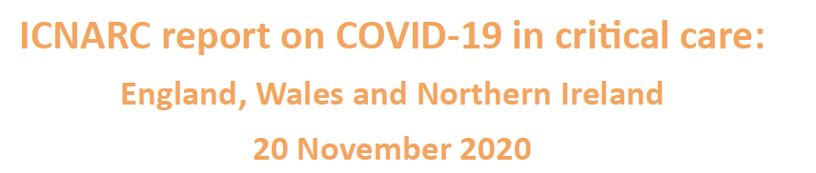

Slide 14
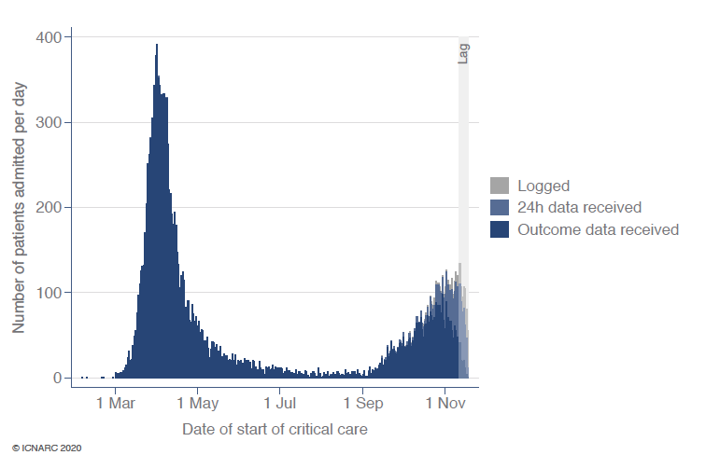

Slide 15
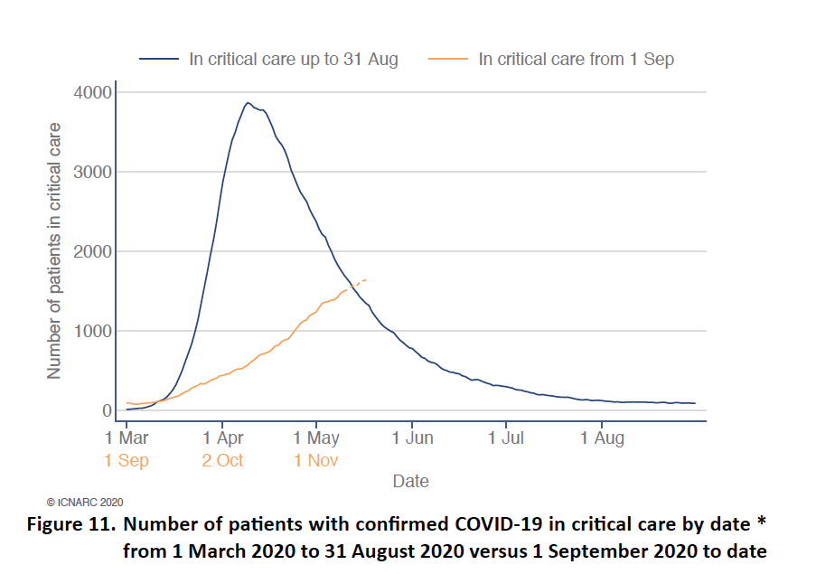

Slide 16
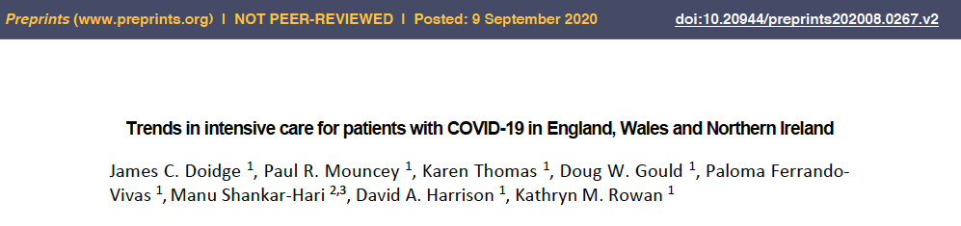
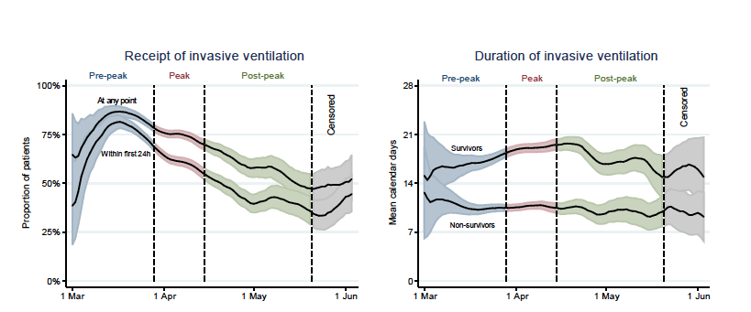

Slide 17
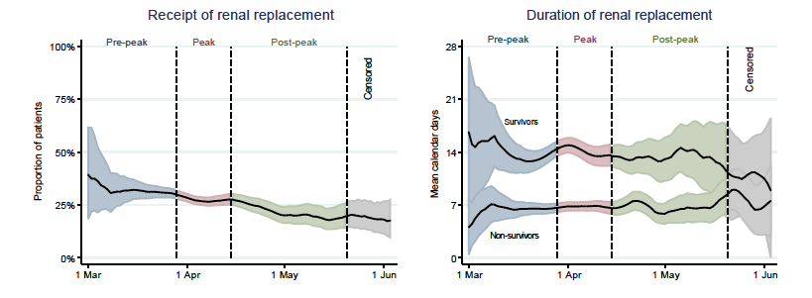

Slide 18
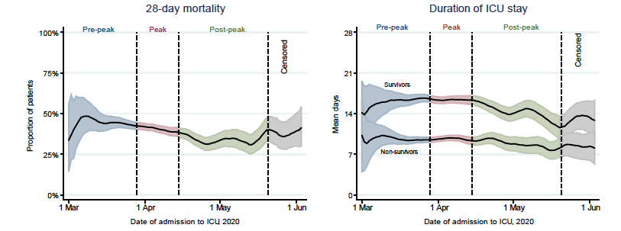

Slide 19
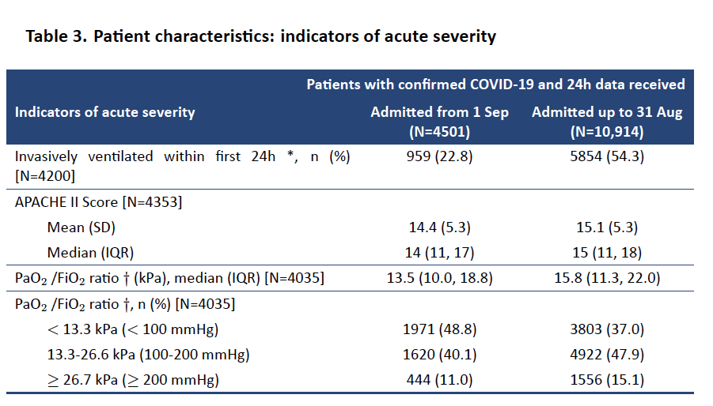

Slide 20
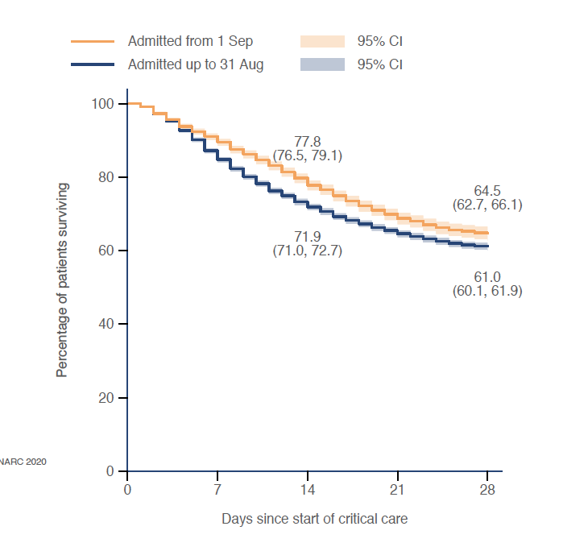

Slide 21
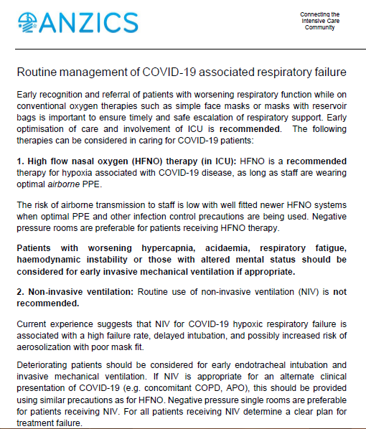

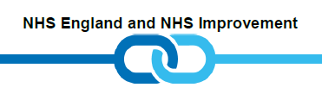
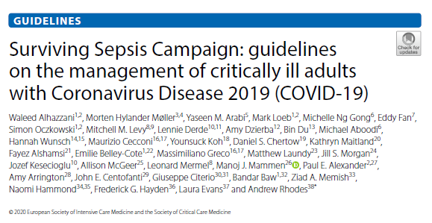
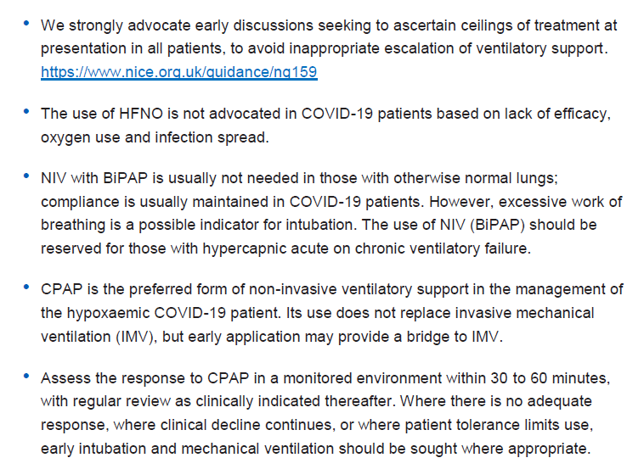
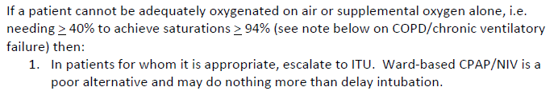
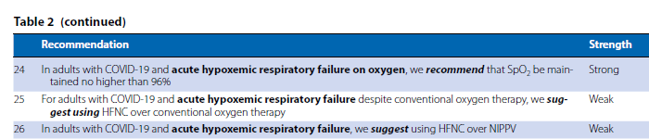


Slide 22
Need for the trial
COVID-19: wide spectrum of clinical severity, ranging from asymptomatic to critically illness
Acute hypoxaemic respiratory failure- important complication
Excess demand on limited ventilator availability and critical care bed capacity is currently being witnessed worldwide
Uncertainty as to best strategy to reduce need for tracheal intubation in COVID-19
Variable practice
Oxygen only pathway – straight to intubation
CPAP, with potential for HFNO
No CPAP – oxygen therapy
HFNO

Slide 23


Aim: To determine if CPAP or HFNO is clinically effective compared to standard oxygen therapy in patients with confirmed or suspected COVID-19
INTERVENTION ARMS (1:1:1 randomisation)
Patients must remain in allocated arm and not receive the treatments in the other arms
Chief Medical Officers Urgent Public Health Trial

Slide 24
CONTROLLED OXYGEN THERAPY
CPAP
HFNO
Titrate FiO2 to maintain adequate SpO2 | Titrate FiO2 and CPAP to maintain adequate SpO2 | Titrate FiO2 and FLOW to maintain adequate SpO2
ESCALATION OPTIONS
CPAP - NO | CPAP - YES | CPAP - NO
HFNO - NO | HFNO - NO | HFNO – YES
INV. VENTILATION - YES | INV. VENTILATION - YES | INV. VENTILATION - YES

Slide 25


PRIMARY OUTCOME
or
Within 30 days
www.warwick.ac.uk/recovery-rs
Notes:
Secondary outcomes
Intubation rates
Duration of invasive ventilation
Time to intubation
Time to death (mortality)
Mortality in critical care (level 2/3)
Mortality in hospital stay
Mortality at 30 days
Length of stay in critical care (level 2/3)
Length of stay in hospital
AEs/SAEs

Slide 26
Trial Design
Adaptive, randomised controlled, open label trial comparing CPAP vs HFNO vs standard care
Multi-centre 74 NHS hospitals or purpose built-hospitals currently open.
Adult, critically ill patients, with suspected or confirmed, COVID-19

Slide 27
Lessons learn so far
Lessons Learnt
We can do this
Uncertainty
Clinical pathways
Adherence to randomised intervention
Collaboration

Slide 28
Trial progress summary
Date | Recruitment
April-20 | 31
May-20 | 71
June-20 | 26
Jul-20 | 14
Aug-20 | 11
Sep-20 | 35
Oct-20 | 114
Nov-20 | 164
Total | 439
Sites
73 open
2 in set up
Patients
439 randomised
120 declined
42 sites recruited
31 sites not recruited

Slide 29
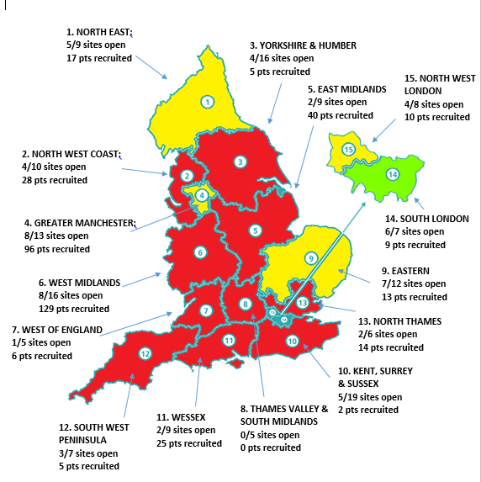
Regional recruitment

Slide 30
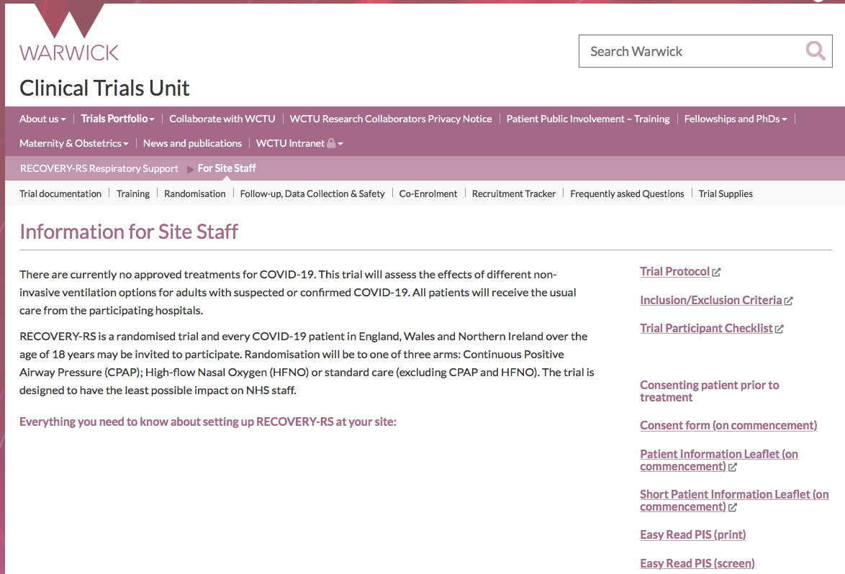
How trainees can get involved?
Review website
Identify site PI and research team (if not got one – find one !)
Discuss trial with colleagues
Help identify eligible patients
Consent / enrol / randomise
Facilitate engagement between ward / ITU teams
How can we help you?

Slide 31
Q&A session

