Slide 1

RECOVERY-RS Respiratory Support: Respiratory Strategies in COVID-19; CPAP, High-flow, and standard care
Site Training – Background

Slide 2





Acknowledgements

Slide 3
General Study Information
Chief Investigator | Prof. Gavin Perkins & Prof. Danny McAuley
Sponsor | University of Warwick
Funder | National Institute for Health Research
Co-ordinating Centre | Warwick Clinical Trials Unit
Contact | RECOVERY-RS@warwick.ac.uk
Website | www.warwick.ac.uk/recovery-rs

Slide 4
Background and need for trial
COVID-19: wide spectrum of clinical severity, ranging from asymptomatic to critically illness
Acute hypoxaemic respiratory failure- important complication
Excess demand on limited ventilator availability and critical care bed capacity is currently being witnessed worldwide
Uncertainty as to best strategy to reduce need for tracheal intubation in COVID-19

Slide 5
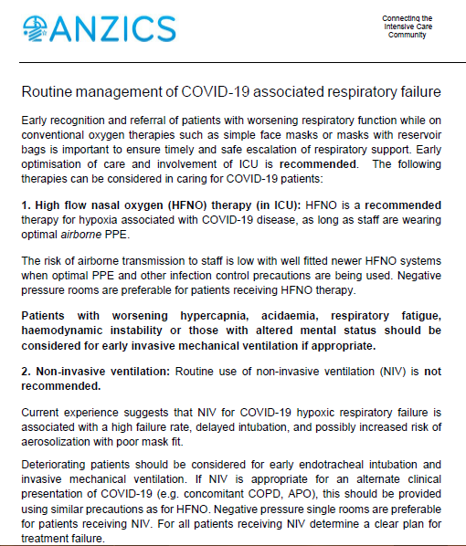

Slide 6
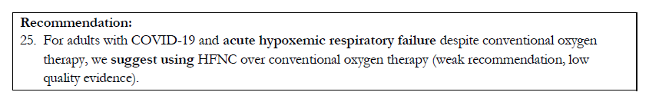

Slide 7
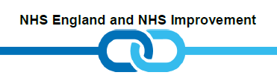
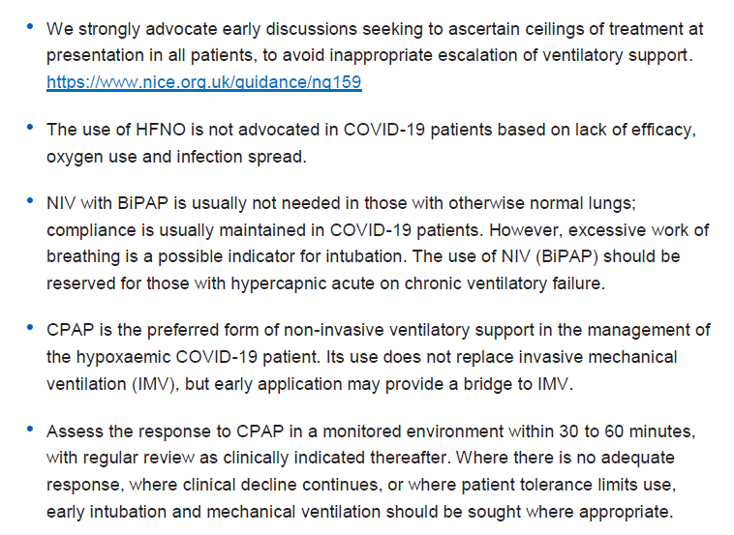

Slide 8
What are sites doing in practice?
Variable practice
Oxygen only pathway – straight to intubation
CPAP, with potential for HFNO
No CPAP – oxygen therapy
HFNO

Slide 9
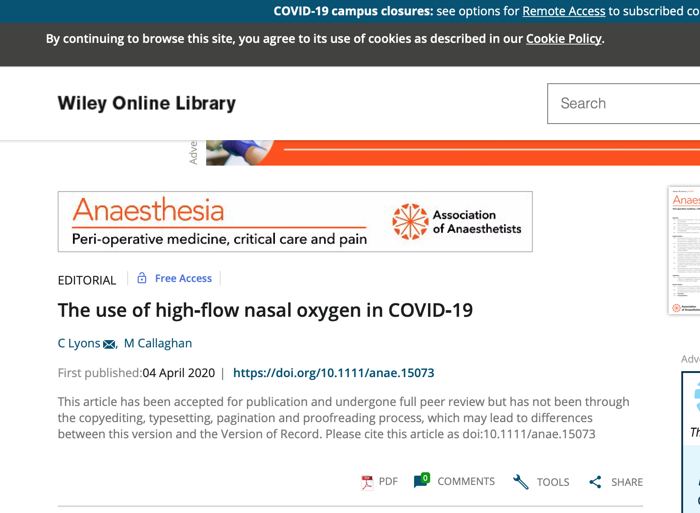
Editorial from Ireland
Don’t dismiss role of HFNO

Slide 10
Need for trial
COVID-19
New disease; different physiology
Evidence base for interventions lacking
Other anecdotal therapies (anti-IL-G, hydroxychloroquine, MSCs) now being evaluated in clinical trials
Benefits and potential risks of each approach
BUT….no high quality evidence base for guiding clinical practice
Urgent need for trial of High Flow Nasal Oxygen (HFNO) vs Continuous Positive Airway Pressure (CPAP) vs standard care oxygen

Slide 11
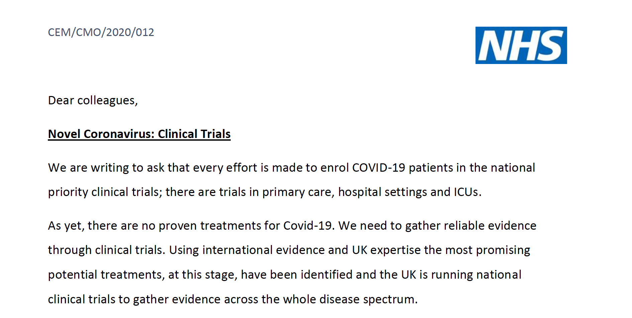


RECOVERY-RS is listed as a priority UPH study:
https://www.nihr.ac.uk/covid-studies/study-detail.htm?entryId=282338

Slide 12
Aim of trial
To determine if CPAP or HFNO is clinically effective compared to standard care (excluding CPAP or HFNO) in relation to intubation and mortality in patients with confirmed or suspected COVID-19

Slide 13
Design
Adaptive, randomised controlled, open label trial comparing CPAP vs HFNO vs standard care*
Multi-centre, approx. 60+ NHS hospitals or purpose built-hospitals
Adult, critically ill patients, with suspected or confirmed, COVID-19
Overall recruitment target 4002 patients over 12 months
* Uncertainty/equipoise between UK and ANZICS guidance regarding the use of CPAP and HFNO

Slide 14
Outcomes
Primary outcome
Intubation or mortality
within 30 days
Secondary outcomes
Intubation rates
Duration of invasive ventilation
Time to intubation
Time to death (mortality)
Mortality in critical care (level 2/3)
Mortality in hospital stay
Mortality at 30 days
Admission to ICU
Length of stay in critical care (level 2/3)
Length of stay in hospital
AEs/SAEs

Slide 15
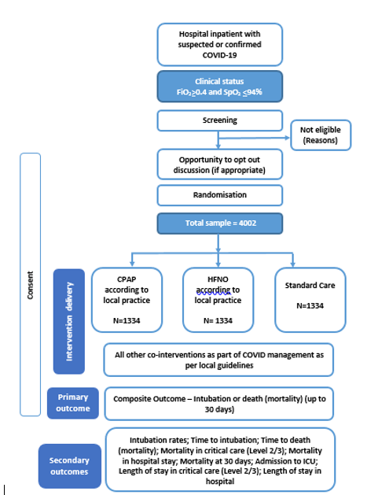
Trial Flow Diagram

Slide 16
Trial Interventions
Ensure clear plans and safety measures in place in relation to oxygen usage and flow
1. Continuous Positive Airway Pressure
2. High Flow Nasal Oxygen
3. Standard care
CPAP will be administered according to local protocol/guidelines. Details of initial settings (PEEP and FiO₂) will be recorded on the CRF
HFNO will be administered according to local protocol/guidelines
Standard care will comprise regular oxygen therapy according to local protocol/guidelines, and exclude use of CPAP and HFNO
Administration of all interventions are left to clinical discretion for management

Slide 17


Trial Interventions
Ensure clear plans and safety measures in place in relation to oxygen usage and flow
1. Continuous Positive Airway Pressure
2. High Flow Nasal Oxygen
Both intervention arms are aerosol generating. Ensure appropriate PPE (as per national guidelines) are used.
Administration of all interventions are left to clinical discretion for management

Slide 18
Safety Alert: High-Flow Oxygen
Dr Ganesh Suntharalingam - President, Intensive Care Society
Urgently ensure liaison between clinicians and hospital oxygen engineering teams to ascertain:
the maximum flow rate from your VIE
any additional limitations to oxygen delivery owing to pipework architecture
calculate the maximum number of patients who can be treated with high flow devices such as wall CPAP and communication of this to the relevant clinical teams
undertake a daily count of the number of high-flow systems where the potential oxygen flow rate exceeds 10 L/min (this will include most wall CPAP systems, High Flow Nasal Oxygen (HFNO), some non-invasive ventilators used in acute settings, and many ventilators used in critical care units or operating theatres)
implement safety measures to prevent accidental O2 system failure (such as limiting the number of these devices available for clinical use)
“low oxygen pressure alarms” = indication of approaching flow limitation
TAKE URGENT ACTION: Review usage, reduce demand, escalate for engineering assistance

Slide 19

Eligibility
Inclusion criteria
Adults ≥ 18 years
Hospital inpatient with suspected or proven COVID-19
FiO₂ >0.4 and SpO₂ <94%*
Plan for escalation to intubation if needed
Exclusion criteria
Planned intubation and mechanical ventilation imminent within 1 hour
Known or clinically apparent pregnancy
Any absolute contraindication to CPAP or HFNO
Decision not to intubate due to ceiling of treatment or withdrawal of treatment anticipated
Equipment for both CPAP and HFNO not available
*Requirement for oxygenation should be ongoing (not transient)

Slide 20
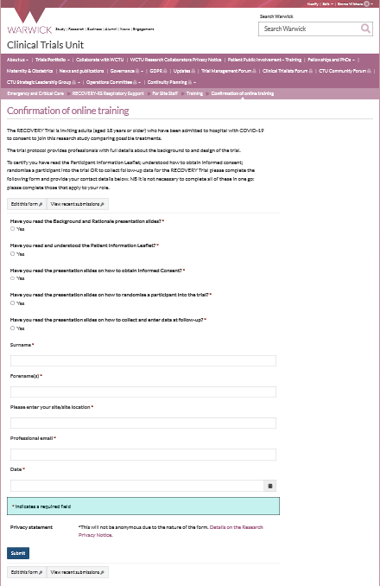
Training requirements QA
Training is available on the trial website
As a minimum the PI of the site must complete and sign off all training modules on the website
PI to ensure that staff (e.g. doctor, nurse, research practitioner) have the appropriate knowledge and understanding of trial
All training should be recorded on the Confirmation of Online Training Form
Optional GCP training available on website
There is no need for the PI to provide a CV and GCP certificate.

Slide 21
Study oversight
Investigator Site File (ISF)
Available on website
Close Out
Resolve any outstanding queries
Collect any outstanding data
Ongoing responsibilities
Site to archive trial documentation and data (at least 10 years)
Monitoring
Central monitoring approach will be developed that will take into account the challenging circumstances and staff pressures
Notes:
How do you want to be informed of amendments?

Slide 22
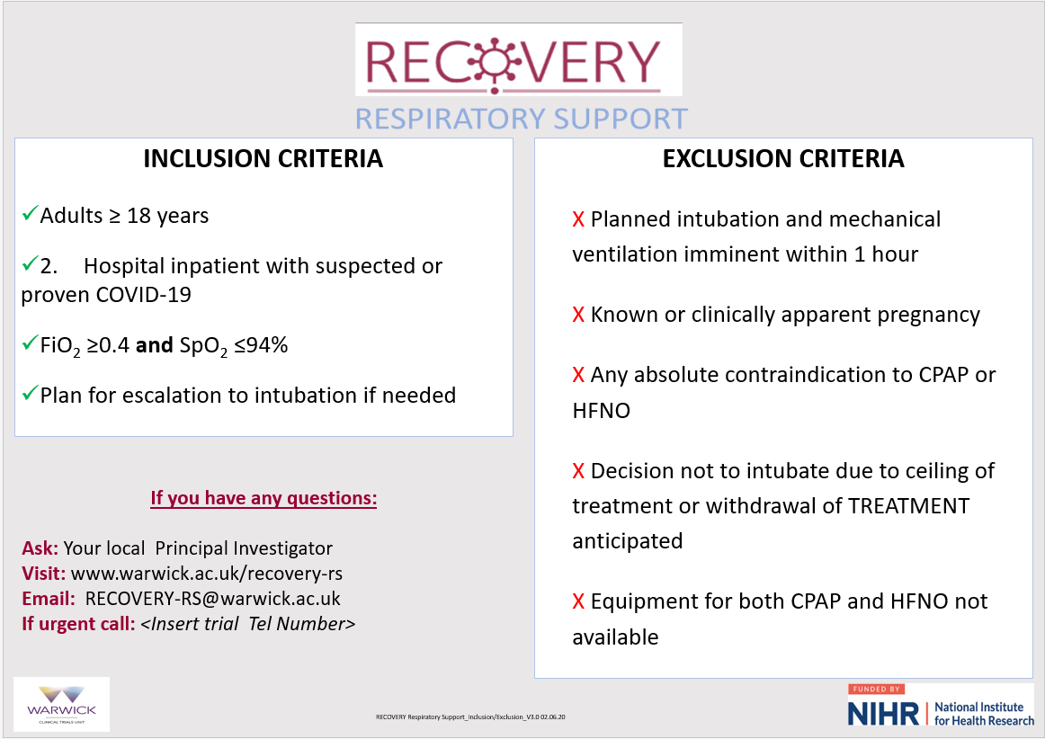
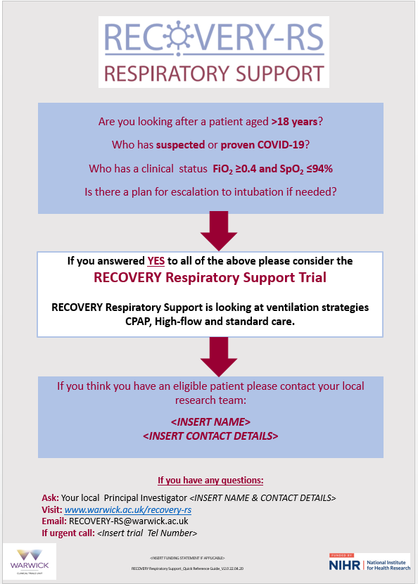
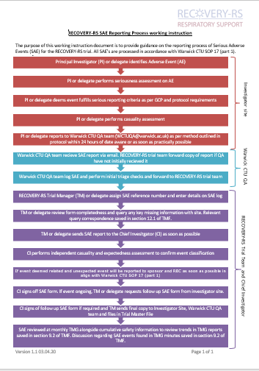
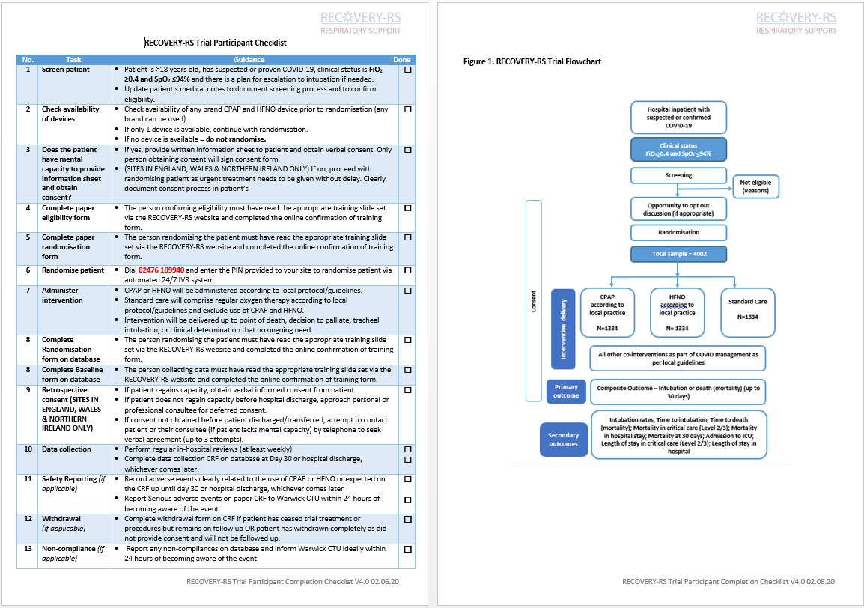
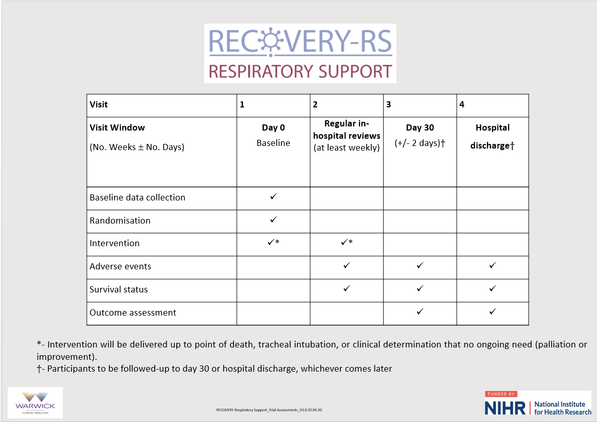
Aide memoirs – available on website

