Slide 1

RECOVERY-RS Respiratory Support: Respiratory Strategies in COVID-19; CPAP, High-flow, and standard care
Site Training – Receiving Consent

Slide 2





Acknowledgements

Slide 3
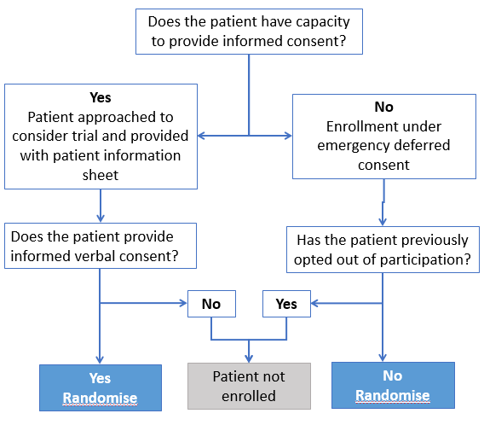
Consent process (England, Wales and Northern Ireland)
Notes:
Main process

Slide 4
Deferred consent (England, Wales and Northern Ireland)
If patient regains capacity, they should be given the option to consent/withdraw
* Long version available on website if requested
Documents including the PIS can be found on the website
If consent not obtained before patient discharged/transferred, attempt to contact patient or their consultee (if patient lacks mental capacity) by telephone to seek verbal agreement (up to 3 attempts).
Provide details of website which contains PIS to download (www.warwick.ac.uk/recovery-rs/patients)
Explain
Trial and go through short Patient Information Sheet*
Consent
Obtain VERBAL CONSENT ONLY from patient
Document
Verbal consent on deferred consent form

Slide 5
Consultee opinion (England, Wales and Northern Ireland)
If patient does not re-gain capacity by hospital discharge, approach a personal or professional consultee
Personal consultee before professional consultee, if there is one available
* Long version available on website if requested
Documents available on website under Patient Tab
Explain
Trial and go through short Patient Information Sheet*
Objection
Ask if objection to research expressed by patient
Document
Verbal confirmation of non objection on declaration form
Notes:
Due to visiting restrictions, it is likely that a personal consultee will not be available, in which case the opinion of a professional consultee will be sought.
Likely that personal consultee consent will be several days after enrolment.

Slide 6
Deferred Consent
The deferred consent process, including assessment of capacity, will be undertaken by a member of the team delivering the trial at the hospital (e.g. doctor, nurse, research practitioner)
Personal Consultee
Contact by telephone
Documents available on website
A person who is:
engaged in caring for the participant (not professionally or for payment) or is interested in his/her welfare, and
is prepared to be consulted
Professional Consultee
Ordinarily registered medical practitioner who has no connection with the trial and is willing to be consulted

Slide 7
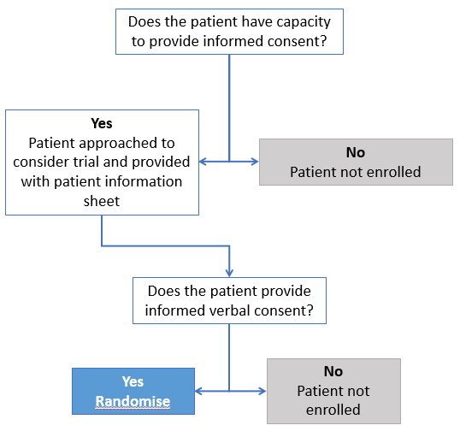
Consent process (Scotland)
Notes:
Main process

Slide 8
Consent process (Scotland)
For patients that lack capacity, it is not practical or appropriate to consult a guardian/welfare attorney prior to enrolment without placing the potential participant at risk of harm from delaying treatment.
These processes will also not be feasible or safe to undertake in order to minimise risk of viral transmission to those involved.
Significant limitations have been placed on the visitation of COVID-19 patients and therefore a guardian is unlikely to be immediately be available, and to attempt contact via telephone will delay treatment. Therefore these patients will not be entered into the study as Scottish regulation do not allow emergency deferred consent.
Notes:
Main process

Slide 9
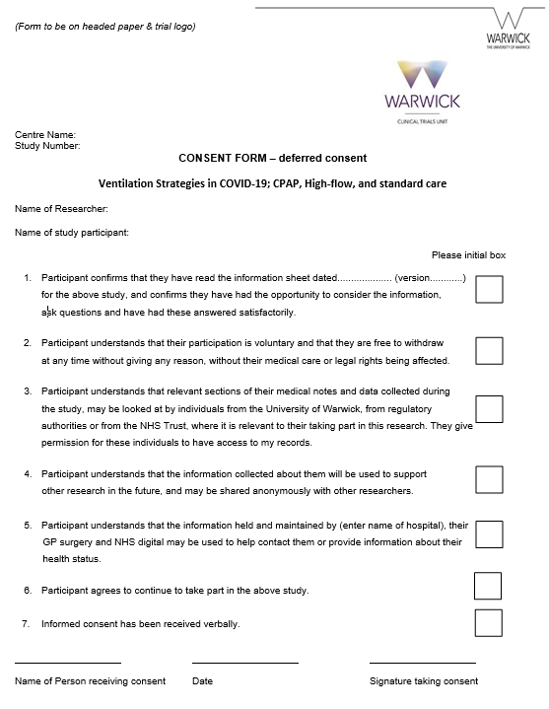
Consent process
Consent should be received verbally from both patients and consultees to reduce risk of infection transmission
Only person receiving consent should sign the consent/declaration form
Three signed copies:
  One for ISF
  One for patient/consultee
  One for medical notes
Do not send copies of consent forms to Warwick CTU. They should be stored securely at site
Consent should be documented in the patient’s medical notes

Slide 10
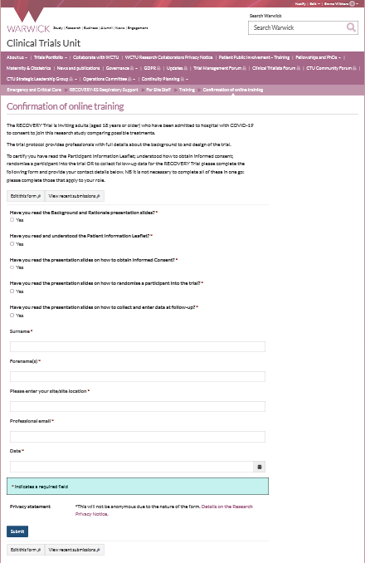
Training requirements QA
Training is available on the trial website
As a minimum the PI of the site must complete and sign off all training modules on the website
PI to ensure that staff (e.g. doctor, nurse, research practitioner) have the appropriate knowledge and understanding of trial
All training should be recorded on the Confirmation of Online Training Form
Optional GCP training available on website
There is no need for the PI to provide a CV and GCP certificate.

Slide 11
Study oversight
Investigator Site File (ISF)
Available on website
Close Out
Resolve any outstanding queries
Collect any outstanding data
Ongoing responsibilities
Site to archive trial documentation and data (at least 10 years)
Monitoring
Central monitoring approach will be developed that will take into account the challenging circumstances and staff pressures
Notes:
How do you want to be informed of amendments?

Slide 12
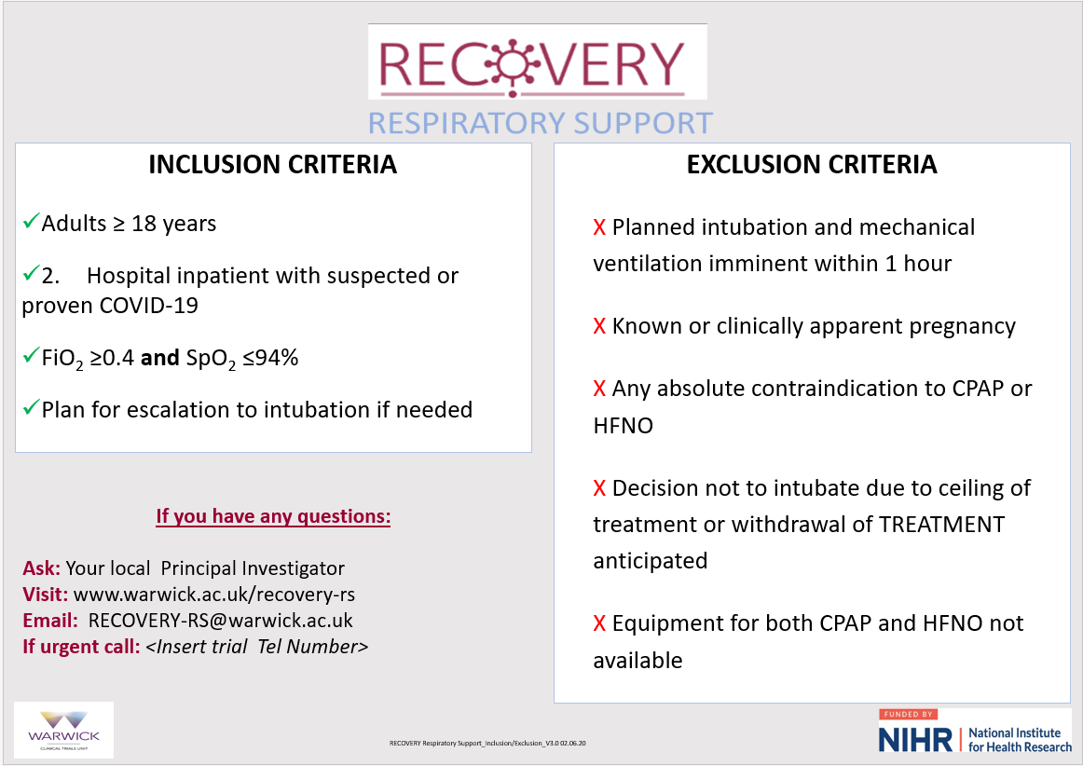
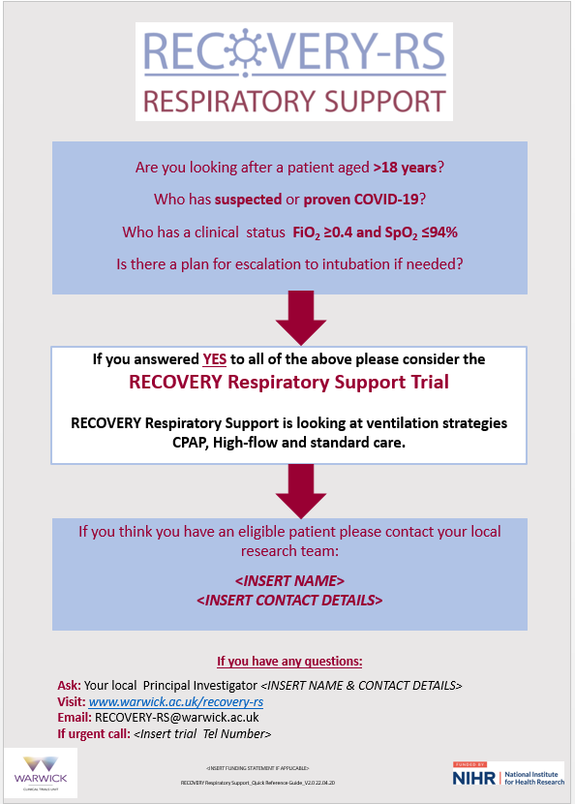
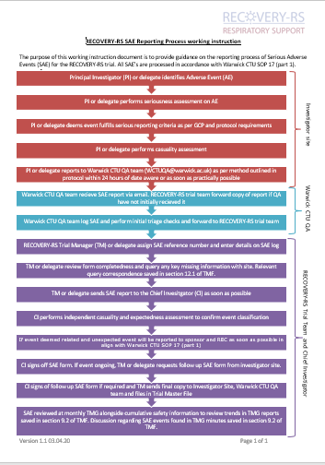
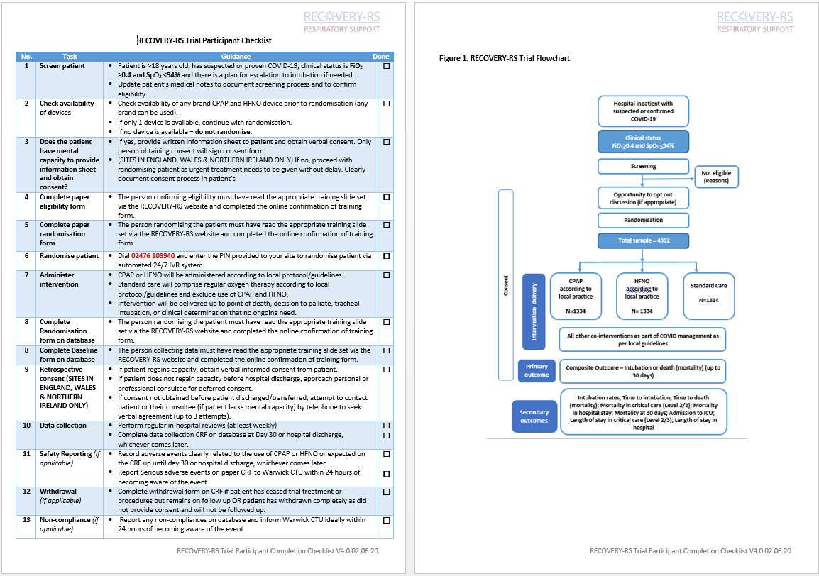
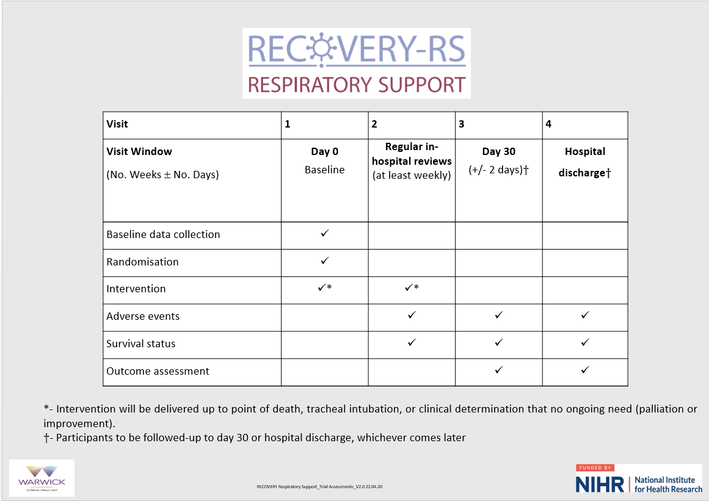
Aide memoirs – available on website

